Slide 1
Employee Data Analysis using Excel
STUDENT NAME:Subha. M
REGISTER NO: 122204061
DEPARTMENT:B.com(cs)
COLLEGE:shri Krishnaswamy college for women

Slide 2
PROJECT TITLE
Employee Gender Analysis using Excel

Slide 3


AGENDA
Problem Statement
Project Overview
End Users
Our Solution and Proposition
Dataset Description
Modelling Approach
Results and Discussion
Conclusion
3/21/2024 Annual Review

Slide 4

PROBLEM STATEMENT
Microsoft Excel is the market leader when it comes to data analysis, both in HR and other business functions. While it is no substitute for an HR Information System and does not offer the most advanced people analytics capabilities, it is the all-time favorite for quick analysis and data visualization.

Slide 5

PROJECT OVERVIEW
Project Overview: Employee Data Analysis In this comprehen
sive Employee Data Analysis project, we delved into key insights reflecting the dynamics within our company of 3000 employees. Here's a snapshot of our findings:
.
Employee Demographics:
General ethnicity distribution: 629 Asian, 618 Black, 599 White, 572 Hispanic, and 582 Other employees.
Job roles with highest average years of experience: Data Analyst (20 years), CPO (17 years), and Clerical (15.5 years).

Slide 6

OUR SOLUTION AND ITS VALUE PROPOSITION
A value proposition is a core component of a modern, actionable data and analytics strategy. Most data and analytics strategies define goals and discuss a roadmap but lack an explicit description of their value proposition(s). However, data and analytics initiatives are not necessarily self-evident.
A value proposition is a core component of a modern, actionable data and analytics strategy. Most data and analytics strategies define goals and discuss a roadmap but lack an explicit description of their value proposition(s). However, data and analytics initiatives are not necessarily self-evident.

Slide 7
Dataset Description
A dataset description typically includes the following information:
Identifier: A number or handle that uniquely identifies the dataset
Creator: The name of the person who created the dataset
Title: A name that describes what the data represents
A dataset is a collection of data related to a specific topic, theme, or industry. It can include numbers, text, images,
videos, and audio, and can be stored in a variety of formats, such as CSV, JSON, or SQL

Slide 8

THE "WOW" IN OUR SOLUTION
1. Visualizations: Incorporate interactive and dynamic visualizations to showcase insights and patterns in the data. This could include dashboards, heatmaps, or scatter plots.2. Storytelling: Use narratives to convey the impact and significance of your findings. Highlight how the recommendation engine will improve user experience and drive business growth.3. Personalization: Emphasize how the engine's personalized recommendations will cater to individual user preferences, increasing engagement and satisfaction.By incorporating these "wow" factors, you can create a solution that impresses stakeholders and demonstrates the value of your work.
3/21/2024 Annual Review
8

Slide 9
MODELLING
Here are some tips for modeling employee data in Excel:
*Employee Data Model*
Create a table with the following columns: - Employee ID (unique identifier) - Name - Job Title - Department - Location - Hire Date - Salary - Benefits (e.g., health insurance, retirement plan)
2. Consider adding additional columns for: - Performance ratings - Training and development programs - Education and certifications - Work experience - Skills and competencies
9

Slide 10
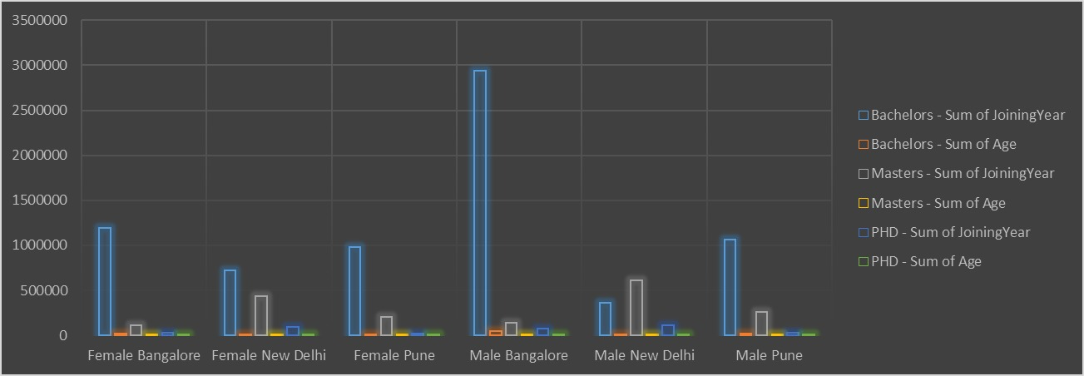
RESULTS
10

Slide 11
conclusion
Analyzing the Employee Attrition dataset provides a compelling glimpse into the dynamics of employee turnover and retention. By leveraging data analytics techniques—from initial exploration and cleaning to advanced visualization and interpretation—this analysis not only uncovers actionable insights but also demonstrates the power of data-driven decision-making in enhancing employee retention strategies and overall organizational performance.
Whether you’re an HR professional, manager, or organizational leader, exploring such datasets offers invaluable opportunities to understand and improve the way we approach employee retention, fostering a more engaged and stable workforce.
Your conclusion should revisit the purpose of your experiment and hypothesis in light of your data analysis. Make sure you address your original question or problem when you interpret your data. Your conclusions should be valid (that is, logical) and limited to the results of the experiment. Evaluate your data.

