Slide 1
Business Case#1
Environment
IDE: Use any IDE such as Eclipse
Java Framework: Spring Boot
Build Tool: Maven
Code Repository: GitHub – create your account and share path
Server Implementation: Apache Tomcat
DB: Oracle
Web Service Implementation
REST API
JAX-RS
Problem Statement
Develop getCustomerInfo REST API that gets CustomerID (4 digits) as the INPUT and returns Customer Name (string) and Customer City (String) as the OUTPUT to the consuming Web Service

Slide 2
Functionality
Primary Functionality: Customer information is returned when queried with “Customer Id”.
Additional Functionality: CRUD operations to manage/maintain Customer information such as personal details and Mobile Plan details.
The two functionalities are intended to be used by different parties.
Code Repository: https://github.com/Subzzy/subhayuRepository.git

Slide 3
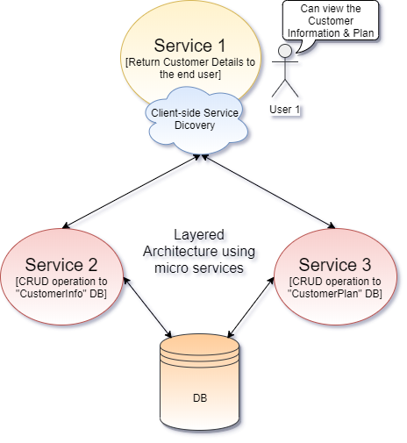
Solution Approach & Technology
Solution Approach: Different REST services are developed to manage and view the customer information. Each service is independent and Standalone. Each service is deployed as microservices in different tomcat containers. All services use a shared database.
Technology Used: REST SQL [Oracle 12c] Spring boot [Web, Oracle Driver, Spring data JPA] Spring Cloud [Eureka Discovery Client & Server] Tomcat [Application Server]
Tool used: Spring Tool Suite [IDE for Spring boot] SQL Developer Postman [REST Client] Github [Code repository] SonarQube

Slide 4
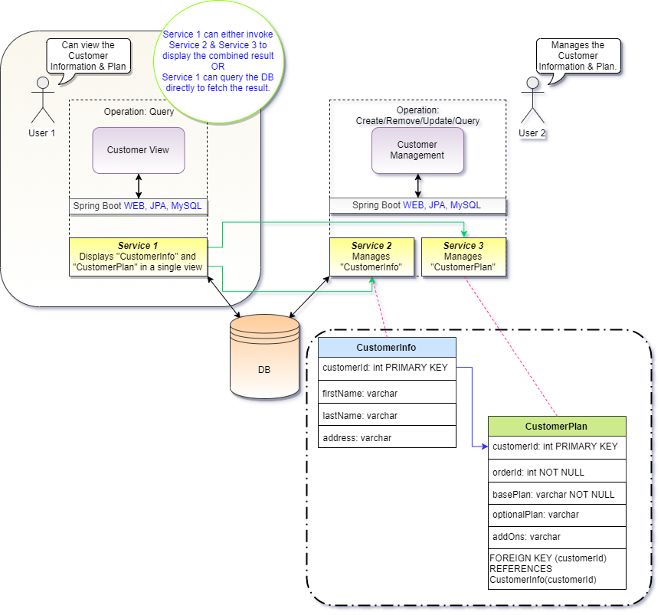
Solution Overview
Service 1: Used to view the customer information. There are two options via which a user can fetch the data. Option 1: Invokes Service 2 and Service 3 and then combines the results and return the response back. Option 2: In case Service 2 and/or Service 3 goes down then Service 1 can directly connect to the database to fetch the results. Note: Option 1 is the default way for displaying the result. Option 2 is just another monolithic way to get the result. Service 2: Service 2 is used manage/maintain the “CustomerInfo” database. It is a standalone service and can perform CRUD operation to only “CustomerInfo”. Service 3: Service 3 is used manage/maintain the “CustomerPlan” database. It is a standalone service and can perform CRUD operation to only “CustomerPlan”.

Slide 5
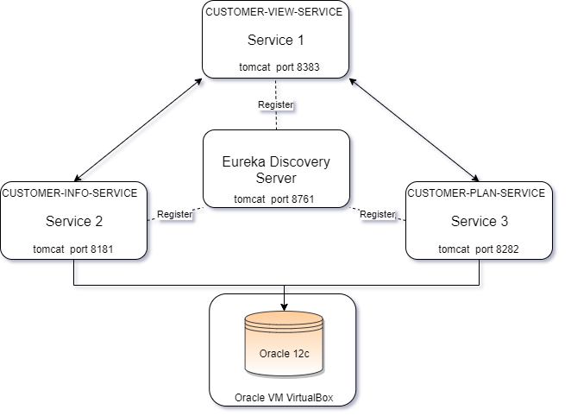
Deployment Architecture
All the services are standalone and deployed in different containers. In real environment dockers can be used to host the services. This diagram shows how I have locally deployed the application.

Slide 6
Advantages of the Layered Architecture
Small focused
A service should not perform more than one business task, hence small in size and easy to maintain than any other monolithic application
Loosely Coupled
Autonomous business unit of the entire application making it more loosely coupled, which helps to reduce the maintenance cost.
Language Neutral
Supports different technologies, helping developers to use the correct technology at the correct place.
Bounded Context
One microservice doesn’t need to understand the implementation of the other.

Slide 7
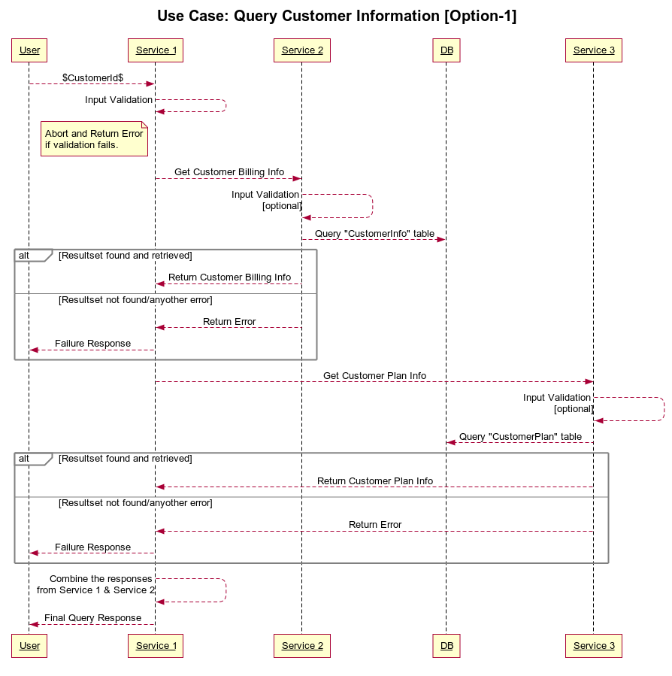
Sequence Diagrams – Service 1 [Option 1]
This is a Layered Architecture. Following are some of the advantages of this solution: The top layer service i.e. ‘Service 1’ provides the interface to the user. Service 1 hides the internal complexity such from the user. The second layer services i.e. ‘Service 2’ and ‘Service 3’ are standalone and both interact with the databases. In case of any changes in the DB layer only corresponding service from the send layer will get impacted. Top layer service does not need to worry about it. Having the application distributed across different small services it becomes scalable, high-available and suitable for continuous deployment through Dev-Ops.

Slide 8
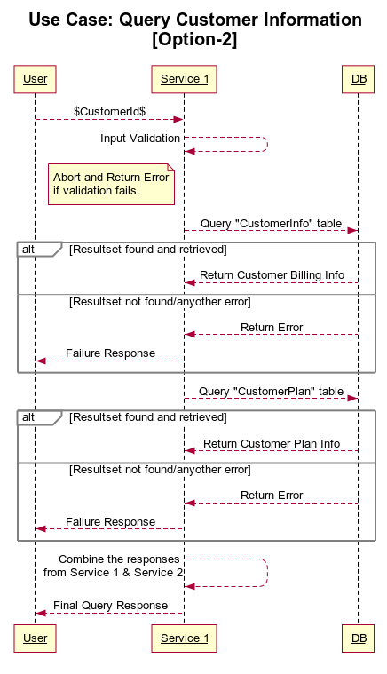
Sequence Diagrams – Service 1 [Option 2]
This is a Monolithic Architecture. This option is not meant for the regular used. With proper authentication and authorization in place for a standard application this should only be used during the case of disaster recovery. This solution has all the drawbacks of a monolithic application.

Slide 9
Application Verification Steps
Code quality of each services are checked via Sonarqube.
E2E functionality was tested by using Postman and Web browser,
List of Test Cases: <On High-Level>
Positive Scenarios: Ensure all the services are properly deployed and are visible in the Eureka Discovery Server. Return the Customer information against a valid “Customer Id” using Service 1. Return all the Customer information using Service 1. Add a new customer information and plan in to the Database using Service 2 and Service 3. Update an existing customer information using Service 2 and Service 3. Delete an existing customer information using Service 2 and Service 3. Negative Scenarios: Return error against a invalid “Customer Id” from Service 1. Return error from Service 1 when any of the Service 2 or Service 3 is down. Try to delete a customer information from “CustomerInfo” table with deleting it from “CustomerPlan” table

Slide 10
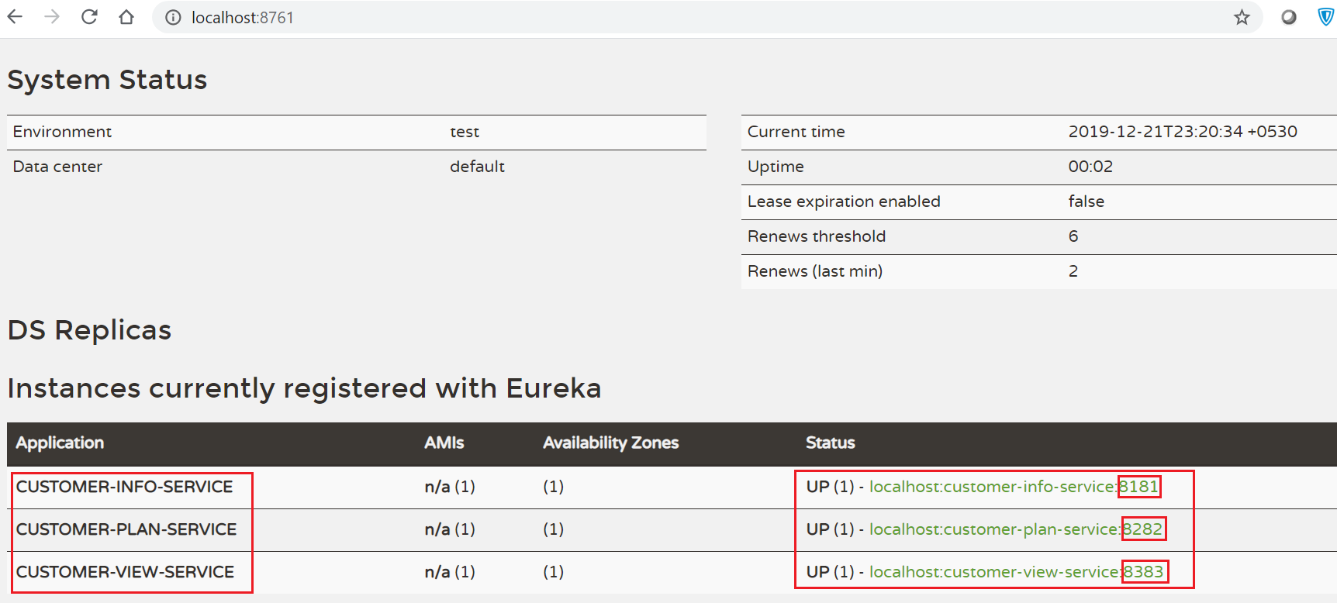
Application Verification Results
#1 All the 3 services are up and are visible in the spring Eureka server.

Slide 11
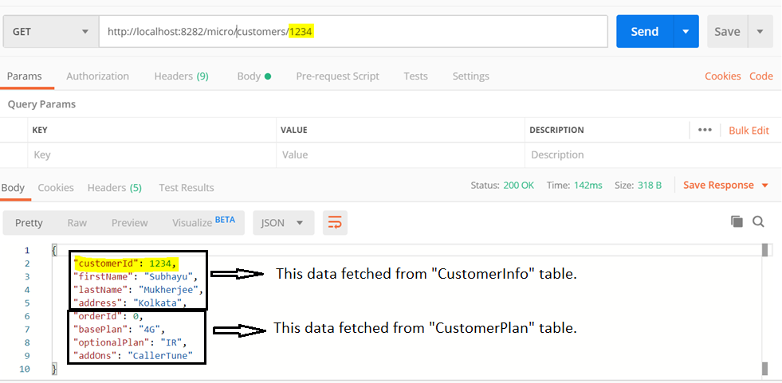
Application Verification Results
#2 Customer information against a valid “Customer Id” using Service 1.

Slide 12
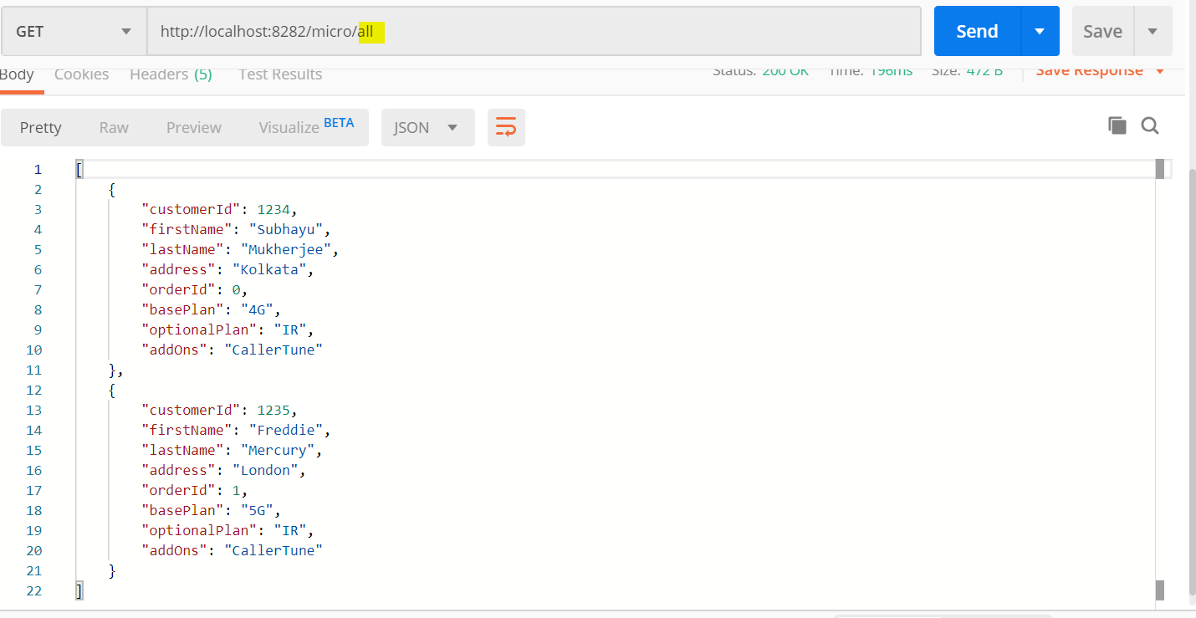
Application Verification Results
#3 All the Customer information using Service 1.
The above example shows combined response from “Service 1” that internally calls “Service 2” and “Service 3”
to fetch data from “CustomerInfo” table respectively.

Slide 13
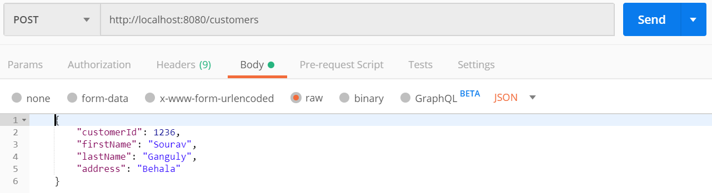
Application Verification Results
#4 Add a new Customer Information
The above example shows only for “CustomerInfo” table. Similar operation can also be performed in “CustomerPlan” table.

Slide 14
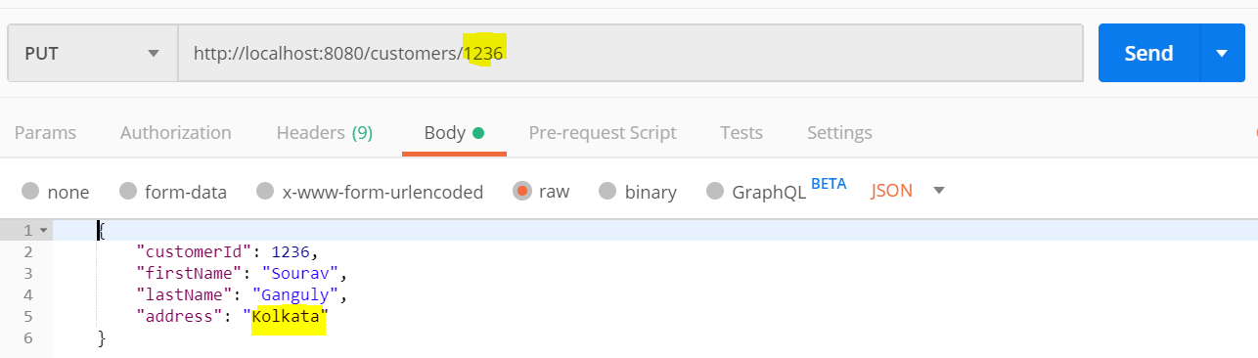
Application Verification Results
#4 Update a new Customer Information
The above example shows only for “CustomerInfo” table. Similar operation can also be performed in “CustomerPlan” table.

Slide 15
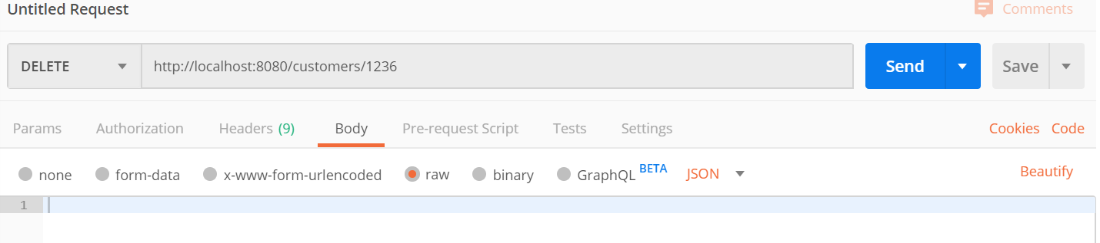
Application Verification Results
#6 Removing a Customer Information
The above example shows only for “CustomerInfo” table. Similar operation can also be performed in “CustomerPlan” table.

