Slide 1
Inking
Why Inking
Introduction
POC app
Ink tool bar and Ruler
Demo of Ink tool bar and Ruler
Inking Future Video

Slide 2
Why Inking
See Video

Slide 3
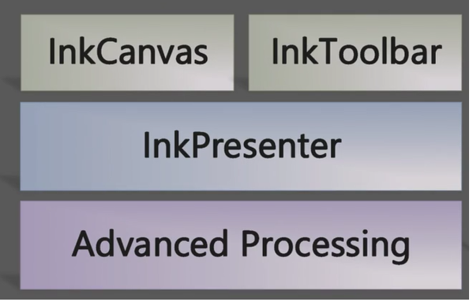
Introduction

Slide 4
Inking API POC App demo
Show the Code
Inking API Real time Usage
Show Charting + Inking app

Slide 5
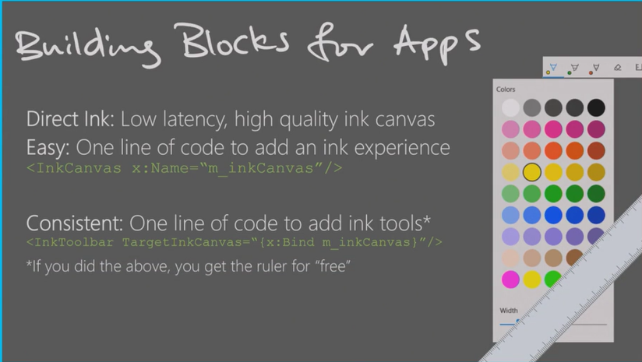
Ink tool bar and Ruler

Slide 6
Demo of Ink tool bar and Ruler
See Videos
Inking Future Video
See Video

Slide 7
Thank you.!!

