Slide 1



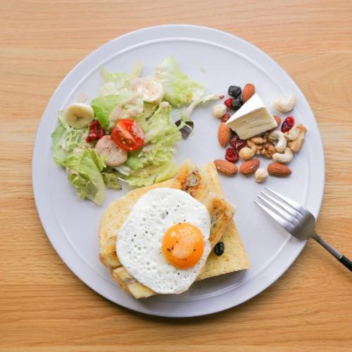
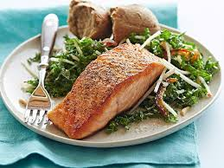
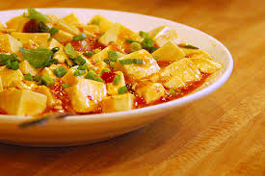
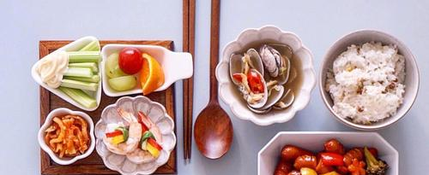






Johnson Grade
Jsgrate-gmail
Edit Your Account
4.7/5
5.7k
Followers
Followers
All
Recommendation
Like
Cooking
Task
Me

Slide 2

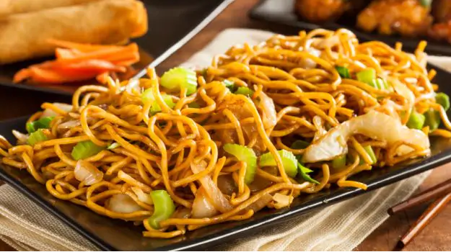

Fired Chicken
Spicy-5
4.5/5
8.7k
4.8/5
13.5K
Spicy
Easy to cook
Easy to cook
Spicy
Easy to cook
Easy to cook
Fired Chicken
Spicy-5
4.5/5
8.7k
4.8/5
13.5K
Spicy
Easy to cook
Easy to cook
Spicy
Easy to cook
Easy to cook
Recommendation
Like
Cooking
Task
Me

Slide 3


Fired Chicken
Spicy-5
4.5/5
8.7k
4.8/5
13.5K
Spicy
Easy to cook
Easy to cook
Spicy
Easy to cook
Easy to cook
Fired Chicken
Spicy-5
4.5/5
8.7k
4.8/5
13.5K
Spicy
Easy to cook
Easy to cook
Johnson Grade
Jsgrate-gmail
Spicy
Easy to cook
Fired Chicken
Spicy-5
Easy to cook
4.2/5
5.9k
4.5/5
293
Recommendation
Like
Cooking
Task
Me

Slide 4
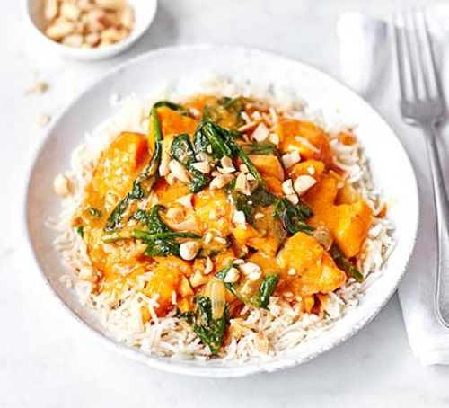
Common | Spicy | Sour | Fish | Chicken | Beef
Fired Chicken
Spicy-5
4.5/5
2938
Fired Chicken
Spicy-5
4.5/5
2938
Fired Chicken
Spicy-5
4.5/5
2938
Fired Chicken
Spicy-5
4.5/5
2938
Recommendation
Like
Cooking
Task
Me

