Slide 1


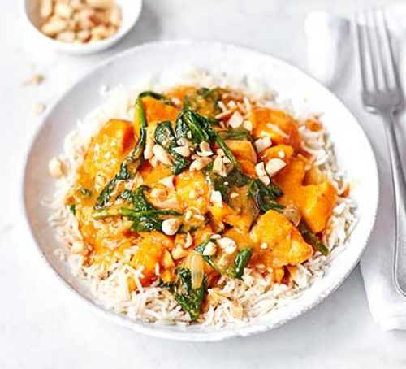





Common | Spicy | Sour | Fish | Chicken | Beef
Fired Chicken
Spicy-5
4.5/5
2938
Fired Chicken
Spicy-5
4.5/5
2938
Fired Chicken
Spicy-5
4.5/5
2938
Fired Chicken
Spicy-5
4.5/5
2938
Recommendation
Like
Cooking
Task
Me

Slide 2

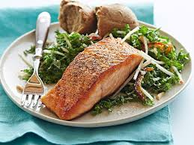

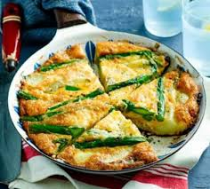

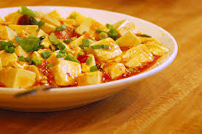
Common | Spicy | Sour | Fish | Chicken | Beef
Johnson Grade
Jsgrate-gmail
Fired Chicken
Spicy-5
4.7/5
5.7k
4.5/5
2938
Johnson Grade
Jsgrate-gmail
Fired Chicken
Spicy-5
4.7/5
5.7k
4.0/5
1902
4.0/5
1902
Johnson Grade
Jsgrate-gmail
Fired Chicken
Spicy-5
Toasted fish of Version vegetable-2 is a very special dish that contains a variety of...
4.5/5
8.7k
4.8/5
13.5K
Johnson Grade
Jsgrate-gmail
Fired Chicken
Spicy-5
More
4.2/5
5.9k
4.5/5
293
Rate | Add to Task
Recommendation
Like
Cooking
Task
Me

Slide 3
Common | Spicy | Sour | Fish | Chicken | Beef
Johnson Grade
Jsgrate-gmail
Fired Chicken
Spicy-5
4.7/5
5.7k
4.5/5
2938
Johnson Grade
Jsgrate-gmail
Fired Chicken
Spicy-5
4.7/5
5.7k
4.0/5
1902
D, E, B6, B12 and so on. Besides, Eating fish is an important source of omega-3 fatty acids. These essential nutrients keep our heart and brain healthy. Two omega-3 fatty acids found in fish are EPA (eicosapentaenoic acid) and DHA (docosahexaenoic acid). Our bodies don't produce omega-3 fatty acids so we must get them through the food we eat. Omega-3 fatty acids are found in every kind of fish, but are especially high in fatty fish. Some good choices are salmon, trout, sardines, herring, canned mackerel, canned light tuna, and oysters.
The cooking process could be described in three stages: Stage 1 is the pre-heat stage which heats the fish slowly unit the fish changes its color. Stage 2 is all about flavor
Johnson Grade
Jsgrate-gmail
Fired Chicken
Spicy-5
4.5/5
8.7k
4.8/5
13.5K
Johnson Grade
Jsgrate-gmail
Fired Chicken
Spicy-5
4.2/5
5.9k
4.5/5
293
4.0/5
1902
Recommendation
Like
Cooking
Task
Me

Slide 4
Common | Spicy | Sour | Fish | Chicken | Beef
Johnson Grade
Jsgrate-gmail
Fired Chicken
Spicy-5
4.7/5
5.7k
4.5/5
2938
Johnson Grade
Jsgrate-gmail
Fired Chicken
Spicy-5
4.7/5
5.7k
4.0/5
1902
4.0/5
1902
Johnson Grade
Jsgrate-gmail
Fired Chicken
Spicy-5
Toasted fish of Version vegetable-2 is a very special dish that contains a variety of...
4.5/5
8.7k
4.8/5
13.5K
Johnson Grade
Jsgrate-gmail
Fired Chicken
Spicy-5
4.2/5
5.9k
4.5/5
293
Routine | Now
Recommendation
Like
Cooking
Task
Me

Slide 5
Common | Spicy | Sour | Fish | Chicken | Beef
Johnson Grade
Jsgrate-gmail
Fired Chicken
Spicy-5
4.7/5
5.7k
4.5/5
2938
Johnson Grade
Jsgrate-gmail
Fired Chicken
Spicy-5
4.7/5
5.7k
4.0/5
1902
4.0/5
1902
Johnson Grade
Jsgrate-gmail
Fired Chicken
Spicy-5
Toasted fish of Version vegetable-2 is a very special dish that contains a variety of...
4.5/5
8.7k
4.8/5
13.5K
Johnson Grade
Jsgrate-gmail
Fired Chicken
Spicy-5
4.2/5
5.9k
4.5/5
293
Recommendation
Like
Cooking
Task
Me

Slide 6
Common | Spicy | Sour | Fish | Chicken | Beef
Johnson Grade
Jsgrate-gmail
Fired Chicken
Spicy-5
4.7/5
5.7k
4.5/5
2938
Johnson Grade
Jsgrate-gmail
Fired Chicken
Spicy-5
4.7/5
5.7k
4.0/5
1902
4.0/5
1902
Johnson Grade
Jsgrate-gmail
Fired Chicken
Spicy-5
Toasted fish of Version vegetable-2 is a very special dish that contains a variety of...
4.5/5
8.7k
4.8/5
13.5K
Johnson Grade
Jsgrate-gmail
Fired Chicken
Spicy-5
4.2/5
5.9k
4.5/5
293
Recommendation
Like
Cooking
Task
Me

Slide 7
Common | Spicy | Sour | Fish | Chicken | Beef
Fired Chicken
Spicy-5
Fired Chicken
Spicy-5
Fired Chicken
Spicy-5
Fired Chicken
Spicy-5
4.5/5
2938
4.5/5
2938
4.5/5
2938
4.5/5
2938
Fired Chicken
Spicy-5
Fired Chicken
Spicy-5
4.5/5
2938
4.5/5
2938
Fired Chicken
Spicy-5
Fired Chicken
Spicy-5
Fired Chicken
Spicy-5
4.5/5
2938
Fired Chicken
Spicy-5
4.5/5
2938
4.5/5
2938
4.5/5
2938
Recommendation
Like
Cooking
Task
Me

