Slide 1










Johnson Grade
Jsgrate-gmail
| Following |
| Followers |
| All |
4.2/5
5.9k
4.7/5
5.7k
Kate Hill
Jsgrate-gmail
Johnson Grade
Jsgrate-gmail
4.2/5
5.9k
4.2/5
5.9k
Johnson Grade
Jsgrate-gmail
Johnson Grade
Jsgrate-gmail
4.2/5
5.9k
4.2/5
5.9k
Recommendation
Like
Cooking
Task
Me

Slide 2
Johnson Grade
Jsgrate-gmail
| Following |
| Followers |
| All |
4.2/5
5.9k
4.7/5
5.7k
Kate Hill
Jsgrate-gmail
Johnson Grade
Jsgrate-gmail
4.2/5
5.9k
4.2/5
5.9k
Johnson Grade
Jsgrate-gmail
Johnson Grade
Jsgrate-gmail
4.2/5
5.9k
4.2/5
5.9k
Recommendation
Like
Cooking
Task
Me

Slide 3

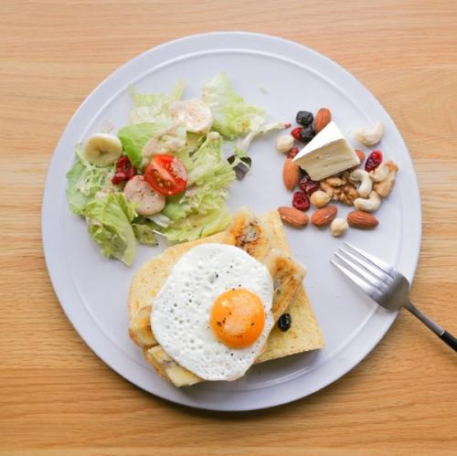
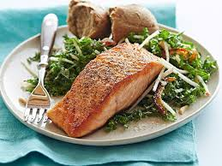
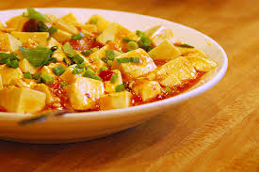
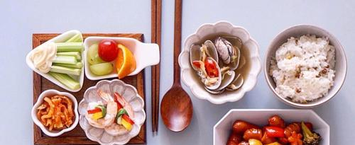
Johnson Grade
Jsgrate-gmail
Edit Your Account
4.7/5
5.7k
Followers
Followers
All
Recommendation
Like
Cooking
Task
Me

Slide 4

Johnson Grade
Jsgrate-gmail
| Create Table |
| Enter Table |
Current Table: 2490
Johnson Grade
Jsgrate-gmail
Notice:
1. Add 10% less salt.
2. Add 23% less cooking oil.
3. Add 12% more sugar.
Fired Chicken
Spicy-5
4.5/5
293
Fired Chicken
Spicy-5
Notice:
1. Add 10% less salt.
2. Add 23% less cooking oil.
3. Add 12% more sugar.
4.5/5
293
Recommendation
Like
Cooking
Task
Me

Slide 5
Johnson Grade
Jsgrate-gmail
4.0/5
1902
| Following |
Toasted fish of Version vegetable-2 is a very special dish that contains a variety of nutrition including Vitamin B, C,
| Followers |
| All |
4.2/5
5.9k
4.7/5
5.7k
Johnson Grade
Jsgrate-gmail
Fired Chicken
Spicy-5
D, E, B6, B12 and so on. Besides, Eating fish is an important source of omega-3 fatty acids. These essential nutrients keep our heart and brain healthy. Two omega-3 fatty acids found in fish are EPA (eicosapentaenoic acid) and DHA (docosahexaenoic acid). Our bodies don't produce omega-3 fatty acids so we must get them through the food we eat. Omega-3 fatty acids are found in every kind of fish, but are especially high in fatty fish. Some good choices are salmon, trout, sardines, herring, canned mackerel, canned light tuna, and oysters.
The cooking process could be described in three stages: Stage 1 is the pre-heat stage which heats the fish slowly unit the fish changes its color. Stage 2 is all about flavor
4.2/5
5.9k
4.5/5
293
Johnson Grade
Jsgrate-gmail
Fired Chicken
Spicy-5
4.2/5
5.9k
4.5/5
293
Johnson Grade
Jsgrate-gmail
Fired Chicken
Spicy-5
4.2/5
5.9k
| Edit |
4.5/5
293
Recommendation
Like
Cooking
Task
Me

Slide 6
Drop
Save
Dish Name
Dish Version
| upload Image |
Please input the code:
Please input the detail:
Recommendation
Like
Cooking
Task
Me

Slide 7


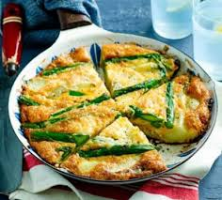
Kate Hill
Jsgrate-gmail
| Following |
| Followers |
| All |
4.2/5
5.9k
Kate Hill
Jsgrate-gmail
Fired Chicken
Spicy-5
4.2/5
5.9k
4.5/5
293
Common
Johnson Grade
Jsgrate-gmail
Fired Chicken
Spicy-5
Spicy
4.5/5
8.7k
4.8/5
13.5K
Sour
Johnson Grade
Jsgrate-gmail
Fired Chicken
Spicy-5
4.2/5
5.9k
4.5/5
293
Save | More
Recommendation
Like
Cooking
Task
Me

Slide 8
Johnson Grade
Jsgrate-gmail
| Following |
| Followers |
| All |
4.2/5
5.9k
4.7/5
5.7k
Followers
Following
Recommendation
Like
Cooking
Task
Me

