Slide 1



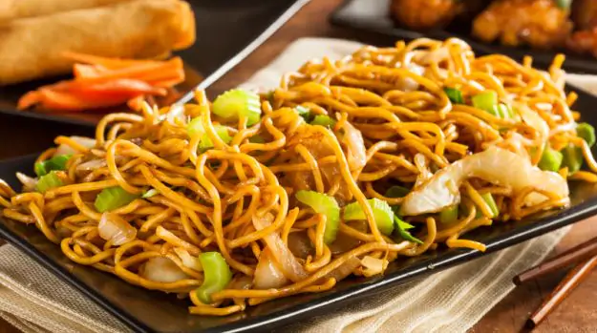


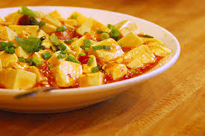






Fired Chicken
Spicy-5
4.5/5
8.7k
4.8/5
13.5K
Spicy
Easy to cook
Easy to cook
Spicy
Easy to cook
Easy to cook
Fired Chicken
Spicy-5
4.5/5
8.7k
4.8/5
13.5K
Spicy
Easy to cook
Easy to cook
Johnson Grade
Jsgrate-gmail
Spicy
Easy to cook
Fired Chicken
Spicy-5
Easy to cook
4.2/5
5.9k
4.5/5
293
Recommendation
Like
Cooking
Task
Me

Slide 2
Fired Chicken
Spicy-5
4.5/5
8.7k
4.8/5
13.5K
Spicy
Easy to cook
Easy to cook
Spicy
Easy to cook
Easy to cook
Fired Chicken
Spicy-5
4.5/5
8.7k
4.8/5
13.5K
Spicy
Easy to cook
Easy to cook
Spicy
Easy to cook
Easy to cook
Recommendation
Like
Cooking
Task
Me

Slide 3

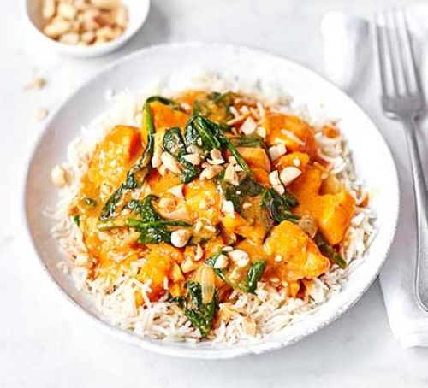
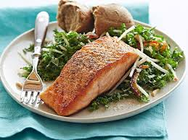


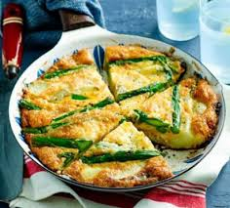
Johnson Grade
Jsgrate-gmail
Fired Chicken
Spicy-5
4.7/5
5.7k
4.5/5
2938
Johnson Grade
Jsgrate-gmail
Fired Chicken
Spicy-5
4.7/5
5.7k
4.0/5
1902
Common
Johnson Grade
Jsgrate-gmail
Fired Chicken
Spicy-5
Spicy
4.5/5
8.7k
4.8/5
13.5K
Sour
Johnson Grade
Jsgrate-gmail
Fired Chicken
Spicy-5
4.2/5
5.9k
4.5/5
293
Save | Detail
Recommendation
Like
Cooking
Task
Me

Slide 4
Johnson Grade
Jsgrate-gmail
Fired Chicken
Spicy-5
Toasted fish of Version vegetable-2 is a very special dish that contains a variety of nutrition including Vitamin B, C,
4.7/5
5.7k
4.5/5
2938
Johnson Grade
Jsgrate-gmail
Fired Chicken
Spicy-5
4.7/5
5.7k
4.0/5
1902
D, E, B6, B12 and so on. Besides, Eating fish is an important source of omega-3 fatty acids. These essential nutrients keep our heart and brain healthy. Two omega-3 fatty acids found in fish are EPA (eicosapentaenoic acid) and DHA (docosahexaenoic acid). Our bodies don't produce omega-3 fatty acids so we must get them through the food we eat. Omega-3 fatty acids are found in every kind of fish, but are especially high in fatty fish. Some good choices are salmon, trout, sardines, herring, canned mackerel, canned light tuna, and oysters.
The cooking process could be described in three stages: Stage 1 is the pre-heat stage which heats the fish slowly unit the fish changes its color. Stage 2 is all about flavor
Johnson Grade
Jsgrate-gmail
Fired Chicken
Spicy-5
4.5/5
8.7k
4.8/5
13.5K
Johnson Grade
Jsgrate-gmail
Fired Chicken
Spicy-5
4.2/5
5.9k
4.5/5
293
Recommendation
Like
Cooking
Task
Me

