Slide 1
React Form
In React, forms are used to take input from users, like text, numbers, or selections. They work just like HTML forms but are often controlled by React state
In standard HTML, form elements maintain their own value based on user input.
In React, the value of the form element is kept in the component's state property and updated only with the setState() function.

Slide 2
HTML Form
function MyForm() {
return (
<form>
<label>Enter your name:
<input type="text" />
</label>
</form>
)
}
This will work as normal, the form will submit and the page will refresh. But this is generally not what we want to happen in React.
We want to prevent this default behavior and let React control the form.

Slide 3
HTML Forms vs. React Forms
In standard HTML, form elements maintain their own value based on user input and keeps track of its own value in the HTML DOM
In React, the value of the form element is kept in the component's state property and updated only with the setState() function.
In other words; React provides a way to manage form data through component state, leading to what are known as "controlled components."

Slide 4
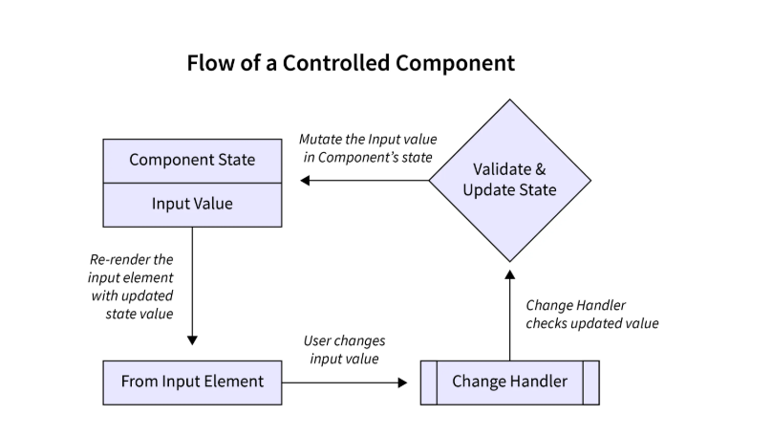
Form and Manual Handling

Slide 5
State Management (React 19+)
Introduction to Actions
useActionState
useFormStatus
useOptimistic

Slide 6
Introduction to Actions
Server Actions for async mutations
Used for forms, DB writes, API calls
Removes need for useState/useEffect for forms
Automatic serialization & Suspense support(Modern Framework like Next JS etc which supports automatic serialization and suspense and React 18+)

Slide 7
Cont..
Server Actions are a feature that deeply integrates with the server. To fully leverage them with ease, we need a framework that supports server-side capabilities out of the box.
Next.js has first-class support for React Actions (often called Server Actions), making it the perfect environment to learn this powerful new feature.

Slide 8
Automatic Serialization
Modern frameworks (like Next.js Server Components) automatically handle the serialization of data fetched on the server
What it does: It serializes data from server components (server side) to client components (client side) seamlessly.
Benefits: Reduces the need to manually create API endpoints for every data fetch and eliminates the need for manual JSON.stringify and JSON.parse operations in many cases.
Workflow: Data fetched within an async server component is automatically serialized, allowing the component to be rendered progressively.

Slide 9
Suspense for Data Fetching
React Suspense is a built-in feature designed to manage asynchronous operations, allowing developers to declaratively define loading states while waiting for data or components to load
Declarative Loading: Instead of managing isLoading booleans, you wrap asynchronous components in <Suspense fallback={<LoadingSpinner />}>.
Streaming Content: When used with React Server Components, Suspense allows the server to stream HTML to the client in chunks.
Progressive Rendering: The browser can render the shell of a page instantly and then populate parts of the UI as the data arrives, improving perceived performance.

Slide 10
Automatic Serialization and Suspense
How They Work Together
Request: The server receives a request for a page
Server Rendering (Async): The server begins rendering, hitting a <Suspense> boundary.
Streaming: The server sends the initial HTML immediately (without waiting for the data inside the Suspense boundary).
Automatic Serialization: As soon as the async data inside the boundary is ready, it is serialized and sent to the client.
Rehydration: The client replaces the fallback UI with the actual content, often without requiring a full page re-render.

Slide 11
What Are Actions?
Save data
Validate form input
Update the database
Authenticate a user
Send an email
Perform any server-side logic
React lets your UI call these Actions directly, without manually wiring up complicated API requests or old form handlers.

Slide 12
Why React 19 Introduced Actions
Before Actions, React developers had to manage forms manually:
Now Actions solve these problems like
No need for onSubmit
No need for APIs for many cases
No need for manual loading logic
No need for manual state syncing
React now handles the entire lifecycle for you.

Slide 13
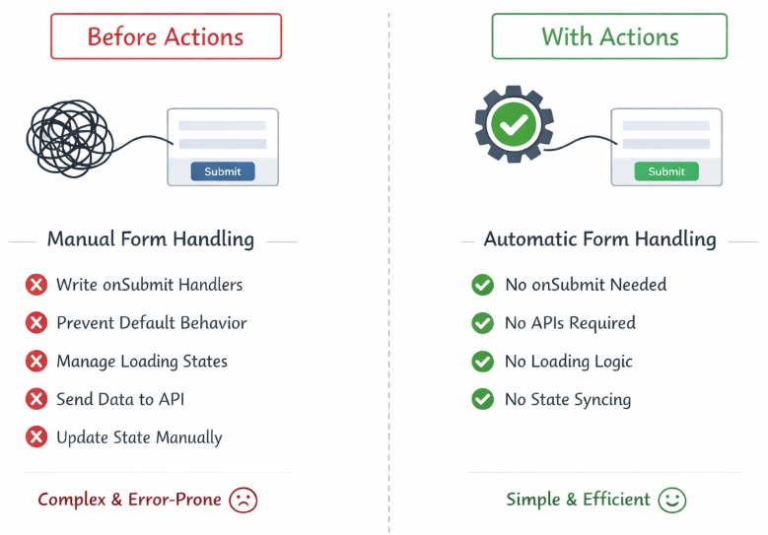
Diagram

Slide 14
Setting up Next.js
npx create-next-app@latest day-4-training
Select default during installation prompts
cd day-4-training
npm run dev
Now you can get a running server-capable React environment ready for Actions!

Slide 15
Managing Forms with useActionState
we will learn how to build modern, server-powered forms using useActionState.
This hook replaces old form-handling patterns like onSubmit, manual fetch requests, and custom loading states.
With useActionState:
Sends the form data to a Server Action for you
It stores the server’s response automatically
It re-renders your component when the Action finishes
No custom handlers needed
useActionState always works together with a Server Action.

Slide 16
What it does
This Action:
Runs on the server
Receives form data
Returns a new state object
useActionState will store that object in the UI.
Note: useActionState is a hook, this component must be a Client Component. That is why we add "use client" at the top of page

Slide 17
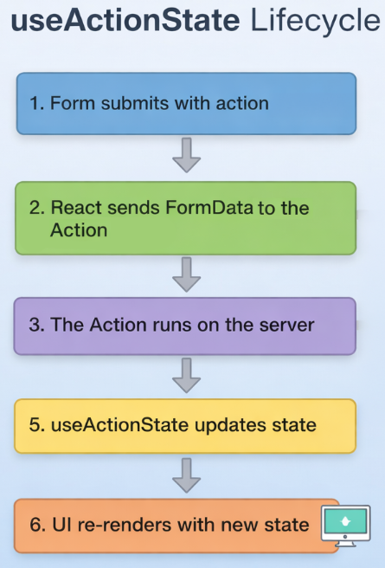
useActionState Lifecycle

Slide 18
useFormStatus-Client Component
Helps you manage loading states inside deeply nested components. This pattern is essential when building real-world forms where submit buttons, inputs, and status messages live in different parts of the UI.
Detects nested form loading state
Useful for SubmitButton components
pending state auto-updated

Slide 19
Nested Forms with useFormStatus
A nested form is simply a form where: inputs, submit buttons, messages are located in different parts of the component tree.
Structure
Form
├── InputSection
├── MessageSection
└── Footer
└── SubmitButton

Slide 20
Cont…
The submit button is not directly next to the form tag. It may be several components deep.
React 19 makes this easy by allowing nested components to access the form’s submission state using useFormStatus.
useFormStatus() works inside any descendant of the form, even several levels deep.

Slide 21
Cont..
To use useFormStatus, the component must be rendered inside a form. Also, because it uses a hook and SubmitButton must be a Client Component ("use client").

Slide 22
Key Differences: useActionState vs useFormStatus
Feature | useActionState | useFormStatus
Where to call | In the same component as the <form> | In a child component of the <form>
Main Purpose | To get the result/data back from the server | To get the loading status of the form
Arguments | Takes an action and initial state | Takes no arguments

Slide 23
useOptimistic
Instant UI updates before server confirmation
Automatic rollback on failure
Great for comments, likes, lists
Handles optimistic updates safely
Works directly with Actions
Integrates with server transitions
Keeps code clean and declarative

Slide 24
Mini Project: Smart Feedback App
Feedback form with rating
Step 1: Create the Server Action
Step 2: Build the Feedback Page with Action and Optimistic State

Slide 25
Project Structure
actions/feedback.ts
components/FeedbackForm.tsx
components/FeedbackList.tsx
App.tsx

