Slide 1
Discrete Mathematics and Its Applications

Slide 2
What is Discrete Mathematics?
Discrete mathematics is the part of mathematics devoted to the study of discrete (as opposed to continuous) objects.
Calculus deals with continuous objects and is not part of discrete mathematics.
Examples of discrete objects: integers, steps taken by a computer program, distinct paths to travel from point A to point B on a map along a road network, ways to pick a winning set of numbers in a lottery.
A course in discrete mathematics provides the mathematical background needed for all subsequent courses in computer science and for all subsequent courses in the many branches of discrete mathematics.

Slide 3
Kinds of Problems Solved Using Discrete Mathematics
How many ways can a password be chosen following specific rules?
How many valid Internet addresses are there?
What is the probability of winning a particular lottery?
Is there a link between two computers in a network?
How can I identify spam email messages?
How can I encrypt a message so that no unintended recipient can read it?
How can we build a circuit that adds two integers?

Slide 4
Kinds of Problems Solved Using Discrete Mathematics
What is the shortest path between two cities using a transportation system?
Find the shortest tour that visits each of a group of cities only once and then ends in the starting city.
How can we represent English sentences so that a computer can reason with them?
How can we prove that there are infinitely many prime numbers?
How can a list of integers be sorted so that the integers are in increasing order?
How many steps are required to do such a sorting?
How can it be proved that a sorting algorithm always correctly sorts a list?

Slide 5
Goals of a Course in Discrete Mathematics
Mathematical Reasoning: Ability to read, understand, and construct mathematical arguments and proofs.
Combinatorial Analysis: Techniques for counting objects of different kinds.
Discrete Structures: Abstract mathematical structures that represent objects and the relationships between them. Examples are sets, permutations, relations, graphs, trees, and finite state machines.

Slide 6
Goals of a Course in Discrete Mathematics
Algorithmic Thinking: One way to solve many problems is to specify an algorithm. An algorithm is a sequence of steps that can be followed to solve any instance of a particular problem. Algorithmic thinking involves specifying algorithms, analyzing the memory and time required by an execution of the algorithm, and verifying that the algorithm will produce the correct answer.
Applications and Modeling: It is important to appreciate and understand the wide range of applications of the topics in discrete mathematics and develop the ability to develop new models in various domains. Concepts from discrete mathematics have not only been used to address problems in computing, but have been applied to solve problems in many areas such as chemistry, biology, linguistics, geography, business, etc.

Slide 7
Discrete Mathematics is a Gateway Course
Topics in discrete mathematics will be important in many courses that you will take in the future:
Computer Science: Computer Architecture, Data Structures, Algorithms, Programming Languages, Compilers, Computer Security, Databases, Artificial Intelligence, Networking, Graphics, Game Design, Theory of Computation, ……
Mathematics: Logic, Set Theory, Probability, Number Theory, Abstract Algebra, Combinatorics, Graph Theory, Game Theory, Network Optimization, …
The concepts learned will also be helpful in continuous areas of mathematics.
Other Disciplines: You may find concepts learned here useful in courses in philosophy, economics, linguistics, and other departments.

Slide 8
The Foundations: Logic and Proofs
Chapter 1, Part I: Propositional Logic

Slide 9
Chapter Summary
Propositional Logic
The Language of Propositions
Applications
Logical Equivalences
Predicate Logic
The Language of Quantifiers
Logical Equivalences
Nested Quantifiers
Proofs
Rules of Inference
Proof Methods
Proof Strategy

Slide 10
Propositional Logic Summary
The Language of Propositions
Connectives
Truth Values
Truth Tables
Applications
Translating English Sentences
System Specifications
Logic Puzzles
Logic Circuits
Logical Equivalences
Important Equivalences
Showing Equivalence
Satisfiability

Slide 11
Propositional Logic
Section 1.1

Slide 12
Section Summary
Propositions
Connectives
Negation
Conjunction
Disjunction
Implication; contrapositive, inverse, converse
Biconditional
Truth Tables

Slide 13
Propositions
A proposition is a declarative sentence that is either true or false.
Examples of propositions:
The Moon is made of green cheese.
Trenton is the capital of New Jersey.
Toronto is the capital of Canada.
1 + 0 = 1
0 + 0 = 2
Examples that are not propositions.
Sit down!
What time is it?
x + 1 = 2
x + y = z

Slide 14
Examples
Which of these are propositions? What are the truth values of those that are propositions?
a) Do not pass go.
b) What time is it?
c) There are no black flies in Maine.
d) 4 + x = 5.
e) The moon is made of green cheese.
f ) 2n ≥ 100.

Slide 15
Propositional Logic
Constructing Propositions
Propositional Variables: p, q, r, s, …
The proposition that is always true is denoted by T and the proposition that is always false is denoted by F.
Compound Propositions; constructed from logical connectives and other propositions
Negation ¬
Conjunction ∧
Disjunction ∨
Implication →
Biconditional ↔

Slide 16
Compound Propositions: Negation
The negation of a proposition p is denoted by ¬p and has this truth table:
Example: If p denotes “The earth is round.”, then ¬p denotes “It is not the case that the earth is round,” or more simply “The earth is not round.”
p | ¬p
T | F
F | T

Slide 17
EXAMPLE
4. What is the negation of each of these propositions?
a) Jennifer and Teja are friends.
b) There are 13 items in a baker’s dozen.
c) Abby sent more than 100 text messages every day.
d) 121 is a perfect square.

Slide 18
Conjunction
The conjunction of propositions p and q is denoted by p ∧ q and has this truth table:
Example: If p denotes “I am at home.” and q denotes “It is raining.” then p ∧q denotes “I am at home and it is raining.”
p | q | p ∧ q
T | T | T
T | F | F
F | T | F
F | F | F

Slide 19
Disjunction
The disjunction of propositions p and q is denoted by p ∨q and has this truth table:
Example: If p denotes “I am at home.” and q denotes “It is raining.” then p ∨q denotes “I am at home or it is raining.”
p | q | p ∨q
T | T | T
T | F | T
F | T | T
F | F | F

Slide 20
The Connective Or in English
In English “or” has two distinct meanings.
“Inclusive Or” - In the sentence “Students who have taken CS202 or Math120 may take this class,” we assume that students need to have taken one of the prerequisites, but may have taken both. This is the meaning of disjunction. For p ∨q to be true, either one or both of p and q must be true.
“Exclusive Or” - When reading the sentence “Soup or salad comes with this entrée,” we do not expect to be able to get both soup and salad. This is the meaning of Exclusive Or (Xor). In p ⊕ q , one of p and q must be true, but not both. The truth table for ⊕ is:
p | q | p ⊕q
T | T | F
T | F | T
F | T | T
F | F | F

Slide 21
Implication
If p and q are propositions, then p →q is a conditional statement or implication which is read as “if p, then q ” and has this truth table:
Example: If p denotes “I am at home.” and q denotes “It is raining.” then p →q denotes “If I am at home then it is raining.”
In p →q , p is the hypothesis (antecedent or premise) and q is the conclusion (or consequence).
p | q | p →q
T | T | T
T | F | F
F | T | T
F | F | T

Slide 22
Understanding Implication
In p →q there does not need to be any connection between the antecedent or the consequent. The “meaning” of p →q depends only on the truth values of p and q.
These implications are perfectly fine, but would not be used in ordinary English.
“If the moon is made of green cheese, then I have more money than Bill Gates. ”
“If the moon is made of green cheese then I’m on welfare.”
“If 1 + 1 = 3, then your grandma wears combat boots.”

Slide 23
Understanding Implication (cont)
One way to view the logical conditional is to think of an obligation or contract.
“If I am elected, then I will lower taxes.”
“If you get 100% on the final, then you will get an A.”
If the politician is elected and does not lower taxes, then the voters can say that he or she has broken the campaign pledge. Something similar holds for the professor. This corresponds to the case where p is true and q is false.

Slide 24
Different Ways of Expressing p →q
if p, then q p implies q
if p, q p only if q
q unless ¬p q when p
q if p
q whenever p p is sufficient for q
q follows from p q is necessary for p
a necessary condition for p is q
a sufficient condition for q is p

Slide 25
Converse, Contrapositive, and Inverse
From p →q we can form new conditional statements .
q →p is the converse of p →q
¬q → ¬ p is the contrapositive of p →q
¬ p → ¬ q is the inverse of p →q
Example: Find the converse, inverse, and contrapositive of “It raining is a sufficient condition for my not going to town.”
Solution:
converse: If I do not go to town, then it is raining.
inverse: If it is not raining, then I will go to town.
contrapositive: If I go to town, then it is not raining.

Slide 26
EXAMPLE
Let p and q be the propositions
p : I bought a lottery ticket this week.
q : I won the million dollar jackpot.
Express each of these propositions as an English sentence.
a) ￢p b) p ∨ q c) p → q
d) p ∧ q e) p ↔ q f ) ￢p →￢q
g) ￢p ∧￢q h) ￢p ∨ (p ∧ q)

Slide 27
Biconditional
If p and q are propositions, then we can form the biconditional proposition p ↔q , read as “p if and only if q .” The biconditional p ↔q denotes the proposition with this truth table:
If p denotes “I am at home.” and q denotes “It is raining.” then p ↔q denotes “I am at home if and only if it is raining.”
p | q | p ↔q
T | T | T
T | F | F
F | T | F
F | F | T

Slide 28
Expressing the Biconditional
Some alternative ways “p if and only if q” is expressed in English:
p is necessary and sufficient for q
if p then q , and conversely
p iff q

Slide 29
Truth Tables For Compound Propositions
Construction of a truth table:
Rows
Need a row for every possible combination of values for the atomic propositions.
Columns
Need a column for the compound proposition (usually at far right)
Need a column for the truth value of each expression that occurs in the compound proposition as it is built up.
This includes the atomic propositions

Slide 30
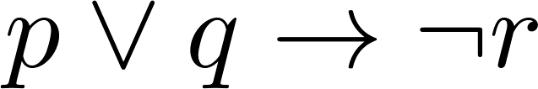
Example Truth Table
Construct a truth table for
p | q | r | ¬r | p ∨ q | p ∨ q → ¬r
T | T | T | F | T | F
T | T | F | T | T | T
T | F | T | F | T | F
T | F | F | T | T | T
F | T | T | F | T | F
F | T | F | T | T | T
F | F | T | F | F | T
F | F | F | T | F | T

Slide 31
Equivalent Propositions
Two propositions are equivalent if they always have the same truth value.
Example: Show using a truth table that the conditional is equivalent to the contrapositive.
Solution:
p | q | ¬ p | ¬ q | p →q | ¬q → ¬ p
T | T | F | F | T | T
T | F | F | T | F | F
F | T | T | F | T | T
F | F | T | T | T | T

Slide 32
Using a Truth Table to Show Non-Equivalence
Example: Show using truth tables that neither the converse nor inverse of an implication are not equivalent to the implication.
Solution:
p | q | ¬ p | ¬ q | p →q | ¬ p →¬ q | q → p
T | T | F | F | T | T | T
T | F | F | T | F | T | T
F | T | T | F | T | F | F
F | F | T | T | T | T | T

Slide 33
Problem
How many rows are there in a truth table with n propositional variables?
Solution: 2^{n} We will see how to do this in Chapter 6.
Note that this means that with n propositional variables, we can construct 2^{n} distinct (i.e., not equivalent) propositions.

Slide 34
Precedence of Logical Operators
Operator | Precedence
¬ | 1
∧ ∨ | 2 3
→ ↔ | 4 5
p ∨q → ¬r is equivalent to (p ∨q) → ¬r
If the intended meaning is p ∨(q → ¬r )
then parentheses must be used.

Slide 35
Examples
32. Construct a truth table for each of these compound propositions.
a) p →￢p b) p ↔￢p
c) p ⊕ (p ∨ q) d) (p ∧ q) → (p ∨ q)
e) (q →￢p) ↔ (p ↔ q)
f ) (p ↔ q) ⊕ (p ↔￢q)

Slide 36
HOMEWORK
#1, #3, #9, #33

Slide 37
Applications of Propositional Logic
Section 1.2

Slide 38
Applications of Propositional Logic: Summary
Translating English to Propositional Logic
System Specifications
Boolean Searching
Logic Puzzles
Logic Circuits

Slide 39
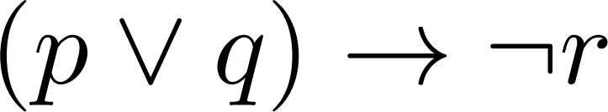
Translating English Sentences
Steps to convert an English sentence to a statement in propositional logic
Identify atomic propositions and represent using propositional variables.
Determine appropriate logical connectives
“If I go to Harry’s or to the country, I will not go shopping.”
p: I go to Harry’s
q: I go to the country.
r: I will go shopping.
If p or q then not r.

Slide 40
Example
Problem: Translate the following sentence into propositional logic:
“You can access the Internet from campus only if you are a computer science major or you are not a freshman.”
One Solution: Let a, c, and f represent respectively “You can access the internet from campus,” “You are a computer science major,” and “You are a freshman.”
a→ (c ∨ ¬ f )

Slide 41
EXAMPLE
You can see the movie only if you are over 18 years old or you have the permission of a parent. Express your answer in terms of m: “You can see the movie,” e: “You are over 18 years old,” and p: “You have the permission of a parent.”

Slide 42
System Specifications
System and Software engineers take requirements in English and express them in a precise specification language based on logic.
Example: Express in propositional logic:
“The automated reply cannot be sent when the file system is full”
Solution: One possible solution: Let p denote “The automated reply can be sent” and q denote “The file system is full.”
q→ ¬ p

Slide 43
Consistent System Specifications
Definition: A list of propositions is consistent if it is possible to assign truth values to the proposition variables so that each proposition is true.
Exercise: Are these specifications consistent?
“The diagnostic message is stored in the buffer or it is retransmitted.”
“The diagnostic message is not stored in the buffer.”
“If the diagnostic message is stored in the buffer, then it is retransmitted.”
Solution: Let p denote “The diagnostic message is stored in the buffer.” Let q denote “The diagnostic message is retransmitted” The specification can be written as: p ∨ q, ¬p, p → q. When p is false and q is true all three statements are true. So the specification is consistent.
What if “The diagnostic message is not retransmitted is added.”
Solution: Now we are adding ¬q and there is no satisfying assignment. So the specification is not consistent.

Slide 44
EXAMPLE
There these system specifications consistent? “Whenever the system software is being upgraded, users cannot access the file system. If users can access the file system, then they can save new files. If users cannot save new files, then the system software is not bein upgraded.”

Slide 45
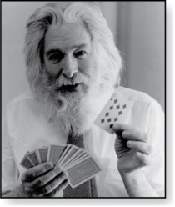
Logic Puzzles
Raymond Smullyan
(Born 1919)
An island has two kinds of inhabitants, knights, who always tell the truth, and knaves, who always lie.
You go to the island and meet A and B.
A says “B is a knight.”
B says “The two of us are of opposite types.”
Example: What are the types of A and B?
Solution: Let p and q be the statements that A is a knight and B is a knight, respectively. So, then ¬p represents the proposition that A is a knave and ¬q that B is a knave.
If A is a knight, then p is true. Since knights tell the truth, q must also be true. Then (p ∧ ¬ q)∨ (¬ p ∧ q) would have to be true, but it is not. So, A is not a knight and therefore ¬p must be true.
If A is a knave, then B must not be a knight since knaves always lie. So, then both ¬p and ¬q hold since both are knaves.

Slide 46
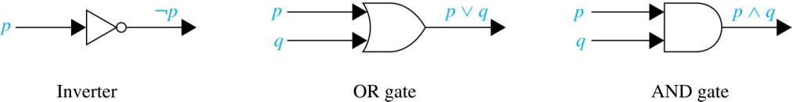
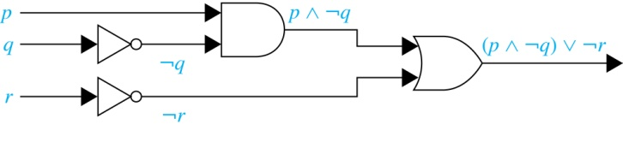
Logic Circuits (Studied in depth in Chapter 12)
Electronic circuits; each input/output signal can be viewed as a 0 or 1.
0 represents False
1 represents True
Complicated circuits are constructed from three basic circuits called gates.
The inverter (NOT gate)takes an input bit and produces the negation of that bit.
The OR gate takes two input bits and produces the value equivalent to the disjunction of the two bits.
The AND gate takes two input bits and produces the value equivalent to the conjunction of the two bits.
More complicated digital circuits can be constructed by combining these basic circuits to produce the desired output given the input signals by building a circuit for each piece of the output expression and then combining them. For example:

Slide 47
HOMEWORK
#1, #9, #25

Slide 48
Propositional Equivalences
Section 1.3

Slide 49
Section Summary
Tautologies, Contradictions, and Contingencies.
Logical Equivalence
Important Logical Equivalences
Showing Logical Equivalence
Normal Forms (optional, covered in exercises in text)
Disjunctive Normal Form
Conjunctive Normal Form
Propositional Satisfiability
Sudoku Example

Slide 50
Tautologies, Contradictions, and Contingencies
A tautology is a proposition which is always true.
Example: p ∨¬p
A contradiction is a proposition which is always false.
Example: p ∧¬p
A contingency is a proposition which is neither a tautology nor a contradiction, such as p
P | ¬p | p ∨¬p | p ∧¬p
T | F | T | F
F | T | T | F

Slide 51
Logically Equivalent
Two compound propositions p and q are logically equivalent if p↔q is a tautology.
We write this as p⇔q or as p≡q where p and q are compound propositions.
Two compound propositions p and q are equivalent if and only if the columns in a truth table giving their truth values agree.
This truth table shows that ¬p ∨ q is equivalent to p → q.
p | q | ¬p | ¬p ∨ q | p→ q
T | T | F | T | T
T | F | F | F | F
F | T | T | T | T
F | F | T | T | T

Slide 52
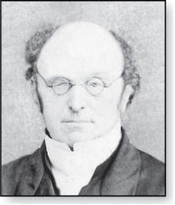
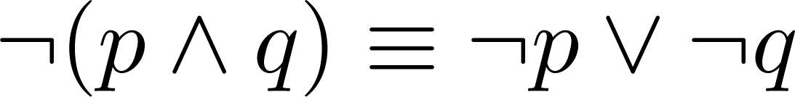
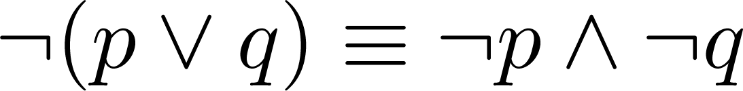
De Morgan’s Laws
Augustus De Morgan
1806-1871
This truth table shows that De Morgan’s Second Law holds.
p | q | ¬p | ¬q | (p∨q) | ¬(p∨q) | ¬p∧¬q
T | T | F | F | T | F | F
T | F | F | T | T | F | F
F | T | T | F | T | F | F
F | F | T | T | F | T | T

Slide 53
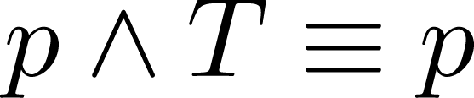
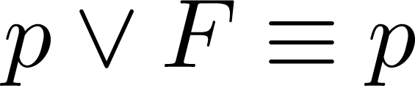
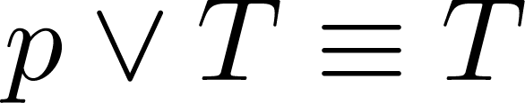
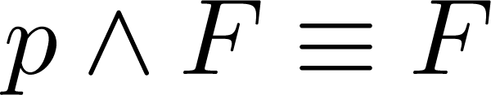
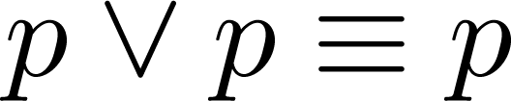
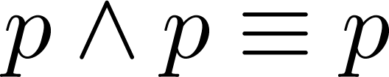
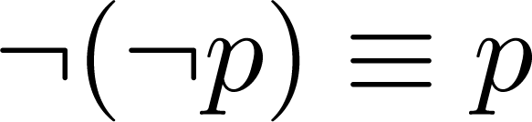
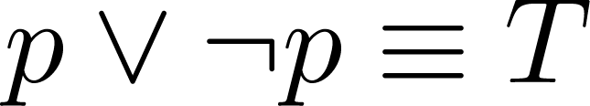
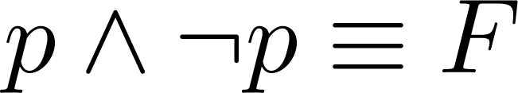
Key Logical Equivalences
Identity Laws: ,
Domination Laws: ,
Idempotent laws: ,
Double Negation Law:
Negation Laws: ,

Slide 54
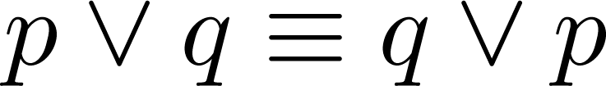
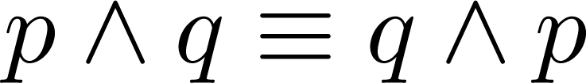
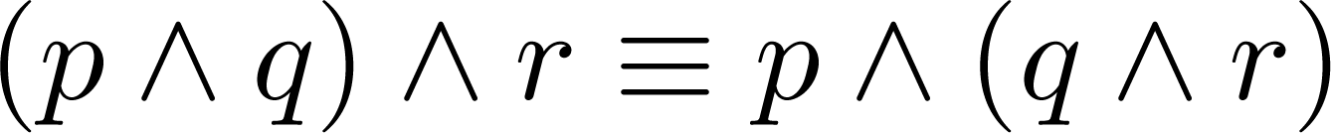
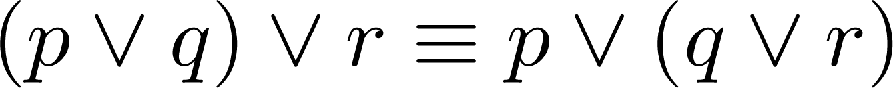
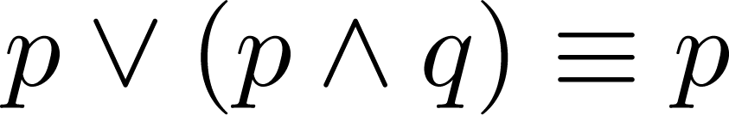
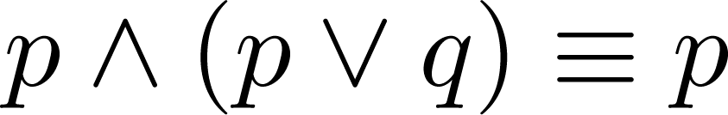
Key Logical Equivalences (cont)
Commutative Laws: ,
Associative Laws:
Distributive Laws:
Absorption Laws:

Slide 55
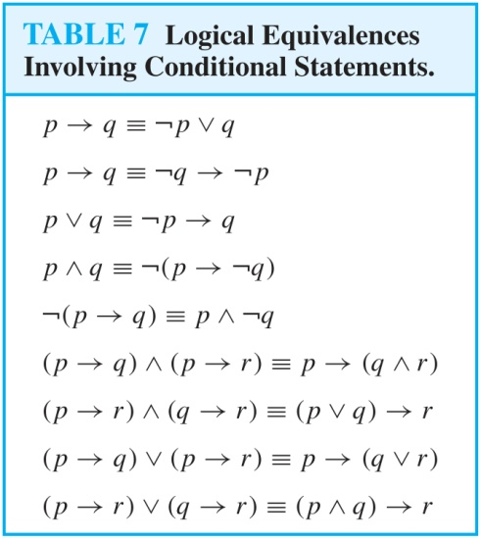
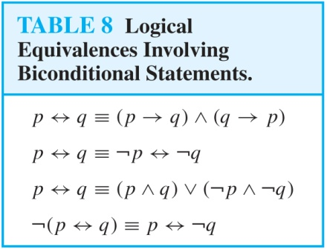
More Logical Equivalences

Slide 56

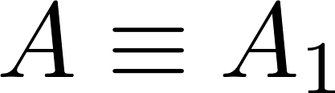
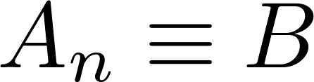
Constructing New Logical Equivalences
We can show that two expressions are logically equivalent by developing a series of logically equivalent statements.
To prove that we produce a series of equivalences beginning with A and ending with B.
Keep in mind that whenever a proposition (represented by a propositional variable) occurs in the equivalences listed earlier, it may be replaced by an arbitrarily complex compound proposition.

Slide 57
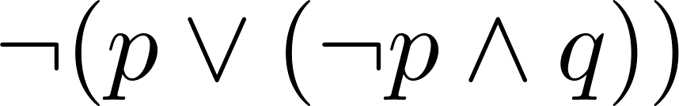
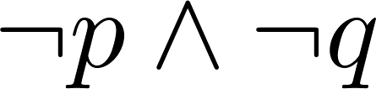
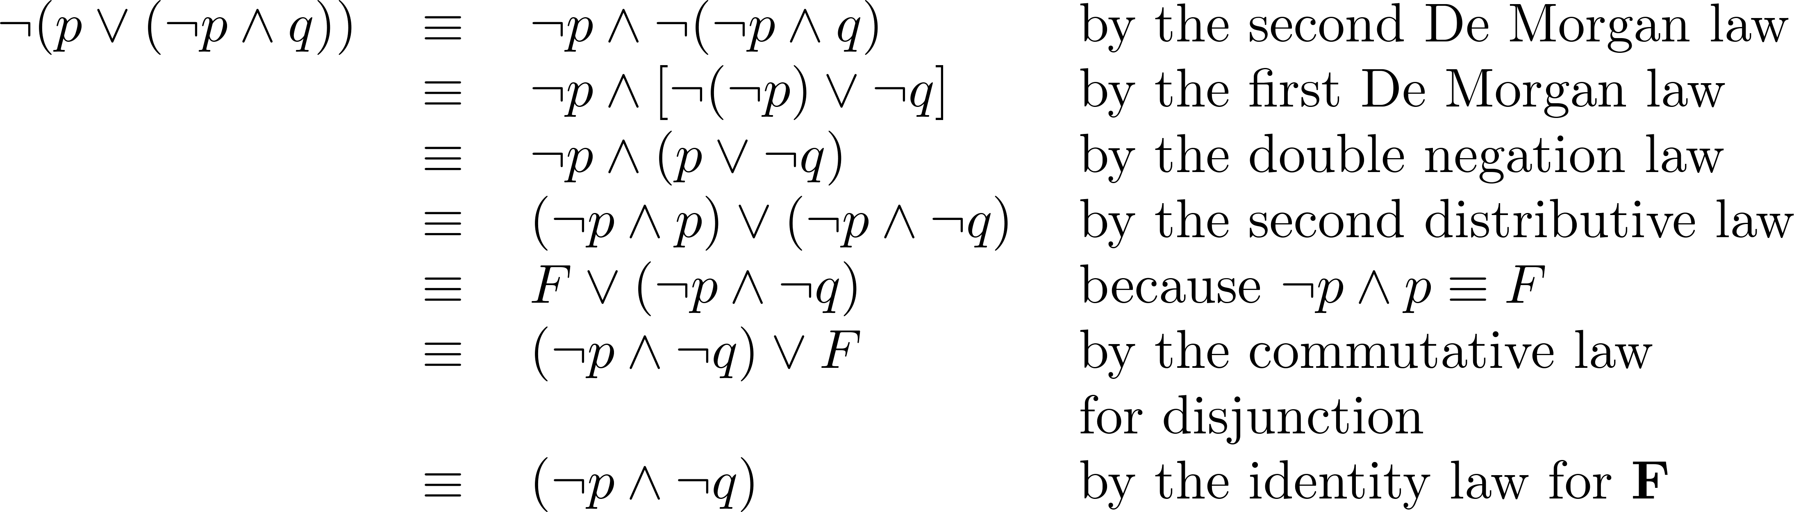
Equivalence Proofs
Example: Show that
is logically equivalent to
Solution:

Slide 58
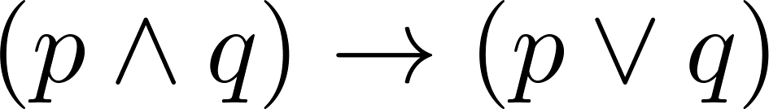
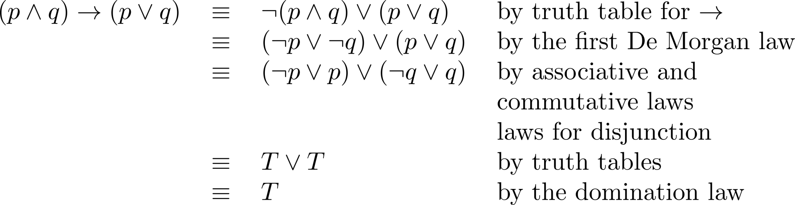
Equivalence Proofs
Example: Show that
is a tautology.
Solution:

Slide 59
EXAMPLE
Show that (p → q) ∨ (p → r) and p → (q ∨ r) are logically equivalent

Slide 60
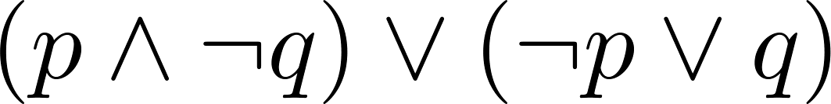
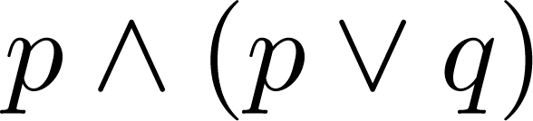
Disjunctive Normal Form (optional)
A propositional formula is in disjunctive normal form if it consists of a disjunction of (1, … ,n) disjuncts where each disjunct consists of a conjunction of (1, …, m) atomic formulas or the negation of an atomic formula.
Yes
No
Disjunctive Normal Form is important for the circuit design methods discussed in Chapter 12.

Slide 61
Disjunctive Normal Form (optional)
Example: Find the Disjunctive Normal Form (DNF) of
(p∨q)→¬r
Solution: This proposition is true when r is false or when both p and q are false.
(¬ p∧ ¬ q) ∨ ¬r

Slide 62
Conjunctive Normal Form
A compound proposition is in Conjunctive Normal Form (CNF) if it is a conjunction of disjunctions.
Every proposition can be put in an equivalent CNF.
Conjunctive Normal Form (CNF) can be obtained by eliminating implications, moving negation inwards and using the distributive and associative laws.
Important in resolution theorem proving used in artificial Intelligence (AI).
A compound proposition can be put in conjunctive normal form through repeated application of the logical equivalences covered earlier.

Slide 63
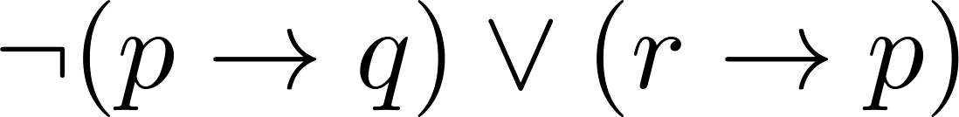
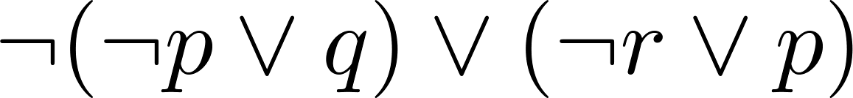
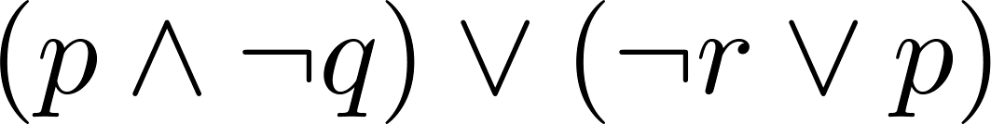
Conjunctive Normal Form (optional)
Example: Put the following into CNF:
Solution:
Eliminate implication signs:
Move negation inwards; eliminate double negation:
Convert to CNF using associative/distributive laws

Slide 64
Propositional Satisfiability
A compound proposition is satisfiable if there is an assignment of truth values to its variables that make it true. When no such assignments exist, the compound proposition is unsatisfiable.
A compound proposition is unsatisfiable if and only if its negation is a tautology.

Slide 65
Questions on Propositional Satisfiability
Example: Determine the satisfiability of the following compound propositions:
Solution: Satisfiable. Assign T to p, q, and r.
Solution: Satisfiable. Assign T to p and F to q.
Solution: Not satisfiable. Check each possible assignment of truth values to the propositional variables and none will make the proposition true.

Slide 66
EXAMPLE
Determine whether each of these compound propositions
is satisfiable.
a) (p ∨ q ∨￢r) ∧ (p ∨￢q ∨￢s) ∧ (p ∨￢r ∨￢s) ∧ (￢p ∨￢q ∨￢s) ∧ (p ∨ q ∨￢s)
b) (￢p ∨￢q ∨ r) ∧ (￢p ∨ q ∨￢s) ∧ (p ∨￢q ∨
￢s) ∧ (￢p ∨￢r ∨￢s) ∧ (p ∨ q ∨￢r) ∧ (p ∨
￢r ∨￢s)
c) (p ∨ q ∨ r) ∧ (p ∨￢q ∨￢s) ∧ (q ∨￢r ∨ s) ∧ (￢p ∨ r ∨ s) ∧ (￢p ∨ q ∨￢s) ∧ (p ∨￢q ∨￢r) ∧ (￢p ∨￢q ∨ s) ∧ (￢p ∨￢r ∨￢s)

Slide 67
Notation

Slide 68
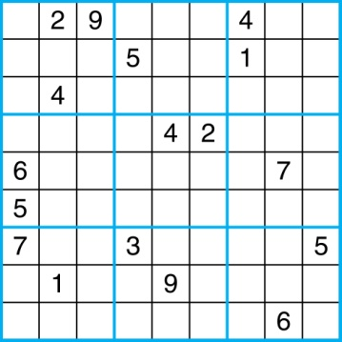
Sudoku
A Sudoku puzzle is represented by a 9×9 grid made up of nine 3×3 subgrids, known as blocks. Some of the 81 cells of the puzzle are assigned one of the numbers 1,2, …, 9.
The puzzle is solved by assigning numbers to each blank cell so that every row, column and block contains each of the nine possible numbers.
Example

Slide 69
Encoding as a Satisfiability Problem
Let p(i,j,n) denote the proposition that is true when the number n is in the cell in the ith row and the jth column.
There are 9×9 × 9 = 729 such propositions.
In the sample puzzle p(5,1,6) is true, but p(5,j,6) is false for j = 2,3,…9

Slide 70
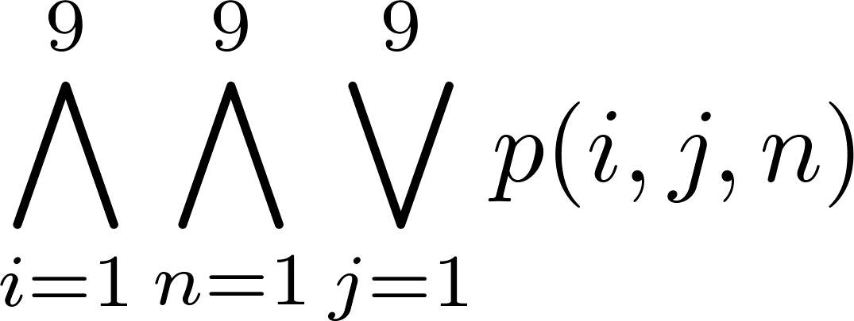
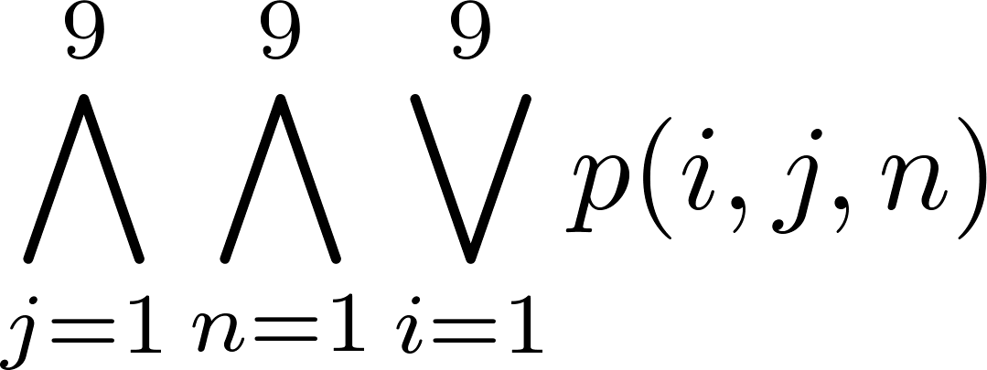
Encoding (cont)
For each cell with a given value, assert p(i,j,n), when the cell in row i and column j has the given value.
Assert that every row contains every number.
Assert that every column contains every number.

Slide 71
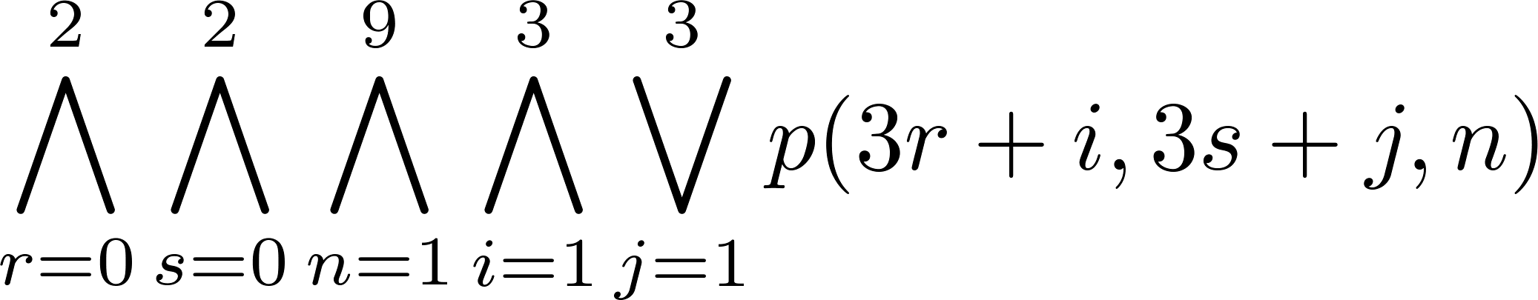
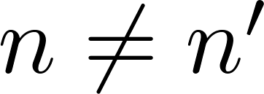
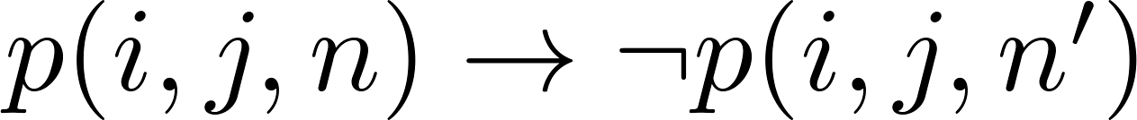
Encoding (cont)
Assert that each of the 3 x 3 blocks contain every number.
(this is tricky - ideas from chapter 4 help)
Assert that no cell contains more than one number. Take the conjunction over all values of n, n’, i, and j, where each variable ranges from 1 to 9 and ,
of

Slide 72
Solving Satisfiability Problems
To solve a Sudoku puzzle, we need to find an assignment of truth values to the 729 variables of the form p(i,j,n) that makes the conjunction of the assertions true. Those variables that are assigned T yield a solution to the puzzle.
A truth table can always be used to determine the satisfiability of a compound proposition. But this is too complex even for modern computers for large problems.
There has been much work on developing efficient methods for solving satisfiability problems as many practical problems can be translated into satisfiability problems.

Slide 73
HOMEWORK
#23, #61

