Slide 1
The Foundations: Logic and Proofs
Chapter 1, Part III: Proofs

Slide 2
Summary
Valid Arguments and Rules of Inference
Proof Methods
Proof Strategies

Slide 3
Rules of Inference
Section 1.6

Slide 4
Section Summary
Valid Arguments
Inference Rules for Propositional Logic
Using Rules of Inference to Build Arguments
Rules of Inference for Quantified Statements
Building Arguments for Quantified Statements

Slide 5
Revisiting the Socrates Example
We have the two premises:
“All men are mortal.”
“Socrates is a man.”
And the conclusion:
“Socrates is mortal.”
How do we get the conclusion from the premises?

Slide 6
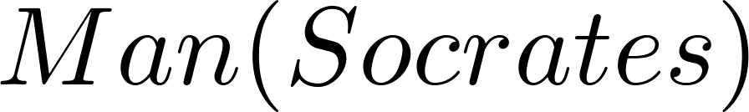
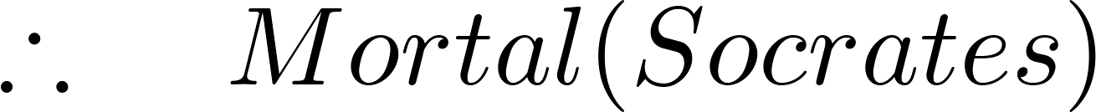
The Argument
We can express the premises (above the line) and the conclusion (below the line) in predicate logic as an argument:
We will see shortly that this is a valid argument.

Slide 7
Valid Arguments
We will show how to construct valid arguments in two stages; first for propositional logic and then for predicate logic. The rules of inference are the essential building block in the construction of valid arguments.
Propositional Logic
Inference Rules
Predicate Logic
Inference rules for propositional logic plus additional inference rules to handle variables and quantifiers.

Slide 8
Arguments in Propositional Logic
An argument in propositional logic is a sequence of propositions. All but the final proposition are called premises. The last statement is the conclusion.
The argument is valid if the premises imply the conclusion. An argument form is an argument that is valid no matter what propositions are substituted into its propositional variables.
If the premises are p₁ ,p₂, …,p_{n} and the conclusion is q then
(p₁ ∧ p₂ ∧ … ∧ p_{n} ) → q is a tautology.
Inference rules are all argument simple argument forms that will be used to construct more complex argument forms.

Slide 9
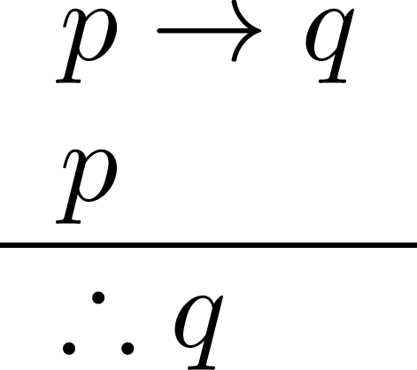
Rules of Inference for Propositional Logic: Modus Ponens
Corresponding Tautology:
(p ∧ (p →q)) → q
Example:
Let p be “It is snowing.”
Let q be “I will study discrete math.”
“If it is snowing, then I will study discrete math.”
“It is snowing.”
“Therefore , I will study discrete math.”

Slide 10
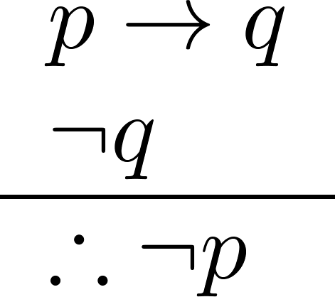
Modus Tollens
Corresponding Tautology:
(¬q∧(p →q))→¬p
Example:
Let p be “it is snowing.”
Let q be “I will study discrete math.”
“If it is snowing, then I will study discrete math.”
“I will not study discrete math.”
“Therefore , it is not snowing.”

Slide 11
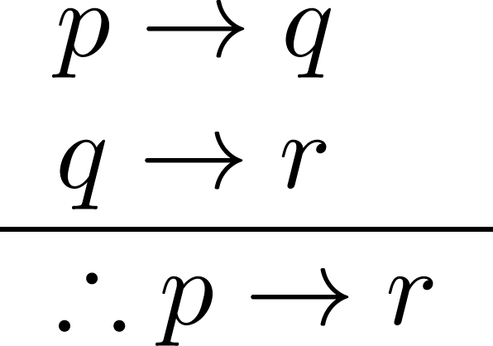
Hypothetical Syllogism
Corresponding Tautology:
((p →q) ∧ (q→r))→(p→ r)
Example:
Let p be “it snows.”
Let q be “I will study discrete math.”
Let r be “I will get an A.”
“If it snows, then I will study discrete math.”
“If I study discrete math, I will get an A.”
“Therefore , If it snows, I will get an A.”

Slide 12
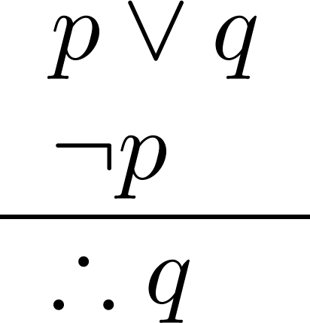
Disjunctive Syllogism
Corresponding Tautology:
(¬p∧(p ∨q))→q
Example:
Let p be “I will study discrete math.”
Let q be “I will study English literature.”
“I will study discrete math or I will study English literature.”
“I will not study discrete math.”
“Therefore , I will study English literature.”

Slide 13
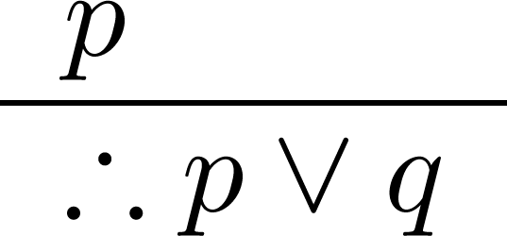
Addition
Corresponding Tautology:
p →(p ∨q)
Example:
Let p be “I will study discrete math.”
Let q be “I will visit Las Vegas.”
“I will study discrete math.”
“Therefore, I will study discrete math or I will visit
Las Vegas.”

Slide 14
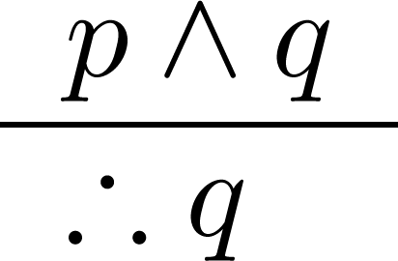
Simplification
Corresponding Tautology:
(p∧q) →p
Example:
Let p be “I will study discrete math.”
Let q be “I will study English literature.”
“I will study discrete math and English literature”
“Therefore, I will study discrete math.”

Slide 15
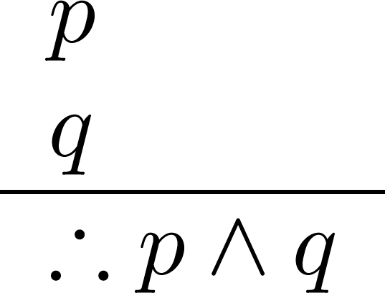
Conjunction
Corresponding Tautology:
((p) ∧ (q)) →(p ∧ q)
Example:
Let p be “I will study discrete math.”
Let q be “I will study English literature.”
“I will study discrete math.”
“I will study English literature.”
“Therefore, I will study discrete math and I will study English literature.”

Slide 16
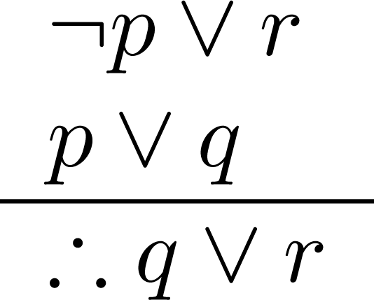
Resolution
Resolution plays an important role in AI and is used in Prolog.
Corresponding Tautology:
((¬p ∨ r ) ∧ (p ∨ q)) →(q ∨ r)
Example:
Let p be “I will study discrete math.”
Let r be “I will study English literature.”
Let q be “I will study databases.”
“I will not study discrete math or I will study English literature.”
“I will study discrete math or I will study databases.”
“Therefore, I will study databases or I will study English literature.”

Slide 17

Using the Rules of Inference to Build Valid Arguments
A valid argument is a sequence of statements. Each statement is either a premise or follows from previous statements by rules of inference. The last statement is called conclusion.
A valid argument takes the following form:
S₁
S₂
.
.
.
S_{n}
C

Slide 18
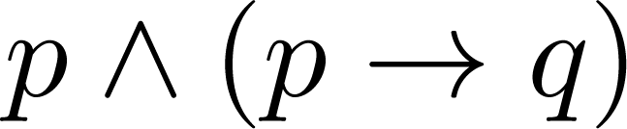
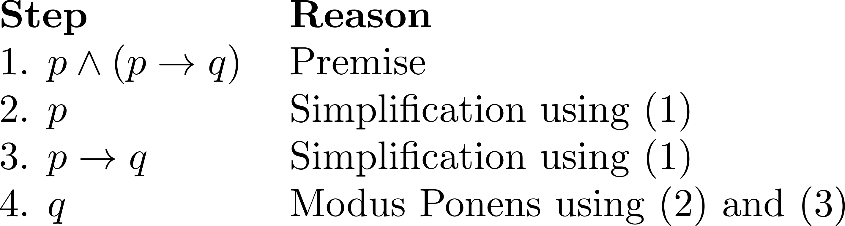
Valid Arguments
Example 1: From the single proposition
Show that q is a conclusion.
Solution:

Slide 19
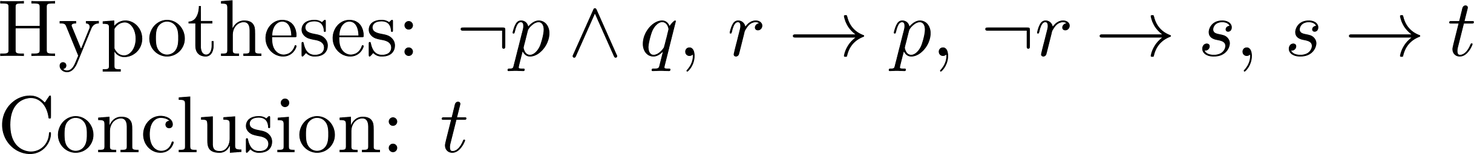
Valid Arguments
Example 2:
With these hypotheses:
“It is not sunny this afternoon and it is colder than yesterday.”
“We will go swimming only if it is sunny.”
“If we do not go swimming, then we will take a canoe trip.”
“If we take a canoe trip, then we will be home by sunset.”
Using the inference rules, construct a valid argument for the conclusion:
“We will be home by sunset.”
Solution:
Choose propositional variables:
p : “It is sunny this afternoon.” r : “We will go swimming.” t : “We will be home by sunset.”
q : “It is colder than yesterday.” s : “We will take a canoe trip.”
Translation into propositional logic:

Slide 20
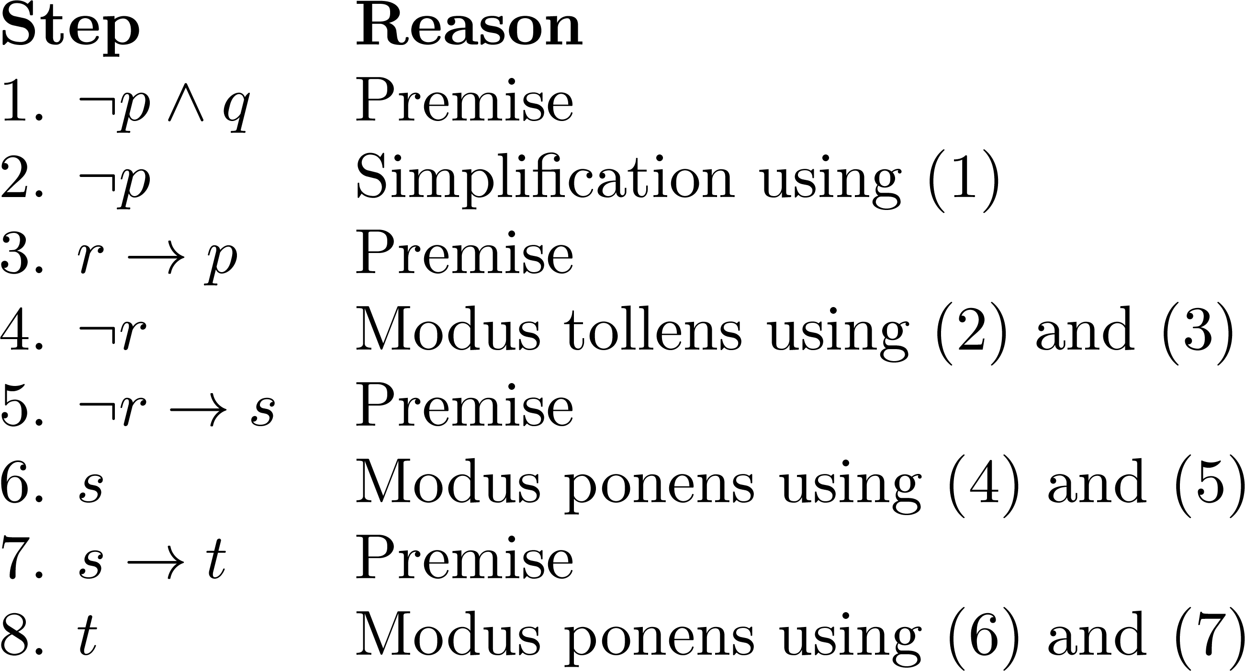
Valid Arguments
3. Construct the Valid Argument
Notes:
Note that a truth table would have 32 rows since we have 5 propositional variables.

Slide 21
Handling Quantified Statements
Valid arguments for quantified statements are a sequence of statements. Each statement is either a premise or follows from previous statements by rules of inference which include:
Rules of Inference for Propositional Logic
Rules of Inference for Quantified Statements
The rules of inference for quantified statements are introduced in the next several slides.

Slide 22
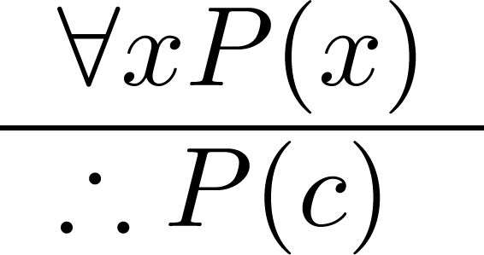
Universal Instantiation (UI)
Example:
Our domain consists of all dogs and Fido is a dog.
“All dogs are cuddly.”
“Therefore, Fido is cuddly.”

Slide 23
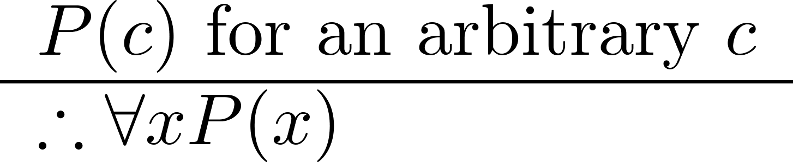
Universal Generalization (UG)
Used often implicitly in Mathematical Proofs.

Slide 24
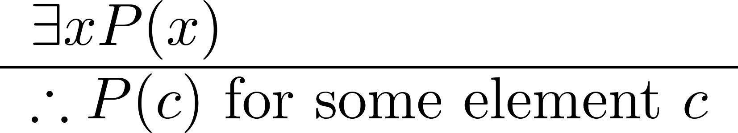
Existential Instantiation (EI)
Example:
“There is someone who got an A in the course.”
“Let’s call her a and say that a got an A”

Slide 25
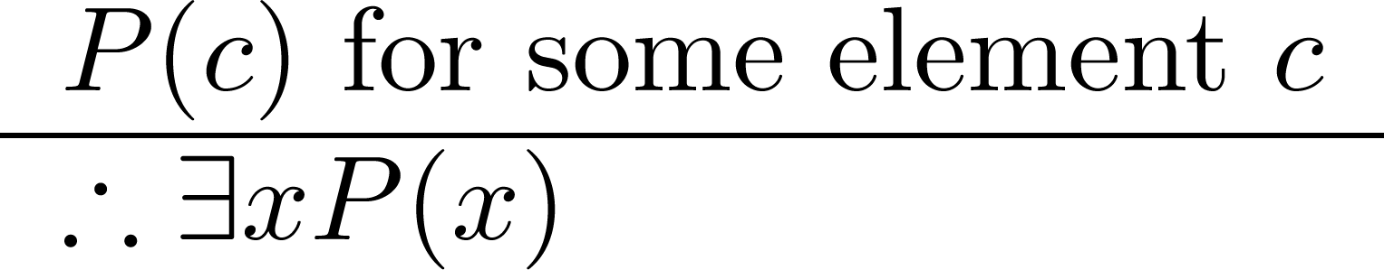
Existential Generalization (EG)
Example:
“Michelle got an A in the class.”
“Therefore, someone got an A in the class.”

Slide 26
Using Rules of Inference
Example 1: Using the rules of inference, construct a valid argument to show that
“John Smith has two legs”
is a consequence of the premises:
“Every man has two legs.” “John Smith is a man.”
Solution: Let M(x) denote “x is a man” and L(x) “ x has two legs” and let John Smith be a member of the domain.

Slide 27
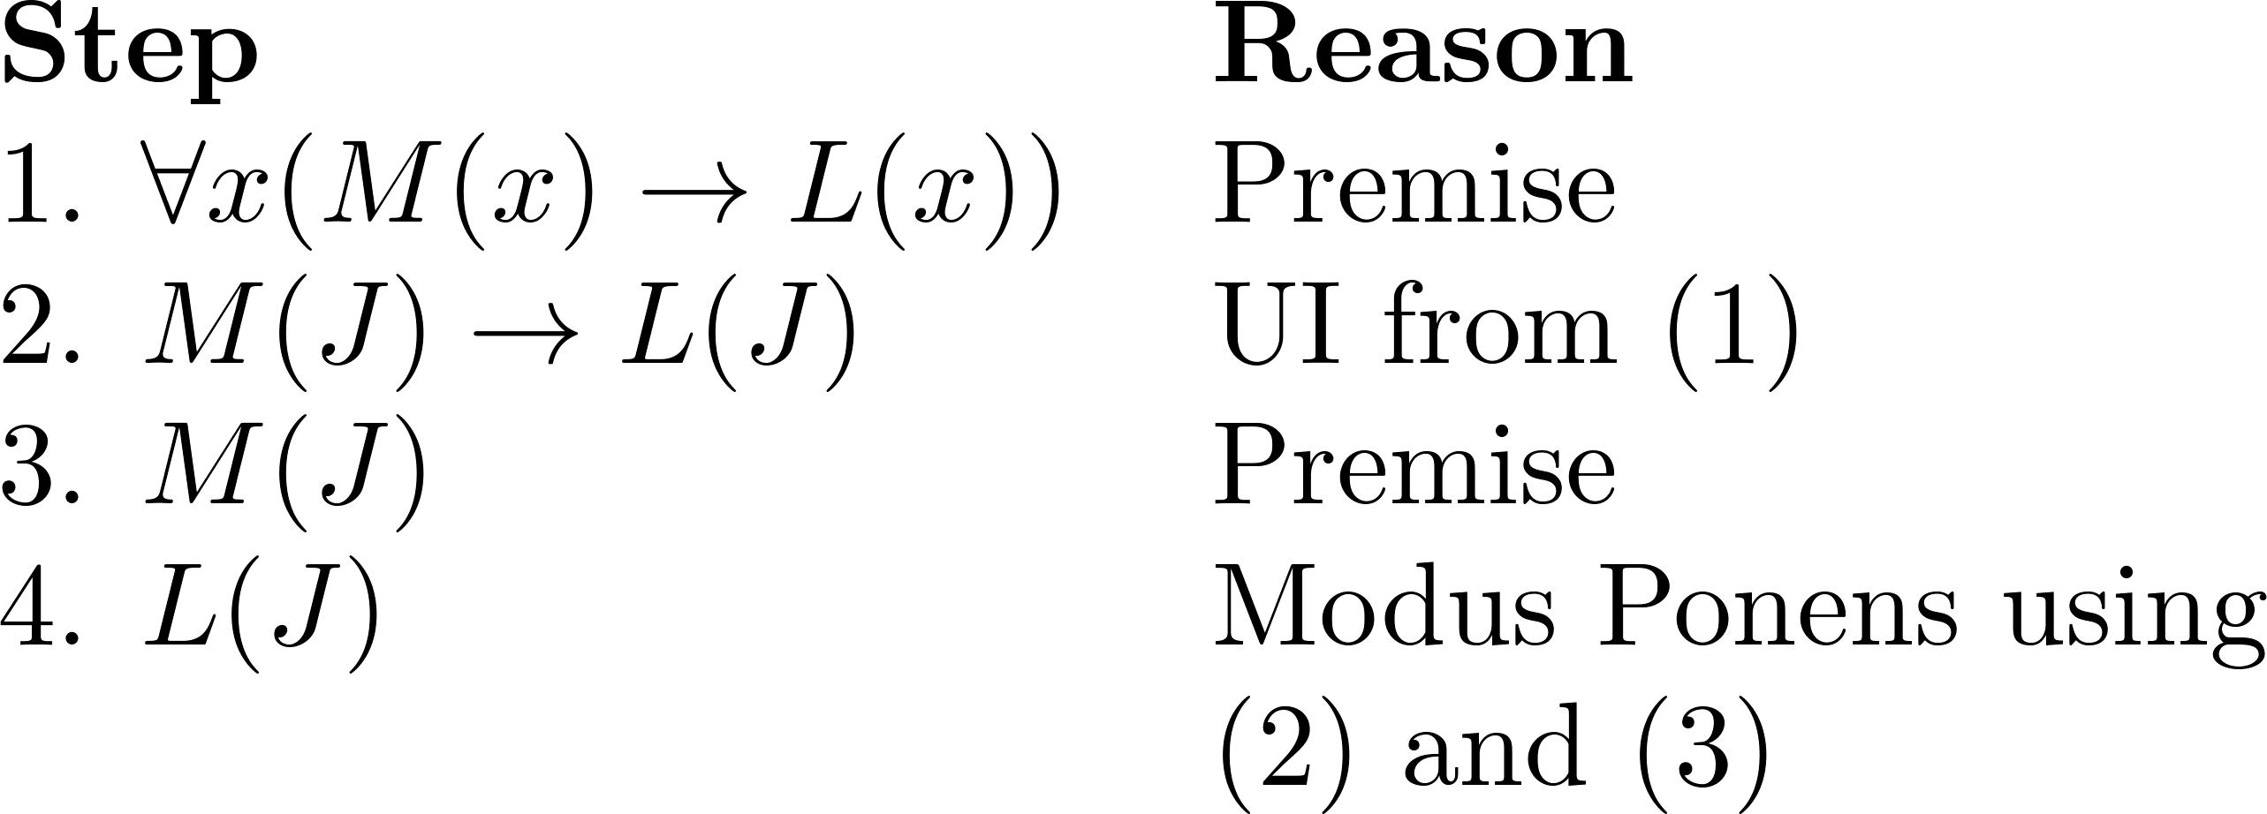
Using Rules of Inference
Example 1: Using the rules of inference, construct a valid argument to show that
“John Smith has two legs”
is a consequence of the premises:
“Every man has two legs.” “John Smith is a man.”
Solution: Let M(x) denote “x is a man” and L(x) “ x has two legs” and let John Smith be a member of the domain.
Valid Argument:

Slide 28
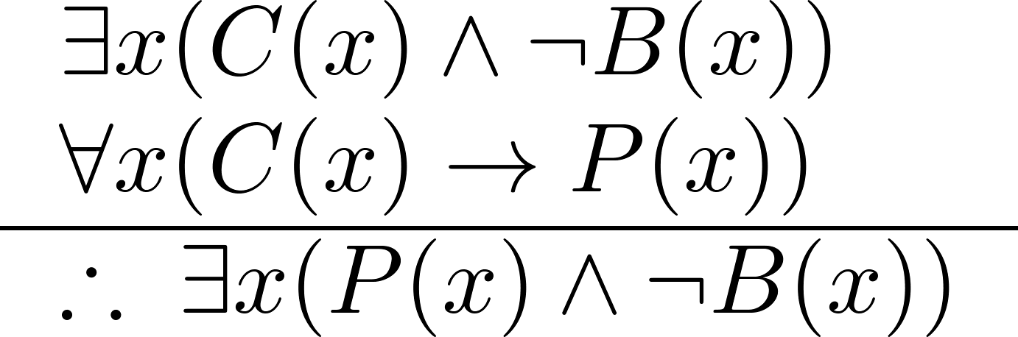
Using Rules of Inference
Example 2: Use the rules of inference to construct a valid argument showing that the conclusion
“Someone who passed the first exam has not read the book.”
follows from the premises
“A student in this class has not read the book.”
“Everyone in this class passed the first exam.”
Solution: Let C(x) denote “x is in this class,” B(x) denote “ x has read the book,” and P(x) denote “x passed the first exam.”
First we translate the
premises and conclusion
into symbolic form.

Slide 29
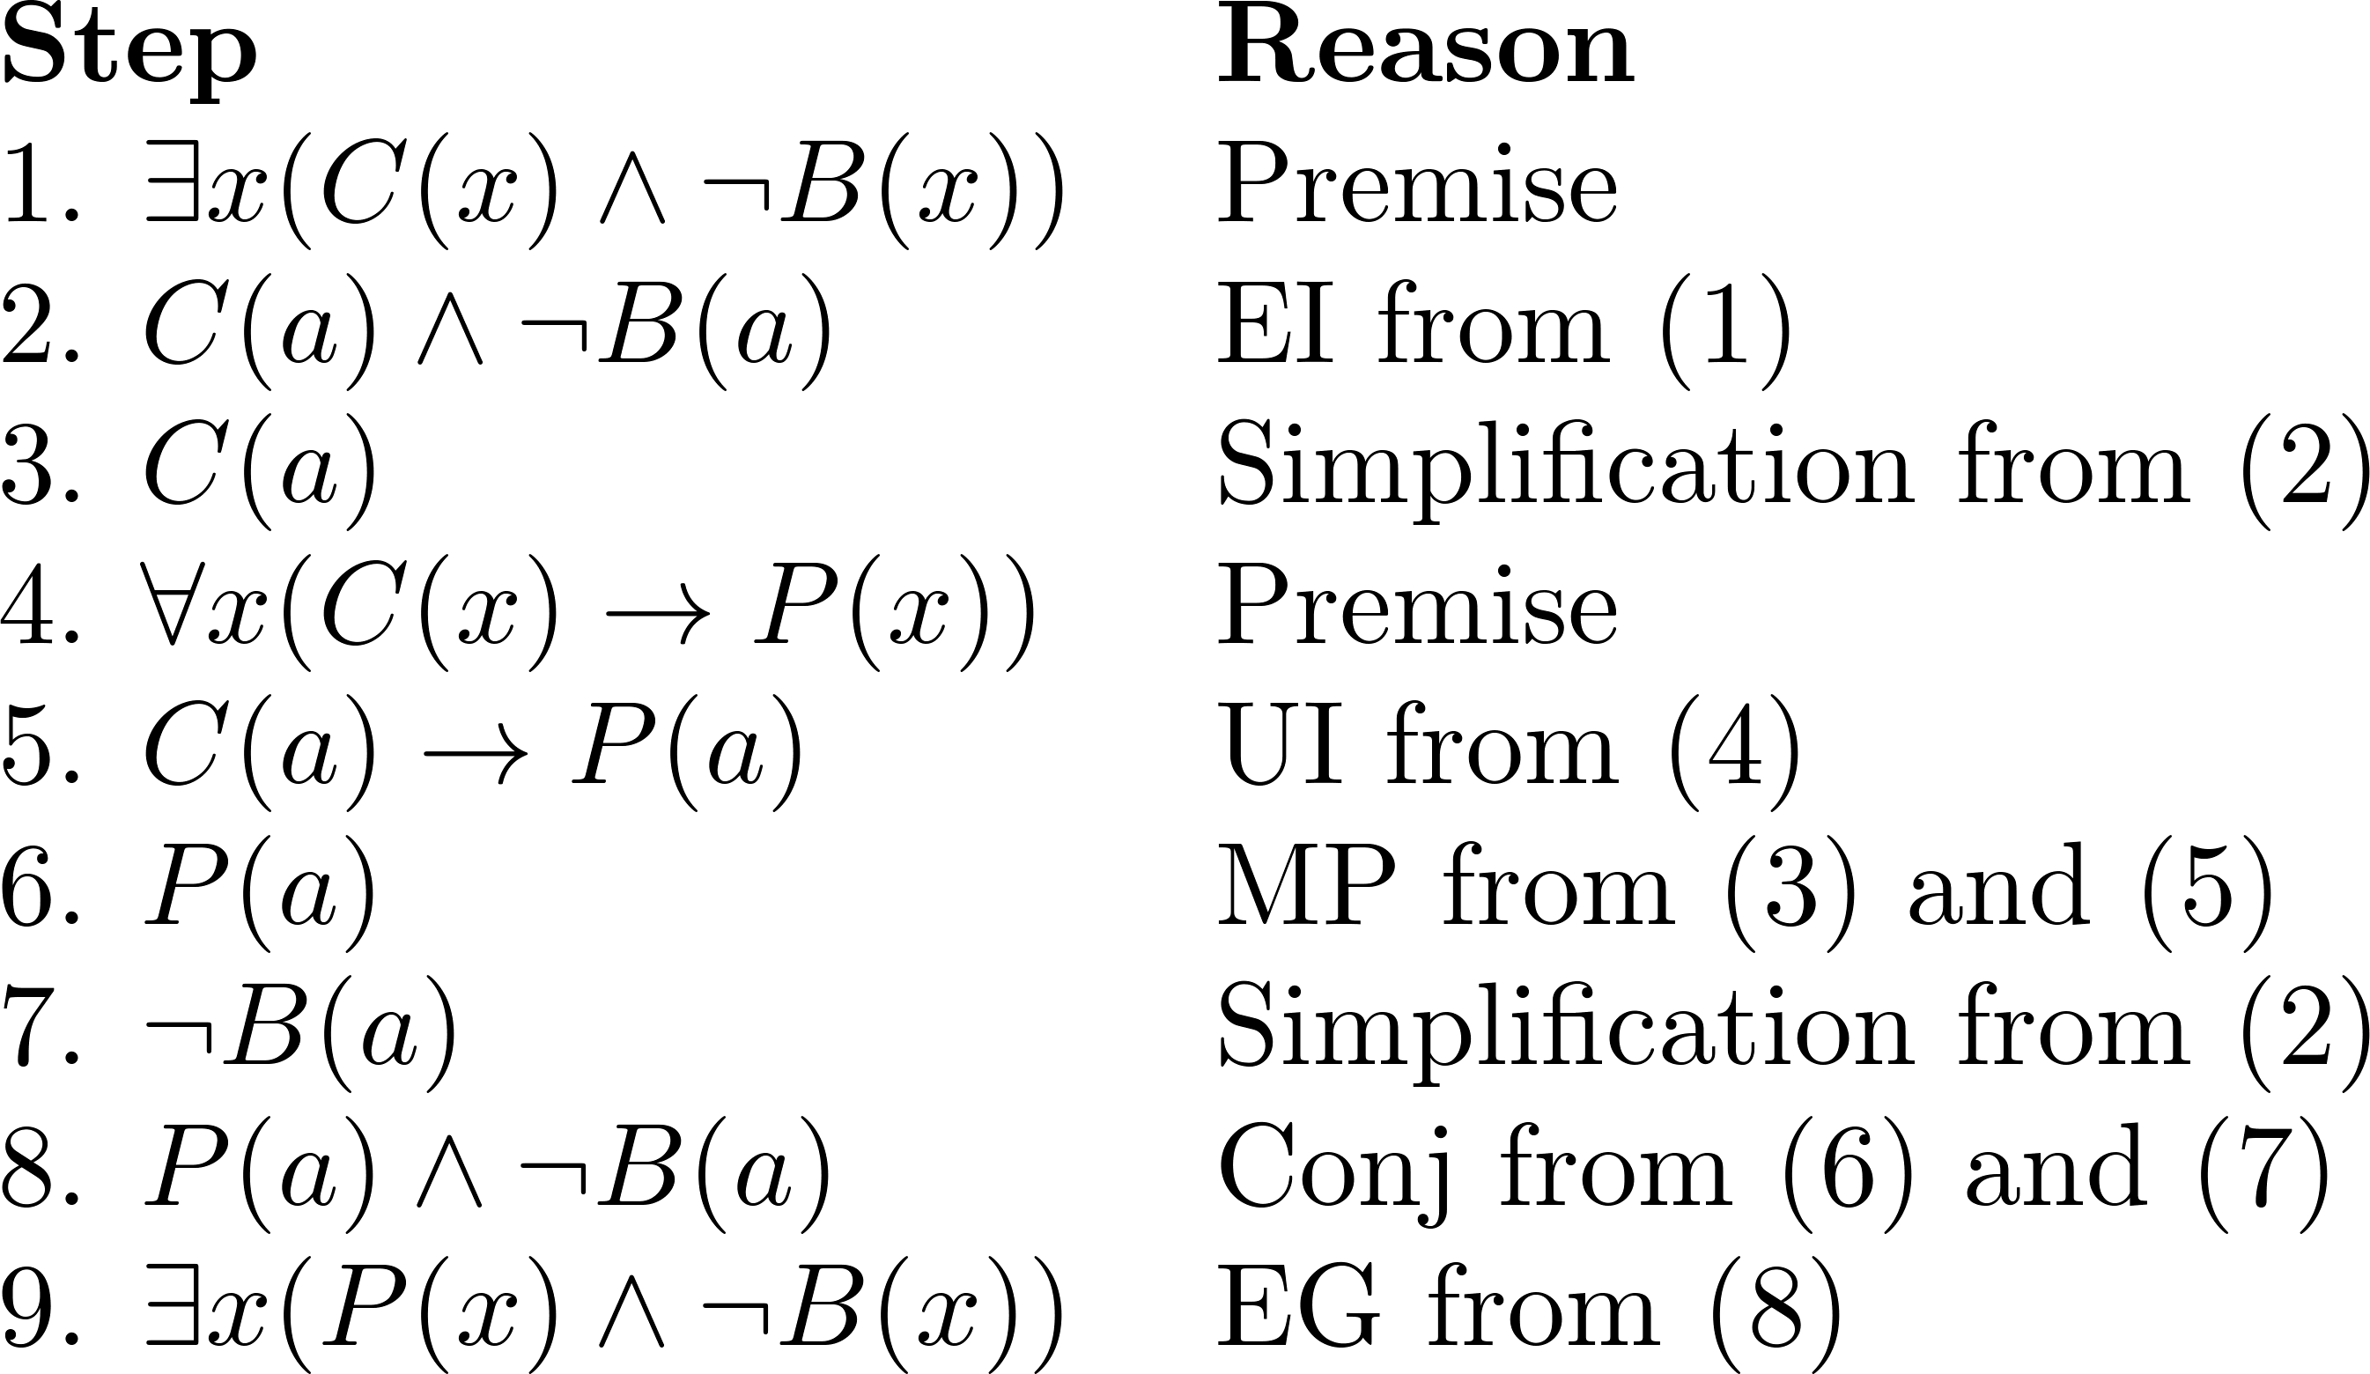
Using Rules of Inference
Valid Argument:

Slide 30
Returning to the Socrates Example

Slide 31
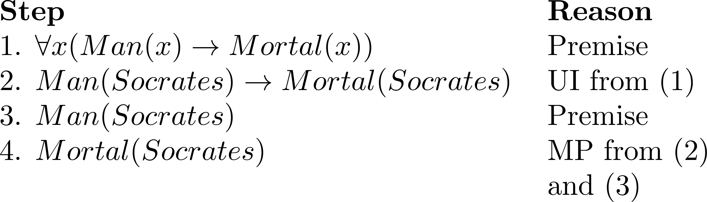
Solution for Socrates Example
Valid Argument

Slide 32
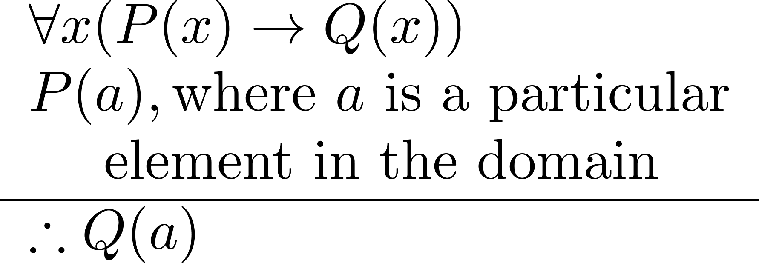
Universal Modus Ponens
Universal Modus Ponens combines universal instantiation and modus ponens into one rule.
This rule could be used in the Socrates example.

Slide 33
EXAMPLE
Use rules of inference to show that the hypotheses “If it does not rain or if it is not foggy, then the sailing race will be held and the lifesaving demonstration will go on,” “If the sailing race is held, then the trophy will be awarded,” and “The trophy was not awarded” imply the conclusion “It rained.”

Slide 34
EXAMPLE
For each of these arguments, explain which rules of inference are used for each step.
a) “Linda, a student in this class, owns a red convertible. Everyone who owns a red convertible has gotten at least one speeding ticket. Therefore, someone in this class has gotten a speeding ticket.”

Slide 35
HOMEWORK
#5, #13

Slide 36
Introduction to Proofs
Section 1.7

Slide 37
Section Summary
Mathematical Proofs
Forms of Theorems
Direct Proofs
Indirect Proofs
Proof of the Contrapositive
Proof by Contradiction

Slide 38
Proofs of Mathematical Statements
A proof is a valid argument that establishes the truth of a statement.
In math, CS, and other disciplines, informal proofs which are generally shorter, are generally used.
More than one rule of inference are often used in a step.
Steps may be skipped.
The rules of inference used are not explicitly stated.
Easier for to understand and to explain to people.
But it is also easier to introduce errors.
Proofs have many practical applications:
verification that computer programs are correct
establishing that operating systems are secure
enabling programs to make inferences in artificial intelligence
showing that system specifications are consistent

Slide 39
Definitions
A theorem is a statement that can be shown to be true using:
definitions
other theorems
axioms (statements which are given as true)
rules of inference
A lemma is a ‘helping theorem’ or a result which is needed to prove a theorem.
A corollary is a result which follows directly from a theorem.
Less important theorems are sometimes called propositions.
A conjecture is a statement that is being proposed to be true. Once a proof of a conjecture is found, it becomes a theorem. It may turn out to be false.

Slide 40
Forms of Theorems
Many theorems assert that a property holds for all elements in a domain, such as the integers, the real numbers, or some of the discrete structures that we will study in this class.
Often the universal quantifier (needed for a precise statement of a theorem) is omitted by standard mathematical convention.
For example, the statement:
“If x > y, where x and y are positive real numbers, then x² > y² ”
really means
“For all positive real numbers x and y, if x > y, then x² > y² .”

Slide 41
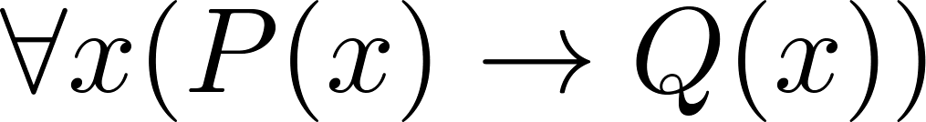
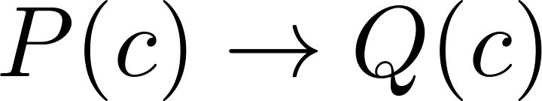

Proving Theorems
Many theorems have the form:
To prove them, we show that where c is an arbitrary element of the domain,
By universal generalization the truth of the original formula follows.
So, we must prove something of the form:

Slide 42
Proving Conditional Statements: p → q
Trivial Proof: If we know q is true, then
p → q is true as well.
“If it is raining then 1=1.”
Vacuous Proof: If we know p is false then
p → q is true as well.
“If I am both rich and poor then 2 + 2 = 5.”
[ Even though these examples seem silly, both trivial and vacuous proofs are often used in mathematical induction, as we will see in Chapter 5]

Slide 43
Even and Odd Integers
Definition: The integer n is even if there exists an integer k such that n = 2k, and n is odd if there exists an integer k, such that n = 2k + 1. Note that every integer is either even or odd and no integer is both even and odd.

Slide 44
Proving Conditional Statements: p → q
Direct Proof: Assume that p is true. Use rules of inference, axioms, and logical equivalences to show that q must also be true.
Example: Give a direct proof of the theorem “If n is an odd integer, then n² is odd.”
Solution: Assume that n is odd. Then n = 2k + 1 for an integer k. Squaring both sides of the equation, we get:
n² = (2k + 1)² = 4k² + 4k +1 = 2(2k² + 2k) + 1= 2r + 1,
where r = 2k² + 2k , an integer.
We have proved that if n is an odd integer, then n² is an odd integer.
( marks the end of the proof. Sometimes QED is used instead. )

Slide 45
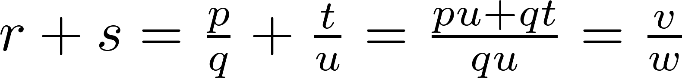
Proving Conditional Statements: p → q
Definition: The real number r is rational if there exist integers p and q where q≠0 such that r = p/q
Example: Prove that the sum of two rational numbers is rational.
Solution: Assume r and s are two rational numbers. Then there must be integers p, q and also t, u such that
Thus the sum is rational.
where v = pu + qt
w = qu ≠ 0

Slide 46
Proving Conditional Statements: p → q
Proof by Contraposition: Assume ¬q and show ¬p is true also. This is sometimes called an indirect proof method. If we give a direct proof of ¬q → ¬p then we have a proof of p → q.
Why does this work?
Example: Prove that if n is an integer and 3n + 2 is odd, then n is odd.
Solution: Assume n is even. So, n = 2k for some integer k. Thus
3n + 2 = 3(2k) + 2 =6k +2 = 2(3k + 1) = 2j for j = 3k +1
Therefore 3n + 2 is even. Since we have shown ¬q → ¬p , p → q must hold as well. If n is an integer and 3n + 2 is odd (not even) , then n is odd (not even).

Slide 47
Proving Conditional Statements: p → q
Example: Prove that for an integer n, if n² is odd, then n is odd.
Solution: Use proof by contraposition. Assume n is even (i.e., not odd). Therefore, there exists an integer k such that n = 2k. Hence,
n² = 4k² = 2 (2k²)
and n² is even(i.e., not odd).
We have shown that if n is an even integer, then n² is even. Therefore by contraposition, for an integer n, if n² is odd, then n is odd.

Slide 48
Proving Conditional Statements: p → q
Proof by Contradiction: (AKA reductio ad absurdum).
To prove p, assume ¬p and derive a contradiction such as p ∧ ¬p. (an indirect form of proof). Since we have shown that ¬p →F is true , it follows that the contrapositive T→p also holds.
Example: Prove that if you pick 22 days from the calendar, at least 4 must fall on the same day of the week.
Solution: Assume that no more than 3 of the 22 days fall on the same day of the week. Because there are 7 days of the week, we could only have picked 21 days. This contradicts the assumption that we have picked 22 days.

Slide 49
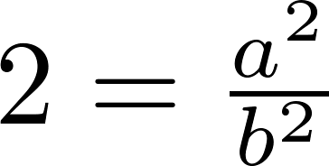
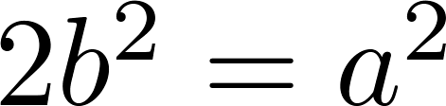
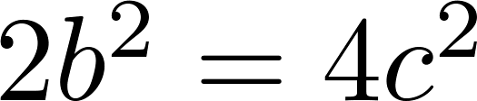
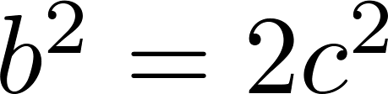
Proof by Contradiction
A preview of Chapter 4.
Example: Use a proof by contradiction to give a proof that √2 is irrational.
Solution: Suppose √2 is rational. Then there exists integers a and b with √2 = a/b, where b≠ 0 and a and b have no common factors (see Chapter 4). Then
Therefore a² must be even. If a² is even then a must be even (an exercise). Since a is even, a = 2c for some integer c. Thus,
Therefore b² is even. Again then b must be even as well.
But then 2 must divide both a and b. This contradicts our assumption that a and b have no common factors. We have proved by contradiction that our initial assumption must be false and therefore √2 is irrational .

Slide 50
Proof by Contradiction
A preview of Chapter 4.
Example: Prove that there is no largest prime number.
Solution: Assume that there is a largest prime number. Call it p_{n}. Hence, we can list all the primes 2,3,.., p_{n}. Form
None of the prime numbers on the list divides r. Therefore, by a theorem in Chapter 4, either r is prime or there is a smaller prime that divides r. This contradicts the assumption that there is a largest prime. Therefore, there is no largest prime.

Slide 51
Theorems that are Biconditional Statements
To prove a theorem that is a biconditional statement, that is, a statement of the form p ↔ q, we show that p → q and q →p are both true.
Example: Prove the theorem: “If n is an integer, then n is odd if and only if n² is odd.”
Solution: We have already shown (previous slides) that both p →q and q →p. Therefore we can conclude p ↔ q.
Sometimes iff is used as an abbreviation for “if an only if,” as in
“If n is an integer, then n is odd iif n² is odd.”

Slide 52
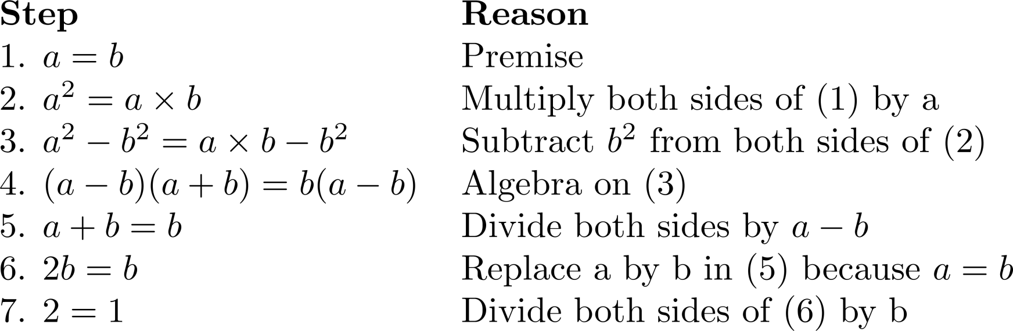
What is wrong with this?
“Proof” that 1 = 2
Solution: Step 5. a - b = 0 by the premise and division by 0 is undefined.

Slide 53
EXAMPLES
Use a direct proof to show that the product of two odd
numbers is odd.

Slide 54
EXAMPLE
Prove that if n is an integer and 3n + 2 is even, then n is even using
a) a proof by contraposition.
b) a proof by contradiction.

Slide 55
HOMEWORK
#5, #7

Slide 56
Proof Methods and Strategy
Section 1.8

Slide 57
Section Summary
Proof by Cases
Existence Proofs
Constructive
Nonconstructive
Disproof by Counterexample
Nonexistence Proofs
Uniqueness Proofs
Proof Strategies
Proving Universally Quantified Assertions
Open Problems

Slide 58
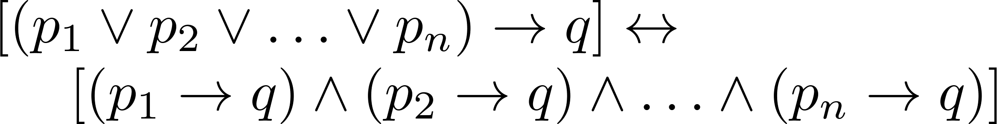

Proof by Cases
To prove a conditional statement of the form:
Use the tautology
Each of the implications is a case.

Slide 59
Proof by Cases
Example: Let a @ b = max{a, b} = a if a ≥ b, otherwise a @ b = max{a, b} = b.
Show that for all real numbers a, b, c
(a @b) @ c = a @ (b @ c)
(This means the operation @ is associative.)
Proof: Let a, b, and c be arbitrary real numbers.
Then one of the following 6 cases must hold.
a ≥ b ≥ c
a ≥ c ≥ b
b ≥ a ≥c
b ≥ c ≥a
c ≥ a ≥ b
c ≥ b ≥ a

Slide 60
Proof by Cases
Case 1: a ≥ b ≥ c
(a @ b) = a, a @ c = a, b @ c = b
Hence (a @ b) @ c = a = a @ (b @ c)
Therefore the equality holds for the first case.
A complete proof requires that the equality be shown to hold for all 6 cases. But the proofs of the remaining cases are similar. Try them.

Slide 61
Without Loss of Generality
Example: Show that if x and y are integers and both x∙y and x+y are even, then both x and y are even.
Proof: Use a proof by contraposition. Suppose x and y are not both even. Then, one or both are odd. Without loss of generality, assume that x is odd. Then x = 2m + 1 for some integer m.
Case 1: y is even. Then y = 2n for some integer n, so x + y = (2m + 1) + 2n = 2(m + n) + 1 is odd.
Case 2: y is odd. Then y = 2n + 1 for some integer n, so x ∙ y = (2m + 1) (2n + 1) = 2(2m ∙ n +m + n) + 1 is odd.
We only cover the case where x is odd because the case where y is odd is similar. The use phrase without loss of generality (WLOG) indicates this.

Slide 62
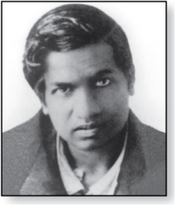
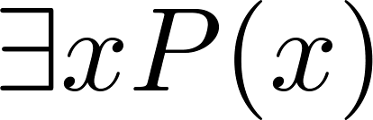
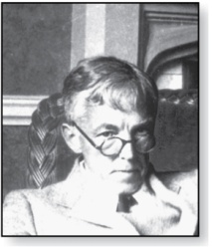
Existence Proofs
Srinivasa Ramanujan
(1887-1920)
Proof of theorems of the form .
Constructive existence proof:
Find an explicit value of c, for which P(c) is true.
Then is true by Existential Generalization (EG).
Example: Show that there is a positive integer that can be written as the sum of cubes of positive integers in two different ways:
Proof: 1729 is such a number since
1729 = 10³ + 9³ = 12³ + 1³
Godfrey Harold Hardy
(1877-1947)

Slide 63
Nonconstructive Existence Proofs
In a nonconstructive existence proof, we assume no c exists which makes P(c) true and derive a contradiction.
Example: Show that there exist irrational numbers x and y such that x^{y} is rational.
Proof: We know that √2 is irrational. Consider the number √2 ^{√2} . If it is rational, we have two irrational numbers x and y with x^{y} rational, namely x = √2 and y = √2. But if √2 ^{√2} is irrational, then we can let x = √2 ^{√2} and y = √2 so that x^{y} = (√2 ^{√2} )^{√2} = √2 ^{(√2 √2)} = √2 ² = 2.

Slide 64
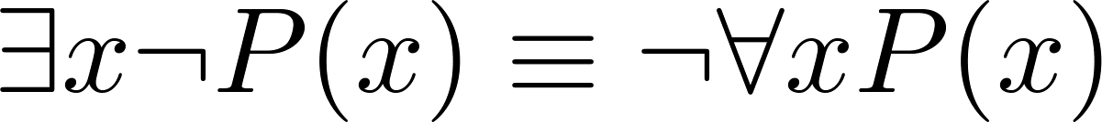
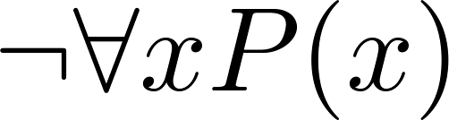
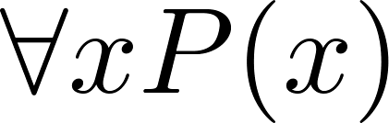
Counterexamples
Recall .
To establish that is true (or is false) find a c such that ¬P(c) is true or P(c) is false.
In this case c is called a counterexample to the assertion .
Example: “Every positive integer is the sum of the squares of 3 integers.” The integer 7 is a counterexample. So the claim is false.

Slide 65
Uniqueness Proofs
Some theorems asset the existence of a unique element with a particular property, ∃!x P(x). The two parts of a uniqueness proof are
Existence: We show that an element x with the property exists.
Uniqueness: We show that if y≠x, then y does not have the property.
Example: Show that if a and b are real numbers and a ≠0, then there is a unique real number r such that ar + b = 0.
Solution:
Existence: The real number r = −b/a is a solution of ar + b = 0 because a(−b/a) + b = −b + b =0.
Uniqueness: Suppose that s is a real number such that as + b = 0. Then ar + b = as + b, where r = −b/a. Subtracting b from both sides and dividing by a shows that r = s.

Slide 66
Proof Strategies for proving p → q
Choose a method.
First try a direct method of proof.
If this does not work, try an indirect method (e.g., try to prove the contrapositive).
For whichever method you are trying, choose a strategy.
First try forward reasoning. Start with the axioms and known theorems and construct a sequence of steps that end in the conclusion. Start with p and prove q, or start with ¬q and prove ¬p.
If this doesn’t work, try backward reasoning. When trying to prove q, find a statement p that we can prove with the property p → q.

Slide 67
Backward Reasoning
Example: Suppose that two people play a game taking turns removing, 1, 2, or 3 stones at a time from a pile that begins with 15 stones. The person who removes the last stone wins the game. Show that the first player can win the game no matter what the second player does.
Proof: Let n be the last step of the game.
Step n: Player₁ can win if the pile contains 1,2, or 3 stones.
Step n-1: Player₂ will have to leave such a pile if the pile that he/she is faced with has 4 stones.
Step n-2: Player₁ can leave 4 stones when there are 5,6, or 7 stones left at the beginning of his/her turn.
Step n-3: Player₂ must leave such a pile, if there are 8 stones .
Step n-4: Player₁ has to have a pile with 9,10, or 11 stones to ensure that there are 8 left.
Step n-5: Player₂ needs to be faced with 12 stones to be forced to leave 9,10, or 11.
Step n-6: Player₁ can leave 12 stones by removing 3 stones.
Now reasoning forward, the first player can ensure a win by removing 3 stones and leaving 12.

Slide 68

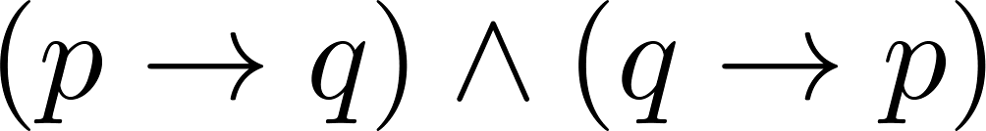
Universally Quantified Assertions
To prove theorems of the form ,assume x is an arbitrary member of the domain and show that P(x) must be true. Using UG it follows that .
Example: An integer x is even if and only if x² is even.
Solution: The quantified assertion is
∀x [x is even ↔ x² is even]
We assume x is arbitrary.
Recall that is equivalent to
So, we have two cases to consider. These are considered in turn.

Slide 69
Universally Quantified Assertions
Case 1. We show that if x is even then x² is even using a direct proof (the only if part or necessity).
If x is even then x = 2k for some integer k.
Hence x² = 4k² = 2(2k² ) which is even since it is an integer divisible by 2.
This completes the proof of case 1.
Case 2 on next slide →

Slide 70
Universally Quantified Assertions
Case 2. We show that if x² is even then x must be even (the if part or sufficiency). We use a proof by contraposition.
Assume x is not even and then show that x² is not even.
If x is not even then it must be odd. So, x = 2k + 1 for some k. Then x² = (2k + 1)² = 4k² + 4k + 1 = 2(2k² + 2k) + 1
which is odd and hence not even. This completes the proof of case 2.
Since x was arbitrary, the result follows by UG.
Therefore we have shown that x is even if and only if x² is even.

Slide 71
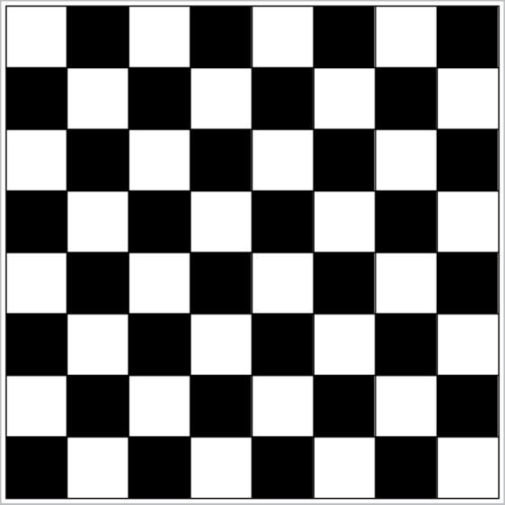
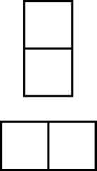
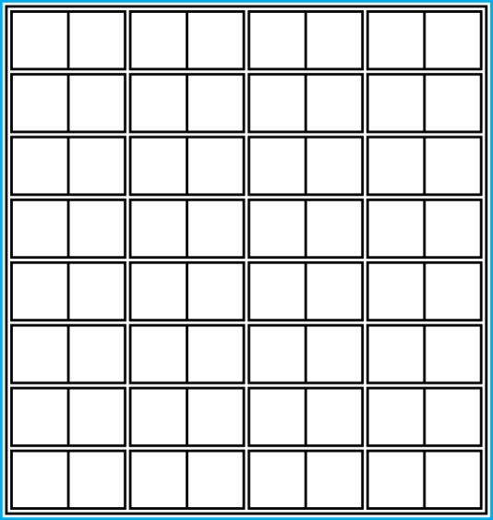
Proof and Disproof: Tilings
Example 1: Can we tile the standard checkerboard using dominos?
Solution: Yes! One example provides a constructive existence proof.
Two Dominoes
The Standard Checkerboard
One Possible Solution

Slide 72
Tilings
Example 2: Can we tile a checkerboard obtained by removing one of the four corner squares of a standard checkerboard?
Solution:
Our checkerboard has 64 − 1 = 63 squares.
Since each domino has two squares, a board with a tiling must have an even number of squares.
The number 63 is not even.
We have a contradiction.

Slide 73

Tilings
Example 3: Can we tile a board obtained by removing both the upper left and the lower right squares of a standard checkerboard?
Nonstandard Checkerboard
Dominoes
Continued on next slide →

Slide 74
Tilings
Solution:
There are 62 squares in this board.
To tile it we need 31 dominos.
Key fact: Each domino covers one black and one white square.
Therefore the tiling covers 31 black squares and 31 white squares.
Our board has either 30 black squares and 32 white squares or 32 black squares and 30 white squares.
Contradiction!

Slide 75
The Role of Open Problems
Unsolved problems have motivated much work in mathematics. Fermat’s Last Theorem was conjectured more than 300 years ago. It has only recently been finally solved.
Fermat’s Last Theorem: The equation x^{n} + y^{n} = z^{n}
has no solutions in integers x, y, and z, with xyz≠0 whenever n is an integer with n > 2.
A proof was found by Andrew Wiles in the 1990s.

Slide 76
An Open Problem
The 3x + 1 Conjecture: Let T be the transformation that sends an even integer x to x/2 and an odd integer x to 3x + 1. For all positive integers x, when we repeatedly apply the transformation T, we will eventually reach the integer 1.
For example, starting with x = 13:
T(13) = 3∙13 + 1 = 40, T(40) = 40/2 = 20, T(20) = 20/2 = 10,
T(10) = 10/2 = 5, T(5) = 3∙5 + 1 = 16,T(16) = 16/2 = 8,
T(8) = 8/2 = 4, T(4) = 4/2 = 2, T(2) = 2/2 = 1
The conjecture has been verified using computers up to 5.6 ∙ 10¹³ .

Slide 77
Additional Proof Methods
Later we will see many other proof methods:
Mathematical induction, which is a useful method for proving statements of the form ∀n P(n), where the domain consists of all positive integers.
Structural induction, which can be used to prove such results about recursively defined sets.
Cantor diagonalization is used to prove results about the size of infinite sets.
Combinatorial proofs use counting arguments.

Slide 78
EXAMPLES
Prove that there are no positive perfect cubes less than 1000 that are the sum of the cubes of two positive integers.

Slide 79
EXAMPLES
Prove that there is a positive integer that equals the sum of the positive integers not exceeding it. Is your proof constructive or nonconstructive?

Slide 80
EXAMPLES

Slide 81
HOMEWORK
#1, #7, #29

