Slide 1
Graphs
Chapter 10

Slide 2
Graphs and Graph Models
Section 10.1

Slide 3
Section Summary
Introduction to Graphs
Graph Taxonomy
Graph Models

Slide 4
Graphs
Definition: A graph G = (V, E) consists of a nonempty set V of vertices (or nodes) and a set E of edges. Each edge has either one or two vertices associated with it, called its endpoints. An edge is said to connect its endpoints.
Remarks:
The graphs we study here are unrelated to graphs of functions studied in Chapter 2.
We have a lot of freedom when we draw a picture of a graph. All that matters is the connections made by the edges, not the particular geometry depicted. For example, the lengths of edges, whether edges cross, how vertices are depicted, and so on, do not matter
A graph with an infinite vertex set is called an infinite graph. A graph with a finite vertex set is called a finite graph. We (following the text) restrict our attention to finite graphs.
Example:
a
b
This is a graph with four vertices and five edges.
d
c

Slide 5
Some Terminology
In a simple graph each edge connects two different vertices and no two edges connect the same pair of vertices.
Multigraphs may have multiple edges connecting the same two vertices. When m different edges connect the vertices u and v, we say that {u,v} is an edge of multiplicity m.
An edge that connects a vertex to itself is called a loop.
A pseudograph may include loops, as well as multiple edges connecting the same pair of vertices.
Example:
This pseudograph has both multiple edges and a loop.
a
b
Remark: There is no standard terminology for graph theory. So, it is crucial that you understand the terminology being used whenever you read material about graphs.
c

Slide 6
Directed Graphs
Definition: An directed graph (or digraph) G = (V, E) consists of a nonempty set V of vertices (or nodes) and a set E of directed edges (or arcs). Each edge is associated with an ordered pair of vertices. The directed edge associated with the ordered pair (u,v) is said to start at u and end at v.
Remark:
Graphs where the end points of an edge are not ordered are said to be undirected graphs.

Slide 7
Some Terminology (continued)
A simple directed graph has no loops and no multiple edges.
A directed multigraph may have multiple directed edges. When there are m directed edges from the vertex u to the vertex v, we say that (u,v) is an edge of multiplicity m.
Example:
a
b
This is a directed graph with three vertices and four edges.
c
Example:
In this directed multigraph the multiplicity of (a,b) is 1 and the multiplicity of (b,c) is 2.
a
b
c

Slide 8
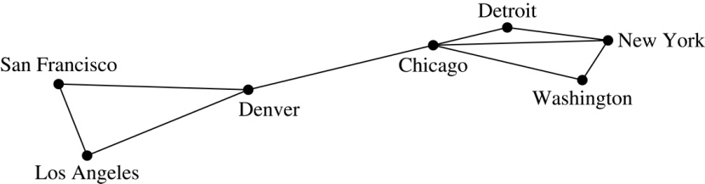
Graph Models: Computer Networks
When we build a graph model, we use the appropriate type of graph to capture the important features of the application.
We illustrate this process using graph models of different types of computer networks. In all these graph models, the vertices represent data centers and the edges represent communication links.
To model a computer network where we are only concerned whether two data centers are connected by a communications link, we use a simple graph. This is the appropriate type of graph when we only care whether two data centers are directly linked (and not how many links there may be) and all communications links work in both directions.

Slide 9
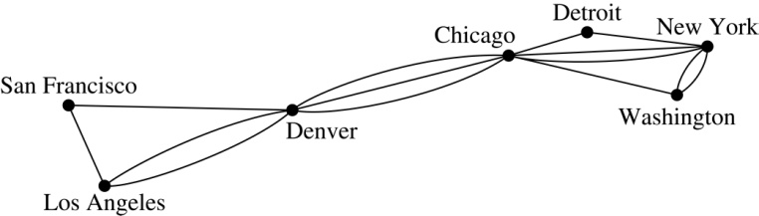
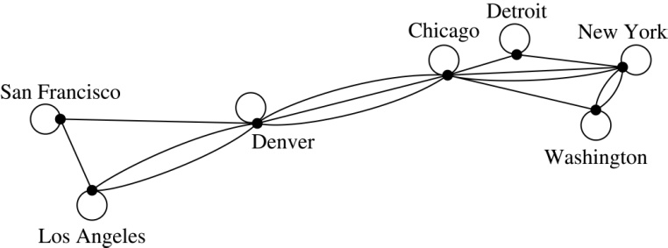
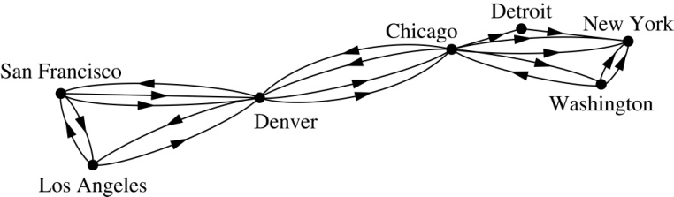
Graph Models: Computer Networks (continued)
To model a computer network where we care about the number of links between data centers, we use a multigraph.
To model a computer network with diagnostic links at data centers, we use a pseudograph, as loops are needed.
To model a network with multiple one-way links, we use a directed multigraph. Note that we could use a directed graph without multiple edges if we only care whether there is at least one link from a data center to another data center.

Slide 10
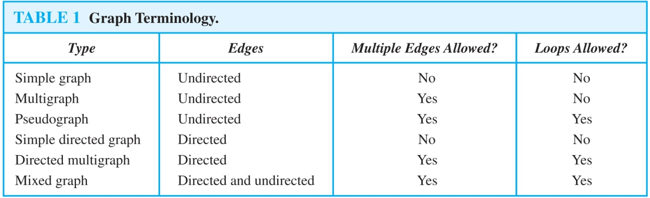
Graph Terminology: Summary
To understand the structure of a graph and to build a graph model, we ask these questions:
Are the edges of the graph undirected or directed (or both)?
If the edges are undirected, are multiple edges present that connect the same pair of vertices? If the edges are directed, are multiple directed edges present?
Are loops present?

Slide 11
Other Applications of Graphs
We will illustrate how graph theory can be used in models of:
Social networks
Communications networks
Information networks
Software design
Transportation networks
Biological networks
It’s a challenge to find a subject to which graph theory has not yet been applied. Can you find an area without applications of graph theory?

Slide 12
Graph Models: Social Networks
Graphs can be used to model social structures based on different kinds of relationships between people or groups.
In a social network, vertices represent individuals or organizations and edges represent relationships between them.
Useful graph models of social networks include:
friendship graphs - undirected graphs where two people are connected if they are friends (in the real world, on Facebook, or in a particular virtual world, and so on.)
collaboration graphs - undirected graphs where two people are connected if they collaborate in a specific way
influence graphs - directed graphs where there is an edge from one person to another if the first person can influence the second person

Slide 13
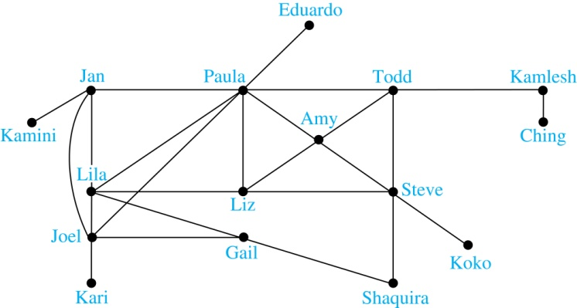
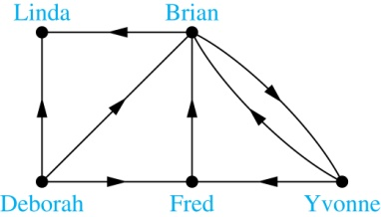
Graph Models: Social Networks (continued)
Example: A friendship graph where two people are connected if they are Facebook friends.
Example: An influence graph
Next Slide: Collaboration Graphs

Slide 14
Examples of Collaboration Graphs
The Hollywood graph models the collaboration of actors in films.
We represent actors by vertices and we connect two vertices if the actors they represent have appeared in the same movie.
We will study the Hollywood Graph in Section 10.4 when we discuss Kevin Bacon numbers.
An academic collaboration graph models the collaboration of researchers who have jointly written a paper in a particular subject.
We represent researchers in a particular academic discipline using vertices.
We connect the vertices representing two researchers in this discipline if they are coauthors of a paper.
We will study the academic collaboration graph for mathematicians when we discuss Erdős numbers in Section 10.4.

Slide 15
Applications to Information Networks
Graphs can be used to model different types of networks that link different types of information.
In a web graph, web pages are represented by vertices and links are represented by directed edges.
A web graph models the web at a particular time.
We will explain how the web graph is used by search engines in Section 11.4.
In a citation network:
Research papers in a particular discipline are represented by vertices.
When a paper cites a second paper as a reference, there is an edge from the vertex representing this paper to the vertex representing the second paper.

Slide 16
Transportation Graphs
Graph models are extensively used in the study of transportation networks.
Airline networks can be modeled using directed multigraphs where
airports are represented by vertices
each flight is represented by a directed edge from the vertex representing the departure airport to the vertex representing the destination airport
Road networks can be modeled using graphs where
vertices represent intersections and edges represent roads.
undirected edges represent two-way roads and directed edges represent one-way roads.

Slide 17
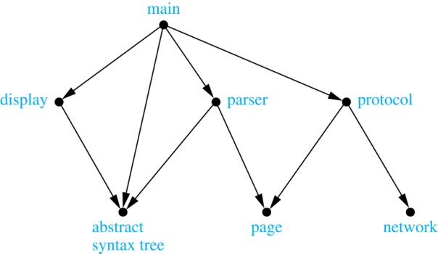
Software Design Applications
Graph models are extensively used in software design. We will introduce two such models here; one representing the dependency between the modules of a software application and the other representing restrictions in the execution of statements in computer programs.
When a top-down approach is used to design software, the system is divided into modules, each performing a specific task.
We use a module dependency graph to represent the dependency between these modules. These dependencies need to be understood before coding can be done.
In a module dependency graph vertices represent software modules and there is an edge from one module to another if the second module depends on the first.
Example: The dependencies between the seven modules in the design of a web browser are represented by this module dependency graph.

Slide 18
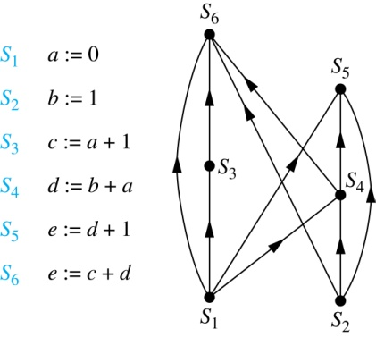
Software Design Applications (continued)
We can use a directed graph called a precedence graph to represent which statements must have already been executed before we execute each statement.
Vertices represent statements in a computer program
There is a directed edge from a vertex to a second vertex if the second vertex cannot be executed before the first
Example: This precedence graph shows which statements must already have been executed before we can execute each of the six statements in the program.

Slide 19
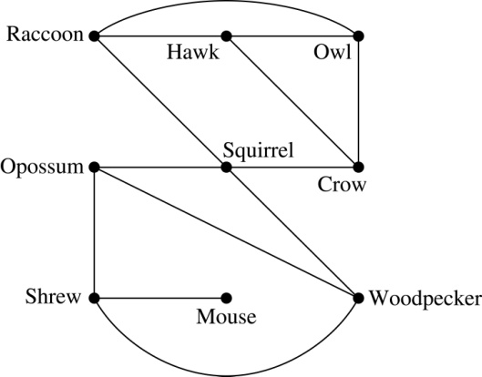
Biological Applications
Graph models are used extensively in many areas of the biological science. We will describe two such models, one to ecology and the other to molecular biology.
Niche overlap graphs model competition between species in an ecosystem
Vertices represent species and an edge connects two vertices when they represent species who compete for food resources.
Example: This is the niche overlap graph for a forest ecosystem with nine species.

Slide 20
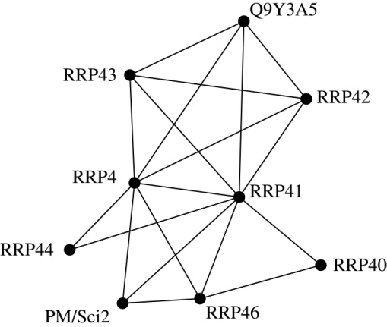
Biological Applications (continued)
We can model the interaction of proteins in a cell using a protein interaction network.
In a protein interaction graph, vertices represent proteins and vertices are connected by an edge if the proteins they represent interact.
Protein interaction graphs can be huge and can contain more than 100,000 vertices, each representing a different protein, and more than 1,000,000 edges, each representing an interaction between proteins
Protein interaction graphs are often split into smaller graphs, called modules, which represent the interactions between proteins involved in a particular function.
Example: This is a module of the protein interaction graph of proteins that degrade RNA in a human cell.

Slide 21
EXAMPLE

Slide 22
HOMEWORK
#15

