Slide 1
Number Theory and Cryptography
Chapter 4

Slide 2
Chapter Motivation
Number theory is the part of mathematics devoted to the study of the integers and their properties.
Key ideas in number theory include divisibility and the primality of integers.
Representations of integers, including binary and hexadecimal representations, are part of number theory.
Number theory has long been studied because of the beauty of its ideas, its accessibility, and its wealth of open questions.
We’ll use many ideas developed in Chapter 1 about proof methods and proof strategy in our exploration of number theory.

Slide 3
Divisibility and Modular Arithmetic
Section 4.1

Slide 4
Section Summary
Division
Division Algorithm
Modular Arithmetic

Slide 5
Division
Definition: If a and b are integers with a ≠ 0, then a divides b if there exists an integer c such that b = ac.
When a divides b we say that a is a factor or divisor of b and that b is a multiple of a.
The notation a | b denotes that a divides b.
If a | b, then b/a is an integer.
If a does not divide b, we write a ∤ b.
Example: Determine whether 3 | 7 and whether 3 | 12.

Slide 6
Properties of Divisibility
Theorem 1: Let a, b, and c be integers, where a ≠0.
If a | b and a | c, then a | (b + c);
If a | b, then a | bc for all integers c;
If a | b and b | c, then a | c.
Proof: (i) Suppose a | b and a | c, then it follows that there are integers s and t with b = as and c = at. Hence,
b + c = as + at = a(s + t). Hence, a | (b + c)
(Exercises 3 and 4 ask for proofs of parts (ii) and (iii).) Corollary: If a, b, and c be integers, where a ≠0, such that a | b and a | c, then a | mb + nc whenever m and n are integers.
Can you show how it follows easily from from (ii) and (i) of Theorem 1?

Slide 7
Division Algorithm
When an integer is divided by a positive integer, there is a quotient and a remainder. This is traditionally called the “Division Algorithm,” but is really a theorem.
Division Algorithm: If a is an integer and d a positive integer, then there are unique integers q and r, with 0 ≤ r < d, such that a = dq + r (proved in Section 5.2).
d is called the divisor.
a is called the dividend.
q is called the quotient.
r is called the remainder.
Examples:
What are the quotient and remainder when 101 is divided by 11?
Solution: The quotient when 101 is divided by 11 is 9 = 101 div 11, and the remainder is 2 = 101 mod 11.
What are the quotient and remainder when −11 is divided by 3?
Solution: The quotient when −11 is divided by 3 is −4 = −11 div 3, and the remainder is 1 = −11 mod 3.
Definitions of Functions div and mod
q = a div d
r = a mod d

Slide 8
Congruence Relation
Definition: If a and b are integers and m is a positive integer, then a is congruent to b modulo m if m divides a – b.
The notation a ≡ b (mod m) says that a is congruent to b modulo m.
We say that a ≡ b (mod m) is a congruence and that m is its modulus.
Two integers are congruent mod m if and only if they have the same remainder when divided by m.
If a is not congruent to b modulo m, we write
a ≢ b (mod m)
Example: Determine whether 17 is congruent to 5 modulo 6 and whether 24 and 14 are congruent modulo 6.

Slide 9
Congruence Relation
Example: Determine whether 17 is congruent to 5 modulo 6 and whether 24 and 14 are congruent modulo 6.
Solution:
17 ≡ 5 (mod 6) because 6 divides 17 − 5 = 12.
24 ≢ 14 (mod 6) since 24 − 14 = 10 is not divisible by 6.

Slide 10
More on Congruences
Theorem 4: Let m be a positive integer. The integers a and b are congruent modulo m if and only if there is an integer k such that a = b + km.
Proof:
If a ≡ b (mod m), then (by the definition of congruence) m | a – b. Hence, there is an integer k such that a – b = km and equivalently a = b + km.
Conversely, if there is an integer k such that a = b + km, then km = a – b. Hence, m | a – b and a ≡ b (mod m).

Slide 11
The Relationship between (mod m) and mod m Notations
The use of “mod” in a ≡ b (mod m) and a mod m = b are different.
a ≡ b (mod m) is a relation on the set of integers.
In a mod m = b, the notation mod denotes a function.
The relationship between these notations is made clear in this theorem.
Theorem 3: Let a and b be integers, and let m be a positive integer. Then a ≡ b (mod m) if and only if a mod m = b mod m. (Proof in the exercises)

Slide 12
Congruences of Sums and Products
Theorem 5: Let m be a positive integer. If a ≡ b (mod m) and c ≡ d (mod m), then
a + c ≡ b + d (mod m) and ac ≡ bd (mod m)
Proof:
Because a ≡ b (mod m) and c ≡ d (mod m), by Theorem 4 there are integers s and t with b = a + sm and d = c + tm.
Therefore,
b + d = (a + sm) + (c + tm) = (a + c) + m(s + t) and
b d = (a + sm) (c + tm) = ac + m(at + cs + stm).
Hence, a + c ≡ b + d (mod m) and ac ≡ bd (mod m).
Example: Because 7 ≡ 2 (mod 5) and 11 ≡ 1 (mod 5) , it follows from Theorem 5 that
18 = 7 + 11 ≡ 2 + 1 = 3 (mod 5)
77 = 7 ∙ 11 ≡ 2 ∙ 1 = 2 (mod 5)

Slide 13
Algebraic Manipulation of Congruences
Multiplying both sides of a valid congruence by an integer preserves validity.
If a ≡ b (mod m) holds then c∙a ≡ c∙b (mod m), where c is any integer, holds by Theorem 5 with d = c.
Adding an integer to both sides of a valid congruence preserves validity.
If a ≡ b (mod m) holds then c + a ≡ c + b (mod m), where c is any integer, holds by Theorem 5 with d = c.
Dividing a congruence by an integer does not always produce a valid congruence.
Example: The congruence 14≡ 8 (mod 6) holds. But dividing both sides by 2 does not produce a valid congruence since 14/2 = 7 and 8/2 = 4, but 7≢4 (mod 6).
See Section 4.3 for conditions when division is ok.

Slide 14
Computing the mod m Function of Products and Sums
We use the following corollary to Theorem 5 to compute the remainder of the product or sum of two integers when divided by m from the remainders when each is divided by m.
Corollary: Let m be a positive integer and let a and b be integers. Then
(a + b) (mod m) = ((a mod m) + (b mod m)) mod m
and
ab mod m = ((a mod m) (b mod m)) mod m.
(proof in text)

Slide 15
Arithmetic Modulo m
Definitions: Let Z_{m} be the set of nonnegative integers less than m: {0,1, …., m−1}
The operation +_{m} is defined as a +_{m} b = (a + b) mod m. This is addition modulo m.
The operation ∙_{m} is defined as a ∙_{m} b = (a ∙ b) mod m. This is multiplication modulo m.
Using these operations is said to be doing arithmetic modulo m.
Example: Find 7 +₁₁ 9 and 7 ∙₁₁ 9.
Solution: Using the definitions above:
7 +₁₁ 9 = (7 + 9) mod 11 = 16 mod 11 = 5
7 ∙₁₁ 9 = (7 ∙ 9) mod 11 = 63 mod 11 = 8

Slide 16
Arithmetic Modulo m
The operations +_{m} and ∙_{m} satisfy many of the same properties as ordinary addition and multiplication.
Closure: If a and b belong to Z_{m} , then a +_{m} b and a ∙_{m} b belong to Z_{m} .
Associativity: If a, b, and c belong to Z_{m} , then (a +_{m} b) +_{m} c = a +_{m} (b +_{m} c) and (a ∙_{m} b) ∙_{m} c = a ∙_{m} (b ∙_{m} c).
Commutativity: If a and b belong to Z_{m} , then a +_{m} b = b +_{m} a and a ∙_{m} b = b ∙_{m} a.
Identity elements: The elements 0 and 1 are identity elements for addition and multiplication modulo m, respectively.
If a belongs to Z_{m} , then a +_{m} 0 = a and a ∙_{m} 1 = a.
continued →

Slide 17
Arithmetic Modulo m
Additive inverses: If a≠ 0 belongs to Z_{m} , then m− a is the additive inverse of a modulo m and 0 is its own additive inverse.
a +_{m} (m− a ) = 0 and 0 +_{m} 0 = 0
Distributivity: If a, b, and c belong to Z_{m} , then
a ∙_{m} (b +_{m} c) = (a ∙_{m} b) +_{m} (a ∙_{m} c) and (a +_{m} b) ∙_{m} c = (a ∙_{m} c) +_{m} (b ∙_{m} c).
Exercises 42-44 ask for proofs of these properties.
Multiplicatative inverses have not been included since they do not always exist. For example, there is no multiplicative inverse of 2 modulo 6.
(optional) Using the terminology of abstract algebra, Z_{m} with +_{m} is a commutative group and Z_{m} with +_{m} and ∙_{m} is a commutative ring.

Slide 18
EXAMPLES
What are the quotient and remainder when
a) 44 is divided by 8?
b) 777 is divided by 21?
c) −123 is divided by 19?
d) −1 is divided by 23?
e) −2002 is divided by 87?
f ) 0 is divided by 17?
g) 1,234,567 is divided by 1001?
h) −100 is divided by 101?

Slide 19
EXAMPLES

Slide 20
EXAMPLES

Slide 21
EXAMPLES

Slide 22
HOMEWORK
#9, #13, #21, #25

Slide 23
Primes and Greatest Common Divisors
Section 4.3

Slide 24
Section Summary
Prime Numbers and their Properties
Conjectures and Open Problems About Primes
Greatest Common Divisors and Least Common Multiples
The Euclidian Algorithm
gcds as Linear Combinations

Slide 25
Primes
Definition: A positive integer p greater than 1 is called prime if the only positive factors of p are 1 and p. A positive integer that is greater than 1 and is not prime is called composite.
Example: The integer 7 is prime because its only positive factors are 1 and 7, but 9 is composite because it is divisible by 3.

Slide 26
The Fundamental Theorem of Arithmetic
Theorem: Every positive integer greater than 1 can be written uniquely as a prime or as the product of two or more primes where the prime factors are written in order of nondecreasing size.
Examples:
100 = 2 ∙ 2 ∙ 5 ∙ 5 = 2² ∙ 5²
641 = 641
999 = 3 ∙ 3 ∙ 3 ∙ 37 = 3³ ∙ 37
1024 = 2 ∙ 2 ∙ 2 ∙ 2 ∙ 2 ∙ 2 ∙ 2 ∙ 2 ∙ 2 ∙ 2 = 2¹⁰

Slide 27
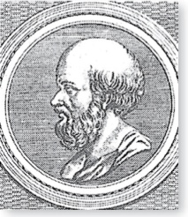
The Sieve of Erastosthenes
Erastothenes
(276-194 B.C.)
The Sieve of Erastosthenes can be used to find all primes not exceeding a specified positive integer. For example, begin with the list of integers between 1 and 100.
Delete all the integers, other than 2, divisible by 2.
Delete all the integers, other than 3, divisible by 3.
Next, delete all the integers, other than 5, divisible by 5.
Next, delete all the integers, other than 7, divisible by 7.
Since all the remaining integers are not divisible by any of the previous integers, other than 1, the primes are:
{2,3,5,7,11,15,1719,23,29,31,37,41,43,47,53,
59,61,67,71,73,79,83,89, 97}
continued →

Slide 28
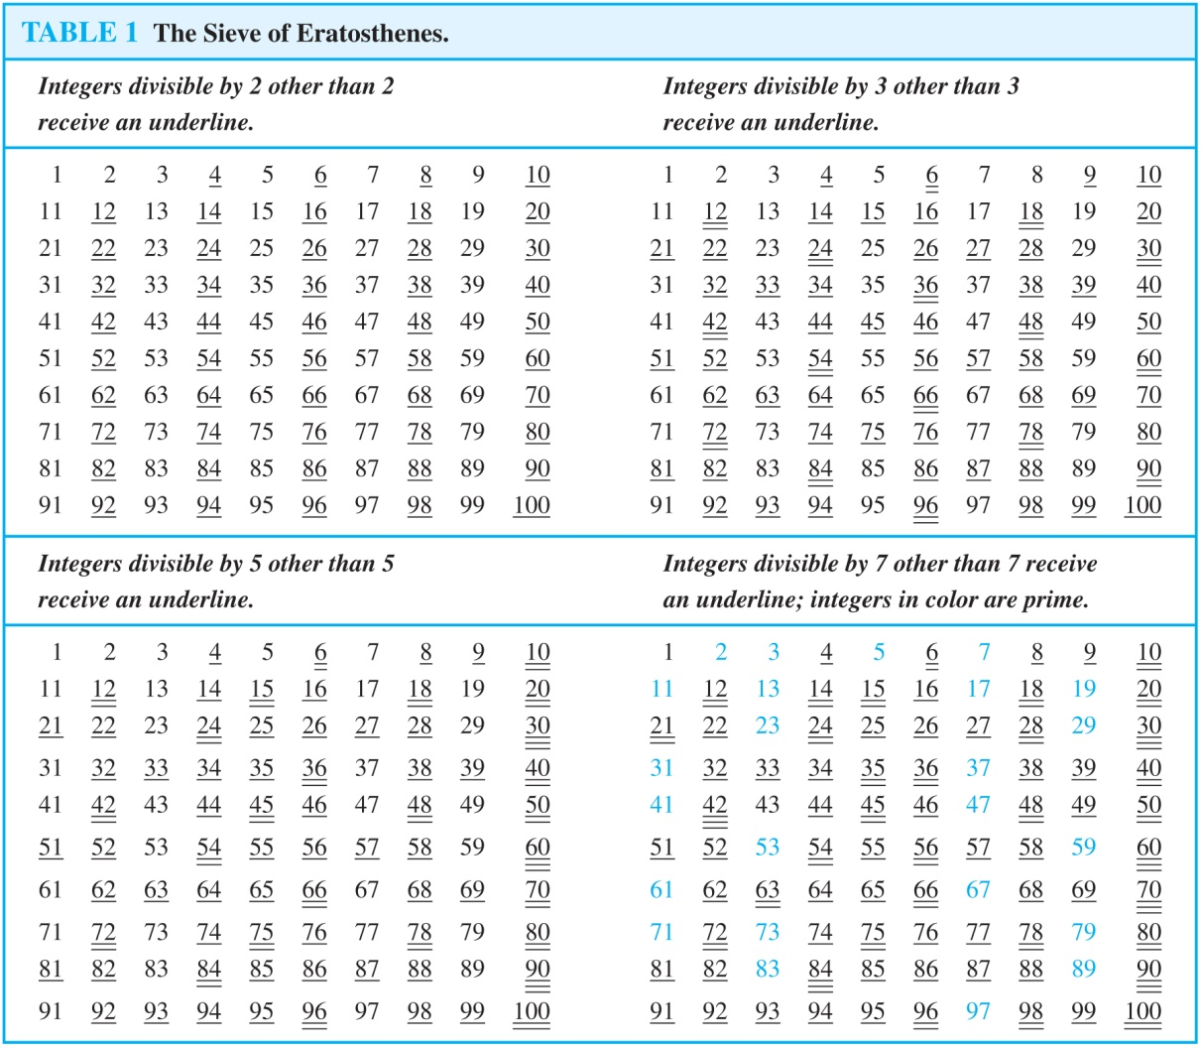
The Sieve of Erastosthenes
If an integer n is a composite integer, then it has a prime divisor less than or equal to √n.
To see this, note that if n = ab, then a ≤ √n or b ≤√n.
Trial division, a very inefficient method of determining if a number n is prime, is to try every integer i ≤√n and see if n is divisible by i.

Slide 29
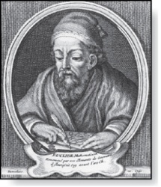
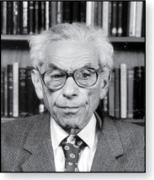
Infinitude of Primes
Euclid
(325 B.C.E. – 265 B.C.E.)
Theorem: There are infinitely many primes. (Euclid)
Proof: Assume finitely many primes: p₁, p₂, ….., p_{n}
Let q = p₁p₂∙∙∙ p_{n} + 1
Either q is prime or by the fundamental theorem of arithmetic it is a product of primes.
But none of the primes p_{j} divides q since if p_{j} | q, then p_{j} divides q − p₁p₂∙∙∙ p_{n} = 1 .
Hence, there is a prime not on the list p₁, p₂, ….., p_{n}. It is either q, or if q is composite, it is a prime factor of q. This contradicts the assumption that p₁, p₂, ….., p_{n} are all the primes.
Consequently, there are infinitely many primes.
This proof was given by Euclid The Elements. The proof is considered to be one of the most beautiful in all mathematics. It is the first proof in The Book, inspired by the famous mathematician Paul Erdős’ imagined collection of perfect proofs maintained by God.
Paul Erdős
(1913-1996)

Slide 30
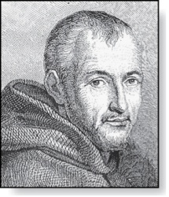
Mersene Primes
Marin Mersenne
(1588-1648)
Definition: Prime numbers of the form 2^{p} − 1 , where p is prime, are called Mersene primes.
2² − 1 = 3, 2³ − 1 = 7, 2⁵ − 1 = 37 , and 2⁷ − 1 = 127 are Mersene primes.
2¹¹ − 1 = 2047 is not a Mersene prime since 2047 = 23∙89.
There is an efficient test for determining if 2^{p} − 1 is prime.
The largest known prime numbers are Mersene primes.
As of mid 2011, 47 Mersene primes were known, the largest is 2^{43,112,609} − 1, which has nearly 13 million decimal digits.
The Great Internet Mersene Prime Search (GIMPS) is a distributed computing project to search for new Mersene Primes.
http://www.mersenne.org/

Slide 31
Distribution of Primes
Mathematicians have been interested in the distribution of prime numbers among the positive integers. In the nineteenth century, the prime number theorem was proved which gives an asymptotic estimate for the number of primes not exceeding x.
Prime Number Theorem: The ratio of the number of primes not exceeding x and x/ln x approaches 1 as x grows without bound. (ln x is the natural logarithm of x)
The theorem tells us that the number of primes not exceeding x, can be approximated by x/ln x.
The odds that a randomly selected positive integer less than n is prime are approximately (n/ln n)/n = 1/ln n.

Slide 32

Primes and Arithmetic Progressions (optional)
Euclid’s proof that there are infinitely many primes can be easily adapted to show that there are infinitely many primes in the following 4k + 3, k = 1,2,… (See Exercise 55)
In the 19th century G. Lejuenne Dirchlet showed that every arithmetic progression ka + b, k = 1,2, …, where a and b have no common factor greater than 1 contains infinitely many primes. (The proof is beyond the scope of the text.)
Are there long arithmetic progressions made up entirely of primes?
5,11, 17, 23, 29 is an arithmetic progression of five primes.
199, 409, 619, 829, 1039,1249,1459,1669,1879,2089 is an arithmetic progression of ten primes.
In the 1930s, Paul Erdős conjectured that for every positive integer n greater than 1, there is an arithmetic progression of length n made up entirely of primes. This was proven in 2006, by Ben Green and Terrence Tau.
Terence Tao
(Born 1975)

Slide 33
Generating Primes
The problem of generating large primes is of both theoretical and practical interest.
We will see (in Section 4.6) that finding large primes with hundreds of digits is important in cryptography.
So far, no useful closed formula that always produces primes has been found. There is no simple function f(n) such that f(n) is prime for all positive integers n.
But f(n) = n² − n + 41 is prime for all integers 1,2,…, 40. Because of this, we might conjecture that f(n) is prime for all positive integers n. But f(41) = 41² is not prime.
More generally, there is no polynomial with integer coefficients such that f(n) is prime for all positive integers n. (See supplementary Exercise 23.)
Fortunately, we can generate large integers which are almost certainly primes. See Chapter 7.

Slide 34
Conjectures about Primes
Even though primes have been studied extensively for centuries, many conjectures about them are unresolved, including:
Goldbach’s Conjecture: Every even integer n, n > 2, is the sum of two primes. It has been verified by computer for all positive even integers up to 1.6 ∙10¹⁸. The conjecture is believed to be true by most mathematicians.
There are infinitely many primes of the form n² + 1, where n is a positive integer. But it has been shown that there are infinitely many primes of the form n² + 1, where n is a positive integer or the product of at most two primes.
The Twin Prime Conjecture: The twin prime conjecture is that there are infinitely many pairs of twin primes. Twin primes are pairs of primes that differ by 2. Examples are 3 and 5, 5 and 7, 11 and 13, etc. The current world’s record for twin primes (as of mid 2011) consists of numbers 65,516,468,355∙23^{33,333} ±1, which have 100,355 decimal digits.

Slide 35
Greatest Common Divisor
Definition: Let a and b be integers, not both zero. The largest integer d such that d | a and also d | b is called the greatest common divisor of a and b. The greatest common divisor of a and b is denoted by gcd(a,b).
One can find greatest common divisors of small numbers by inspection.
Example:What is the greatest common divisor of 24 and 36?
Solution: gcd(24, 36) = 12
Example:What is the greatest common divisor of 17 and 22?
Solution: gcd(17,22) = 1

Slide 36
Greatest Common Divisor
Definition: The integers a and b are relatively prime if their greatest common divisor is 1.
Example: 17 and 22
Definition: The integers a₁, a₂, …, a_{n} are pairwise relatively prime if gcd(a_{i}, a_{j})= 1 whenever 1 ≤ i<j ≤n.
Example: Determine whether the integers 10, 17 and 21 are pairwise relatively prime.
Solution: Because gcd(10,17) = 1, gcd(10,21) = 1, and gcd(17,21) = 1, 10, 17, and 21 are pairwise relatively prime.
Example: Determine whether the integers 10, 19, and 24 are pairwise relatively prime.
Solution: Because gcd(10,24) = 2, 10, 19, and 24 are not pairwise relatively prime.

Slide 37
Greatest Common Divisor
Definition: The integers a and b are relatively prime if their greatest common divisor is 1.
Example: 17 and 22
Definition: The integers a₁, a₂, …, a_{n} are pairwise relatively prime if gcd(a_{i}, a_{j})= 1 whenever 1 ≤ i<j ≤n.
Example: Determine whether the integers 10, 17 and 21 are pairwise relatively prime.
Solution: Because gcd(10,17) = 1, gcd(10,21) = 1, and gcd(17,21) = 1, 10, 17, and 21 are pairwise relatively prime.
Example: Determine whether the integers 10, 19, and 24 are pairwise relatively prime.
Solution: Because gcd(10,24) = 2, 10, 19, and 24 are not pairwise relatively prime.

Slide 38
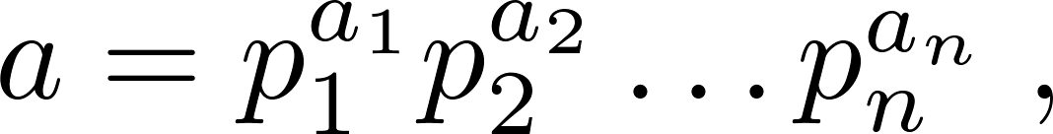
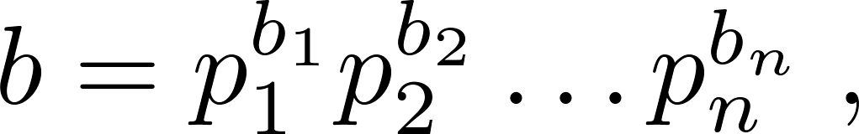
Finding the Greatest Common Divisor Using Prime Factorizations
Suppose the prime factorizations of a and b are:
where each exponent is a nonnegative integer, and where all primes occurring in either prime factorization are included in both. Then:
This formula is valid since the integer on the right (of the equals sign) divides both a and b. No larger integer can divide both a and b.
Example: 120 = 2³ ∙3 ∙5 500 = 2² ∙5³
gcd(120,500) = 2^{min(3,2)} ∙3^{min(1,0)} ∙5^{min(1,3)} = 2² ∙3⁰ ∙5¹ = 20
Finding the gcd of two positive integers using their prime factorizations is not efficient because there is no efficient algorithm for finding the prime factorization of a positive integer.

Slide 39
Least Common Multiple
Definition: The least common multiple of the positive integers a and b is the smallest positive integer that is divisible by both a and b. It is denoted by lcm(a,b).
The least common multiple can also be computed from the prime factorizations.
This number is divided by both a and b and no smaller number is divided by a and b.
Example: lcm(2³3⁵7², 2⁴3³) = 2^{max(3,4)} 3^{max(5,3)} 7^{max(2,0)} = 2⁴ 3⁵ 7²
The greatest common divisor and the least common multiple of two integers are related by:
Theorem 5: Let a and b be positive integers. Then
ab = gcd(a,b) ∙lcm(a,b)
(proof is Exercise 31)

Slide 40
Euclidean Algorithm
Euclid
(325 B.C.E. – 265 B.C.E.)
The Euclidian algorithm is an efficient method for computing the greatest common divisor of two integers. It is based on the idea that gcd(a,b) is equal to gcd(a,c) when a > b and c is the remainder when a is divided by b.
Example: Find gcd(91, 287):
287 = 91 ∙ 3 + 14
91 = 14 ∙ 6 + 7
14 = 7 ∙ 2 + 0
gcd(287, 91) = gcd(91, 14) = gcd(14, 7) = 7
Divide 287 by 91
Divide 91 by 14
Divide 14 by 7
Stopping condition
continued →

Slide 41
Euclidean Algorithm
The Euclidean algorithm expressed in pseudocode is:
In Section 5.3, we’ll see that the time complexity of the algorithm is O(log b), where a > b.
procedure gcd(a, b: positive integers)
x := a
y := b
while y ≠ 0
r := x mod y
x := y
y := r
return x {gcd(a,b) is x}

Slide 42
Correctness of Euclidean Algorithm
Lemma 1: Let a = bq + r, where a, b, q, and r are integers. Then gcd(a,b) = gcd(b,r).
Proof:
Suppose that d divides both a and b. Then d also divides a − bq = r (by Theorem 1 of Section 4.1). Hence, any common divisor of a and b must also be any common divisor of b and r.
Suppose that d divides both b and r. Then d also divides bq + r = a. Hence, any common divisor of a and b must also be a common divisor of b and r.
Therefore, gcd(a,b) = gcd(b,r).

Slide 43
Correctness of Euclidean Algorithm
r₀ = r₁q₁ + r₂ 0 ≤ r₂ < r₁,
r₁ = r₂q₂ + r₃ 0 ≤ r₃ < r₂,
∙
∙
∙
r_{n-2} = r_{n-1}q_{n-1} + r₂ 0 ≤ r_{n} < r_{n-1},
r_{n-1} = r_{n}q_{n} .
Suppose that a and b are positive
integers with a ≥ b.
Let r₀ = a and r₁ = b.
Successive applications of the division
algorithm yields:
Eventually, a remainder of zero occurs in the sequence of terms: a = r₀ > r₁ > r₂ > ∙ ∙ ∙ ≥ 0. The sequence can’t contain more than a terms.
By Lemma 1
gcd(a,b) = gcd(r₀,r₁) = ∙ ∙ ∙ = gcd(r_{n-1},r_{n}) = gcd(r_{n} , 0) = r_{n}.
Hence the greatest common divisor is the last nonzero remainder in the sequence of divisions.

Slide 44
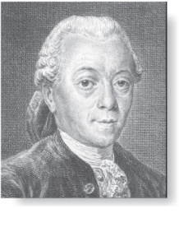
gcds as Linear Combinations
Étienne Bézout
(1730-1783)
Bézout’s Theorem: If a and b are positive integers, then there exist integers s and t such that gcd(a,b) = sa + tb.
(proof in exercises of Section 5.2)
Definition: If a and b are positive integers, then integers s and t such that gcd(a,b) = sa + tb are called Bézout coefficients of a and b. The equation gcd(a,b) = sa + tb is called Bézout’s identity.
By Bézout’s Theorem, the gcd of integers a and b can be expressed in the form sa + tb where s and t are integers. This is a linear combination with integer coefficients of a and b.
gcd(6,14) = (−2)∙6 + 1∙14

Slide 45
Finding gcds as Linear Combinations
Example: Express gcd(252,198) = 18 as a linear combination of 252 and 198.
Solution: First use the Euclidean algorithm to show gcd(252,198) = 18
252 = 1∙198 + 54
198 = 3 ∙54 + 36
54 = 1 ∙36 + 18
36 = 2 ∙18
Now working backwards, from iii and i above
18 = 54 − 1 ∙36
36 = 198 − 3 ∙54
Substituting the 2nd equation into the 1st yields:
18 = 54 − 1 ∙(198 − 3 ∙54 )= 4 ∙54 − 1 ∙198
Substituting 54 = 252 − 1 ∙198 (from i)) yields:
18 = 4 ∙(252 − 1 ∙198) − 1 ∙198 = 4 ∙252 − 5 ∙198
This method illustrated above is a two pass method. It first uses the Euclidian algorithm to find the gcd and then works backwards to express the gcd as a linear combination of the original two integers. A one pass method, called the extended Euclidean algorithm, is developed in the exercises.

Slide 46
Consequences of Bézout’s Theorem
Lemma 2: If a, b, and c are positive integers such that gcd(a, b) = 1 and a | bc, then a | c.
Proof: Assume gcd(a, b) = 1 and a | bc
Since gcd(a, b) = 1, by Bézout’s Theorem there are integers s and t such that
sa + tb = 1.
Multiplying both sides of the equation by c, yields sac + tbc = c.
From Theorem 1 of Section 4.1:
a | tbc (part ii) and a divides sac + tbc since a | sac and a|tbc (part i)
We conclude a | c, since sac + tbc = c.
Lemma 3: If p is prime and p | a₁a₂∙∙∙a_{n}, then p | a_{i} for some i.
(proof uses mathematical induction; see Exercise 64 of Section 5.1)
Lemma 3 is crucial in the proof of the uniqueness of prime factorizations.

Slide 47


Uniqueness of Prime Factorization
We will prove that a prime factorization of a positive integer where the primes are in nondecreasing order is unique. (This part of the fundamental theorem of arithmetic. The other part, which asserts that every positive integer has a prime factorization into primes, will be proved in Section 5.2.)
Proof: (by contradiction) Suppose that the positive integer n can be written as a product of primes in two distinct ways:
n = p₁p₂ ∙∙∙ p_{s} and n = q₁q₂ ∙∙∙ p_{t}.
Remove all common primes from the factorizations to get
By Lemma 3, it follows that divides , for some k, contradicting the assumption that and are distinct primes.
Hence, there can be at most one factorization of n into primes in nondecreasing order.

Slide 48
EXAMPLE
Find the prime factorization of each of these integers.
a) 39 b) 81 c) 101
d) 143 e) 289 f ) 899

Slide 49
EXAMPLE
Determine whether the integers in each of these sets are
pairwise relatively prime.
a) 21, 34, 55 b) 14, 17, 85
c) 25, 41, 49, 64 d) 17, 18, 19, 23

Slide 50
EXAMPLE
Use the Euclidean algorithm to find
a) gcd(1, 5). b) gcd(100, 101).
c) gcd(123, 277). d) gcd(1529, 14039).
e) gcd(1529, 14038). f ) gcd(11111, 111111).

Slide 51
HOMEWORK
#3, #17, #33

