Slide 1
Induction and recursion
Chapter 5

Slide 2
Mathematical Induction
Section 5.1

Slide 3
Section Summary
Mathematical Induction
Examples of Proof by Mathematical Induction
Mistaken Proofs by Mathematical Induction
Guidelines for Proofs by Mathematical Induction

Slide 4
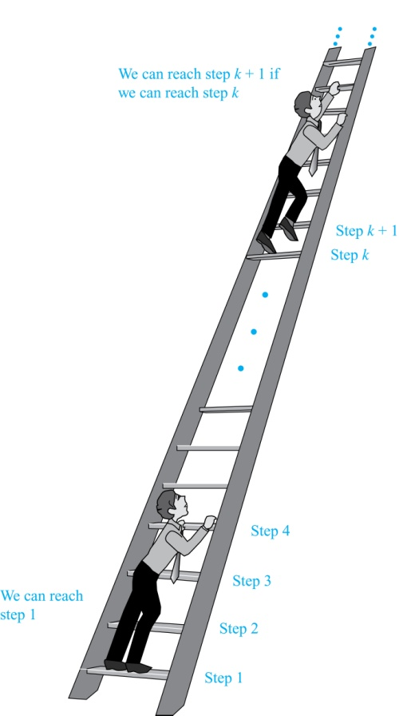
Climbing an Infinite Ladder
Suppose we have an infinite ladder:
We can reach the first rung of the ladder.
If we can reach a particular rung of the ladder, then we can reach the next rung.
From (1), we can reach the first rung. Then by applying (2), we can reach the second rung. Applying (2) again, the third rung. And so on. We can apply (2) any number of times to reach any particular rung, no matter how high up.
This example motivates proof by mathematical induction.

Slide 5
Principle of Mathematical Induction
Principle of Mathematical Induction: To prove that P(n) is true for all positive integers n, we complete these steps:
Basis Step: Show that P(1) is true.
Inductive Step: Show that P(k) → P(k + 1) is true for all positive integers k.
To complete the inductive step, assuming the inductive hypothesis that P(k) holds for an arbitrary integer k, show that must P(k + 1) be true.
Climbing an Infinite Ladder Example:
BASIS STEP: By (1), we can reach rung 1.
INDUCTIVE STEP: Assume the inductive hypothesis that we can reach rung k. Then by (2), we can reach rung k + 1.
Hence, P(k) → P(k + 1) is true for all positive integers k. We can reach every rung on the ladder.

Slide 6
Important Points About Using Mathematical Induction
Mathematical induction can be expressed as the rule of inference
where the domain is the set of positive integers.
In a proof by mathematical induction, we don’t assume that P(k) is true for all positive integers! We show that if we assume that P(k) is true, then P(k + 1) must also be true.
Proofs by mathematical induction do not always start at the integer 1. In such a case, the basis step begins at a starting point b where b is an integer. We will see examples of this soon.
(P(1) ∧ ∀k (P(k) → P(k + 1))) → ∀n P(n),

Slide 7
Validity of Mathematical Induction
Mathematical induction is valid because of the well ordering property, which states that every nonempty subset of the set of positive integers has a least element (see Section 5.2 and Appendix 1). Here is the proof:
Suppose that P(1) holds and P(k) → P(k + 1) is true for all positive integers k.
Assume there is at least one positive integer n for which P(n) is false. Then the set S of positive integers for which P(n) is false is nonempty.
By the well-ordering property, S has a least element, say m.
We know that m can not be 1 since P(1) holds.
Since m is positive and greater than 1, m − 1 must be a positive integer. Since m − 1 < m, it is not in S, so P(m − 1) must be true.
But then, since the conditional P(k) → P(k + 1) for every positive integer k holds, P(m) must also be true. This contradicts P(m) being false.
Hence, P(n) must be true for every positive integer n.

Slide 8
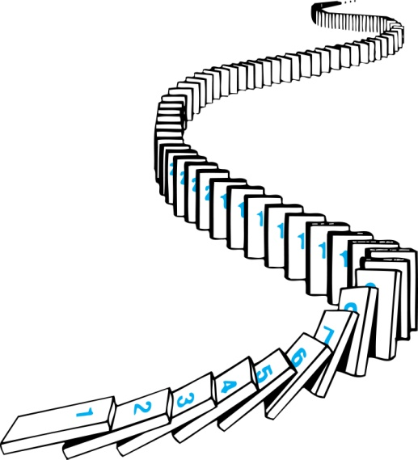
Remembering How Mathematical Induction Works
Consider an infinite sequence of dominoes, labeled 1,2,3, …, where each domino is standing.
We know that the first domino is knocked down, i.e., P(1) is true .
We also know that if whenever the kth domino is knocked over, it knocks over the (k + 1)st domino, i.e, P(k) → P(k + 1) is true for all positive integers k.
Let P(n) be the proposition that the nth domino is knocked over.
Hence, all dominos are knocked over.
P(n) is true for all positive integers n.

Slide 9
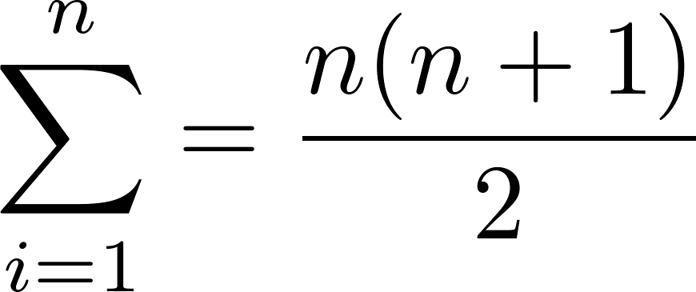
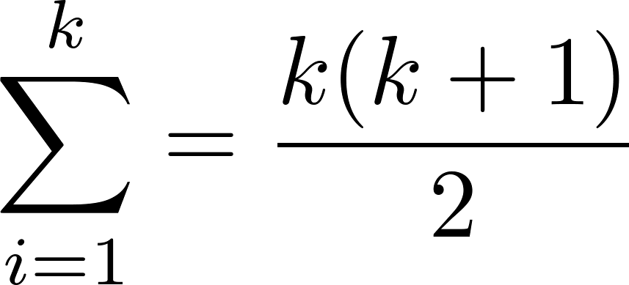
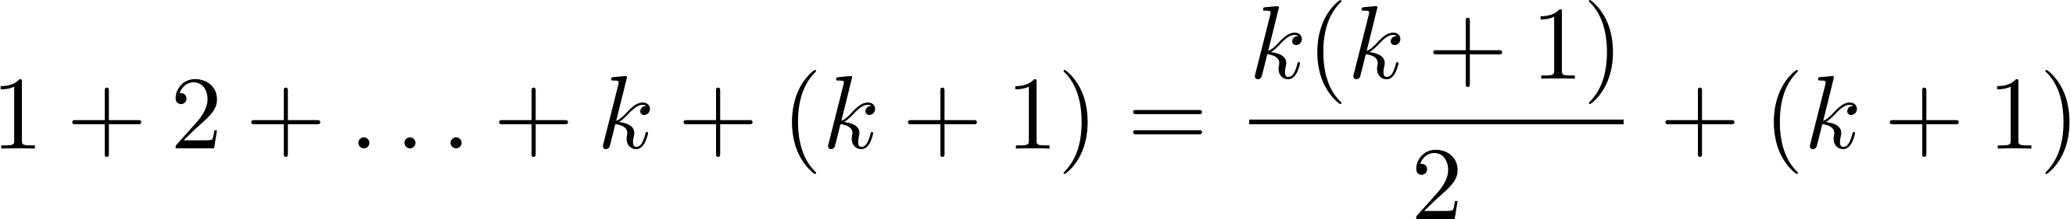
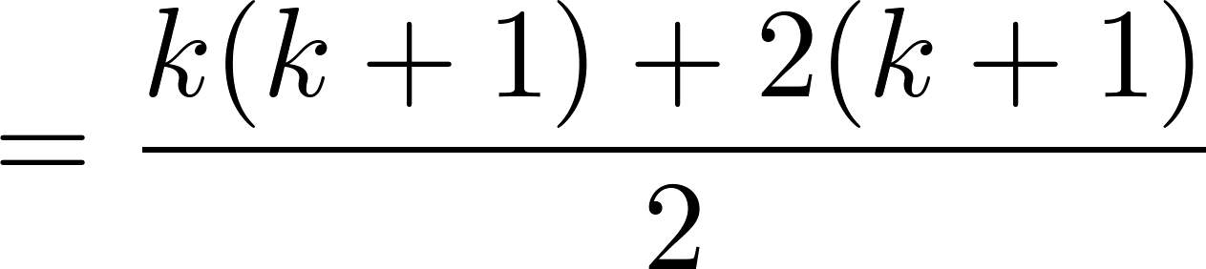
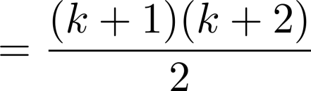
Proving a Summation Formula by Mathematical Induction
Note: Once we have this conjecture, mathematical induction can be used to prove it correct.
Example: Show that:
Solution:
BASIS STEP: P(1) is true since 1(1 + 1)/2 = 1.
INDUCTIVE STEP: Assume true for P(k).
The inductive hypothesis is
Under this assumption,

Slide 10
Conjecturing and Proving Correct a Summation Formula
Example: Conjecture and prove correct a formula for the sum of the first n positive odd integers. Then prove your conjecture.
Solution: We have: 1= 1, 1 + 3 = 4, 1 + 3 + 5 = 9, 1 + 3 + 5 + 7 = 16, 1 + 3 + 5 + 7 + 9 = 25.
We can conjecture that the sum of the first n positive odd integers is n²,
We prove the conjecture is proved correct with mathematical induction.
1 + 3 + 5 + ∙∙∙+ (2n − 1) + (2n + 1) =n² .
Inductive Hypothesis: 1 + 3 + 5 + ∙∙∙+ (2k − 1) =k²
1 + 3 + 5 + ∙∙∙+ (2k − 1) + (2k + 1) =[1 + 3 + 5 + ∙∙∙+ (2k − 1)] + (2k + 1)
= k² + (2k + 1) (by the inductive hypothesis)
= k² + 2k + 1
= (k + 1) ²

Slide 11
Conjecturing and Proving Correct a Summation Formula
BASIS STEP: P(1) is true since 1² = 1.
INDUCTIVE STEP: P(k) → P(k + 1) for every positive integer k.
Assume the inductive hypothesis holds and then show that P(k + 1) holds has well.
So, assuming P(k), it follows that:
Hence, we have shown that P(k + 1) follows from P(k). Therefore the sum of the first n positive odd integers is n².
1 + 3 + 5 + ∙∙∙+ (2n − 1) + (2n + 1) =n² .
Inductive Hypothesis: 1 + 3 + 5 + ∙∙∙+ (2k − 1) =k²
1 + 3 + 5 + ∙∙∙+ (2k − 1) + (2k + 1) =[1 + 3 + 5 + ∙∙∙+ (2k − 1)] + (2k + 1)
= k² + (2k + 1) (by the inductive hypothesis)
= k² + 2k + 1
= (k + 1) ²

Slide 12
Proving Inequalities
Example: Use mathematical induction to prove that n < 2^{n} for all positive integers n.

Slide 13
Proving Inequalities
Example: Use mathematical induction to prove that n < 2^{n} for all positive integers n.
Solution: Let P(n) be the proposition that n < 2^{n}.
BASIS STEP: P(1) is true since 1 < 2¹ = 2.
INDUCTIVE STEP: Assume P(k) holds, i.e., k < 2^{k}, for an arbitrary positive integer k.
Must show that P(k + 1) holds. Since by the inductive hypothesis, k < 2^{k}, it follows that:
k + 1 < 2^{k} + 1 ≤ 2^{k} + 2^{k} = 2 ∙ 2^{k} = 2^{k+1}
Therefore n < 2^{n} holds for all positive integers n.

Slide 14
Proving Inequalities
Example: Use mathematical induction to prove that 2^{n} < n!, for every integer n ≥ 4.

Slide 15
Proving Inequalities
Example: Use mathematical induction to prove that 2^{n} < n!, for every integer n ≥ 4.
Solution: Let P(n) be the proposition that 2^{n} < n!.
BASIS STEP: P(4) is true since 2⁴ = 16 < 4! = 24.
INDUCTIVE STEP: Assume P(k) holds, i.e., 2^{k} < k! for an arbitrary integer k ≥ 4. To show that P(k + 1) holds:
2^{k+1} = 2∙2^{k}
< 2∙ k! (by the inductive hypothesis)
< (k + 1)k!
= (k + 1)!
Therefore, 2^{n} < n! holds, for every integer n ≥ 4.
Note that here the basis step is P(4), since P(0), P(1), P(2), and P(3) are all false.

Slide 16
Proving Divisibility Results
Example: Use mathematical induction to prove that n³ − n is divisible by 3, for every positive integer n.

Slide 17
Proving Divisibility Results
Example: Use mathematical induction to prove that n³ − n is divisible by 3, for every positive integer n.
Solution: Let P(n) be the proposition that n³ − n is divisible by 3.
BASIS STEP: P(1) is true since 1³ − 1 = 0, which is divisible by 3.
INDUCTIVE STEP: Assume P(k) holds, i.e., k³ − k is divisible by 3, for an arbitrary positive integer k. To show that P(k + 1) follows:
(k + 1)³ − (k + 1) = (k³ + 3k² + 3k + 1) − (k + 1)
= (k³ − k) + 3(k² + k)
By the inductive hypothesis, the first term (k³ − k) is divisible by 3 and the second term is divisible by 3 since it is an integer multiplied by 3. So by part (i) of Theorem 1 in Section 4.1 , (k + 1)³ − (k + 1) is divisible by 3.
Therefore, n³ − n is divisible by 3, for every integer positive integer n.

Slide 18
Number of Subsets of a Finite Set
Example: Use mathematical induction to show that if S is a finite set with n elements, where n is a nonnegative integer, then S has 2^{n} subsets.

Slide 19
Number of Subsets of a Finite Set
Example: Use mathematical induction to show that if S is a finite set with n elements, where n is a nonnegative integer, then S has 2^{n} subsets.
(Chapter 6 uses combinatorial methods to prove this result.)
Solution: Let P(n) be the proposition that a set with n elements has 2^{n} subsets.
Basis Step: P(0) is true, because the empty set has only itself as a subset and 2⁰ = 1.
Inductive Step: Assume P(k) is true for an arbitrary nonnegative integer k.
continued →

Slide 20
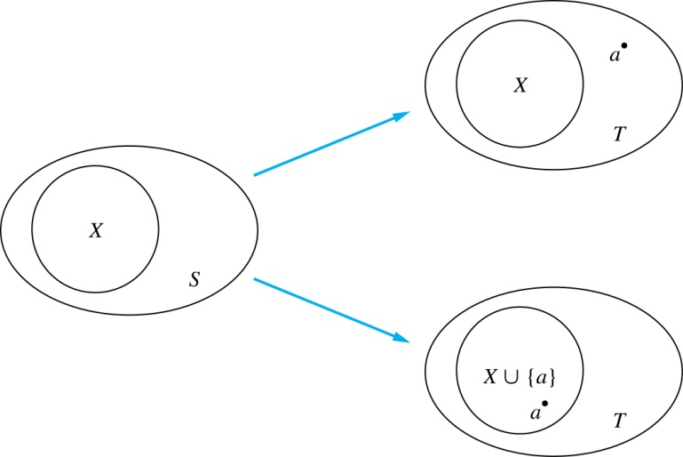
Number of Subsets of a Finite Set
Inductive Hypothesis: For an arbitrary nonnegative integer k, every set with k elements has 2^{k} subsets.
Let T be a set with k + 1 elements. Then T = S ∪ {a}, where a ∈ T and S = T − {a}. Hence |S| = k.
For each subset X of S, there are exactly two subsets of T, i.e., X and X ∪ {a}.
By the inductive hypothesis S has 2^{k} subsets. Since there are two subsets of T for each subset of S, the number of subsets of T is 2 ∙2^{k} = 2^{k+1} .

Slide 21


Tiling Checkerboards
Example: Show that every 2^{n} ×2^{n} checkerboard with one square removed can be tiled using right triominoes.
Solution: Let P(n) be the proposition that every 2^{n} ×2^{n} checkerboard with one square removed can be tiled using right triominoes. Use mathematical induction to prove that P(n) is true for all positive integers n.
BASIS STEP: P(1) is true, because each of the four 2 ×2 checkerboards with one square removed can be tiled using one right triomino.
INDUCTIVE STEP: Assume that P(k) is true for every 2^{k} ×2^{k} checkerboard, for some positive integer k.
A right triomino is an L-shaped tile which covers three squares at a time.
continued →

Slide 22


Tiling Checkerboards
Consider a 2^{k+1} ×2^{k+1} checkerboard with one square removed. Split this checkerboard into four checkerboards of size 2^{k} ×2^{k},by dividing it in half in both directions.
Remove a square from one of the four 2^{k} ×2^{k} checkerboards. By the inductive hypothesis, this board can be tiled. Also by the inductive hypothesis, the other three boards can be tiled with the square from the corner of the center of the original board removed. We can then cover the three adjacent squares with a triominoe.
Hence, the entire 2^{k+1} ×2^{k+1} checkerboard with one square removed can be tiled using right triominoes.
Inductive Hypothesis: Every 2^{k} ×2^{k} checkerboard, for some positive integer k, with one square removed can be tiled using right triominoes.

Slide 23
An Incorrect “Proof” by Mathematical Induction
Example: Let P(n) be the statement that every set of n lines in the plane, no two of which are parallel, meet in a common point. Here is a “proof” that P(n) is true for all positive integers n ≥ 2.
continued →

Slide 24
An Incorrect “Proof” by Mathematical Induction
Example: Let P(n) be the statement that every set of n lines in the plane, no two of which are parallel, meet in a common point. Here is a “proof” that P(n) is true for all positive integers n ≥ 2.
BASIS STEP: The statement P(2) is true because any two lines in the plane that are not parallel meet in a common point.
INDUCTIVE STEP: The inductive hypothesis is the statement that P(k) is true for the positive integer k ≥ 2, i.e., every set of k lines in the plane, no two of which are parallel, meet in a common point.
We must show that if P(k) holds, then P(k + 1) holds, i.e., if every set of k lines in the plane, no two of which are parallel, k ≥ 2, meet in a common point, then every set of k + 1 lines in the plane, no two of which are parallel, meet in a common point.
continued →

Slide 25
An Incorrect “Proof” by Mathematical Induction
Consider a set of k + 1 distinct lines in the plane, no two parallel. By the inductive hypothesis, the first k of these lines must meet in a common point p₁. By the inductive hypothesis, the last k of these lines meet in a common point p₂.
If p₁ and p₂ are different points, all lines containing both of them must be the same line since two points determine a line. This contradicts the assumption that the lines are distinct. Hence, p₁ = p₂ lies on all k + 1 distinct lines, and therefore P(k + 1) holds. Assuming that k ≥2, distinct lines meet in a common point, then every k + 1 lines meet in a common point.
There must be an error in this proof since the conclusion is absurd. But where is the error?
Answer: P(k)→ P(k + 1) only holds for k ≥3. It is not the case that P(2) implies P(3). The first two lines must meet in a common point p₁ and the second two must meet in a common point p₂. They do not have to be the same point since only the second line is common to both sets of lines.
Inductive Hypothesis: Every set of k lines in the plane, where k ≥ 2, no two of which are parallel, meet in a common point.

Slide 26
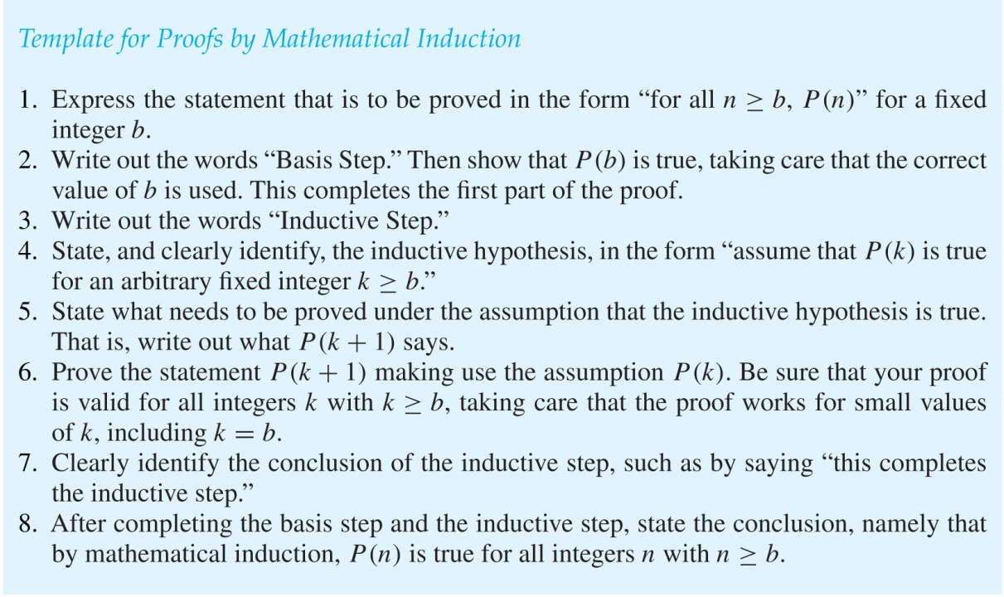
Guidelines: Mathematical Induction Proofs

Slide 27
EXAMPLE

Slide 28
EXAMPLE

Slide 29
EXAMPLE

Slide 30
HOMEWORK
#3, #11, #13

Slide 31
Strong Induction and Well-Ordering
Section 5.2

Slide 32
Section Summary
Strong Induction
Example Proofs using Strong Induction
Using Strong Induction in Computational Geometry (not yet included in overheads)
Well-Ordering Property

Slide 33
Strong Induction
Strong Induction: To prove that P(n) is true for all positive integers n, where P(n) is a propositional function, complete two steps:
Basis Step: Verify that the proposition P(1) is true.
Inductive Step: Show the conditional statement [P(1) ∧ P(2) ∧∙∙∙ ∧ P(k)] → P(k + 1) holds for all positive integers k.
Strong Induction is sometimes called the second principle of mathematical induction or complete induction.

Slide 34
Strong Induction and the Infinite Ladder
Strong induction tells us that we can reach all rungs if:
We can reach the first rung of the ladder.
For every integer k, if we can reach the first k rungs, then we can reach the (k + 1)st rung.
To conclude that we can reach every rung by strong induction:
BASIS STEP: P(1) holds
INDUCTIVE STEP: Assume P(1) ∧ P(2) ∧∙∙∙ ∧ P(k)
holds for an arbitrary integer k, and show that
P(k + 1) must also hold.
We will have then shown by strong induction that for every positive integer n, P(n) holds, i.e., we can
reach the nth rung of the ladder.

Slide 35
Proof using Strong Induction
Example: Suppose we can reach the first and second rungs of an infinite ladder, and we know that if we can reach a rung, then we can reach two rungs higher. Prove that we can reach every rung.
(Try this with mathematical induction.)
Solution: Prove the result using strong induction.
BASIS STEP: We can reach the first step.
INDUCTIVE STEP: The inductive hypothesis is that we can reach the first k rungs, for any k ≥ 2. We can reach the (k + 1)st rung since we can reach the (k − 1)st rung by the inductive hypothesis.
Hence, we can reach all rungs of the ladder.

Slide 36
Which Form of Induction Should Be Used?
We can always use strong induction instead of mathematical induction. But there is no reason to use it if it is simpler to use mathematical induction. (See page 335 of text.)
In fact, the principles of mathematical induction, strong induction, and the well-ordering property are all equivalent. (Exercises 41-43)
Sometimes it is clear how to proceed using one of the three methods, but not the other two.

Slide 37
Completion of the proof of the Fundamental Theorem of Arithmetic
Example: Show that if n is an integer greater than 1, then n can be written as the product of primes.
Solution: Let P(n) be the proposition that n can be written as a product of primes.
BASIS STEP: P(2) is true since 2 itself is prime.
INDUCTIVE STEP: The inductive hypothesis is P(j) is true for all integers j with 2 ≤ j ≤ k. To show that P(k + 1) must be true under this assumption, two cases need to be considered:
If k + 1 is prime, then P(k + 1) is true.
Otherwise, k + 1 is composite and can be written as the product of two positive integers a and b with 2 ≤ a ≤ b < k + 1. By the inductive hypothesis a and b can be written as the product of primes and therefore k + 1 can also be written as the product of those primes.
Hence, it has been shown that every integer greater than 1 can be written as the product of primes.
(uniqueness proved in Section 4.3)

Slide 38
Proof using Strong Induction
Example: Prove that every amount of postage of 12 cents or more can be formed using just 4-cent and 5-cent stamps.
Solution: Let P(n) be the proposition that postage of n cents can be formed using 4-cent and 5-cent stamps.
BASIS STEP: P(12), P(13), P(14), and P(15) hold.
P(12) uses three 4-cent stamps.
P(13) uses two 4-cent stamps and one 5-cent stamp.
P(14) uses one 4-cent stamp and two 5-cent stamps.
P(15) uses three 5-cent stamps.
INDUCTIVE STEP: The inductive hypothesis states that P(j) holds for 12 ≤ j ≤ k, where k ≥ 15. Assuming the inductive hypothesis, it can be shown that P(k + 1) holds.
Using the inductive hypothesis, P(k − 3) holds since k − 3 ≥ 12. To form postage of k + 1 cents, add a 4-cent stamp to the postage for k − 3 cents.
Hence, P(n) holds for all n ≥ 12.

Slide 39
Proof of Same Example using Mathematical Induction
Example: Prove that every amount of postage of 12 cents or more can be formed using just 4-cent and 5-cent stamps.

Slide 40
Proof of Same Example using Mathematical Induction
Example: Prove that every amount of postage of 12 cents or more can be formed using just 4-cent and 5-cent stamps.
Solution: Let P(n) be the proposition that postage of n cents can be formed using 4-cent and 5-cent stamps.
BASIS STEP: Postage of 12 cents can be formed using three 4-cent stamps.
INDUCTIVE STEP: The inductive hypothesis P(k) for any positive integer k is that postage of k cents can be formed using 4-cent and 5-cent stamps. To show P(k + 1) where k ≥ 12 , we consider two cases:
If at least one 4-cent stamp has been used, then a 4-cent stamp can be replaced with a 5-cent stamp to yield a total of k + 1 cents.
Otherwise, no 4-cent stamp have been used and at least three 5-cent stamps were used. Three 5-cent stamps can be replaced by four 4-cent stamps to yield a total of k + 1 cents.
Hence, P(n) holds for all n ≥ 12.

Slide 41
EXAMPLE

Slide 42
EXAMPLE

Slide 43
HOMEWORK
#5, #15

