Slide 1
Advanced Counting Techniques
Chapter 8

Slide 2
Applications of Recurrence Relations
Section 8.1

Slide 3
Section Summary
Applications of Recurrence Relations
Fibonacci Numbers
The Tower of Hanoi
Counting Problems
Algorithms and Recurrence Relations (not currently included in overheads)

Slide 4
Recurrence Relations (recalling definitions from Chapter 2)
Definition: A recurrence relation for the sequence {a_{n}} is an equation that expresses a_{n} in terms of one or more of the previous terms of the sequence, namely, a₀, a₁, …, a_{n-1}, for all integers n with n ≥ n₀, where n₀ is a nonnegative integer.
A sequence is called a solution of a recurrence relation if its terms satisfy the recurrence relation.
The initial conditions for a sequence specify the terms that precede the first term where the recurrence relation takes effect.

Slide 5
Rabbits and the Fiobonacci Numbers
Example: A young pair of rabbits (one of each gender) is placed on an island. A pair of rabbits does not breed until they are 2 months old. After they are 2 months old, each pair of rabbits produces another pair each month. Find a recurrence relation for the number of pairs of rabbits on the island after n months, assuming that rabbits never die.
This is the original problem considered by Leonardo Pisano (Fibonacci) in the thirteenth century.

Slide 6
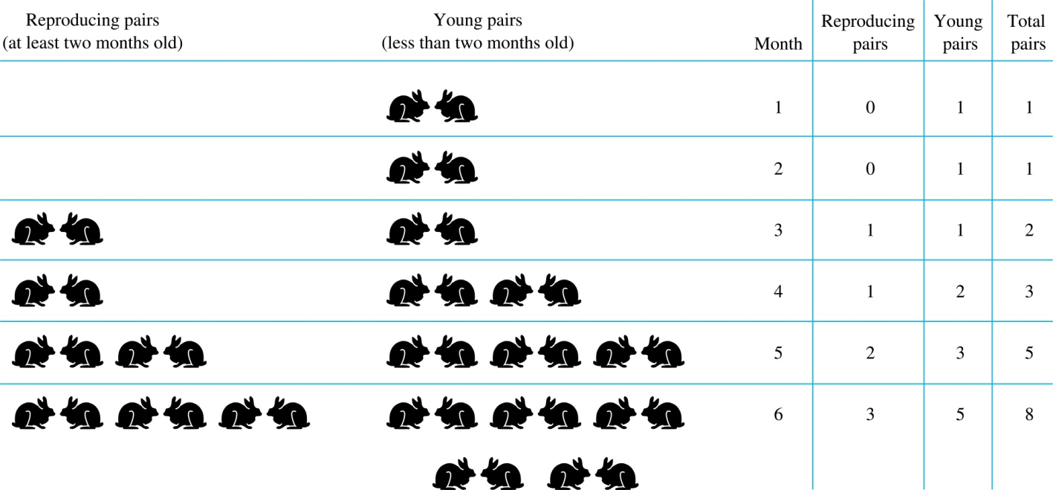
Rabbits and the Fiobonacci Numbers (cont.)
Modeling the Population Growth of Rabbits on an Island

Slide 7
Rabbits and the Fibonacci Numbers (cont.)
Solution: Let f_{n} be the number of pairs of rabbits after n months.
There are is f₁ = 1 pairs of rabbits on the island at the end of the first month.
We also have f₂ = 1 because the pair does not breed during the first month.
To find the number of pairs on the island after n months, add the number on the island after the previous month, f_{n-1}, and the number of newborn pairs, which equals f_{n-2}, because each newborn pair comes from a pair at least two months old.
Consequently the sequence {f_{n} } satisfies the recurrence relation f_{n} = f_{n-1} + f_{n-2} for n ≥ 3 with the initial conditions f₁ = 1 and f₂ = 1.
The number of pairs of rabbits on the island after n months is given by the nth Fibonacci number.

Slide 8
The Tower of Hanoi
In the late nineteenth century, the French mathematician Édouard Lucas invented a puzzle consisting of three pegs on a board with disks of different sizes. Initially all of the disks are on the first peg in order of size, with the largest on the bottom.
Rules: You are allowed to move the disks one at a time from one peg to another as long as a larger disk is never placed on a smaller.
Goal: Using allowable moves, end up with all the disks on the second peg in order of size with largest on the bottom.

Slide 9
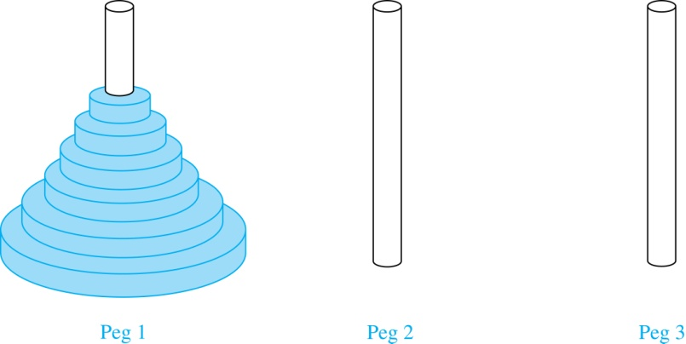
The Tower of Hanoi (continued)
The Initial Position in the Tower of Hanoi Puzzle

Slide 10
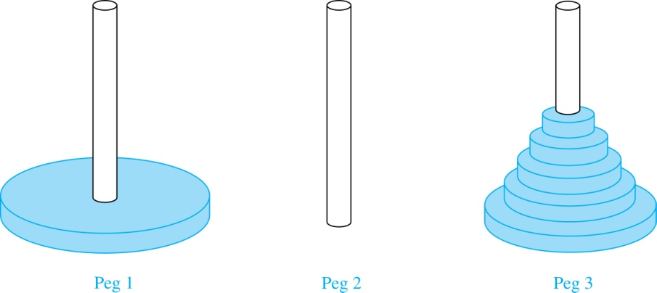
The Tower of Hanoi (continued)
Solution: Let {H_{n}} denote the number of moves needed to solve the Tower of Hanoi Puzzle with n disks. Set up a recurrence relation for the sequence {H_{n}}. Begin with n disks on peg 1. We can transfer the top n −1 disks, following the rules of the puzzle, to peg 3 using H_{n−1} moves.
First, we use 1 move to transfer the largest disk to the second peg. Then we transfer the n −1 disks from peg 3 to peg 2 using H_{n−1} additional moves. This can not be done in fewer steps. Hence,
H_{n} = 2H_{n−1} + 1.
The initial condition is H₁= 1 since a single disk can be transferred from peg 1 to peg 2 in one move.

Slide 11
The Tower of Hanoi (continued)
We can use an iterative approach to solve this recurrence relation by repeatedly expressing H_{n} in terms of the previous terms of the sequence.
H_{n} = 2H_{n−1} + 1
= 2(2H_{n−2} + 1) + 1 = 2² H_{n−2} +2 + 1
= 2²(2H_{n−3} + 1) + 2 + 1 = 2³ H_{n−3} +2² + 2 + 1
⋮
= 2^{n-1}H₁ + 2^{n−2} + 2^{n−3} + …. + 2 + 1
= 2^{n−1} + 2^{n−2} + 2^{n−3} + …. + 2 + 1 because H₁= 1
= 2^{n} − 1 using the formula for the sum of the terms of a geometric series
There was a myth created with the puzzle. Monks in a tower in Hanoi are transferring 64 gold disks from one peg to another following the rules of the puzzle. They move one disk each day. When the puzzle is finished, the world will end.
Using this formula for the 64 gold disks of the myth,
2⁶⁴ −1 = 18,446, 744,073, 709,551,615
days are needed to solve the puzzle, which is more than 500 billion years.
Reve’s puzzle (proposed in 1907 by Henry Dudeney) is similar but has 4 pegs. There is a well-known unsettled conjecture for the the minimum number of moves needed to solve this puzzle. (see Exercises 38-45)

Slide 12
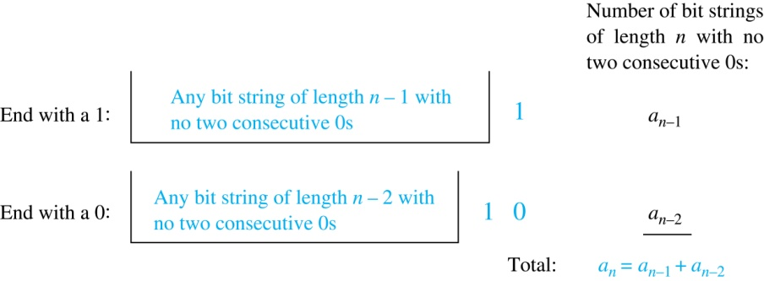
Counting Bit Strings
Example 3: Find a recurrence relation and give initial conditions for the number of bit strings of length n without two consecutive 0s. How many such bit strings are there of length five?
Solution: Let a_{n} denote the number of bit strings of length n without two consecutive 0s. To obtain a recurrence relation for {a_{n} } note that the number of bit strings of length n that do not have two consecutive 0s is the number of bit strings ending with a 0 plus the number of such bit strings ending with a 1.
Now assume that n ≥ 3.
The bit strings of length n ending with 1 without two consecutive 0s are the bit strings of length n −1 with no two consecutive 0s with a 1 at the end. Hence, there are a_{n−1} such bit strings.
The bit strings of length n ending with 0 without two consecutive 0s are the bit strings of length n −2 with no two consecutive 0s with 10 at the end. Hence, there are a_{n−2} such bit strings.
We conclude that a_{n} = a_{n−1} + a_{n−2} for n ≥ 3.

Slide 13
Bit Strings (continued)
The initial conditions are:
a₁ = 2, since both the bit strings 0 and 1 do not have consecutive 0s.
a₂ = 3, since the bit strings 01, 10, and 11 do not have consecutive 0s, while 00 does.
To obtain a₅ , we use the recurrence relation three times to find that:
a₃ = a₂ + a₁ = 3 + 2 = 5
a₄ = a₃ + a₂ = 5+ 3 = 8
a₅ = a₄ + a₃ = 8+ 5 = 13
Note that {a_{n} } satisfies the same recurrence relation as the Fibonacci sequence. Since a₁ = f₃ and a₂ = f₄ , we conclude that a_{n} = f_{n+2} .

Slide 14
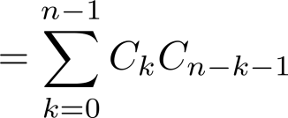
Counting the Ways to Parenthesize a Product
Example: Find a recurrence relation for C_{n} , the number of ways to parenthesize the product of
n + 1 numbers, x₀ ∙ x₁ ∙ x₂ ∙ ⋯ ∙ x_{n}, to specify the order of multiplication.
For example, C₃ = 5, since all the possible ways to parenthesize 4 numbers are
((x₀ ∙ x₁ )∙ x₂ )∙ x₃ , (x₀ ∙ (x₁ ∙ x₂ ))∙ x₃ , (x₀ ∙ x₁ )∙ (x₂ ∙ x₃ ), x₀ ∙ (( x₁ ∙ x₂ ) ∙ x₃ ), x₀ ∙ ( x₁ ∙ ( x₂ ∙ x₃ ))
Solution: Note that however parentheses are inserted in x₀ ∙ x₁ ∙ x₂ ∙ ⋯ ∙ x_{n}, one “∙” operator remains outside all parentheses. This final operator appears between two of the n + 1 numbers, say x_{k} and x_{k+1}. Since there are C_{k} ways to insert parentheses in the product x₀ ∙ x₁ ∙ x₂ ∙ ⋯ ∙ x_{k} and C_{n−k−1} ways to insert parentheses in the product x_{k+1} ∙ x_{k+2} ∙ ⋯ ∙ x_{n}, we have
The initial conditions are C₀ = 1 and C₁ = 1.
The sequence {C_{n} } is the sequence of Catalan Numbers. This recurrence relation can be solved using the method of generating functions; see Exercise 41 in Section 8.4.

Slide 15
EXAMPLE
a) Find a recurrence relation for the number of ways to
climb n stairs if the person climbing the stairs can take
one, two, or three stairs at a time.
b) What are the initial conditions?
c) In many ways can this person climb a flight of eight
stairs?
A string that contains only 0s, 1s, and 2s is called a ternary string.

Slide 16
HOMEWORK
#11

Slide 17
Solving Linear Recurrence Relations
Section 8.2

Slide 18
Section Summary
Linear Homogeneous Recurrence Relations
Solving Linear Homogeneous Recurrence Relations with Constant Coefficients.
Solving Linear Nonhomogeneous Recurrence Relations with Constant Coefficients.

Slide 19
Linear Homogeneous Recurrence Relations
Definition: A linear homogeneous recurrence relation of degree k with constant coefficients is a recurrence relation of the form a_{n} = c₁a_{n−1} + c₂a_{n−2} + ….. + c_{k} a_{n−k ,} where c₁, c₂, ….,c_{k} are real numbers, and c_{k} ≠ 0
it is linear because the right-hand side is a sum of the previous terms of the sequence each multiplied by a function of n.
it is homogeneous because no terms occur that are not multiples of the a_{j}s. Each coefficient is a constant.
the degree is k because a_{n} is expressed in terms of the previous k terms of the sequence.
By strong induction, a sequence satisfying such a recurrence relation is uniquely determined by the recurrence relation and the k initial conditions a₀ = C₁, a₀ = C₁ ,… , a_{k−1} = C_{k−1}.

Slide 20
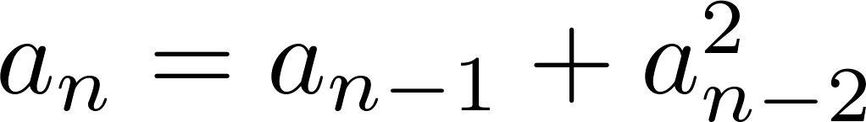
Examples of Linear Homogeneous Recurrence Relations
P_{n} = (1.11)P_{n-1} linear homogeneous recurrence relation of degree one
f_{n} = f_{n-1} + f_{n-2} linear homogeneous recurrence relation of degree two
not linear
H_{n} = 2H_{n−1} + 1 not homogeneous
B_{n} = nB_{n−1} coefficients are not constants

Slide 21
Solving Linear Homogeneous Recurrence Relations
The basic approach is to look for solutions of the form a_{n} = r^{n}, where r is a constant.
Note that a_{n} = r^{n} is a solution to the recurrence relation a_{n} = c₁a_{n−1} + c₂a_{n−2} + ⋯ + c_{k} a_{n−k} if and only if r^{n} = c₁r^{n−1} + c₂r^{n−2} + ⋯ + c_{k} r^{n−k} .
Algebraic manipulation yields the characteristic equation:
r^{k} − c₁r^{k−1} − c₂r^{k−2} − ⋯ − c_{k−1}r − c_{k} = 0
The sequence {a_{n}} with a_{n} = r^{n} is a solution if and only if r is a solution to the characteristic equation.
The solutions to the characteristic equation are called the characteristic roots of the recurrence relation. The roots are used to give an explicit formula for all the solutions of the recurrence relation.

Slide 22
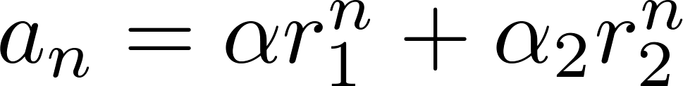
Solving Linear Homogeneous Recurrence Relations of Degree Two
Theorem 1: Let c₁ and c₂ be real numbers. Suppose that r² – c₁r – c₂ = 0 has two distinct roots r₁ and r₂. Then the sequence {a_{n}} is a solution to the recurrence relation a_{n} = c₁a_{n−1} + c₂a_{n−2} if and only if
for n = 0,1,2,… , where α₁ and α₂ are constants.

Slide 23
Using Theorem 1
Example: What is the solution to the recurrence relation
a_{n} = a_{n−1} + 2a_{n−2} with a₀ = 2 and a₁ = 7?
Solution: The characteristic equation is r² − r − 2 = 0.
Its roots are r = 2 and r = −1 . Therefore, {a_{n}} is a solution to the recurrence relation if and
only if a_{n} = α₁2^{n} + α₂(−1)^{n}, for some constants α₁ and α₂.
To find the constants α₁ and α₂, note that
a₀ = 2 = α₁ + α₂ and a₁ = 7 = α₁2 + α₂(−1).
Solving these equations, we find that α₁ = 3 and α₂ = −1.
Hence, the solution is the sequence {a_{n}} with a_{n} = 3∙2^{n} − (−1)^{n}.

Slide 24
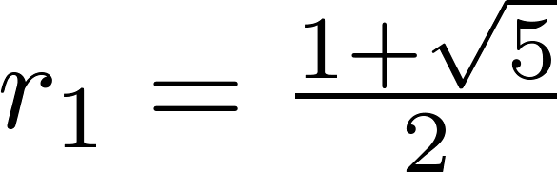
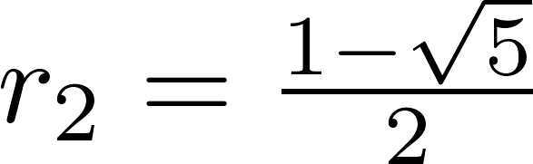
An Explicit Formula for the Fibonacci Numbers
We can use Theorem 1 to find an explicit formula for the Fibonacci numbers. The sequence of Fibonacci numbers satisfies the recurrence relation f_{n} = f_{n−1} + f_{n−2} with the initial conditions: f₀ = 0 and f₁ = 1.
Solution: The roots of the characteristic equation r² – r – 1 = 0 are

Slide 25
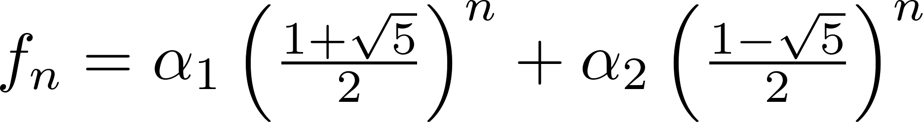
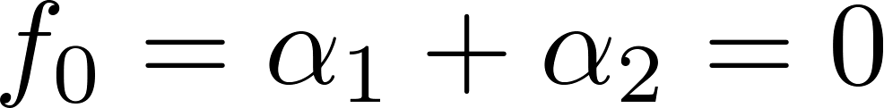
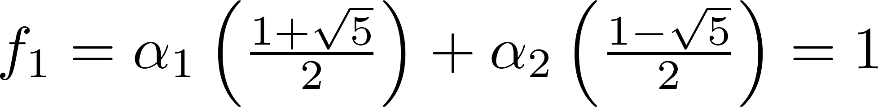
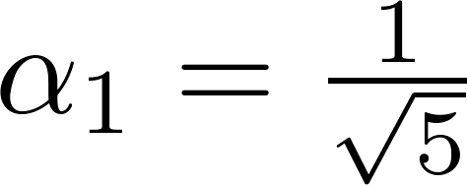
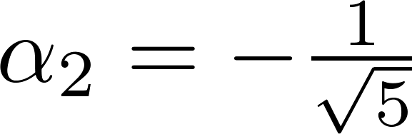
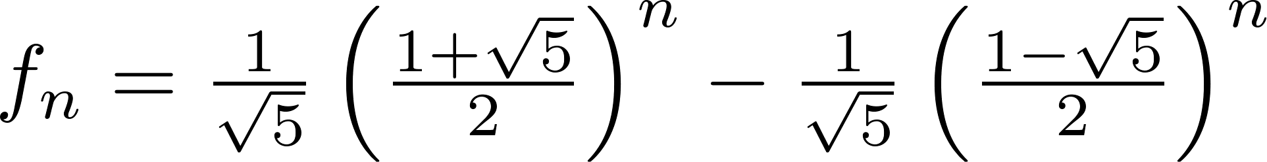
Fibonacci Numbers (continued)
Therefore by Theorem 1
for some constants α₁ and α₂.
Using the initial conditions f₀ = 0 and f₁ = 1 , we have
Solving, we obtain .
Hence,
.
,

Slide 26
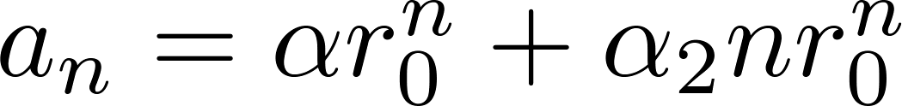
The Solution when there is a Repeated Root
Theorem 2: Let c₁ and c₂ be real numbers with c₂ ≠ 0. Suppose that r² – c₁r – c₂ = 0 has one repeated root r₀. Then the sequence {a_{n}} is a solution to the recurrence relation a_{n} = c₁a_{n−1} + c₂a_{n−2} if and only if
for n = 0,1,2,… , where α₁ and α₂ are constants.

Slide 27
Using Theorem 2
Example: What is the solution to the recurrence relation a_{n} = 6a_{n−1} − 9a_{n−2} with a₀ = 1 and a₁ = 6?
Solution: The characteristic equation is r² − 6r + 9 = 0.
The only root is r = 3. Therefore, {a_{n}} is a solution to the recurrence relation if and only if
a_{n} = α₁3^{n} + α₂n(3)^{n}
where α₁ and α₂ are constants.
To find the constants α₁ and α₂, note that
a₀ = 1 = α₁ and a₁ = 6 = α₁ ∙ 3 + α₂ ∙3.
Solving, we find that α₁ = 1 and α₂ = 1 .
Hence,
a_{n} = 3^{n} + n3^{n} .

Slide 28
Solving Linear Homogeneous Recurrence Relations of Arbitrary Degree
This theorem can be used to solve linear homogeneous recurrence relations with constant coefficients of any degree when the characteristic equation has distinct roots.
Theorem 3: Let c₁, c₂ ,…, c_{k} be real numbers. Suppose that the characteristic equation
r^{k} – c₁r^{k−1} –⋯ – c_{k} = 0
has k distinct roots r₁, r₂, …, r_{k}. Then a sequence {a_{n}} is a solution of the recurrence relation
a_{n} = c₁a_{n−1} + c₂a_{n−2} + ….. + c_{k} a_{n−k}
if and only if
for n = 0, 1, 2, …, where α₁, α₂,…, α_{k} are constants.

Slide 29
The General Case with Repeated Roots Allowed
Theorem 4: Let c₁, c₂ ,…, c_{k} be real numbers. Suppose that the characteristic equation
r^{k} – c₁r^{k−1} –⋯ – c_{k} = 0
has t distinct roots r₁, r₂, …, r_{t} with multiplicities m₁, m₂, …, m_{t}, respectively so that m_{i} ≥ 1 for i = 0, 1, 2, …,t and m₁ + m₂ + … + m_{t} = k. Then a sequence {a_{n}} is a solution of the recurrence relation
a_{n} = c₁a_{n−1} + c₂a_{n−2} + ….. + c_{k} a_{n−k}
if and only if
for n = 0, 1, 2, …, where α_{i,j} are constants for 1≤ i ≤ t and 0≤ j ≤ m_{i−1}.

Slide 30
Linear Nonhomogeneous Recurrence Relations with Constant Coefficients
Definition: A linear nonhomogeneous recurrence relation with constant coefficients is a recurrence relation of the form:
a_{n} = c₁a_{n−1} + c₂a_{n−2} + ….. + c_{k} a_{n−k} + F(n) ,
where c₁, c₂, ….,c_{k} are real numbers, and F(n) is a function not identically zero depending only on n.
The recurrence relation
a_{n} = c₁a_{n−1} + c₂a_{n−2} + ….. + c_{k} a_{n−k ,}
is called the associated homogeneous recurrence relation.

Slide 31
Linear Nonhomogeneous Recurrence Relations with Constant Coefficients (cont.)
The following are linear nonhomogeneous recurrence relations with constant coefficients:
a_{n} = a_{n−1} + 2^{n} ,
a_{n} = a_{n−1} + a_{n−2} + n² + n + 1,
a_{n} = 3a_{n−1} + n3^{n} ,
a_{n} = a_{n−1} + a_{n−2} + a_{n−3} + n!
where the following are the associated linear homogeneous recurrence relations, respectively:
a_{n} = a_{n−1 ,}
a_{n} = a_{n−1} + a_{n−2},
a_{n} = 3a_{n−1} ,
a_{n} = a_{n−1} + a_{n−2} + a_{n−3}

Slide 32
Solving Linear Nonhomogeneous Recurrence Relations with Constant Coefficients
Theorem 5: If {a_{n}^{(p)}} is a particular solution of the nonhomogeneous linear recurrence relation with constant coefficients
a_{n} = c₁a_{n−1} + c₂a_{n−2} + ⋯ + c_{k} a_{n−k} + F(n) ,
then every solution is of the form {a_{n}^{(p)} + a_{n}^{(h)}}, where {a_{n}^{(h)}} is a solution of the associated homogeneous recurrence relation
a_{n} = c₁a_{n−1} + c₂a_{n−2} + ⋯ + c_{k} a_{n−k .}

Slide 33
Solving Linear Nonhomogeneous Recurrence Relations with Constant Coefficients (continued)
Example: Find all solutions of the recurrence relation a_{n} = 3a_{n−1} + 2n.
What is the solution with a₁ = 3?
Solution: The associated linear homogeneous equation is a_{n} = 3a_{n−1}.
Its solutions are a_{n}^{(h)} = α3^{n}, where α is a constant.
Because F(n)= 2n is a polynomial in n of degree one, to find a particular solution we might try a linear function in n, say p_{n} = cn + d, where c and d are constants. Suppose that p_{n} = cn + d is such a solution.
Then a_{n} = 3a_{n−1} + 2n becomes cn + d = 3(c(n− 1) + d)+ 2n.
Simplifying yields (2 + 2c)n + (2d − 3c) = 0. It follows that cn + d is a solution if and only if
2 + 2c = 0 and 2d − 3c = 0. Therefore, cn + d is a solution if and only if c = − 1 and d = − 3/2.
Consequently, a_{n}^{(p)} = −n − 3/2 is a particular solution.
By Theorem 5, all solutions are of the form a_{n} = a_{n}^{(p)} + a_{n}^{(h)} = −n − 3/2 + α3^{n}, where α is a constant.
To find the solution with a₁ = 3, let n = 1 in the above formula for the general solution.
Then 3 = −1 − 3/2 + 3 α, and α = 11/6. Hence, the solution is a_{n} = −n − 3/2 + (11/6)3^{n}.

Slide 34
EXAMPLE

Slide 35
HOMEWORK
#3

