Slide 1

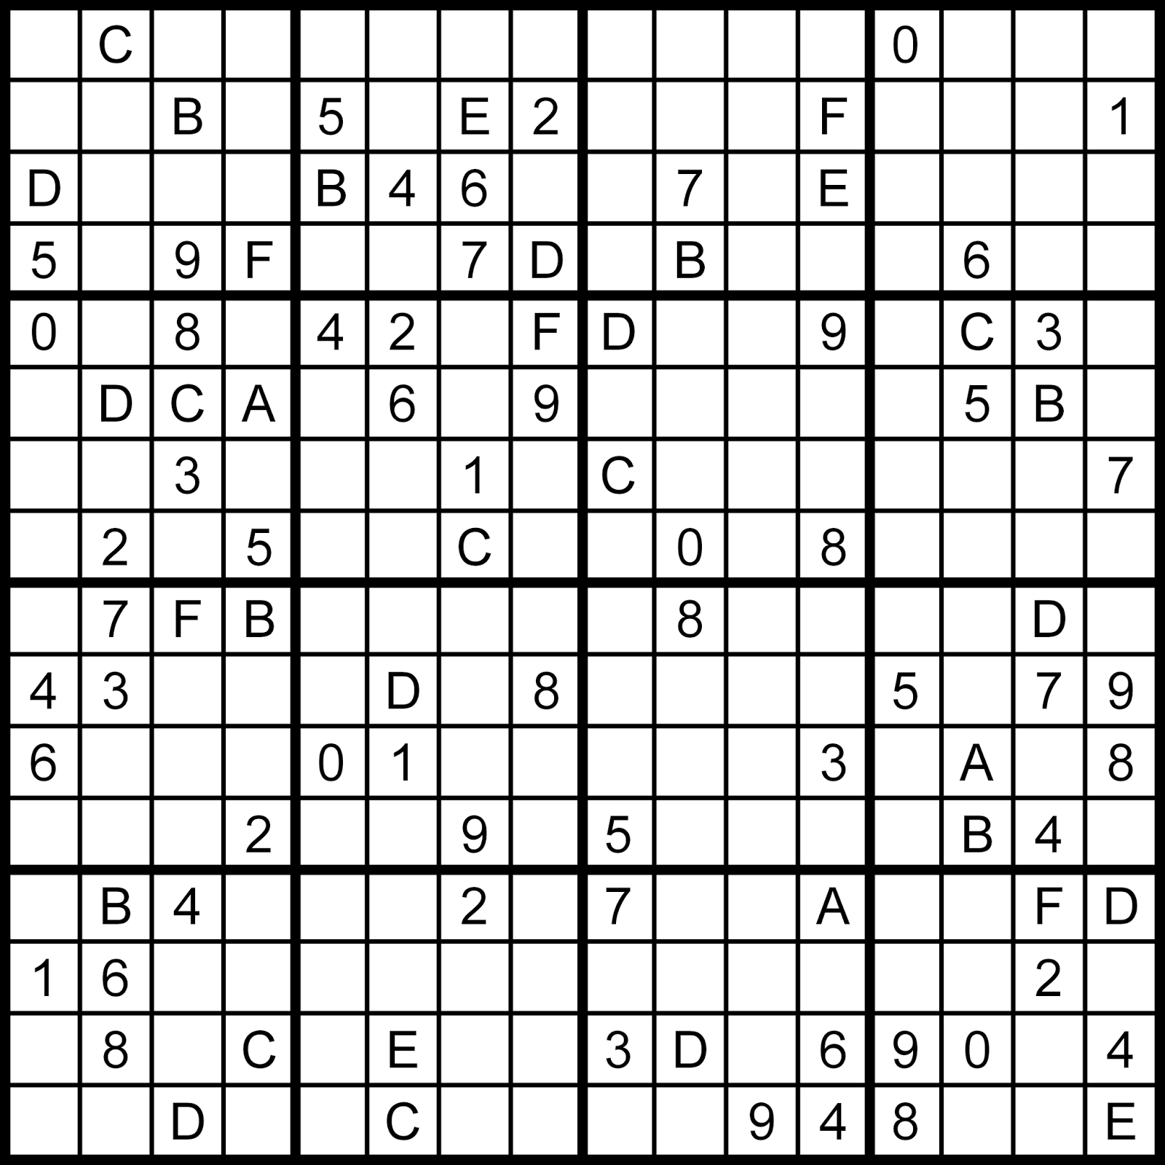
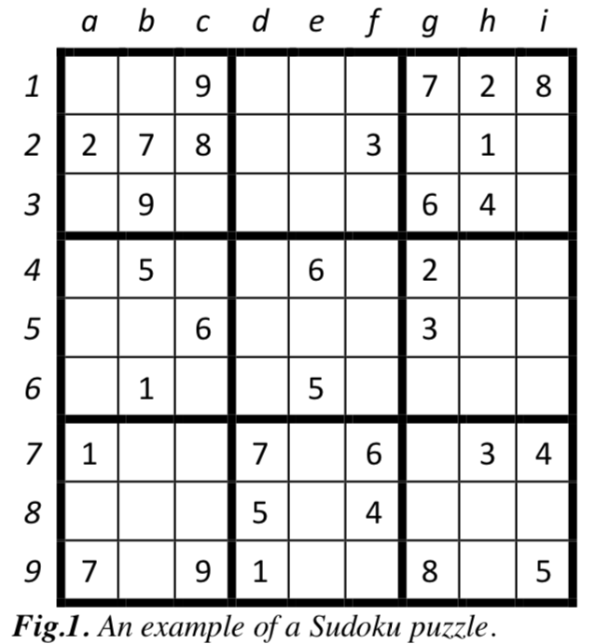
Heuristic Solver for Various Sudoku Yelun Bao, Zhenxiao Liang Institute of Interdisciplinary Information Science
Introduction
In the last decade, solving the Sudoku puzzle has become every one’s passion. The simplicity of puzzle’s structure and the low requirement of mathematical skills caused people to have enormous interest in accepting challenges to solve the puzzle. Therefore, developers have tried to find algorithms in order to generate the variety of puzzles for human players so that they could be even solved by computer programming.
Sudoku Fundamentals
Sudoku is a popular logic-based puzzle where the objective is to fill a 9×9 grid with numbers, with a subset of the solution already given, so that each column, each row, and each of the nine 3×3 sub-grids contains all of the numbers from 1 to 9. The puzzle is often given like Fig.1.
Variation of Sudoku
There are also many variation of Sudoku. For example, the 16x16 Sudoku has the similar rules with the classic 9×9 one, but the alphabet is 1 to 16. And the number of cells in one sub-grid is 16.
Already-known Solvers
Solver | Algorithm | Test Unique? | Language | Compatible
JSolve | backtracking | Yes | C | No
kudoku | backtracking | Yes | C | Yes
fast_solv_9r2 | DLX | Yes | C | Yes
kudoku | backtracking | Yes | Java | Yes
kudoku | backtracking | Yes | JavaScript | Yes
kudoku | backtracking | Yes | Lua | Yes
sudoku-bb | Backtrack | No | Python | No
sudoku-gh | DLX | Yes | JavaScript | No
Peter Norvig’s | backtracking | No | Python | No
kudoku | backtracking | Yes | Python | Yes
sudoku-pk | backtracking | No | Javascript | No
sudoku-aa | DLX | Yes | Python | No
sudoku_db | backtracking | No | Python | No
Sudoku_bc | backtracking | Yes | Java | No
Sudoku_dl | unknown | No | Java | No
Sudoku_6l | brute-force | No | Java | No
Fig.2. An example of 16x16 Sudoku puzzle.
Results
We used two different criterions to measure the performance of Sudoku algorithms. One is by time the algorithm used to search while the other is by number of nodes the search process explored. The latter one is independent of platform used.
The Following are some comparisons between the known algorithms and ours. We ran our solver on 20 very hard 9×9 Sudoku puzzles and five 16x16 Sudoku puzzles, which are chosen as test data (differ from the data to adjust the Heuristic.)
Used Techniques
A number of techniques were used to speed up the existing search algorithms.
Order of Cell Exploration: select the cell or the constraint with the minimum choices, fix to one number and move forward; when a cell is left with no choice, we go back to the previous step and select the next allowed number. The key to fast solving is to quickly find cells that can be determined with simple logic, including at least the naked single and hidden single rules.
Order of choices: the known solvers just select the cell by the order with the minimum choices to explore, but we do not have the idea which digit to try first. This step is not very important in classic 9×9 Sudoku, since the feasible choices are very few in the cell. But the case is more complicated in a larger Sudoku, like 16x16 Sudoku, where we are often faced with quite many choices. We introduce the sum of rest feasible choices in all grids after filling a digit as Heuristic function. However we need find a balance between the ascending order and descending order, which needs trial and adjustment.
Nodes expanded | 9x9 | 16x16
Basic solver | 2872 | 2536
Heuristic Solver | 2164 | 1872
Literature Cited
[1]. Astraware Limited. Techniques For Solving Sudoku. [homepage on the Internet]. 2008. Available from Website: http://www.sudokuoftheday.com/techniques/
[2]. Marwala T. Stochastic Optimization Approaches for Solving Sudoku. [homepage on the Internet]. 2008. Available from Website: http://arxiv.org/abs/0805.0697
[3]. Cazenave T. A search based Sudoku solver. [homepage on the Internet]. No date. Available from Website: http://citeseerx.ist.psu.edu/viewdoc/summary?doi=10.1.1.64.459
[4]. Knuth, Donald (2000). "Dancing links". Millennial Perspectives in Computer Science. P159. 187. arXiv:cs/0011047 Freely accessible. Retrieved 2006-07-11.
Time(ms) | 9x9 | 16x16
Basic solver | 8428 | 33039
Heuristic Solver | 6012 | 24713

