Slide 1


Slide 2

A PROJECT FINAL DEFENSE ON
IQ Test
Presentation by :-
Suchak Niraula
Shirish Shrestha
Pranjal Neupane

Slide 3
Table Of Content
Introduction
Problem Statement
Objectives
Scope
Block Diagram
Background Study
Literature Review
Requirement Analysis
Feasibility Analysis
Algorithm

Slide 4
Table Of Content
Result
Flowchart
Test Cases
Limitation
Future Work
Recommendation
Conclusion

Slide 5
Introduction
Measures a range of cognitive abilities.
Measures an individual's intellectual abilities and potential.
Verbal intelligence.
Numerical intelligence.
Spatial intelligence.
Logical intelligence.
Easily accessible.

Slide 6
Problem Statement
Make an individual familiar with the prospects of spatial relation skills.
Make an individual familiar objectivity of the questions.
Gain the experience of testing their IQ.
Help diagnose intellectual disabilities or measure someone’s intellectual potential.
Helps to increase their knowledge.

Slide 7
Objectives
To make IQ Test program more easily accessible using a highly versatile language.
To provide people with a source of information that will increase their knowledge.
To utilize our knowledge in C Programming to make something useful.

Slide 8
Scopes
Our project is applicable in any place that has access to a computer regardless of its specifications and its hardware capabilities. This is made possible by the versatility and popularity of C programming language.

Slide 9
Background Study
IQ test is an application developed to conduct a quiz based on time constraints.
The rules and regulations are displayed that includes number of questions to be answered and scoring methods.
The game is started by displaying one question with four options.
If the answer is correct, 10 points is added and no negative marks for wrong answers.
Final score will be displayed and updated in the database with username.

Slide 10
Background Study
Well-liked game.
Familiar to the users.
Facilitate a user-friendly environment for all user.
Reduces the manual effort.

Slide 11
Literature Review(1)
Sarah Forest:
When it comes to quizzes, it’s important to create one that captures the interest of your audience and effortlessly guides them towards their “next steps.” This is the key to creating a quiz that is a tool for growing your business–instead of just being a fun activity. While it’s easy to come up with a great concept for a quiz, it’s often difficult to translate that into questions, answers, and results. This is where implementing an effective planning method comes into play.

Slide 12
Literature Review
Kendra Cherry
An IQ test is an assessment that measures a range of cognitive abilities and provides a score that is intended to serve as a measure of an individual’s intellectual abilities and potential. IQ tests are among the most commonly administered psychological tests.

Slide 13
Literature Review(3)
Shery Jacobson
We all know that during the rush of the development process, we are generally more focused on making our program work than making it fully readable. This situation becomes even more complicated when we face a problem never seen before and have a tight deadline to deliver the work. Sometimes we have to appeal to Stack Overflow to find a solution or take some time to read all similar questions until finding a new idea of how to work around the problem.

Slide 14
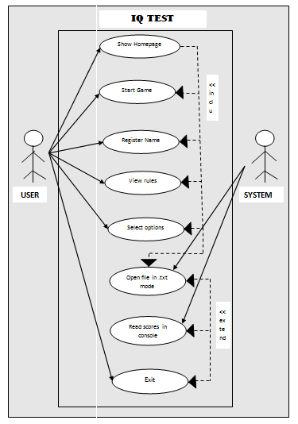
Requirement Analysis
Functional Requirement
Fig: Use case diagram for the project

Slide 15
Requirement Analysis
Non-functional requirement
Accessibility
Performance
Appearance

Slide 16
Feasibility Analysis
Technical Feasibility
Operational Feasibility
Economic Feasibility
Schedule Feasibility

Slide 17
Algorithm
Step 1:- Start
Step 2: -Show the main home screen.
Step 3: - Ask to press ‘Enter’ to take the test or press ‘Esc’ to exit.
Step 4: - Ask to register your name.
Step 5: -Read the set of rules in the screen.
Step 6: -Press enter to take the test.
Step 7: Press A, B, C or D in each of 10 questions as shown in the screen respectively.
Step 8: -View scores obtained in score1.txt file.
Step 9: -Press “R” or “r” to view score in console.
Step 10: -Go to step 2 to play the game again by pressing ‘Y’ or press ‘N’ to exit.
Step 11: -End

Slide 18
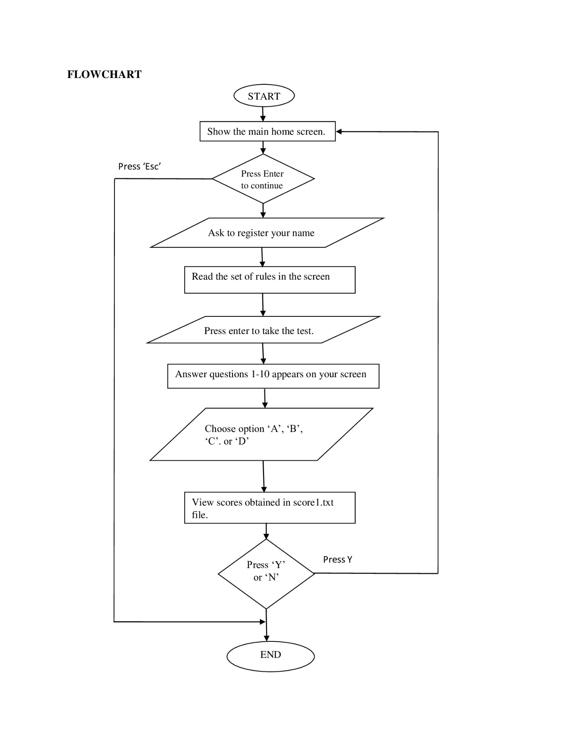
Flow-Chart

Slide 19
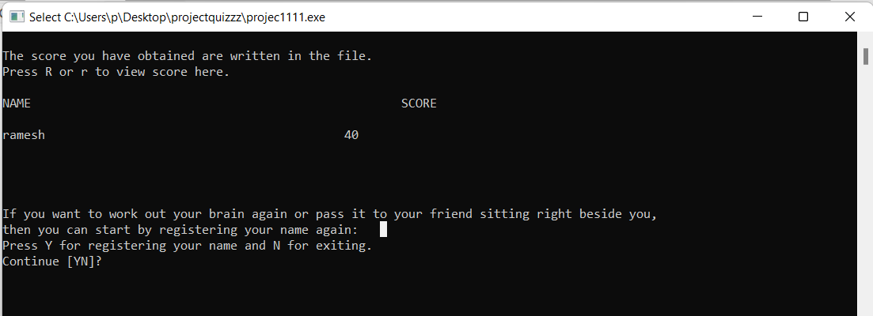
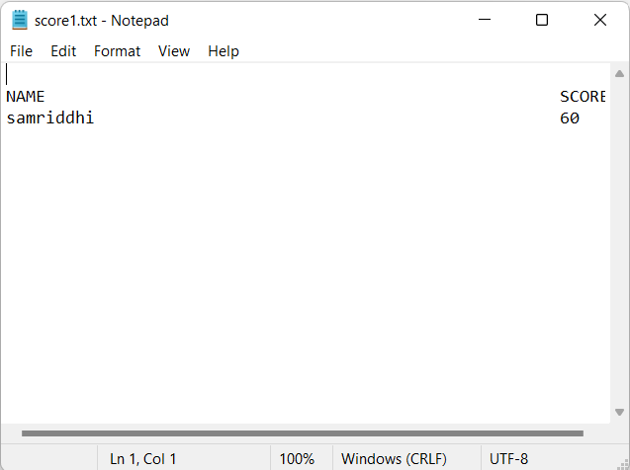
Result
Figure: SCREENSHOT OF THE RESULT
Figure: SCREENSHOT OF THE RESULT FILE

Slide 20
Test Cases
Test Case ID | TC-L01
Test Case Description | Showing of the main screen after starting the program.
Pre-Requisites | Dev-C++ Output Console
Test Scenario | On opening program file
Test Data | Desired Screen Size (1920 x 1080)
Steps | Expected Result | Actual Result | Pass/Fail
a. Open the program b. Provide desired screen size | Main homepage of desired screen size should be shown | Main homepage of desired screen size should be shown | Pass

Slide 21
Test Cases
Test Case ID | TC-L02
Test Case Description | Pressing enter to continue or escape key to exit.
Pre-Requisites | Dev-C++ Output Console
Test Scenario | Pressing valid keys from keyboard
Test Data | <<Enter>><<Esc>>
Steps | Expected Result | Actual Result | Pass/Fail
a. Entered key is ‘Enter’. b. Entered key is ‘Esc’ c. Neither of a. or b. | a. Move to next page b. Exit status 1 c. Show “Sorry! You entered a wrong key.” | a. Move to next page b. Exit status 1 c. Show “Sorry! You entered a wrong key.” | Pass

Slide 22
Limitations
Technical knowledge
Not available to a larger audience
We could not include timer functions.
File handling operations weren’t coded properly.

Slide 23
Future Work
Introducing to graphics
Involving Network
Inclusion of Timer functions
Randomization in questions
High scores among users

Slide 24
Recommendation
Use proper database which is much more secure than storing data in files.
Make sure you plan the resources which can be written as code and can be done depending on your circumstances.
Improvise.

Slide 25
Conclusion
At last, it was an exceptional project for us as we were working with file handling theory in C for the very first time. There were a lot of frustrations as we hit the dead end a lot of times on various aspects of the development. However, when we thought it was all over, we always had a ‘what if’ thought and slowly and steady moved us forward ourselves. This was indeed a great experience for our team.

Slide 26
Reference
K. Cherry, "Very Well Mind," 25 01 2022. [Online]. Available: https://www.verywellmind.com/how-are-scores-on-iq-tests-calculated-2795584. [Accessed 25 01 2022].
W. J. Schneider, "Scientific American Blog," 03 02 2014. [Online].
Available: https://blogs.scientificamerican.com/beautiful-minds/what-do-iq-tests-test-interview-with-psychologist-w-joel-schneider/. [Accessed 25 01 2022].
J. D. Russo, "Towards Data Science," 15 01 2020. [Online].
Available: https://towardsdatascience.com/10-lessons-i-have-learnt-while-starting-programming-as-a-beginner-6eea32be00e3. [Accessed 26 01 2021].
S. Forest, "Interact.blog," [Online].
Available: https://www.tryinteract.com/blog/how-to-plan-your-first-quiz/. [Accessed 26 01 2022].

Slide 27

ANY QUIRIES

