Slide 1
Compute Vision & Image Processing
Multi-Class Land Cover Classification
Using Hybrid Spectral-Spatial Deep Learning

Slide 2
01
Problem Statement

Slide 3
Traditional land cover classification methods struggle to accurately identify
complex environments where multiple land cover types coexist within a single
image.
These methods often rely on either low-resolution RGB imagery or raw spectral
bands independently, leading to:
Loss of critical spatial details in RGB images due to low resolution
Underutilization of spectral information crucial for distinguishing similar land types
Inability to handle multi-label classification, where more than one land cover type is present
There is a need for a hybrid deep learning approach that can intelligently
combine enhanced spatial features and selective spectral features, enabling
accurate and efficient multi-label land cover classification in remote sensing
imagery.

Slide 4
02
Objective

Slide 5
To develop a hybrid deep learning model that fuses both spatial (RGB) and spectral (NIR, SWIR) data for improved classification accuracy
To enhance low-resolution RGB images using super-resolution techniques (ESRGAN)
To apply PCA-based spectral band selection for dimensionality reduction and efficient feature extraction
To design a multi-stream CNN architecture for parallel processing of RGB and spectral inputs
To incorporate attention mechanisms for focusing on the most informative spatial-spectral regions
To perform multi-label classification of land cover types with high precision and recall
To evaluate the model using metrics like F1-Score, Precision, Recall and deploy it through Gradio App

Slide 6
03
Reasearch Gap

Slide 7
Existing models often use only RGB or spectral data, not both together.
Most studies focus on single-label classification, while real-world land areas often have multiple land cover types.
Very few models combine spatial (RGB) and spectral (NIR, SWIR) features in one system.
Attention mechanisms are rarely used to focus on the most important features.
Low-resolution satellite images are common, but most models don’t improve their quality before classification.

Slide 8
04
Dataset Description

Slide 9
EuroSAT Dataset
Dataset contains all the RGB and Bands images from Sentinel-2
Context
This dataset is being used for classifying the use of land in geospatial images.
The end goal for the classification is that the top 2 uses of land in an image are given as output to the user.
Content
This dataset contains images belonging to the EuroSAT dataset. There are 2 folders, namely,
EuroSAT → Contains RGB images collected from the Sentinel Dataset.
EuroSATallBands → Contains .tif files which have all the bands(13 bands) of the spectrum as collected from the Sentinel-2 satellite.
They were all collected from the Sentinel-2 satelliteEach image is 64x64 pixels with a Ground Sampling Distance of 10m.

Slide 10


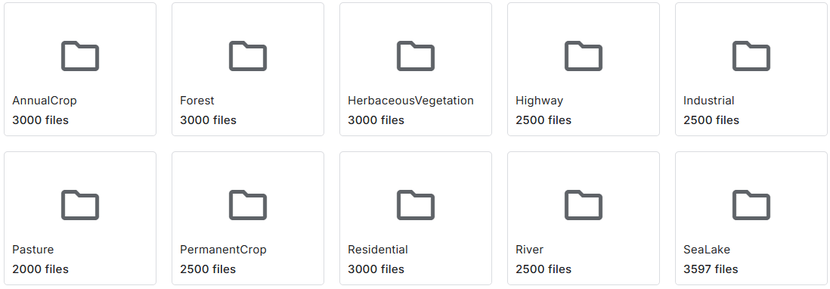
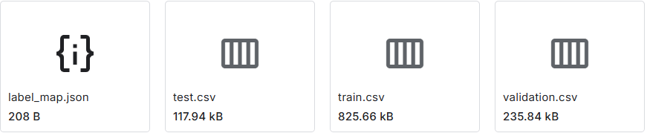
The 2 directories containing the
following class folders :
AnnualCrop
Forest
HerbaceousVegatation
Highway
Industrial
Pasture
PermanentCrop
Residential
River
SeaLake
Supporting Files in the EuroSAT Dataset →

Slide 11
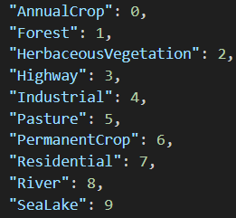
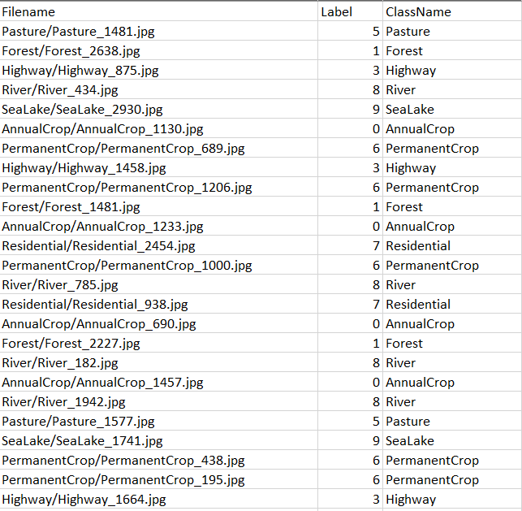
1. label_map.json:
A JSON file that contains the mapping of class names to numeric labels.
2. train.csv
Contains the file paths and labels for all training samples.
Typical columns:
- filename – relative path to the image
- label – class name or numeric label (can be extended to multi-label)
Used for feeding data into the training pipeline.
3. validation.csv
Similar structure to train.csv, but contains the validation split.
Helps evaluate model performance during training and tuning.
4. test.csv
Contains unseen data used for final model evaluation.
Ensures the model is tested on images it hasn’t seen during training or validation.

Slide 12
05
Methodology

Slide 13
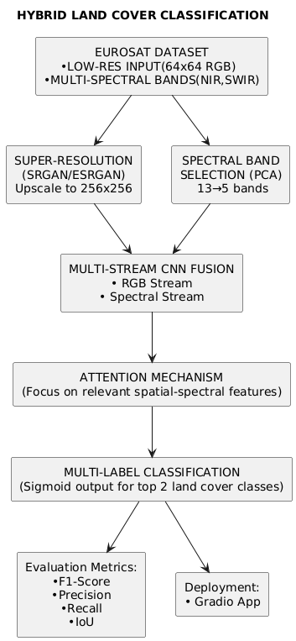
System Architecture

Slide 14
Pre-processing
1. ESRGAN(Enhanced Super-Resolution Generative Adversarial Network)
The input RGB satellite images are low-resolution (64×64).
ESRGAN is used to enhance image quality by upscaling them to 256×256.
This improves spatial details and helps the model learn fine features for better classification.
Working in our Project:
Set up RRDBNet( Residual-in-Residual Dense Block Network) Architecture
Loads Pretrained ESRGAN Weights
Run sanity checks, Validates input
Upscaling
Returns Enhanced Image

Slide 15
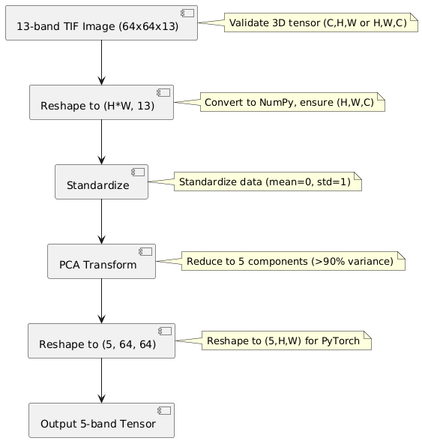
Pre-processing
2. PCA(Principal Component Analysis) for Spectral Band Selection
The dataset includes multiple spectral bands (e.g., NIR, SWIR).
Instead of using all spectral bands, Principal Component Analysis (PCA) is applied to:
- Reduce dimensionality.
- Retain the most informative spectral features.
This optimizes model performance and reduces computational cost.
Working in our Project:

Slide 16
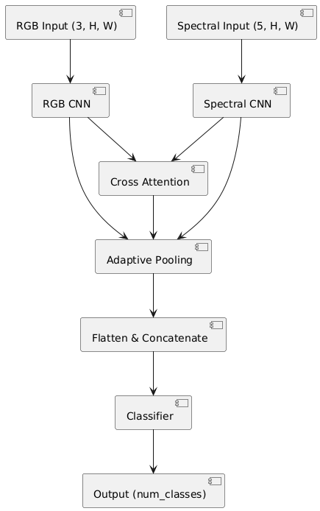
Feature Extraction & Attention Mechanism
3. Multi-Stream CNN Fusion
Two separate streams are created:
- One for the Enhanced RGB image.
- One for the selected spectral bands.
Each stream has its own CNN, which extracts spatial and spectral features.
Features from both streams are then fused to create a rich representation that captures both visual and spectral cues.
4. Attention Mechanism
An Attention Layer is introduced after feature fusion.
It helps the model focus on the most relevant spatial-spectral features.
This enhances classification performance by giving importance to significant regions in the image.

Slide 17
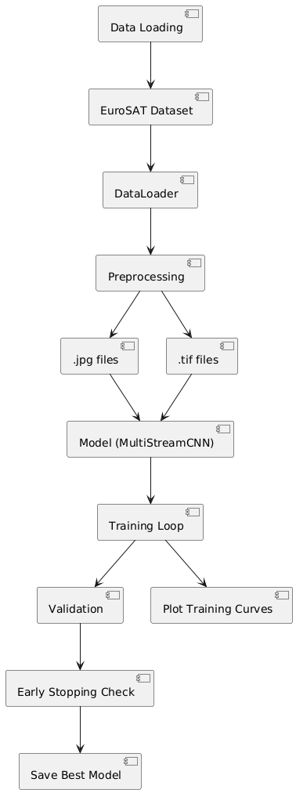
5. Multi-Label Classification Output
The task is multi-label classification (an image can belong to more than one land cover class).
A Sigmoid activation function is used in the output layer.
The top predicted labels (e.g., top-2 classes) are selected based on probability scores.
6. Evaluation & Deployment
Model is evaluated using metrics like:
-F1-Score – for balancing precision and recall.
Finally, the model is deployed as a web app using Gradio, allowing users to upload satellite images and get predicted land cover classes in real-time.

Slide 18
06
Results & Discussions

Slide 19
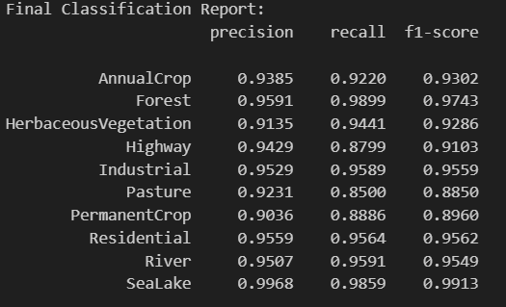

Model Performance
The model achieved a final accuracy of 92.67% on the training set and 95.44% on the validation set, indicating strong generalization.

Slide 20
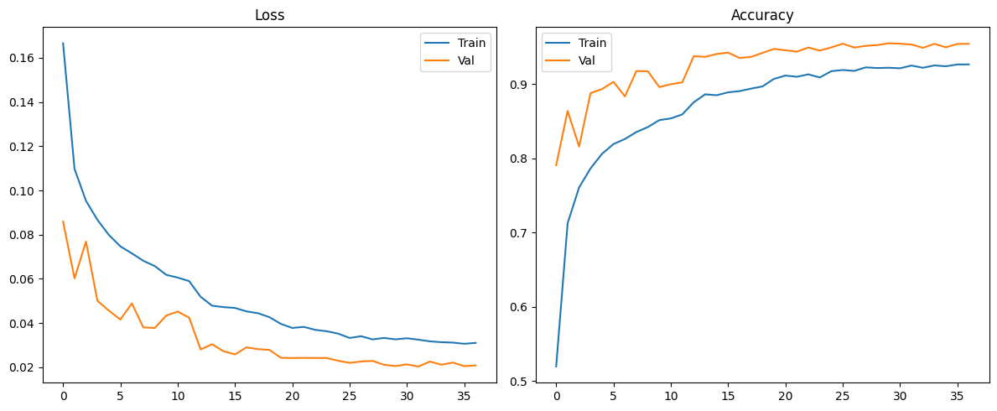
Graph
Loss Curves:
Steady decline in training/validation loss with minimal divergence, suggesting effective learning without severe overfitting.
Accuracy Trends:
Validation accuracy (~95%) consistently matched training accuracy (~93%), indicating robust model tuning.

Slide 21
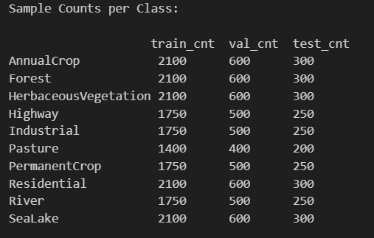
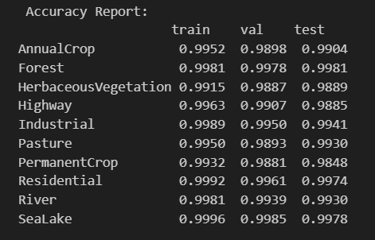
Class – wise Analysis
High Accuracy Classes:
Forest, SeaLake, Residential – Test accuracy > 99.7%.
Likely due to distinctive features and balanced sample distribution.
Moderate Accuracy Classes:
Highway, HerbaceousVegetation, PermanentCrop – Test accuracy ~98.5–98.9%.
Possible feature overlap or variability within class.
Lowest Accuracy Class:
Pasture – Test accuracy 99.3%.
Lowest training samples (1400), may affect generalization.

Slide 22
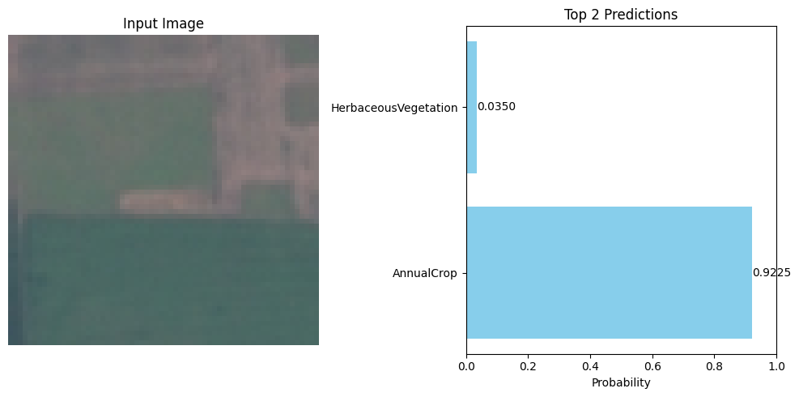

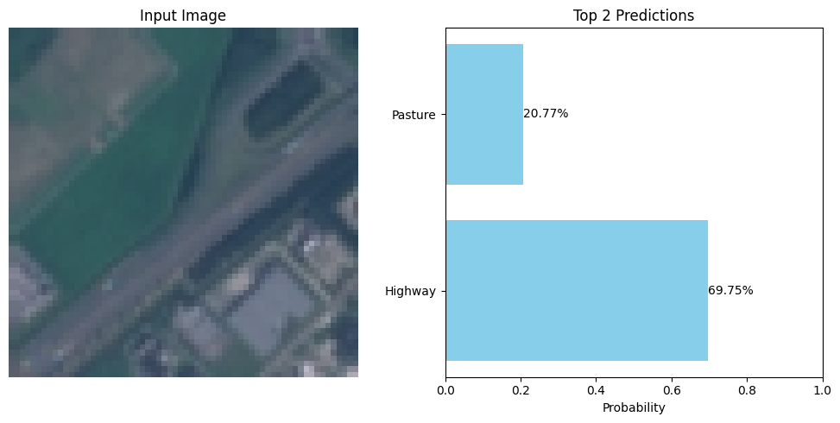

Testing
Input: AnnualCrop_1275.jpg
Input: Highway_2260.jpg

Slide 23
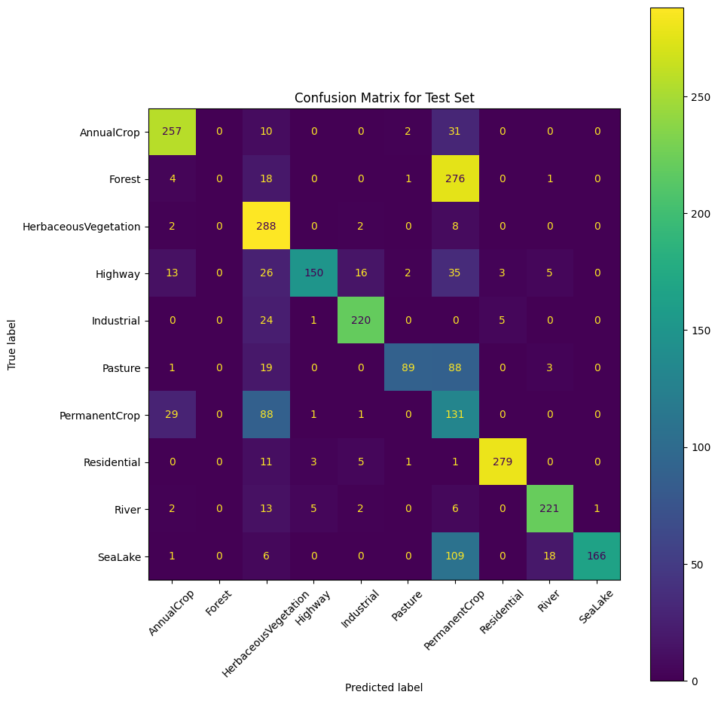
Confusion Matrix Insights
Highly Accurate Classes:
Residential, Forest, HerbaceousVegetation show strong diagonal dominance with minimal misclassifications.
Moderate Confusion:
Highway is often confused with HerbaceousVegetation and Industrial.
Pasture is confused with HerbaceousVegetation and PermanentCrop.
Significant Misclassification:
PermanentCrop is frequently misclassified as HerbaceousVegetation and vice versa.
Clear Misclassification Cases:
AnnualCrop occasionally misclassified as River.
SeaLake predictions confuse with PermanentCrop and River in a few cases.
General Observation:
Most predictions are on the diagonal, indicating strong overall model performance.

Slide 24
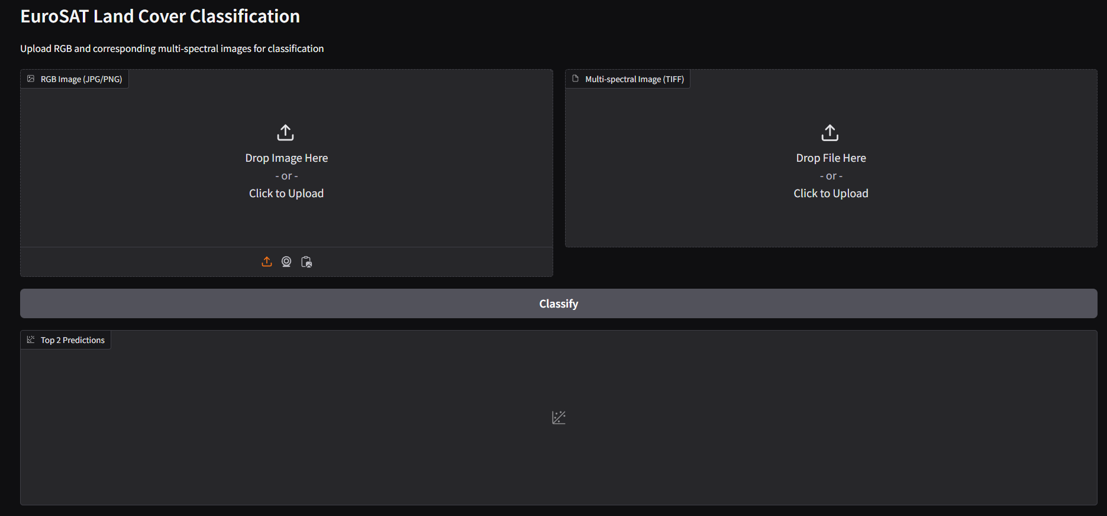
Deployment – Gradio App

Slide 25
Data and Limitations
Class Imbalance: Despite balanced splits (e.g., 300 test samples per major class), Pasture and Highway had fewer samples, potentially affecting their performance.
Hybrid Model Strengths: The hybrid spectral-spatial approach excelled for classes with unique signatures (e.g., Industrial, SeaLake) but faced challenges with spectrally similar classes (e.g., crops/pastures, Forests).
In Conclusion, the model demonstrates strong capability for distinct land cover classes but requires targeted improvements for spectrally overlapping categories to enhance real-world applicability.

Slide 26
Thank You!

