Slide 1


AI in Social Engineering and Phishing Campaigns
Cybersecurity Internship Research Presentation 2025
Presented by
Sucharita Das
Intern, Digisuraksha Parhari Foundation
12th May 2025
Powered by: Infinisec Technologies Pvt. Ltd

Slide 2
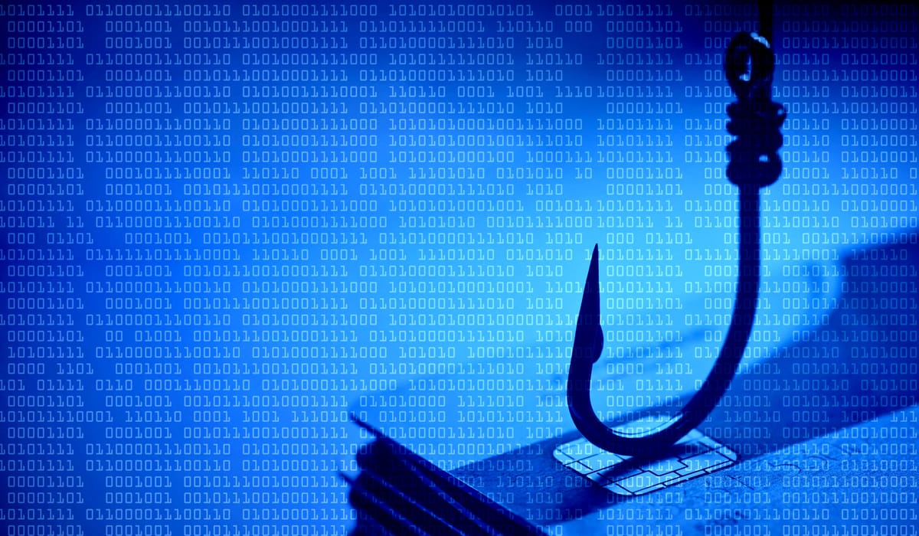
Abstract
This research explores the growing role of Artificial Intelligence (AI) in modern phishing and social engineering campaigns. As AI technologies like large language models (LLMs), deepfake tools, and voice cloning software become increasingly accessible, cybercriminals are leveraging them to craft highly personalized, convincing, and large-scale attacks that traditional security systems struggle to detect.
The study investigates how tools such as ChatGPT, WormGPT, Eleven Labs, and DeepFaceLab are being misused to manipulate human behavior, automate phishing, and impersonate trusted individuals. Real-world case studies are analyzed to understand the impact of AI-enhanced threats on organizations and individuals.
This research also highlights the ethical challenges, market relevance, and future risks associated with AI-driven social engineering, while emphasizing the need for AI-aware cybersecurity professionals and proactive defense strategies. The findings underline the urgent necessity for both technical and educational measures to keep pace with evolving AI-powered cyber threats.

Slide 3

Problem Statement & Objective
Problem Statement:
With the advancement of AI technologies, phishing and social engineering attacks have become more sophisticated, personalized, and difficult to detect. Cybercriminals are using AI tools like large language models, voice clones, and deepfakes to manipulate targets at scale. Traditional security tools often fail to recognize AI-generated content, and the general public lacks awareness of these evolving threats.
Research Objective:
To explore how AI is enhancing phishing and social engineering techniques.
To identify the tools, platforms, and strategies used by attackers.
To analyze the ethical implications and security challenges posed by AI-driven threats.
To propose preventive measures and the need for AI-aware cybersecurity professionals.

Slide 4

Defense Strategies
AI-Powered Detection Tools:
Use security tools that integrate AI for behavioral analysis, email filtering, and real-time anomaly detection.
2. User Awareness Training :
Regularly train individuals to recognize AI-generated scams, voice phishing, and deepfakes.
3. Policy & Access Control:
Implement stricter access controls and data verification layers in communication workflows.
4. AI Usage Regulation:
Enforce ethical AI development standards and control open-source AI misuse.
Collaboration & Intelligence Sharing:
Encourage threat intelligence sharing across industries to stay ahead of evolving AI techniques..

Slide 5

Research Methodology
1. Secondary Research:
Reviewed academic journals, cybersecurity whitepapers, industry reports, and government advisories.
Analyzed content from trusted sources such as Europol, CISA, IEEE, IBM X-Force, and Forbes.
2. Case Study Analysis:
Studied real-world incidents where AI tools were used in phishing, voice scams, and deepfake impersonations.
Evaluated the impact and method of each attack to understand trends and effectiveness.
3. Tool Exploration:
Investigated how specific AI tools (e.g., ChatGPT, WormGPT, ElevenLabs, DeepFaceLab) are used or misused in phishing campaigns.
Focused on their capabilities, accessibility, and risk level.
4. Ethical and Market Relevance Review:
Considered the ethical implications of dual-use technologies.
Explored industry responses and the growing demand for AI-aware cybersecurity professionals.

Slide 6
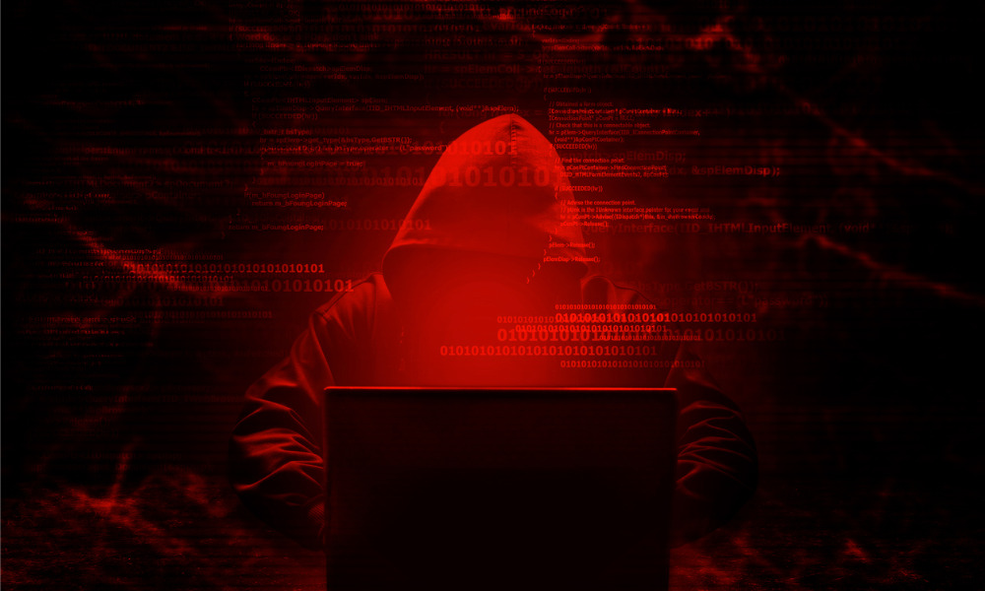
Literature Review
LLMs (Large Language Models) like ChatGPT and WormGPT are being exploited to generate highly convincing phishing emails and scripts. According to a Europol report (2023), these tools significantly reduce the time and effort needed to create scams that mimic real organizations or individuals.
Voice Cloning Tools, such as ElevenLabs, are being used in vishing (voice phishing) attacks. Cybercriminals can replicate a person’s voice using only short audio samples, making scams more believable and emotionally manipulative.
Deepfake Technologies like DeepFaceLab allow attackers to create fake video content, which has been used in job interview scams and virtual meeting fraud.
Security agencies and tech companies including CISA, IBM, and Symantec have documented an increase in AI-assisted cyberattacks, emphasizing the need for AI-integrated threat detection and public awareness.

Slide 7
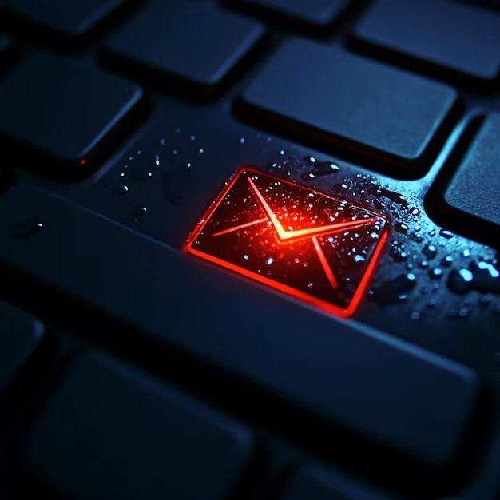
Tool Implementation
This project is based on theoretical research and case study analysis, with no practical tool developed or deployed. However, to understand the risks and functionality of AI-driven social engineering, the research examined how various tools are commonly misused in phishing attacks:
ChatGPT / WormGPT: These LLMs are used to auto-generate phishing emails, SMS scams, and deceptive chat messages that mimic human communication.
ElevenLabs: A powerful voice cloning tool that can replicate a person's voice from short audio samples—commonly used in vishing scams.
DeepFaceLab: A deepfake video creation tool often used to impersonate someone visually in online meetings or interviews.
AI Chatbots: Attackers program bots to simulate support agents or authority figures, tricking users into sharing credentials or personal data.

Slide 8
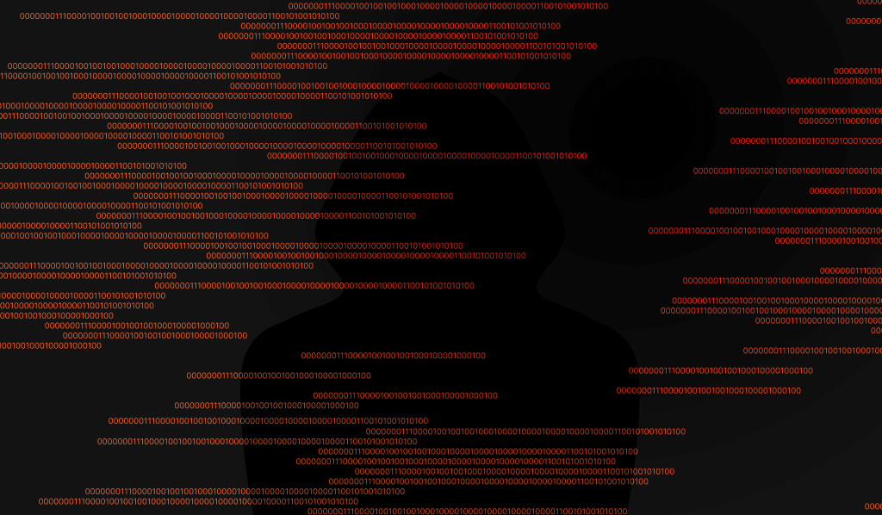
Results & Observations
1. AI Greatly Increases Attack Success Rates:
AI-generated messages are context-aware, well-written, and highly convincing—making them far more successful than traditional phishing content.
2. Automation at Scale:
Tools like ChatGPT and WormGPT allow attackers to generate thousands of personalized scam messages in seconds, eliminating the need for manual effort.
3. Deepfakes and Voice Cloning Amplify Trust Exploitation:
Attackers now use cloned voices and fake video content to impersonate bosses, coworkers, or family members, adding a visual or auditory layer of manipulation.
4. Harder to Detect with Traditional Filters:
Because AI-generated content is grammatically correct and mimics real communication, it often bypasses traditional spam filters and email security systems.
5. Growing Public Unawareness:
Many people are unaware of how realistic and accessible AI-generated content can be, increasing their vulnerability to deception.

Slide 9

Ethical Impact & Market Relevance
Ethical Impact:
Misuse of Technology = AI tools developed for educational or productivity purposes are now being exploited for malicious attacks—raising serious concerns about open access and responsible development.
Lack of Accountability = When phishing attacks are carried out using AI-generated content, it becomes difficult to trace the origin or assign responsibility.
Privacy Violations = Deepfake videos and voice cloning often involve using someone’s likeness or data without consent, breaching privacy and human rights.
Dual-Use Dilemma = Tools with legitimate applications (e.g., voice assistants, chatbots) can be repurposed to deceive and harm, making ethical boundaries blurry.
Market Relevance:
Demand for AI-Aware Cybersecurity Professionals = Organizations now look for security experts who understand both AI threats and defensive AI techniques.
Emerging Startups and Tools = The market is seeing growth in companies focused on deepfake detection, AI threat intelligence, and phishing simulation tools.
Business Risk Priority = According to surveys by IBM and Gartner, AI-based phishing is now a top concern for CISOs across industries like finance, healthcare, and tech.

Slide 10

Future Enhancements
Hyper-Realistic Deepfakes:
Deepfake technology will become indistinguishable from real video and audio, making visual scams even harder to detect.
Autonomous Phishing Bots:
AI agents may be deployed on social media and messaging platforms to automatically identify, engage, and phish victims in real time using personalized data.
AI-Augmented Cyber Defense:
The future will also see the rise of AI in cybersecurity defense—such as automated phishing detection, behavioral analysis, and real-time anomaly tracking.
AI-Ethics and Policy Frameworks:
There will be an increased push for global AI regulation and ethical guidelines to prevent the misuse of generative AI tools.
Upskilling the Workforce:
Organizations will need AI-trained cybersecurity professionals who can understand both the risks and countermeasures associated with intelligent cyber threats.

Slide 11

References
MIT Technology Review (2023) = Coverage on AI misuse in phishing and scams.
2. Europol Report on AI and Crime (2023) = Use of LLMs and deepfakes in cybercrime.
3. CISA (Cybersecurity & Infrastructure Security Agency) = Public alerts on phishing trends.
4. IEEE Research Papers = Technical studies on deepfake detection and AI ethics.
5. Symantec AI Threat Report = Insights into AI-generated malware and phishing campaigns.
6. OWASP AI Security Guidelines = Best practices for AI safety in cybersecurity.
7. IBM X-Force Threat Intelligence Index = Case studies and data on phishing and fraud.
8. Forbes Cybersecurity Predictions = Trends and forecasts about AI threats.
9. Wired Magazine = Articles on real-world examples of AI in scams.
10. Bleeping Computer = News reports on AI voice cloning, deepfake interviews, and more.

Slide 12

Thank you for your time and attention!

