Slide 1
BUAN 6356.002 - BA with R Predictive Modelling
For Diabetes Risk Assessment
Group No. 15
Notes:
Hi everyone, my name is Anuj Garg, and today, I, along with my team, am excited to present our project titled Predictive Modeling for Diabetes Risk Assessment. We’ve worked diligently to explore how data-driven insights can make a significant impact on identifying individuals at risk of developing diabetes. This project showcases the powerful way on how data science and healthcare.
0

Slide 2
Table of contents
01
04
02
05
03
06
Objectives
Findings
Data Overview
Impact & Value
Challenges
Conclusion
Notes:
In today’s presentation, we’ll cover:
• The objective of our project, detailing what we set out to achieve and its significance.
• The dataset, providing an overview of its key features and the source.
• Walk you through the approach and challenges we faced using various predictive models.
• Some of the Key findings which reveal the insights derived from our analysis and model.
• The impact and value of this work, emphasizing how our results contribute to better healthcare decisions
Lets start with the objective of the project.

Slide 3
Objectives
Our aim
To develop a predictive model identifying individuals at risk of diabetes using demographic and health-related data.
Significance
Early detection can lead to timely intervention, reducing long-term health complications and costs.
Notes:
The objective of our project was to develop a predictive model capable of identifying individuals at risk of diabetes using a combination of demographic and health-related data.
The significance of this work is immense, as early detection can lead to timely medical intervention. This not only reduces long-term health complications but also significantly lowers healthcare costs for patients and providers alike.

Slide 4
Dataset Overview
Source : Kaggle: 100,000 Diabetes Clinical Dataset
The dataset used for our analysis comprises 100,000 records of individuals,
including various demographic and health-related features.
Key
Attributes
Year
Age
Race
Hypertension
Heart Disease
BMI
HbA1c Level
Blood Glucose Level
Diabetes
Notes:
Now, let’s take a closer look at the dataset we used.
Our dataset was sourced from Kaggle and is titled the 100,000 Diabetes Clinical Dataset. It comprises records of 100,000 individuals, providing a robust foundation for our predictive modeling.
The dataset comprises of both numerical and categorical variables
Some of the key attributes are
Now i will hand it over to kartik for further presentation.

Slide 5
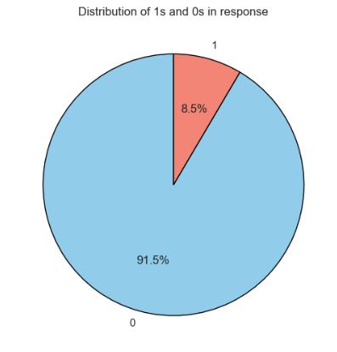
Data Distribution
Around 8.5% of the people in the dataset have diabetes and 91.5% of the entries are non-diabetic.

Slide 6
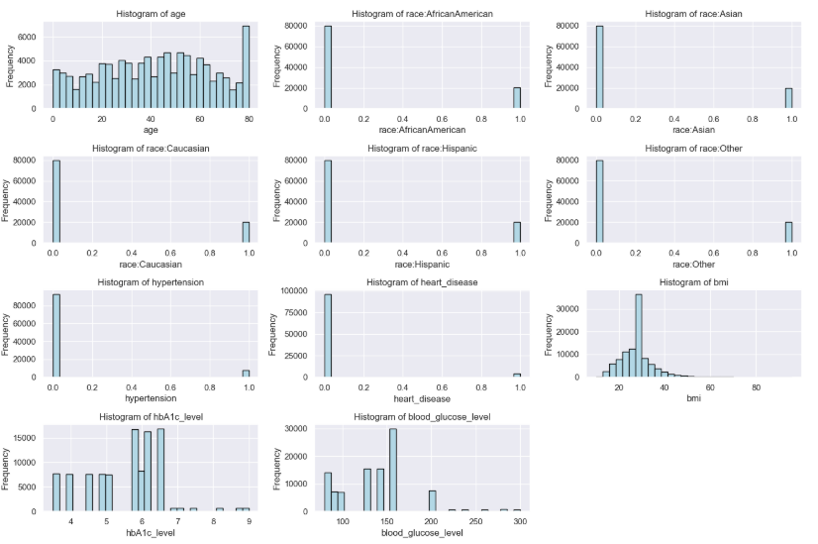
Data Preparation
Applied BoxCox Transformation and fit_transform() for cleaning the data for further analysis.

Slide 7
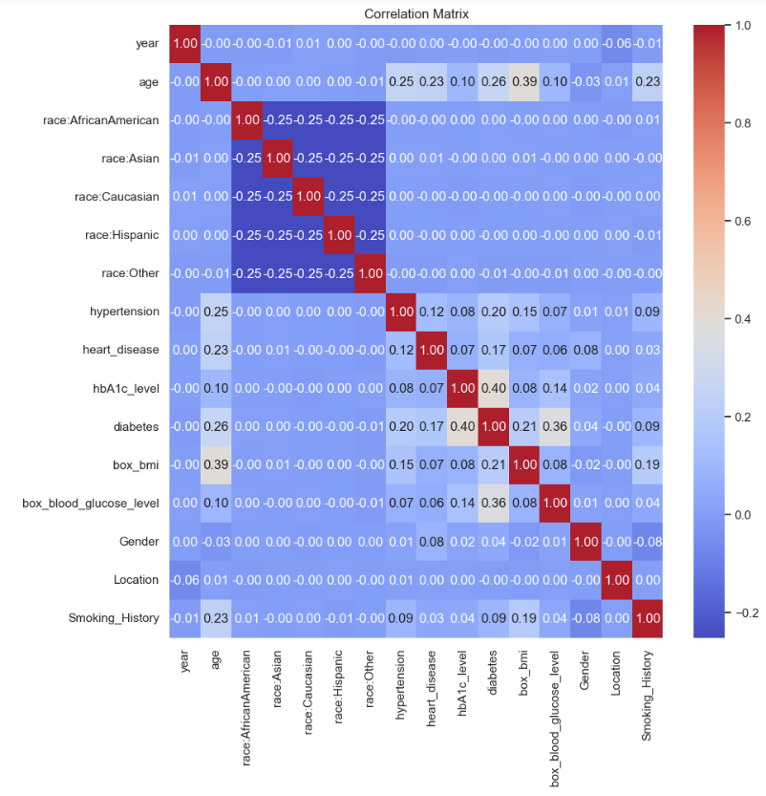
Correlation Matrix
It is clear that age, hypertension, heart_disease, hbA1c_level, box_blood_glucose_level, box_bmi, Smoking_History are the features which strong correlation with diabetes.
It is obvious to ignore the “race” features which proves that a person’s race is independent to diabetes.

Slide 8
Models Used
1. Logistic Regression
2. Neural Network
3. Decision Tree
4. Random Forest

Slide 9
Challenges
Challenge 1
Challenge 2
Challenge 3
The dataset had a significant class imbalance, with only 8.5% of individuals diagnosed with diabetes.
Metrics such as BMI, HbA1c levels, and blood glucose levels exhibited high skewness.
While models like Neural Networks and Random Forests provided high accuracy, their complexity made interpretability challenging
Solution 1
Solution 2
Solution 3
We applied the SMOTEENN technique (Synthetic Minority Oversampling Technique and Edited Nearest Neighbors) to address the class imbalance.
We applied boxcox transformation to ensure uniformity and stability across models.
We supplemented these models with simpler algorithms like Decision Trees, which provided clear decision rules and interpretable results
Notes:
Talking Points:
• Highlight the primary challenges faced during the project:
• Class Imbalance: “The dataset was highly imbalanced, with only 8.5% of entries representing diabetic individuals. This posed a significant challenge for the model, as it tended to favor the majority class.”
• Skewness in Key Features: “Metrics like BMI, HbA1c levels, and blood glucose levels exhibited high skewness, which could impact the stability of our models.”
• Model Complexity: “While Neural Networks and Random Forests provided high accuracy, their interpretability was a concern, especially for healthcare applications.”
•• “We applied the SMOTEENN technique to address class imbalance, ensuring our models could learn effectively from the data.”
• “Box-Cox transformation was used to reduce skewness, making the data more uniform for analysis.”
• “We supplemented complex models with simpler ones like Decision Trees, which offered interpretability and transparency in decision-making.”

Slide 10
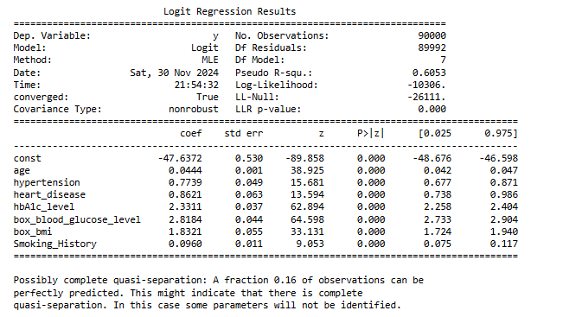
Key Findings
Logistic Regression
Notes:
Logistic Regression on the previously mentioned variables showed all the variables used are significant for the output
About 60% of the variance of the target variable is explained

Slide 11
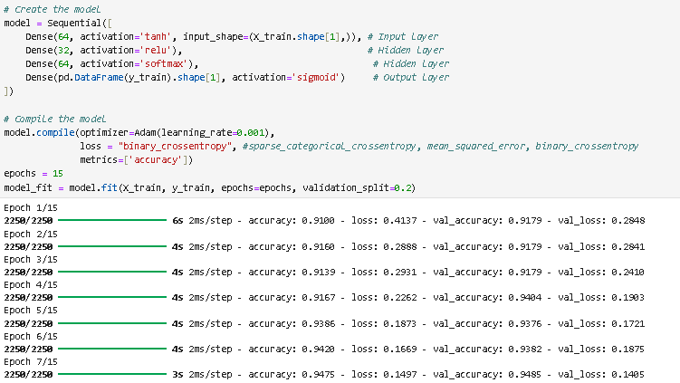
Neural Network
Notes:
The neural network required some fine tuning of the hyperparameters but finally this the model we finalized upon. This is a Neural network with 4 layers. Tanh for the input layer followed by reluand softmax hidden layers and a sigmoid output layer so that the outputs are probabilities.
We tried out a few loss functions but binary cross-entropy, which is also the most popular loss function for binary classification problems, worked best.
After 15 epochs we were noticing overfitting, as the validation loss was going up.

Slide 12
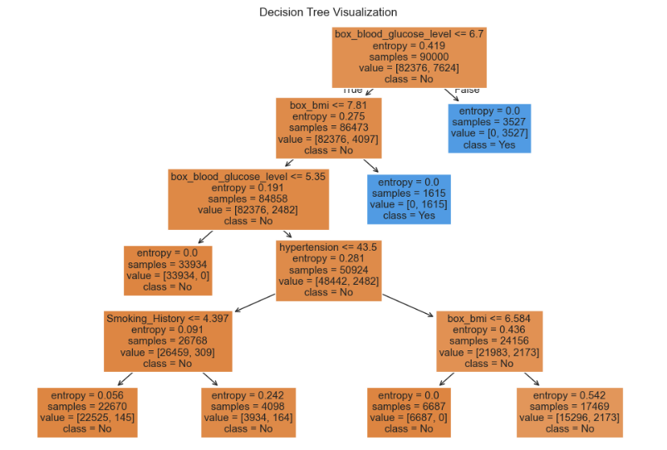
Decision Tree
Random Forest
RandomForestClassifier(max_depth=10, random_state=42)
Notes:
DT with max depth 5 to avoid overfitting
RF with max depth 10

Slide 13








Logistic Regression
Neural Network
Decision Tree
Random Forest
Without SMOTEENN:
Without SMOTEENN:
Without SMOTEENN:
Without SMOTEENN:
With SMOTEENN:
With SMOTEENN:
With SMOTEENN:
With SMOTEENN:
Insights:
Age, hypertension, and HbA1c levels have a strong association with diabetes diagnosis.
Insights:
Neural networks does not provide a great scope for interpretability of results because of being a BlackBox
Insights:
HbA1c level, bmi and blood glucose level were frequently selected by trees as important predictors.
Insights:
Ensemble approach enhanced robustness and reduced overfitting.
Notes:
Before applying oversampling, the models exhibited high accuracy; however, for this particular use case, our primary concern was minimizing the misclassification of true positives. In other words, we prioritized achieving strong recall values, as identifying individuals at risk of diabetes is critical for timely intervention.
As previously mentioned, the imbalance in the dataset led to a significant number of false negatives before oversampling. By implementing the SMOTEENN technique, we effectively addressed this issue. All models showed notable improvements in recall, with a substantial reduction in false negatives.
Among the models, the Random Forest achieved the best performance, with an impressive 96% accuracy and 96% recall, making it the most reliable for our use case.
The Neural Network was a close second in performance. With further fine-tuning of hyperparameters, its predictive potential could be enhanced even further, offering a promising avenue for future improvement.

Slide 14
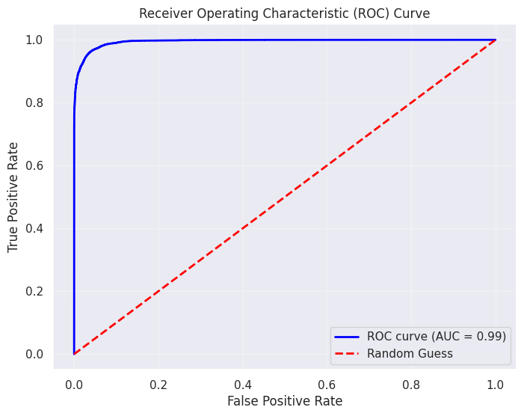
Impact and Value
High accuracy (96% with Random Forest) ensures reliable predictions for clinical use and the ability to generalize across diverse patient demographics enhances applicability.
Models can be scaled to analyze larger datasets across multiple regions or healthcare systems.
Provides a foundation for exploring other diseases using similar methodologies, expanding healthcare analytics.
Insights into key predictors like HbA1c levels and BMI allow for tailored healthcare plans. Encourages proactive management through lifestyle changes and regular monitoring.
Random Forest
Notes:
After analysing all the models we see random forest has the highest accuracy rate of 96% . We have also ploted the ROC curve and the Area under the curve value is 0.99. as the recall value is high we can say that there are less false negative. During the analysis we got to know abot the key predictors like HbA1c levels and blood glucose which were helpful in decision-making.

Slide 15
Key Takeaway
Comprehensive Analysis
Successfully identified key predictors of diabetes, such as HbA1c levels, blood glucose, and BMI.
Analyzed relationships between demographic and health factors to better understand diabetes prevalence.
Model Effectiveness
Achieved high accuracy and precision with models like Decision Tree and Random Forest.
Neural Network demonstrated strong capability in capturing non-linear relationships.
Impact
Insights support early detection and personalized healthcare interventions.
Provides actionable data for public health policies and healthcare planning.
Notes:
These are few key takeaways after completing the data analysis. As we started withe the business problem of diabetes prediction we would like to conclude that Models can be scaled to analyze larger datasets across multiple regions or healthcare systems. This also Provides a foundation for exploring other diseases using similar methodologies, expanding healthcare analytics.

Slide 16
Thank You
Presented By:
Dwaipayan Roy
Karthik Raj Sarpangala
Sucharita Naha
Anuj Garg

