Slide 1

Applied Internet of Things(CSE 2198) Project Presentation on IoT Car Parking System with Raspberry Pi & MQTT Integration
Presented by:
Sucharita Gorai(2241007031)
Ruchismita Bastia(2241002056)
Dibyajyoti Sahoo(2241019074)
Prem Kumar Khuntia(2241011061)
Supervisor:
Dr. Biswaranjan Swain
Department of Computer Science and Engineering (IOT)
Institute of Technical Education & Research (FET)
Siksha ‘O’ Anusandhan Deemed to be University, Bhubaneswar
May, 2024

Slide 2
Contents
Introduction
Literature Survey
Design Scheme
Testing, Analysis, And Evaluation
Socio-economic Issues Associated With The Project
Engineering Tools And Standards
Conclusion

Slide 3
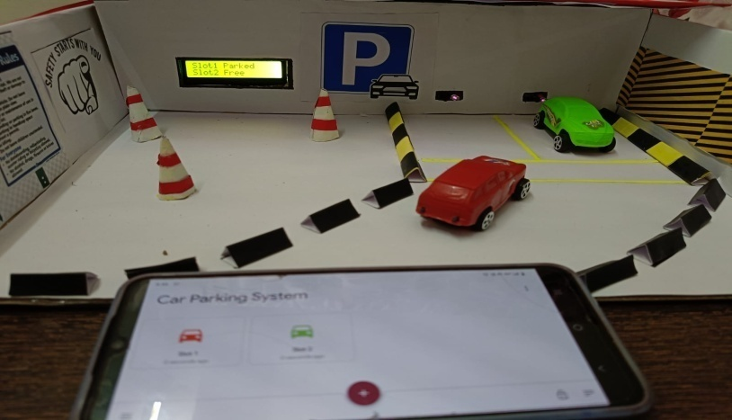
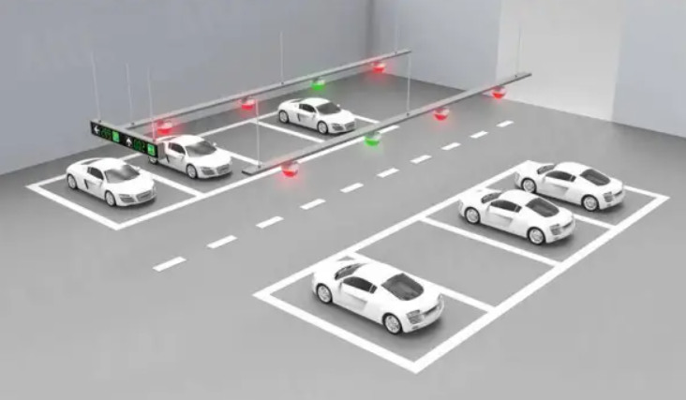
Introducing a smart parking system!!!
Nowadays, people face a lot of parking problems. It's frustrating to drive around endlessly, searching for a spot, especially in busy areas.
But what if there was a solution that could make finding parking a breeze? That's where our IoT Car Parking System with Raspberry Pi & MQTT Integration comes in.
This innovative system is designed to tackle parking issues head-on, offering a seamless solution that benefits both drivers and parking lot owners.
Let's dive into how this system works and how it can transform the parking experience for everyone involved.

Slide 4
Literature Survey
Implemented in the car parking that can help to improve the process of finding a vacant parking space which becomes troublesome for most of the car users.
It has been used to detect the presence of persons, whenever they enter into a particular zone to control the room’s lights.
In 2017, the system is designed for traffic jam detection, and the idea is to count the direction of the car wisely.
This system has been created to avoid the dustbin to overflow by a message, indicating that the trash bin is almost filled up using this concept.
Also by using this concept, sensor detects any movement at the home as the camera module turned on and captured the picture of the person in front of the entrance of a house.

Slide 5
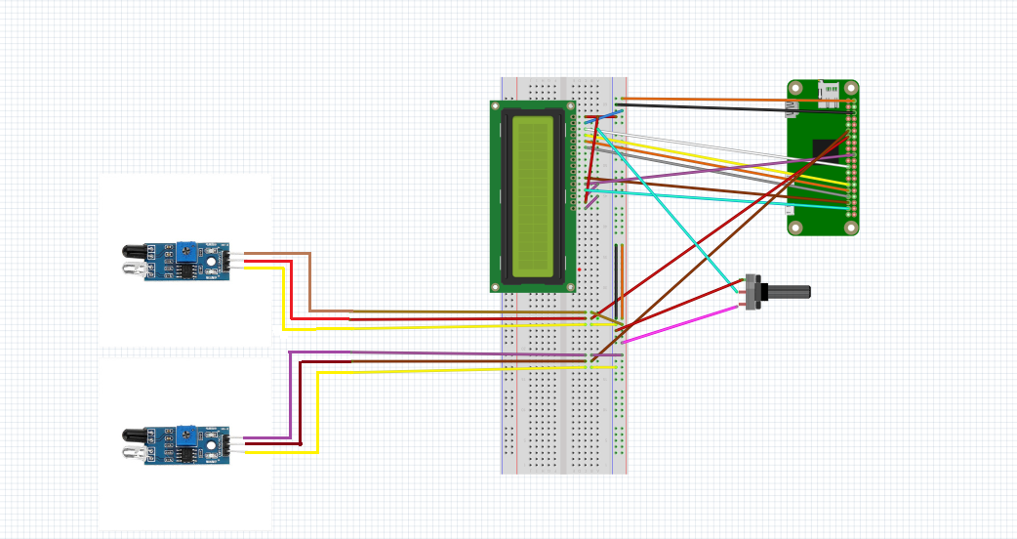
Design Scheme
Circuit Diagram:
16x2 LCD Display
IR sensor 1
Raspberry PI Zero 2W
Potentiometer
IR sensor 2
Breadboard

Slide 6
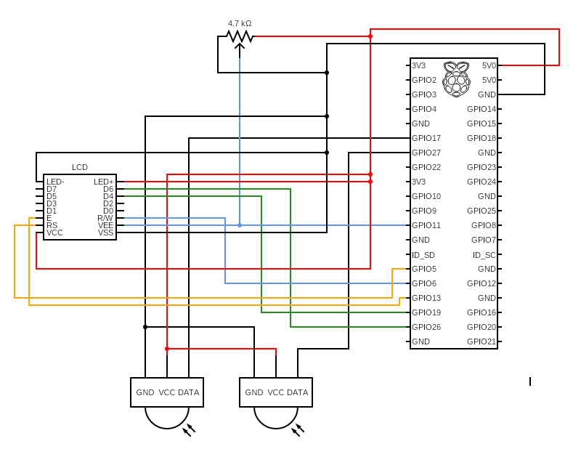
Design Scheme
Block Diagram:

Slide 7
Testing (Breadboard Implementation)
Implementing an IoT-based car parking system using MQTT on a breadboard involves several steps:
Gather Components:
- Raspberry Pi (with Wi-Fi capabilities)
- IR sensors
- LEDs or LCD display for indicating parking spot status
- Breadboard and jumper wires for prototyping
Connect IR Sensors:
- Wire the VCC pin of the ultrasonic sensor to the 5V pin on the Raspberry Pi.
- Connect the GND pin of the IR sensor to the ground (GND) pin on the Raspberry Pi.
- Connect the out pin of the IR sensor to the GPIO pin on the Raspberry Pi.
Connect LCD Display(BOARD connection):
- LCD_RS = 37
- LCD_E = 35
- LCD_D4 = 33
- LCD_D5 = 31
- LCD_D6 = 29
- LCD_D7 = 23

Slide 8
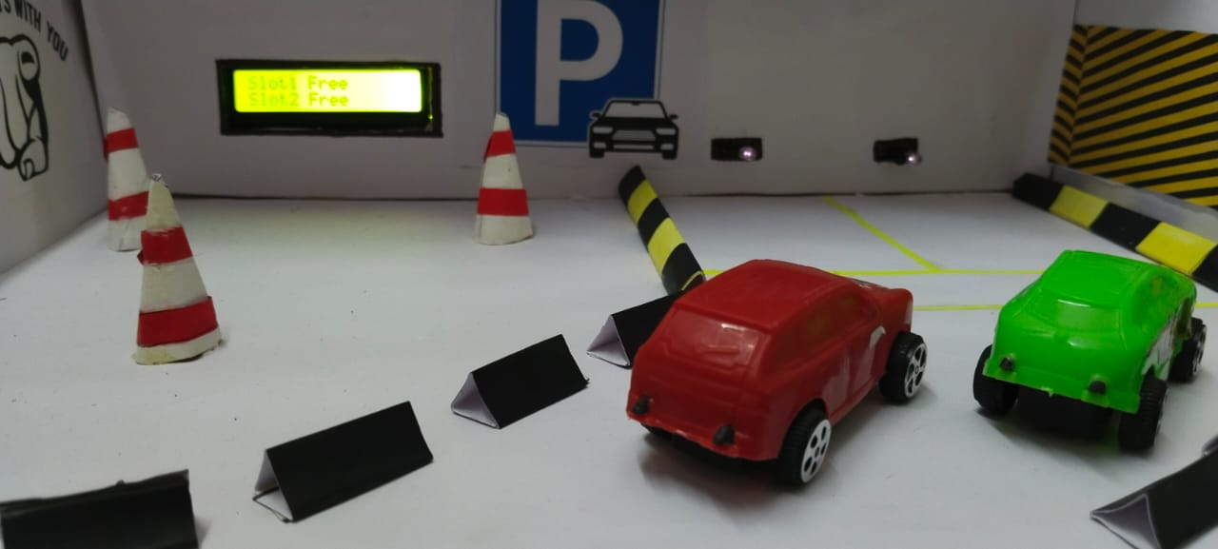
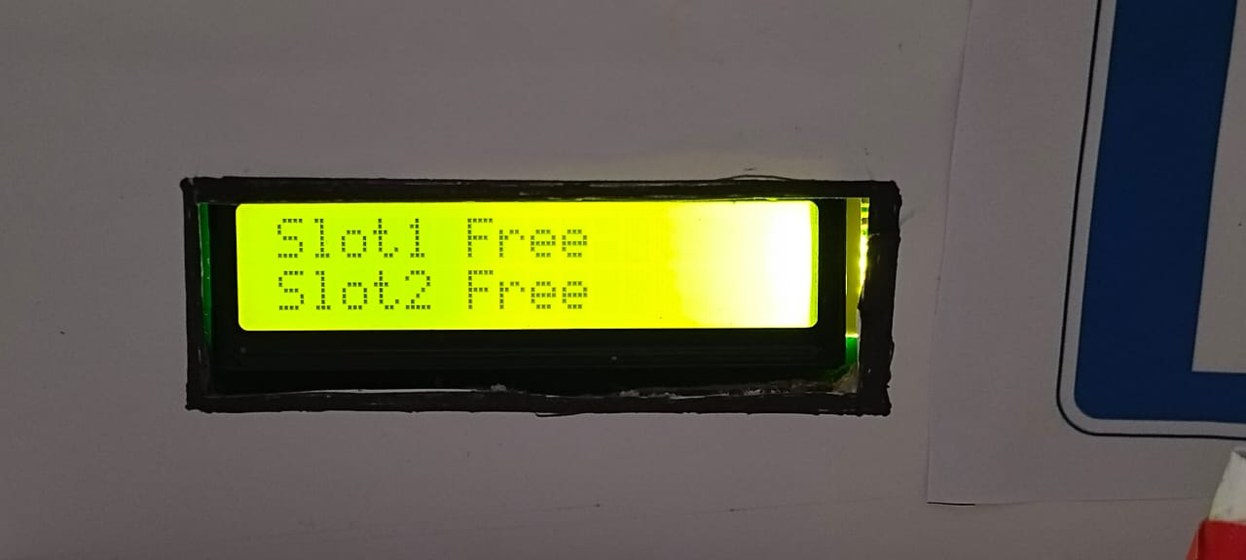
Results, Analysis and Evaluation
Stage 1: When there is no car in the parking area IR sensor signals that the parking slot is free.

Slide 9
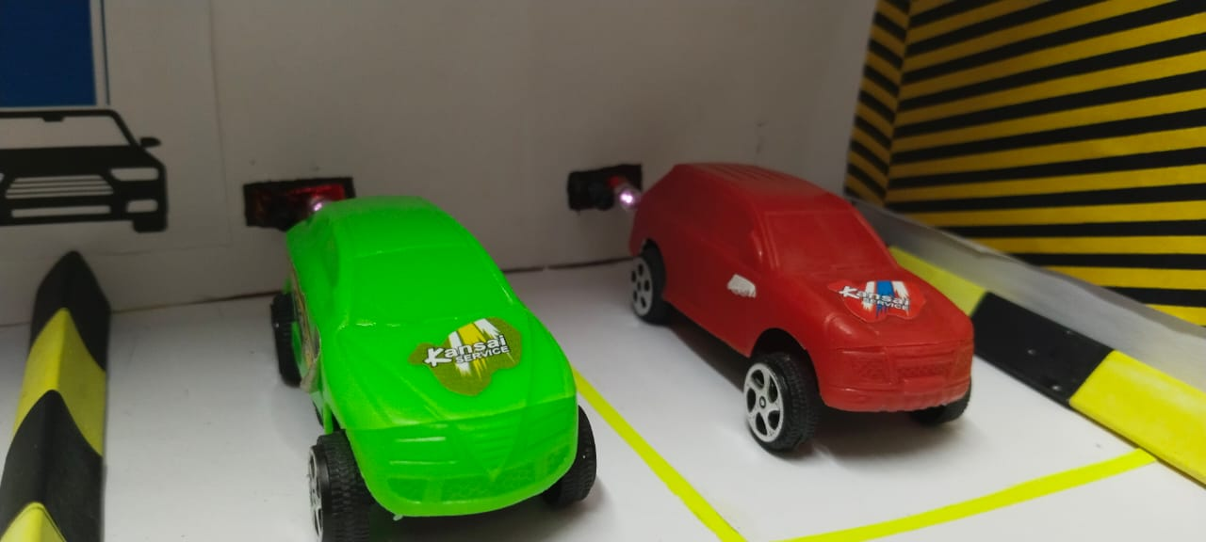
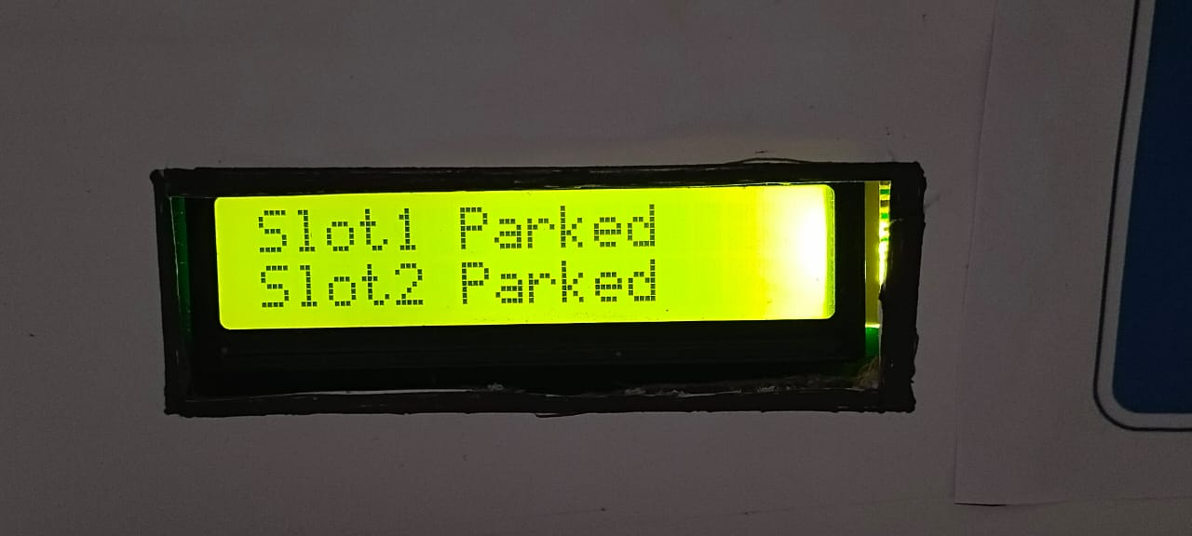
Results, Analysis and Evaluation
Stage 2: When car enters the parking area IR sensor that is present before the car, the sensor turns on signalling that the parking slot is occupied.

Slide 10
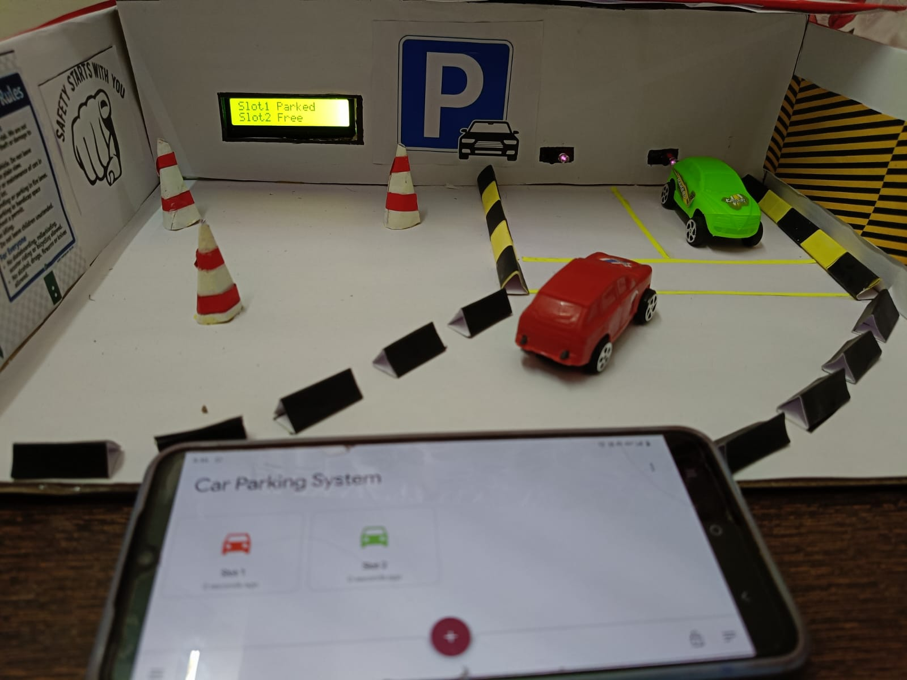
Results, Analysis and Evaluation
Stage 3: When car is parked or not, then the MQTT(Message Queuing Telemetry Transport) dashboard on the mobile phone shows the slot is already is occupied or not.

Slide 11
Socio-economic Issues Associated With The Project
In this presentation slide we will explore the socioeconomic issues surrounding smart parking systems.
Smart parking utilizes technology to manage parking availability and pricing, offering potential benefits like efficiency and reduced congestion.
However, it's crucial to acknowledge that these systems can also create challenges, particularly regarding social equity and economic accessibility.
Cities must address issues like the digital divide, potential cost increases for low-income residents, the impact on small businesses, and privacy concerns.
By ensuring equitable access, transparent data practices, and collaboration with stakeholders, smart parking systems can be a valuable tool for creating a more efficient and equitable urban transportation landscape.

Slide 12
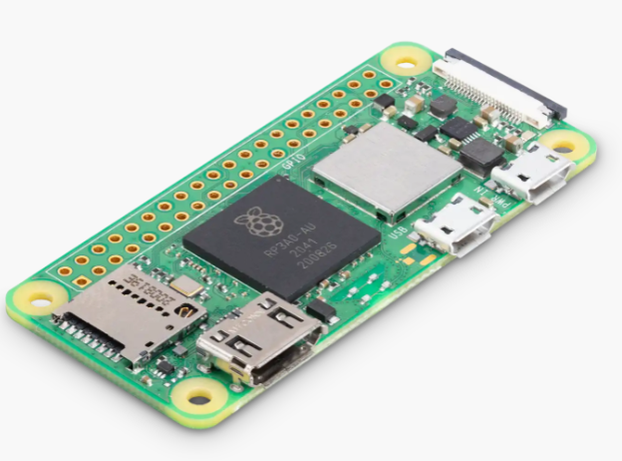
Engineering Tools And Standards
In this project we have used some engineering tools such as:
Raspberry Pi Zero 2W:
The Raspberry Pi Zero 2 W is a tiny but powerful single-board computer released by the Raspberry Pi Foundation.
It's the successor to the original Raspberry Pi Zero W and is designed to be even more compact while providing improved performance.

Slide 13
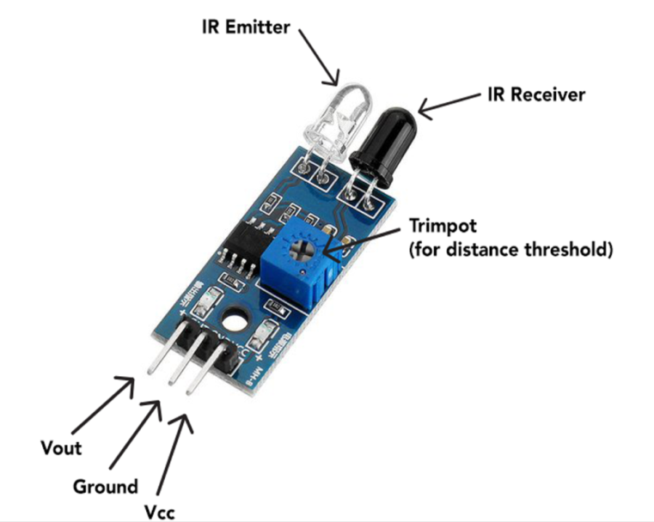
Engineering Tools And Standards:
- IR Sensor:
An IR (Infrared) sensor is a device that detects infrared radiation in its surrounding environment.
It's commonly used in various applications such as remote controls, motion detectors, proximity sensors, and even in industrial automation.
IR sensors work by detecting changes in the intensity of infrared radiation emitted by objects.

Slide 14
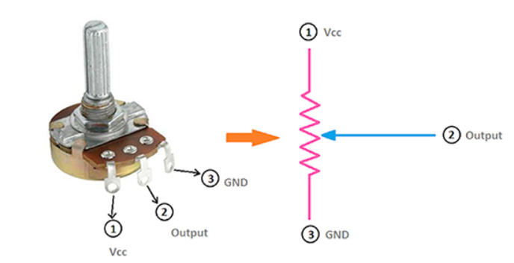
Engineering Tools And Standards:
Potentiometer:
A potentiometer, often abbreviated as "pot," is a type of variable resistor that allows you to manually adjust the resistance along a continuous range by turning a knob or slider.
It's a common electronic component used for various purposes, such as controlling the volume on audio equipment, adjusting the brightness of a display, or tuning circuits in electronic devices.

Slide 15
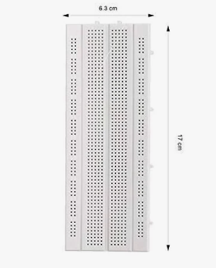
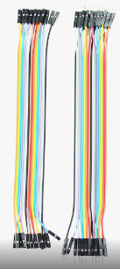
Engineering Tools And Standards:
Breadboard:
- Breadboard is a fundamental tool used in
electronics prototyping and experimentation.
- It provides a way to build and test electronic circuits
without soldering, allowing for easy assembly and
modification of circuits.
Wires:
Wires are essential components in electronics that
conduct electrical signals or power between various
components within a circuit.
In this project we have used male to male and male to
female wires for connectivity in the circuit.

Slide 16
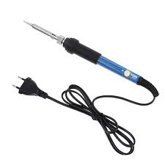

Engineering Tools And Standards:
Soldering iron:
It helps us soldering the metal pins in the motherboard.
Raspberry pi imager:
It plays a vital role in installing the OS in the raspberry pi 02W motherboard.
Real VNC:
It provides us the software environment which provides us programming platform like THONNY, where we are initiating our program.

Slide 17
Engineering Tools And Standards:
- Standards and Guidelines:
ISO 16787:2016 - This standard sets minimum functionality requirements for Assisted Parking Systems (APS) in light-duty vehicles, such as passenger cars, pick-up trucks, and SUVs.
ISO 7000:3027 – This standard identifies the control or indicator for a parking assistance system.

Slide 18
Conclusion
When smart parking solutions come in use, riders will witness a fall in traffic congestion.
Once the rider reaches their chosen parking spot, The parking smart phone app will then navigate the driver into their selected parking space.
With the rise of connected devices, IoT-based smart parking systems are becoming more and more popular.
These parking systems empower drivers with advanced information about available parking slots.
The smart parking system also allows drivers to use the space remotely via their smart phones, which is convenient if drivers prefer not to walk to find a space or avoid potential traffic congestion.

Slide 19
References
https://www.youtube.com/watch?v=w-9ddDrOlew
https://www.youtube.com/watch?v=azCb5Zj76UQ
Raspberry Pi Cookbook , Author:- Simon Monk
Title: "Smart Parking System using Raspberry Pi and IR Sensors"
Authors: Shashank Vishwakarma, Rahul Kumar, and Tanya Srivastava

Slide 20


Slide 21


