Slide 1
Superstore Sales & Profit Dashboard
An interactive Power BI dashboard for business insights
Sucharitha Chintala
Data Analyst Internship
June 2025

Slide 2
Dashboard Objective & Dataset
Objective:
Create an interactive dashboard for analyzing sales and profit trends using Power BI.
Dataset:
Name: Superstore.csv
Source: Kaggle
Fields: Order Date, Sales, Profit, Category, Region, Segment, State, etc.

Slide 3
KPIs and Dashboard Features
KPIs Used:
Total Sales
Total Profit
Number of Orders
Dashboard Features:
Time-series trend analysis
Bar charts for category/region analysis
Interactive slicers (Year, Region, Segment)
Summary cards
Clean, consistent layout

Slide 4
Key Insights from the Dashboard
Sales peaked during Q4 in most years.
'Technology' category yielded the highest profit.
'West' region recorded the highest total sales.
Consumer segment generated the most orders.

Slide 5
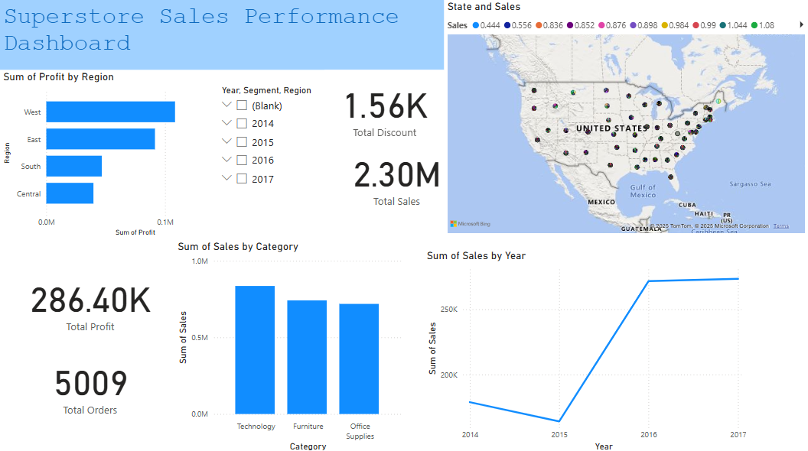
Dashboard Preview

