Slide 1

BIRLA VISHVAKARMA MAHAVIDYALAYA (An Autonomous Institution) Information Technology Department AY: 2022 -23 4IT33 – Major Project Final Presentation

Slide 2
PROJECT TITLE:
Q&A BASED BOT APPLICATION
NAME : SATHAVARA SUCHI
ID NO : 19IT402
GROUP NUMBER : G1
Faculty Guide: Prof.Prachi Shah
Industry Guide: Janki Patel

Slide 3
Key Points
Brief Summary
Objectives
Scope
Modules
Tech Stack
Tools
Diagrams
Implementation

Slide 4
BRIEF SUMMARY
Q&A bot application is type of application that will allow employees to get information about things like purchase order, po line, unit wise prices, total cost, activity status, amount of quantity just by entering their query.
Employees have to register themselves to use the functionality of the system and the approval will be provided to them by the admin.

Slide 5
OBJECTIVE
To be able to answer for following subjects of questions:
Purchase Order Information(PO Line, PO seq etc.)
Supplier Information
Pending order Information
Timing for particular order
Pending & require Quantity

Slide 6
Shipment Information
Subcontract Information
Total Amount of business with particular client

Slide 7
SCOPE
This application will reduce much of manual work which will affect timeframe.
This application is beneficial for the employees who wants to track and manage their work.
This application provides detailed information about purchase as well as shipment orders so that will help to make future partnership with only consistent dealers.

Slide 8
MODULES
1. Module: MODEL
1.1 Database Management Module
Collect, import and load the data files,
To get the server data into one - same type of format
Pre Processing of data:
Remove duplicates, Find and fill the missing value.
Create knowledge base.

Slide 9
MODULE-2
1.2. Query Management Module:
Make structured query script
Record queries entered by user
1.3. Intent and Response:
Contain JSON file with intents, patterns (questions) and the responses for each intent
All the questions in the file were tokenized (only monograms)

Slide 10
MODULE-3
2. Integration Module:
The ability to integrate with external data sources such as databases, APIs, or application to provide more comprehensive answers.
3. Employee Module:
Employees will get access to use android application for Q&A. Which will have following features:
1. Login
2. Registration
3. Bot Page

Slide 11
MODULE-4
4. Admin Web Panel:
SignIn
To use the functionalities, admin have to login first.
Approval to the employees
A web panel for admin which will give approval to the employees.
Manage employee account
Perform operation like creating, deleting and updating employee’s account.
Able to see queries entered by employee.

Slide 12
TECH-STACK
Java ( Mobile Application )
ReactJS ( Front End – Web App )
Python ( Back End )
SQL ( Database )

Slide 13
Tools:
PyCharm
Postman
MSSMS
Visual Studio code
Android Studio
Pythonanywhere

Slide 14
DIAGRAMS:
Diagrams

Slide 15
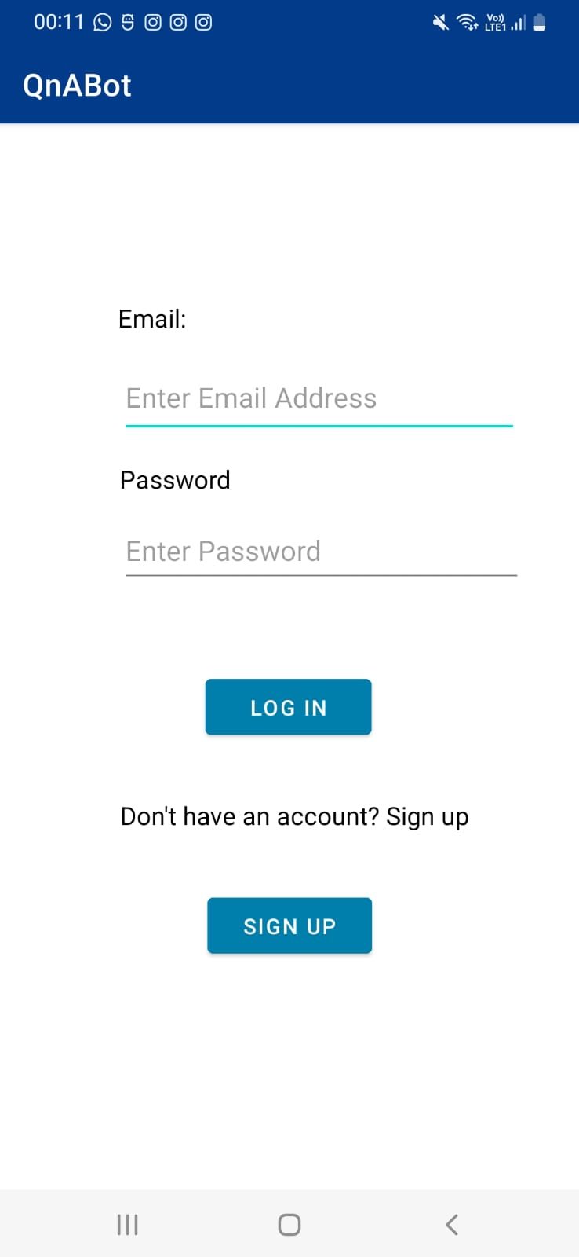
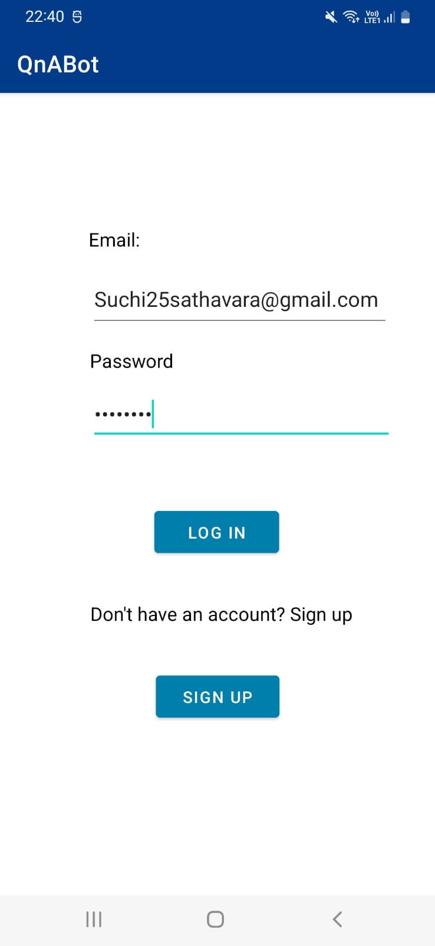
Implementation:

Slide 16
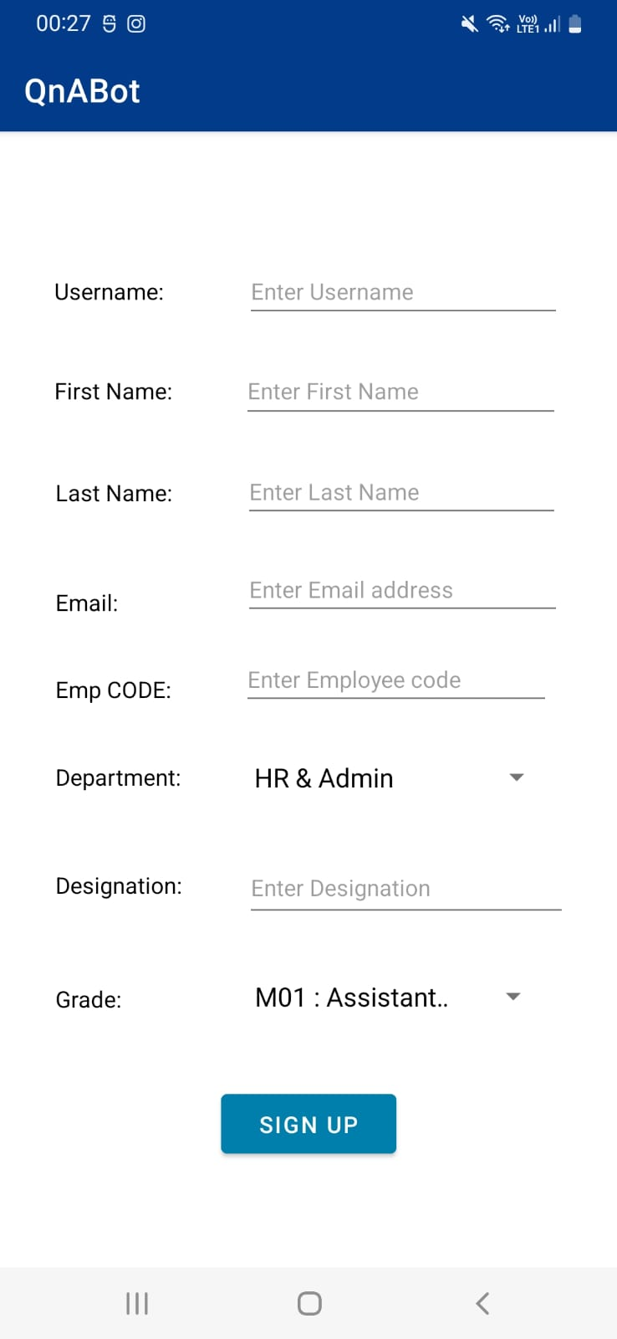
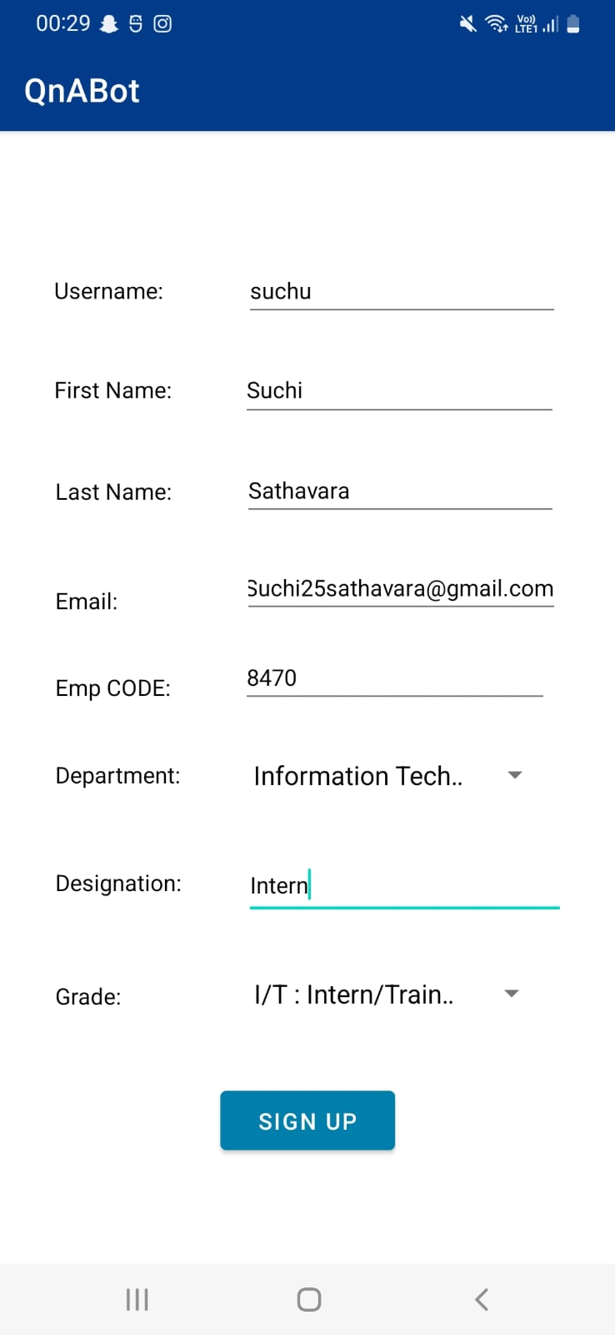
Sign-up:

Slide 17
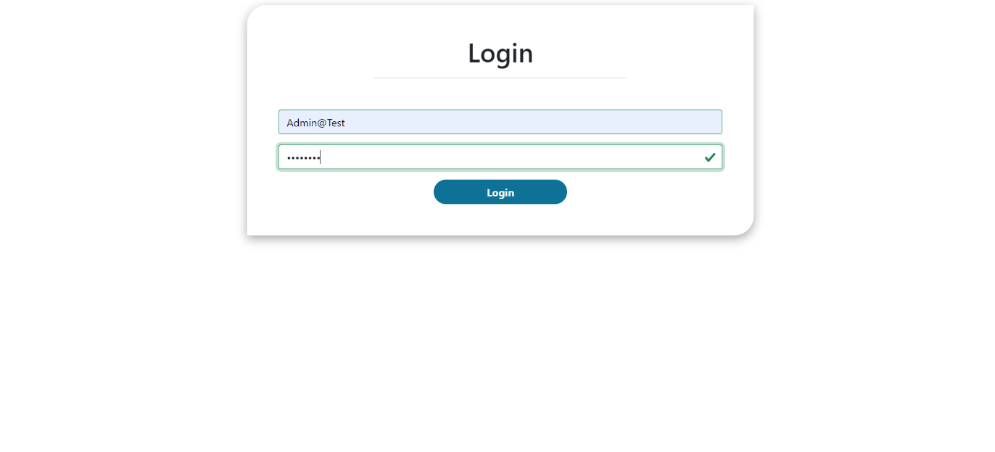
Admin Panel-1:

Slide 18
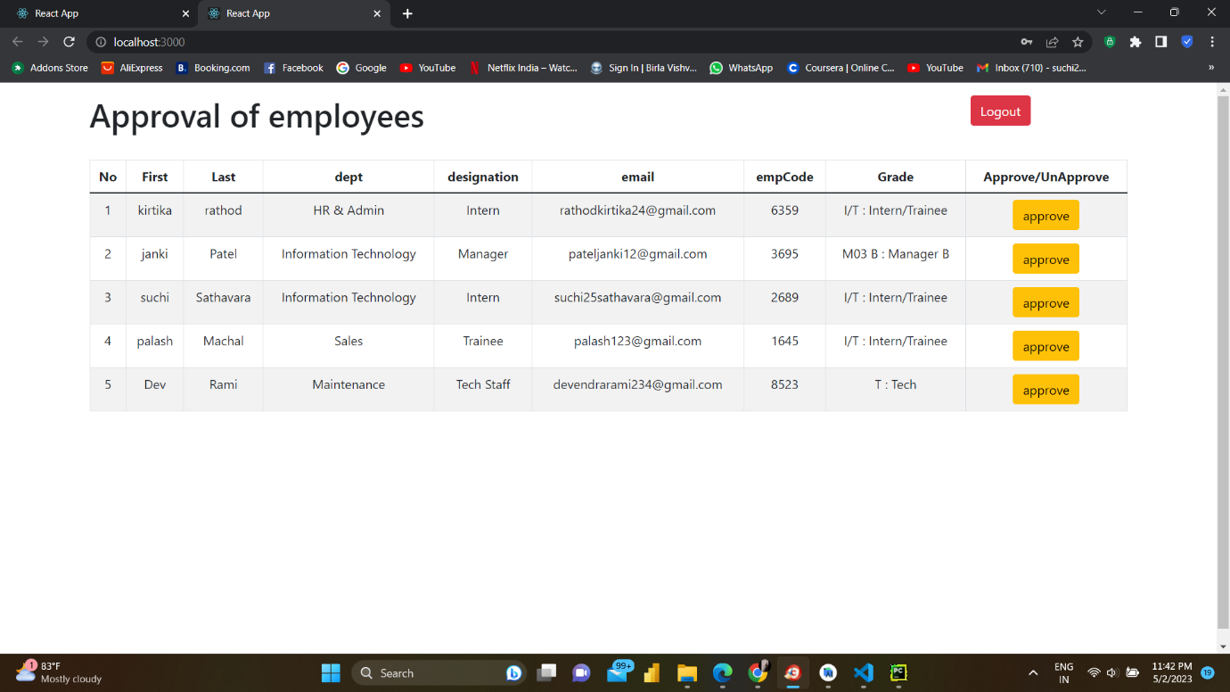
Admin Panel-2:

Slide 19
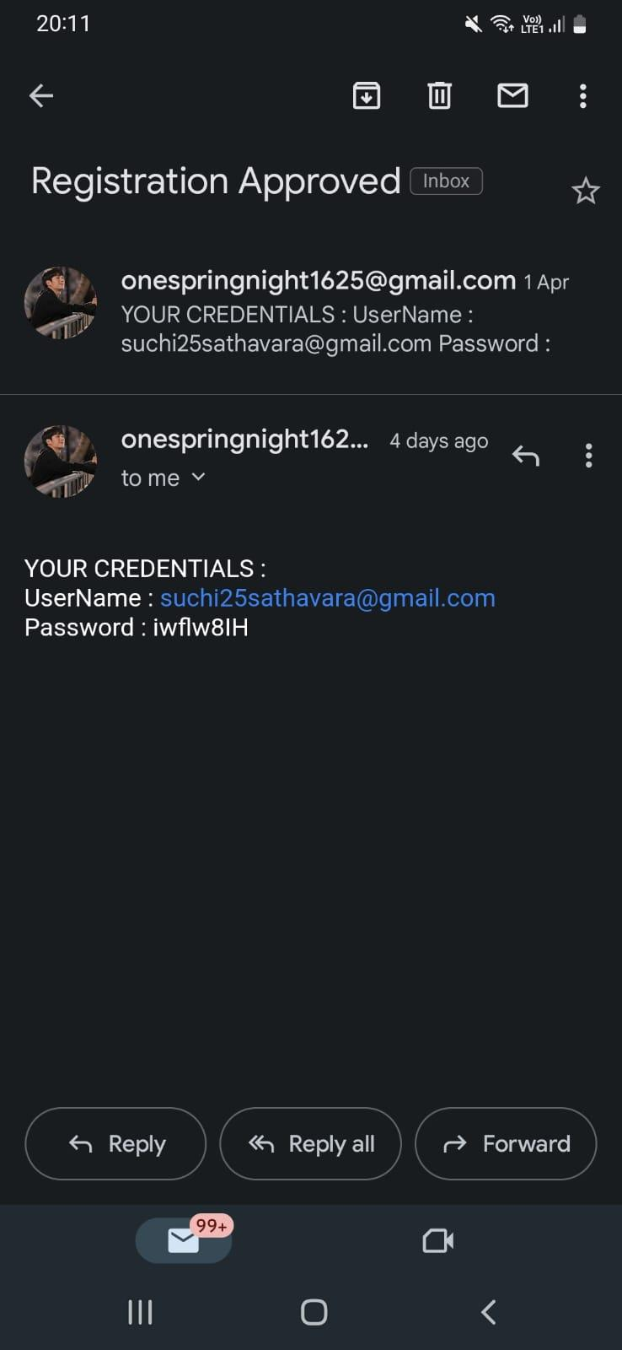
Approval:

Slide 20
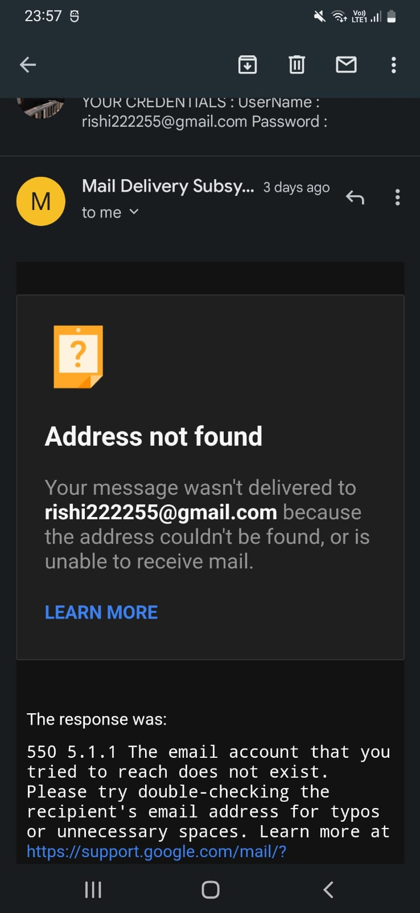
Email Authentication:

Slide 21
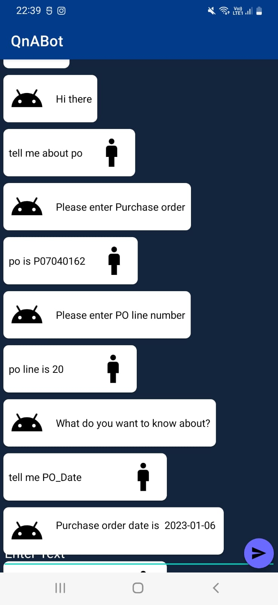
QnA Bot:

Slide 22
Conclusion:
Q & A bot application is type of application that will allow employees to get information about things like purchase order, po line, unit wise prices, total cost, activity status, amount of quantity just by entering their query. In which employees have to register themselves to use the functionality of the system and the approval will be provided to them by the admin.

Slide 23


