Slide 1
Urbanization in G20 members
An International study on urbanization in big economies
-- Xiaoxue Chang, Margaret Furr, Yirong Jing, Andrew Lightner
Institute of Data Science, University of Virginia
August, 2014

Slide 2
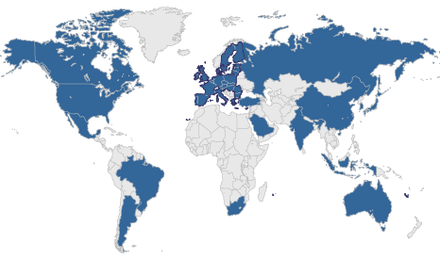
Who are G20 members?
G20: nineteen countries plus European Union
19 countries: Australia, Brazil, Canada, China, France, Germany, India, Indonesia, Italy, Japan, Republic of Korea, Mexico, Russian Federation, Saudi Arabia, South Africa, Turkey, United Kingdom, and the United States
Importance in global economy:
90% of the global economy
80% of global trade
66% of the world population
85% of fossil fuel emissions

Slide 3

Data
Source: World Bank World Development Indicators database
World Bank: United Nations international financial institution
Time: 2010
Notes:
World Bank maintains a large data base of economic statistics and we used a subset under the category of World Development Indicators.
Right after this slide, show data structure via firefox

Slide 4
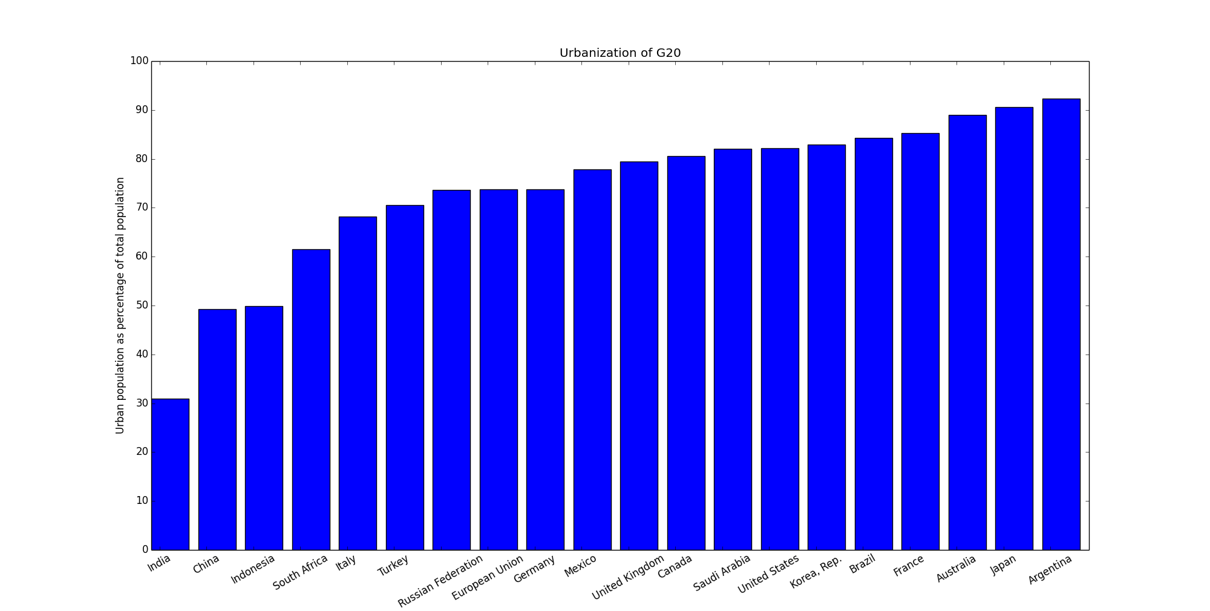
Overlook on urbanization data

Slide 5
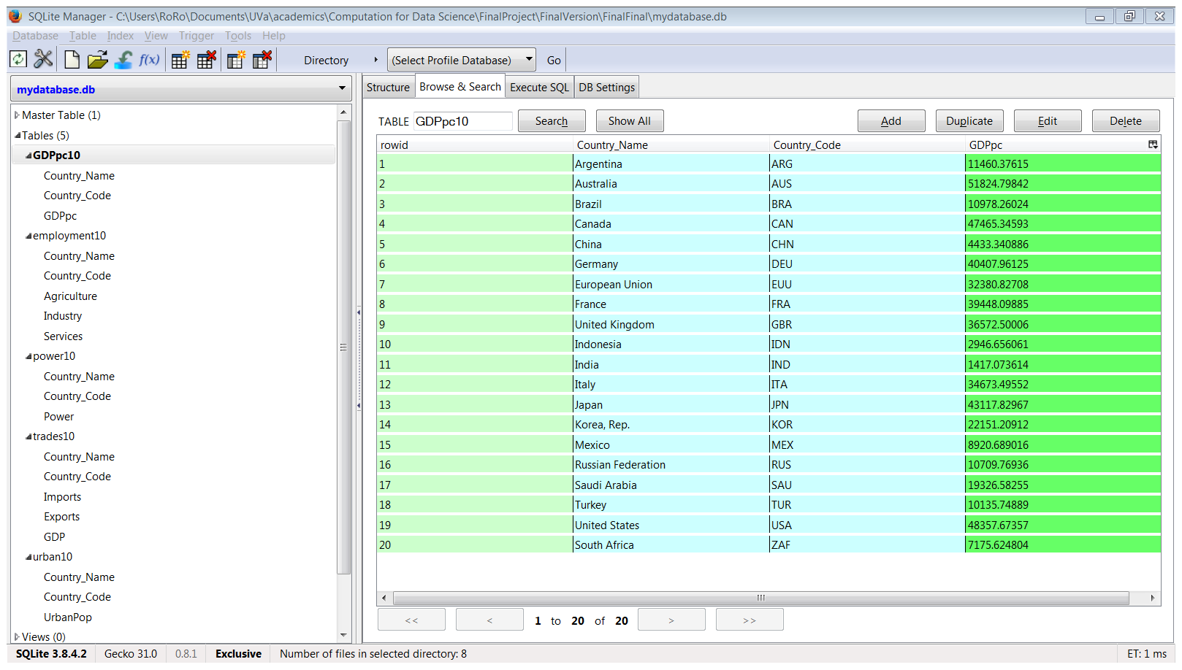
Database

Slide 6
Four Questions
Urbanization versus economic development
Urbanization versus labor structure
Urbanization versus power consumption
Urbanization versus trade openness

Slide 7
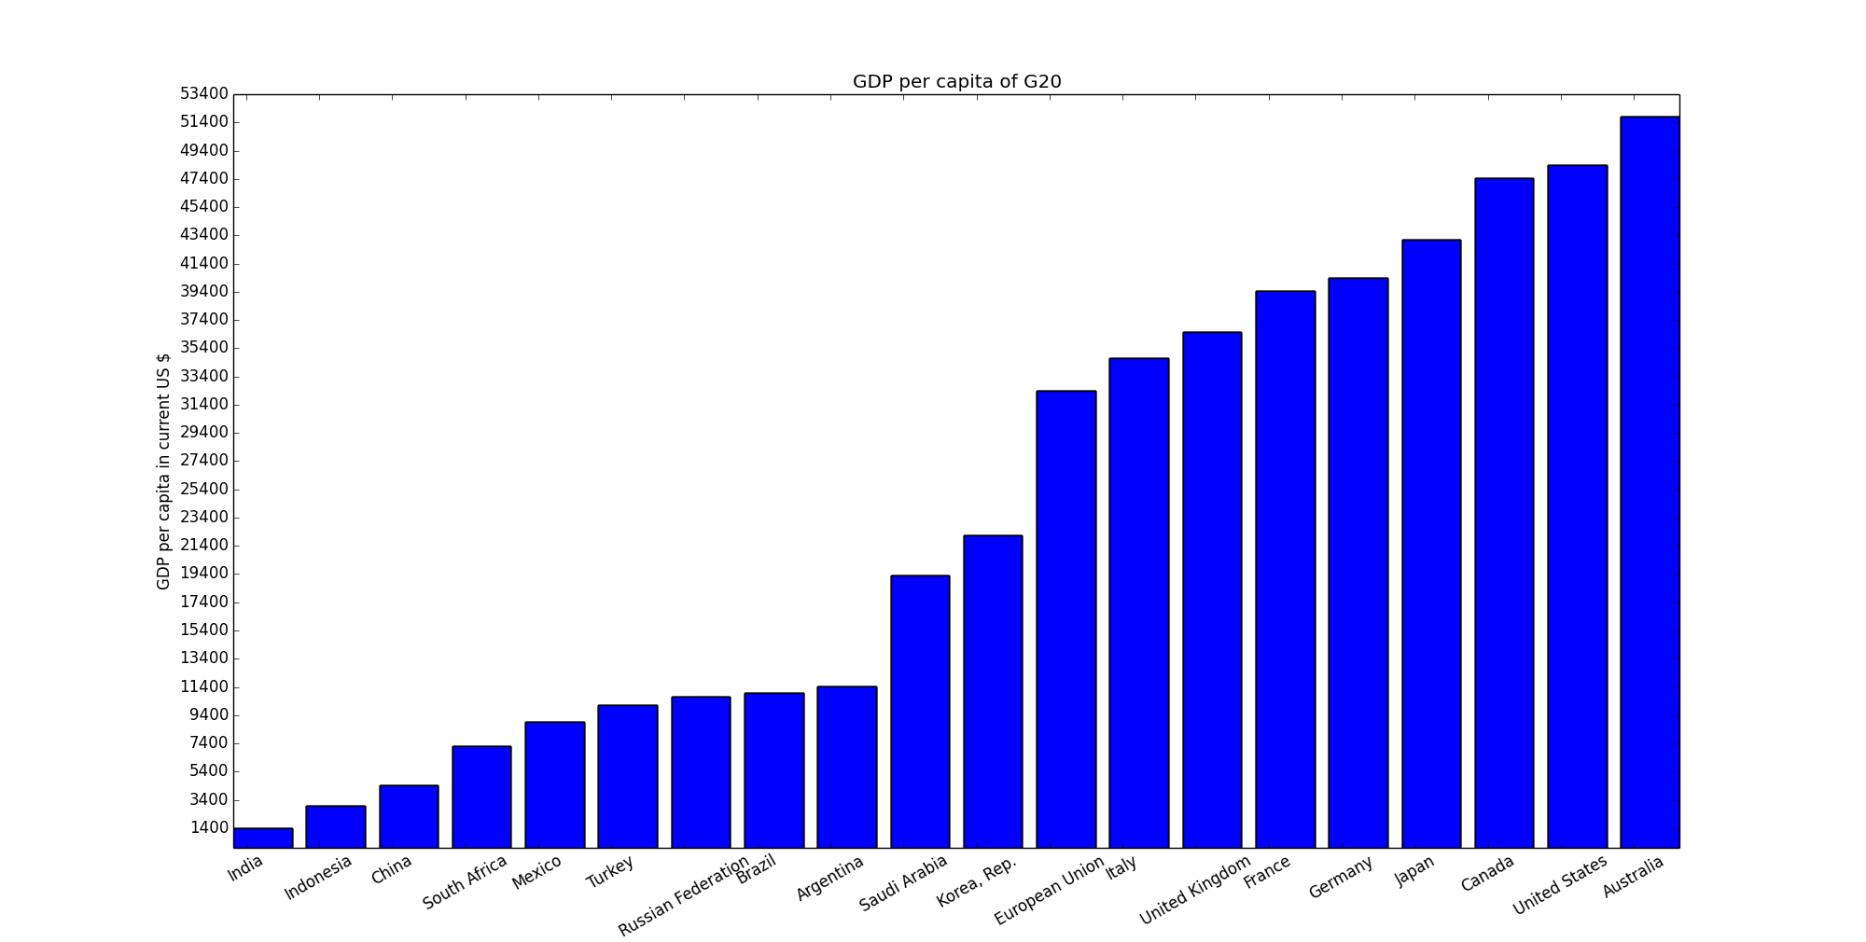
Query #1.1: GDP per capita by group
bottom
top
Notes:
World bank classifies the economic development by GNI, while UN ….
No data for GNI
Saudi Arabia: fuel exporting country

Slide 8
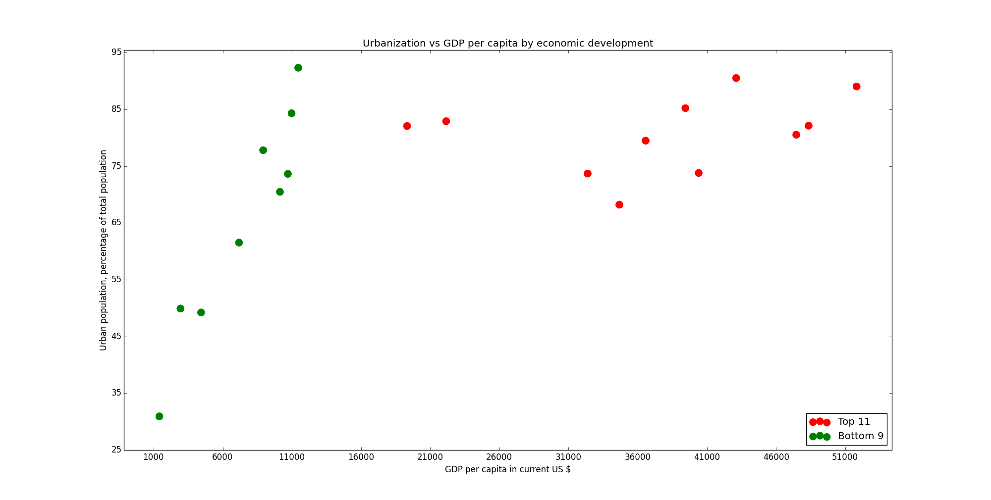
Query #1.2: Versus GDP per capita
Urbanization speeds up

Slide 9
SQL code
Combine tables
create table urbanpc10 as select * from urban10 natural join GDP
Bot9 table
create table bot9 as
select Country_Name, urbanPop, GDPpc from urbanpc10
order by GDPpc ASC
limit 9
Top11 data
select Country_Name, urbanPop, GDPpc from urbanpc10
except
select Country_Name, urbanPop, GDPpc from bot9

Slide 10
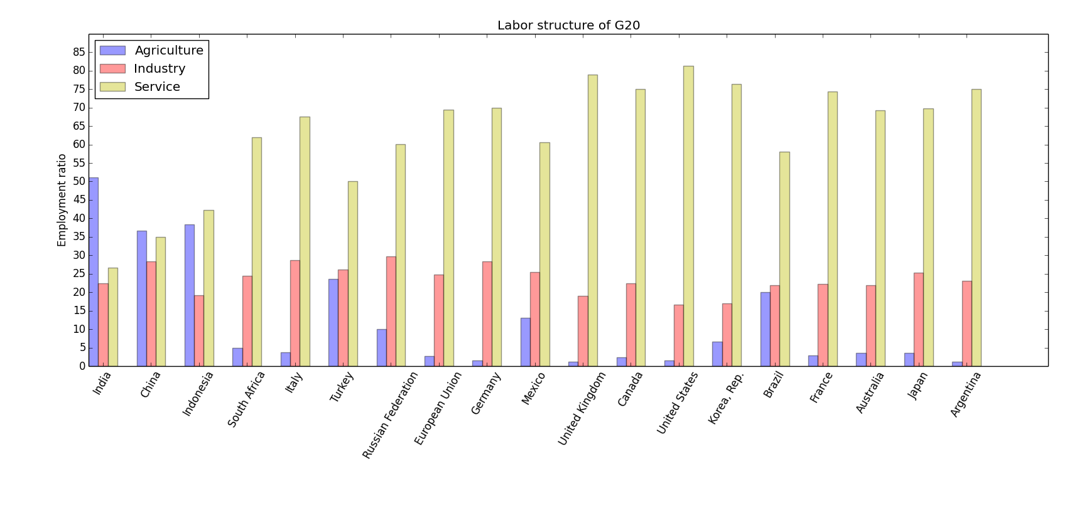
Query #2: Labor structure of G20
As we can see in the bar chart, the more urbanized countries will have more labor working in the industry and service sector
Although Brazil is the fifth urbanized country of G20, it still have a relatively higher employment ratio in agriculture sector.

Slide 11
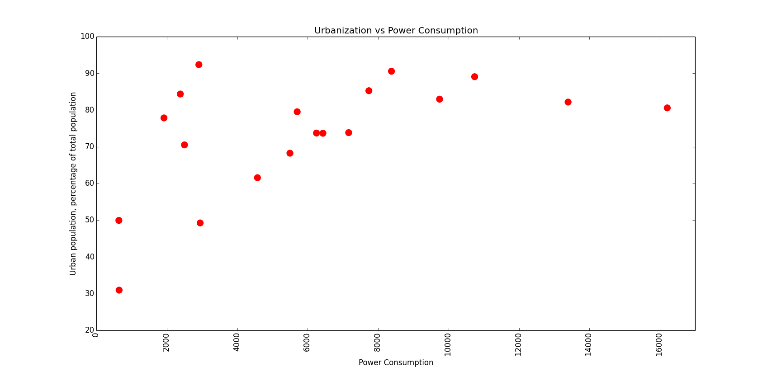
Query #3 Urbanization VS Power Consumption
Basically, there is a positive relationship between urbanization and Power Consumption.
However, there are two outliers:
Canada and
United States
US
Canada

Slide 12
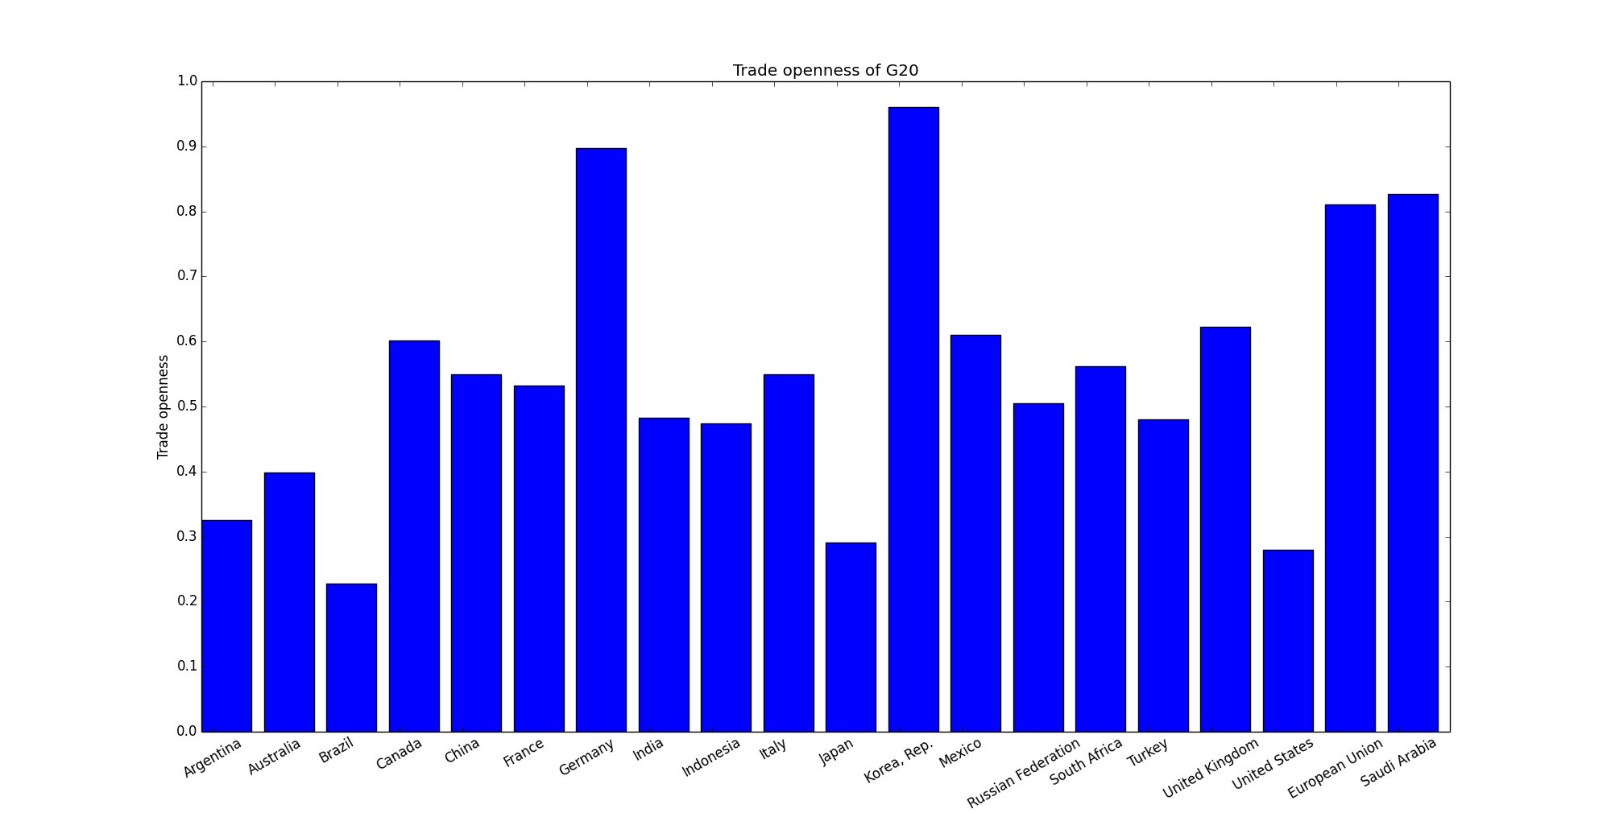

Query #4. 1: trade openness index
$$trade openness index$$
$$=\frac{exports+imports}{GDP}$$
Notes:
Saudi Arabia: fuel exporting country

Slide 13
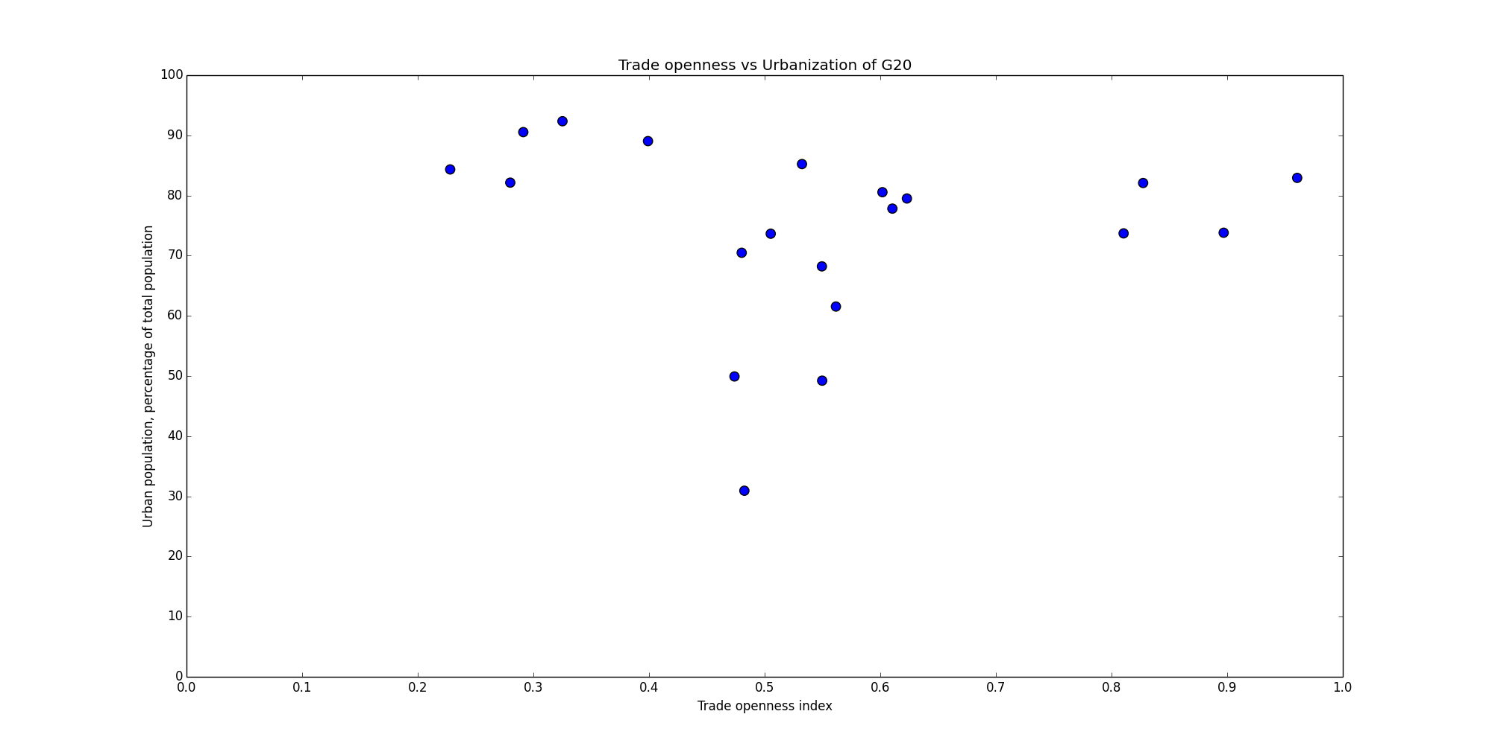
Query #4 Versus trade openness
Trade openness:
Mid-level
Low urbanization
Low- and high-levels
High urbanization

Slide 14
Conclusions
High Urbanization does show stronger economic development
High Urbanization does lead to a labor structure heavy in service employment
High urbanization does show more power usage
Higher urbanization is associated with either highly closed or highly closed economies

Slide 15
References
[1] “G20 Members | G20 2014,” Australia 2014, 2014. [Online]. Available: https://www.g20.org/about_g20/g20_members. [Accessed: 10-Aug-2014].
[2] “What We Do,” The World Bank, 2014. [Online]. Available: http://www.worldbank.org/en/about/what-we-do. [Accessed: 10-Aug-2014].
[3] “Indicators | Data,” The World Bank, 2014. [Online]. Available: http://data.worldbank.org/indicator. [Accessed: 10-Aug-2014].
[4] “Lump together and like it,” The Economist, 06-Nov-2008.
[5] “Population Distribution, Urbanization,Internal Migration and Development:An International Perspective,” in The United Nations, United Nations Publication, 2011.

