Slide 1
Aware
the smarter employee survey

Slide 2
Team
Steven Babitch - Presidential Innovation Fellow Mentor
Margaret Furr
Neil Martis
Lyndsey Newsome

Slide 3


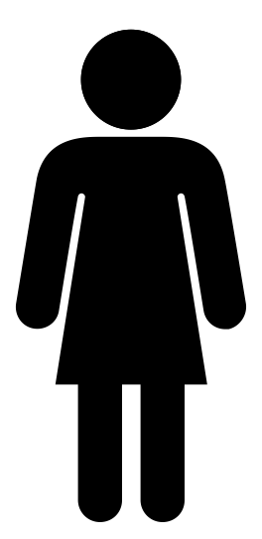

Slide 4
Did you know?
Women are paid just 79 cents for every dollar a man is paid.
African-American and Latina women are paid just 60 and
55 cents for every dollar.
Women are overrepresented in the lowest wage professions.

Slide 5


40 percent
of the pay gap cannot be explained by controlling for factors
Unconscious bias
Motherhood penalty
Negotiation skills
Company culture
Transparency
Industry sector
Race

Slide 6




Market
57 companies have already signed the White House Pledge.
These companies pledge to conduct an annual analysis of the gender pay gap to eliminate inequitable compensation.

Slide 7


Problem
?
!
!
!
!
Yet companies do not know what information related to the gender gap to collect from employees.
Companies may not have an incentive to do something with the insights gleaned from the data on the pay gap.

Slide 8
Solution
Aware
the smarter employee survey
Aware is essentially a survey application, and in the long term, will evolve into a data analytics platform that will help companies better understand their employees as well as provide new ways of measuring a company’s capital based on how fairly they pay and treat employees/
As a third, intermediary party our goal is to improve the employee-employer relationship.

Slide 9
Solution
Aware
the smarter employee survey
Aware also plans to have an experience around the app that allows companies determine how to translate insights from data into policies and programs.
Included on the app, in the long term, Aware will have an engine that recommends policies and steps to employers based on contextual information regarding the political environment and successful steps that other companies have taken.

Slide 10



Metric
Sample Questions
How satisfied are you with the level of gender equality at your company?
How happy are you about your current job?
How satisfied are you with the amount of diversity at your company?
How confident are you when networking within your company?
How challenged are you in your current position?
How fair do you think your current salary is?
Salary/Industry/Education
Fair Pay Metric
“JUST Capital” (See Non-Profit in NYC)

Slide 11
Data Used
Aware is currently operating through data that will exist once a survey function is implemented.
Aware is collecting the data through a service that is similar to other employee-employer engagement applications, but is novel because of the metric that will be constructed and the service that is entirely for solving the gender pay gap.
External APIs, primarily the MIDAAS API will be used.

Slide 12
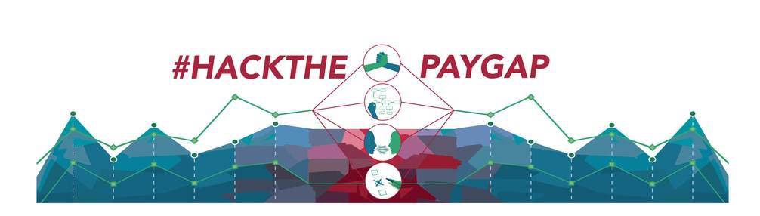
Join Us in Hacking the Pay Gap
Twitter: @AwareAppUSA
Email: awareappusa@gmail.com
Read about us: https://medium.com/presidential-innovation-fellows/how-we-hacked-the-gender-pay-gap-1d7a9304950
Notes:
Why work with Aware? We help companies be more in tune with its employees needs and how best to take action.

Slide 13
Thank You
"Perhaps the most impactful use of HR analytics is how data can be used to influence top leaders…When armed with facts that are clear and actionable, decision makers will be able to tackle pinpointed organizational issues, and use resources appropriately.”
-Anne Loehr
“We shouldn’t think of a technology as radical or transformative unless it benefits every single person.”
-D. J. Patil, Chief Data Scientist, Office of Science and Technology Policy, White House
Notes:
Why work with Aware? We help companies be more in tune with its employees needs and how best to take action.

