Slide 1

Sentiment Analysis of X (Twitter) Data
ShadowFox Data Science Internship Project — NLP + Machine Learning classifying tweets as Positive, Neutral, Negative. Logistic Regression: 85.57% accuracy. Naive Bayes: 70.45%.

Slide 2

Abstract & Objectives
Abstract
Objectives
EDA, word clouds, and ML models used to analyze sentiment patterns in ~162,969 tweets.
Classify tweets into Positive, Neutral, Negative; extract insights; compare ML algorithms.

Slide 3
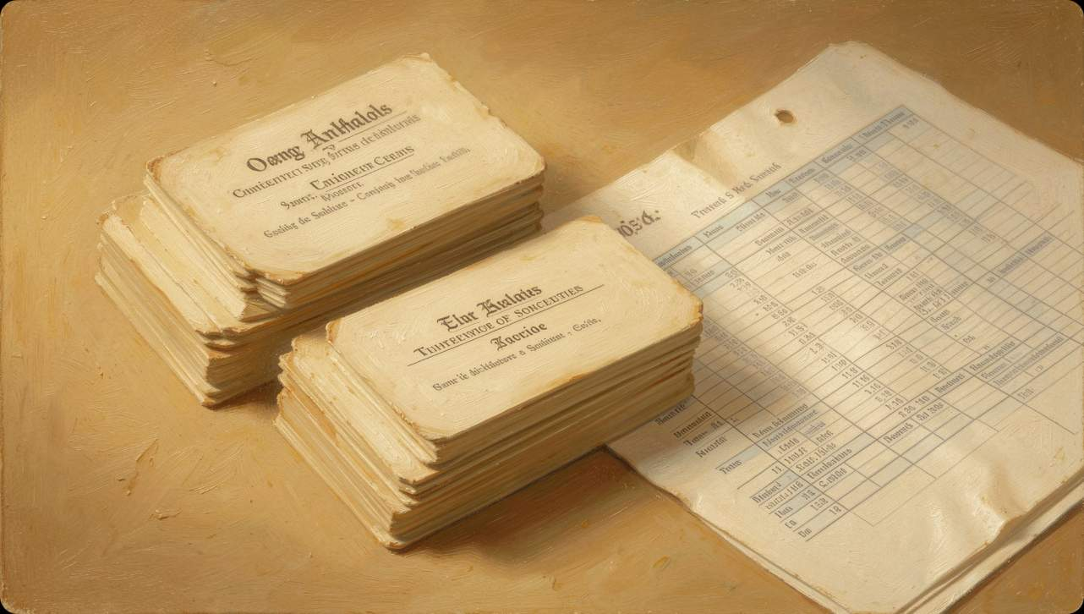
Dataset Overview
Key Facts
~162,969 tweets collected from X (Twitter).
Features: clean_text (preprocessed), category (label).
Labels: -1 = Negative, 0 = Neutral, 1 = Positive.

Slide 4
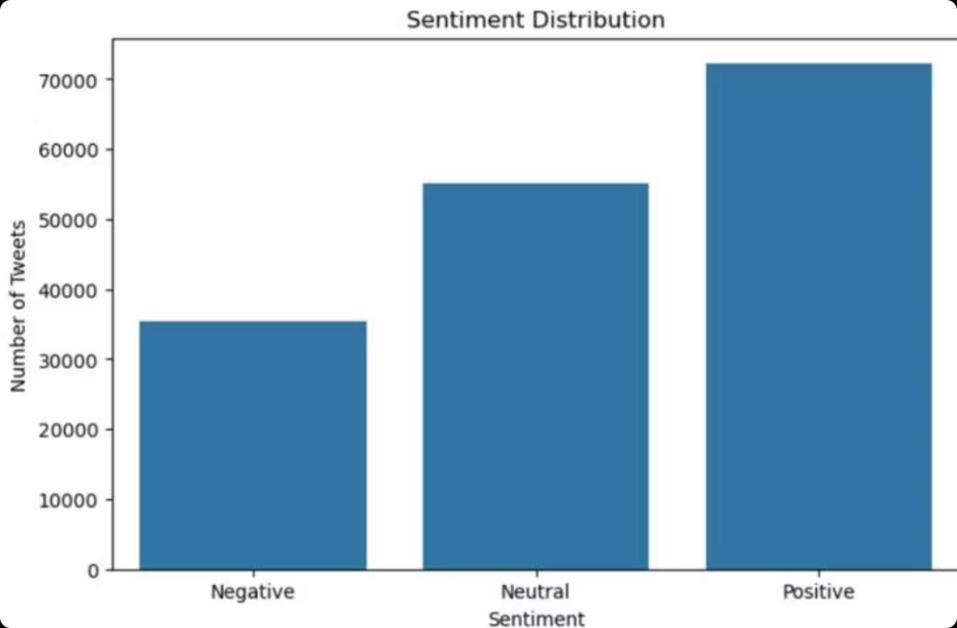
EDA — Sentiment Distribution
Distribution shows Positive as largest group (~72,000), Neutral (~55,000), Negative (~35,000). Overall trend: majority positive sentiment.

Slide 5
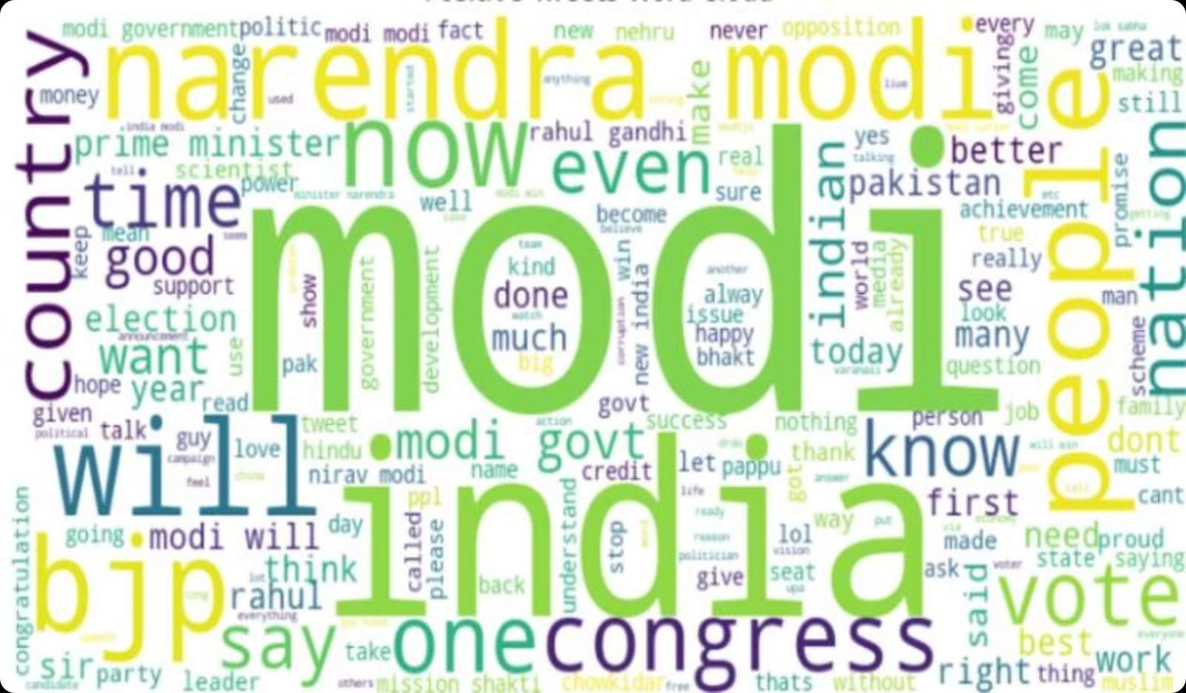
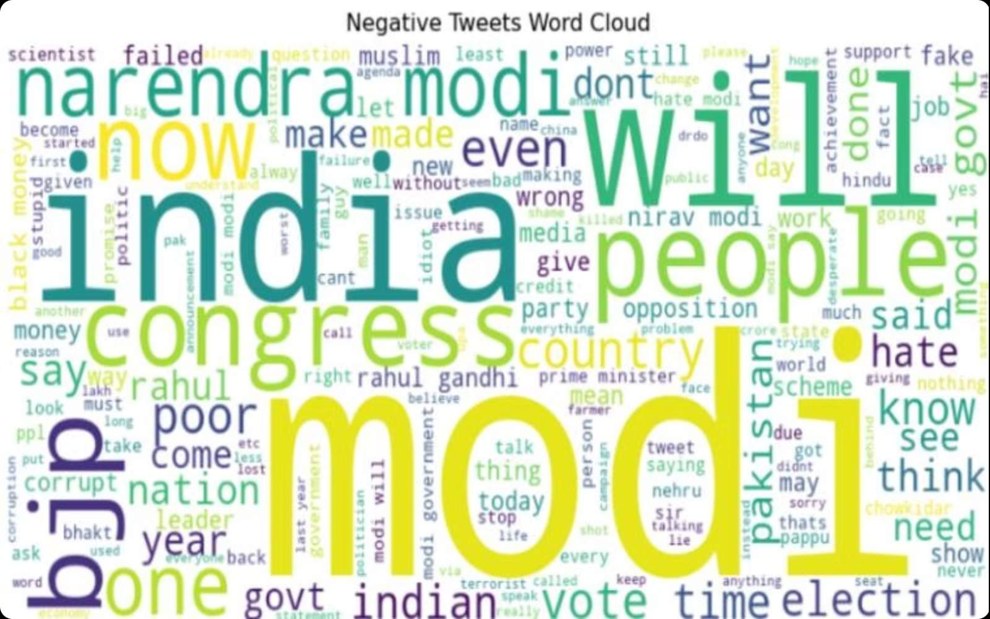
Word Cloud Insights
Positive tweets highlight political and governance terms: Modi, India, BJP, Congress, vote.
Negative tweets also center on political topics: Modi, India, Congress, corrupt, poor, hate.

Slide 6
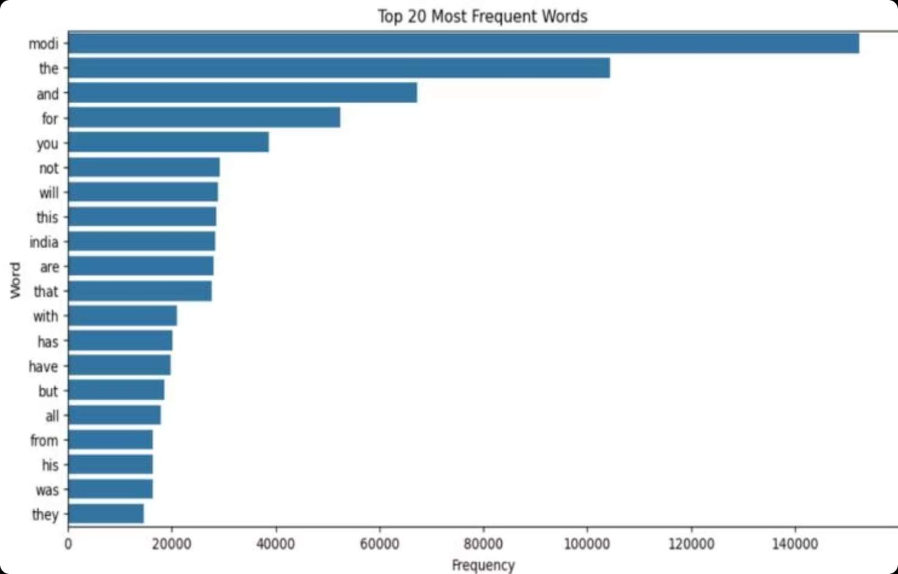
Top 20 Frequent Words
Highlights
'modi' is by far the most frequent term (~150,000).
Other common tokens: the, and, for, you, india — indicating political focus.

Slide 7

Feature Engineering — TF‑IDF
TF‑IDF Vectorization
Transforms text to numeric vectors, emphasizes meaningful words and downweighs common tokens.
Feature Space
Limited to top 5,000 most relevant terms to reduce dimensionality and noise.

Slide 8



Models Trained
Logistic Regression
Widely used for text classification on sparse, high-dimensional data.
Accuracy: 85.57%
Naive Bayes
Probabilistic baseline commonly used in sentiment tasks.
Accuracy: 70.45%

Slide 9
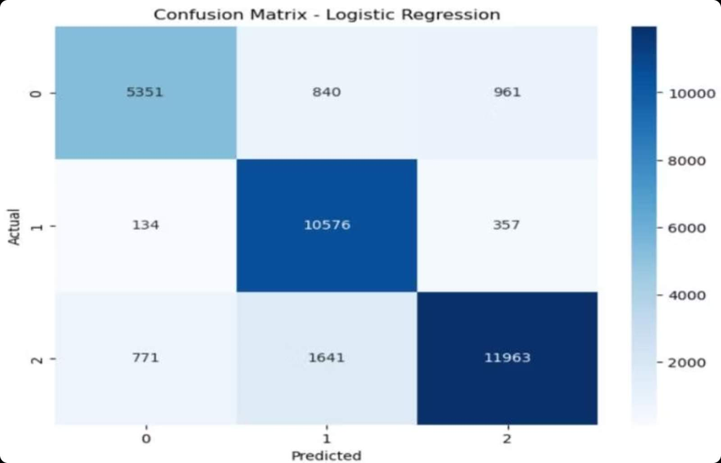
Evaluation Details
Logistic Regression — Confusion Matrix
Shows true vs predicted across 3 classes. Notable cells: 10,576 correct Neutral and 11,963 correct Positive predictions.
Classification Report (LR)
Negative: P 0.86 / R 0.75 / F1 0.80. Neutral: P 0.81 / R 0.96 / F1 0.88. Positive: P 0.90 / R 0.83 / F1 0.87.

Slide 10

Conclusions & Future Scope
Conclusions
Future Directions
Positive sentiment dominated. Political topics drive conversations. TF‑IDF + Logistic Regression delivered best results (85.57%).
Real‑time sentiment pipelines, deep learning (LSTM/GRU/BERT), multilingual models, hashtag/emoji analysis, interactive dashboards.

