Slide 1
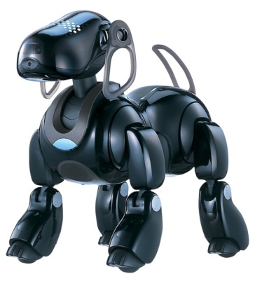

Interpolation
Prof. Noah Snavely
CS1114
http://www.cs.cornell.edu/courses/cs1114

Slide 2
Administrivia
Assignment 3 due tomorrow by 5pm
  Please sign up for a demo slot
Assignment 4 will be posted tomorrow evening
Quiz 3 next Thursday

Slide 3

Today: back to images
This photo is too small:
Might need this for forensics:
  http://www.youtube.com/watch?v=3uoM5kfZIQ0

Slide 4

Zooming
First consider a black and white image
(one intensity value per pixel)
We want to blow it up to poster size (say, zoom in by a factor of 16)
First try: repeat each row 16 times, then repeat each column 16 times

Slide 5
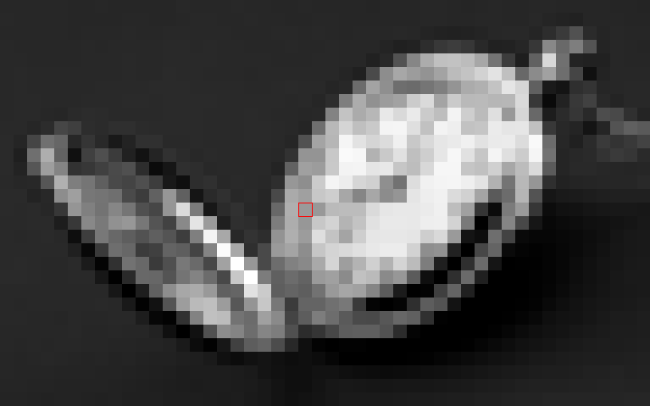
Zooming: First attempt

Slide 6
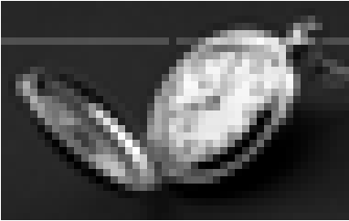
Interpolation
That didn’t work so well
We need a better way to find the in between values
Let’s consider one horizontal slice through the image (one scanline)

Slide 7
Interpolation
Problem statement:
We are given the values of a function f at a few locations, e.g., f(1), f(2), f(3), …
Want to find the rest of the values
  What is f(1.5)?
This is called interpolation
We need some kind of model that predicts how the function behaves

Slide 8
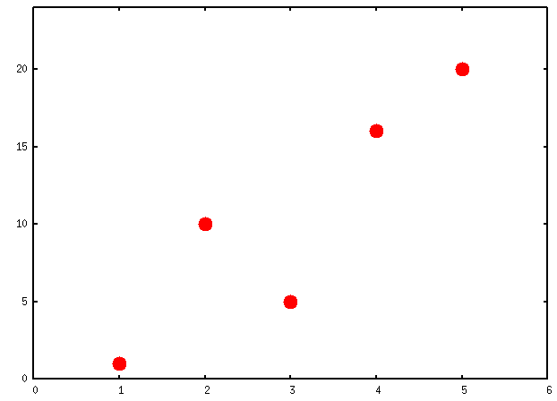
Interpolation
Example:
f(1) = 1, f(2) = 10, f(3) = 5 , f(4) = 16, f(5) = 20

Slide 9
Interpolation
How can we find f(1.5)?
One approach: take the average of f(1) and f(2)
f (1.5) = 5.5

Slide 10
Linear interpolation (lerp)
Fit a line between each pair of data points

Slide 11
Linear interpolation
What is f(1.8)?
      Answer: 0.2 f(1) + 0.8 f(2)
f (1.8) = 0.2 (1) + 0.8 (10) = 8.2

Slide 12
Linear interpolation
To compute f(x), find the two points x_{left} and x_{right} that x lies between
f (x_{left})
f (x) = (x_{right} - x) / (x_{left} – x_{right}) f (x_{left}) +
(x - x_{left}) / (x_{left} – x_{right}) f (x_{right})
f (x_{right})
x_{left}
x
x_{right}

Slide 13
Nearest neighbor interpolation
The first technique we tried
We use the value of the data point we are closest to
This is a fast way to get a bad answer

Slide 14
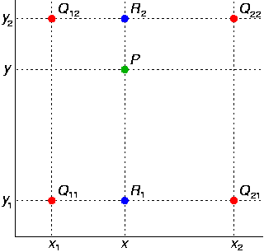
Bilinear interpolation
What about in 2D?
  Interpolate in x, then in y
Example
  We know the red values
  Linear interpolation in x between red values gives us the blue values
  Linear interpolation in y between the blue values gives us the answer
http://en.wikipedia.org/wiki/Bilinear_interpolation

Slide 15
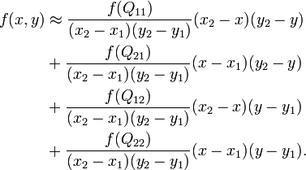
Bilinear interpolation
http://en.wikipedia.org/wiki/Bilinear_interpolation

Slide 16
Nearest neighbor interpolation

Slide 17

Bilinear interpolation

Slide 18
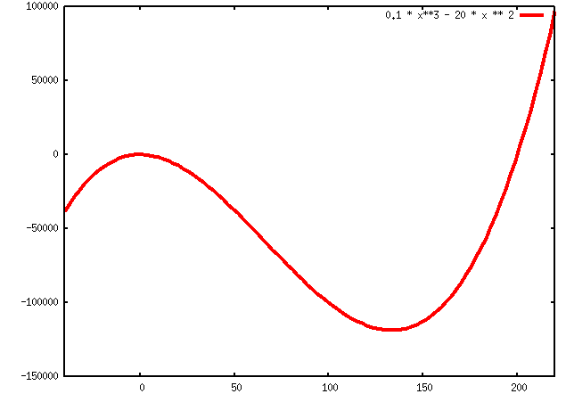
Beyond linear interpolation
Fits a more complicated model to the pixels in a neighborhood
E.g., a cubic function
http://en.wikipedia.org/wiki/Bicubic_interpolation

Slide 19
Bilinear interpolation

Slide 20

Bicubic interpolation
Smoother, but we’re still not resolving more detail

Slide 21
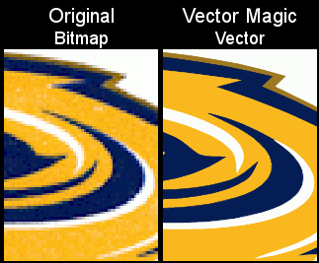
Even better interpolation
Detect curves in the image, represents them analytically

Slide 22




Even better interpolation
nearest-neighbor
interpolation
hq4x filter
SNES resolution: 256x224
Typical PC resolution: 1920x1200
As seen in ZSNES

Slide 23
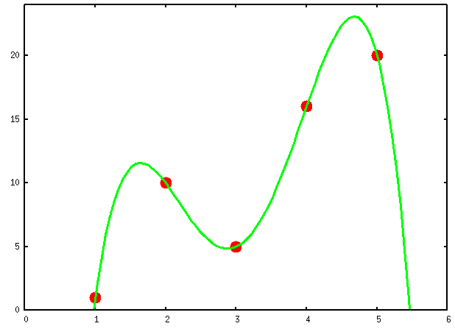
Polynomial interpolation
Given n points to fit, we can find a polynomial p(x) of degree n – 1 that passes through every point exactly
p(x) = -2.208 x⁴ + 27.08x³ - 114.30 x² + 195.42x - 104

Slide 24
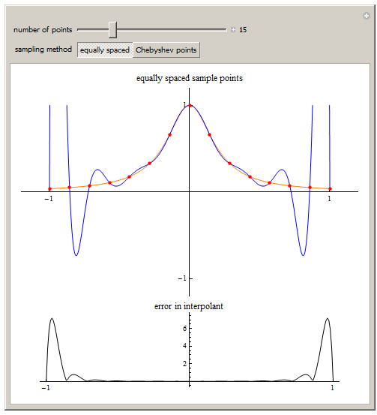
Polynomial interpolation
For large n, this doesn’t work so well…

Slide 25
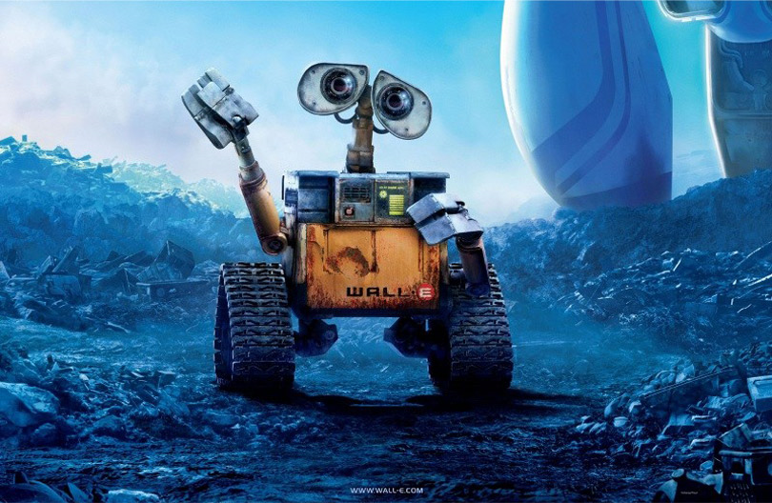

Other applications of interpolation
Computer animation (keyframing)

Slide 26
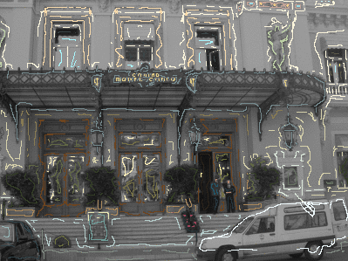

Gray2Color
http://www.cs.huji.ac.il/~yweiss/Colorization/
(Matlab code available)

Slide 27
Limits of interpolation
Can you prove that it is impossible to interpolate correctly?
Suppose I claim to have a correct way to produce an image with 4x as many pixels
  Correct, in this context, means that it gives what a better camera would have captured
  Can you prove this cannot work?
Related to impossibility of compression

Slide 28
Example algorithm that can’t exist
Consider a compression algorithm, like zip
  Take a file F, produce a smaller version F’
  Given F’, we can uncompress to recover F
  This is lossless compression, because we can “invert” it
    MP3, JPEG, MPEG, etc. are not lossless
Claim: there is no such algorithm that always produces a smaller file F’ for every input file F

Slide 29
Proof of claim (by contradiction)
Pick a file F, produce F’ by compression
  F’ is smaller than F, by assumption
Now run compression on F’
  Get an even smaller file, F’’
At the end, you’ve got a file with only a single byte (a number from 0 to 255)
  Yet by repeatedly uncompressing this you can eventually get F
However, there are more than 256 different files F that you could start with!

Slide 30
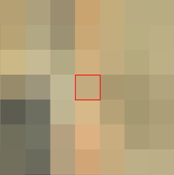
Conclusions
Some files will get larger if you compress them (usually files with random data)
We can’t (always) correctly recover missing data using interpolation
A low-res image can represent multiple high-res images

Slide 31
Extrapolation
Suppose you only know the values f(1), f(2), f(3), f(4) of a function
  What is f(5)?
This problem is called extrapolation
  Much harder than interpolation: what is outside the image?
  For the particular case of temporal data, extrapolation is called prediction (what will the value of MSFT stock be tomorrow?)
  If you have a good model, this can work well

Slide 32
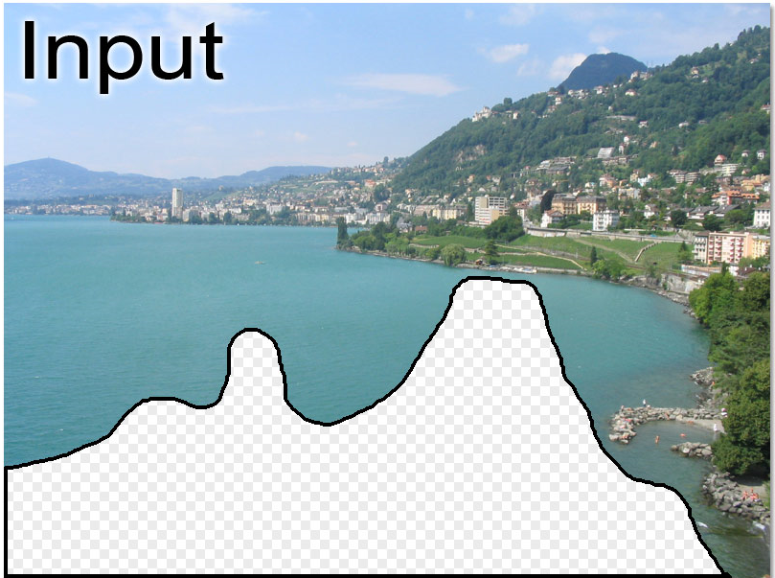
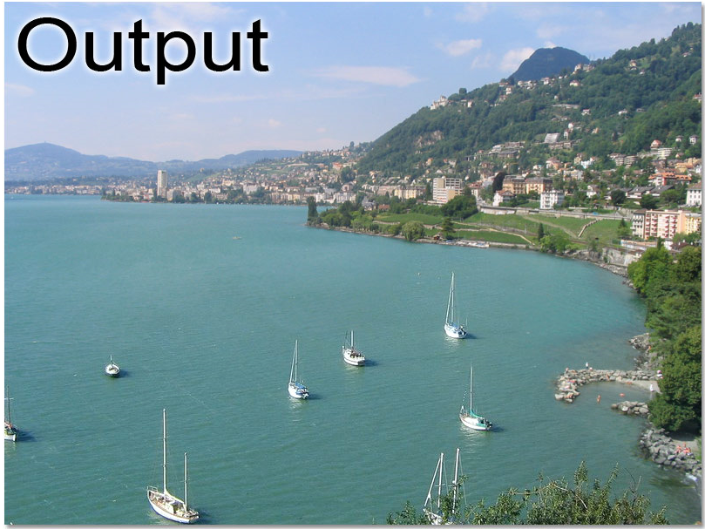
Image extrapolation
http://graphics.cs.cmu.edu/projects/scene-completion/
Computed using a database of millions of photos

Slide 33

Questions?

