Slide 1
VISUALISATION WITH PARALLEL COORDINATES
Suchismitha Vedala

Slide 2
PROBLEM DEFINITION
Viewing large data set becomes increasingly difficult in a 2D or 3D space.
The current visualization techniques implement viewing the data on the axis orthogonal to each other.
This becomes increasingly difficult as multiple axes referring to one axis cannot be correlated.
With the increase in complexity of data, the traditional visualization techniques like bar graphs, pi-charts etc, limit themselves while representing higher order data.

Slide 3
Parallel Coordinates
Parallel Coordinates are useful in representing high dimension data.
This includes visualizing the dimensions parallel to each other rather than orthogonal to each other.
A parallel coordinates plot may have either horizontal or vertical orientation of the attribute axis. The orientation has no influence on interpretation of the plot and its use.

Slide 4
USE OF D3 Java Script
D3.js (or just D3 for Data-Driven Documents) is a Javascript library for producing dynamic, interactive data visualizations in web browsers.
It makes use of the HTML, CSS standards.
When called with data, the d3.js can dynamically create svg objects and perform operations.
Advantage: Processing large data sets to SVG using d3.js is easy and can generate rich dynamic visualisation.

Slide 5
IDEA
A sample data set of top apps being used is extracted with different attributes and where each belongs to some categories.
Organize the data based on some attribute value.
Implementing the idea. Extract the data from the file and calculate the attributes and assigning a scale value to each. Visualizing the outcome (setting window and chart size) and assigning the colors to the attributes.

Slide 6
IDEA
Implementing the hsv color scheme, color legends and brushing concepts to the data. We also implement the opacity function
We implement functions such that based on the axis selection the data changes and we update the axes dynamically.
Dynamic concepts such as moving the axes, inverting is applied to the plot. The feedback function of rendering and rendering speed are implemented
The user can dynamically select a part of data that needs to be visualized or removed. So we implement remove, keep functions and respective dynamic programming concepts.

Slide 7
IMPLEMENTATION
The details of 500 apps which are being used the most is used.
The categories to which these apps belong to is also shown on the page.
The d3 javascript files are downloaded which include the packages required to develop and implement the parallel coordinates dynamically with the html on the browser.
The necessary underscore.js file which includes supporting packages are to be included in the source before calling the main javascript file.

Slide 8
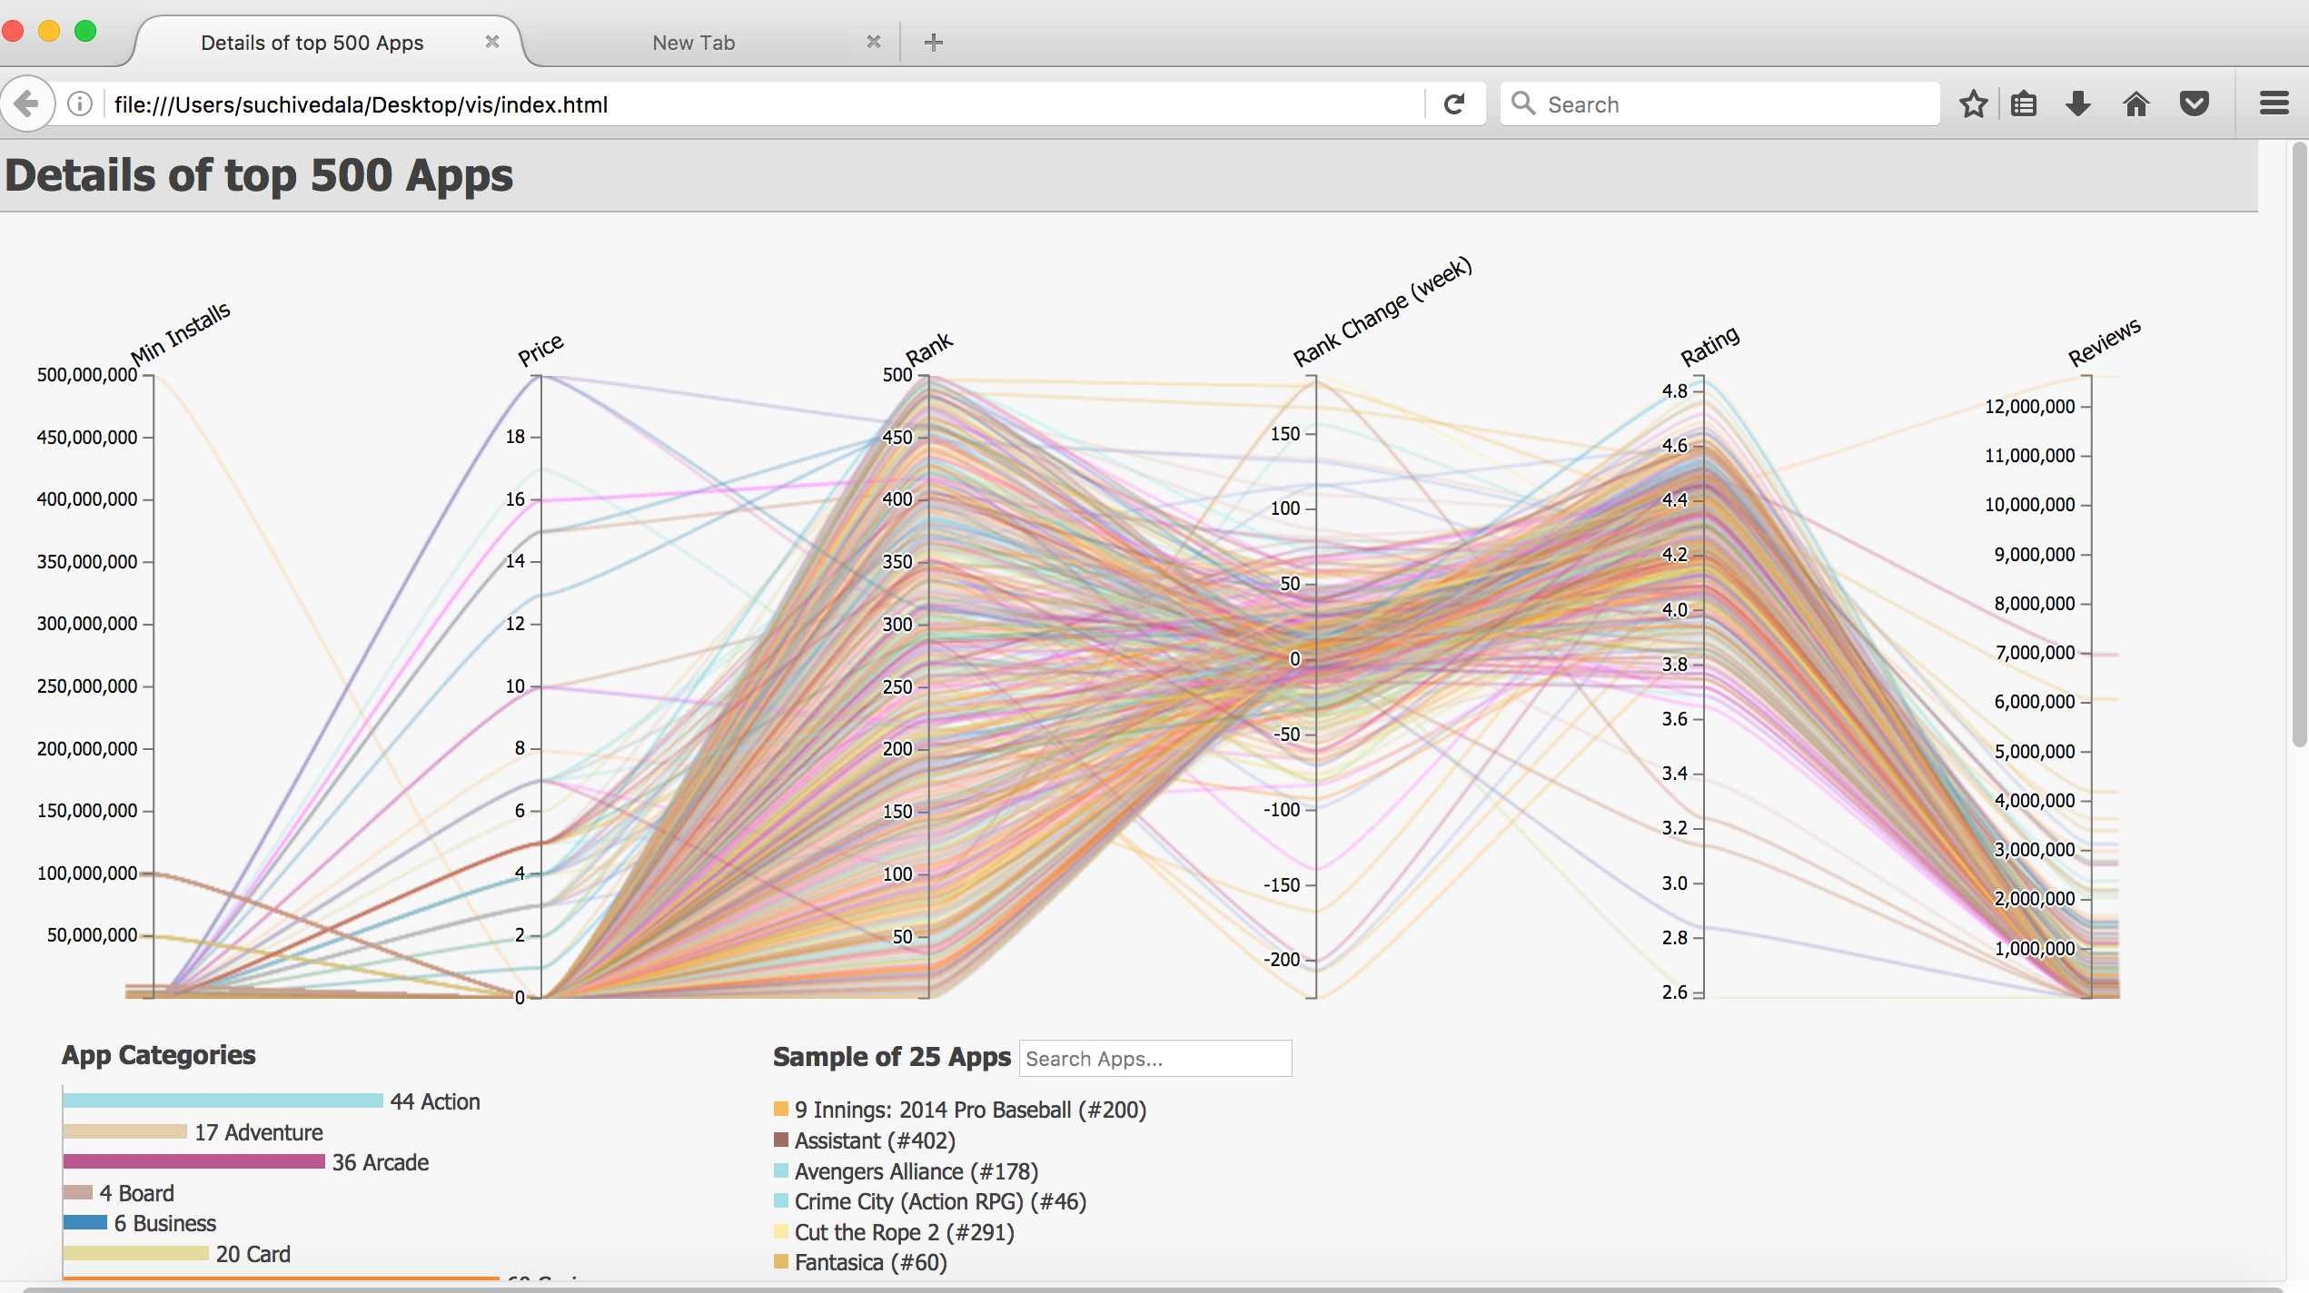
ImPLEMENTATION

Slide 9
FUTURE WORK
Opacity slider to be implemented.
Trying to implement the Smoothness of the curves.
Trying to implement a feature where the user can select which data to keep and which data to export dynamically.
To load the csv file dynamically and compute the axis and visualize.

Slide 10
LIMITATIONS
Parallel Coordinates implementation does not work effectively on categorical data or data with fewer values per axis.
Overplotting.
Performance at all instances cannot be garanteed.

Slide 11
REFERENCES
Kai Chang - Visually Exploring Multidimensional Data : https://youtu.be/ypc7Ul9LkxA
http://davis.wpi.edu/~xmdv/docs/vis99_HPC.pdf
http://www.cse.ust.hk/~huamin/eurovis08_zhou.pdf

Slide 12
ANY QUESTIONS?

