Slide 1
Microsurgery study By Suchismitha Vedala Lavanya.S.S Yashwanth Reddy Venati

Slide 2
Agenda
Introduction
Quality control
Biographic Data
Trait Psychometric Data
State Psychometric Data
Peri nasal Perspiration
Performance Data
Hypothesis Testing
Conclusion

Slide 3
Introduction
Relationship of sympathetic arousal and skill in learning micro- surgical task
Treatments
Baseline
Cutting
Suturing
Data organization

Slide 4
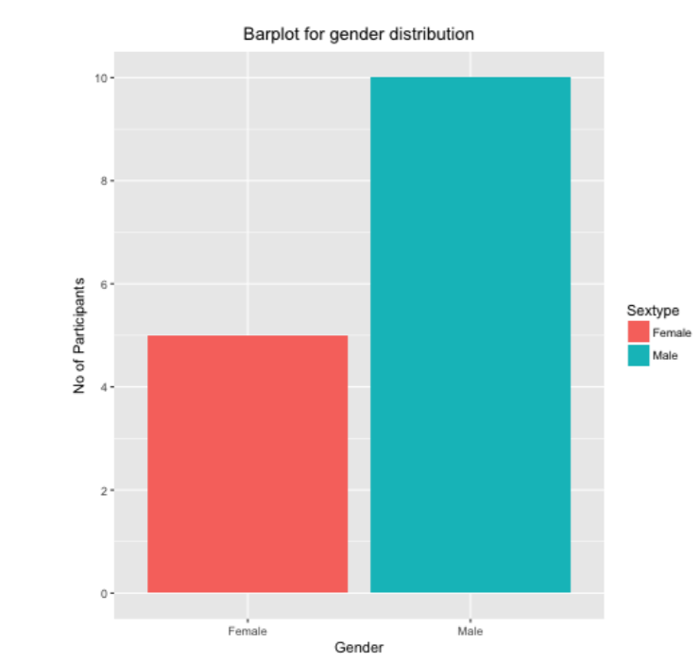
Biographic data
By referring to the Bar plot of gender distribution we can infer that the number of male subjects is more than the number of female subjects
Number of female subject is half as number of male subjects

Slide 5
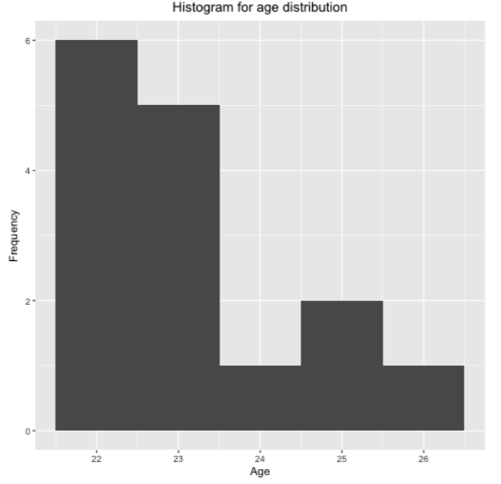
Age Distribution
By referring to the Bar plot of Age distribution , we can infer that more number of subjects are in the age group 22and 23
Also we can see from the dataset that few subjects age has been changed over the period of study

Slide 6
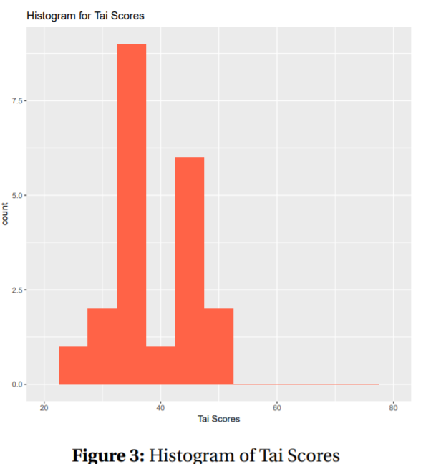
Trait Psychometric Data
Trait Anxiety Inventory(TAI) scores
Range 20-80
Higher value – over anxious individuals
Most of the subjects had TAI scores in the range 25-55

Slide 7
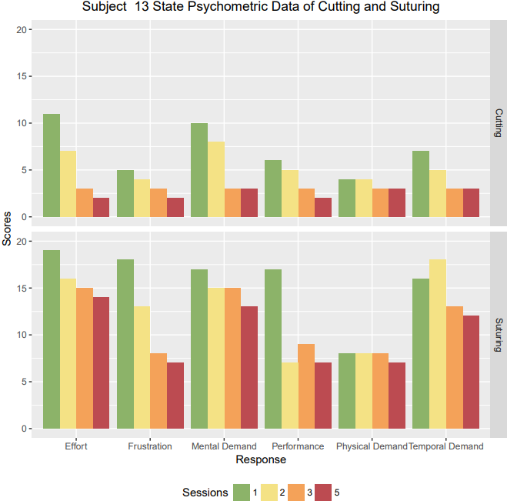
State Psychometric Data
Downward Trend
As we can see from the plot the effort , frustration , mental demand , performance and physical demand , temporal demand are all maintaining a downward trend

Slide 8
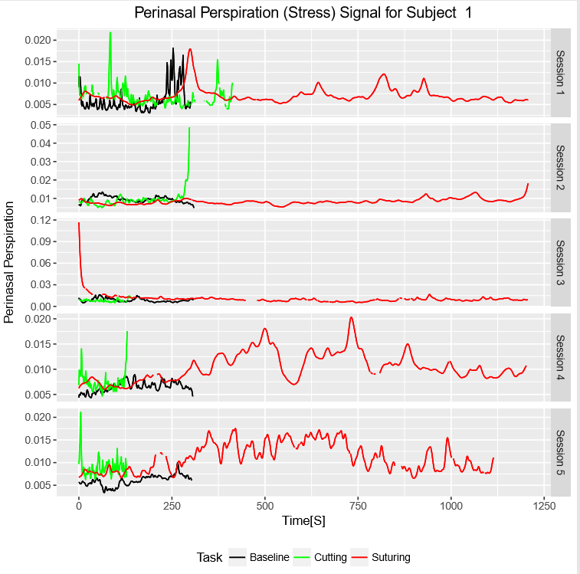
Peri nasal Perspiration (Stress) Signal Data
While performing Suturing Stress signals were observed for more duration
Suturing is more strenuous task
Baseline is at the lower level
Down sampling of data - Averaged data will give smoother signals

Slide 9
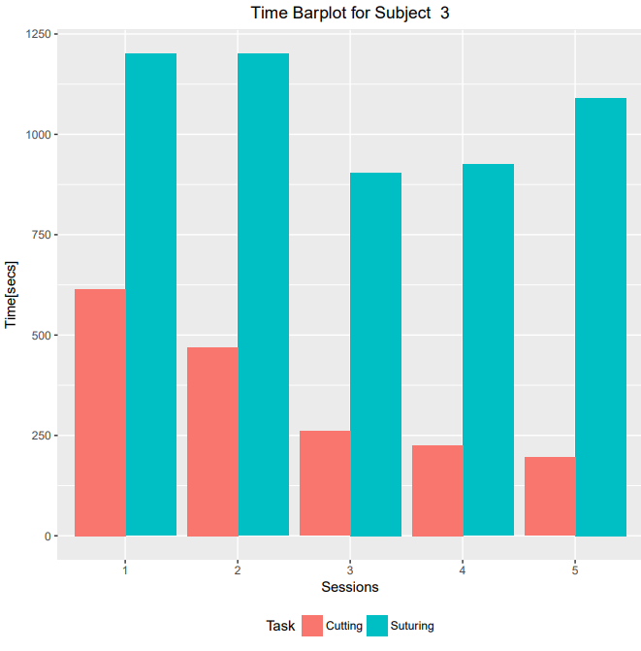
Performance Data
Time taken by subject to perform cutting is decreasing session by session
The Subject has mastered the task of cutting and can do it faster after each session
Downward trend for Cutting task
It is not the same in case of suturing, as we have already observed from peri nasal perspiration data
suturing is more strenuous task so It takes more time to finish

Slide 10
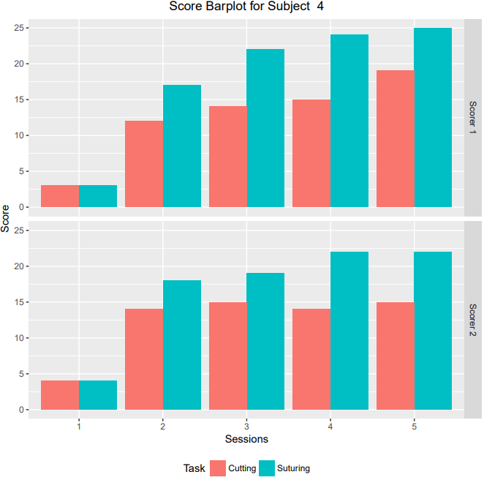
Performance Data
We can observe Ascending trend
The scores obtained for cutting and suturing is increasing for each session
The subject is becoming more adept in the tasks

Slide 11
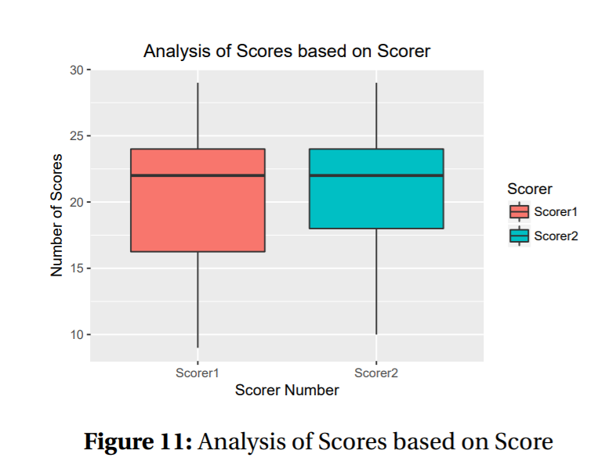
HYPOTHESES - TESTING
Linear modelling
We can observe the range of scores given by
scorer 1 is from 16-24
scorer 2 is from 18-24
Scores given by scorer1 was in a wider range when compared to scorer2

Slide 12
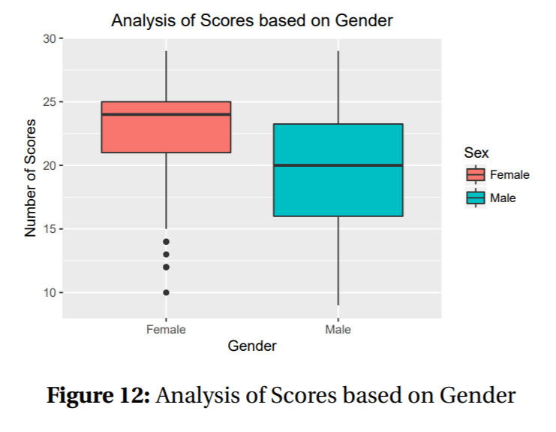
Female subjects performed well when compared to Male subjects
The scores obtained by female subjects are in the range 22-25
The scores obtained by male subjects are in the range 16-24

Slide 13
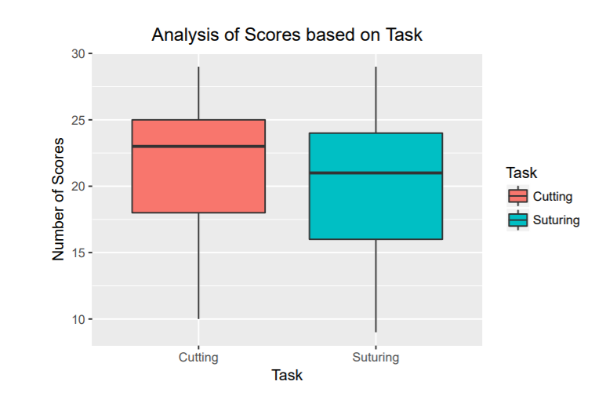
Analysis of scores Based on Task
We can observe the scores of subjects obtained in cutting task is more compared to suturing task
The range of scores for cutting task is from 17-25
The range of scores for suturing task is from 16-24

Slide 14
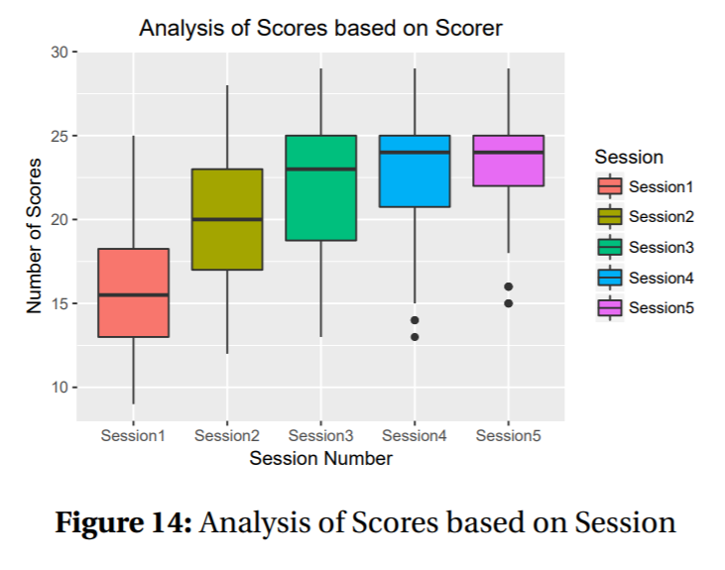
Analysis of scores Based on Session
As expected the Subjects have obtained more score in the session 5
While learning the task ,subjects scored less scores and it gradually increased with sessions

Slide 15
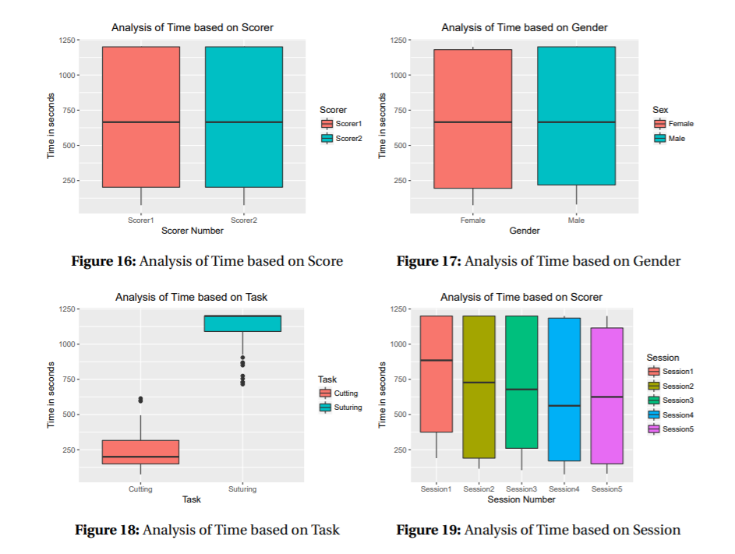
Analysis of Time

Slide 16
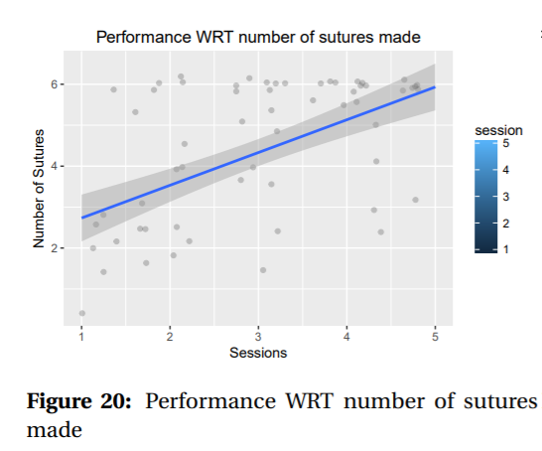
Performance Analysis of Suturing Task
The number of sutures increases with each session.

Slide 17
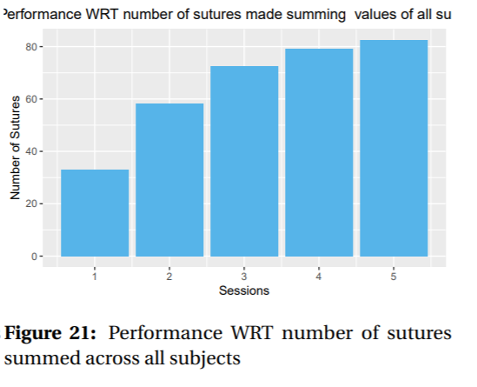
Performance Analysis of Suturing Task
the number of sutures is highly dependent on sessions

Slide 18
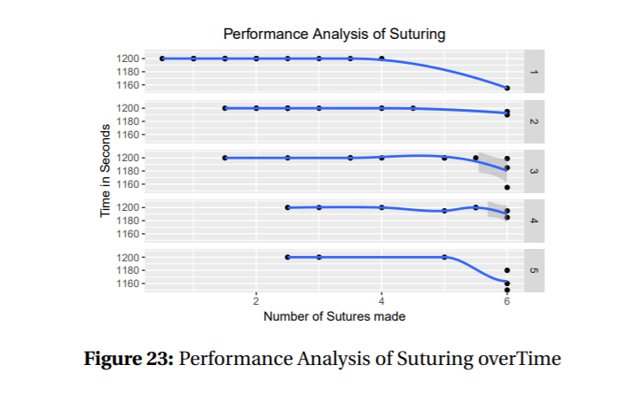
Performance Analysis of Suturing
Inference: The number of sutures made increases with each session and takes less time
The subjects are performing well session by session

Slide 19
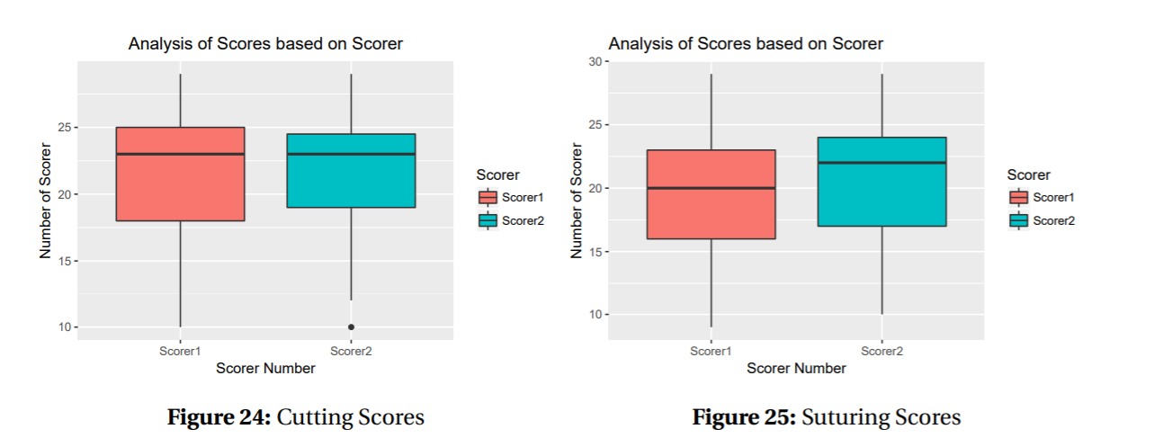
Analysis of Scorers on Task
Wilcox test
Cutting :p-value is greater than 0.05, which applies the means have not changed
Suturing: p-value is less than 0.05, which states that the means of the scorers is different
Scorer has an effect on final scores of Suturing and Cutting

Slide 20
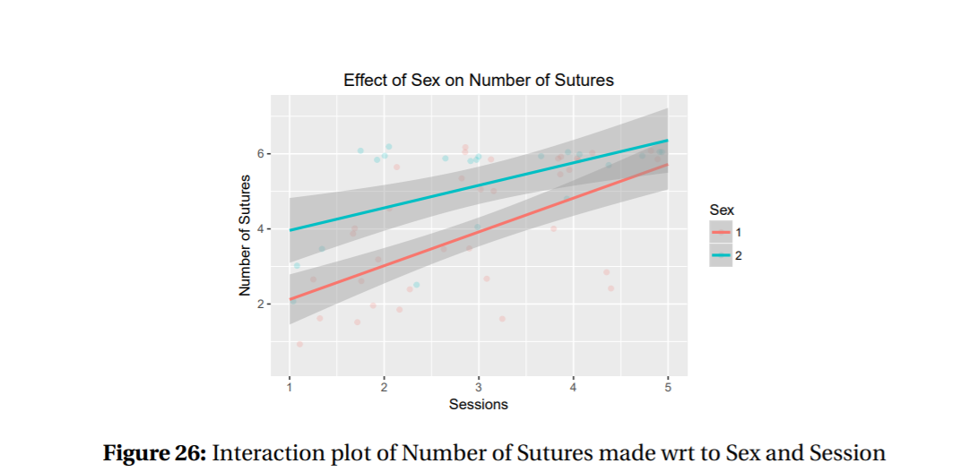
Sex has an effect on Number of Sutures made and females made more number of Sutures in 20 minutes
subject’s performance gets better with each session.

Slide 21
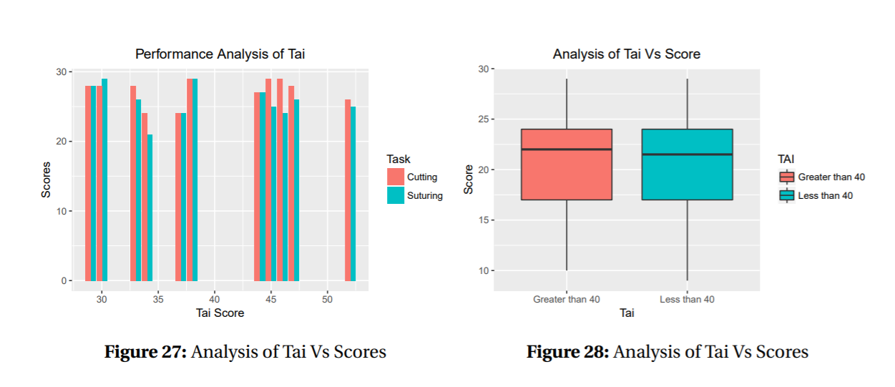

Slide 22
Conclusion

