Slide 1


“Employee Get Data Project”
Submitted by:Suchita Satyawan kadam
Submission type : Individual
Name: Suchita Satyawan Kadam
Trainer: Javeed Sir
Batch :HDFC API - 1
LMS Id : suchitakadam0591@gmail.com
Program : HDFC API Development Program
Date: 27/04/2023

Slide 2



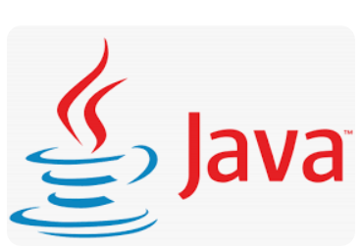
Table of contents
Introduction
Project Overview
Architecture Design
User Interface Design
Back-end Development
Testing
Deployment
Conclusion
Future Work
References
Appendices

Slide 3

Introduction
The Employee Get Data Project is a web service that allows users to retrieve employee data from a database. The project is implemented using Java and Spring Boot, and the data is stored in a MySQL database. The project is designed to be deployed on a Tomcat server and can be accessed via HTTP or HTTPS.

Slide 4
Project Overview
The project consists of a single RESTful endpoint .
The code for the project is hosted on a Git repository and is built and deployed using Jenkins.
Jenkins is configured to automatically build and deploy the project whenever changes are made to the Git repository.
The project also includes logging functionality using Log4j.
The project is also designed to be secure, with HTTPS support using a self-signed certificate. This ensures that sensitive employee data is not transmitted in plain text over the internet.
The project also includes encryption of the DateOfBirth field using AES-256. This ensures that the employee's date of birth is not stored in plain text in the database and can only be accessed by authorized users with the decryption key.

Slide 5
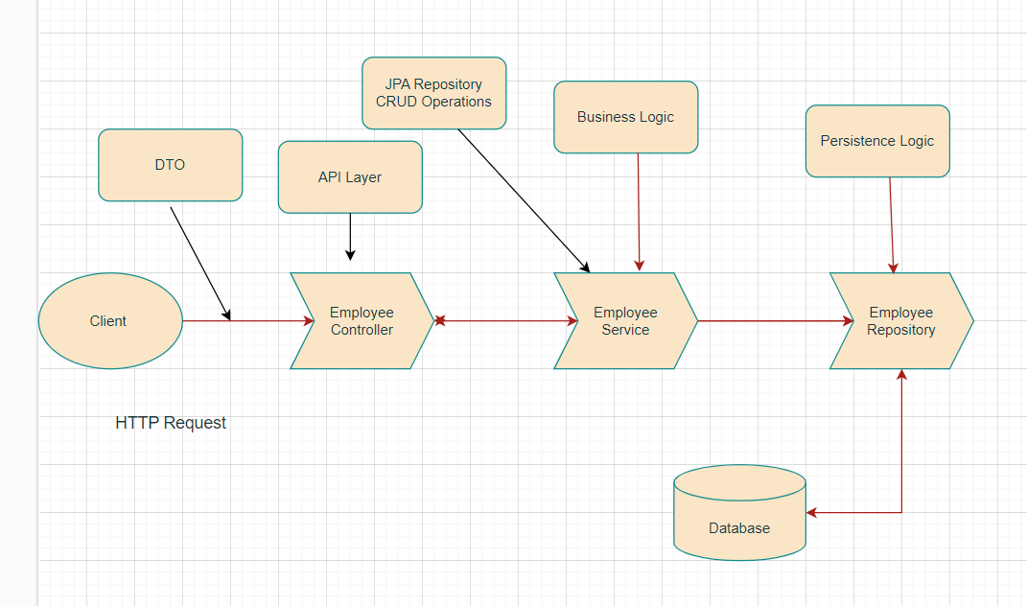
Architecture Design

Slide 6
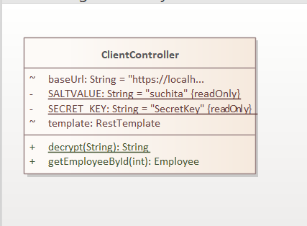
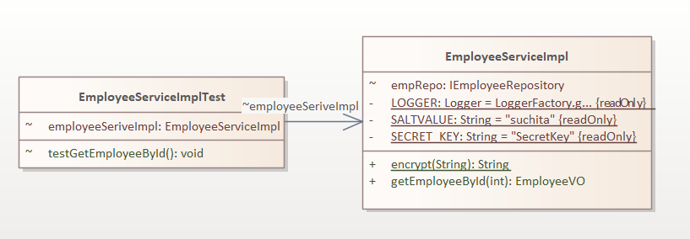
Architecture Design

Slide 7
User Interface Design
The user interface for the Employee Get Data Project is designed to be simple and easy to use.
The main screen of the application consists of a single input field where the user can enter the EmployeeID.
If the EmployeeID is valid, the application will display the employee's name and date of birth on the screen. If the EmployeeID is not valid, an error message will be displayed indicating that the EmployeeID is invalid.
Overall, the user interface for the Employee Get Data Project is designed to be intuitive and user-friendly, allowing users to quickly and easily retrieve employee information.
.

Slide 8
Back-end Development
The back-end development of the Employee Get Data Project involves designing and implementing the database, creating the RESTful endpoint, and securing the application.
Design and implement the database:
Create a database The "EmployeeID" column should be the primary key.
Create the RESTful endpoint:
Create a RESTful endpoint that accepts an EmployeeID parameter and returns the corresponding employee data from the database.
Secure the application:
Implement HTTPS support using a self-signed certificate to ensure that sensitive employee data is not transmitted in plain text over the internet.
Additionally, encrypt the "DateOfBirth" field using AES-256 to ensure that it is not stored in plain text in the database and can only be accessed by authorized users with the decryption key.
Implement logging functionality:
Configure logging using a logging framework such as Log4j to record each request made to the server.

Slide 9
Integration and Testing
Integration testing:
This includes testing the integration of the front-end user interface with the back-end server, as well as testing the integration of the various components of the back-end system such as the database, RESTful endpoint, and logging functionality.
Unit testing:
Perform unit testing on the individual components of the system, such as the database queries, RESTful endpoint, and encryption/decryption logic.
Functional testing:
This includes testing the retrieval of employee data based on valid and invalid EmployeeIDs, verifying that the encrypted "DateOfBirth" field can be decrypted properly, and testing the logging functionality.
Security testing:
This includes testing the HTTPS support, verifying that the encryption/decryption logic is working properly.

Slide 10
Deployment
Deploy the application: Deploy the application to a Tomcat server and test the functionality using Postman. Used Jenkins to automate the build and deployment process, and deploy the application on Kubernetes with multiple container instances running for scalability and availability.
Set up continuous deployment by integrating the deployment process with a CI/CD pipeline using tools such as Jenkins, GitHub Actions. This will ensure that any changes to the code are automatically built, tested, and deployed to the production environment, providing a streamlined and efficient deployment process.

Slide 11
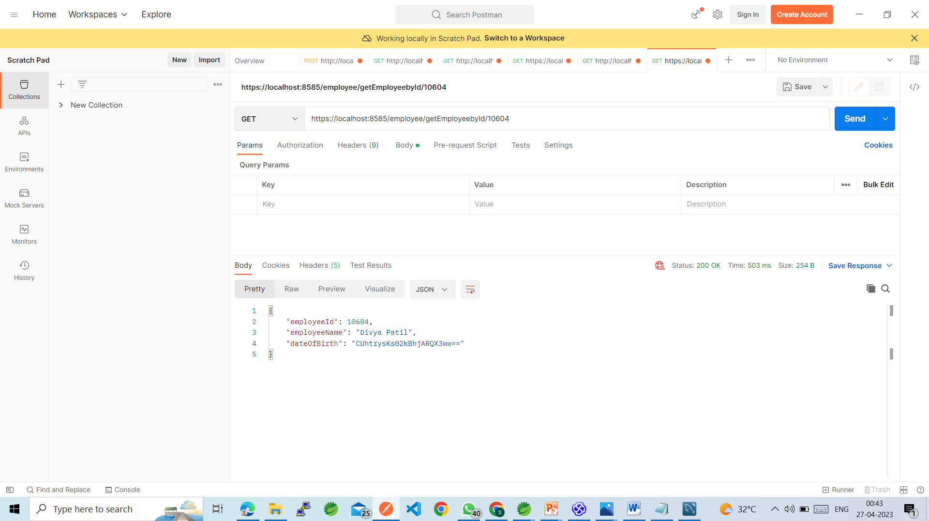
Get Encrypted data

Slide 12
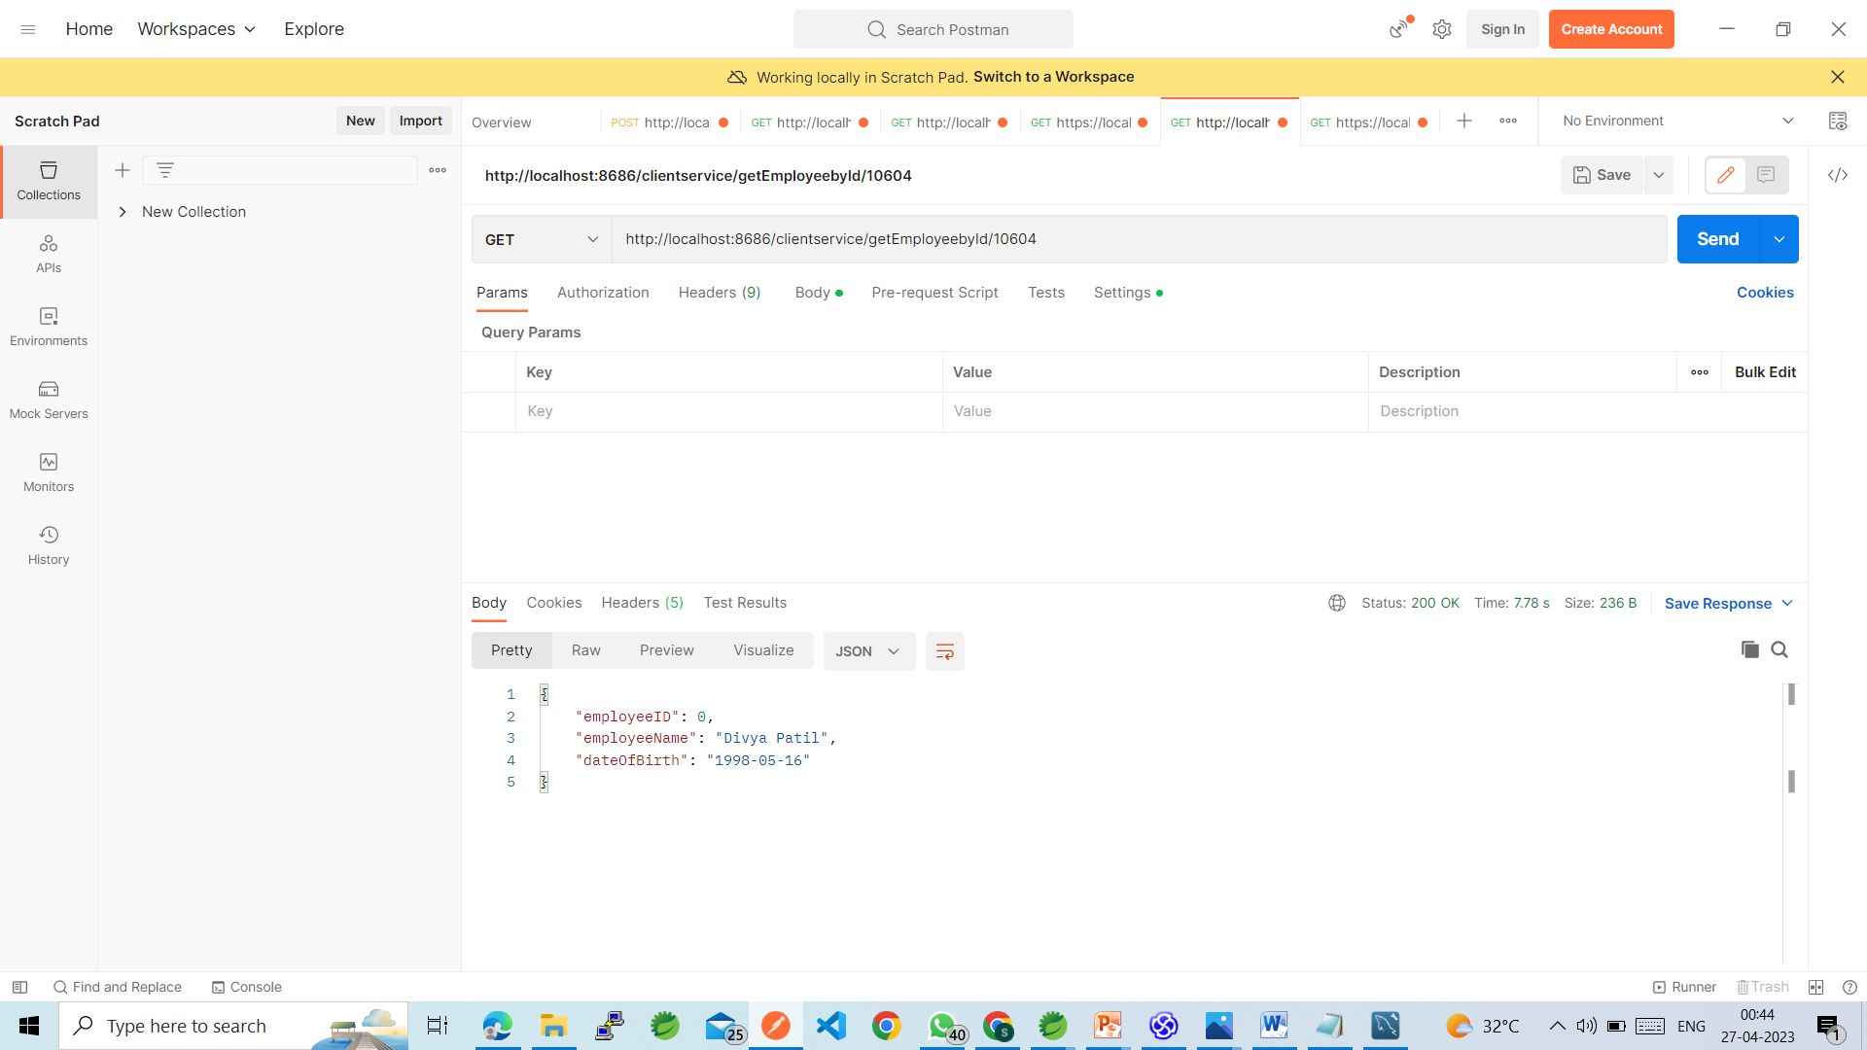
Get Decrypted Data

Slide 13
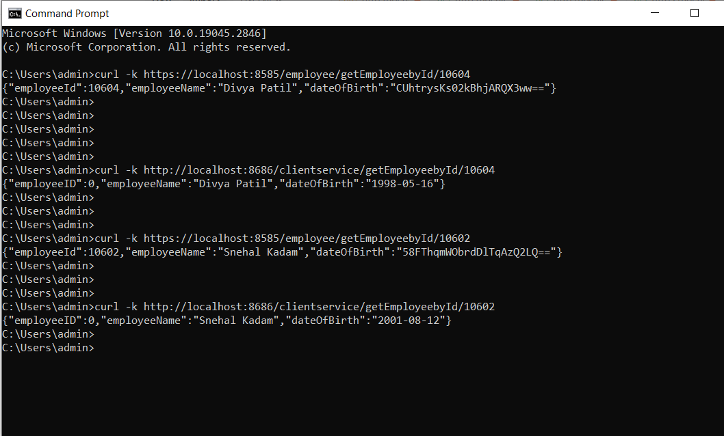
CURL Command

Slide 14
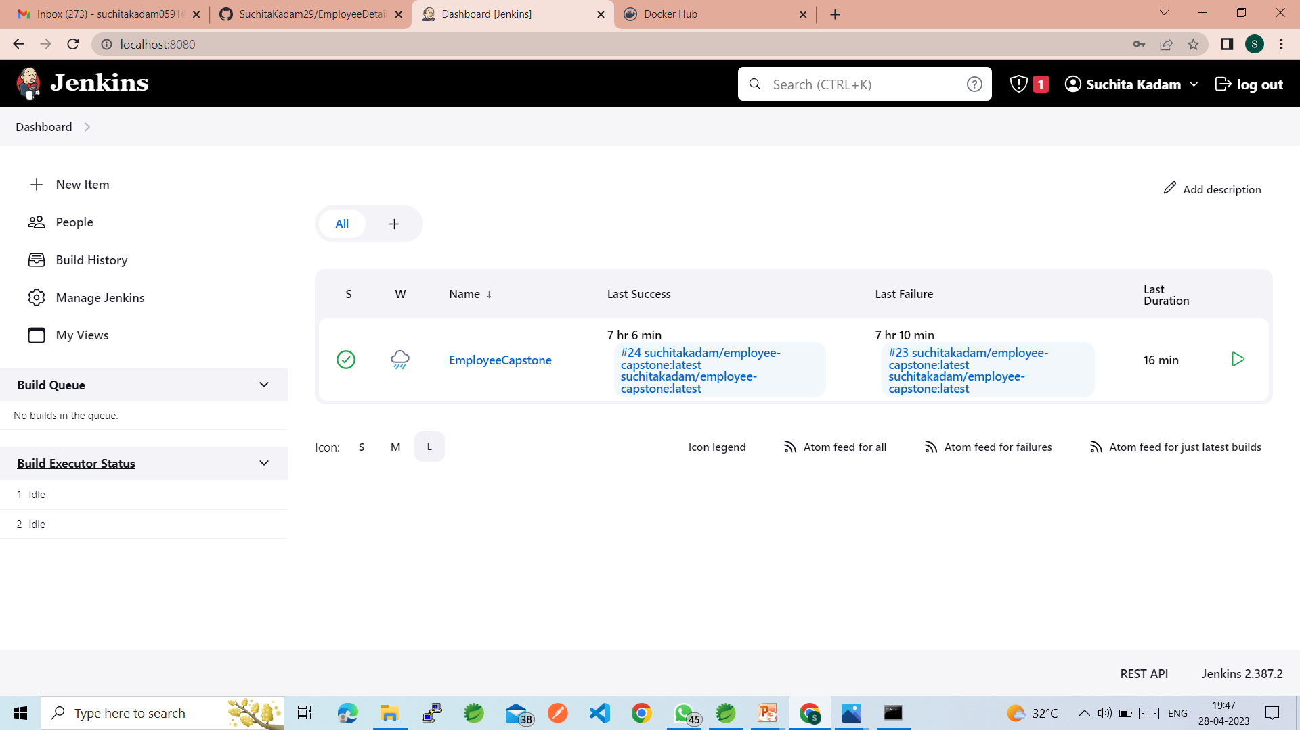

Slide 15
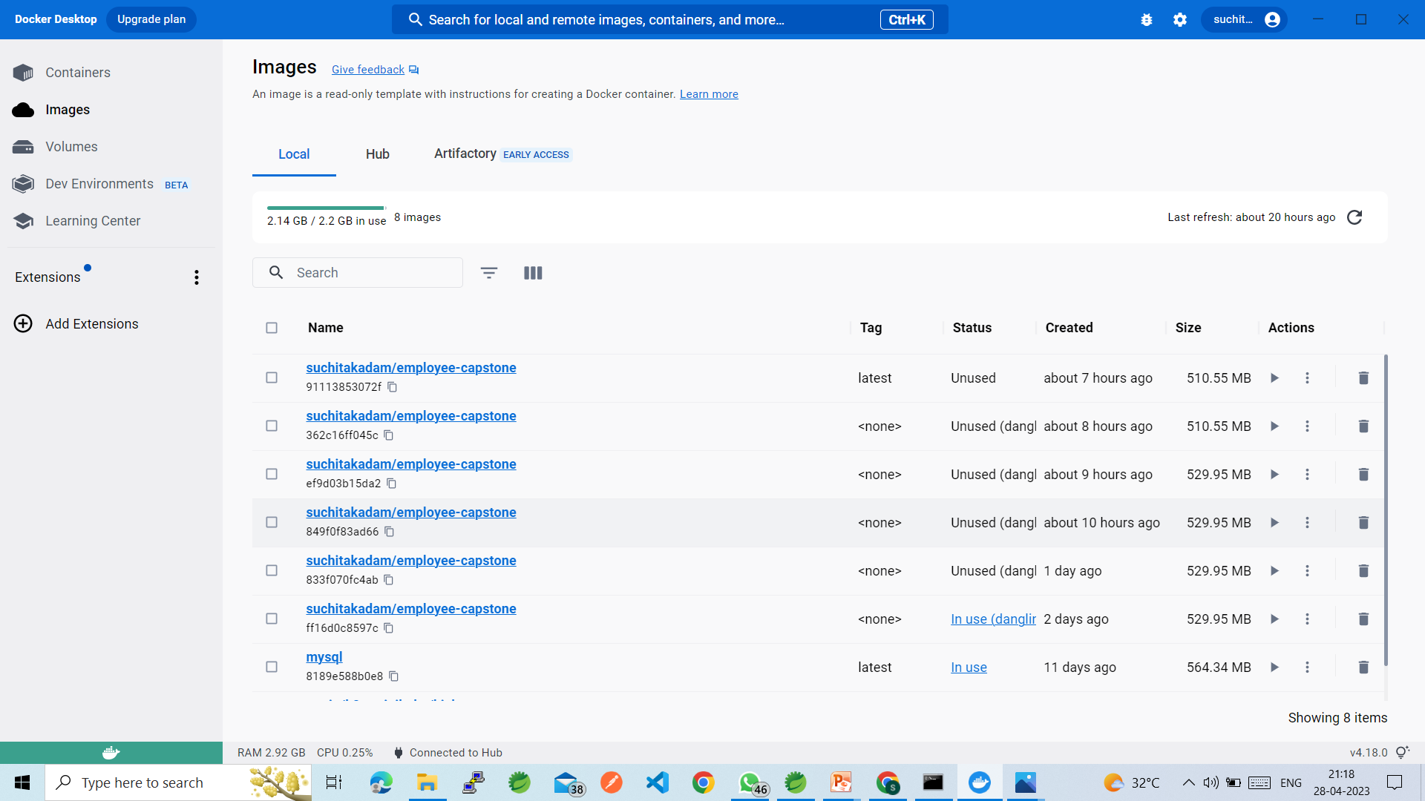

Slide 16
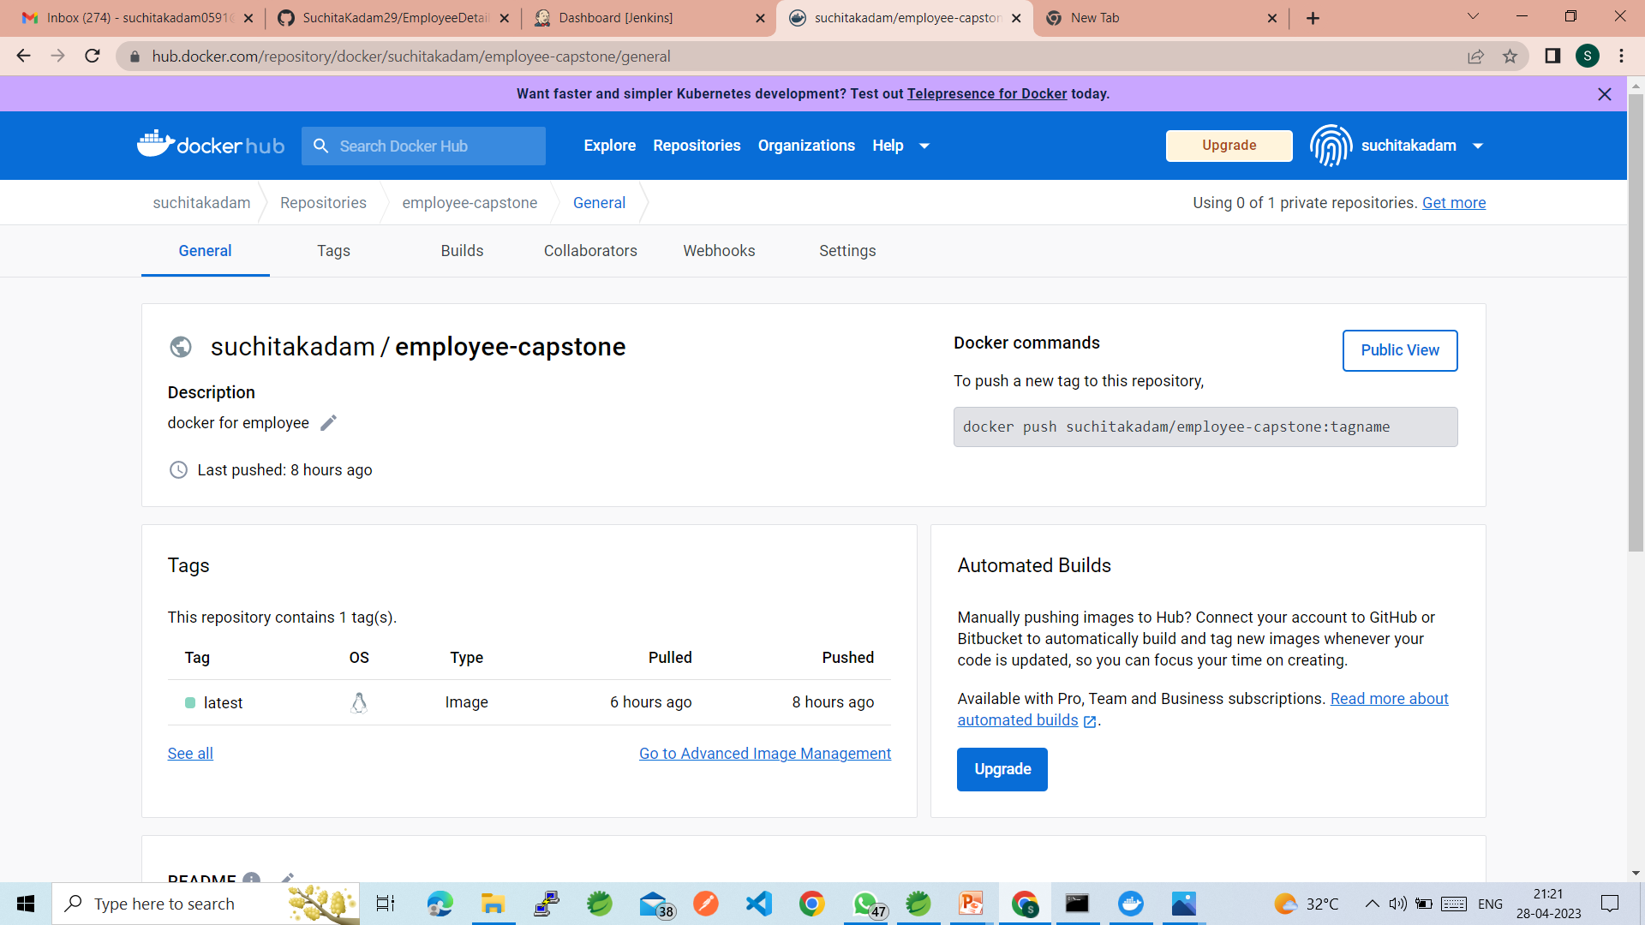

Slide 17
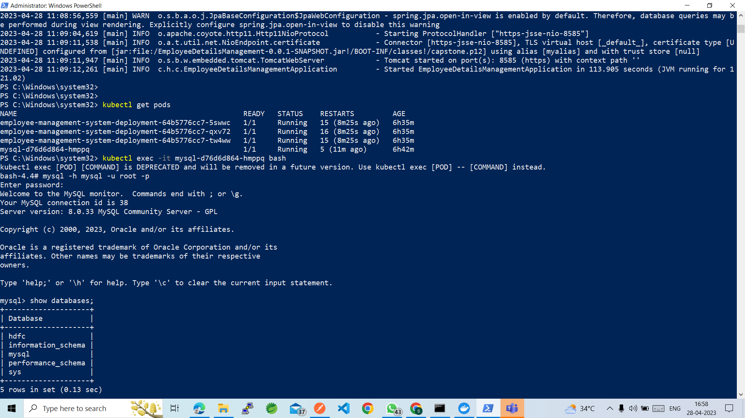

Slide 18
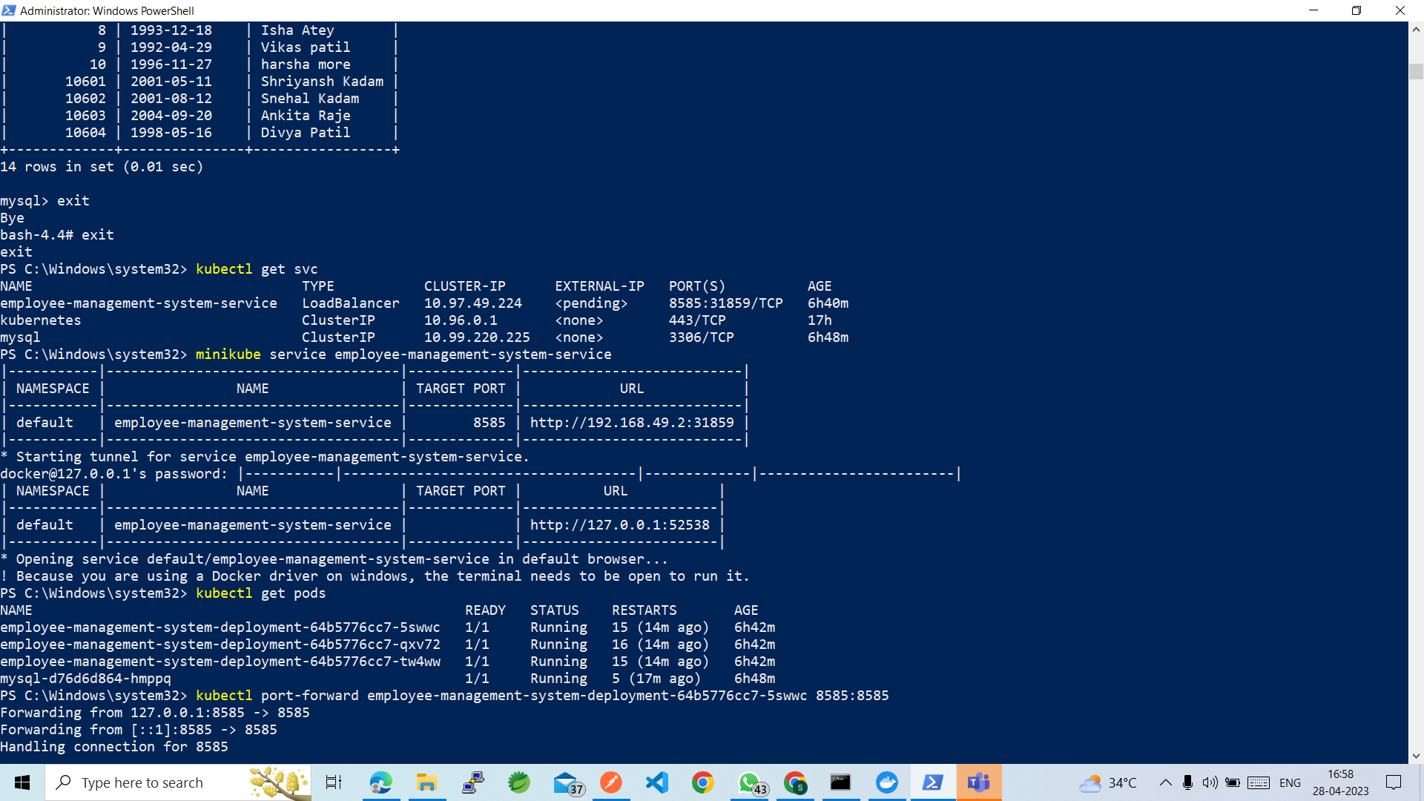

Slide 19
Conclusion
The Employee Get Data Project demonstrates how to implement a secure and reliable web service for retrieving employee data from a database. The use of Java, Spring Boot, MySQL, and Log4j allowed for easy implementation and deployment of the project, while Jenkins and Git provided efficient version control and continuous integration. The project can be easily extended to include additional functionality and can serve as a basis for future web service projects.

Slide 20
Future Work
Role-based access control: Enhance the security of the application by implementing role-based access control (RBAC) to restrict access to sensitive employee data based on user roles and permissions.
API documentation: Create comprehensive documentation for the application programming interface (API) to help developers understand how to use the API and integrate it with other applications.
Additional functionality: Add new functionality to the application, such as the ability to update or delete employee data, search for employees based on specific criteria, or generate reports on employee data.
By implementing these enhancements, the Employee Get Data Project can continue to evolve and improve to meet the needs of its users.

Slide 21
References
https://github.com/javeed512/HDFC_JAVA
Self-Signed SSL Certificate Generator - https://www.sslshopper.com/article-how-to-create-a-self-signed-certificate-in-iis-7.html
Continuous Integration and Continuous Deployment (CI/CD) with Jenkins - https://www.jenkins.io/doc/tutorials/build-a-java-app-with-maven/
Kubernetes Documentation - https://kubernetes.io/docs/home/
These resources can provide guidance and support for the development, testing, deployment, and maintenance of the Employee Get Data Project.

