Slide 1
Branch Predictor
CE6304 fall 21
Netra Shah (NPS210000)
Suchith Natraj Javali (SXJ200024)

Slide 2
Contents
Branch Predictors Overview
Comparison of different branch predictors
Working with Gem5
Modifications in Source code
Results
Analysis
Conclusion

Slide 3
Overview of Branch Predictors
Motivation
Branch Prediction Idea
BP Types in Gem5
Comparison and Trade-offs

Slide 4
Motivation [Importance of BP]
Deeply pipelined processor enforce control dependencies through branch hazards and stalls
These control hazards cause greater performance loss than data hazards
Important to keep pipeline full without stalls (NOP instructions)
Loop unrolling which is a compile-time technique reduces branch hazards
As pipeline get deeper and potential penalty of branch increases, aggressive means of branch prediction required

Slide 5
Branch Prediction Idea
Definition
Predict the branch direction, start fetching the instruction based on it
Predict branch direction
Prediction based on branch history
Fetch instructions at predicted directions
Instead of NOP instructions, run potential instruction
Prediction correct -> Zero branch penalty
Prediction Incorrect ->
Flush wrongly fetched and issued instructions
Fetch and issue instructions from different path
Severe misprediction penalty
Miss prediction recovery

Slide 6
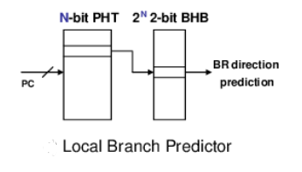
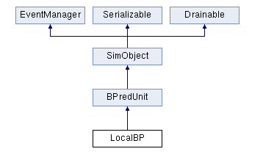
2-bit Local branch predictor
Correlates the outcomes taken in past by the same branch
Implements a local predictor that uses the PC to index into a table of saturating counters
Makes use of temporal locality which works well for loops
It has a separate history buffer for each conditional jump instruction known as a Branch history table (BHT)
Value of saturating counters determine the local prediction

Slide 7
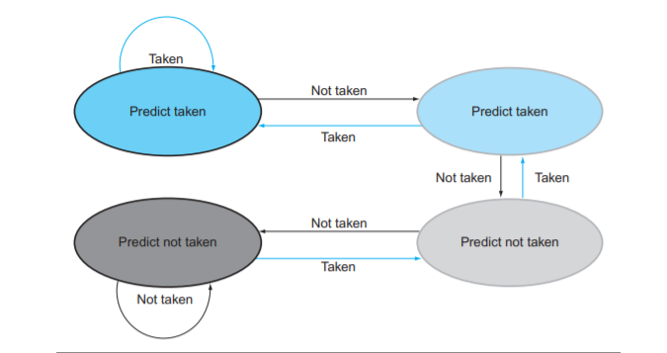
2-bit Local branch predictor (con’t)
The outcome of the branch is stored (In local history register) and serves as the entry to the Local history table, for 2 bit predictors, last 2 branches are relevant
Each of the branch’s local history pattern has a Pattern history table associated with it which contains the branch prediction value
2bit local branch predictor has 2 bit state machine which implies change prediction only on 2 consecutive mispredictions
Drawbacks
Other branches might direct to the same entry
Branch prediction rates saturates at 97%
History of other branches are same and might map
to the same counter entry

Slide 8
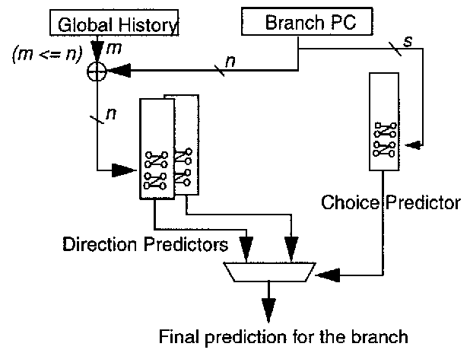
Bi-mode Predictor
It’s type of dynamic branch predictor which divides the prediction tables into two halves and selects the appropriate half for prediction
It preserves the merits of global history based prediction while reducing destructive aliasing and, as a result, improving prediction accuracy
Second level counter is divided into two halves
Branch PC is used to provide final selection for these two second level counters

Slide 9
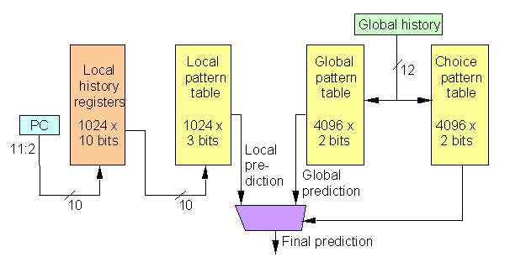
Tournament Predictor
Considers both local and global branch predictors and choose the better one as per branch
It selects between 1 local and 1 global information depending on their accuracy. Idea is, prediction bit of 2 bit counter tells which of the 2 predictors to be selected
Used in modern high performance cores
It has better accuracy because it combines strength of two type of predictors
It needs selector mechanism
It has longer access latency

Slide 10
Gem5
What is Gem5?
It is an open source processor and system-level simulator
Features
Modular platform used to simulate multiple ISAs (ARM, Alpha, MIPS, x86, RISC-V), processor types, full system emulation and CPUs.
Multiple interchangeable CPU models
A trace based CPU

Slide 11
Gem5 Setup
Accessed Gem5 on ce6304.utdallas.edu server via UTD VPN
Command in terminal :
To access server - “ssh nps210000@ce6304.utdallas.edu”
To copy Gem5 for local directory – cp –rf /usr/local/gem5 /home/nps210000/m5out
To build x86 - scons build/X86/gem5.opt
This would build the “gem5.opt” executable which we will use to run the simulations
Challenges :
Server disconnected several times due to IT server error
Requested IT team via professor to install python3 as per the prompt
Incorrect stats.txt file – Deleted build and stats files, recompiled and run again
Had to wait long time to check few of the build results

Slide 12
Branch Predictors available in Gem5
2-bit Local Predictor
Bi-mode Predictor
Tournament Predictor
CPU Benchmarks Used
458.sjeng
470.lbm

Slide 13

Working with Gem5
Adding Branch predictors to Timing Simple CPU
Edit “BaseSimpleCPU.py” and modify the line as shown below

Slide 14
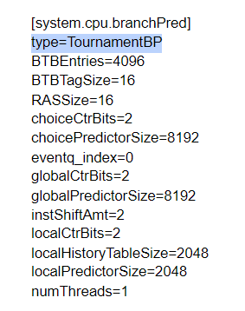
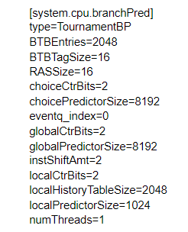
Working with Gem5 (Con’t)
Recompile using scons build/X86/gem5.opt
Run HelloWorld program to generate config.ini file in m5out folder in $gem5-stable directory
Config.ini file is submitted in the file
config.ini for 458.sjeng
config.ini for 470.lbm

Slide 15
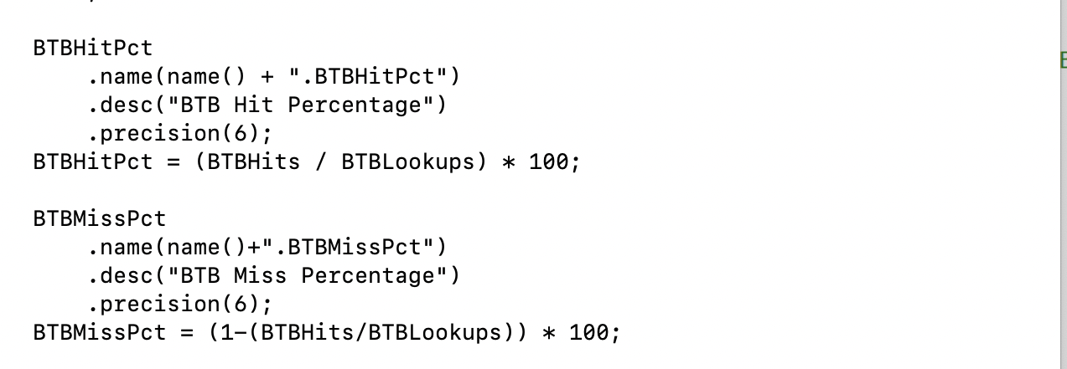
Adding BTB miss percentage
BTBMissPct is defined and declared in .cc and .hh files
$Gem5/src/cpu/pred/bpred_unit.cc

Slide 16
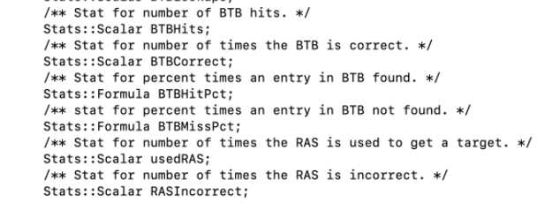
Adding BTB miss percentage
BTBMissPct is defined and declared in .cc and .hh files
$Gem5/src/cpu/pred/bpred_unit.hh

Slide 17
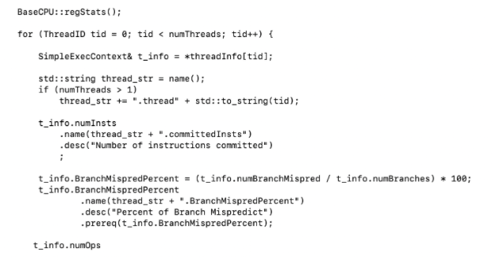
Adding Branch miss prediction percentage to the stats.txt file
$Gem5/src/cpu/simple/base.cc

Slide 18
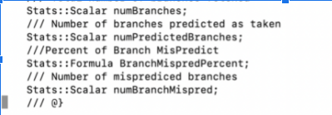
Adding Branch miss prediction percentage to the stats.txt file
$Gem5/src/cpu/simple/exec_context.hh

Slide 19
Terminologies
BTB Hits -> total number of BTB Hits
BTBLookups -> total number of BTB References
numBranchMispred -> total number of mis predicted Branches
numBranches -> total number of branches fetched
BTBHitPct –> The ratio of number of times branch predictor has successful HIT to the total number of times the CPU looked up to the branch predictor
BTBMissPct –> Number of times branch predictor failed to give a HIT or when the lookup encountered a miss
(1 - BTBHitPct) x 100 or (1 – BTBHits/BTBLookups) x 100

Slide 20
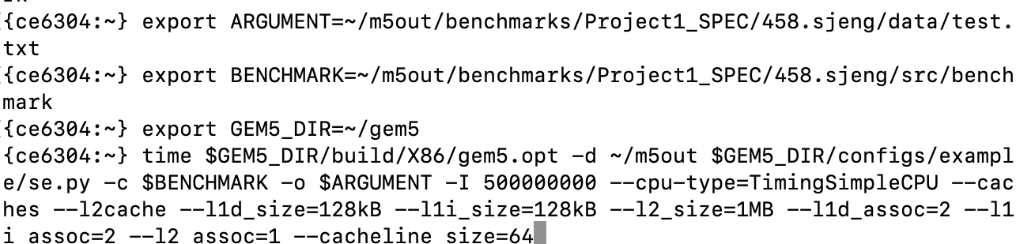
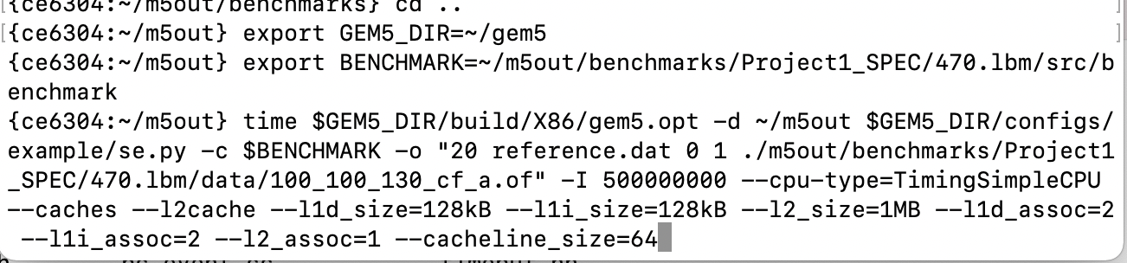
Running the benchmarks
458.sjeng
470.lbm

Slide 21
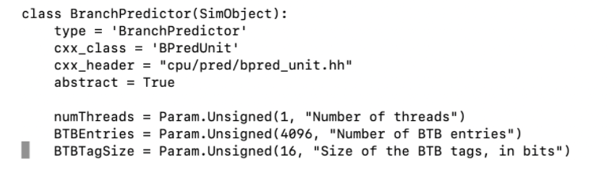
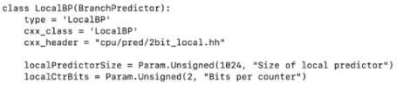
Example of change of BTB entries and size of predictors in source code “BaseSimpleCPU.py”
Changing BTB entries
Change in size of local predictor for Local BP

Slide 22
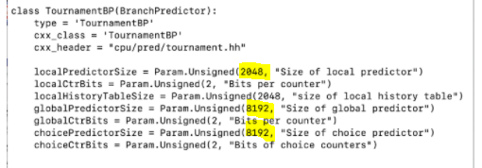
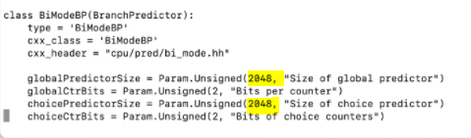
Change in size of local, global, choice predictor for tournament predictor
Change in size of global, choice predictor for BiMode predictor

Slide 23
Result and Analysis
Comparing different branch predictors in 2 benchmarks

Slide 24
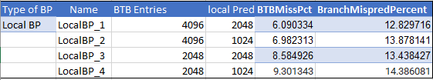
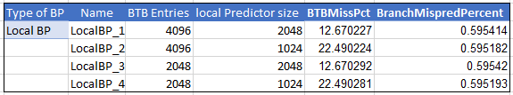
Local Branch predictor in 458.sjeng
Local Branch predictor in 470.lbm

Slide 25
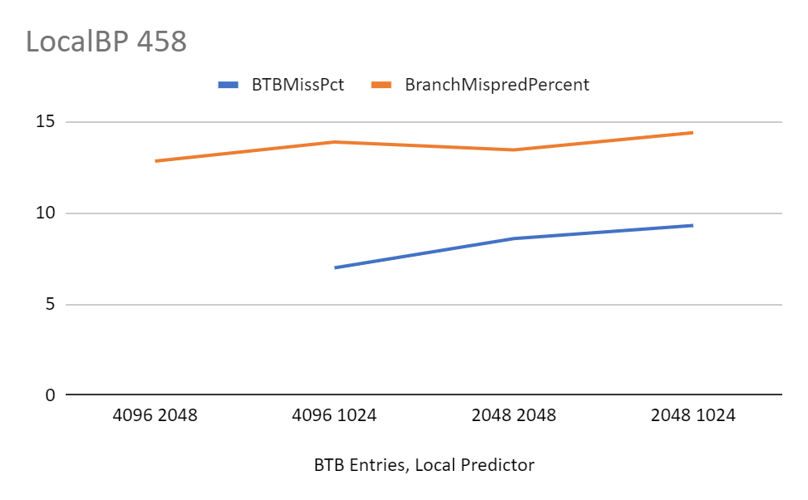
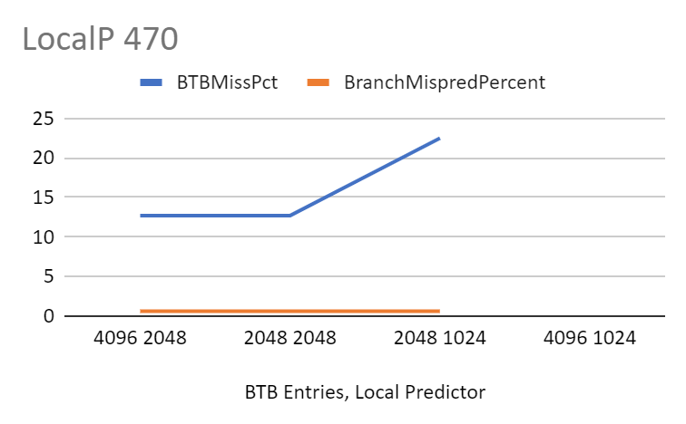

Slide 26
Observation
Comparing Local Branch predictor in 458.sjeng and 470.lbm, we find that local BP performs better in 470.sjeng benchmark in terms of branch mis prediction as it is on lower side for the same values but has higher BTB miss percentage
Rate of increase in BTB mis percentage is high in 470 benchmark
In both the benchmarks, keeping predictor size constant, as the BTB entries decrease, BTB miss percentage and branch mis prediction increases but this rate is more in 458 than 470 benchmark
With reduction in branch history table size, the associated predicted outcome of the branch now has lesser values to lookup to
Keeping BTB entries constant, reducing the BP size, Branch mis prediction size increase at high rate in 458 while it decreases slightly in 470
Larger the history buffer, the better would it perform. Hence we can explain its behaviour when the branch size was reduced

Slide 27
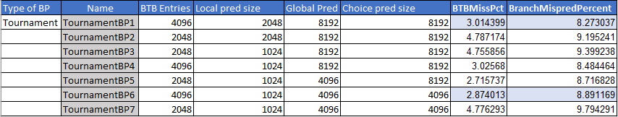
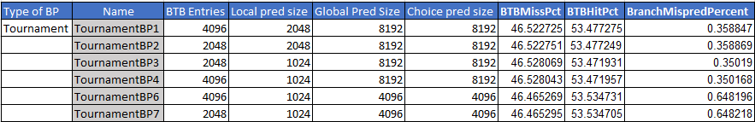
Tournament BP in 458.sjeng
Tournament BP in 470.lbm

Slide 28
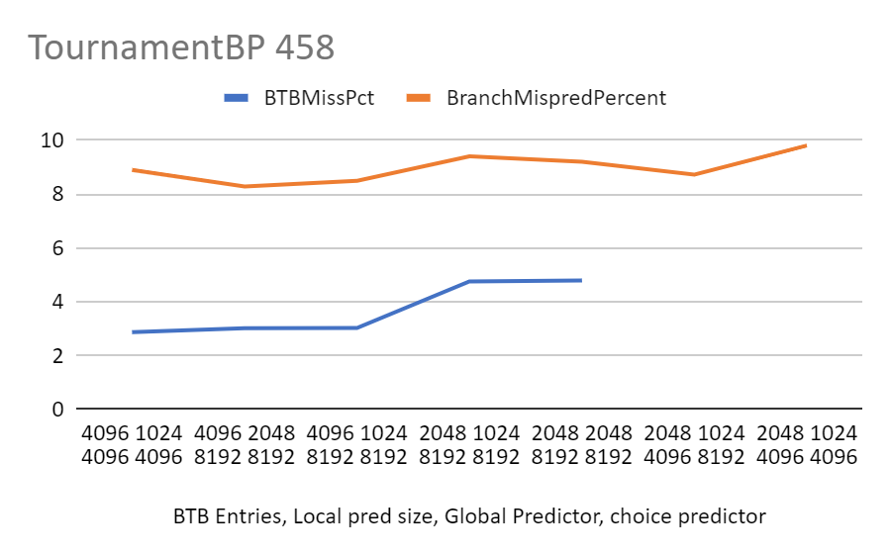
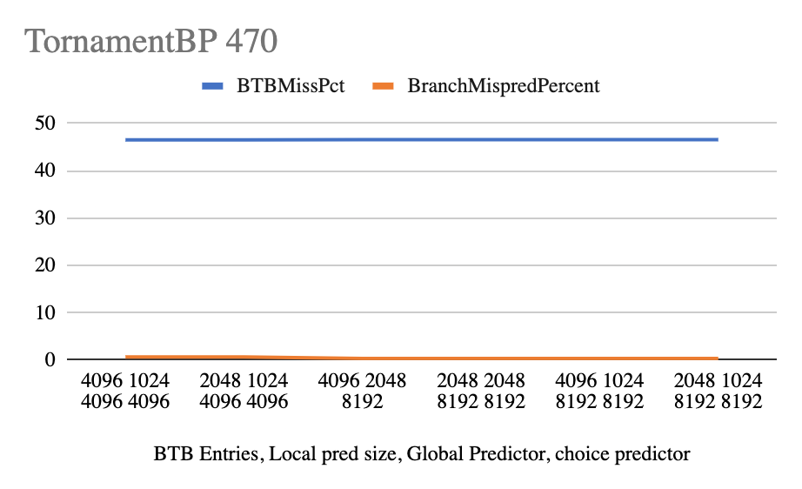

Slide 29
Observation
In both the benchmarks for tournament predictor, decreasing the predictor size by keeping BTB entries constant, there is increase in BTB miss percentage and branch mis prediction percentage. But the rate is very less compared to the values that we observed in local BP
Since the tournament predictor being a hybrid predictor, containing Local, Global and Choice predictors, reducing the branch sizes forces the predictor to now have lesser number of branch entries in its local/global history buffers
Branch predictor refers to its history register to predict the next target address, so smaller the size, more inaccurate is the prediction
We can observe that accuracy is directly proportional to size of predictors and BTB entries in both the cases
Decreasing BTB entries keeping BP size constant also results in similar trend
When we compare the data between 458.sjeng benchmark and 470.lbm , BTB miss percentage is more in 470.lbm but branch miss prediction is less
So, according to the requirement, we can choose between the two for better performance and less branch mis prediction.

Slide 30
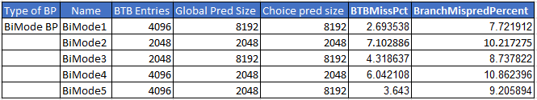
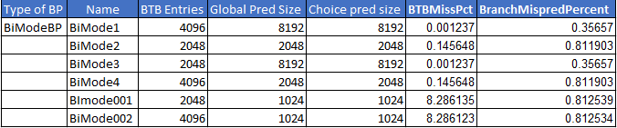
BiMode BP in 458.sjeng
BiMode BP in 470.lbm

Slide 31
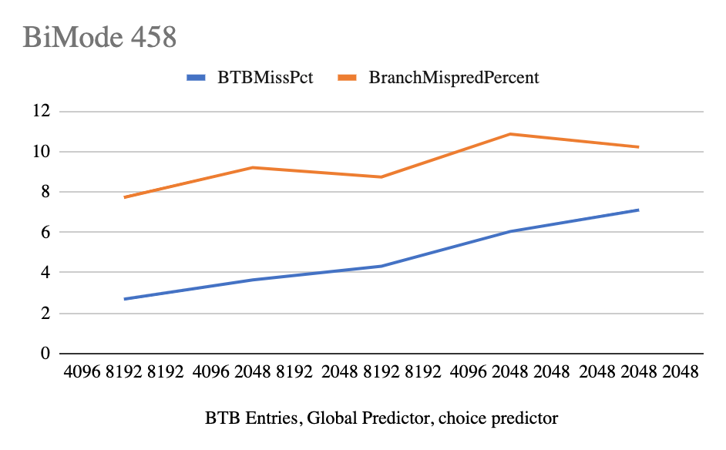
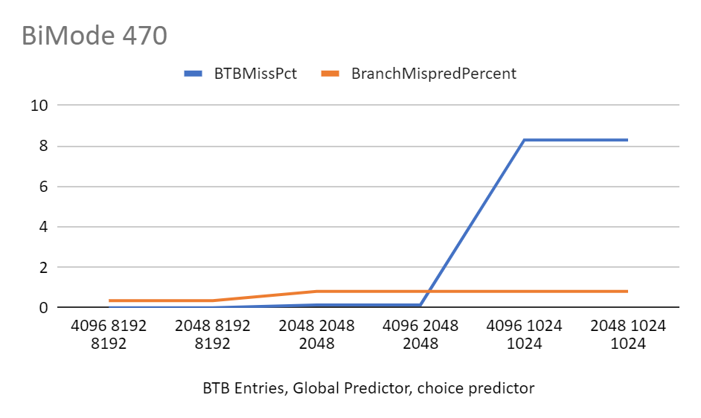

Slide 32
Observation
In both the benchmarks for Bi Mode predictor, decreasing the predictor size by keeping BTB entries constant, there is increase in BTB miss percentage and branch mis prediction percentage
BiMode predictor performs better when compared to Local predictor, but has very similar scoring as tournament predictor
Reducing the table size (BTB entries) also increases the inaccuracy but the change observed is very less
With a reduced branch size, lesser amount of branch history is stored. This causes the reduction in performance we observe in the data tables

Slide 33
Conclusion
In 458.sjeng benchmark among all the branch predictors, Tournament BP is way better than local BP but when compared with BiMode BP, it is very close yet is more consistent with the values which means rate of change is very less while we change the parameters
In 470.lbm, local BP fluctuates a lot with change in parameters. Tournament BP has very high BTB miss rate even though misprediction percentage is less. BiMode has less BTB miss Percentage but fluctuates more compared to Tournament BP. Considering branch misprediction, tournament BP makes better BP in this particular benchmark overtaking BiMode by slight margin

Slide 34
References
http://pages.cs.wisc.edu/~swilson/gem5-docs/
https://www.gem5.org/

Slide 35
THANK YOU

