Slide 1






Scalable Network I/O:
From select to io_uring
Empirical Performance & Architectural Analysis of Linux Socket Multiplexing

Slide 2




The C10K Concurrency Problem
Thread-per-Client Limitation: Traditional blocking servers spawn a dedicated OS thread per client connection, allocating ~8MB stack space each and quickly exhausting memory limits.
Context Switch Overhead: Running thousands of concurrent threads triggers intense CPU context-switching thrashing, destroying cache locality and degrading overall throughput.
Resource Exhaustion: Systems run out of memory and CPU cycles long before saturating the physical network bandwidth available.
Core Architectural Goal: Shift from blocking multithreading to high-efficiency single-threaded event loops and asynchronous kernel completion queues.

Slide 3
Evolution of Linux I/O Models
Examining the paradigm shift from synchronous readiness polling to zero-syscall asynchronous completion rings.

Slide 4



Synchronous Readiness: select() vs poll()
select() Mechanics
poll() Mechanics
Fixed FD Cap: Hard-capped at 1,024 file descriptors defined by FD_SETSIZE in the Linux kernel.
Dynamic Arrays: Uses an array of struct pollfd, successfully removing the 1,024 descriptor limit.
User-Kernel Copies: Bitmask sets must be fully copied from user space to kernel space on every loop iteration.
Memory Re-use: Separates input events from output results, avoiding full bitmask rebuilds every cycle.
O(N) Scans: Application code must iterate through all socket numbers linearly to find which ones are ready for reading or writing.
O(N) Scaling Bottleneck: Both the kernel and application must still iterate over the entire array per event, causing performance degradation under heavy load.

Slide 5







Event-Driven Scalability: epoll()
Red-Black Tree
O(1) Ready Queue
Edge-Triggered Mode
Monitored sockets are registered once in kernel memory via epoll_ctl(), completely eliminating per-iteration memory copies.
Hardware NIC interrupts populate a ready linked list. epoll_wait() returns only ready sockets in constant O(1) time.
EPOLLET delivers notifications only on socket state transitions, demanding non-blocking read/write loops until EAGAIN.

Slide 6

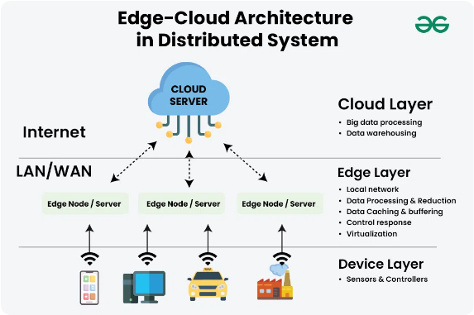
True Asynchronous Completion: io_uring
Completion Paradigm: Moves beyond "readiness notification" (epoll) to executing I/O asynchronously and posting completion events.
Shared Lockless Rings: Communicates via two ring buffers—Submission Queue (SQ) and Completion Queue (CQ)—mapped into shared kernel-user memory.
Zero Syscall Overhead: Requests and results are submitted and consumed without per-I/O system call context switches.
Maximum Throughput: Eliminates kernel-trap latency on hot path execution, enabling peak CPU efficiency at high scale.

Slide 7



Implementation & System Codebase
Production C Servers
Testing & Benchmark Harness
5 Complete Implementations: Built standalone, fully functional C TCP echo servers for Blocking, select, poll, epoll, and io_uring.
Validation Script: Python test suite (test_servers.py) verifying payload echo integrity and clean socket disconnects.
Shared Utilities: Developed common.h for non-blocking socket flag configuration and robust memory safety error handling.
Async Load Generator: Custom Python asyncio benchmark script generating up to 5,000 persistent parallel client connections.
Build Pipeline: Automated build system using GCC with -O3 optimization and strict diagnostic flags.
Metrics Tracked: Real-time request throughput (req/s), connection scaling limits, and Resident Set Size (RSS) memory consumption.

Slide 8


Functional Verification & Correctness
Server Binary | Architecture Type | Verification Criteria | Test Status
server_blocking | Thread-per-client multithreading | Exact payload echo & socket disconnect cleanup
server_select | Synchronous fd_set bitmask multiplexing | Exact payload echo & socket disconnect cleanup
server_poll | Array-based struct pollfd multiplexing | Exact payload echo & socket disconnect cleanup
server_epoll | Edge-triggered O(1) event queue | Exact payload echo & socket disconnect cleanup
server_uring | Async completion ring buffer | Exact payload echo & socket disconnect cleanup
Suite Summary: 100% Pass Rate across all 5 C server implementations on Linux x86_64.

Slide 9


Empirical Performance Benchmarks
I/O Model | 10 Conns | 500 Conns | 1,000 Conns | 5,000 Conns | Key Finding
Blocking | 27,431 req/s | 37,707 req/s | 37,883 req/s | 32,373 req/s | High RSS memory overhead (~12.4 MB)
select() | 89,682 req/s | 117,831 req/s | 87,445 req/s |  | Hard capped at 1,024 File Descriptors
poll() | 78,590 req/s | 123,672 req/s | 108,819 req/s | 77,367 req/s | O(N) CPU array scanning penalty
epoll() | 75,667 req/s | 79,541 req/s | 71,059 req/s | 56,459 req/s | O(1) queue stability (~1.5 MB RSS)
io_uring | 65,636 req/s | 70,026 req/s | 64,213 req/s | 46,399 req/s | Zero per-I/O system call overhead

Slide 10



Architectural Trade-offs
Syscall & CPU Overhead
Memory Footprint (RSS)
O(N) CPU Degradation: select() and poll() suffer from severe CPU overhead under thousands of sockets due to scanning inactive connections.
Stack Overhead: Blocking multithreading consumes ~12.4 MB RSS at high load due to thread stack allocations.
Lightweight Footprint: epoll maintains a sleek ~1.5 MB RSS footprint even with 5,000 active concurrent connections.
O(1) Predictability: epoll maintains constant event processing latency regardless of idle connection counts.
FD Limit Wall: select() fails completely past 1,024 file descriptors, rendering it unfit for modern high-density web services.
Zero-Syscall Batching: io_uring batches Submission Queue Entries (SQEs), minimizing kernel traps on high-volume I/O pipelines.

Slide 11







Core Architectural Takeaways
Event-Driven Model
Kernel Structures
Production Standard
Single-threaded event loops eliminate thread-creation overhead and context switching thrashing, unlocking reliable high concurrency.
In-kernel Red-Black trees and ready lists keep per-socket overhead under a few kilobytes, maximizing memory efficiency.
epoll remains the industry benchmark for socket readiness, while io_uring represents the future of async Linux I/O.

Slide 12

Questions & Discussion
Full implementation, reports, and benchmark scripts are available in the repository.
CS331: Computer Networks | Team T002 | Project ID: 13

