Slide 1
PROJECT
DIGITAL SIGNAL PROCESSING
Sapta Swaras Analysis And Generation Of Graha Bedham
EE19B047 M.Suchithra
EE19B049 Surya Pratap

Slide 2
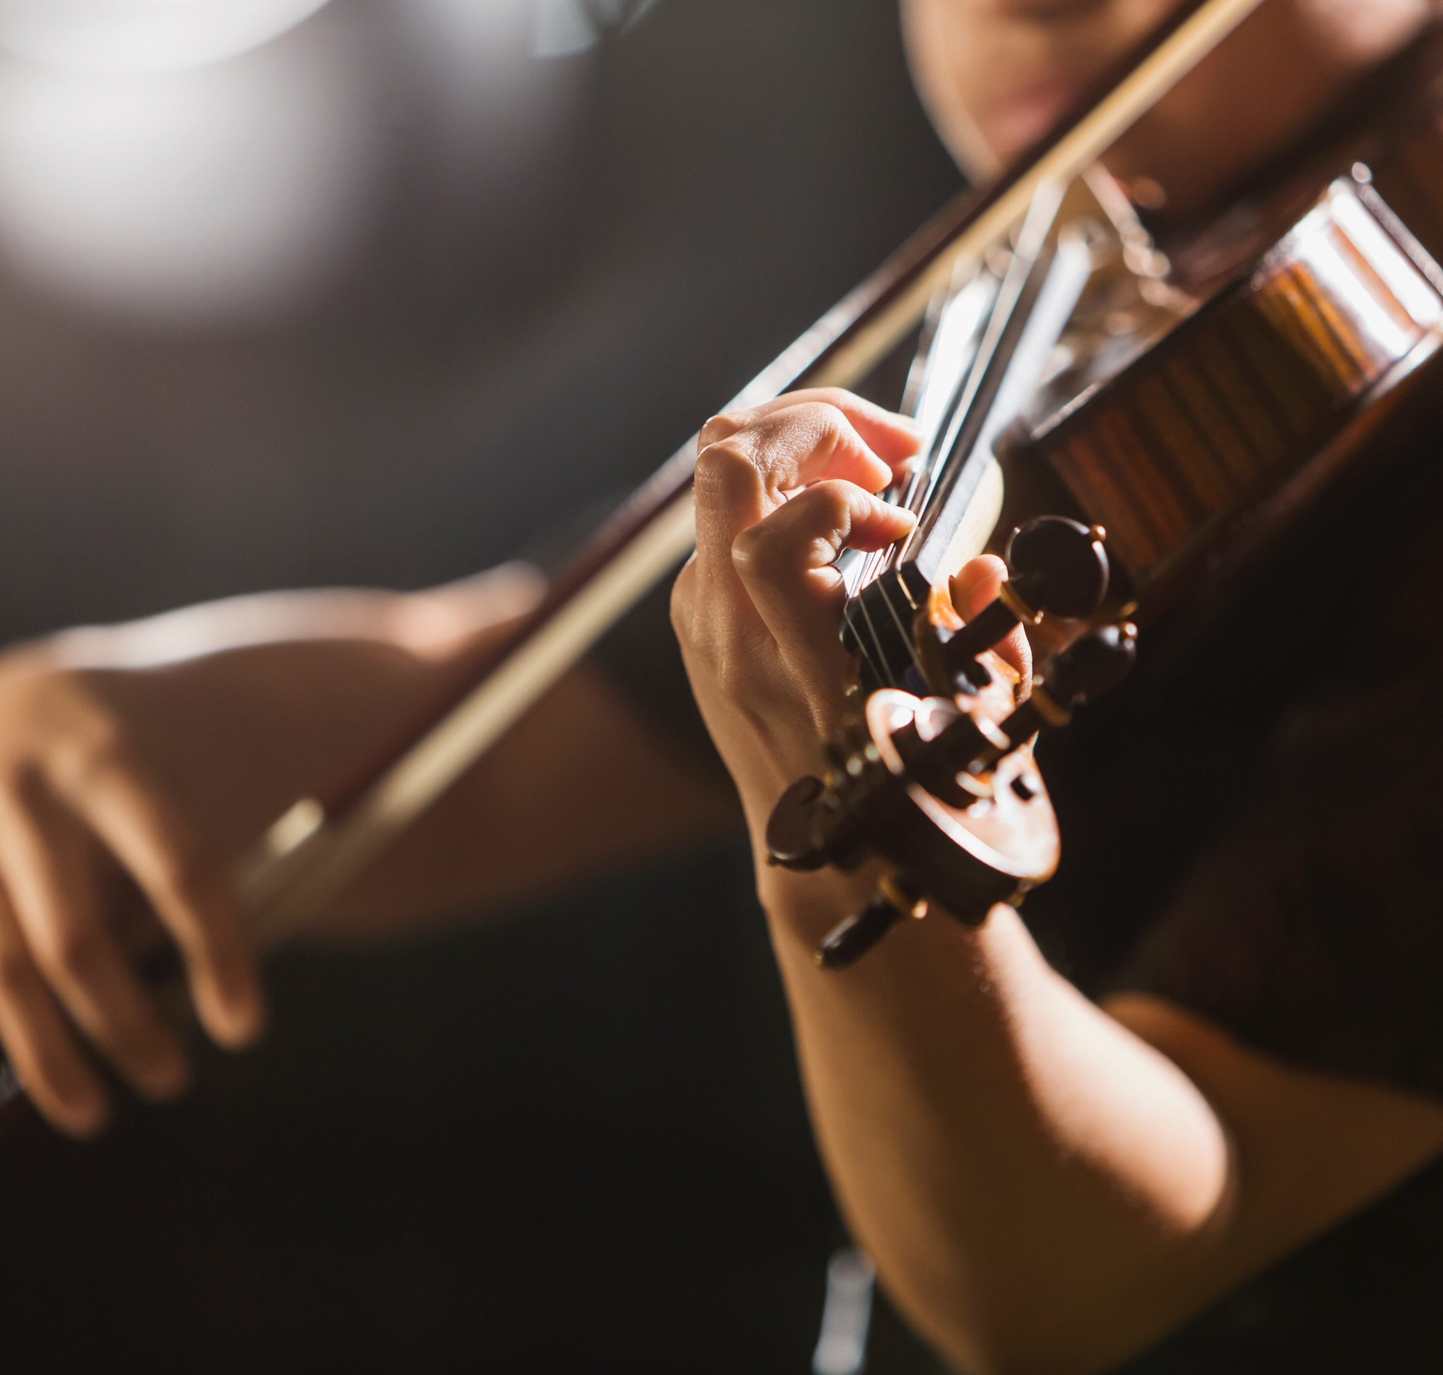
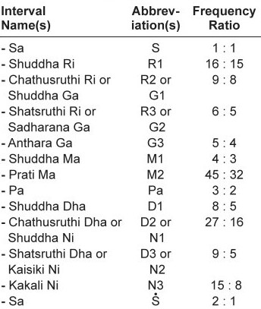


ANALYSIS OF SWAPTHA SWARAS:
Carnatic Music
SA RI GA MA PA DA NI
Sa:Ga:Pa ::4:5:6
Ma:Da:Sa’::4:5:6
Pa:Ne:Ri’::4:5:6

Slide 3
GENERATION OF GRAHA BEDHAM:
Graha Bhedam in Carnatic music is the process of shifting the Tonic note (sruti) to another note in the ragam and arriving at a different ragam.
Graha literally means position and Bhedam means change.Since the position of the sruti changed it is also sometimes called Swara Bhedam or Sruti Bhedam.

Slide 4
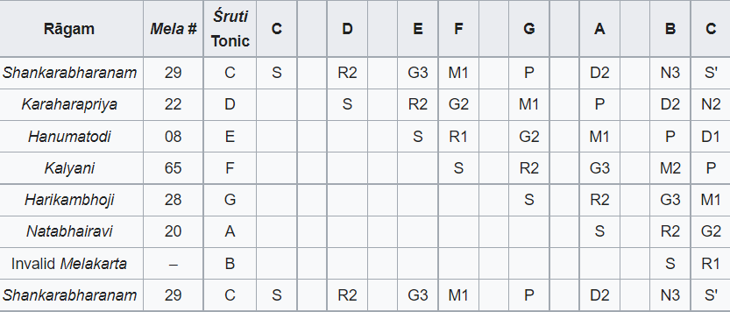
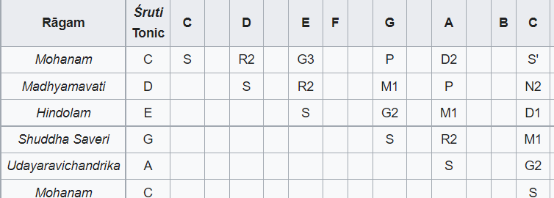
Shankarabharanam:
Mohanam:

Slide 5
Graha bedham logic
d=zeros(1,length(l)); % l is the input
d(1)=1;
for i=1:length(d)-2
d(i+1)=l(i+2)-l(i+1)+d(i);
end
d(end)=13;
Explanation:
To get the derivative of the input ragam we shift the second element of the input ragam to the base frequency(sa) and correspondingly the other sruti will also change in such a way that the gaps between the srutis in input ragam and its derivative are same.

Slide 6
THANK YOU
Source:
https://en.wikipedia.org/wiki/Graha_bhedam

