Slide 1
PORTFOLIO PROJECT
E-Commerce
Sales & Customer
Analytics
From raw transactional data to business recommendations
EXCEL
MYSQL
POWER BI
DAX
Business Intelligence • Data Analytics

Slide 2
01 • PROJECT
The business story in numbers
A concise view of what the analysis uncovered.
REVENUE
ORDERS
CUSTOMERS
REPEAT RATE
$9.08M
20,000
5,000
84.86%
Total revenue analyzed.
Transactions across the dataset.
Unique customers analyzed.
A major customer-retention strength.
What I set out to answer
• Where is revenue coming from?
• Which customers and products create the most value?
• Where are the operational risks?
• What should the business focus on next?
ANALYTICAL APPROACH
Transform → Validate → Model → Measure → Visualize → Recommend
02

Slide 3
02 • EXCEL + POWER QUERY
Data preparation came first
The objective was to create a clean, consistent dataset before reporting.
Excel analysis layer
POWER QUERY
Make the data
analysis-ready.
COUNTIF / COUNTIFS
Customer repetition & order counts
SUMIF / SUMIFS
Revenue and spending analysis
• Changed data types
• Renamed columns
• Handled missing / null values
• Created custom columns
• Validated transformed data
IFS / IF
Customer & spending classifications
Pivot Tables + Charts
Business summaries and trends
Slicers
Interactive dashboard filtering
OUTPUT
A repeatable MIS reporting layer for sales, customers and products.
03

Slide 4
03 • MYSQL
Turn data into business questions
SQL was used for date correction, joins, aggregation, ranking and validation.
SQL techniques
DATA QUALITY FIX
Text date → DATE / DATETIME
JOINs
GROUP BY
SUM / COUNT / AVG
Reliable time-based analysis
Subqueries
DENSE_RANK()
WHY IT MATTERED
BUSINESS QUERIES
• Top customers and top products
• Most-sold products and popular categories
• Average product price by category
• Never-purchased customers
• Out-of-stock products
• Top 3 products within each category
SQL gave me a validated analytical view before building the Power BI model.
04

Slide 5
04 • POWER BI
Build the model. Then measure it.
Relationships connected the business entities; DAX converted them into reusable KPIs.
DATA MODEL
Customers
→
Orders
→
OrderItems
→
Products
→
Categories
CustomerID
CustomerID • OrderID
OrderID • ProductID
ProductID • CategoryID
CategoryID
DAX KPI layer
CALCULATED COLUMNS
$9.08M
20K
5K
• Customer segmentation
• Customer type / retention
• Spending distribution
• Row-level classifications
Revenue
Orders
Customers
$454
87.7K
84.86%
AOV
Units
Repeat Rate
05

Slide 6
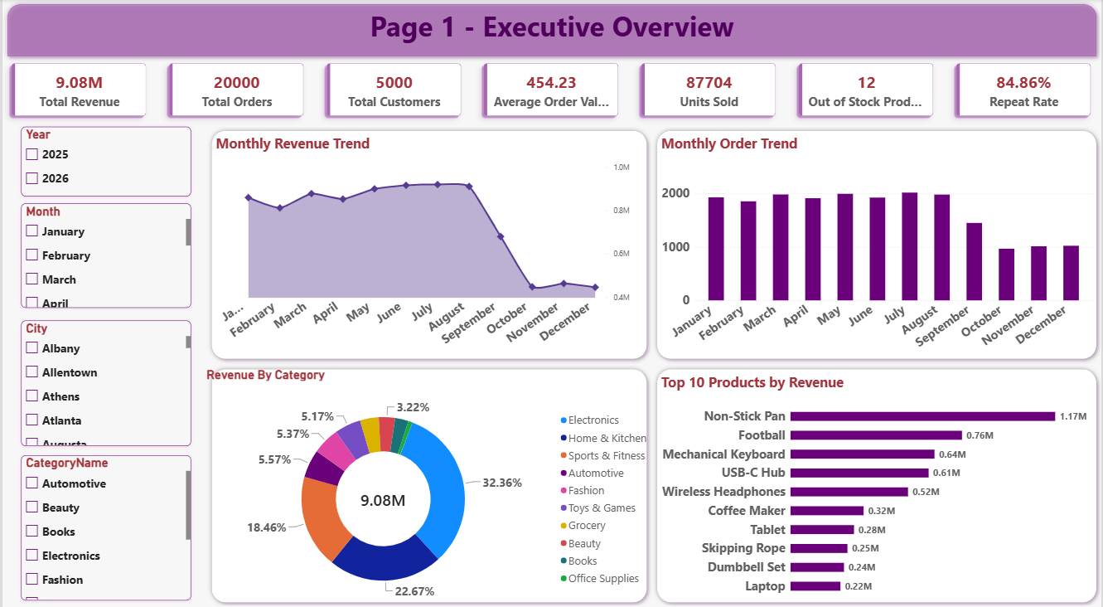
05 • DASHBOARD
Executive Overview
One page to monitor revenue, orders, customers, categories and product performance.
06

Slide 7
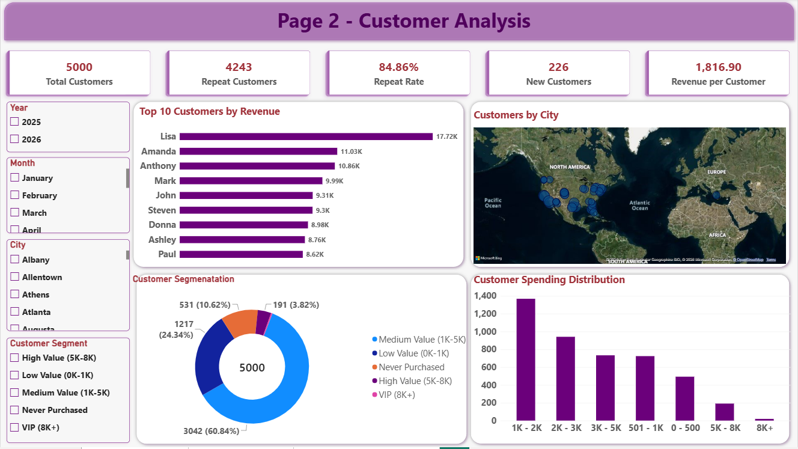
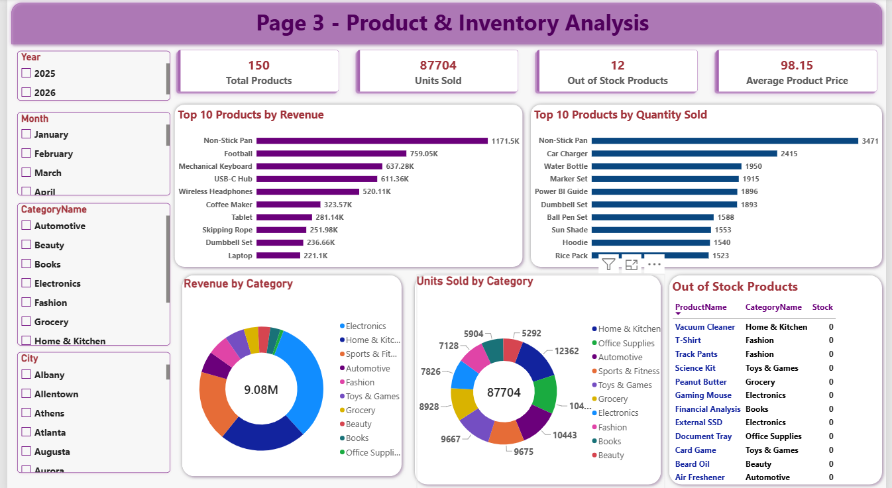
06 • DASHBOARD
Customer + Product Intelligence
Focused views for retention, spending, product performance and inventory.
CUSTOMER ANALYSIS
PRODUCT & INVENTORY
07

Slide 8
07 • BUSINESS IMPACT
What the data says.
What the business should do.
RETENTION
CONCENTRATION
ACTIVATION
84.86%
~73.5%
531
Customer repeat behavior is a major strength.
Three categories drive most revenue.
Customers had never placed an order.
INVENTORY
SALES TREND
PRIORITIES
12 / 150
↓ After Aug
• Investigate post-August decline
• Protect high-demand products
• Grow Medium-Value customers
• Activate never-purchased customers
Products were out of stock.
Revenue and orders need root-cause analysis.
FINAL TAKEAWAY
Strong retention + strong revenue, with clear opportunities in sales recovery, inventory planning and customer value growth.
EXCEL • MYSQL • POWER BI • DAX
08

