Slide 1

Frito Lay
Employee Analysis
Case Study 2 | Brandon Sucrese

Slide 2
Predicting Attrition: Important Variables
MOST IMPORTANT POSITIVE/NEGATIVE FACTORS
Monthly Income
Age
Total Working Years
Years at the Company
Daily Rate
Distance from Home

Slide 3
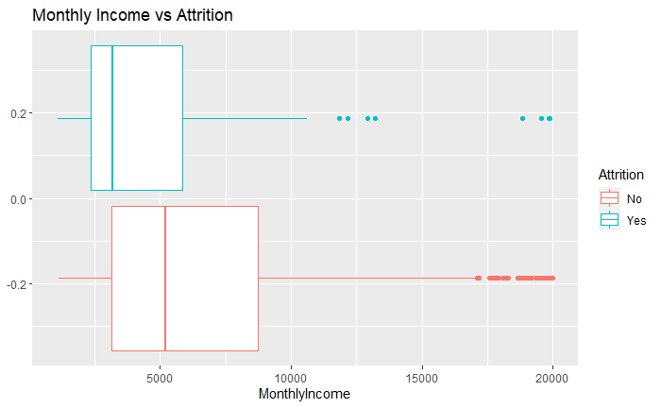
Predicting Attrition: Monthly Income

Slide 4
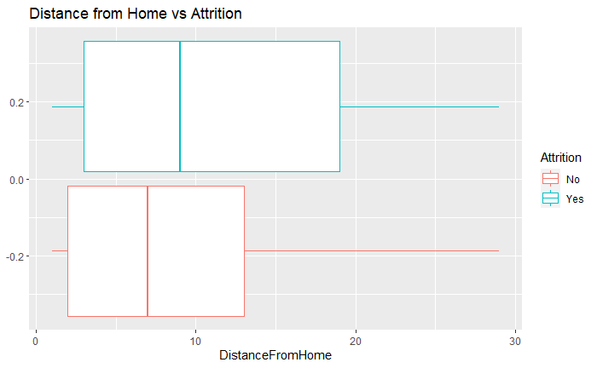
Predicting Attrition: Distance From Home

Slide 5
Predicting Attrition: Model Performance
Target Sensitivity/Specificity
0.600/0.600
Model Sensitivity/Specificity
0.8667/0.833
Model Type | Accuracy | Sensitivity | Specificity
Simple Model (Naive Bayes) | 0.8238 | 0.9356 | 0.4407
Complex Model (Random Forest) | 0.8659 | 0.8667 | 0.8333

Slide 6
Predicting Salary: Important Variables
POSITIVE MONTHLY INCOME FACTORS
Job Level
Manager
Research Director
Working Years
Travels Rarely
POSITIVE MONTHLY INCOME FACTORS
Laboratory Technician
Research Scientist

Slide 7
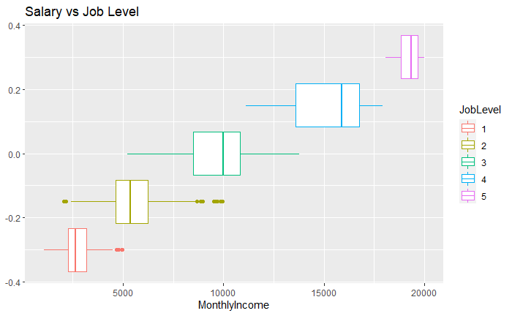
Predicting Salary: Job Levels

Slide 8
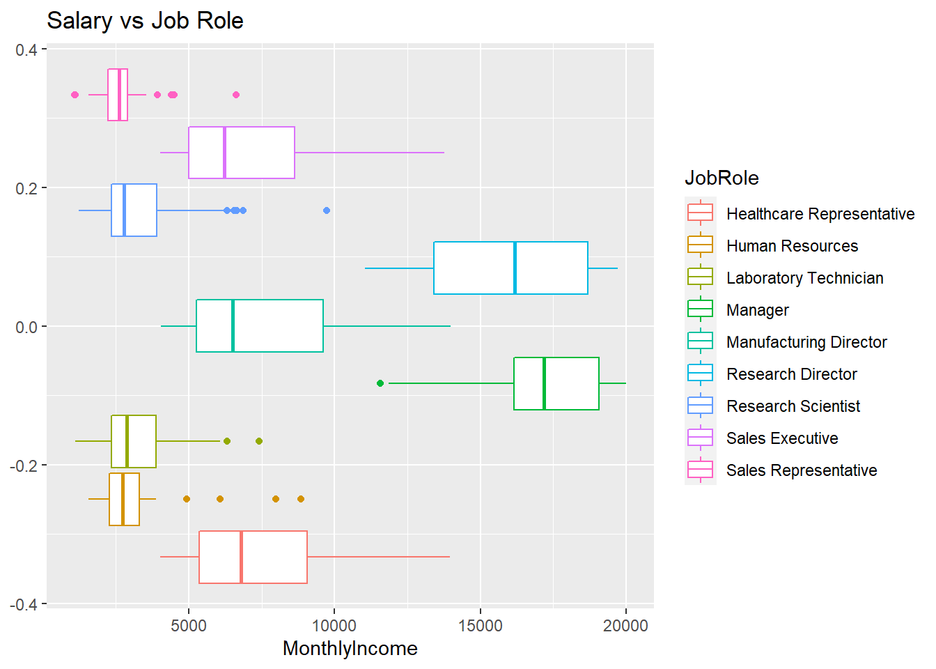
Predicting Salary: Job Role

Slide 9
Predicting Salary: Model Performance
Target Error Goal (RSME)
$<3,000
Model Error (RSME)
$1051.678
Model Type | RMSE | r2
Simple Model (Linear Regression) | 1051.678 | .9473

Slide 10
THANK YOU!

