Slide 1

University College Cork
Improving EEG seizure detection in newborns through self-distillation
Kai Deng
Notes:
proposal for improving EEG seizure detection in newborns through self-distillation.

Slide 2

01
Introduction
02
Current Research
Overview
03
Research Objectives
04
Methodology
05
Plan And Timeline

Slide 3
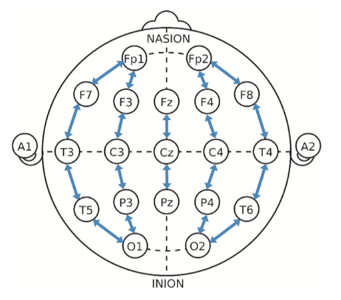
01
Introduction
The electroencephalogram (EEG), a measure of electrical activity in the brain, is an important tool in the diagnosis of neurological disorders.
Seizures is a distinct, abnormal electrographic event with a clear beginning and end comprising sustained, repetitive evolving spike/sharp waves or rhythmic waveforms [1].
For a newborn infants the seizures can only be detected through EEG.
Figure: Brain electrode position map
Source: Nature

Slide 4

Current Research
02
Current research focuses on integrating modern technologies and algorithms, as well as wearable devices, to improve the accuracy and efficiency of epilepsy detection.
Integration of EEG and ECG[2]
Deep Learning[3]
Wearable EEG[4]
Source: Isaac Hunter
Notes:
1. Integration of EEG and ECG:
- Algorithm combining EEG and ECG is proposed to improve the accuracy and efficiency of detection.
The sensitivity is 92% but the false alarm rate is 1.85 per hour.
2. Deep Learning Applications:
- Use deep learning techniques to process EEG data, including mixed time-frequency EEG inputs, and semi-supervised generative adversarial networks.
SeizNet: sensitive 93.3%, False alarm 0.58 per hour.
FCN (full connect network): sensitive 99.6%, false alarm 0.5 per hour.
LSTM performance is not well, only 87.7 accuracy.
3. Wearable EEG:
- Wearable EEG devices for long-term monitoring and epilepsy management, particularly in non-clinical settings.
Average sensitive: 78.83%
But the result looks wired, it is looks like the third one is do the real experimental but the result is low.

Slide 5

Research Objectives
03
Develop a machine learning model using self-distillation to improve the accuracy of EEG-based neonatal seizure detection.
Compare the performance of the self-distilled model against traditional methods.
Assess the model's ability to generalize across different sets of EEG data.
Source: Anisarianii

Slide 6

Methodology
03
Need to discuss
Source: SCISPACE

Slide 7

Plan And Timeline
04
From mid to end of May.
- Focus on intensive literature review.
- Finish introduction part.
- Finish Literature review part.
From June to July.
- Discuss research questions and methodology.
- Start experimental and coding.
- Finish the methodology part.
- Finish Result part.
From start of August to mid of August.
- Finish discussion, conclusion and abstract.
Rest time.
- Prepare slides and practice presentation.
Source: One Calendar

Slide 8
[1] S. N. J, K. Tapani, L. Lauronen, and S. Vanhatalo, “A dataset of neonatal EEG recordings with seizure annotations,” Scientific Data, vol. 6, no. 1, p. 190039, 2019, doi: https://doi.org/10.1038/sdata.2019.39.
01
[2] Amr Zeedan, Khaled Al-Fakhroo, and Abdulaziz Barakeh, “EEG-Based Seizure Detection Using Feed- Forward and LSTM Neural Networks Based on a Neonates Dataset,” OPAL (Open@LaTrobe) (La Trobe University), Sep. 2022, doi: https://doi.org/10.36227/techrxiv.20728411.
02
Reference
[3] M. Bhagubai et al., “The Power of ECG in Semi-Automated Seizure Detection in Addition to Two-Channel behind-the-Ear EEG,” Bioengineering, vol. 10, no. 4, pp. 491–491, Apr. 2023, doi: https://doi.org/10.3390/bioengineering10040491.
03
[4] G. Japaridze et al., “Automated detection of absence seizures using a wearable electroencephalographic device: a phase 3 validation study and feasibility of automated behavioral testing,” Epilepsia, Mar. 2022, doi: https://doi.org/10.1111/epi.17200.
04

Slide 9



University College Cork
Thank You

