Slide 1
Part-1

Slide 2
PA current source

Slide 3
Part-2

Slide 4
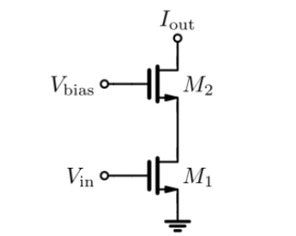
Circuit
Cascode amplifier combines a common source(M1) and a common gate stage (cascode device, M2).
They are used in operational amplifiers that implement very large voltage gains and in precision current mirrors.
The resistance looking into drain of cascode device M2 is quite high.
The overall gain of the circuit is given as:
  gm,1*ro,1*gm,2*ro,2

Slide 5
Layout generation
Layout of parameterized cascode common source
DRC
LVS

Slide 6
Ngspice testbench

Slide 7
Simulation testbench

