Slide 1

Introduction to ARM Cortex-M Processors
CDAC ACTS, Pune

Slide 2
My promise !
I am confident that this course will save you many, many hours of studying/experimenting/googling time to learn about this processor.
I stand behind this course 100% and am committed to helping you .
A Promise that I need from you !
Daily 30Mins of Revision of what is taught in the class

Slide 3
What am I going to get from this course?
Programming Micro-controllers using ‘C'
Learn about embedded software development and debugging using STM Cube IDE
Learn about Mixed ‘C’ and Assembly Coding
Demystifying Memory, Bus interfaces, NVIC, Exception handling with lots of animation
Low level register Programming for interrupts, System Exceptions, Setting Priorities, Preemption etc.
Learn writing IRQ handlers , IRQ numbers, NVIC and many more
Learn about OS related features like SVC, SysTick, PendSv and many more

Slide 4
Cortex M3 @ S/W Developer point of View
Programming Model
How exceptions are handled
The Memory Map
Peripheral Interfacing
How to use software driver libraries from Microcontroller Vendor.
CMSIS Core API’s
STM32CUBE Libraries

Slide 5
Agenda
What are the ARM Cortex M Processors?
The CortexM3 and M4 Processors
The Cortex-M Processor Family
Advantage of the Cortex-M Processors
Low Power
Performance
Energy Efficiency
Code Density
Interrupts
Ease of use, C friendly
Scalability
Application of the ARM Cortex-M Processor
Background and History
ARM processor evolution
Architecture versions and Thumb ISA

Slide 6

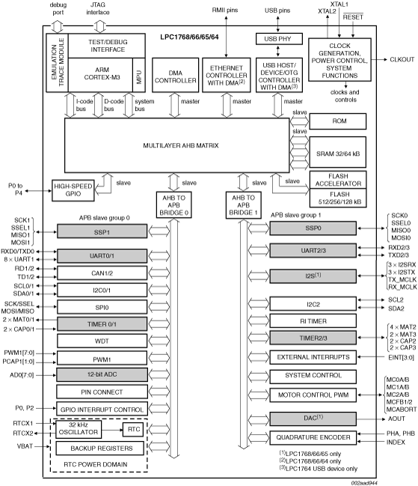
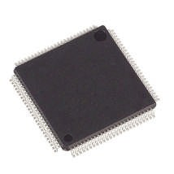

What’s Happening in Microcontrollers?
Microcontrollers are getting cheap
32-bit ARM Cortex-M3 Microcontrollers @ INR 1200
Some microcontrollers sell for as little as INR 400
Microcontrollers are getting powerful
Lots of processing, memory, I/O in one package
Floating-point is even available in some!
Microcontrollers are getting interactive
Internet connectivity, new sensors and actuators
LCD and display controllers are common
Creates new opportunities for microcontrollers

Slide 7
What are ARM Cortex M processors?
The Cortex-M3 and Cortex-M4 are processors designed by ARM. The Cortex-M3 processor was the first of the Cortex generation of processors, released by ARM in 2005 (silicon products released in 2006). The Cortex-M4 processor was released in 2010 (released products also in 2010).
The Cortex-M3 and Cortex-M4 processors use a 32-bit architecture.
Internal registers in the register bank, the data path, and the bus interfaces are all 32 bits wide. The Instruction Set Architecture (ISA) in the Cortex-M processors is called the Thumb ISA and is based on Thumb-2 Technology which supports a mixture of 16-bit and 32-bit instructions.

Slide 8
Microcontroller Containing ARM IP Products

Slide 9
ARM Cortex-M3 Microcontroller
▪
▪
▪
▪
▪
▪
18 x 32-bit registers Excellent compiler target
Reduced pin count requirements Efficient interrupt handling Power management
Efficient debug and development support features
Breakpoints, Watchpoints,
Flash Patch support,
Instruction Trace Strong OS support
User/Supervisor model
OS support features
Designed to be fully programmed in C (even reset, interrupts and exceptions)
▪
▪

Slide 10
ARM Cortex-M3 Microcontroller
▪
▪
▪
▪
▪
▪
▪
▪
▪
▪
▪
▪
▪
ARMv7M Architecture No Cache - No MMU
Debug is optimized for microcontroller applications Vector table contains addresses, not instructions
DIV instruction
Interrupts automatically save/restore state
Exceptions programmed in C (No Coprocessor 15 - All registers are memory-mapped) Interrupt controller is part of Cortex-M3 macrocell
Fixed memory map Bit-banding
Non-Maskable Interrupt (NMI) Only one processor status reg Thumb-2 processing core
▪
▪
Mix of 16 and 32 bit instructions for very high code density Gives complete Thumb compatibility

Slide 11
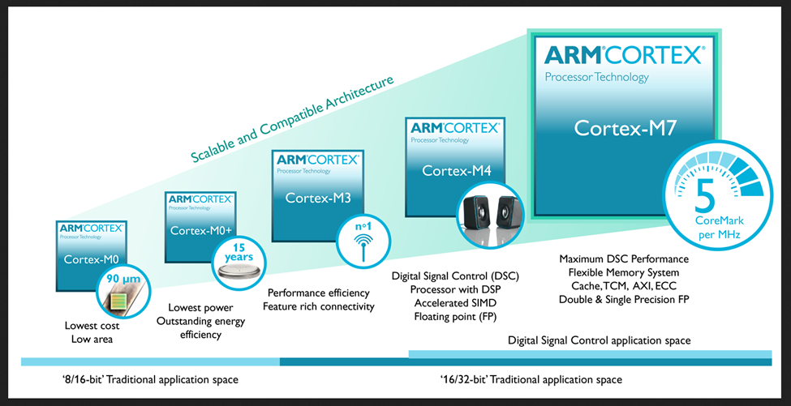
The Cortex M Processor Family

Slide 12
Advantage of Cortex –M Processor
Low Power
Currently, many Cortex-M microcontrollers have power consumption of less than 200 uA/MHz, with some of them well under 100 uA/MHz. In addition, the Cortex-M processors also include support for sleep mode features and can be used with various advanced ultra-low power design technologies.
Performance
The Cortex-M3 and Cortex-M4 processors can deliver over 3 CoreMark/MHz & 1.25 DMIPS
Energy Efficiency
Code Density
Interrupts
Ease of use, C friendly

Slide 13
Features Cont.
Scalability
Debug Friendly
OS Support
Versatile system features
Bit Banding
MPU
Software portability and reusability
CMSIS
Application of Cortex M Processors
Microcontrollers
Automotive
Industrial Control
Consumer Products
DSP

Slide 14
Architecture Version and Thumb ISA
The successful ARM7TDMI is based on the architecture version ARMv4T (The “T” means Thumb instruction support).
Note that architecture version numbers are independent of processor names.
The Architecture version 7 is divided into three profiles
Cortex-A Processors: ARMv7-A Architecture
Cortex-R Processors: ARMv7-R Architecture
Cortex-M Processors: ARMv7-M ,ARMv7-EM(for M4) ARMv6-M Architectures

Slide 15
ISA Enhancement and Evolution

Slide 16
Introduction to Embedded Software Development
CDAC ACTS, Pune

Slide 17
Agenda
What are inside typical ARM microcontrollers?
What you need to start
Development Suites
Development Boards
Debug Adaptor
Documentation and other resources
Software Development Flow
Compiling your Application
Software flow
Polling
Interrupt Driven
Multi Tasking System
Input, output and peripherals accesses
Microcontroller interfaces
Cortex Microcontroller software interface standard (CMSIS)

Slide 18








What are inside typical ARM µC.
In many microcontrollers, the processor takes less than 10% of the silicon area, and the rest of the silicon die is occupied by other components such as:
Program memory (e.g., flash memory)
SRAM
Peripherals
Internal bus infrastructure
Clock generator (including Phase Locked Loop), reset generator, and distribution network for these signals
Voltage regulator and power control circuits
Other analog components (e.g., ADC, DAC, voltage reference circuits)
I/O pads

Slide 19
What you need to start
Development suites
STM32CubeIDE (PG-DESD)
Development Board
STM32F4 Discovery Board (PG-DESD)
Debug Adaptor
STLinkv2 (PG-DESD)
Documents and other Resources
Link to Resources

Slide 20
Software Development Flow

Slide 21
Software Compiling Flow

Slide 22
Polling Flow

Slide 23

Interrupt Driven

Slide 24
Managing the ISR
The code inside an ISR is generally kept as short as possible, in order to minimize the amount of time spent in the interrupt.
This is important for a few reasons:
If the interrupt occurs very often and the ISR contains a lot of instructions, there is a chance that the ISR won't return before being called again.
For communication peripherals such as UART or SPI, this will mean dropped data (which obviously isn't desirable).
Another reason to keep the code short is because other interrupts also need to be serviced.
One way of achieving minimal instructions and responsibility in the ISR is to do the smallest amount of work possible inside the ISR and then set a flag that is checked by code running in the super loop.

Slide 25
Direct Memory Access Systems

Slide 26
DMA Transfer Use Case
In the case of receiving a stream of bytes from a UART without DMA, information from the UART will move into the UART registers, be read by the CPU, and then pushed out to RAM for storage:
1. The CPU must detect when an individual byte (or word) has been received, either by polling the UART register flags, or by setting up an interrupt service routine that will be fired when a byte is ready.
2. After the byte is transferred from the UART, the CPU can then place it into RAM for further processing.
3. Steps 1 and 2 are repeated until the entire message is received.
When DMA is used in the same scenario, the following happens:
1. The CPU configures the DMA controller and peripheral for the transfer.
2. The DMA controller takes care of ALL transfers between the UART peripheral and RAM. This requires no intervention from the CPU.
3. The CPU will be notified when the entire transfer is complete, and it can go directly to processing the entire byte stream.

Slide 27
Need for an RTOS..!!
If the system is dealing with a limited number of responsibilities and none of them are especially complicated or time-consuming, then there may be no need for anything more sophisticated than a super loop.
If the system is also responsible for generating a User Interface (UI), running complex time-consuming algorithms, or dealing with complex communication stacks, it is very likely that these tasks will take a non-trivial amount of time.
These are the types of systems where an RTOS is needed. Guaranteeing that the most time critical tasks are always running when necessary and scheduling lower priority tasks to run whenever spare time is available is a strong point of preemptive schedulers. In this type of setup, the critical sensor readings could be pushed into their own task and assigned a high priority – effectively interrupting anything else in the system (except ISRs) when it was time to deal with the sensor. That complex communication stack could be assigned a lower priority than the critical sensor.

Slide 28
Multi Tasking System
In these applications, a Real-Time Operating System(RTOS) can be used to handle the task scheduling.
An RTOS allows multiple processes to be executed
concurrently, by dividing the processor’s time into time slots and allocating the time
slots to the processes that require services.

Slide 29





RTOS to Handle Multiple Task

Slide 30
RTOS vs Superloop

Slide 31
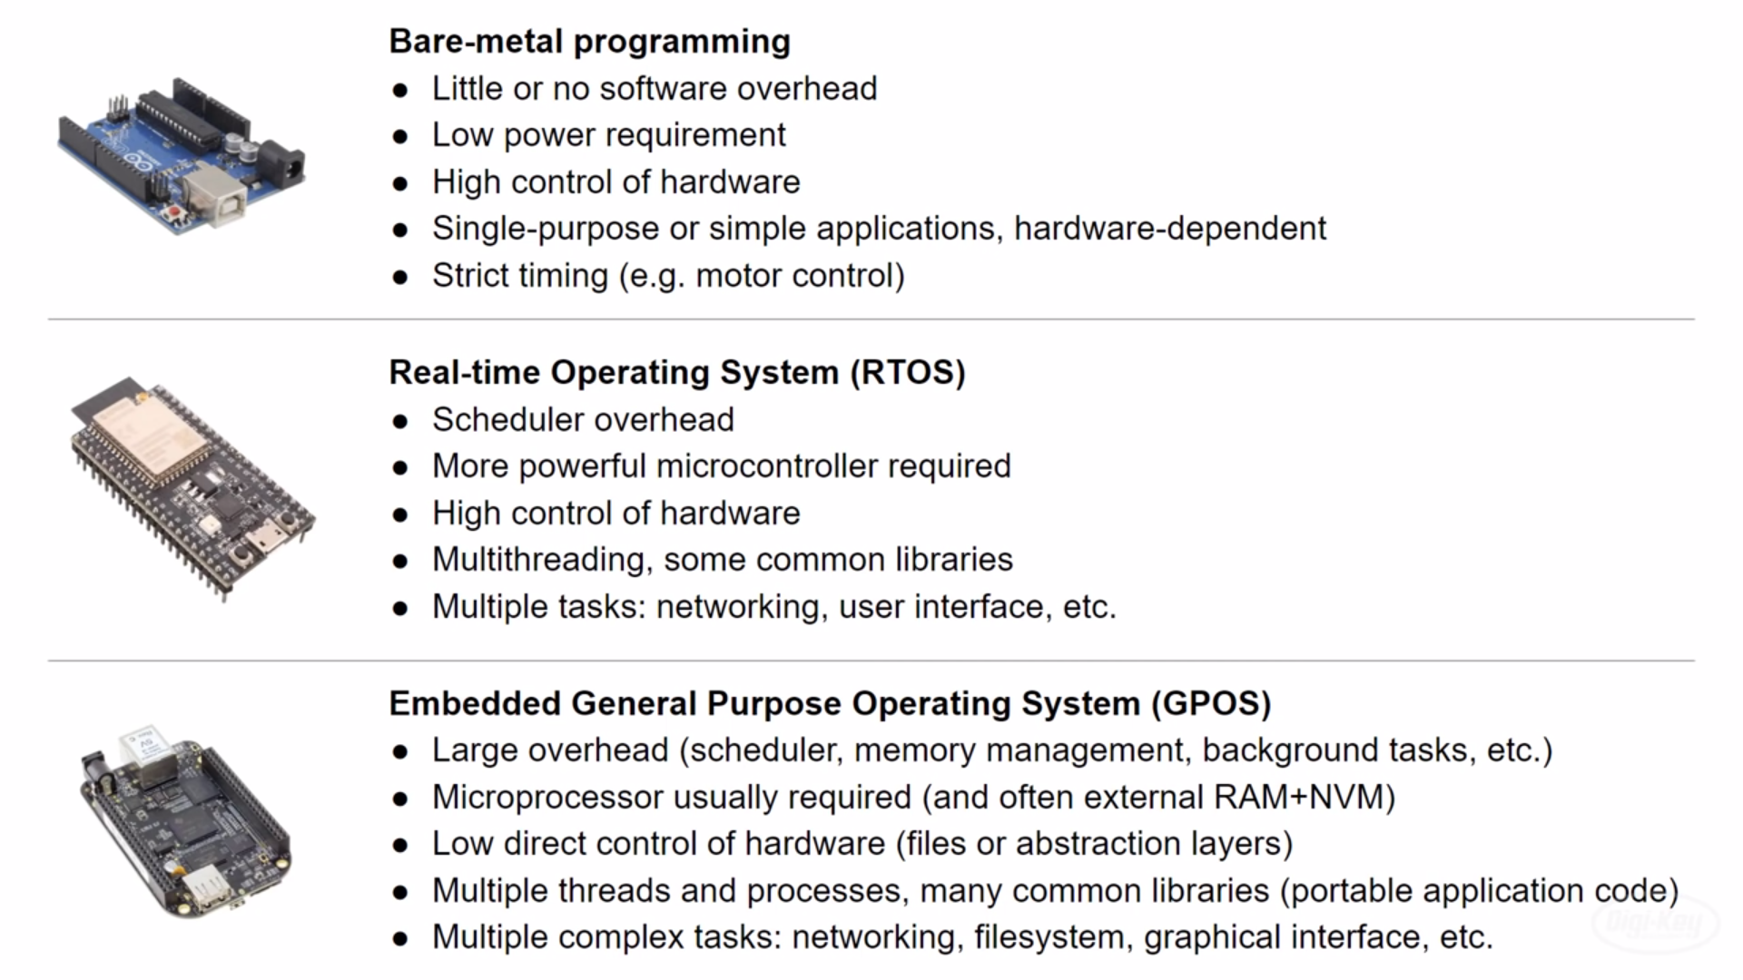
Bare-metal vs RTOS vs GPOS

Slide 32
Technical Overview
CDAC ACTS, Pune

Slide 33
Agenda
General information about Cortex M3 and M4 processors?
Processor type and Architecture
Instruction Set
Block Diagram
Memory system
Interrupt and exception support
Features of Cortex M3 and Cortex M4 Processor
Performance
Code Density
Low Power
Memory System and Protection Unit
Interrupt Handling
OS support
Debug Support
Scalability and Compatibility

Slide 34
Processor type and Architecture
All the ARM Cortex-M processors are 32-bit RISC (Reduced Instruction Set Computing) processors. They have:
32-bit registers
32-bit internal data path
32-bit bus interface
3 Stage Pipelining (FDE)
Harvard Bus Arch.(Simul. Instrn. Fetch & Data Access)
32-bit Addressing which allow 4GB address space
Load and Store Arch.
Processor Arch. ARMv7M

Slide 35
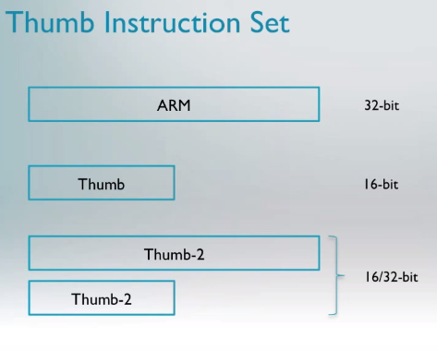

Instruction Set - Thumb2
High Performance
High Performance & High Code Density

Slide 36
ARM and Thumb Mode Switching

Slide 37
Thumb2 No Switching Req.

Slide 38
Block Diagram

Slide 39
Various Bus Interfaces on Cortex M3

Slide 40
AMBA System
High Performance ARM processor
APB
UART
High Bandwidth External Memory Interface
Timer
AHB
APB
Bridge
Keypad
High-bandwidth on-chip RAM
DMA
Bus Master
PIO
Low Power
Non-pipelined Simple Interface
High Performance Pipelined
Burst Support Multiple Bus Masters

Slide 41
Memory Map
Very simple linear 4GB memory map
The Bus Matrix partitions memory access via the AHB and PPB buses

Slide 42

Memory System & Interrupt support
Typically, the microcontroller vendor will need to add the following items to the memory system:
Program memory, typically flash
Data memory, typically SRAM
Peripherals
The Cortex-M3 and Cortex-M4 processors include an interrupt controller called the Nested Vectored Interrupt Controller (NVIC).
It is programmable and its registers are memory mapped.
The address location of the NVIC is fixed and the programmer’s model of the NVIC is consistent across all Cortex-M processors.
NVIC supports a number of system exceptions, including a Non-Maskable Interrupt (NMI).

Slide 43
Features of Cortex M3 - Performance
The three-stage pipeline allows most instructions, including multiply, to execute in a single cycle, and at the same time allows high clock frequencies for microcontroller devices typically over 100 MHz, and up to approx. 200 MHz in modern semiconductor manufacturing processes.
Multiple bus interfaces allow simultaneous instruction and data accesses to be performed.
The pipelined bus interface allows a higher clock frequency in the memory system.
The highly efficient instruction set allows complex operations to be carried out in a low numbers of instructions.
Each instruction fetch is 32-bit, and most instructions are 16-bit. Therefore, up to two instructions can be fetched at a time

Slide 44
Code Density
• Thumb-2 technology allows 16-bit instructions and 32-bit instructions to work together without any state switching overhead. Most simple operations can be carried out with a 16-bit instruction.
Various memory addressing modes for efficient data accesses
Multiple memory accesses can be carried out in a single instruction
Support for hardware divide instructions and Multiply-and-Accumulate (MAC) instructions exist in both Cortex-M3 and Cortex-M4
Instructions for bit field processing in Cortex-M3/M4
Single Instruction, multiple data (SIMD) instruction support exists in Cortex-M4
Optional single precision floating point instructions are available in Cortex

Slide 45
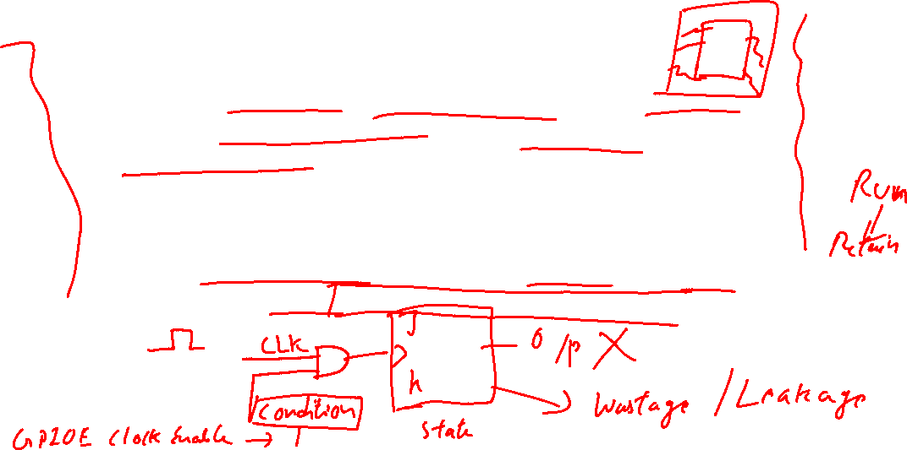
Low Power
The Cortex-M processors provide a number of low power features. These include
Multiple sleep modes defined in the architecture
Integrated architectural clock gating support, which allows clock circuits for parts of the processor to be deactivated when the section is not in use.
The processors also have additional optional hardware support:
Wakeup Interrupt Controller (WIC) to enable advanced low power technologies such as State Retention Power Gating (SRPG).

Slide 46

Memory System and Endianness
Optional bit band feature: two bit addressable regions in SRAM and peripheral regions. Bit value modifications via bit band alias addresses are converted into
atomic Read-Modify-Write operations to bit band regions.
Exclusive accesses for multi-processor system designs. This is important for semaphore operation in multi-processor systems.
Support of little endian or big endian memory systems. The Cortex-M3/M4 processors can operate in both little endian or big endian mode.
LD R1, 0x100
ADDi R1,R1,1 //if Processor 2 reads var i here then it can lead to incorrect value
SD R1, 0x100

Slide 47
Memory Protection Unit
If an MPU is included, applications can divide the memory space into a number of regions and define the access permissions for each of them.
When an access rule is violated, a fault exception is generated and the fault exception handler will be able to analyze the problem and, if possible, correct it.

Slide 48
OS Support and system level features
They have a built-in system tick timer called SysTick, which can be set up to generate regular timer interrupts for OS timekeeping.
The Cortex-M3 processors also have banked stacked pointers:
for OS kernel and interrupts, the Main Stack Pointer (MSP) is used;
for application tasks, the Process Stack Pointer (PSP) is used.
For simple applications without an OS, the MSP can be used all the time.
To improve system reliability further, the Cortex-M3 and Cortex-M4 processors support the separation of privileged and non-privileged operation modes.

Slide 49
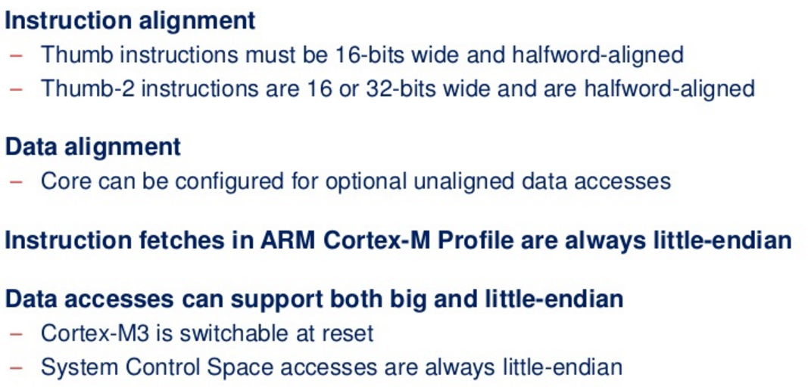
Instruction and Data Alignment

Slide 50
Example of 8 bit Data Alignment

Slide 51
STM32F4x Block Diagram

Slide 52
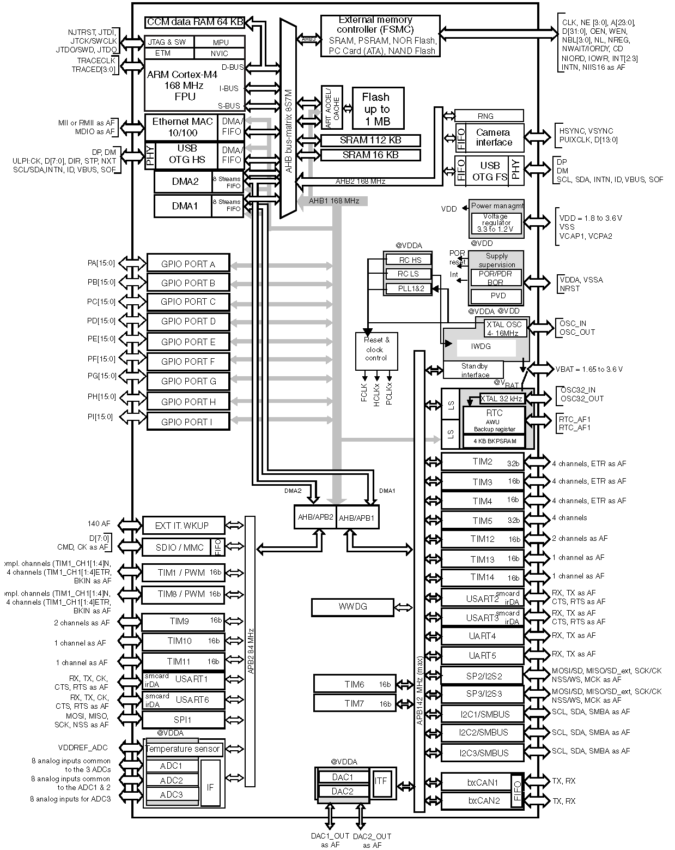


Slide 53
Architecture
CDAC ACTS, Pune

Slide 54

Agenda
Introduction to the Architecture
Programmers Model
Operating Modes and States
Registers
Special registers
Behavior of Application program Status Register(APSR)
Integer status Flags
Q status flag
GE bits
Memory System
Memory system features and Memory Map
Stack Memory & MPU
Exception and Interrupt
What are exceptions?
Nested vector interrupt controller (NVIC)
Vector Table and Fault Handling
System Control Block
Debug and Reset Sequence

Slide 55


Programmer’s Model
Operation states and Modes

Slide 56
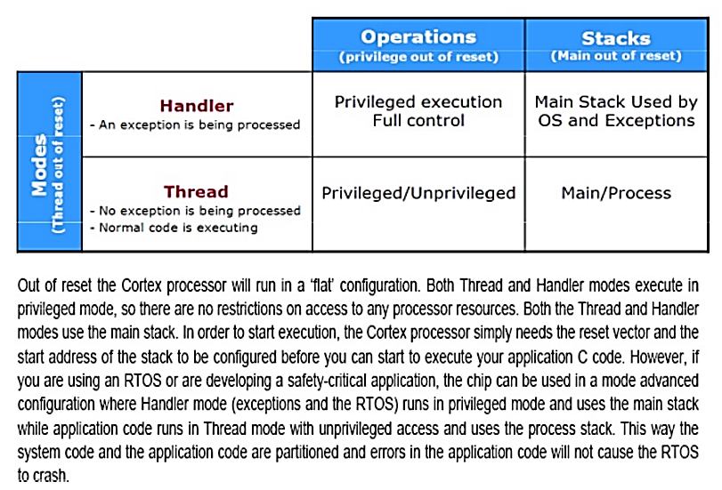

CPU Operating Modes – Cont.
Operation modes
• Handler mode: When executing an exception handler such as an Interrupt Service
Routine (ISR). When in handler mode, the processor always has privileged
access level.
• Thread mode: When executing normal application code, the processor can be
either in privileged access level or unprivileged access level. This is controlled by
a special register called “CONTROL.”

Slide 57
Inline Assembly Code Usage
Purpose of using inline assembly is to include assembly language code in ‘C’
It will allow a mixture ‘C’ and Assembly code
Example: R0= R0+R1
Assembly Instruction : ADD R0,R0,R1
Inline asm. Statement : __asm volatile(“ADD R0,R0,R1”)
Read
void example1(void)
{
__asm volatile(“LDR R0,[R1]”);
__asm volatile(“ LDR R1,[R2]”);
__asm volatile(“ ADD R0,R0,R1”);
__asm volatile(“ STR [R3],R0”);
}
void example2(void)
{
__asm volatile(
“LDR R0,[R1]\n\t”
“LDR R1,[R2]\n\t”
“ADD R0,R0,R1\n\t”
“STR [R3],R0\n\t”
);
}
LDR R0,[R1]
LDR R1,[R2]
ADD R0,R0,R1
STR [R3],R0
Write
Modify

Slide 58
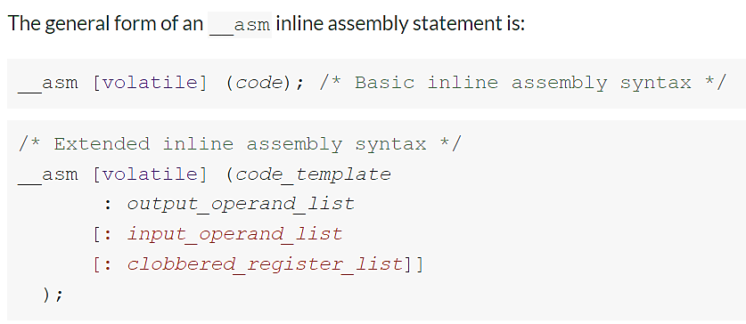
Inline Assembly syntax
Use the volatile qualifier for assembler instructions that have processor side-effects
code is the assembly instruction, for example "ADD R0, R1, R2".
code_template is a template for an assembly instruction, for example "ADD %[result], %[input_i], %[input_j]".
If you specify a code_template rather than code then you must specify the output_operand_list before specifying the optional input_operand_list and clobbered_register_list.
output_operand_list is a list of output operands, separated by commas. Each operand consists of a symbolic name in square brackets, a constraint string, and a C expression in parentheses. In this example, there is a single output operand: [result] "=r" (res). The list can be empty.
For example:
__asm ("ADD R0, %[input_i], %[input_j]" :
/* This is an empty output operand list */
: [input_i] "r" (i), [input_j] "r" (j) );
input_operand_list is an optional list of input operands, separated by commas. Input operands use the same syntax as output operands. In this example, there are two input operands: [input_i] "r" (i), [input_j] "r" (j). The list can be empty.
clobbered_register_list is a comma-separated list of strings. Each string is the name of a register that the assembly code potentially modifies, but for which the final value is not important. To prevent the compiler from using a register for a template string in an inline assembly string, add the register to the clobber list.

Slide 59
Mixed C and Assembly Code
#include <stdio.h>
int add(int i, int j)
{
int res = 0;
__asm volatile("ADD %[result], %[input_i], %[input_j]"
: [result] "=r" (res)
: [input_i] "r" (i), [input_j] "r" (j)
);
return res;
}
int main(void)
{
int a = 1;
int b = 2;
int c = 0;
c = add(a,b);
printf("Result of %d + %d = %d\n", a, b, c);
}

Slide 60
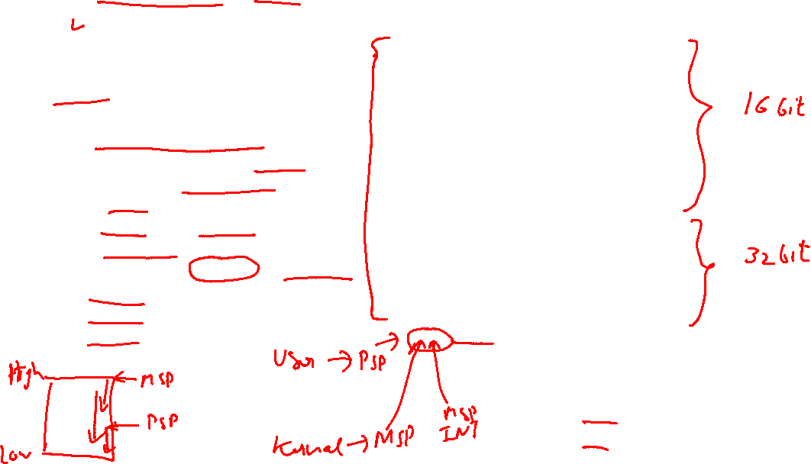
Register Set
R0-R12
General Purpose registers
R0-R7 low registers due to limited space available in IS , many 16 bit instruction can only access the low registers.
R8-R12 high registers can be used by 32-bit instruction
Initial Value of R0-R12 are undefined.
R13 Stack Pointer
R14 Link Register
R15 Program Counter

Slide 61
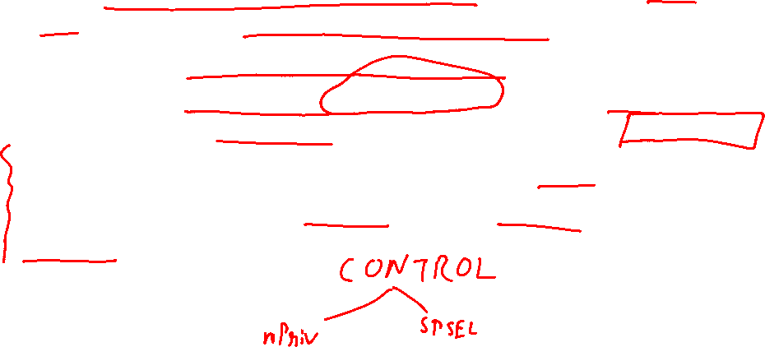
Stack Pointer –R13
Physically there are two different Stack Pointers:
Main Stack Pointer is the default Stack Pointer. It is selected after reset, or when the processor is in Handler Mode.
The other Stack Pointer is called the Process Stack Pointer. The PSP can only be used in Thread Mode. The selection of Stack Pointer is determined by a special register called CONTROL.
The PSP is normally used when an embedded OS is involved, where the stack for the OS kernel and application tasks are separated.

Slide 62

Link Register – R14
This is used for holding the return address when calling a function or subroutine or ISR.
At the end of the function or subroutine, the program control can return to the calling program and resume by loading the value of LR into the Program Counter (PC).
When a function or subroutine call is made, the value of LR is updated automatically.
If a function needs to call another function or subroutine, it needs to save the value of LR in the stack first. Otherwise, the current value in LR will be lost when the function call is made.

Slide 63
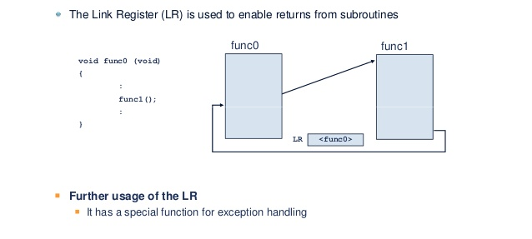
Link Register Flow diagram

Slide 64

Program Counter – R15
It is readable and writeable:
a read returns the current instruction address plus 4 (this is due to the pipeline nature of the design, and compatibility requirement with the ARM7TDMI processor).
Writing to PC (e.g., using data transfer/processing instructions) causes a branch operation.

Slide 65
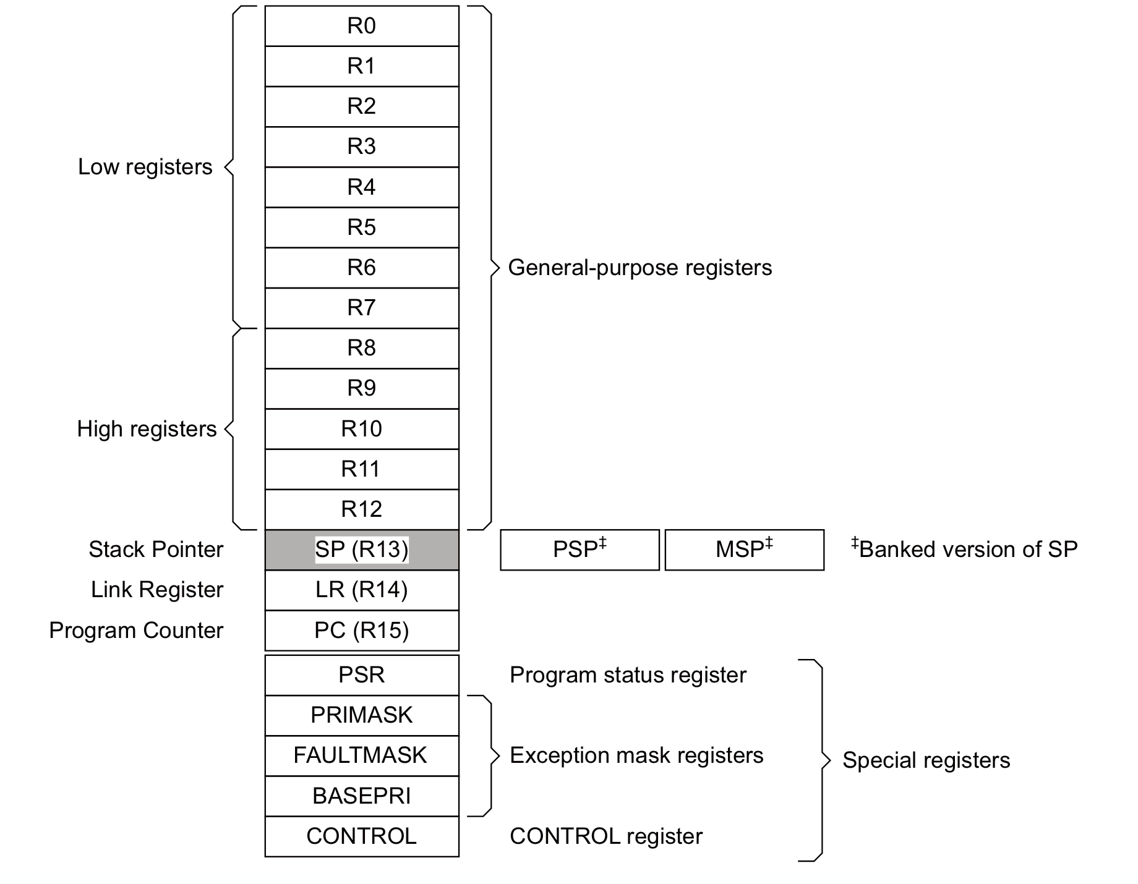

Special Registers
They are needed for development
of an embedded OS, or when advanced interrupt masking features are needed.
Special registers are not memory mapped, and can be accessed using special register
access instructions such as MSR and MRS(Move to ARM register from system coprocessor register).

Slide 66

Program Status Register
31
28 27 26 25 24 23
16 15
10
7
0
N Z C V
Q IT T
IT/ICI
ISR Number
One Status Register consisting of
APSR - Application Program Status Register – ALU flags
IPSR - Interrupt Program Status Register – Interrupt/Exception No.
EPSR - Execution Program Status Register
IT field – If/Then block information
ICI field – Interruptible-Continuable Instruction information
Please note:
• The EPSR cannot be accessed by software code directly using MRS (read as zero) or MSR
• The IPSR is read only and can be read from combined PSR (xPSR).

Slide 67
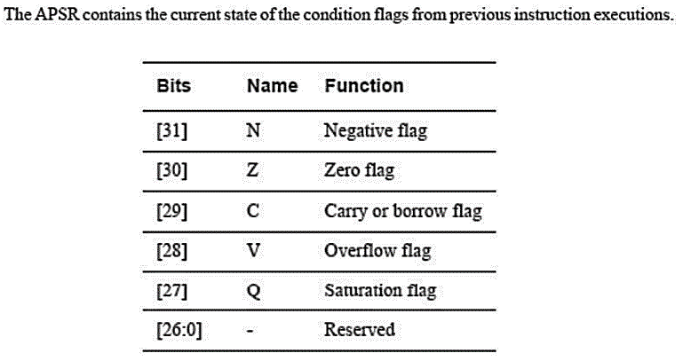
APSR
Q bit – The Q flag is "sticky" it is not cleared my subsequent operations. It can there fore be used to determine whether saturation or overflow occurred at any point since it was last explicitly cleared.
These alu are the only one you can modify in thread mode
V bit -- The C (overflow or carry/borrow) flag is set or cleared as the result of a single arithmetic instruction, so must be tested immediately after the instruction that might set it.

Slide 68
Q Flag – Signed & Unsigned Saturation

Slide 69
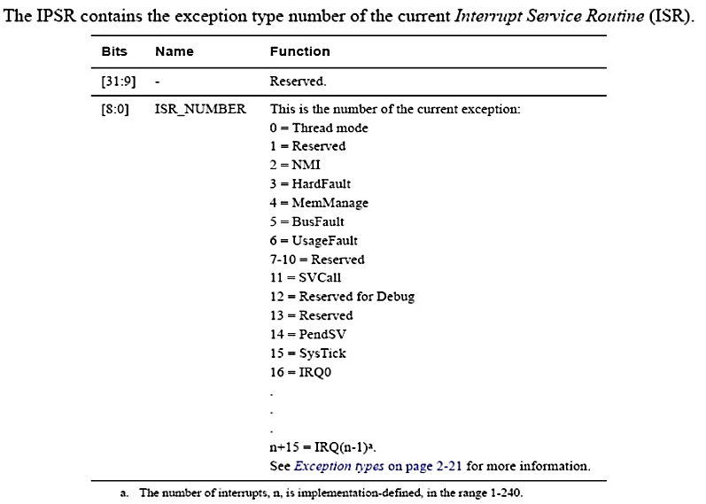

IPSR

Slide 70
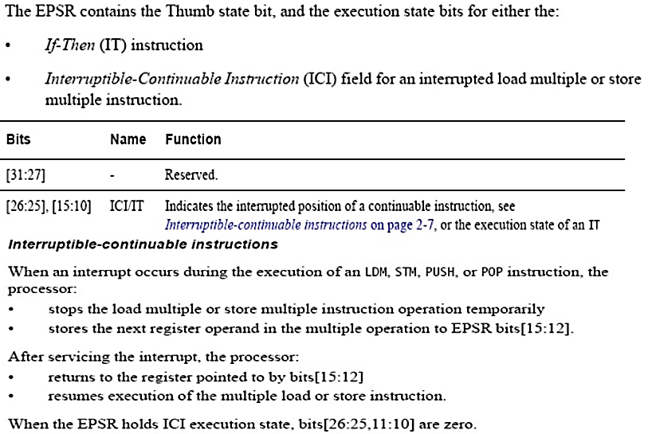


EPSR
*Note: Since Cortex M3 has only thumb2 mode so bit 24 i.e. T bit will always be high and you should never attempt to change it.
The IT (IF-THEN) instruction statement contains the IT instruction opcode with up to an additional
three optional suffixes of “T” (then) and “E” (else), followed by the condition to check against, which is the same as the condition symbol for conditional branches.
The “T”/”E” indicates how many subsequence instructions are inside the IT instruction block, and whether they should or should not be executed if the condition is met.

Slide 71
Mask registers
The PRIMASK register prevents activation of all exceptions with configurable priority.
Write 1 into PRIMASK to disable all interrupts with configurable Priority
-MOV R0, #1
-MSR PRIMASK, R0
Write 0 into PRIMASK to Enable all interrupts
The FAULTMASK register prevents activation of all exceptions except
for Non-Maskable Interrupt (NMI)
The BASEPRI register defines the minimum priority for exception processing.
When BASEPRI is set to a nonzero value, it prevents the activation of all
exceptions with the same or lower priority level as the BASEPRI value.
If we want to disable all interrupts below certain level of Priority
Write priority into BASEPRI
MOV R0, #0x60
MSR BASEPRI, R0

Slide 72

Hard Fault
A hard fault is an exception that occurs because of an error during normal or exception processing. As per the Cortex-M0 Devices Generic User Guide (revision r0p0), the following sources can cause a hard fault:
• execution of an SVC instruction at a priority equal or higher than SVCall
• execution of a BKPT instruction without a debugger attached
• system-generated bus error on a load or store
• system-generated bus error on a vector fetch
• execution of an instruction from a location for which the system generates a bus fault
• execution of an instruction when not in Thumb-State as a result of the T-bit being previously cleared to 0
• execution of an undefined instruction
• attempted load or store to an unaligned address
• execution of an instruction from an XN memory address
The most common user-created causes for hard fault are:
• execution of an undefined instruction
• attempted load or store to an unaligned address.
• execution of an instruction from an XN memory address
Detecting the hard fault
When your system is hung up, the first step is to detect the cause for the hang up. To detect the cause for system hang up, first execute your program in debugging mode and allow the system to run until the system hangs up again, then halt the debugger. There are two ways to determine whether the hang up is due to the hard fault. The first is to watch the Program Counter (PC) register. If this is a hard fault, the PC register will indicate operation in the hard fault handler. The second method is to watch the Interrupt Program Status Register (IPSR).
Exception Number 3 indicates a hard fault.

Slide 73

CONTROL register
The CONTROL register controls the stack used and the privilege level for software execution when the processor is in Thread mode.

Slide 74
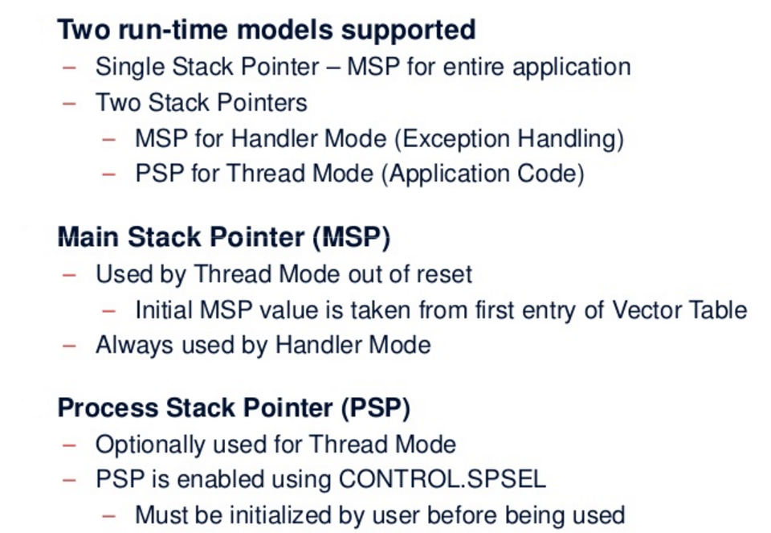

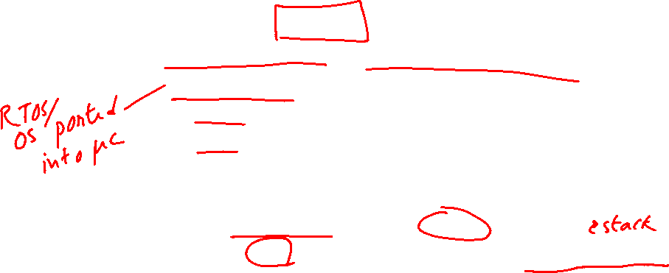
Stacks

Slide 75


Both Thread and Handler using MSP

Slide 76
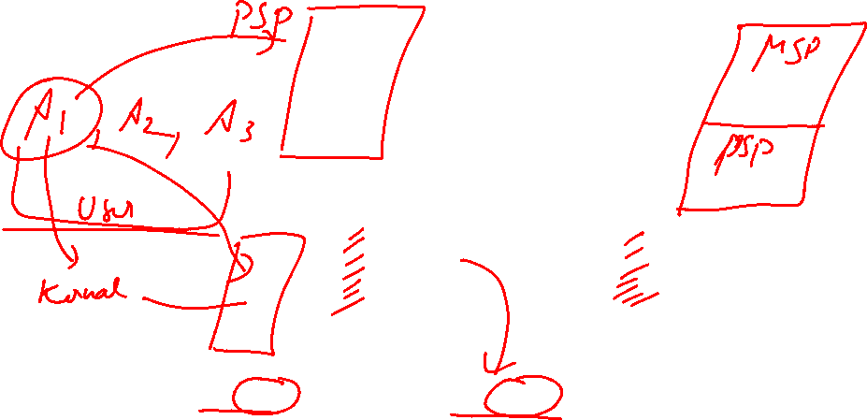
Thread uses PSP & Handler uses MSP

Slide 77

Switching Privileged & Unprivileged

Slide 78
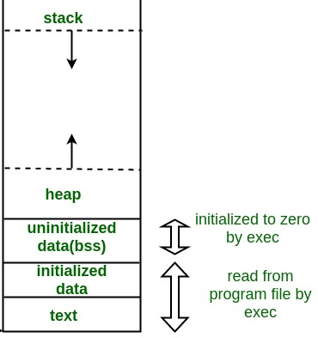

Memory Map
Copy from FLASH to SRAM

Slide 79

Stack Memory

Slide 80
Exceptions and Interrupts
What are exceptions?
Exceptions are events that cause changes to program flow. When one happens, the processor suspends the current executing task and executes a part of the program called the exception handler.
After the execution of the exception handler is completed, the processor then resumes normal program execution.
In the ARM architecture, interrupts are one type of exception. Interrupts are usually generated from peripheral or external inputs, and in some cases they can be triggered by software.
The exception handlers for interrupts are also referred to as Interrupt Service Routines (ISR).
Link
Notes:
https://www.youtube.com/watch?v=uFBNf7F3l60&t=147s

Slide 81
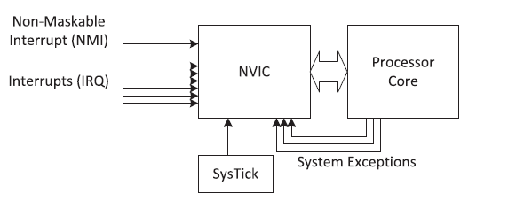
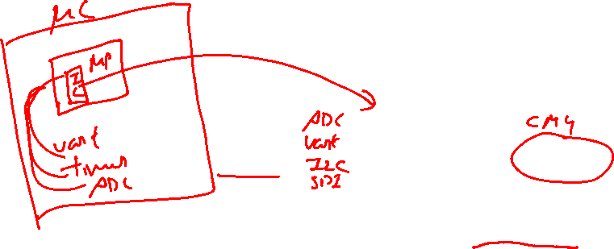
Exception sources and Zero Wait State
Zero Wait State
Zero wait state is a feature of a processor or computer architecture in which the processor does not have to wait to perform memory access.
Non-zero wait state describes the situation when a processor operates at a higher frequency than the memory, it has a wait state during which the processor is idle.

Slide 82

Exception Types

Slide 83

Nested Vectored Interrupt Controller
Features
Flexible exception and interrupt management
Each interrupt (apart from the NMI) can be enabled or disabled and can have its pending status set or cleared by software.
Nested exception/interrupt support
Each exception has a priority level. Some exceptions, such as interrupts, have programmable priority levels and some others (e.g., NMI) have a fixed priority level. When an exception occurs, the NVIC will compare the priority level of this exception to the current level. If the new exception has a higher priority, the current running task will be suspended.
Vectored exception/interrupt entry
The Cortex-M processors automatically locate the starting point of the exception handler from a vector table in the memory. As a result, the delays from the start of the exception to the execution of the exception handlers are reduced.
Interrupt masking

Slide 84


Starting Address of Exception Handler
To determine the starting address of the exception handler, a vector table mechanism is used.
The vector table is an array of word data inside the system memory, each representing the starting address of one exception type.
Example :The vector table is located at address 0x0 after reset.
if the reset is exception type 1, the address of the reset vector is 1 times 4 (each word is 4 bytes), which equals 0x00000004, and the NMI vector (type 2) is located at (n x 4)2 x 4 = 0x00000008 .
The address 0x00000000 is used to store the starting value of the MSP.
The LSB of each exception vector indicates whether the exception is to be executed in the Thumb state. Since the Cortex-M processors can support only Thumb instructions, the LSB of all the exception vectors should be set to 1.

Slide 85




Vector Table
LSB of exception vectors should be set to 1 to indicate Thumb state

Slide 86

Fault Handling

Slide 87

System Control Block (SCB)
One part of the processor that is merged into the NVIC unit is the SCB. The SCB contains various registers for:
Controlling processor configurations (e.g., low power modes)
Providing fault status information (fault status registers)
Vector table relocation (VTOR)
The SCB is memory-mapped. Similar to the NVIC registers, the SCB registers are accessible from the System Control Space (SCS).

Slide 88
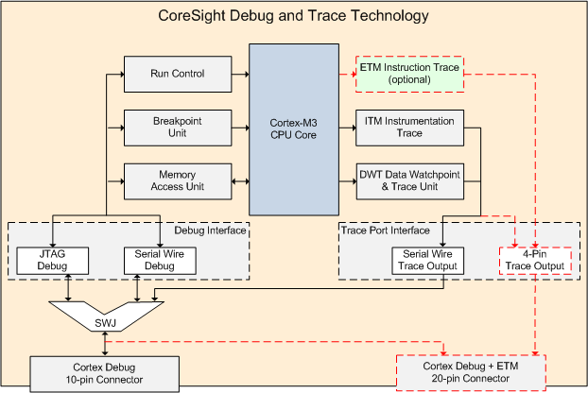

Core Sight Debug and Trace Technology

Slide 89

Core Sight features
Core Sight features can be accessed through a JTAG or Serial Wire interface. Debugging in JTAG and Serial Wire mode at the same time is not possible. Cortex-M processor-based devices can include a:
Debug Interface
The debug interface offers two modes:
JTAG Debug is the industry-standard interface that allows device chaining.
Serial Wire Debug is a 2-pin interface with an optional Serial Wire Trace Output. In contrast to JTAG, devices cannot be chained.
The Debug Interface communicates with the following units:
Run Control: allows the user to start, stop, and single-step through the source code.
Breakpoint Unit: allows the user to set breakpoints even while the processor is running.
Memory Access Unit: allows the user to read or write to memory and peripheral registers even while the program is running.

Slide 90
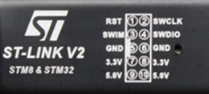
Debug connections

Slide 91
Trace Port Interface Link
The Trace Port Interface encodes and provides trace information via two possible interfaces:
The Serial Wire Trace Output pin (SWO) can be used in Serial Wire Debug mode only.
The 4-Pin Trace Output has a greater bandwidth than Serial Wire Trace Output and uses 5 functional pins. It is the only way to output ETM trace data.
The Trace Port Interface communicates with the following units:
Embedded Trace Macrocell (ETM): can be used for instruction tracing to debug historical sequences, for software profiling, and code coverage analysis. ETM data are output through an extra 4-bit interface.
Instrumentation Trace Macrocell (ITM): provides application information like debug printf(), RTOS information, unit test, or UML annotation.
Data Watchpoint & Trace Unit (DWT): provides PC sampling, event counters, timing, and interrupt execution information. In addition, it allows Access Breakpoints for up to four memory addresses.

Slide 92

Trace Connections

Slide 93
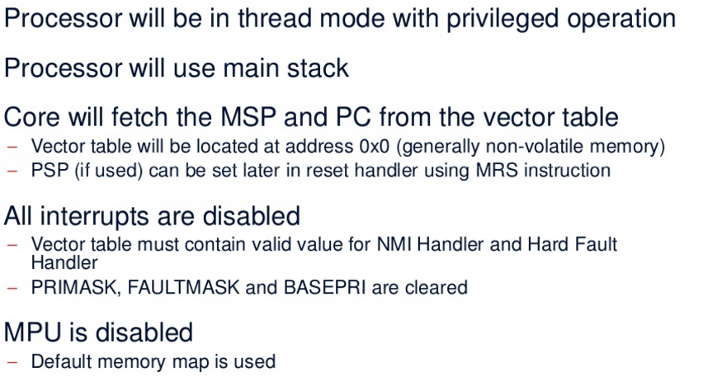

Cortex Reset Sequence & Startup
Link

Slide 94
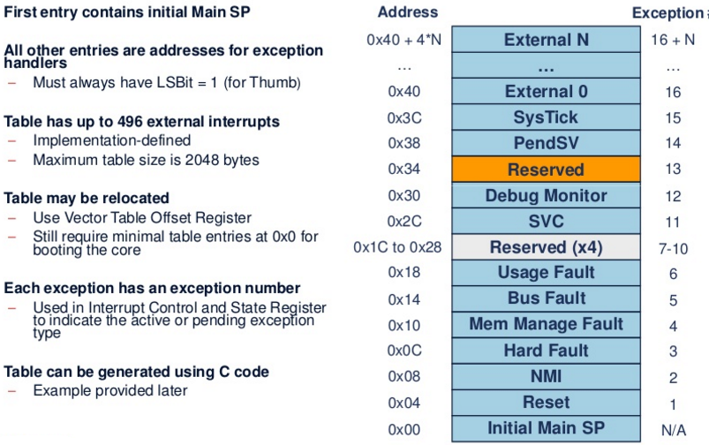

Vector Table at Startup

Slide 95

Reset Sequence

Slide 96
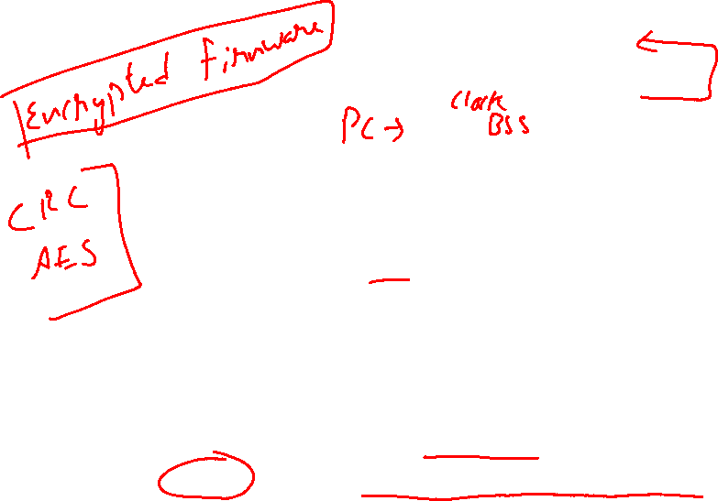
Reset Behavior

Slide 97

Status of SP and PC during reset

Slide 98
C compiler. Memory map. Program in RAM
Sections:
.text: Program code. Read only
.rodata: constants (const modifier) and strings. Read only
.data: Initialized global and static variables (startup value ≠ 0)
.bss: Uninitialized global and static variables (zero value on startup)
0x2001FFFF
stack
free RAM
.bss
.data
.rodata
.text
Vectors (RAM)
_end
The bootloader (bt2.exe) places the .text, .rodata and .data sections into the RAM and then orders the ARM CPU to jump to the reset vector (address 0x20000000)
0x20000040
0x20000000

Slide 99
C compiler. Memory map. Program in Flash
Flash memory RAM memory
0x000F FFFF 0x2001 FFFF
free Flash
.data
.rodata
.text
Vectors (Flash)
stack
free RAM
.bss
.data
Vectors (RAM), unused
Copied on startup
_end
0x0000 0040
0x20000040
0x0000 0000
0x20000000

Slide 100
C compiler. Memory map. Program in Flash
The Flasher program (stlinkv2_utility.exe) writes the .text, .rodata and
.data sections into the Flash. This storage is non volatile
The C runtime startup code (startup_stm32f407vgtx.s file) does some processing before calling the “main” routine. In particular it:
Copies the .data section into RAM, because variables have to be stored in a read/write memory
Fills the .bss section with zeroes
The free RAM area can be dynamically allocated by providing suitable “malloc” and “free” functions
Explicitly stated:
startup_stm32f407vgtx.s : First code to be executed, written in assembler, including:
Reset, interrupt and exception vectors
Basic I/O and system initialization (clocks, UART, etc)
.data and .bss initialization
Call to “main”
Simple I/O library (printf like, provided by author, non standard)
User source code. Must include the “main” function

Slide 101
C compiler. Command line options
arm-none-eabi-gcc -O2 -g –mcpu=cortex-m4 -mthumb -mfloat-abi=softfp -mfpu=fpv4-sp-d16 -nostartfiles –static -Wl,-T STM32F407VGTX_RAM.ld -o code.elf -DCRLF startup_stm32f407vgtx.s main.c
-O2: Optimizer level 2 (0=no optimization, 3=maximum optimization)
-g: Generate debug information
-mcpu=cortex-m4: Generate code for this particular processor
-nostartfiles: Do not link standard start files. We are providing our own start file (startup_stm32f407vgtx.s)
-static: Do not link dynamic libraries (use .a libraries instead of .so)
-Wl,-T STM32F407VGTX_RAM.ld: Use the STM32F407VGTX_RAM.ld linker script. The memory layout, in this case for a RAM stored program, is stated in this file.
-o code.elf: name of the generated objet file (in ELF format)
-DCRLF: Define symbol CRLF for preprocessor (used in crt.S)

Slide 102
Linker script (program stored in RAM)
Specify the available memory blocks:
MEMORY
{
flash | : ORIGIN = | 0x8000000, LENGTH | = 1024K | /* FLASH area | */
ram | : ORIGIN = | 0x20000000, LENGTH | = 128K | /* RAM area | */
}
Specify the section location:
SECTIONS
{
.text :
{
*(.text)
*(.rodata)
_etext = .;
} >ram
/* collect all code related sections */
/* all .text sections (code) */
/* all .rodata sections (constants,…) */
/* define a global symbol _etext */
/* put all the above into RAM */
/* all .data sections to RAM */
/* symbol marking the .data start */
/* all .data sections */
/* symbol marking the .data end */
/* put all the above into RAM */
.data :
{
_data = .;
*(.data)
_edata = .;
} >ram

Slide 103
Linker script (program stored in RAM)
.bss : /* .bss sections to RAM */
{
} >ram | _bss_start *(.bss) | = | .; | /*.bss /* all /* put |  | section start*/ .bss sections */ all the above in RAM */
. = ALIGN(4); |  | /* |  |  | align to 32 bit */
_bss_end = . ; |  | /* |  |  | .bss end symbol */
_end = .; } |  | /* |  |  | end of program RAM symbol */
Define other symbols:
/* Highest address of the user mode stack */
_estack = ORIGIN(RAM) + LENGTH(RAM); /* end of "RAM" Ram type memory */
_Min_Heap_Size = 0x200; /* required amount of heap */
_Min_Stack_Size = 0x400; /* required amount of stack */

Slide 104
Linker script (program stored in Flash)
Specify the available memory blocks:
MEMORY
{
flash : ORIGIN = 0x8000000, LENGTH = 1024K /* FLASH area */ ram : ORIGIN = 0x20000000, LENGTH = 128K /* RAM area */
}
Specify the section location:
SECTIONS
{
.text : { | /* | collect all code related sections */
*(.text) | /* | all .text sections (code) */
*(.rodata) | /* | all .rodata sections (constants,…) */
_etext = .; | /* | define a global symbol _etext */
} >flash | /* | put all the above into flash */
.data :
{
/* all .data sections to RAM */
/* symbol marking the .data start */
/* all .data sections */
/* symbol marking the .data end */
_data = .;
*(.data)
_edata = .;
} >ram AT >flash
/* .data will reside in RAM, but it is stored in the flash */
(The rest is the same as in a RAM stored program)

Slide 105
Object file formats
ELF (Executable and Linkable Format)
Default object format for .o, .a and executable files
Can include symbol, section, and debug information
Standard executable file format in Linux and Solaris
.hex (hexadecimal file format)
Used mainly with flasher programs
Specifies block address and data content with hexadecimal digits. Example:
:1000100018F09FE50000A0E1F0FF1FE510F09FE55C
Number of data bytes (0x10 = 16)
Address (0x0010)
Type of record (0x00: 16-bit address plus data)
Data(0x18,0xF0,0x9F,0xE5,0x00,0x00,0xA0,0xE1,0xF0,0xFF,0x1F,0xE5,0x10,0xF0,0x9F,0xE5)
Checksum (0x5C)
.bin (binary file)
Single block of binary data
No address specified
Used with bootloader (bt2.exe)
objcopy -O <format> file.elf file.<format> can convert elf files into ihex or binary

Slide 106
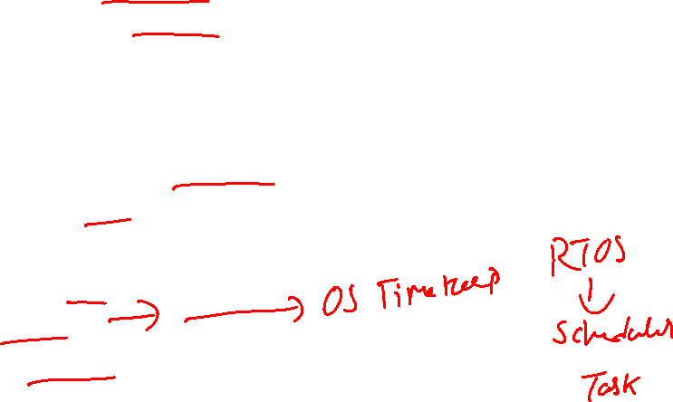
Task to be Performed

Slide 107
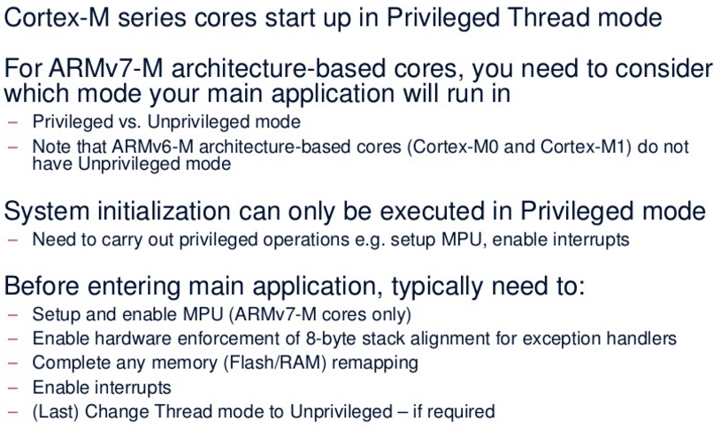

Initialization Summary

Slide 108
Memory System
CDAC ACTS, Pune

Slide 109

Agenda
Memory Map
Connecting the processor to memory and peripheral
Memory Requirements
Memory Endianness
Data alignment and Unaligned data access
Bit-band operations
Default Memory Access permissions
Exclusive access
Memory Barrier
Memory System in a microcontroller

Slide 110
Memory Map

Slide 111


Slide 112

Memory Endianness
The Cortex-M3 (byte-invariant big-endian, BE-8) – Data on
the AHB Bus
Little Endian – Data on the AHB Bus

Slide 113

Data alignment and unaligned data access

Slide 114
Bit Banding
Normally Bit Manipulation requires a READ MODIFY WRITE operations which is expensive in terms of no. of CPU cycles taken.
To overcome this limitation , a technique called bit banding allows direct bit manipulations on section of Peripheral and SRAM memory , without need of special instructions.
While performing Bit banding operations we need to consider two memory regions
Bit Band Region [1 MB]
Bit Band Alias Region [32 MB]
Bit Banding works by mapping each Bit in the Bit Band Region to a Word in Alias Region

Slide 115
Bit Access to Bit band region

Slide 116
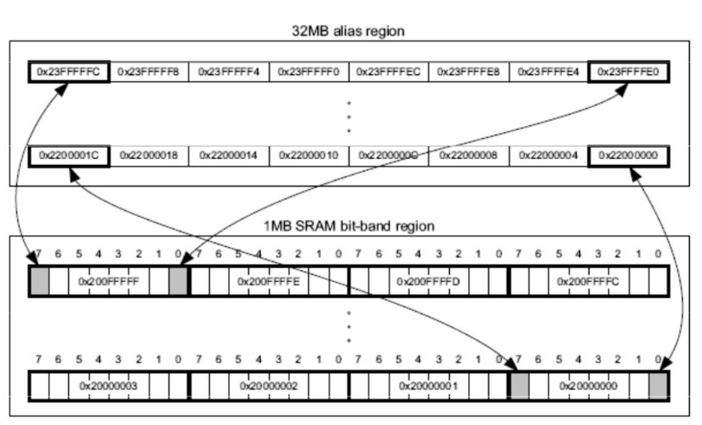
Bit Banding Mapping

Slide 117
Cortex-M3 Bit Banding
Calculate the bit band alias address for given bit band memory address and bit position.
5th bit position of the memory location 0x20000200 using its alias address
Formula:
Alias_address=alias_base+ (32*(bitband_memory_addr – bitband_base_address))+ bit*4

Slide 118
Read Modify Write vs Bit Banding
Assembler sequence to write a bit with and without bit-band
Read from the bit-band alias

Slide 119
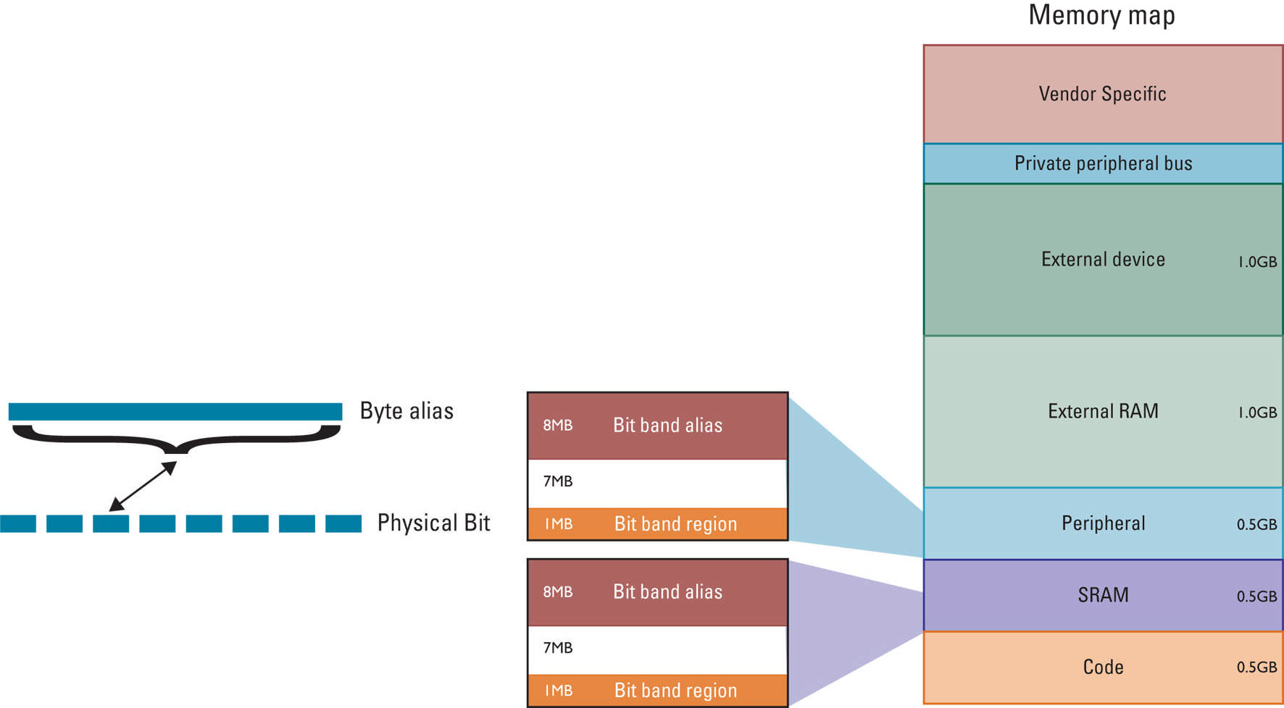
Cortex-M3 Bit Banding
Writes to a word address in the bit band alias affect a single bit in the bit band region
The write is translated to an atomic read-modify-write by the Cortex-M3 bus matrix
Bit 0 of the stored register is written to the appropriate bit
Word alias
32MB
Bit band alias
32MB
31MB
Physical bit
1MB
Bit band region
32MB
Bit band alias
31MB
1MB
Bit band region

Slide 120
Advantages of Bit-Band
Bit-Band vs. Bit-Bang
In the Cortex-M3, we use the term bit-band to indicate that the feature is a special memory band (region) that provides bit accesses.
Bit-bang commonly refers to driving I/O pins under software control to provide serial communication functions. The bit-band feature in the Cortex-M3 can be used for bit-banging implementations, but the definitions of these two terms are different.
Reading the whole register ,Masking the unwanted bits,Comparing and branching
You can simplify the operations by BitBanding to:
Reading the status bit via the bit-band alias (get 0 or 1) ,Comparing and branching

Slide 121

Memory Access attributes
Bufferable: Write to memory can be carried out by a write buffer while the processor continues on to next instruction execution.
Cacheable: Data obtained from memory read can be copied to a memory cache so that next time it is accessed the value can be obtained from the cache to speed up program execution.
Executable: The processor can fetch and execute program code from this memory region.
Sharable: Data in this memory region could be shared by multiple bus masters. The memory system needs to ensure coherency of data between different bus masters in the shareable memory region.

Slide 122
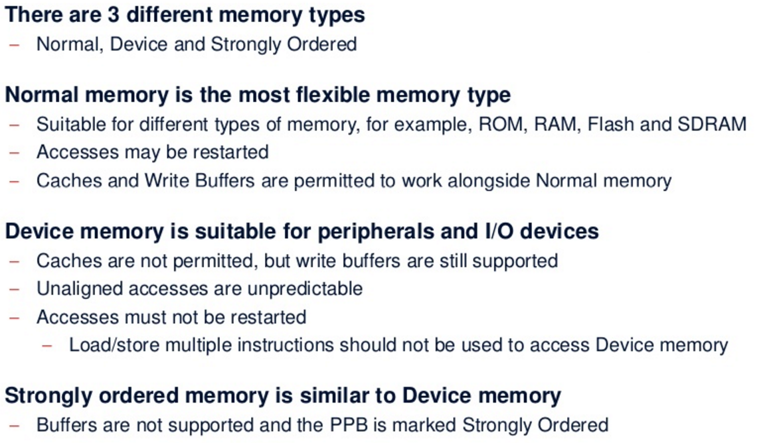
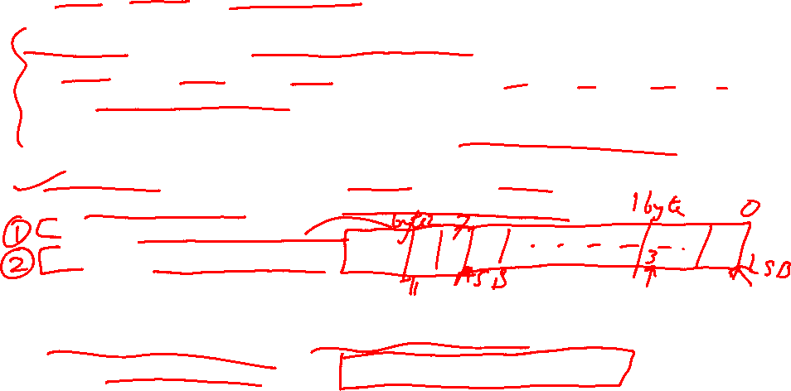
Memory Types and Properties

Slide 123
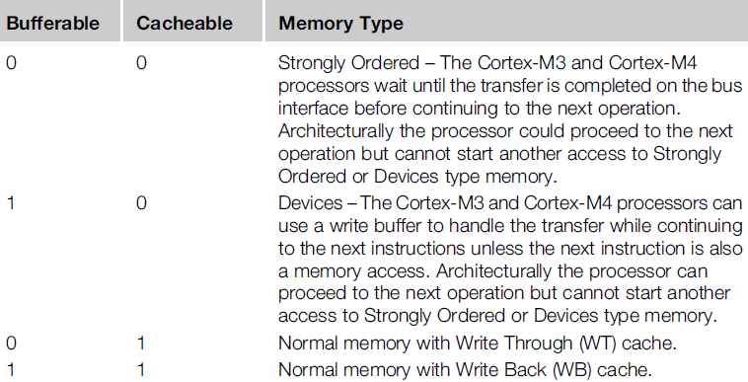

Memory Attributes in Relation to Memory Types

Slide 124
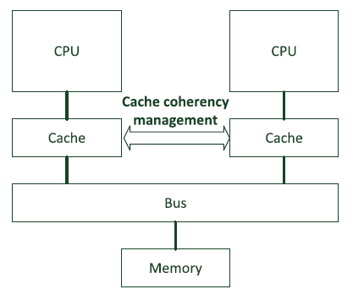
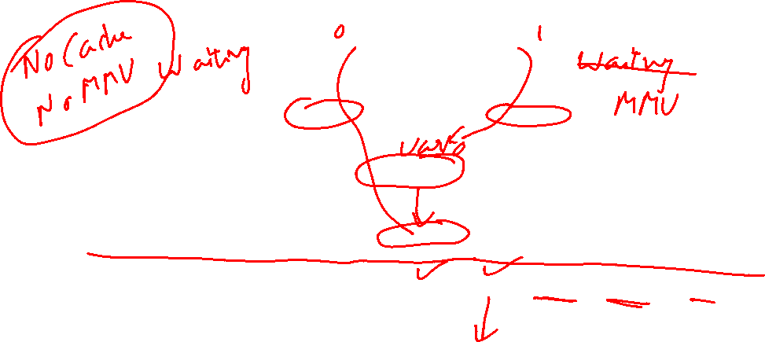
Multi-Processor System Sharable Memory
Buffered write operation

Slide 125
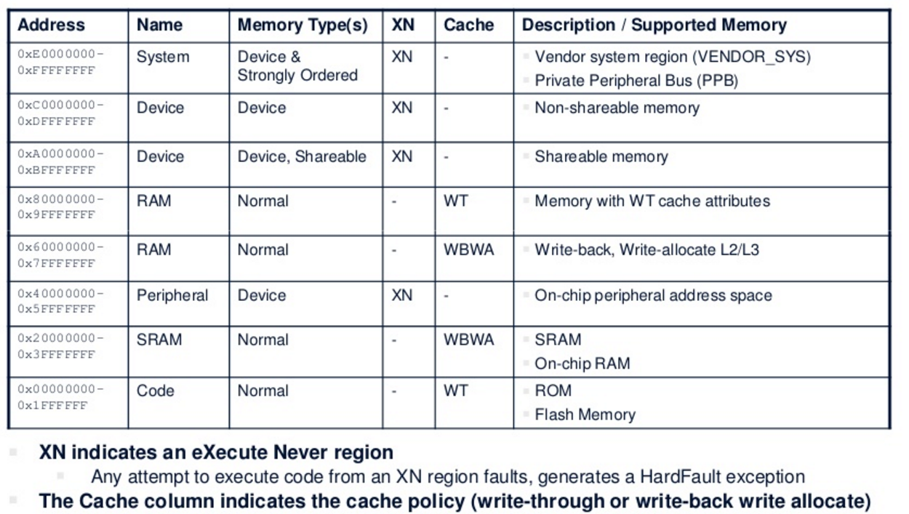
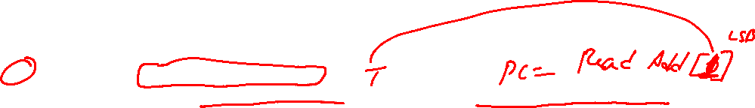

Address Map Overview

Slide 126

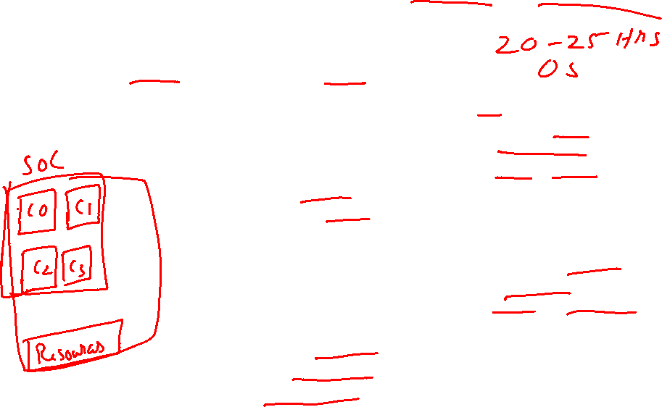
Exclusive Access via MUTEX semaphore

Slide 127

Memory system in a Microcontroller
In many microcontroller devices, the designs integrate additional memory system features such as:
Boot loader
Memory remapping
Memory alias
There are many different reasons why chip designers put a boot loader into the system. For example, to:
Provide a flash programming utility, so that you can program the flash using a simple UART interface, or even program some parts of the flash memory dynamically.
Provide Built-In Self Test (BIST) for the chip.

Slide 128


Bootloaders and Memory Remapping
For chips with a boot loader ROM, the boot loader is executed when the system is started, so it has to be located in address 0 when the system starts at power up.
However, the next time the system starts, it might not need to execute the boot loader again and can run the application in the flash directly, so the memory map needs to be changed.
In order to do this, the address decoder needs to be programmable. A hardware register (e.g., a peripheral register in a system control unit) can be used.
The operation to switch the memory map is called “Memory Remap.” This operation is done by the boot loader.

Slide 129
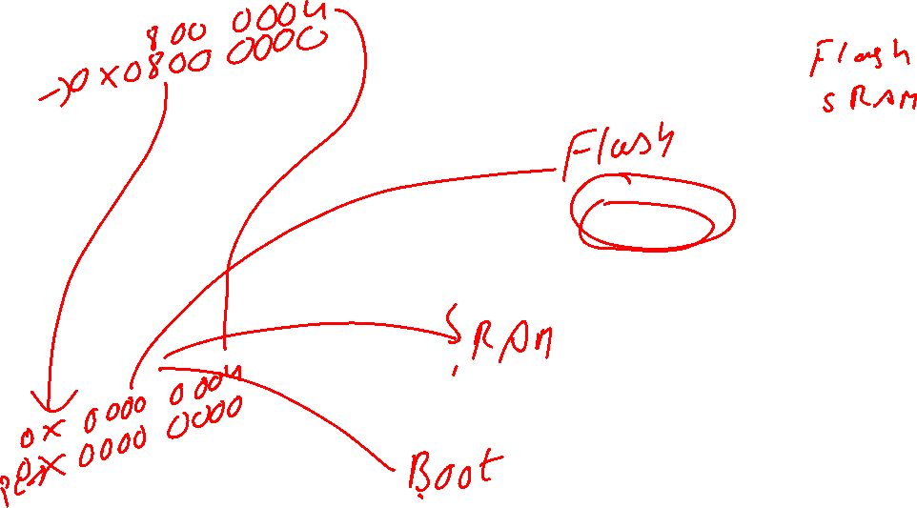

Slide 130
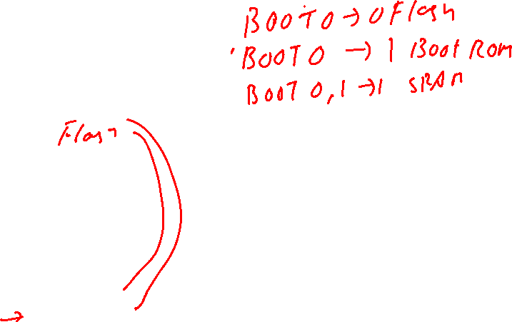
Memory remap implementation with boot loader

Slide 131

Possibilities of Re-mapping
Normally the boot loader is accessible from address 0 using a memory address alias, and the alias can be turned off. There are many possible memory system configurations. What is shown in prev. slide is just one of the possibilities.
Other Possibilities Video Link1, Link2
In some microcontrollers, memory remapping is not needed as the boot loaders present in address 0 are executed every time the system starts up.
The vector table is then relocated using the vector table relocation feature provided by the processor, so there is no need to use any remap to handle vector fetches.

Slide 132
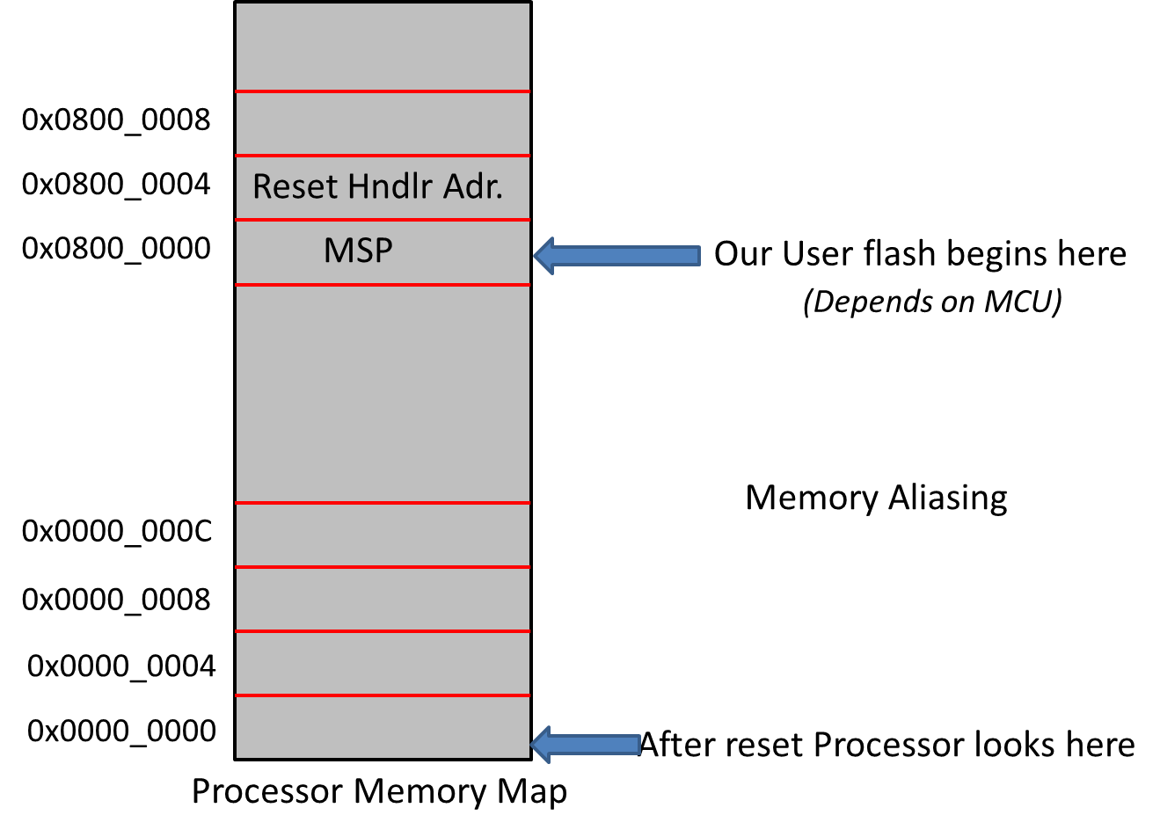




Flash Memory Starting Address after Reset
All ARM Cortex M Based MCUs right after reset does,
Load value @ Memory addr. 0x00000000 in to MSP
Load value @ Memory addr. 0x00000004 in to PC (Value = Addr of the reset handler)
In STM32 Microcontroller ,
MSP value stored at 0x08000000
Vector table starts from 0x08000004
Address of the reset handler found at 0x08000004
So , Don’t you think we should somehow link 0x08000000 to 0x00000000 ??

Slide 133
Exceptions and Interrupts
CDAC ACTS, Pune

Slide 134

Agenda
Exception types
Overview of interrupt management
Definitions of priority
Vector table and vector table relocation
Interrupt inputs and pending behaviors
Details of NVIC registers for interrupt control
Summary
Interrupt enable registers
Interrupt set pending and clear pending
Active status
Priority level
Software trigger interrupt register
Interrupt controller type register

Slide 135
Exception Type

Slide 136

Exception types

Slide 138

List of Interrupts

Slide 139

Commonly Used CMSIS-Core Fxns

Slide 140


Definition of Priority
A priority-level register with 3 bits implemented (8 programmable priority levels)
A priority-level register with 4 bits implemented (16 programmable priority levels)

Slide 141
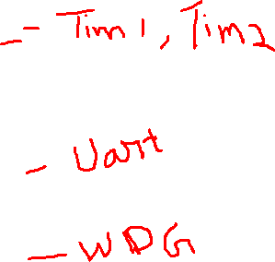

Slide 142
Group Priority
if the priority-level configuration registers are 8-bits wide, there are only 128 pre-emption levels?
This is because the 8-bit register is further divided into two parts: group priority and sub-priority.
Using a configuration register in the System Control Block (SCB) called Priority Group
the priority-level configuration registers for each exception with programmable priority levels is divided into two halves.
The group priority level defines whether an interrupt can take place when the processor is already running another interrupt handler.
The sub-priority level is used only when two exceptions with same group-priority level occur at the same time.

Slide 143

Group Priority

Slide 144

Vector Table and its Relocation
When the Cortex-M processor accepts an exception request, the processor needs to determine the starting address of the exception handler (or ISR if the exception is an interrupt).
This information is stored in the vector table in the memory. By default, the vector table starts at memory address 0.
The vector table is normally defined in the startup codes provided by the microcontroller vendors.
Usually, the starting address (0x00000000) should be boot memory, and it will usually be either flash memory or ROM devices.
The Vector Table Relocation feature provides a programmable register called the Vector Table Offset Register (VTOR)

Slide 145

Vector Table Offset Register

Slide 146
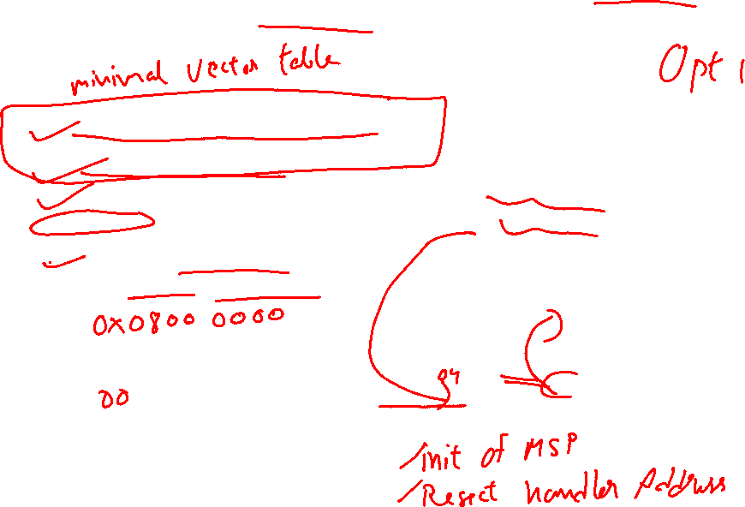
Vector Table Relocation for Boot Rom

Slide 147
Booting from Pen Drive or SD Card
Link

Slide 148










Interrupt Inputs and Pending Behavior
There are various status attributes applicable to each interrupt:
• Each interrupt can either be disabled (default) or enabled
• Each interrupt can either be pending (a request is waiting to be served) or not pending
• Each interrupt can either be in an active (being served) or inactive state
An interrupt request can be accepted
by the processor if:
• The pending status is set,
• The interrupt is enabled, and
• The priority of the interrupt is higher than the current level

Slide 149


Interrupt pending and activation behavior

Slide 150

Register In NVIC for Interrupt Control

Slide 151
Exceptions Handling In Detail
CDAC ACTS, Pune

Slide 152
Agenda
Exception sequences
Exception Entrance and stacking
Exception return and unstacking
Interrupt latency and exception handling optimization
Details of NVIC registers for interrupt control
What is interrupt latency?
Tail Chaining
Late arrival
Pop preemption
Lazy stacking

Slide 153


Exception entrance and stacking

Slide 154

Nested Interrupt Stacking

Slide 155
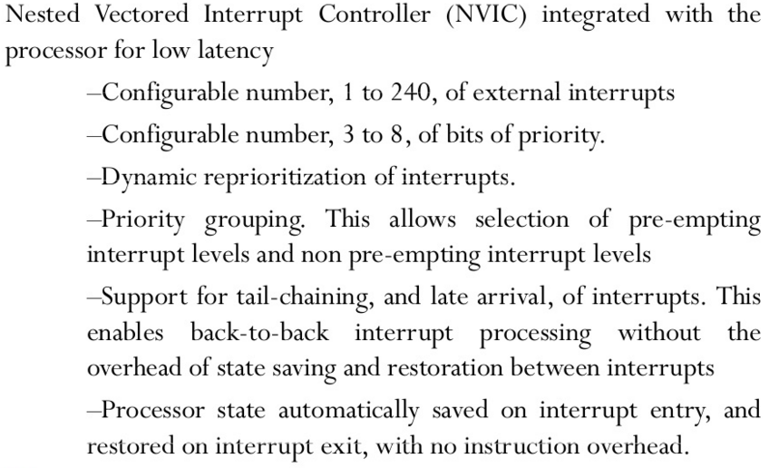


Feature Description of NVIC
Note: Interrupt Inputs are Active HIGH

Slide 156
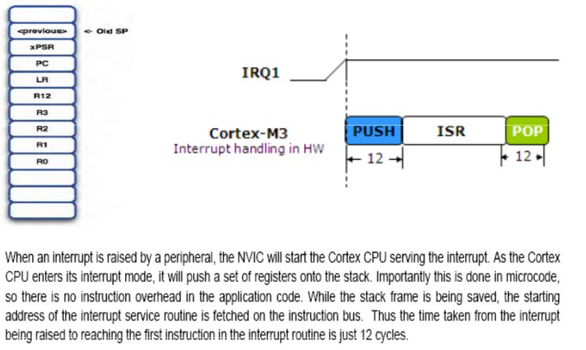

NVIC Operations Exception Entry/Exit

Slide 157
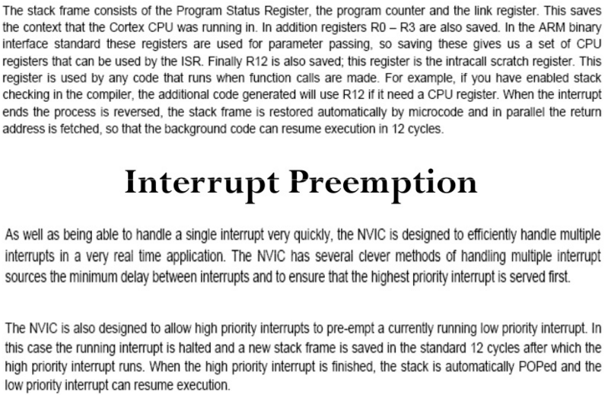
Interrupt Preemption

Slide 158
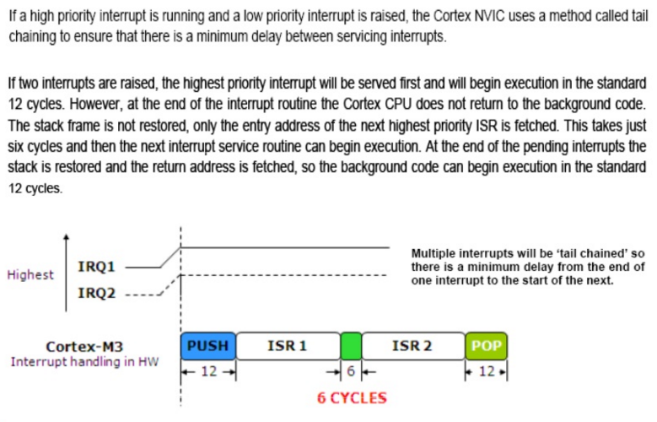
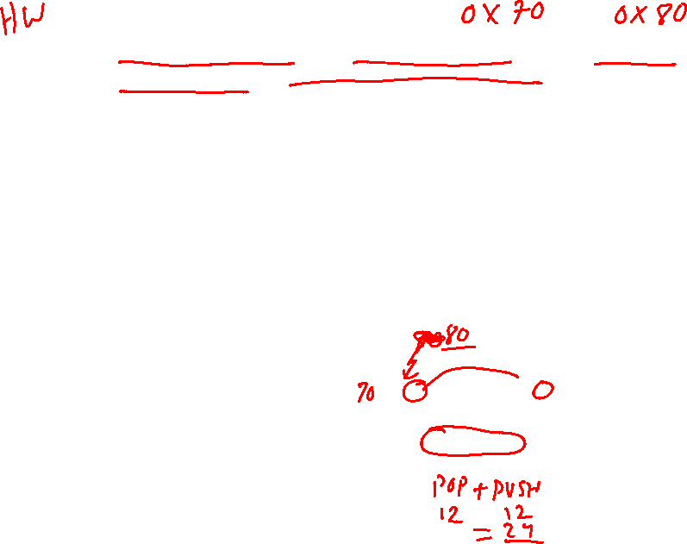
Tail Chaining

Slide 159

Pop Preemption

Slide 160


Late Arrival

Slide 161


Exception for System Level Services
ARM Cortex M Processor Supports two important system level exceptions
SVC (SuperVisor Call)
PendSV (Pendable SerVice)
Supervisory calls are typically used to request privilege operations or access to system resource from an Operating System
SVC Exception is mainly used in OS environment. For E.g. an Unprivileged user task can trigger SVC exception to get system level services(e.g. accessing device drivers, peripherals) from kernel of OS
PendSV is mainly used in an OS environment to carry out context Switching Operation between two tasks when no other exceptions are active in the system.

Slide 162

SVC
The SVC Handler executes right after the SVC instruction is executed, unless there is a higher priority exception arrives at the same time.
SVC instruction is always used along with a number, which can be used to identify the request type.
__asm volatile("SVC #0"); // call SVC 0
The OS will have a lookup table of SVC numbers and call to the corresponding handler of the request number.

Slide 163


PendSV
System Without Pend SV
Here Scheduler plays 2 roles i.e. scheduling task and Context Switching
System With Pend SV
Here Scheduler plays a roles of scheduling task and Pend SV will do Context Switching as Pend SV is the lowest Priority ISR in the System

Slide 164
Low Power and System Control Features
CDAC ACTS, Pune

Slide 165

Power Management
▪
Multiple sleep modes supported
Controlled by NVIC
Sleep Now – Wait for Interrupt/Event instructions
Sleep On Exit – Sleep immediately on return from last ISR
Deep Sleep
Long duration sleep, so PLL can be stopped
Exports additional output signal SLEEPDEEP
▪
Cortex-M3 system is clock gated in all sleep modes
Sleep signal is exported allowing external system to be clock gated also
NVIC interrupt Interface stays awake
▪
Wake-Up Interrupt Controller (WIC)
External wake-up detector allows Cortex-M3 to be fully powered down
Effective with State-Retention / Power Gating (SRPG) methodology

Slide 166


Clock Gating
Clock gating is a popular technique used in many synchronous circuits for reducing dynamic power dissipation.
Clock gating saves power by adding more logic to a circuit to prune the clock tree.
Pruning the clock disables portions of the circuitry so that the flip-flops in them do not have to switch states because Switching states consumes power.
When not being switched, the switching power consumption goes to zero, and only leakage currents are incurred.

Slide 167


Activities in an Interrupt-Driven Application

Slide 168


Various Power Modes

Slide 169

Entering Low Power Modes

Slide 170


Wakeup Interrupt Controller

Slide 171


WIC
The interrupt detection logic of the WIC can be customized by silicon designers to support asynchronous operation.
This means that the WIC can operate without any clock signal.
When an interrupt request arrives, the WIC detects the request and informs the PMU to restore the clock,
Then the processor can wake up, resume operations, and service the interrupt request.

Slide 172
WIC Entry

Slide 173
State Retention Power Gating
In some designs, advanced power-saving techniques called State Retention Power Gating (SRPG) can be used to reduce the leakage current of the chip by a wide margin.
In SRPG designs, the registers (often called flip-flops in IC design terminology) have a separate power supply for state retention elements inside the registers .
When the system is in Deep Sleep mode, the normal power supply can be turned off, leaving only the power to the state retention elements ON.
The leakage in this type of design is greatly reduced because the combinational logic, clock buffers, and most parts of the registers are powered DOWN.

Slide 174

SRPG

Slide 175


System Timer (SysTick)

Slide 176

Cortex System Clock Tree

Slide 177




Cortex-M3 Pipeline
Cortex-M3 has 3-stage fetch-decode-execute pipeline
Similar to ARM7
Cortex-M3 does more in each stage to increase overall performance
1st Stage - Fetch
2nd Stage - Decode
3rd Stage - Execute
AGU
Address Phase & Write Back
Data Phase Load/Store & Branch
Fetch (Prefetch)
Instruction Decode & Register Read
Multiply & Divide
Write
Branch forwarding & speculation
Branch
Shift
ALU & Branch
Execute stage branch (ALU branch & Load Store Branch)

Slide 178



The Cortex microcontroller software interface standard (CMSIS)
• CMSIS was developed by ARM to allow microcontroller and software vendors to use a consistent software infrastructure to develop software solutions for Cortex-M microcontrollers.
• Many software products for Cortex-M microcontrollers are CMSIS-compliant.
Currently the Cortex-M microcontroller market comprises:
• More than 15 microcontroller vendors shipping Cortex-M microcontroller
products, with some other silicon vendors providing Cortex-M based
FPGA and ASICs
• More than 10 toolchain vendors
• More than 30 embedded operating systems
• Additional Cortex-M middleware software providers for codecs, communication
protocol stacks, etc.
With such a large ecosystem, some form of standardization of the way the software
infrastructure works becomes necessary to ensure software compatibility with
various development tools and between different software solutions.

Slide 179

CMSIS
To Increase the interoperability of various software components , ARM worked with various microcontroller vendors, tools vendors, and software solution providers to develop CMSIS, a software framework covering most Cortex-M processors and Cortex-M microcontroller products.
The aims of CMSIS include:
• Enhanced software reusability - makes it easier to reuse software code in
different Cortex-M projects, reducing time to market and verification efforts.
• Enhanced software compatibility - by having a consistent software infrastructure
(e.g., API for processor core access functions, system initialization method,
common style for defining peripherals), software from various sources can work
together, reducing the risk in integration.
• Easy to learn - the CMSIS allows easy access to processor core features
from the C language. In addition, once you learn to use one Cortex-M
microcontroller product, starting to use another Cortex-M product is much easier
because of the consistency in software setup.
• Toolchain independent - CMSIS-compliant device drivers can be used with
various compilation tools, providing much greater freedom.
• Openness - the source code for CMSIS core files can be downloaded and
accessed by everyone, and everyone can develop software products with CMSIS.

Slide 180

CMSIS Projects
• CMSIS-Core (Cortex-M processor support)
• CMSIS-DSP library
• CMSIS-SVD - the CMSIS System View Description
• CMSIS-RTOS - the CMSIS-RTOS is an API specification for embedded OS
• CMSIS-DAP - the CMSIS-DAP (Debug Access Port)

Slide 181


Standardization in CMSIS-Core
Standardized access functions to access processor’s features - These include various functions for interrupt control using NVIC, and functions for accessing special registers in the processors.
Standardized functions for system initialization - Most modern feature-rich microcontroller products require some configuration of clock circuitry and power management registers before the application starts. In CMSIS-compliant
device-driver libraries, these configuration steps are placed in a function called “SystemInit().” However, having a standardized function name and a standardized location where this function can be found makes it much easier for a designer to pick up and start using a new Cortex-M microcontroller device.
Standardized software variables for clock speed information - This might not be obvious, but often our application code does need to know what clock frequency the system is running at. For example, such information might be needed for setting up the baud rate divider in a UART, or to initialize the SysTick timer for an embedded OS. A software variable called “SystemCoreClock” is defined in the CMSIS-Core.

Slide 182

Organization of CMSIS-Core
In a general sense, we can define the CMSIS into multiple layers:
• Core Peripheral Access Layer - Name definitions, address definitions, and helper functions to access core registers and core peripherals. This is processor specific and is provided by ARM.
• Device Peripheral Access Layer - Name definitions, address definitions of peripheral registers, as well as system implementations including interrupt assignments, exception vector definitions, etc. This is device specific (note: multiple devices from the same vendor might use the same file set).
• Access Functions for Peripherals - The driver code for peripheral accesses. This is vendor specific and is optional. You can choose to develop your application using the peripheral driver code provided by the microcontroller vendor, or you can program the peripherals directly if you prefer.
There is also a proposed additional layer for peripheral accesses:
Middleware Access Layer - This layer does not exist in current version of CMSIS. The idea is to develop a set of APIs for interfacing common peripherals such as UART, SPI, and Ethernet. If this layer exists, developers of middleware can develop their applications based on this layer to allow software to be ported between devices easily.

Slide 183

CMSIS-Core structure

Slide 184
Using CMSIS in Project

Slide 185

Cortex-A8
ARMv7-A Architecture
Thumb-2
Thumb-2EE (Jazelle-RCT)
TrustZone extensions
Custom or synthesized design
MMU
64-bit or 128-bit AXI Interface
L1 caches
16 or 32KB each
Unified L2 cache
0-2MB in size
8-way set-associative
Optional features
VFPv3 Vector Floating-Point
NEON media processing engine
Super-scalar 13-stage pipeline

Slide 186

Super Scalar Processor
An approach to equip the processor with multiple processing units to handle several instructions in parallel in each processing stage.
With this arrangement, several instructions start execution in the same clock cycle and the process is said to use multiple issue.
Such processors are capable of achieving an instruction execution throughput of more than one instruction per cycle. They are known as ‘Superscalar Processors’.

Slide 187














Cortex-R: Ideal for safety-critical applications
Safety features
Lockstep implementation
Supports Lockstep
Memory Protection Unit (MPU)
Error-Correcting Code (ECC)
Compare Error
Higher performance
8-stage processor pipeline
Dual issue – two instructions can execute in parallel
Load store unit reduces stalling
Pre-fetch and Branch Prediction Units
Cached*
Output + Control
CCM
Self
Cycle Delay
Test
Real-time / determinism
Tightly Coupled Memory (TCM)
Fast interrupt response
Deterministic interrupt response
Cycle Delay
Note: Lockstep systems are fault-tolerant
computer systems that run the same set of
operations at the same time in parallel.
The redundancy (duplication) allows error
detection and error correction: the output from lockstep operations can be compared to determine if there has been a fault if there are at least two systems (dual modular redundancy), and the error can be automatically corrected if there are at least three systems (triple modular redundancy), via majority vote.
Input + Control

Slide 188

Cortex R4

Slide 189
Cortex-R4 features
Architecture | Armv7-R
Microarchitecture | Eight-stage pipeline with instruction pre-fetch, branch prediction and selected dual-issue execution. Parallel execution paths for load-store, MAC, shift-ALU, divide and floating point.
Tightly-Coupled Memories | Optional Tightly-Coupled Memory interfaces are used for highly deterministic or low-latency applications that may not respond well to caching ( e.g. instruction code for interrupt service routines and data that requires intense processing). One or two logical TCMs, A and B, can be used for any mix of code and data. TCM size can be up to 8 MB.
Interrupt Interface | Standard interrupt, IRQ, and non-maskable fast interrupt, FIQ and inputs are provided together with a VIC interrupt controller vector port. The GIC interrupt controller can also be used if more complex priority-based interrupt handling is required. The processor includes low-latency interrupt technology that allows long multi-cycle instructions to be interrupted and restarted. Lengthy memory accesses are also deferred in certain circumstances. Worst-case interrupt response can be as low as 20-cycles using the FIQ alone.
ECC | Optional single-bit error correction and double-bit error detection for cache and/or TCM memories with ECC bits. Single-bit soft errors automatically corrected by the processor. ECC protection possible on all external interfaces.
Dual-core | A dual-core processor configuration implements a redundant Cortex-R4 CPU in lock step with offset clocks and comparison logic for fault tolerant/fault detecting dependable systems.

Slide 190



Enabling key IoT technologies in mbed!
Internet
Notes:
Make billions of IoT devices a reality (and ARM based…)
the right ecosystem and tools
an army of developers
Engage with customers
User programmable devices: mbed tools
mbed tools for MCU, user programmable radio, smart sensors
Enable a huge user audience to get to volume faster, low-cost boards, analytics
Instant integration of user projects to cloud service and IoT technologies
Enables a solution sell with other components
NXP, Atmel, Cypress, SiLabs, Gainspan targets
How to engage on mbed tools
New, more accessible business model
licensing structure summary
First steps on engagement (collateral, howto)
‘Dumb’ sensor and radio: mbed project
Contribute component to database (very low barrier)
Their users have instant access to ARM mbed community
Primed for licensing ARM Cortex-M processors when the need arises
Maxim, Linear, SiLabs, Analog Devices, Invensense, Vital Connect, Intersil, IDT
ARM licensee radio & sensor groups : mbed project (perhaps hide this slide? we can address doug and Kristen directly on this)
No user programmable ARM processor today
Engage these groups as mbed contributors
Enables them to solution sell of components with MCU
Solve internal communication / software support issues
TI Wireless, Freescale Sensor targets
How to engage on mbed project
This is what the component database looks like
Technical details are on this /blog
Email mbed-contributors@mbed.org to engage
mbed summary
Summary
Your account can add to the open source component database today
New business model on tools
An ecosystem catalyst for IoT
Team picture

Slide 191
Interview Tips
Resume is the Index of your Knowledge; you should be able to explain every keyword.
C Lang: Complete Ashok Pathak (Advance Test in C), Cracking the IT Interview
C++ : Also Cover the C++ Chapter from Cracking the IT Interview
Microcontrollers : Study ARM Arch. + Pay more attention to Buses like SPI , I2C, CAN, UART
OS : Focus more on USER Space part of OS like Thread, IPC’s, Deadlocks, Semaphores, Mutex, Critical Section
You should know everything that’s mentioned in your CV
Use Diagrams while Explaining in Offline Interviews, use Paint in online Interviews(have few diagrams ready before Interview)
Practice Your self by recording Your Introduction and Project Info in your mobile.
While Explaining your Introduction Always prefer Sequence as mentioned: Name, Native, 10th ,12th,B.tech,Cdac and end by throwing some keywords of your Project.
Use PITCH Manipulation and Keywords to make the interview in your direction , as your answer frames the next Question.
Provide Variety of Coding methods to explain the Answers to the Question.
Things also depends on your second account, pay attention to it.
Practice Solving Question on Hackerrank, Hackerearth to avoid first day panic for Written Exam
41

Slide 192

Project Discussion-1
Node 1: STM32F4 Discovery
Cortex M
Driver Implementation
(CAN Driver)
Option Use of FreeRTOS
Data Acquisition System
Sensor Data Collection
Ultrasonic, DHT, 3D Acc
Node 2: BeagleBone Black / STMF4
Cortex A
Socket CAN Implementation
using Python
Information System
Display in I2C Based OLED
Send Data to Cloud (Adafruit,
Think Speak, AWS)
CAN Bus
Microcontroller/IoT Based/RTOS as Middleware
Deep Drive in RTOS: Task Modelling, Designing Time Triggered Arch.
Linux Device Drivers
Networking Based
UART Bus
ESP32 for Cloud

