Slide 1
Village Economic Growth Intelligence
India's 100 fastest-growing villages, 2020–2025, from night lights and land cover
Sudipta Mahato
November 2026
Notes:
Goal: find the 100 Indian villages with the highest economic growth over the last five years using satellite data and open datasets, with a reproducible pipeline.

Slide 2
Growth = more activity plus new capital
DEFINITION
1
SHRUG 2.2 village boundaries
Development Data Lab
648,878 Census 2011 village polygons with state and district codes; the only open all-India village boundary set
A sustained rise in economic activity (night-time lights) together with new physical capital (new buildings), measured against each village's own starting point.
2
Esri 10 m Annual Land Cover
Impact Observatory / Esri, Sentinel-2
Built-up and cropland area per village, 2020 and 2025; 10 m resolves village-scale construction
Both must rise: lights alone can be a single flare or factory; buildings alone can be misclassified land.
VIIRS night lights, monthly
Earth Observation Group, Colorado School of Mines
Night-time radiance per village, every year 2020–2025 (72 months); the standard proxy for economic activity
3
Notes:
Lights capture energy use and activity; built-up area captures investment. Requiring both keeps out single-sensor artefacts. All three datasets are open and cover all of India consistently.

Slide 3
From 6.5 lakh polygons to a top 100
1
2
3
4
Prepare boundaries
Add names, drop non-village gaps, unique IDs, flag towns
Extract in Earth Engine
Built-up and lights per village, sent in 3,242 batches
Score four signals
Percentiles, weighted score, both-signal test
Rank and check
One top-100 list, flags, stability over 1,000 weight sets
HOW THE FIELD NARROWS
648,372
639,782
72,861
100
village polygons
eligible villages
pass the both-signal test
ranked villages
Excluded before scoring: 4,168 towns, 4,409 fragments under 10 ha, 13 villages with missing land cover.
Notes:
Four Python scripts; only step 2 uses Google Earth Engine. Each step writes a file the next reads, so any step can be rerun alone.

Slide 4
Four signals, and both kinds must agree
ACTIVITY
30%
ACTIVITY
20%
THE RULE
Night-light trend
How fast lights grew relative to their start (robust slope over 2021–2025)
Night-light gain
How much light was added per km², 2021 to 2024–25
A village is ranked only if a light signal and a built-up signal are both in India's top 20%.
CONSTRUCTION
25%
CONSTRUCTION
25%
Score = weighted average of the four percentiles.
2021 is the light baseline; 2020 was depressed by the COVID lockdown.
New built-up share
Share of the village's land newly built on, 2020 to 2025
Settlement expansion
New built-up relative to the 2020 settlement size
Notes:
Relative and absolute versions of each signal cover each other's blind spots: relative favours tiny bases, absolute favours places that were already big. Activity and construction get equal weight overall.

Slide 5
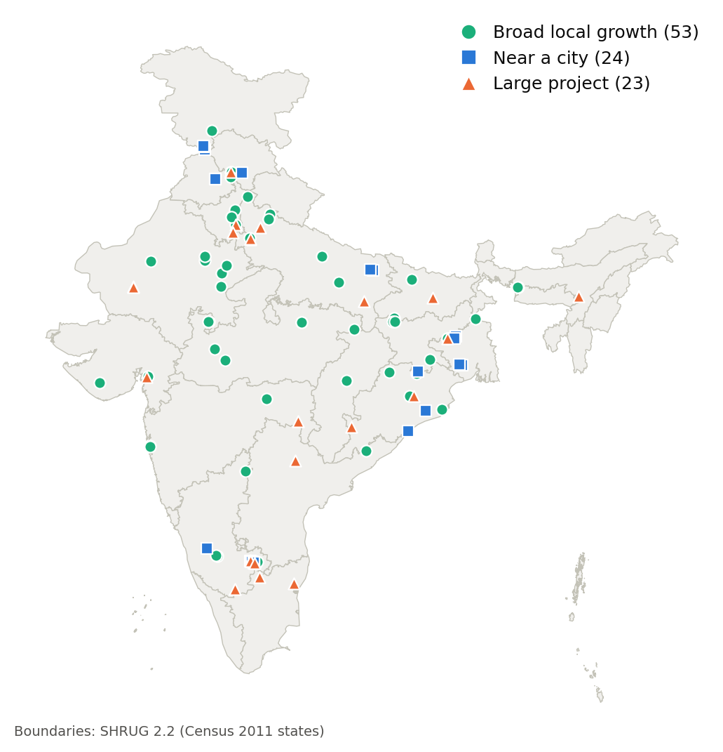
Top villages span 18 states; half grow broadly
+19%
+57%
53
built-up area, all villages
night light, all villages
of the top 100 grow broadly
Notes:
24 villages sit near a major city (Bangalore Rural alone has 10) and 23 are driven by a single large project such as an airport or refinery. The rest show broad local growth.

Slide 6
The ten fastest-growing villages
Rank | Village | District, State | New built-up (ha) | Night light 2021 → 2024–25 | Growth type
1 | Chapparadahalli | Bangalore Rural, Karnataka | 34.9 | 4.6 → 90.7 | Large project
2 | Lachhmanpur | Puruliya, West Bengal | 77.4 | 7.1 → 164.9 | Large project
3 | Banwari Bara | Gautam Buddha Nagar, Uttar Pradesh | 43.0 | 7.9 → 144.1 | Large project
4 | Doddagollahalli | Bangalore Rural, Karnataka | 74.2 | 11.0 → 97.7 | Large project
5 | Kerki | Saraikela-Kharsawan, Jharkhand | 30.0 | 13.6 → 187.4 | Broad local growth
6 | Bounker | Ludhiana, Punjab | 61.2 | 39.9 → 258.3 | Near a city
7 | Muliaguda | Nabarangapur, Odisha | 21.1 | 0.3 → 10.0 | Large project
8 | Kishorpur | Gautam Buddha Nagar, Uttar Pradesh | 47.4 | 15.8 → 342.1 | Large project
9 | Samletu | Bilaspur, Himachal Pradesh | 17.5 | 1.6 → 16.2 | Large project
10 | Palakuppam | Viluppuram, Tamil Nadu | 106.3 | 25.0 → 191.5 | Large project
Median rank stability across 1,000 random weight sets: 67%. Night light = area-weighted sum of annual median radiance.
Notes:
Several leaders match known projects (not yet verified on imagery): Banwari Bara and Kishorpur near the Noida International Airport, Samletu near AIIMS Bilaspur. Kerki (rank 5) is the clearest case of broad local growth in the top ten.

Slide 7
Limits and next steps
LIMITATIONS
NEXT STEPS
1
Proxies, not income: farm-led growth barely shows in lights or buildings
1
Check the top 30 on before/after high-resolution imagery
2
City spillover and big projects count as growth (flagged, not removed)
2
Validate district scores against NFHS-4 → NFHS-5 asset change
3
Census 2011 boundaries, ~1 km error; night lights at ~464 m
3
Add a farm signal: cropping intensity from Sentinel-2
4
Weights are a judgement call; median stability 67%
4
Add Census population for per-capita growth
Notes:
The most valuable next step is independent validation: imagery for the top villages and survey data at district level.

