Slide 1
REMA
Real Estate Management Systems

Slide 2
Topics
Proposed System
Scope
Existing System
Need For New System
Objectives
Problem Definition
Pros & Cons of Proposed System
UML Diagrams ( UseCase Diagram, Activity Diagram, Sequential Diagram)
Data Dictionary
Project Screenshots

Slide 3
Proposed System
In proposed system, a customer visit the website for two reasons which is for rent or sale a property. When the customer confirms the property and visit the property then details of property in the website and details of the property after reaching location will not be the same.
So this creates confusion to the customer due to discrepancy.
To overcome from we have created system called feedback in which if customer feels any discrepancy in the property details while purchasing for rent/sale, he can send the feedback.
Users are required to subscribe for the services available for real estate.
Another feature is when the customer applies for rent/purchase and agrees for it then the property is disabled. Due to that no other customer can apply the same property.

Slide 4
Scope
REMA is targeting Consumers interested in real estate, property owners, and Financers.
Properties can be residential or commercial in our system.
Financers will lend loan to Buyers based on the valuation of property.
Financers can be an individual or a private institutions like Credit Society or Banks.

Slide 5
Existing System
In existing system, consumer visits for two purposes , renting/buying a property.
Consumer enters the criteria which includes Price Range, Location and type of property. The list of properties are displayed according to search criteria.
Customer selects a property. The System notifies about the customer. Customer agrees to buy or rent a property.

Slide 6
Need For New System
In the existing system, when a customer is searching a property for purchase/Rent, sometimes the property details will not be same.
This creates discrepancy and customer may not be able to reach property, which should not be happen.
So, in the new system to handle this issue, we provide feedback functionality. In that if customer feels any discrepancy then customer can send feedback about it.
Second, in existing system, consumer selects property for rent/purchase and agrees for it. But the advertisement is not closed, this creates problem when another customer selects the same property.
So, in the new system we add disable function when the customer select the property for rent/purchase and accepts it then the advertisement of that property is disabled.

Slide 7
Objectives of New System
To keep potential consumer coming in for showings. And to keep the properties leased and occupied.
Make Consumers satisfied by showing relevant properties with proper images and update those properties.

Slide 8
Problem Definition
A consumer wants to buy/rent a property but the incorrect information of the particular property makes confusion to consumer which leads discrepancy and consumer doesn't buy a property.
Targeted Users
➔ Property Owner
➔ Customer
➔ Financial Manager
➔ Admin

Slide 9
Pros And Cons Of Proposed System
Pros (Advantages)
Cons (Limitations)
The Advantages of this system is you can analyse and judge the property without commuting to that location.
The customer can apply loan to purchase the property without going for third party agency.
The Disadvantages of the system is if the customer applies for the property and do not confirm for purchase/rent then the property status goes inactive to active state if the same is accepted by another customer.
Users need to subscribe to enable their respective services.

Slide 10
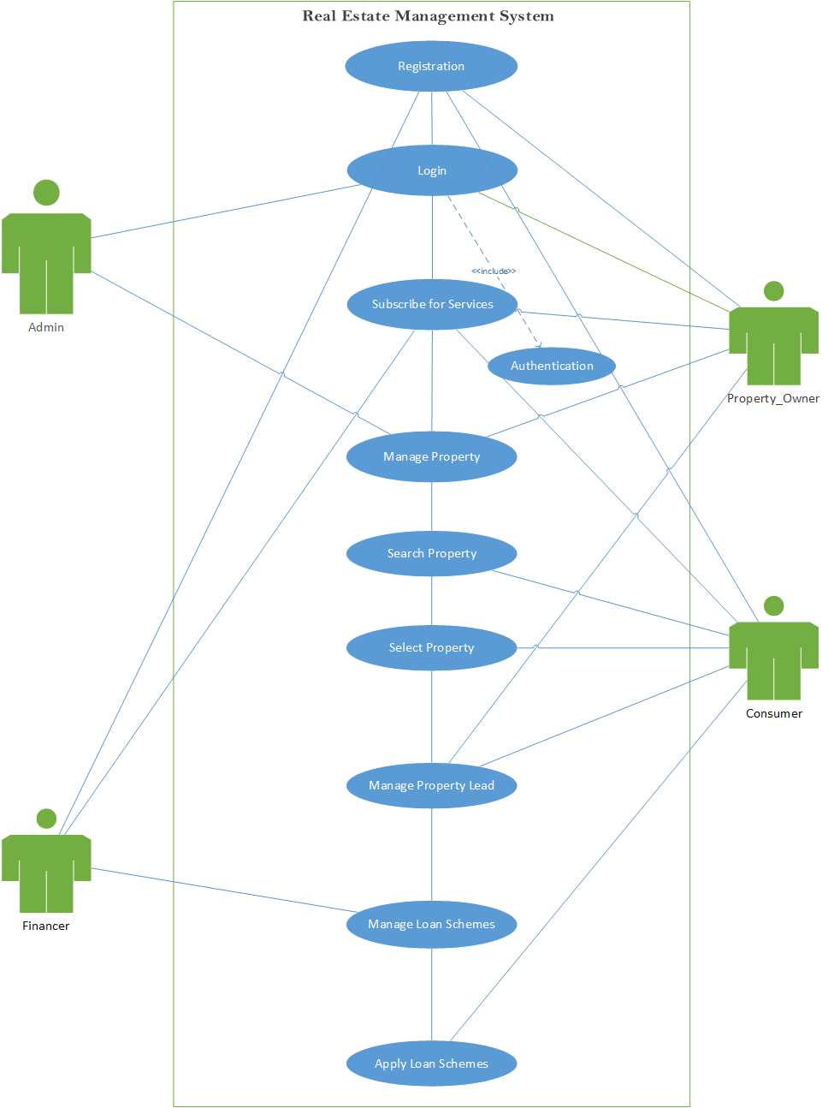
UML Diagrams (Use Case)

Slide 11
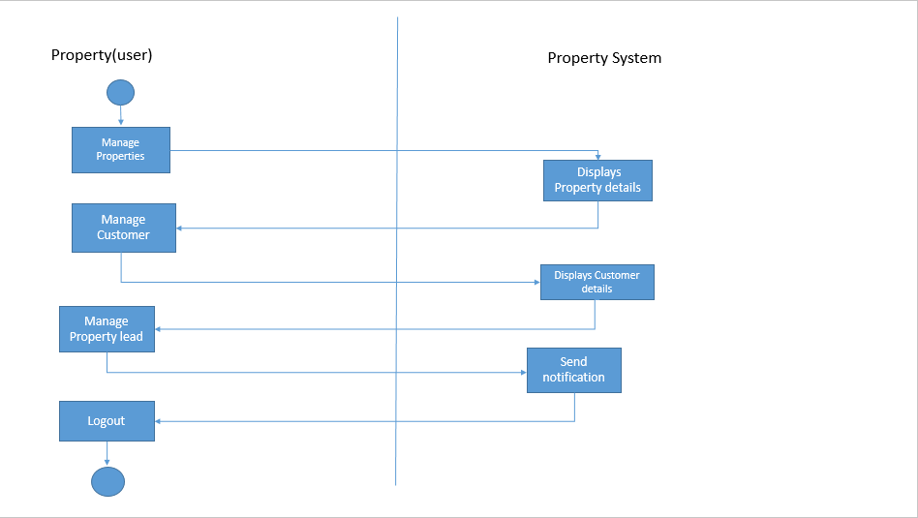
Activity Diagrams Manage Property Leads

Slide 12
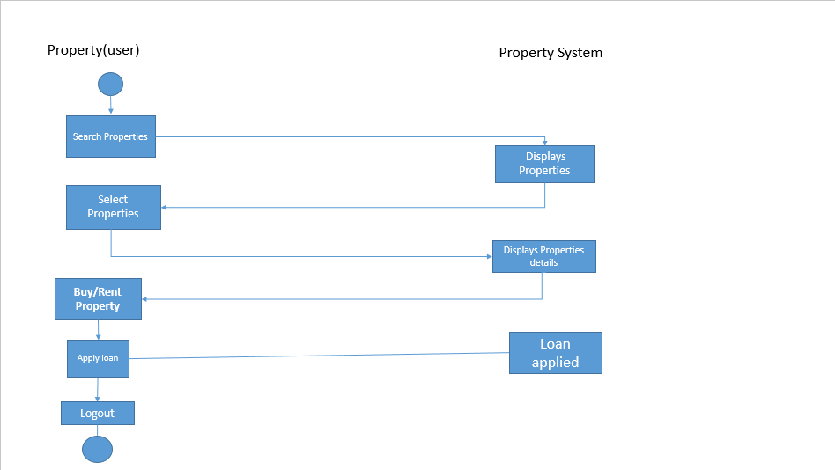
Purchase/Rent Activity

Slide 13
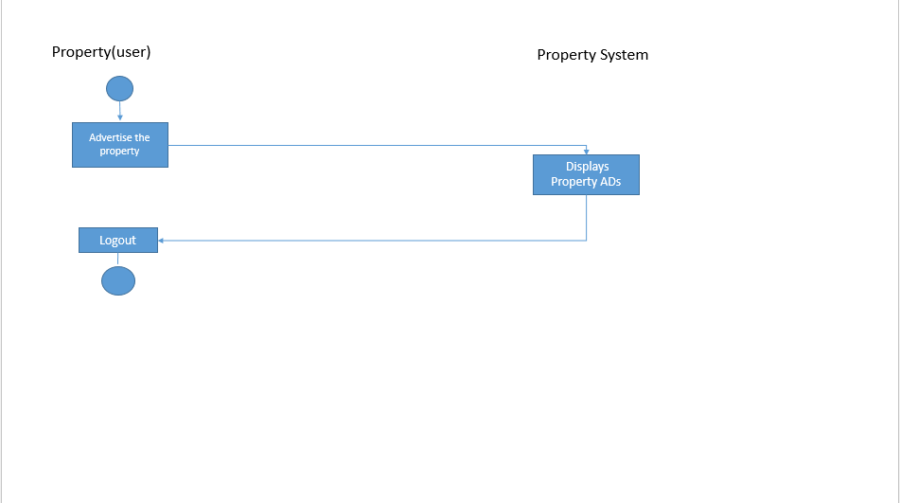
Advertise Property

Slide 14
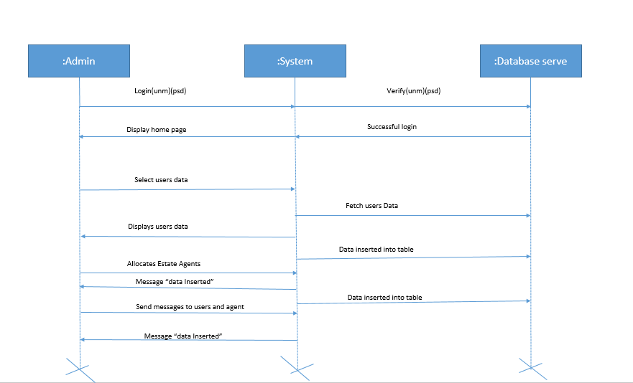
Sequential Diagram (Admin Processes)

Slide 15
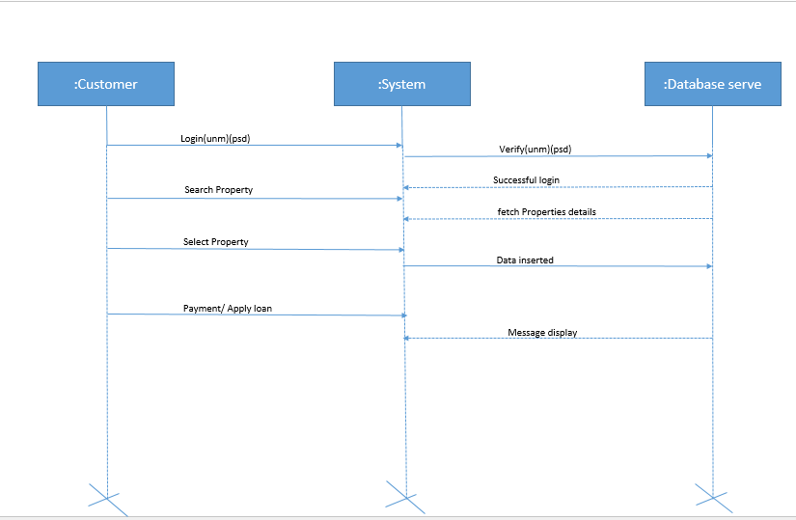
Consumer Processes

Slide 16
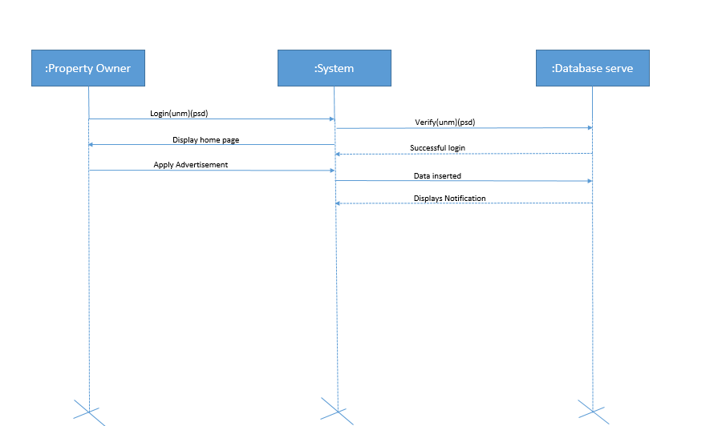
Property Registration Process

Slide 17
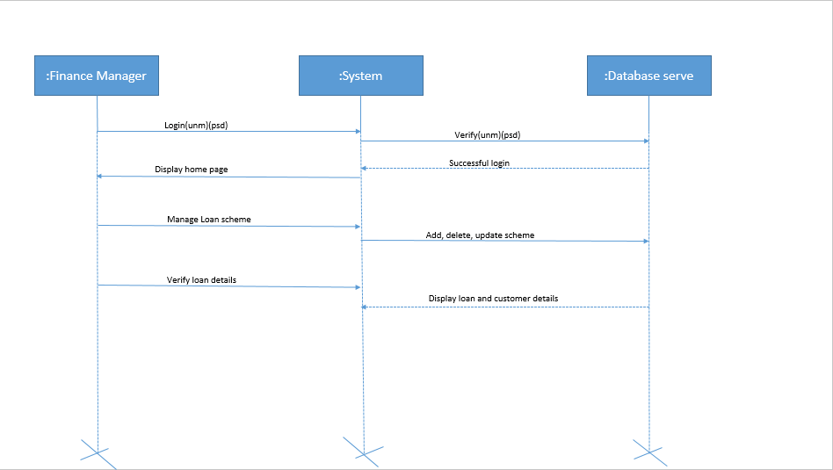
Add Loan Process

Slide 18
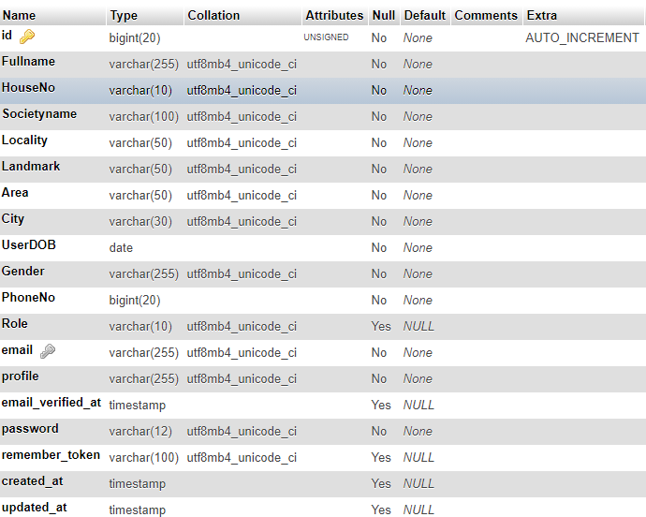
Data Dictionary User Master

Slide 19
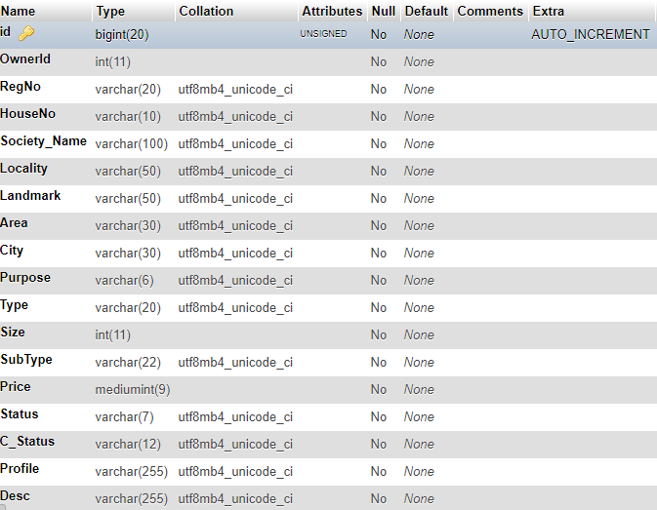
Properties

Slide 20
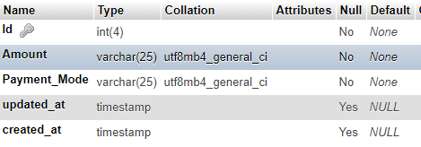
Subscribers

Slide 21
Leads
Data Item | Data Type | Data Format | Size | Description | Constraint
Lead ID | Integer | 1 | 3 |  | Primary Key
Property ID | Integer | 1 | 3 | Property ID | Foreign Key
Consumer ID | Integer | 1 | 3 | Consumer ID | Foreign Key
Owner ID | Integer | 11 | 3 | Owner ID
Property_Price | Integer | 100000 | 6
Purpose | String | “Buy”,”Rent” | 25 |  | Not null

Slide 22
Loan Scheme
Data Item | Data Type | Data Format | Size | Description | Constraint
Loan ID | integer | 1 | 3 |  | Primary Key
Creditor ID | integer | 1 | 3 | Owner ID | Foreign Key
Scheme Name | String | “Commercial Scheme-1” | 20 | Scheme name of Loan | Not null
Organisation Name | string | “Axis Bank Ltd” | 80 | Institution managing the loan | Not null
Amount | integer | 1000 | 7 | Principal amount for loan | Not null
ROI | integer | 5 | 3 | Rate Of Interest | Not null
Duration | integer | 3 | 4 | Duration of Loan | Not null
EMI | integer | 1221 | 5 | Easy Monthly Installment | Not null

Slide 23
Loan Applicant
Data Item | Data Type | Data Format | Size | Description | Constraint
Applicant ID | integer | 1 | 3 |  | Primary Key
Loan ID | integer | 1 | 3 |  | Foreign Key

Slide 24
Agile Project Charter
Title | Details
Project Name | ReEMA (Real Estate Management Systems)
Project Scope | To Develop a new real estate application to allow consumer to rent/buy property online.
Project Description | Online Property advertise, Loan Property, Buy/Rent property, Any property specific process Etc.
Budget | 5000 INR.
Risks
Project Members | Sudarshan Dey (195173693104), Balaji Itika(195173693041), Raj Parmar(185170693010)
Project Guide | Prof. Lajja Choksi
Duration | 3 Months
Start Date | 1st February 2021
End Date | 30th April 2021

Slide 25
Agile Project Plan(1)
Sprint Title | Duration | Start | End | Status
Sprint#1 Project Analysis | 22d | 01/02/2021 | 22/02/2021 | Complete
Users Analysis | 4d | 01/02/2021 | 04/02/2021 | Complete
Process Analysis | 6d | 05/02/2021 | 10/02/2021 | Complete
Feature Analysis | 6d | 11/02/2021 | 16/02/2021 | Complete
DB Analysis | 6d | 17/02/2021 | 22/02/2021 | Complete
Sprint#2 User Interface Design | 6d | 23/02/2021 | 28/02/2021 | Complete
Sprint#3 User Registration | 2d | 01/03/2021 | 02/03/2021 | Complete
Sprint#4 Authentication Process | 3d | 03/03/2021 | 05/03/2021 | Complete
User Login/Logout | 2d | 03/03/2021 | 04/03/2021 | Complete
Change/Forget Password | 1d | 05/03/2021 | 05/03/2021 | Complete

Slide 26
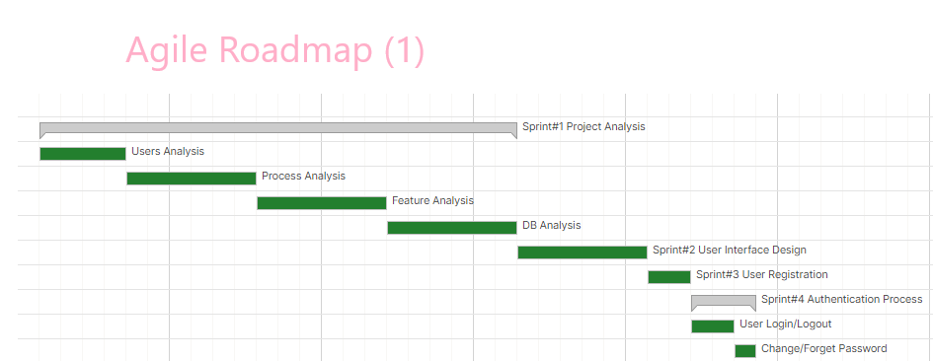
Agile Plan Roadmap

Slide 27
Agile Project Plan(2)
Sprint Title | Duration | Start | End | Status
Sprint#5 User Subscription | 2d | 06/03/2021 | 07/03/2021 | Complete
Sprint#6 Manage Profile | 3d | 08/03/2021 | 10/03/2021 | Complete
Sprint#7 Manage Properties | 3d | 11/03/2021 | 13/03/2021 | Complete
Add and View Property | 2d | 11/03/2021 | 12/03/2021 | Complete
Update/Delete Property | 1d | 13/03/2021 | 13/03/2021 | Complete
Sprint#8 Manage Leads | 5d | 14/03/2021 | 18/03/2021 | Complete
Search Property | 2d | 14/03/2021 | 15/03/2021 | Complete
Select Property(generate lead) | 1d | 16/03/2021 | 16/03/2021 | Complete
View Lead | 1d | 17/03/2021 | 17/03/2021 | Complete
Delete Lead | 1d | 18/03/2021 | 18/03/2021 | Complete

Slide 28
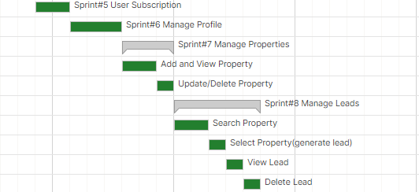
Agile Roadmap (2)

Slide 29
Agile Project Plan(3)
Sprint Title | Duration | Start | End | Status
Sprint#9 Manage Loans | 4d | 19/03/2021 | 22/03/2021 | Complete
Add Loans | 1d | 19/03/2021 | 19/03/2021 | Complete
View Loans | 2d | 20/03/2021 | 21/03/2021 | Complete
Update/Delete Loans | 1d | 22/03/2021 | 22/03/2021 | Complete
Sprint#10 Acquire Property | 3d | 23/03/2021 | 25/03/2021 | Complete
Rent/Buy Property | 1d | 23/03/2021 | 23/03/2021 | Complete
Apply Loan for Property | 2d | 24/03/2021 | 25/03/2021 | Complete
Sprint#11 Manage Users(Admin) | 3d | 26/03/2021 | 28/03/2021 | Complete
Sprint#12 Manage Feedback(Admin) | 3d | 29/03/2021 | 31/03/2021 | InComplete

Slide 30
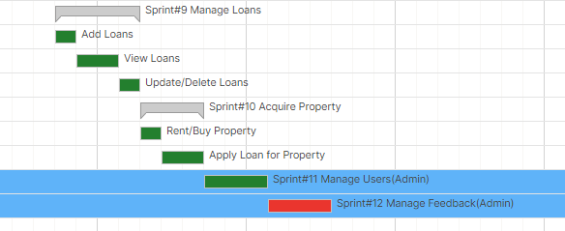
Agile Roadmap (3)

