Slide 1
Final Year Project Presentation
Prediction And Analysis of Trends In Cryptocurrency Market
Carried out by:
1MV14CS093 : Saurabh Prakash
1MV14CS109 : Sudarshan Kumar
Under the guidance of:
Dr. Suma Swamy
Professor
Dept. of Computer Science

Slide 2
Outline
Introduction
Literature Review
<Fill as per your project report>

Slide 3
Introduction

Slide 4
Literature Review
What is Data?
Data is any set of characters that has been gathered and translated for some purpose, usually analysis
It can be any character, including text and numbers, pictures, sound, or video. If data is not put into context, it doesn't do anything to a human or computer.
Within a computer's storage, data is a collection of numbers represented as bytes that are in turn composed of bits (binary digits) that can have the value one or zero.

Slide 5
Literature Review
What is Data?
Data can also be seen as a set of values of qualitative or quantitative variables.
A qualitative variable, also called a categorical variable, are variables that are not numerical. It describes data that fits into categories.
Quantitative variables have a value and they can be added, subtracted, divided or multiplied.

Slide 6
Literature Review
Data Analysis
Data Analysis is a process of inspecting, cleansing, transforming, and modelling data with the goal of discovering useful information, suggesting conclusions, and supporting decision-making.
Data analysis is a process for obtaining raw data and converting it into information useful for decision-making by users.
Data is collected and analysed to answer questions, test hypotheses or disprove theories.

Slide 7
Literature Review
How is Data Analysis Performed?
Following Steps are involved in Data Analysis :
Defining Objectives
Posing Questions
Data Collection
Data Wrangling
Data Analysis
Drawing Conclusions and Making Predictions

Slide 8
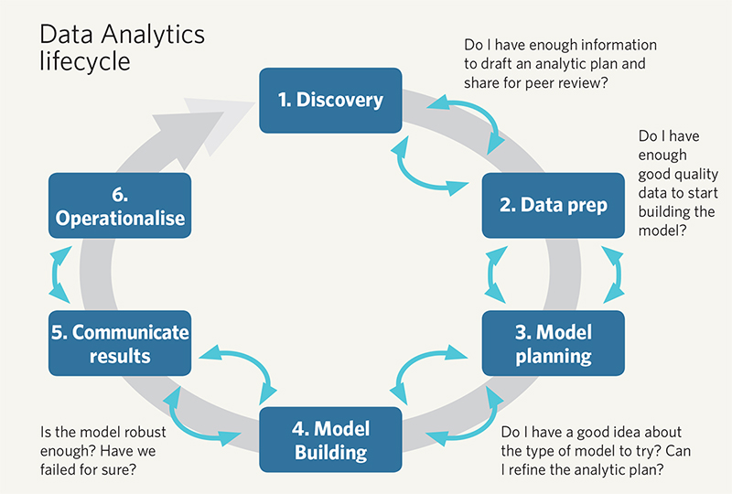
Literature Review

Slide 9
Literature Review
Exploratory Data Analysis
Exploratory Data Analysis (EDA) is an approach/philosophy for data analysis that employs a variety of techniques (mostly graphical) to maximize insight into a data set, uncover underlying structure, extract important variables, detect outliers and anomalies, test underlying assumptions, develop parsimonious models; and determine optimal factor settings.

Slide 10
Literature Review
Exploratory Data Analysis
The primary goal of EDA is to maximize the analyst's insight into a data set and into the underlying structure of a data set, while providing all of the specific items that an analyst would want to extract from a data set, such a good - fitting, parsimonious model, a list of outliers, a sense of robustness of conclusions, estimates for parameters, uncertainties for those estimates, a ranked list of important factors, conclusions as to whether individual factors are statistically significant and a lot more.

Slide 11
Literature Review
The Role of Graphics
Statistics and data analysis procedures can broadly be split into two parts:
quantitative
graphical
Quantitative techniques are the set of statistical procedures that yield numeric or tabular output. Examples of quantitative techniques include:
hypothesis testing
analysis of variance
point estimates and confidence intervals
least squares regression

Slide 12
Literature Review
The Role of Graphics
On the other hand, there is a large collection of statistical tools that are generally referred to as graphical techniques. These include:
scatter plots
histograms
probability plots
residual plots
box plots
block plot

Slide 13
Literature Review
R Programming Language
R is a language and environment for statistical computing and graphics. It is a GNU project which is similar to the S language and environment which was developed at Bell Laboratories (formerly AT&T, now Lucent Technologies) by John Chambers and colleagues.
R provides a wide variety of statistical (linear and nonlinear modelling, classical statistical tests, time-series analysis, classification, clustering,…) and graphical techniques, and is highly extensible.

Slide 14
Literature Review
R Programming Language
One of R’s strengths is the ease with which well-designed publication-quality plots can be produced, including mathematical symbols and formulae where needed. Great care has been taken over the defaults for the minor design choices in graphics, but the user retains full control.

Slide 15
Literature Review
ggplot2
gplot2 is a plotting system for R, based on the grammar of graphics, which tries to take the good parts of base and lattice graphics and none of the bad parts.
It takes care of many of the fiddly details that make plotting a hassle (like drawing legends) as well as providing a powerful model of graphics that makes it easy to produce complex multi-layered graphics.
ggplot2 is an implementation of Leland Wilkinson's Grammar of Graphics—a general scheme for data visualization which breaks up graphs into semantic components such as scales and layers.

Slide 16
Literature Review

Slide 17
References

Slide 18
Thank You

