Slide 1
SOFTWARE ENGINEERING -1
PROJECT PRESENTATION
SUBMITTED TO : SIR,AFTAB HUSSAIN
PRESENTED BY:
MUHAMMAD SUDAIS AKBAR_BSE213039
TALHA BIN SHAHZAD_BSE213031
HASEEB SAGHEER_BSE213181

Slide 2


Slide 3
INTRODUCTION:
The Food Hut website aims to revolutionize the food industry by providing a convenient platform for users to order delicious meals from their favourite restaurants.
With the increasing popularity of online food ordering, there is a growing demand for a user-friendly and efficient system
That connects restaurants, customers, and delivery services

Slide 4
Requirements
Functional Requirements
User Registration and Authentication
Browse and Search
Menu and Ordering
Online Payments
Delivery and Pickup Options
Ratings and Reviews
Personalized Recommendations
Non-Functional Requirement
Performance
Security
Usability

Slide 5
Implementation Details:
Front-end Development:
This section delves into the implementation details of the front-end development process for the Food Hut website. It discusses the technologies and frameworks used, such as HTML, CSS, and JavaScript.
2. Back-end Development:
The back-end development details are explained in this section. It focuses on the server-side technologies and frameworks used, such as Node.js, Express.js, and any relevant database management systems like MySQL or MongoDB.

Slide 6
Software Engineering Model Selection:
Selection of Agile Model
After careful evaluation, the Agile software engineering model is chosen as the most suitable approach for the development of the Food Hut website. The section explains the reasons behind this selection, such as the need for flexibility, continuous feedback, incremental development, and close collaboration with stakeholders.

Slide 7
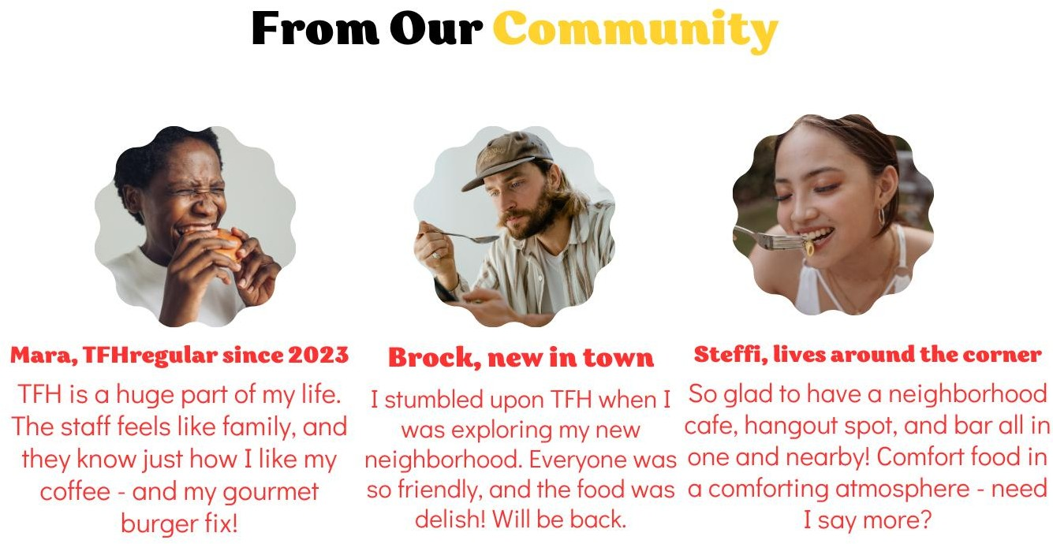

Slide 8
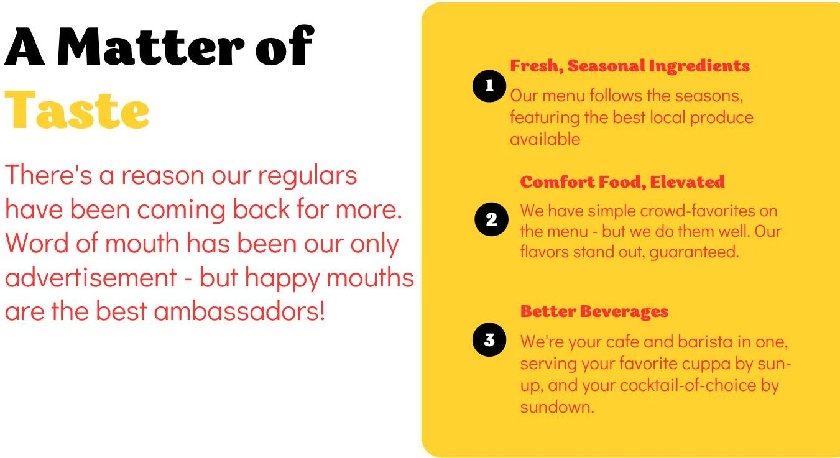

Slide 9
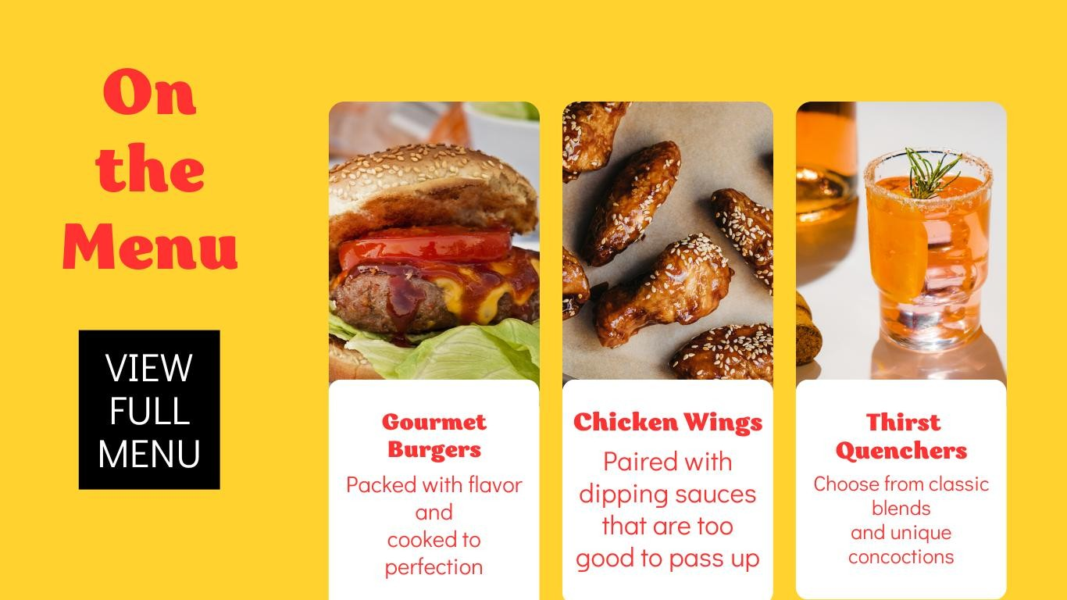

Slide 10


Slide 11
THANK YOU

