Slide 1

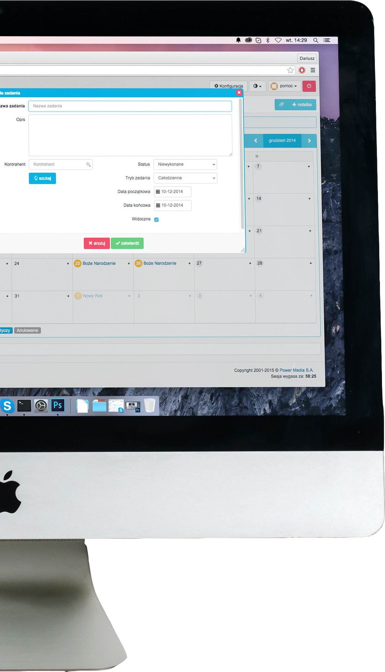

Internet Software Architecture
4CS017

Slide 2


UML Diagrams
Lecture Week 2

Slide 3

What are UML Diagrams?
1.UML Diagrams
1.1.What are UML Diagrams?
1.2.Why need UML Diagrams?
1.3.Which UML diagrams to focus?
1.3.1. Deployment diagram
1.3.1.1. Artifacts
1.3.1.2. Artifacts Instances
1.3.1.3. Node
1.3.2. Activity diagram
1.3.2.1. Basic components of an activity diagram
1.3.3. Sequence Diagram
1.3.3.1. Basic Sequence diagram notations
Unified Modeling Language
Blueprints to visualize how a system has been designed
not a programming language but a visual language
defines behavior and structure of a system
Types of UML diagrams
Structural UML diagrams
Behavioral UML diagrams

Slide 4
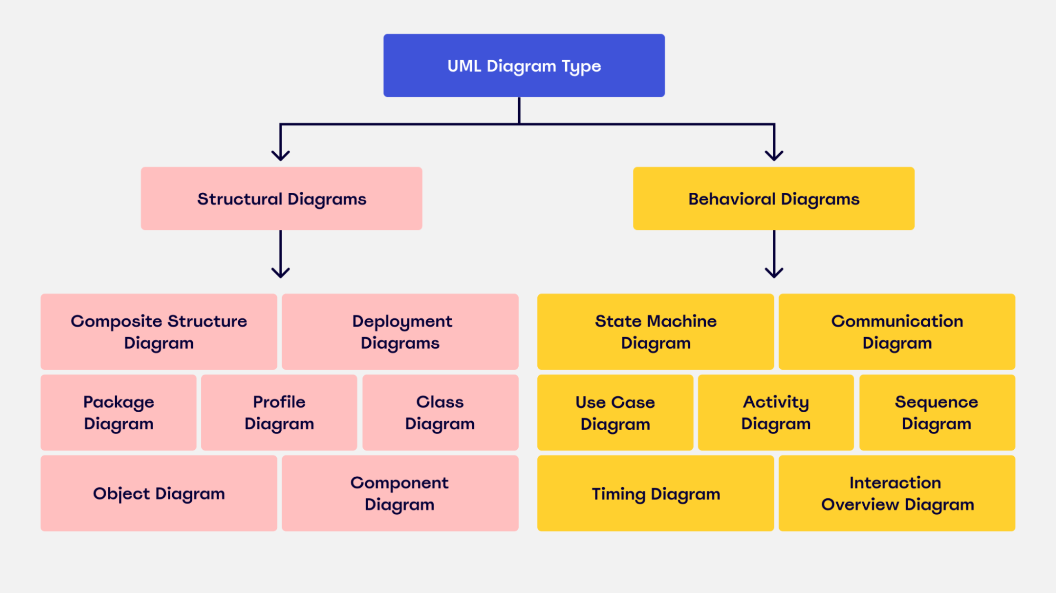
1.UML Diagrams
1.1.What are UML Diagrams?
1.2.Why need UML Diagrams?
1.3.Which UML diagrams to focus?
1.3.1. Deployment diagram
1.3.1.1. Artifacts
1.3.1.2. Artifacts Instances
1.3.1.3. Node
1.3.2. Activity diagram
1.3.2.1. Basic components of an activity diagram
1.3.3. Sequence Diagram
1.3.3.1. Basic Sequence diagram notations

Slide 5

Why need UML diagrams?
1.UML Diagrams
1.1.What are UML Diagrams?
1.2.Why need UML Diagrams?
1.3.Which UML diagrams to focus?
1.3.1. Deployment diagram
1.3.1.1. Artifacts
1.3.1.2. Artifacts Instances
1.3.1.3. Node
1.3.2. Activity diagram
1.3.2.1. Basic components of an activity diagram
1.3.3. Sequence Diagram
1.3.3.1. Basic Sequence diagram notations
Helps to build a clear communication amongst collaborative planning to design complex applications.
Helps non-programmers to understand the requirements and functionalities of the system.
It saves time and allows the team to visualize how the system works or did work.

Slide 6
Which UML diagrams to focus?
1.UML Diagrams
1.1.What are UML Diagrams?
1.2.Why need UML Diagrams?
1.3.Which UML diagrams to focus?
1.3.1. Deployment diagram
1.3.1.1. Artifacts
1.3.1.2. Artifacts Instances
1.3.1.3. Node
1.3.2. Activity diagram
1.3.2.1. Basic components of an activity diagram
1.3.3. Sequence Diagram
1.3.3.1. Basic Sequence diagram notations
Structural UML diagram
Shows how a system is constructed
Includes components, classes, objects and their connection to build a system.
Deployment diagram
Behavioral UML diagram
Visualize how a system interacts with itself, users and other systems.
Activity diagram
Sequence diagram

Slide 7
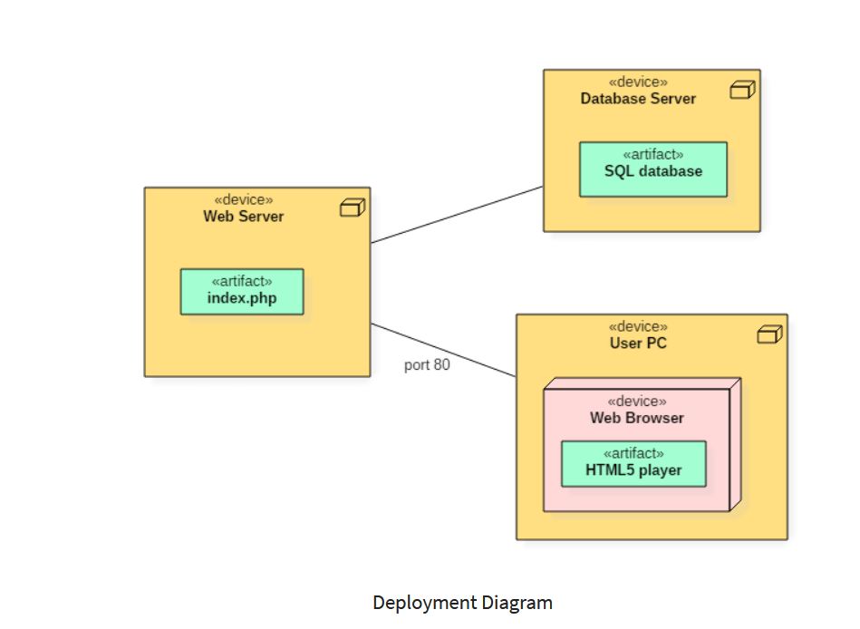
Deployment Diagram
1.UML Diagrams
1.1.What are UML Diagrams?
1.2.Why need UML Diagrams?
1.3.Which UML diagrams to focus?
1.3.1. Deployment diagram
1.3.1.1. Artifacts
1.3.1.2. Artifacts Instances
1.3.1.3. Node
1.3.2. Activity diagram
1.3.2.1. Basic components of an activity diagram
1.3.3. Sequence Diagram
1.3.3.1. Basic Sequence diagram notations
Specifies the physical hardware on which the software system will execute
Determines how the software is deployed on the underlying hardware
Visualize how software interacts with the hardware
Example of deployment diagram:-

Slide 8
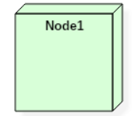
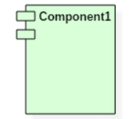
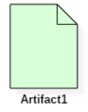
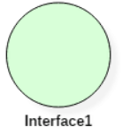
1.UML Diagrams
1.1.What are UML Diagrams?
1.2.Why need UML Diagrams?
1.3.Which UML diagrams to focus?
1.3.1. Deployment diagram
1.3.1.1. Artifacts
1.3.1.2. Artifacts Instances
1.3.1.3. Node
1.3.2. Activity diagram
1.3.2.1. Basic components of an activity diagram
1.3.3. Sequence Diagram
1.3.3.1. Basic Sequence diagram notations
A deployment diagram symbol and notations :-
A node
A component
An artifact
An interface

Slide 9
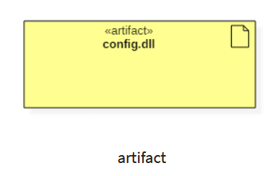
Artifacts
1.UML Diagrams
1.1.What are UML Diagrams?
1.2.Why need UML Diagrams?
1.3.Which UML diagrams to focus?
1.3.1. Deployment diagram
1.3.1.1. Artifacts
1.3.1.2. Artifacts Instances
1.3.1.3. Node
1.3.2. Activity diagram
1.3.2.1. Basic components of an activity diagram
1.3.3. Sequence Diagram
1.3.3.1. Basic Sequence diagram notations
An concrete real-world entity related to software development.
Artifacts are deployed on the nodes
Most common artifacts are:-
Source files
Database tables
DLL files
Scripts
Output files
Artifacts are labelled with <<artifact>>

Slide 10
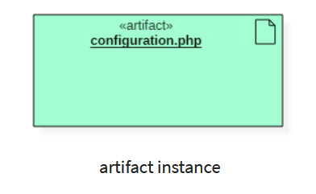
Artifact Instances
1.UML Diagrams
1.1.What are UML Diagrams?
1.2.Why need UML Diagrams?
1.3.Which UML diagrams to focus?
1.3.1. Deployment diagram
1.3.1.1. Artifacts
1.3.1.2. Artifacts Instances
1.3.1.3. Node
1.3.2. Activity diagram
1.3.2.1. Basic components of an activity diagram
1.3.3. Sequence Diagram
1.3.3.1. Basic Sequence diagram notations
Represents an instance of a particular artifact
Artifact instance is denoted with same <<artifact>> symbol except the name is underlined
It allows to differentiate between artifact and artifact instance
Example: -

Slide 11
Node
1.UML Diagrams
1.1.What are UML Diagrams?
1.2.Why need UML Diagrams?
1.3.Which UML diagrams to focus?
1.3.1. Deployment diagram
1.3.1.1. Artifacts
1.3.1.2. Artifacts Instances
1.3.1.3. Node
1.3.2. Activity diagram
1.3.2.1. Basic components of an activity diagram
1.3.3. Sequence Diagram
1.3.3.1. Basic Sequence diagram notations
Node is a hardware resource upon which the artifacts are deployed.
physical thing that can execute one or more artifacts
Describes execution of code and communication between entities
Denoted by 3D box
Node comprises of two types:-
Continue =>

Slide 12
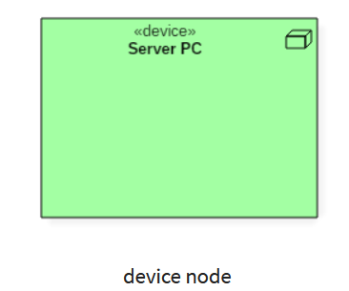
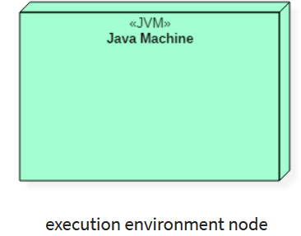
1.UML Diagrams
1.1.What are UML Diagrams?
1.2.Why need UML Diagrams?
1.3.Which UML diagrams to focus?
1.3.1. Deployment diagram
1.3.1.1. Artifacts
1.3.1.2. Artifacts Instances
1.3.1.3. Node
1.3.2. Activity diagram
1.3.2.1. Basic components of an activity diagram
1.3.3. Sequence Diagram
1.3.3.1. Basic Sequence diagram notations
<<device>>
A node that represents physical machine capable of performing computations.
A device can be a router or server PC.
<<execution environment>>
A node that represents an environment in which the software is going to execute.
Example: - Java is executed in Java Virtual Machine (JVM)

Slide 13

Any Questions

Slide 14
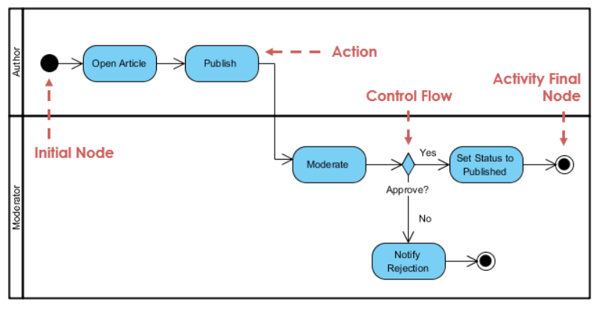
Activity diagram
1.UML Diagrams
1.1.What are UML Diagrams?
1.2.Why need UML Diagrams?
1.3.Which UML diagrams to focus?
1.3.1. Deployment diagram
1.3.1.1. Artifacts
1.3.1.2. Artifacts Instances
1.3.1.3. Node
1.3.2. Activity diagram
1.3.2.1. Basic components of an activity diagram
1.3.3. Sequence Diagram
1.3.3.1. Basic Sequence diagram notations
Flowchart that outlines all the activities performed by the system
Shows everything from start to finish defining the various decision paths to move forward.
Demonstrate logic of an algorithm
Example of activity diagram:

Slide 15
Basic components of an activity
1.UML Diagrams
1.1.What are UML Diagrams?
1.2.Why need UML Diagrams?
1.3.Which UML diagrams to focus?
1.3.1. Deployment diagram
1.3.1.1. Artifacts
1.3.1.2. Artifacts Instances
1.3.1.3. Node
1.3.2. Activity diagram
1.3.2.1. Basic components of an activity diagram
1.3.3. Sequence Diagram
1.3.3.1. Basic Sequence diagram notations
Action: A step in the activity where in the users or perform a given task. Denoted by rounded-edged rectangles.
Decision node: A conditional branch in the flow that is represented by a diamond. It includes a single input and two or more outputs.
Control flows: Another name for the connectors that show the flow between steps in the diagram.
Start node: Symbolizes the beginning of the activity. The start node is represented by a black circle.
Start node: Symbolizes the beginning of the activity. The start node is represented by a black circle.

Slide 16

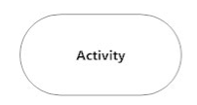

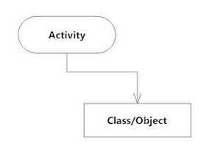
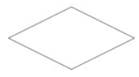
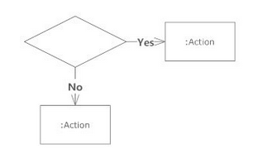

1.UML Diagrams
1.1.What are UML Diagrams?
1.2.Why need UML Diagrams?
1.3.Which UML diagrams to focus?
1.3.1. Deployment diagram
1.3.1.1. Artifacts
1.3.1.2. Artifacts Instances
1.3.1.3. Node
1.3.2. Activity diagram
1.3.2.1. Basic components of an activity diagram
1.3.3. Sequence Diagram
1.3.3.1. Basic Sequence diagram notations
Basic Activity Diagram Notations and Symbols
Initial State or start point
Activity or Action state
Action Flow
Object Flow
Decision and Branching
Guards
End point

Slide 17
Sequence Diagram
1.UML Diagrams
1.1.What are UML Diagrams?
1.2.Why need UML Diagrams?
1.3.Which UML diagrams to focus?
1.3.1. Deployment diagram
1.3.1.1. Artifacts
1.3.1.2. Artifacts Instances
1.3.1.3. Node
1.3.2. Activity diagram
1.3.2.1. Basic components of an activity diagram
1.3.3. Sequence Diagram
1.3.3.1. Basic Sequence diagram notations
Shows interaction between the objects in terms of messages exchanged over time.
Also known as event diagrams.
Good way to visualize and validate various runtime scenarios.
Help to understand logic of complex operations or functions

Slide 18
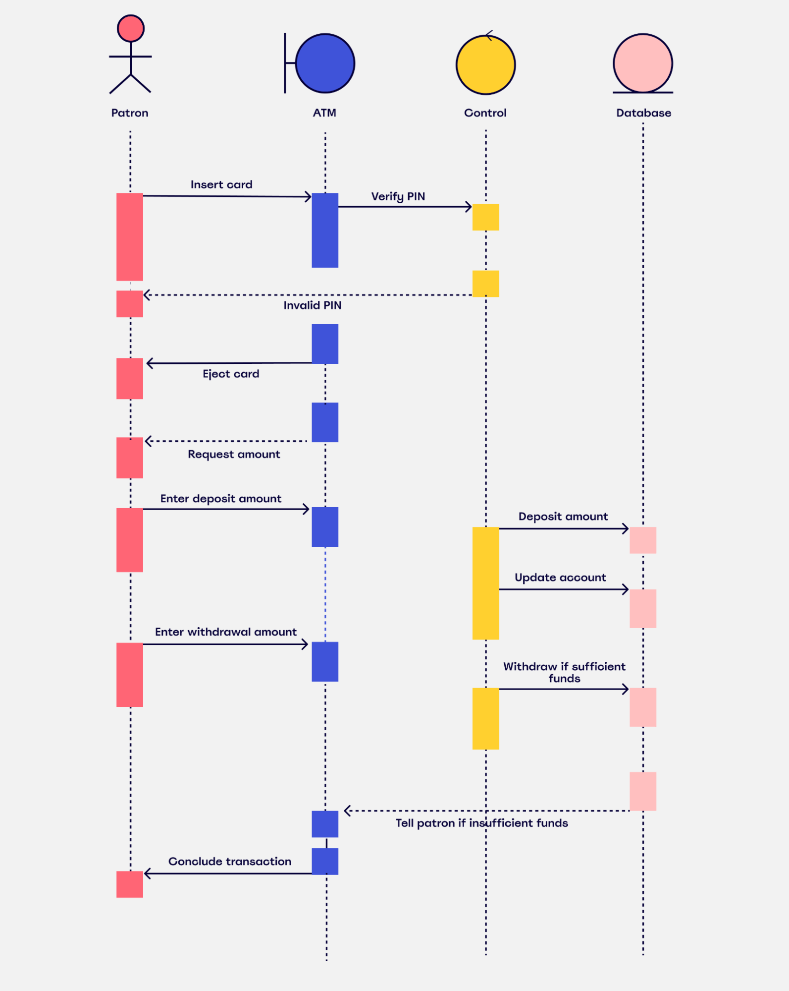
1.UML Diagrams
1.1.What are UML Diagrams?
1.2.Why need UML Diagrams?
1.3.Which UML diagrams to focus?
1.3.1. Deployment diagram
1.3.1.1. Artifacts
1.3.1.2. Artifacts Instances
1.3.1.3. Node
1.3.2. Activity diagram
1.3.2.1. Basic components of an activity diagram
1.3.3. Sequence Diagram
1.3.3.1. Basic Sequence diagram notations

Slide 19



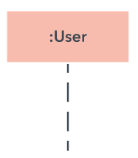
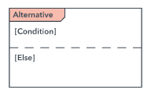
1.UML Diagrams
1.1.What are UML Diagrams?
1.2.Why need UML Diagrams?
1.3.Which UML diagrams to focus?
1.3.1. Deployment diagram
1.3.1.1. Artifacts
1.3.1.2. Artifacts Instances
1.3.1.3. Node
1.3.2. Activity diagram
1.3.2.1. Basic components of an activity diagram
1.3.3. Sequence Diagram
1.3.3.1. Basic Sequence diagram notations
Basic sequence Diagram Notations
Object Symbol :
Activation Symbol:
Actor Symbol:
Lifeline Symbol:
Alternative Symbol:

Slide 20




1.UML Diagrams
1.1.What are UML Diagrams?
1.2.Why need UML Diagrams?
1.3.Which UML diagrams to focus?
1.3.1. Deployment diagram
1.3.1.1. Artifacts
1.3.1.2. Artifacts Instances
1.3.1.3. Node
1.3.2. Activity diagram
1.3.2.1. Basic components of an activity diagram
1.3.3. Sequence Diagram
1.3.3.1. Basic Sequence diagram notations
Common message symbol
Synchronous message symbol :
This symbol is used when a sender must wait for a response to a message before it continues.
Asynchronous message symbol:
Asynchronous messages don't require a response before the sender continues.
Asynchronous create message symbol:
This message creates a new object.
Reply Message Symbol:
these messages are replies to calls.

Slide 21
Any Questions

Slide 22


