Slide 1
Ensembles
Jun Hong

Slide 2
Outline
Basics of ensembles
Bagging/Pasting
Recap of decision trees
Random forests
Boosting

Slide 3
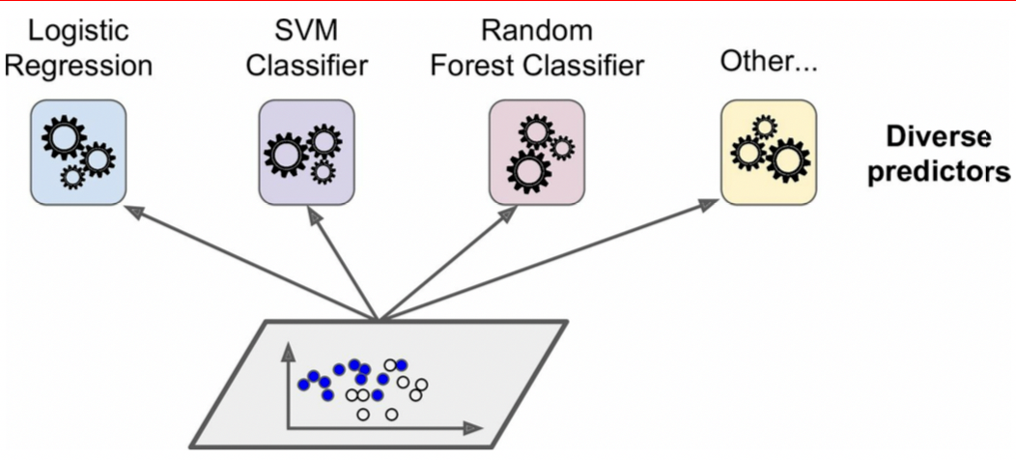
Ensembles – a collection of diverse classifiers
We need both diverse datasets and algorithms
Ensemble: A set of predictors is called an ensemble.
Ensemble learning: train a set of diverse classifiers and aggregate the classifications to make a prediction.

Slide 4
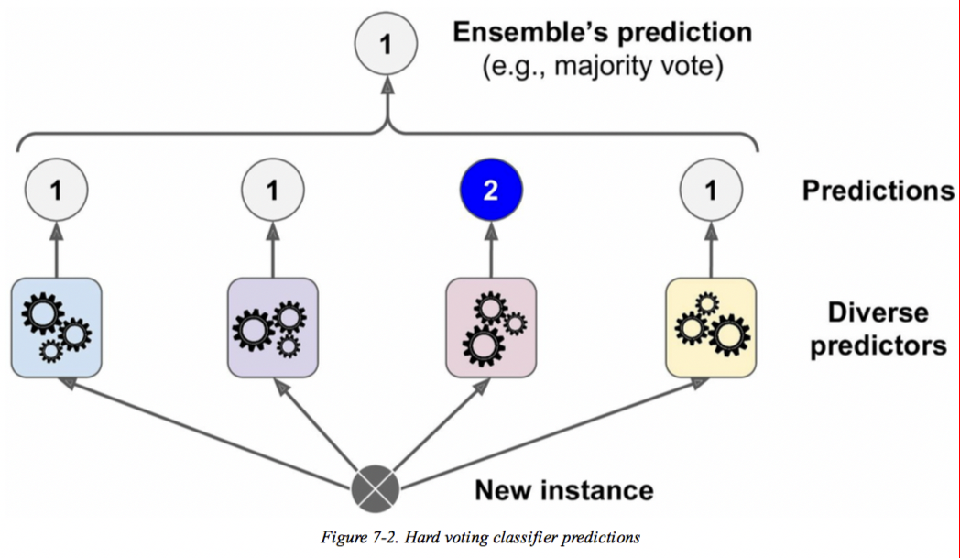
Voting classifiers – Two voting strategies
Majority voting (each having the same weight) –
Hard voting
Majority weighted voting (each having a different weight), e.g. weighted probabilities –
Soft voting

Slide 5
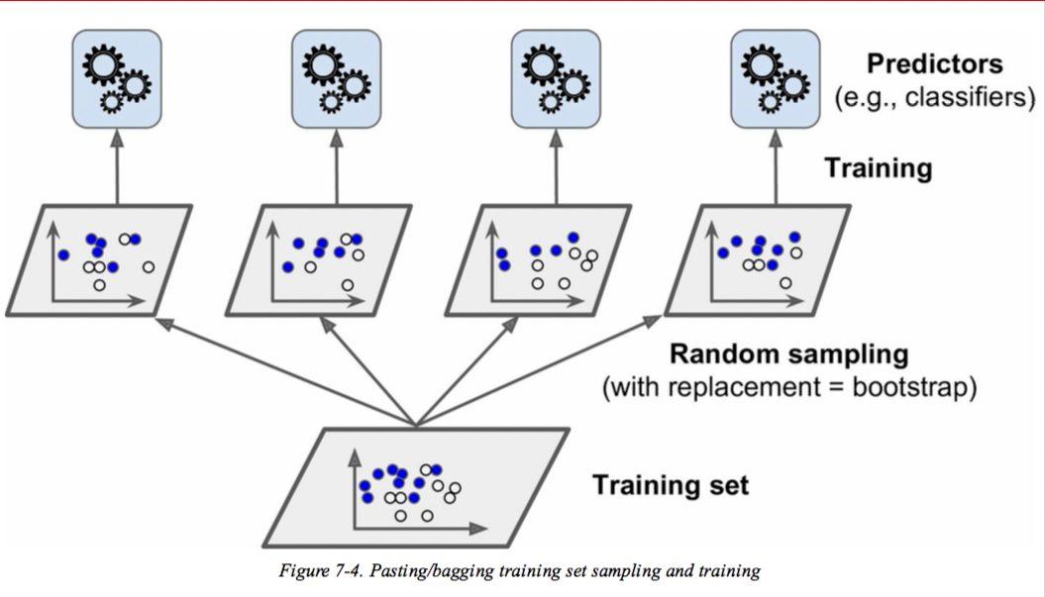
Bagging (Bootstrap aggregating)/Pasting
Bagging: Use the same ML algorithm for every classifier and train them on different random subsets of the training dataset. When sampling is performed with replacement, the approach is called bagging; Otherwise, called pasting.
Similar bias and lower variance: Each individual classifier typically overfits with low bias and high variance because it uses a subset of the training dataset but the aggregation reduces overfitting, resulting in low variance
We focus on diverse datasets to reduce variance so to
improve models that overfit
Notes:
Bootstrap - A statistical method of estimating a population's characteristics (such as its mean) by repeatedly subsampling from a given initial sample.

Slide 6
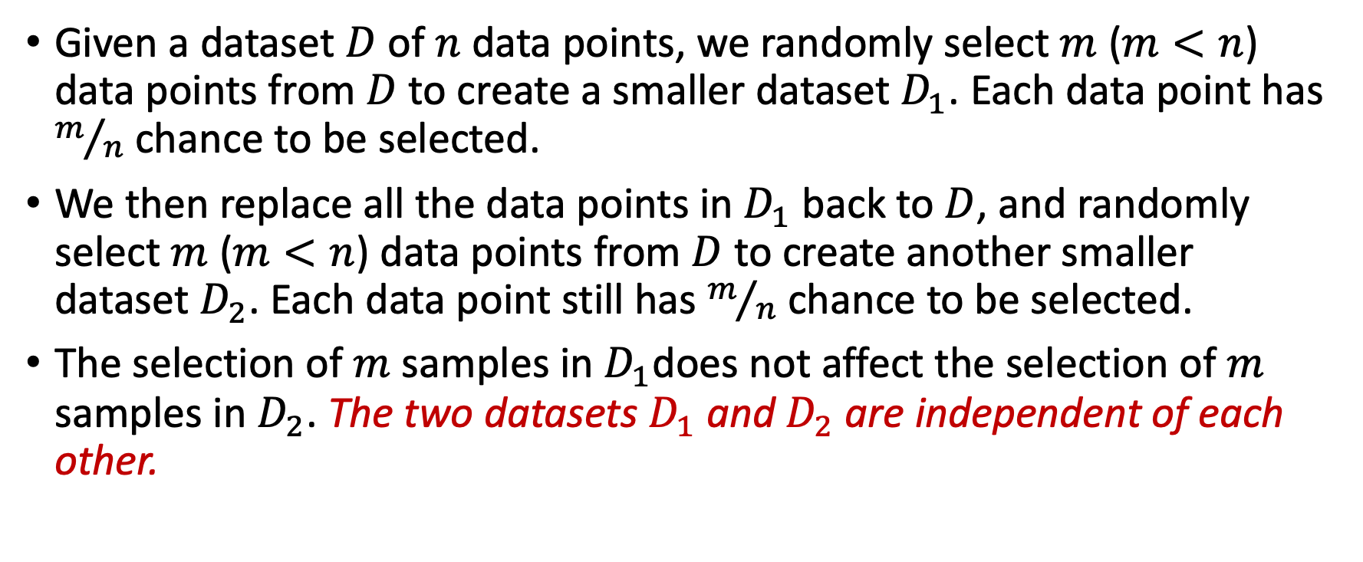
Sampling with replacement - bagging
Given a dataset $D$ of $n$ data points, we randomly select $m$ ($m<n$) data points from $D$ to create a smaller dataset $D_{1}$. Each data point has $m/n$ chance to be selected.
We then replace all the data points in $D_{1}$ back to $D$, and randomly select $m$ ($m<n$) data points from $D$ to create another smaller dataset $D_{2}$. Each data point still has $m/n$ chance to be selected.
The selection of $m$ samples in $D_{1}$does not affect the selection of $m$ samples in $D_{2}$. The two datasets $D_{1}$ and $D_{2}$ are independent of each other.

Slide 7
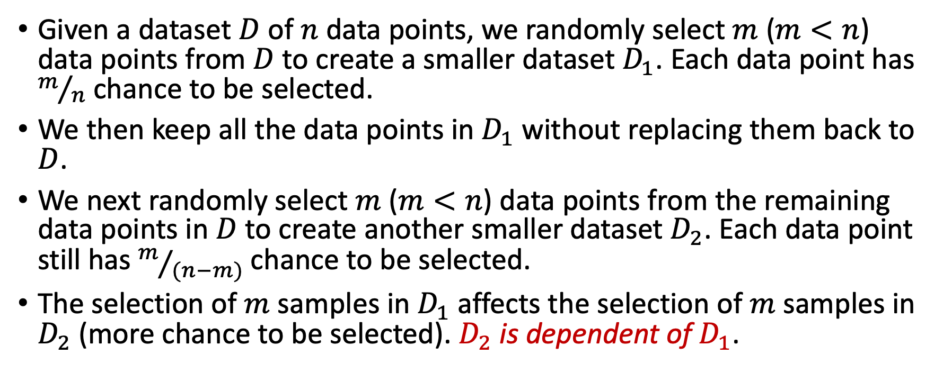
Sampling without replacement - pasting
Given a dataset $D$ of $n$ data points, we randomly select $m$ ($m<n$) data points from $D$ to create a smaller dataset $D_{1}$. Each data point has $m/n$ chance to be selected.
We then keep all the data points in $D_{1}$ without replacing them back to $D$.
We next randomly select $m$ ($m<n$) data points from the remaining data points in $D$ to create another smaller dataset $D_{2}$. Each data point still has $m/{(n−m)}$ chance to be selected.
The selection of $m$ samples in $D_{1}$ affects the selection of $m$samples in $D_{2}$ (more chance to be selected). $D_{2}$ is dependent of $D_{1}$.
Suitable for large datasets

Slide 8
Random Forests

Slide 9
Recap of Decision Trees

Slide 10
Decision Tree Classification Task
Induction - learning general rules from training data points/samples for classification
Note that decision
trees allow categorical
and ordinal features
Decision Tree
Deduction – applying general rules to classify a new data point

Slide 11
Example of a Decision Tree
At each decision point a selected feature is used to split the training samples into binary subsets – a splitting point maybe needed for a continuous feature
categorical
categorical
continuous
class
Splitting Attributes
HO
Yes
No
NO
MarSt
Single, Divorced
Married
AnnInc
NO
< 80K
>= 80K
Splitting Points
NO
YES
Training Data
Model: Decision Tree
Notes:
At each split, a splitting attribute is chosen and a splitting point/rule for the attribute is chosen. This is a binary decision tree so each split is a two-way split based on one attribute.

Slide 12
Another Example of Decision Tree
categorical
categorical
continuous
class
MarSt
Single, Divorced
Married
NO
HO
Yes
No
NO
AnnInc
< 80K
> 80K
NO
YES
There could be more than one tree that fits the same data!
Note the splitting attributes are selected using the attribute importance measure - node impurity, e.g. GINI
Notes:
The splitting attribute needs to be selected. Given a selected attribute, the splitting point needs to be selected.

Slide 13
Measure of Impurity: GINI
  Nodes with homogeneous class distribution are preferred
  Gini – measure of impurity
  Low Gini – low degree of impurity
  Attributes are selected based on the partitions produced
  Partitions of larger subsets with lower Ginis are preferred

Slide 14
Decision Tree Classification Task
Decision Tree

Slide 15
Apply Model to Test Data
Test Data
Start from the root of tree.
HO
Yes
No
NO
MarSt
Single, Divorced
Married
AnnInc
NO
< 80K
>= 80K
NO
YES
Notes:
“How a fitted decision tree is used for classification?” Given a instance, X, for which the associated class label is unknown, the attribute values of the instance are tested against the decision tree. A path is traced from the root to a leaf node, which holds the class prediction for that instance. Decision trees can easily be converted to classification rules.

Slide 16
Apply Model to Test Data
Test Data
HO
Yes
No
NO
MarSt
Single, Divorced
Married
AnnInc
NO
< 80K
> 80K
NO
YES

Slide 17
Apply Model to Test Data
Test Data
HO
Yes
No
NO
MarSt
Single, Divorced
Married
AnnTax
NO
< 80K
> 80K
NO
YES

Slide 18
Apply Model to Test Data
Test Data
HO
Yes
No
NO
MarSt
Single, Divorced
Married
AnnTax
NO
< 80K
> 80K
NO
YES

Slide 19
Apply Model to Test Data
Test Data
HO
Yes
No
NO
MarSt
Single, Divorced
Married
AnnTax
NO
< 80K
> 80K
NO
YES

Slide 20
Apply Model to Test Data
Test Data
HO
Yes
No
NO
MarSt
Single, Divorced
Married
Assign Defaulted to “No”
AnnInc
NO
< 80K
>= 80K
NO
YES

Slide 21
Advantages and limitations of DT
Advantages
  Easy to understand
  Easy to implement
  Easy to use
  Computationally cheap (well!)
  Suitable for linearly (& non linearly) separable classes
  Does regression as well
  Completely invariant to scaling of the data
Main issue
  Overfitting – low bias, high variance
Notes:
For regression, a different measure is needed for the selection of splitting attributes. Instead of entropy and information gain, we can use mean squared error. So instead of ginis we use mses.

Slide 22
Why Random Forests
A single decision tree does not perform well
It is super fast
What if we learn multiple trees?
Good, so we can form an ensemble with multiple trees
However, we need to make sure they do not all just learn the same tree from the training dataset

Slide 23
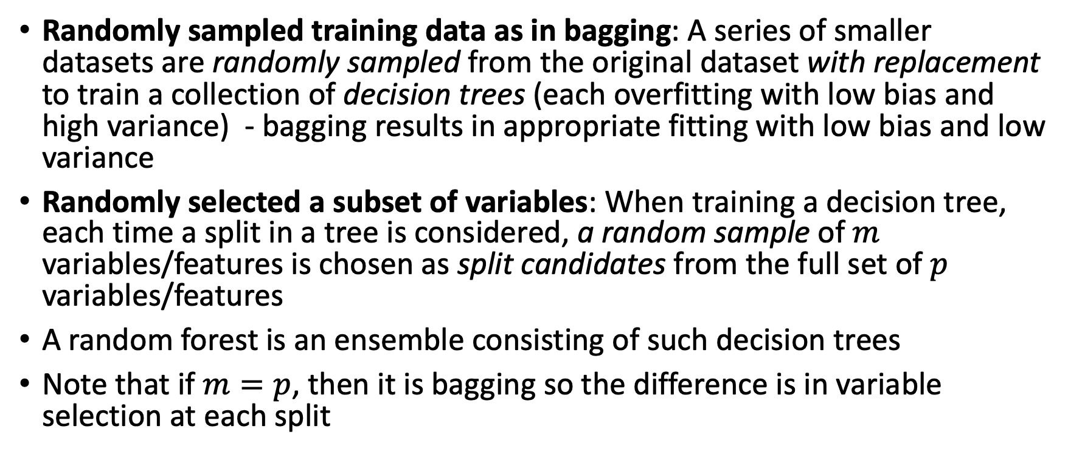
Random Forests - Randomisation
Randomly sampled training data as in bagging: A series of smaller datasets are randomly sampled from the original dataset with replacement to train a collection of decision trees (each overfitting with low bias and high variance) - bagging results in appropriate fitting with low bias and low variance
Randomly selected a subset of variables: When training a decision tree, each time a split in a tree is considered, a random sample of $m$ variables/features is chosen as split candidates from the full set of $p$ variables/features
A random forest is an ensemble consisting of such decision trees
Note that if $m=p$, then it is bagging so the difference is in variable selection at each split

Slide 24
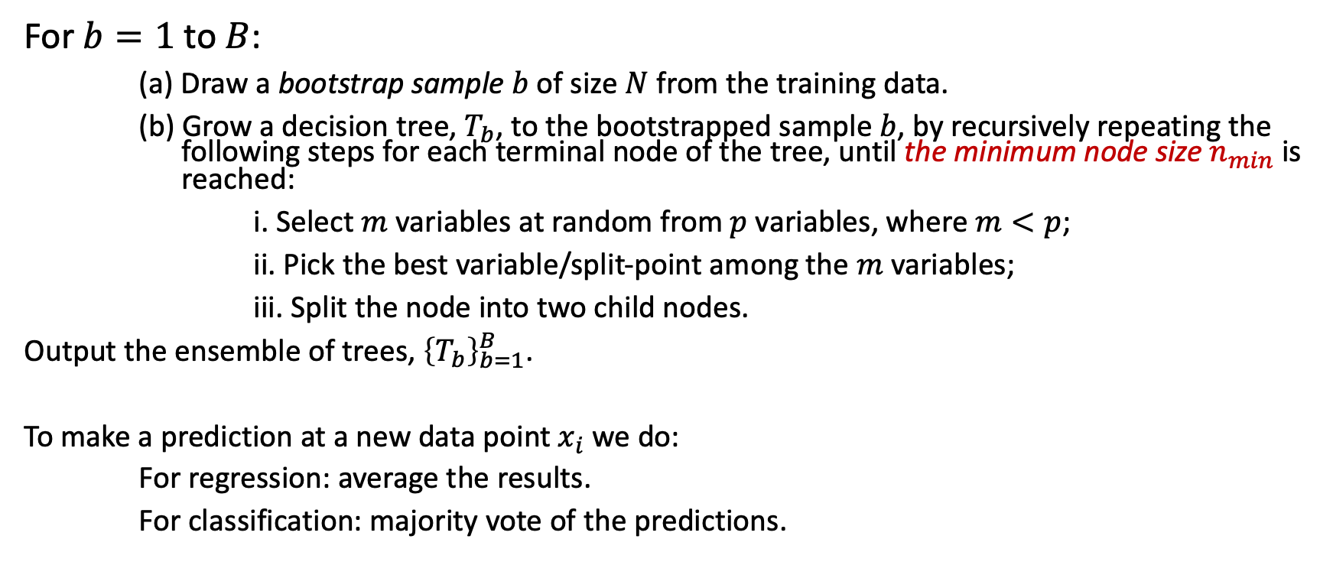
Random Forests Algorithm
For $b=1$ to $B$:
  (a) Draw a bootstrap sample $b$ of size $N$ from the training data.
  (b) Grow a decision tree, $T_{b}$, to the bootstrapped sample $b$, by recursively repeating the following steps for each terminal node of the tree, until the minimum node size $n_{min}$ is reached:
  i. Select $m$ variables at random from $p$ variables, where $m<p$;
  ii. Pick the best variable/split-point among the $m$ variables;
  iii. Split the node into two child nodes.
  Output the ensemble of trees, ${\left\{T_{b}\right\}}_{b=1}^{B}$.
  To make a prediction at a new data point $x_{i}$ we do:
  For regression: average the results.
  For classification: majority vote of the predictions.
Notes:
Note that randomly selecting m variables from p variables prevents the same variable from being selected as the splitting variable, resulting similar trees.

Slide 25
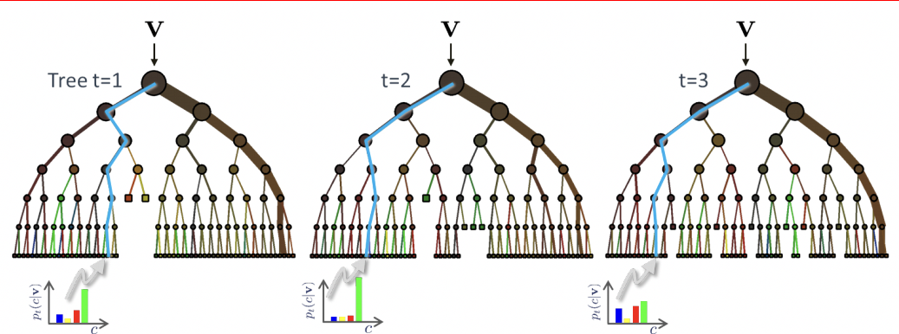
Random Forests
Classification: Majority voting
Classification: Majority vote
Regression: Averaging

Slide 26
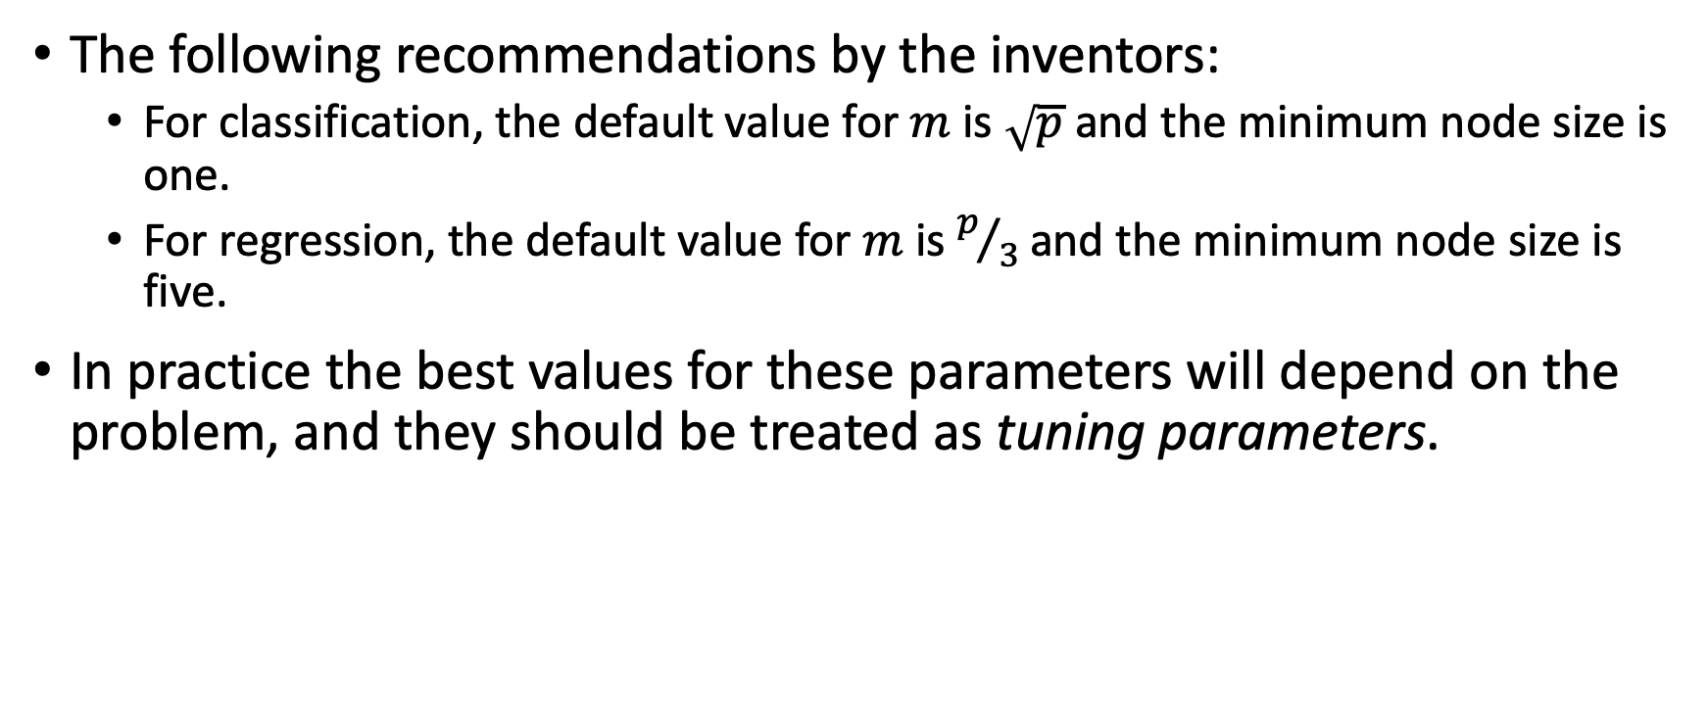
Random Forests – Tuning Parameters
The following recommendations by the inventors:
  For classification, the default value for $m$ is $\sqrt{p}$ and the minimum node size is one.
  For regression, the default value for $m$ is $p/3$ and the minimum node size is five.
In practice the best values for these parameters will depend on the problem, and they should be treated as tuning parameters.

Slide 27
End of Week 7

Slide 28
Boosting
Problem
  We have weak learners with high bias and variance - e.g., shallow decision trees (decision stumps).
Solution
  Create an ensemble to combine the weak learners into a strong one.
  Do not involve bootstrap sampling or random selection of variables to create a set of diverse base classifiers or regressors
  In particular, train weak learners sequentially, each trying to correct its predecessors using information from previous learners.
  Two most common boosting algorithms: AdaBoost (short for adaptive boosting) and gradient boosting (XGBoost – Extreme Gradient Boosting).

Slide 29
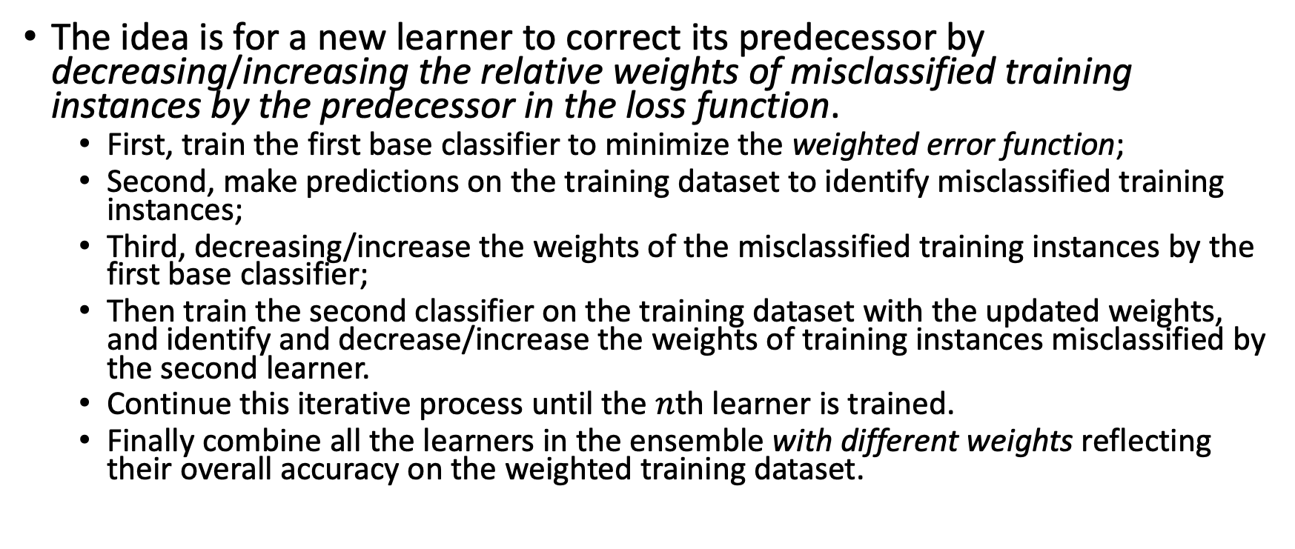
AdaBoost (Adaptive Boosting) - Intuition
The idea is for a new learner to correct its predecessor by decreasing/increasing the relative weights of misclassified training instances by the predecessor in the loss function.
  First, train the first base classifier to minimize the weighted error function;
  Second, make predictions on the training dataset to identify misclassified training instances;
  Third, decreasing/increase the weights of the misclassified training instances by the first base classifier;
  Then train the second classifier on the training dataset with the updated weights, and identify and decrease/increase the weights of training instances misclassified by the second learner.
  Continue this iterative process until the $n$th learner is trained.
  Finally combine all the learners in the ensemble with different weights reflecting their overall accuracy on the weighted training dataset.
Notes:
,

Slide 30
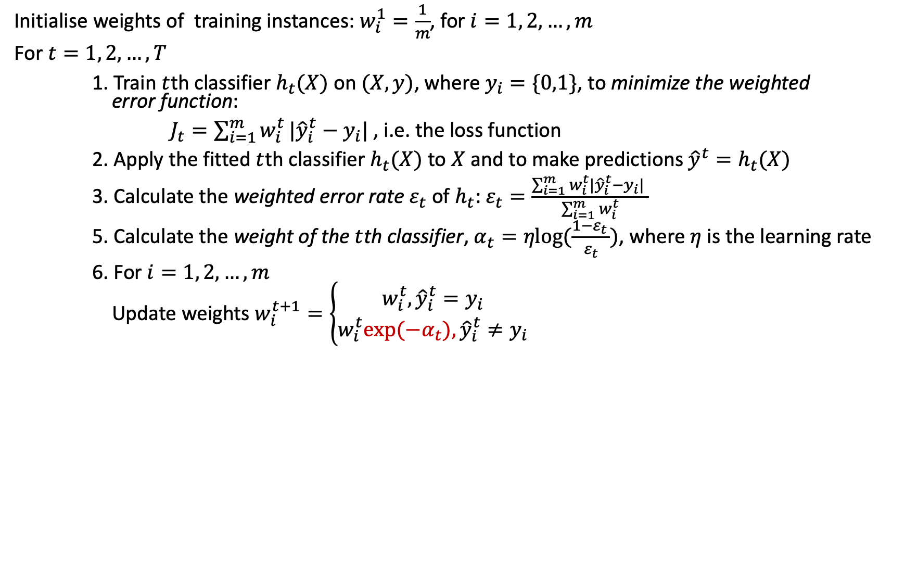
AdaBoost Algorithm
Initialise weights of training instances: $w_{i}^{1}=\frac{1}{m}$, for $i=1, 2, …, m$
For $t=1, 2, …, T$
1. Train $t$th classifier $h_{t}(X)$ on $(X,y)$, where $y_{i}=\{0,1\}$, to minimize the weighted error function:
$J_{t}=\sum_{i=1}^{m}{w_{i}^{t}}|{\hat{y}}_{i}^{t}−y_{i}|$, i.e. the loss function
2. Apply the fitted $t$th classifier $h_{t}(X)$ to $X$ and to make predictions ${\hat{y}}^{t}=h_{t}(X)$
3. Calculate the weighted error rate $ε_{t}$ of $h_{t}$: $ε_{t}=\frac{\sum_{i=1}^{m}{w_{i}^{t}}|{\hat{y}}_{i}^{t}−y_{i}| }{\sum_{i=1}^{m}{w_{i}^{t}}}$
5. Calculate the weight of the $t$th classifier, $α_{t}=ηlog⁡(\frac{1−ε_{t }}{ε_{t}})$, where $η$ is the learning rate
6. For $i=1, 2, …, m$
Update weights $w_{i}^{t+1}=\left\{\begin{aligned}w_{i}^{t},{\hat{y}}_{i}^{t}=y_{i} \\ w_{i}^{t}{exp⁡(−α}_{t}),{\hat{y}}_{i}^{t}≠y_{i}\end{aligned}\right.$
Ratio of weights for wrongly classified instances
No change to the weight if correctly classified
Decrease/increase the weight if incorrectly classified
$exp$ represents the natural exponential function, i.e., ${exp⁡(−α}_{t})=e^{−α_{t}}$.
Notes:
$exp(x)$ represents the natural exponential function, i.e. $e^{x}$. $Η η$ - Eta, $Ε ε$Epsilon

Slide 31
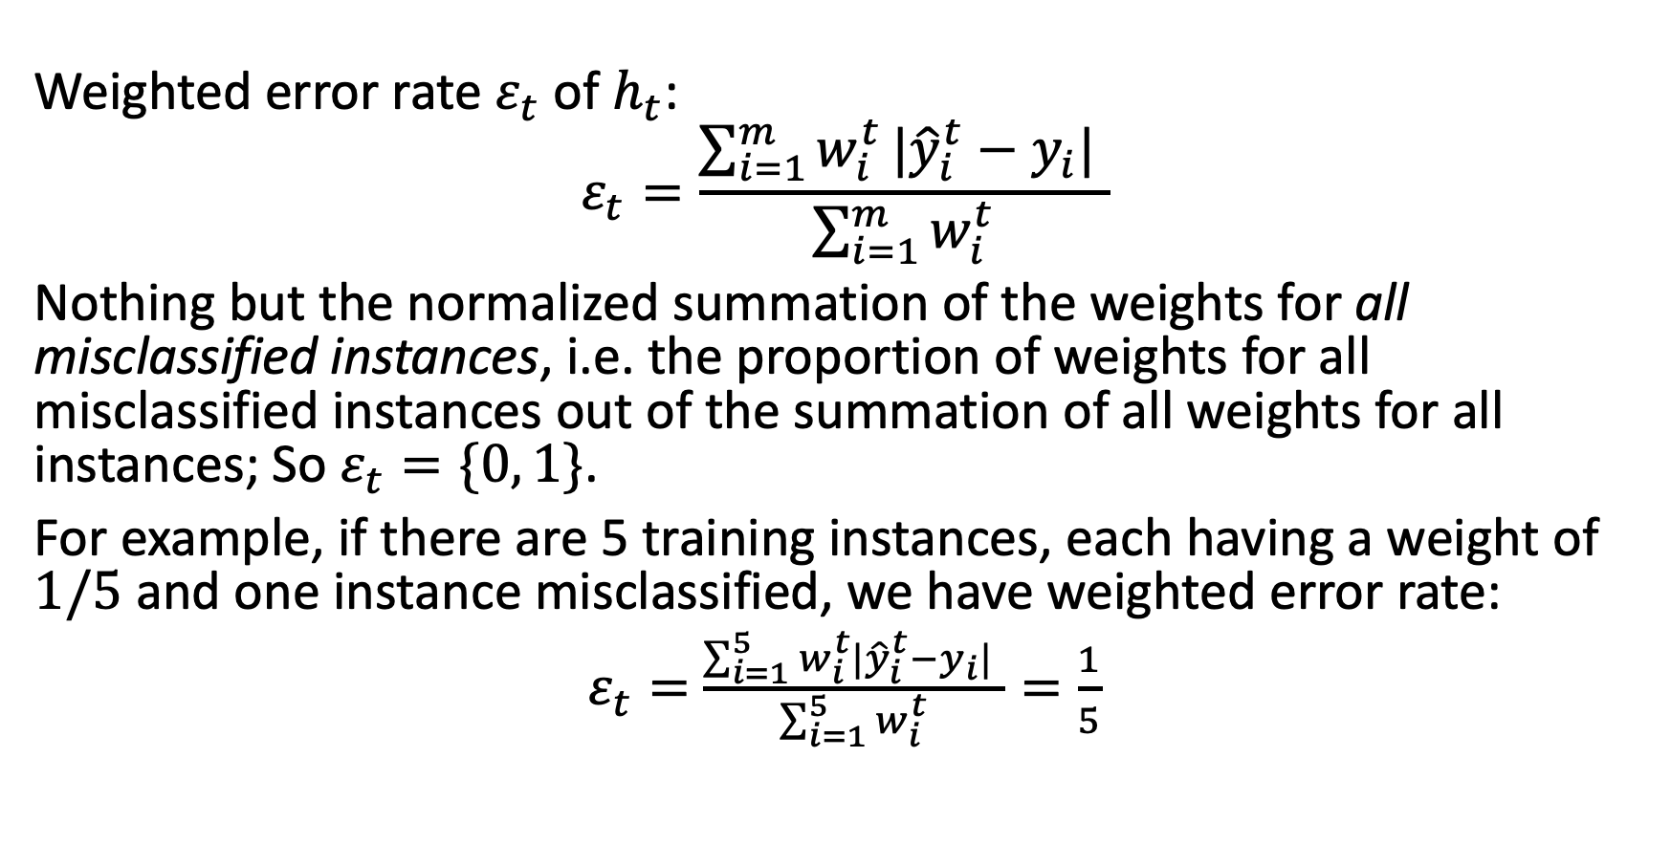
What Is the Weighted Error Rate?
Weighted error rate $ε_{t}$ of $h_{t}$:
$$ε_{t}=\frac{\sum_{i=1}^{m}{w_{i}^{t}}|{\hat{y}}_{i}^{t}−y_{i}| }{\sum_{i=1}^{m}{w_{i}^{t}}}$$
Nothing but the normalized summation of the weights for all misclassified instances, i.e. the proportion of weights for all misclassified instances out of the summation of all weights for all instances; So $ε_{t}=\{0, 1\}$.
For example, if there are 5 training instances, each having a weight of $1/5$ and one instance misclassified, we have weighted error rate:
$ε_{t}=$ $\frac{\sum_{i=1}^{5}{w_{i}^{t}}|{\hat{y}}_{i}^{t}−y_{i}| }{\sum_{i=1}^{5}{w_{i}^{t}}}=\frac{1}{5}$
If all instances are misclassified, the weighted error rate is 1; and if all instances are correctly classified, the rate is 0; Otherwise, the rate is between 0 and 1.

Slide 32
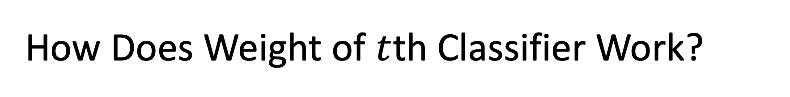

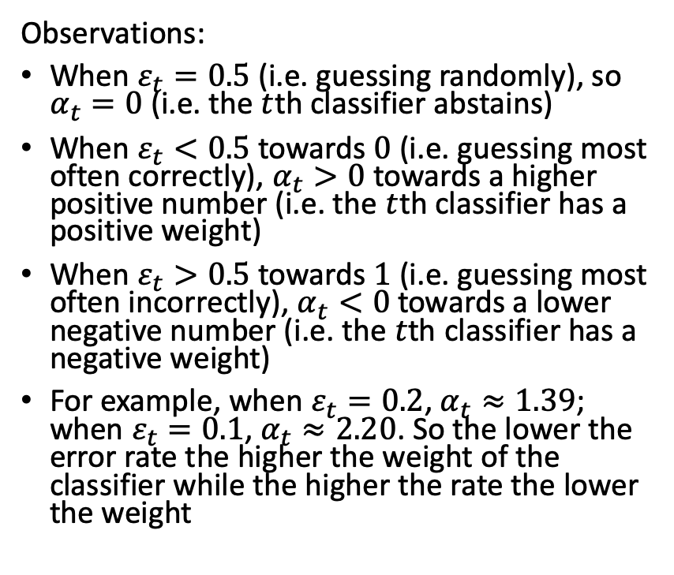
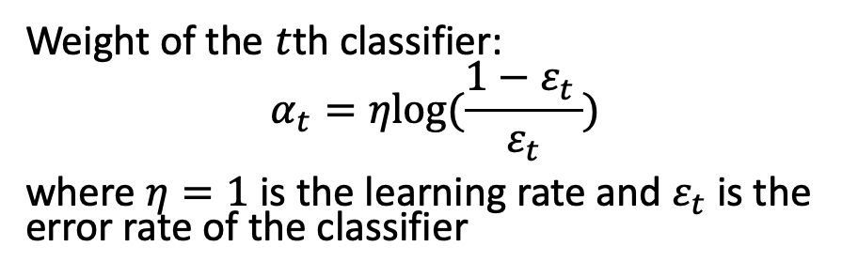
How Does Weight of $t$th Classifier Work?
Weight of the $t$th classifier:
$$α_{t}=ηlog⁡(\frac{1−ε_{t }}{ε_{t}})$$
where $η=1$ is the learning rate and $ε_{t}$ is the error rate of the classifier
Intuitively $α_{t}$ is inversely proportional to $ε_{t}$
Observations:
When $ε_{t}=0.5$ (i.e. guessing randomly), so $α_{t}=0$ (i.e. the $t$th classifier abstains)
When $ε_{t}<0.5$ towards $0$ (i.e. guessing most often correctly), $α_{t}>0$ towards a higher positive number (i.e. the $t$th classifier has a positive weight)
When $ε_{t}>0.5$ towards $1$ (i.e. guessing most often incorrectly), $α_{t}<0$ towards a lower negative number (i.e. the $t$th classifier has a negative weight)
For example, when $ε_{t}=0.2$, $α_{t}≈1.39$; when $ε_{t}=0.1$, $α_{t}≈2.20$. So the lower the error rate the higher the weight of the classifier while the higher the rate the lower the weight

Slide 33
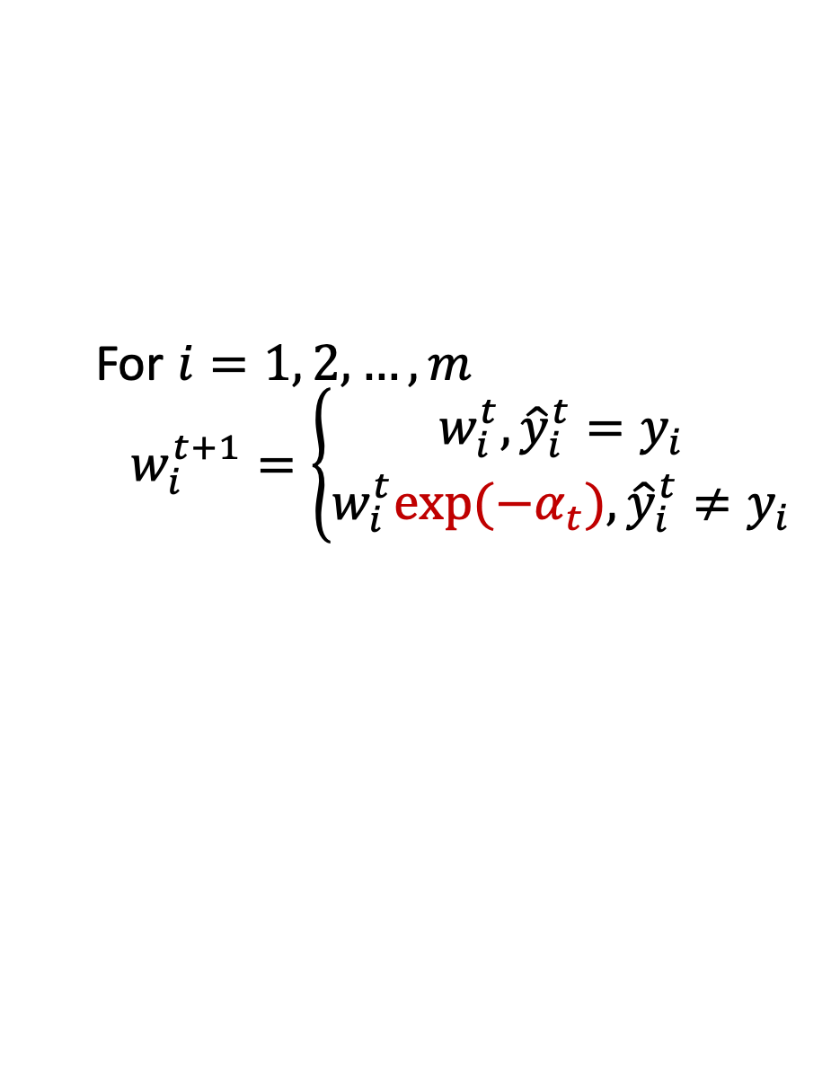
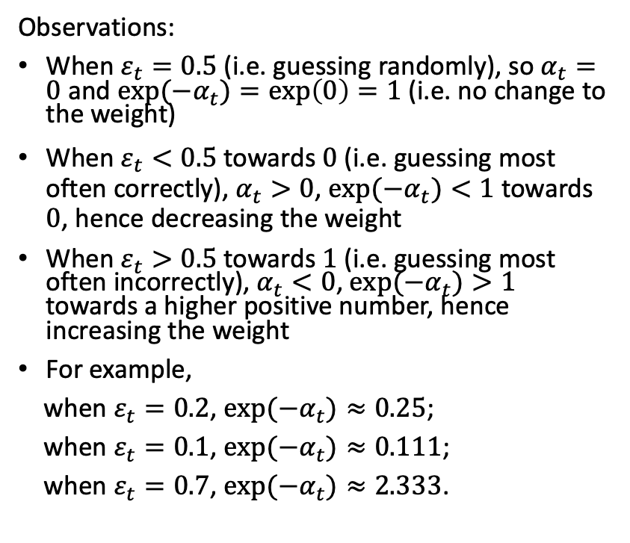
How Are Weights of Training Instances Updated?
For $i=1, 2, …, m$
$$w_{i}^{t+1}=\left\{\begin{aligned}w_{i}^{t},{\hat{y}}_{i}^{t}=y_{i} \\ w_{i}^{t}{exp⁡(−α}_{t}),{\hat{y}}_{i}^{t}≠y_{i}\end{aligned}\right.$$
Observations:
When $ε_{t}=0.5$ (i.e. guessing randomly), so $α_{t}=0$ and ${exp⁡(−α}_{t})=\exp\left(0\right)=1$ (i.e. no change to the weight)
When $ε_{t}<0.5$ towards $0$ (i.e. guessing most often correctly), $α_{t}>0$, ${exp⁡(−α}_{t})<1$ towards $0$, hence decreasing the weight
When $ε_{t}>0.5$ towards $1$ (i.e. guessing most often incorrectly), $α_{t}<0$, ${exp⁡(−α}_{t})>1$ towards a higher positive number, hence increasing the weight
For example,
when $ε_{t}=0.2$, ${exp⁡(−α}_{t})≈0.25$;
when $ε_{t}=0.1$, ${exp⁡(−α}_{t})≈0.111$;
when $ε_{t}=0.7$, ${exp⁡(−α}_{t})≈2.333$.
Intuitively the higher the error rate the higher increase to the weight of a misclassification (i.e. increase the cost of the misclassification.

Slide 34
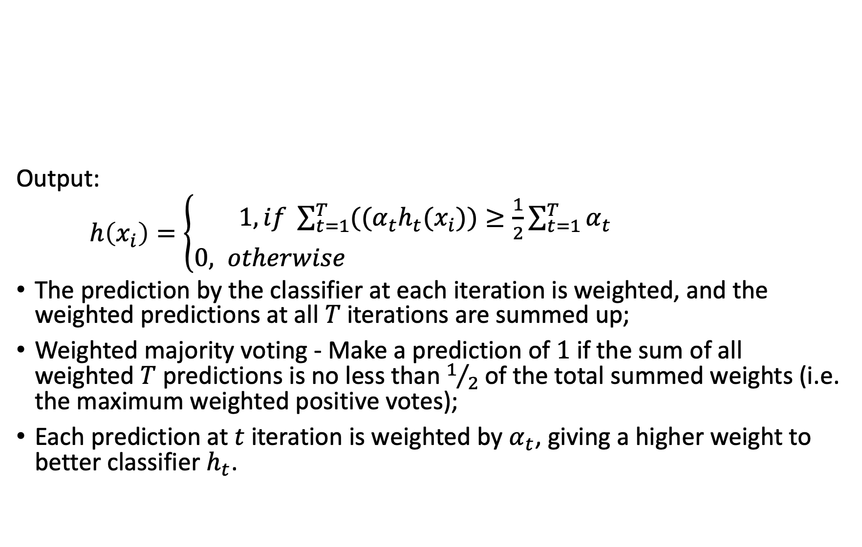
AdaBoost Algorithm
Output:
$h\left(x_{i}\right)=\left\{\begin{aligned}1, if \sum_{t=1}^{T}{((α_{t}h_{t}(x_{i}))≥\frac{1}{2}\sum_{t=1}^{T}{α_{t}}} \\ 0, otherwise \end{aligned}\right.$
The prediction by the classifier at each iteration is weighted, and the weighted predictions at all $T$ iterations are summed up;
Weighted majority voting - Make a prediction of $1$ if the sum of all weighted $T$ predictions is no less than $1/2$ of the total summed weights (i.e. the maximum weighted positive votes);
Each prediction at $t$ iteration is weighted by $α_{t}$, giving a higher weight to better classifier $h_{t}$.

Slide 35
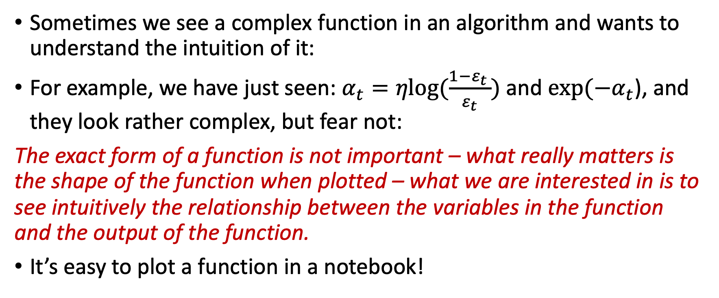
How Does a Function Work in an Algorithm?
Sometimes we see a complex function in an algorithm and wants to understand the intuition of it:
For example, we have just seen: $α_{t}=ηlog⁡(\frac{1−ε_{t }}{ε_{t}})$ and ${exp⁡(−α}_{t}$), and they look rather complex, but fear not:
The exact form of a function is not important – what really matters is the shape of the function when plotted – what we are interested in is to see intuitively the relationship between the variables in the function and the output of the function.
It’s easy to plot a function in a notebook!

Slide 36
How Does Weight of $t$th Classifier Work?
Weight of the $t$th classifier:
$$α_{t}=ηlog⁡(\frac{1−ε_{t }}{ε_{t}})$$
where $η=1$ is the learning rate and $ε_{t}$ is the error rate of the classifier

Slide 37
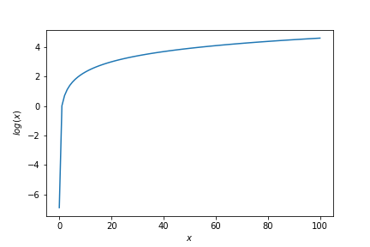
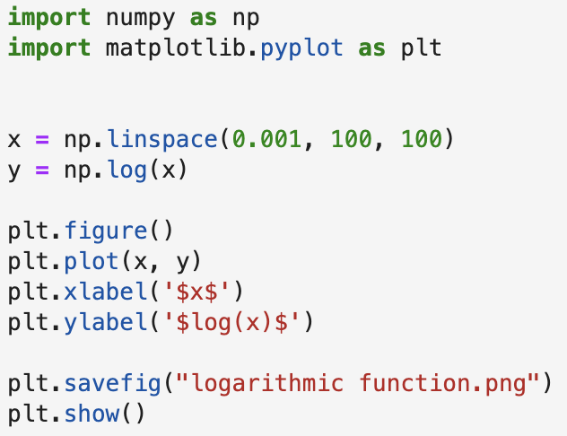
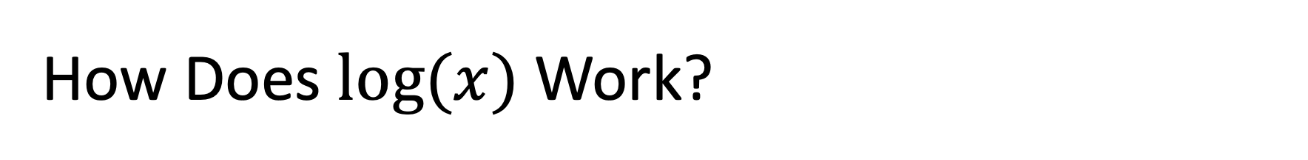
How Does $log⁡(x)$ Work?

Slide 38
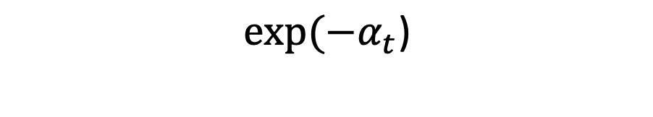
How Much to Update the Weight of a Misclassified Instance?
$${exp⁡(−α}_{t}\text{)}$$

Slide 39
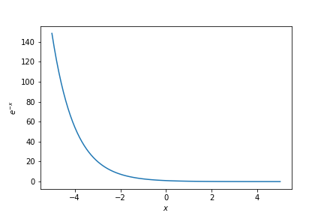
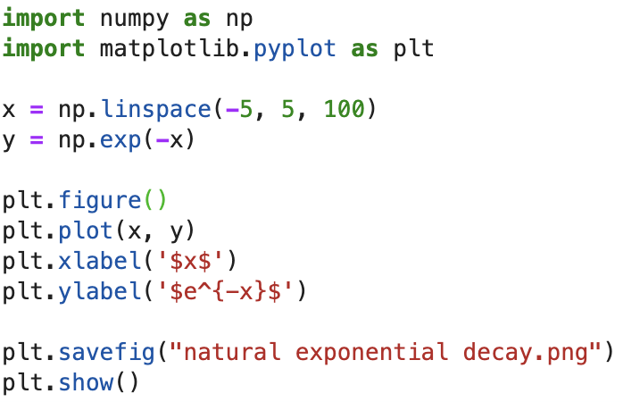
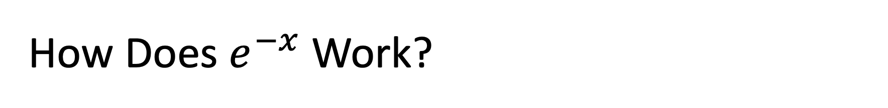
How Does $e^{−x}$ Work?
Notes:
The above function is called exponential decay function.

Slide 40
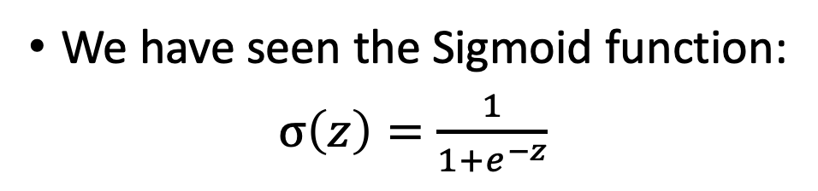
How Does a Function Work in an Algorithm?
We have seen the Sigmoid function:
$σ\left(z\right)=\frac{1}{1+e^{−z}}$

Slide 41
References
A Geron, Hands on ML, Chapters 6 and 7 (pp. 175 –212)

