Slide 1
Profit Analysis (Multi-linear Regression)
Analyzing the Impact of Marketing, R&D and Administration Expenses on Company Profit
Presented by: SUDARMATHI M

Slide 2
Content:
Introduction
Business Challenge
Tools used
Data collection
Data cleaning
Regression analysis & Prediction
Visualization
Analysis Insights
Key Findings & Recommendations
Conclusion

Slide 3
Introduction
In today's competitive business landscape, understanding the impact of various expenditures on a company's profitability is crucial, as it enables organizations to make informed financial decisions, optimize resource allocation, and drive sustainable growth.
This project aims to analyze the relationship between R&D spending, Administration spending, and Marketing spending with the profitability of 50 startups using regression analysis.
By leveraging Regression Analysis, we aim to determine which factors have the most significant influence on profit and provide data-driven insights for better financial planning.
Regression analysis : Regression Analysis is a statistical method used to examine the relationship between a dependent variable and one or more independent variables. It helps in identifying trends, making predictions, and understanding the impact of different factors on an outcome. In this project, Multiple Linear Regression is used to analyze how various expenditures influence startup profitability.

Slide 4
BUSINESS CHALLENGE
Apply Regression Analysis to examine the relationship between Marketing, R&D, and Administration expenses with company profit, identifying which factor has the most significant impact.
Predict future profits by leveraging Regression. By inputting new values for Marketing, R&D, and Administration expenses, businesses can forecast potential profits, enabling them to strategize investments for maximum returns and sustainable growth.

Slide 5



TOOLs USED
Used for Data Extraction
Performed Regression Analysis
Used for Data Visualization

Slide 6
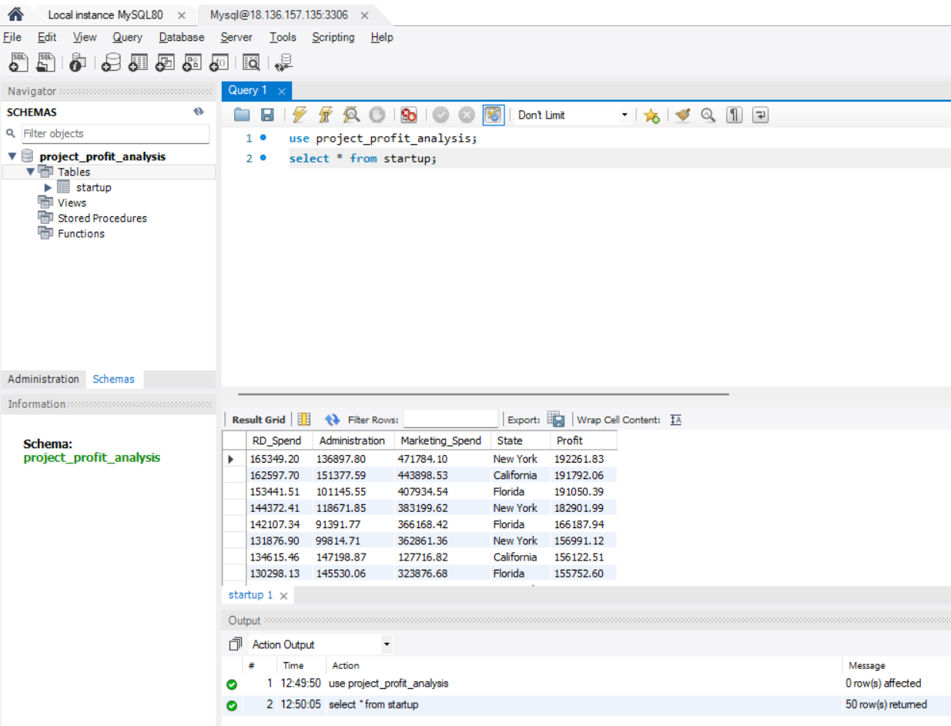
DATA COLLECTION
MySQL was used to connect to the database and extracted dataset using SQL queries.
Exported the dataset as csv file to perform further analysis.

Slide 7
DATA CLEANING
Handling Missing Values:
Using conditional formatting we can easily spot missing values.
These values can be imputed with techniques like mean, median, mode.
Removing Duplicate :
Duplicate records can be identified and removed to ensure data accuracy and prevent skewed analysis.
Check Data Type :
Converting data types from text to Numeric for regression analysis ensures consistency and allows for accurate computations and analysis.
Outlier Detection:
Outliers can be identified and removed or treated using methods like box plot analysis.

Slide 8
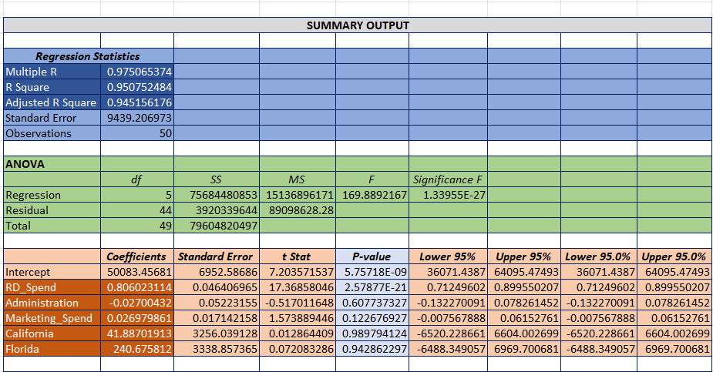
REGRESSION ANALYSIS

Slide 9
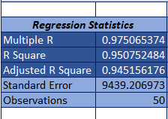
Multiple R (0.9751): This tells us how strongly the independent variables are correlated with profit. A value close to 1 (like 0.975) means there’s a very strong relationship — so when the inputs change, profit changes in a predictable way.
R-Square (0.9507): About 95% of the profit changes are explained by the factors in our model — like R&D Spend, Marketing Spend, etc. That’s a very strong fit.
Adjusted R-Square (0.9452): This adjusts for the number of variables we used and still shows a very good fit. It helps ensure the model isn't just fitting the noise in the data.
Standard Error (9439.21): On average, the difference between actual and predicted profit is about ₹9439. The lower this number, the better. [standard error is less than 10% of our average target value, it’s generally considered good].
Observations (50): We built this model using 50 data records,
Our regression model is highly reliable and accurately predicts profit based on input variables like R&D Spend, Marketing Spend and Administration etc.

Slide 10
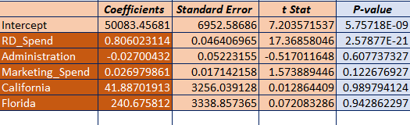
Key Variables Impacting Profit – Coefficients & P-values
Intercept: The predicted value of the dependent variable (like profit) when all independent variables are 0. It’s the starting value of the model.
Coefficient: Shows how much the dependent variable is expected to increase or decrease when an independent variable increases by one unit, holding other variables constant.
P-value: Tells us whether the variable’s effect on the dependent variable is statistically significant. If P-value < 0.05, the variable is considered important for predicting the outcome.

Slide 11
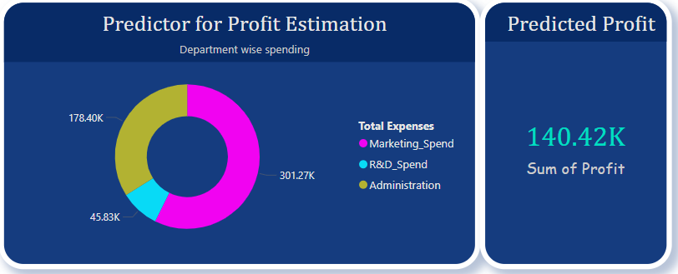
Profit Prediction using regression model
By performing regression analysis, we obtained the coefficients for R&D Spend, Administration, and Marketing Spend, along with the intercept. Using these values, we applied the regression formula to a new dataset to predict the profit. The results shown above represent the predicted profit values based on this model.

Slide 12
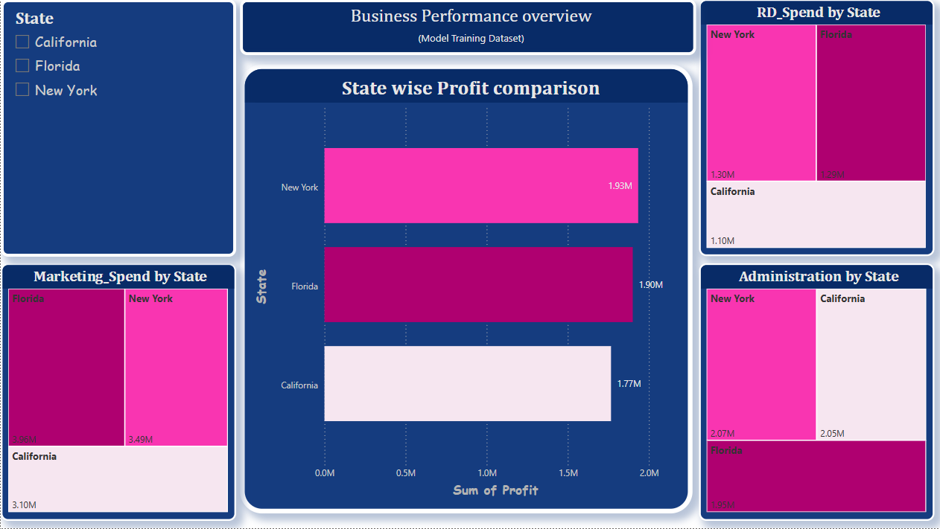

Slide 13
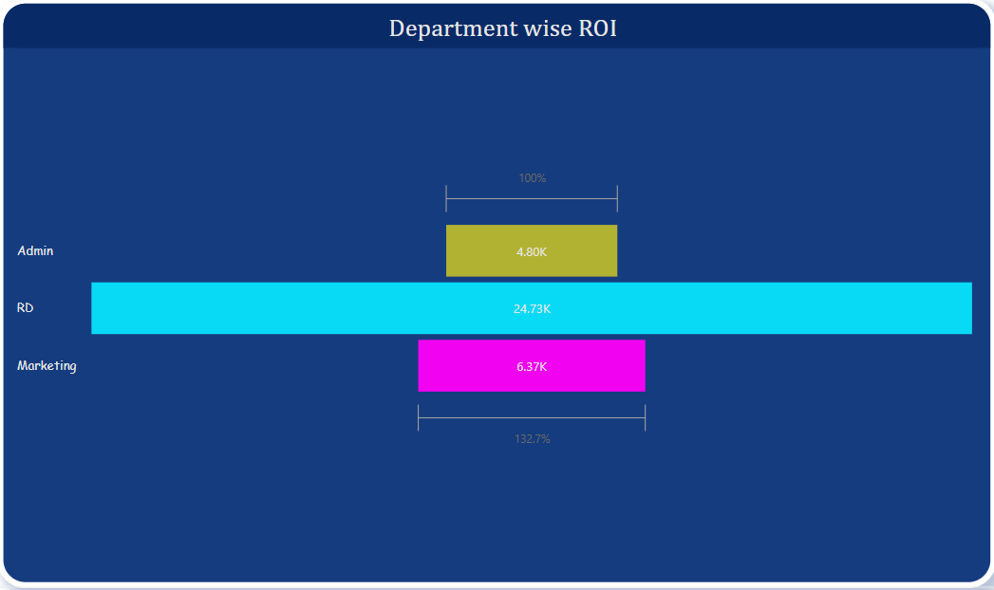

Slide 14
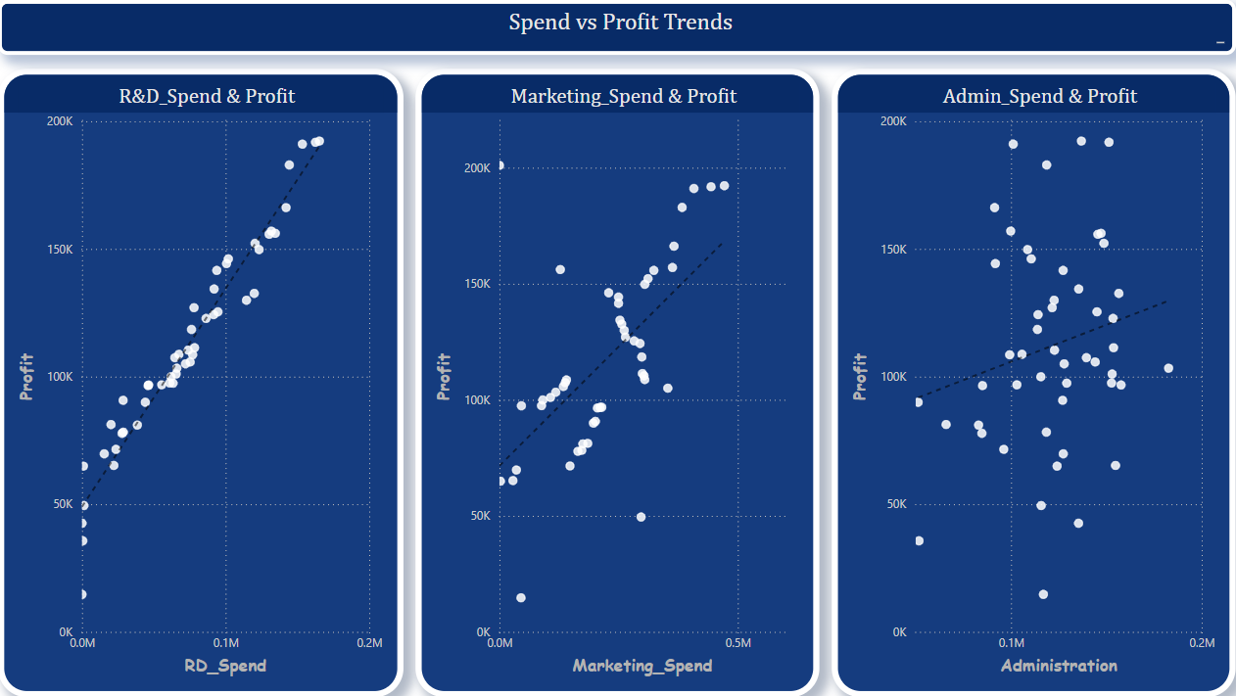

Slide 15
Analysis INSIGHTS
Through regression analysis, I derived key insights that translate raw data into actionable business strategy.
Based on the regression analysis, R&D Spend emerged as the most significant predictor of profit, with a strong positive coefficient of 0.806 and a p-value well below 0.001[2.57877E-21], indicating a high level of statistical significance.
In contrast, Marketing Spend showed a small positive coefficient of 0.026 but was not statistically significant (p = 0.123), implying that while it may have a mild effect on profit, the evidence is not strong enough to draw firm conclusions without further investigation.
Administration Spend had a negligible and statistically insignificant impact on profit, with a coefficient of –0.027 and a p-value of 0.607, indicating that changes in administrative expenses do not meaningfully affect profit in this dataset.

Slide 16
KEY FINDINGS & RECOMMENDATIONS
R&D Spend has the highest positive impact on profit, as confirmed by regression analysis. Increased investment in R&D is strongly correlated with higher profit margins.
Marketing Spend also contributes positively to profit, though its impact is moderate compared to R&D. Strategic marketing can still yield good returns.
Administration Spend shows minimal or no significant effect on profit. This suggests administrative expenses can be optimized without hurting profitability.

