Slide 1
10. DEEP ORDER FLOW IMBALANCE: EXTRACTING ALPHA AT MULTIPLE HORIZONS FROM THE LIMIT ORDER BOOK
Research Seminar
Group 4
PETTER N. KOLM, JEREMY TURIEL AND NICHOLAS WESTRAY
Maselskas Artemiy 241
Polishchuk Anastasia 241
Sudarikova Maria 241

Slide 2
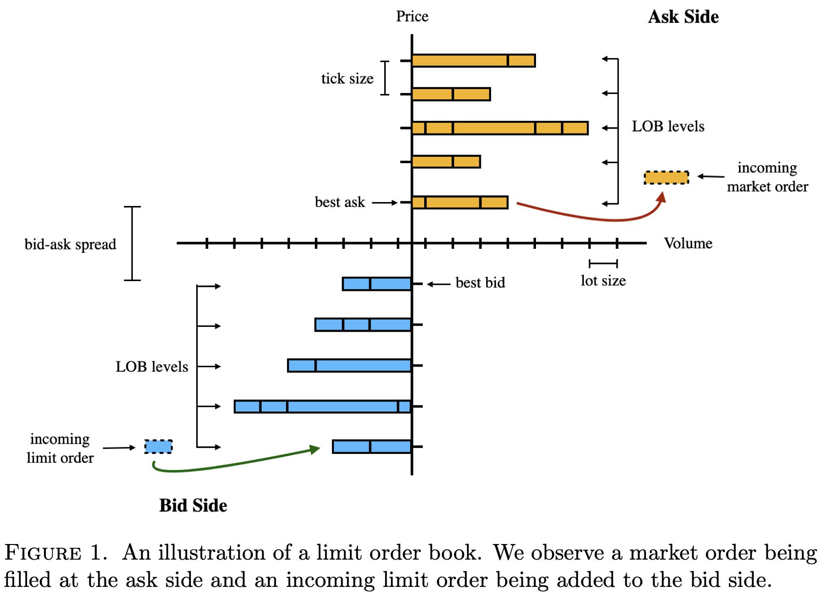
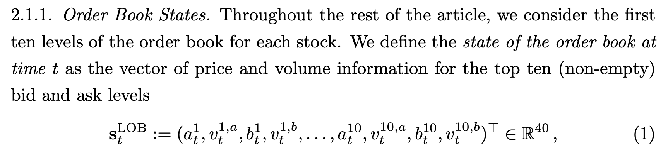
Why is High-Frequency Forecasting so hard?
Research Seminar
The Limit Order Book (LOB): A massive, constantly changing list of all buy and sell orders of equities.
The Challenge: Raw LOB data is non-stationary and incredibly noisy.
Traditional approach: Feed raw prices and volumes into a model (rarely works well).

Slide 3
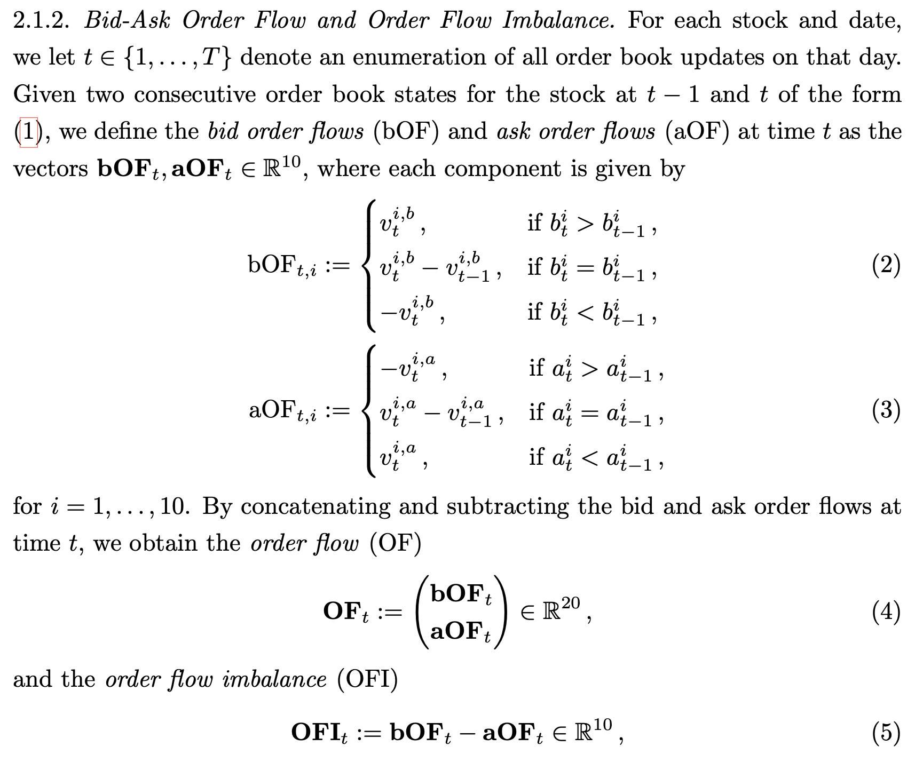
The Paper's Insight: Order Flow
Research Seminar
Stop looking at the snapshot. Look at the flow.
Order Flow (OF): The change in volume at each price level.
Order Flow Imbalance (OFI): The difference between buy pressure and sell pressure (bOF - aOF).
Why it works: OF and OFI transform non-stationary prices into a stationary time series.
Result: Models trained on OF significantly outperform models trained on raw LOB.
Instead of looking at a static picture of the book, we look at the flow - how orders are arriving and canceling. This is called Order Flow, or OF. The original paper proved that this stationary transformation is the secret sauce for high-frequency predictions.

Slide 4
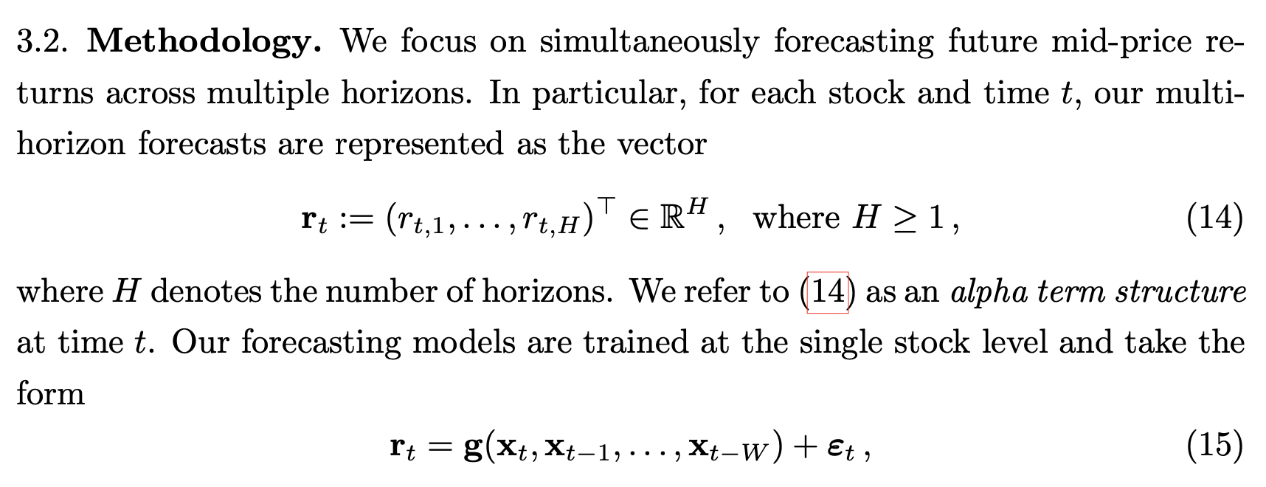
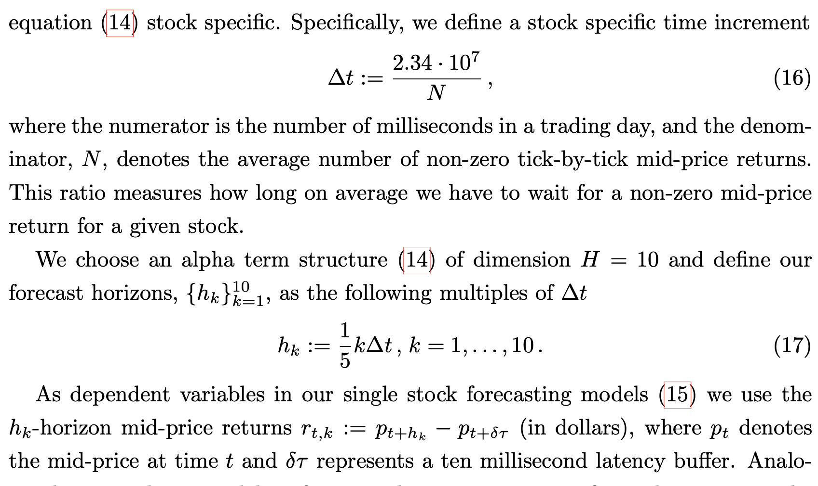
What are we forecasting? Alpha term structure
Research Seminar
What are we actually predicting? We don't just guess one price. We predict a whole curve - an Alpha Term Structure. The variable is the future mid-price return, measured in dollars, minus a 10-millisecond latency. We predict this return for 10 different horizons, ranging from a fraction of a price change to two full price changes. This tells us not just where the price will go, but when it will get there.

Slide 5
Deviations from the Original Study
Research Seminar
Data access. IEX DEEP replaces Nasdaq/LOBSTER because the original data were unavailable to us. Different trading venues limit direct comparison of the results.
Smaller sample. 11 stocks, 12 weeks and 3 rolling windows, versus 115 stocks, 48 weeks and 18 windows. Neural models use 6 stocks. Selection favors large-tick stocks and reduces statistical power.
Training budget. Each epoch samples 400,000 training windows. Early stopping uses 200,000 fixed validation windows. Testing covers the full test week. Sampling can affect model fitting and selection.
Learning settings. MLP and LSTM variants use a learning rate of 10⁻⁴ instead of 10⁻⁵. LSTM (3) has a 12-epoch cap. These choices fit local hardware limits, but may affect convergence.
ARX estimation. Closed-form ridge regression with a validation-selected penalty replaces Adam. Additional Adam runs check how this choice affects the comparison.
Experiment scope. OF is the main input. OFI checks cover ARX, LSTM and MLP. Only ARX (Adam) and MLP run on LOB.
Notes:
Source: current local project, commit da81528, inspected 2026-10-17. This slide summarizes the main deviations, not every row of the source file.
Primary source: /Users/ms/Documents/DEEP-ORDER-FLOW-IMBALANCE-EXTRACTING-ALPHA-AT-MULTIPLE-HORIZONS-FROM-THE-LIMIT-ORDER-BOOK/DEVIATIONS.md
Data access: row 1. The team reports no LOBSTER/Databento access. The slide does not infer a general regional restriction or a current subscription price. IEX DEEP is L2 displayed liquidity only. A venue difference limits numerical comparability. The difference alone does not establish a causal explanation for lower R²OS.
Smaller sample: rows 3, 8, 11. Data cover 59 trading days / 12 weeks, three rolling windows. ARX uses 11 stocks; neural models use BAC, VZ, NKE, USB, OXY, UBER. Selection uses common stocks, Delta t >= 180 ms and >= 300k daily book events on 20260717. The six-stock neural subset includes one-tick spread >=70% plus UBER as a small-tick control. The paper's 48 weeks refer to its rolling evaluation description.
Training budget: rows 2 and 10. Neural epochs sample at most 400,000 training windows; validation uses a fixed subset of at most 200,000. ARX ridge uses the full training and validation loaders. Testing uses the full test week for both. Although the underlying test sample remains complete, different validation sampling can select different weights, so the slide avoids the source's stronger statement that test metrics are unaffected.
Learning settings: rows 12 and 13. The increase from 1e-5 to 1e-4 applies to MLP, LSTM, LSTM(3), LSTM-MLP, not CNN-LSTM. The learning-rate check used LSTM/BAC/window1 validation for four epochs; transferring it to other architectures has no separate validation study. LSTM(3) caps at 12 epochs vs the paper's 50, and the source reports 6 of 18 fits reach the cap. Possible incomplete convergence is a limitation, not a proved signed bias.
ARX: row 7, src/deepofi/models/arx.py, cli.py --sgd. Ridge leaves the intercept unpenalized and chooses its penalty by validation MSE. The --sgd run actually uses Adam. Additional results allow comparison with the paper's estimation method.
Experiment scope: row 9, Decisions where the paper is silent (long-horizon grid), and README.md Appendix B. Current local results include OFI for ARX, LSTM and MLP, which updates the narrower wording of deviation 9. LOB comparisons exist only for Adam ARX and MLP. Long-horizon targets are built but Figure 8 was not run.
Other implementation decisions documented in DEVIATIONS.md: the paper variant of OF is used, composite events use the DEEP end-of-event flag, halt days would be dropped (none observed), Delta t uses past training dates, the metric benchmark is the test-week mean, empty book levels use explicit rules, OF sides are interleaved before CNN level-pair convolutions, and forecasts return to raw price scale before test scoring.
Verbatim source DEVIATIONS.md follows for traceability:
# Deviations from the paper
Kolm, Turiel, Westray (2023), *Deep Order Flow Imbalance*. One row per deviation: what, why, and the expected or observed effect.
| # | What | Why | Effect |
|---|---|---|---|
| 1 | IEX DEEP data (L2, displayed liquidity only) instead of LOBSTER/Nasdaq | LOBSTER and Databento were not available | R²_OS lower than in the paper; the per-stock comparison of Section 4.2 is not directly comparable |
| 2 | `max_samples_per_epoch`: each epoch draws a random subset of 400k training windows | Training on a MacBook M1 Pro | Fewer optimizer steps per epoch; heavier models may be undertrained (see 13) |
| 3 | 11 stocks (6 for the neural networks, see 11) × 12 weeks (3 rolling windows) instead of 115 stocks × 48 weeks (18 windows) | Compute budget and data download | Less statistical power in Tables 3–5 (15 test days per stock) |
| 4 | `of_variant` defaults to `paper` (formulas (2)–(3) as printed); the Cont et al. (2014) variant is available in the config | When a level moves away the paper uses −v(t), Cont et al. use −v(t−1) | Only the `paper` variant was run within the deadline |
| 5 | Composite events are collapsed by the DEEP event flag (a snapshot only after a price level update with flag 0x1), not by identical timestamps (Appendix A) | DEEP marks the end of an atomic book update explicitly | Practically equivalent; in-transition book states never enter the data |
| 6 | A day with a trading halt inside 09:40–15:50 is dropped entirely (`halt_policy: drop_day`) | Targets and windows across a halt are not meaningful; the paper excludes stocks with corporate actions and says nothing about halts | No halts occurred for the selected stocks in the period |
| 7 | ARX is estimated by closed-form ridge regression (unpenalized intercept, λ chosen by validation MSE) instead of Adam with lr 1e-4 and early stopping | Fast and deterministic, no dependence on learning rate or epoch count; early stopping and ridge are related forms of regularization | Checked with `--sgd` (Adam, as in the paper): ridge is stronger on OF (0.27% vs −0.25%) and OFI (0.28% vs 0.05%), and removes the OFI-over-OF gain of Appendix B.1 |
| 8 | Stocks are selected by a rule: common stock, Δt ≥ 180 ms, ≥ 300k book events per day, on the day before the period (20260717); the paper uses Nasdaq 100 members | The displayed IEX book flickers, so Δt is 3–70 times smaller than for the same stocks on Nasdaq; with Δt < 50 ms the first horizon h₁ = Δt/5 is shorter than the δτ = 10 ms latency. 180 ms is the smallest Δt among the paper's stocks (AAPL, Table 6) | The sample leans towards large-tick stocks; less spread in tick size for Table 5 |
| 9 | The LOB input is run only for ARX (trained with Adam) and MLP; main runs use OF, and ARX is also run on OFI (Appendix B.1 check) | Compute budget: on a MacBook M1 Pro, ridge ARX on LOB (4000 features) would take ~10 h and CNN-LSTM on LOB ~30 h for 11 stocks; renting a GPU was not planned | OF vs LOB (Table 3) only for ARX and MLP; no LOB rows for the LSTM-based models in Figures 2, 3 and Table 4 |
| 10 | Early stopping of the neural networks monitors a fixed random subset of the validation week (`max_val_samples` = 200k windows, the same on every epoch) instead of all ~1.5–2M windows; the test week is always complete, and ARX uses the full validation week | On the M1 a full validation pass after every epoch takes longer than the training epoch itself | Epochs about twice as fast; the stopping criterion is slightly noisier (~3× larger standard error); test metrics are unaffected |
| 11 | The neural networks (MLP, LSTM, LSTM (3), LSTM-MLP, CNN-LSTM) are trained on 6 stocks: BAC, VZ, NKE, USB, OXY, UBER; ARX on all 11 | One week for the whole project and limited time on the team's laptops. Selected by tick size, which is known before training: every stock with a one-tick spread ≥ 70% of the time, plus UBER as a small-tick control | Model comparisons use the 6 common stocks; Table 5 has few small-tick stocks, so the tick-size conclusions rest mostly on ARX over 11 stocks |
| 12 | LSTM (3) is trained for at most 12 epochs (`--epochs 12`) instead of 50 | At learning rate 1e-4 one epoch of the three-layer LSTM takes ~3 min on the M1; 50 epochs on 6 stocks did not fit the ~24 h deadline | The cap was reached in 6 of 18 windows (early stopping ended the other 12); LSTM (3) may be slightly undertrained, so its R²_OS is biased down rather than up |
| 13 | Models with learning rate 1e-5 in Table 2 (LSTM, LSTM (3), LSTM-MLP, MLP) are trained with 1e-4 (`--learning-rate 1e-4`) | Our epoch (400k windows) is ~18 times shorter than a full pass over the training set, for which 1e-5 was chosen. Check `scripts/lr_check.py` (LSTM, BAC, window 1, 4 epochs): best validation MSE 1.1821 at 1e-4 vs 1.1845 at 1e-5, and 1e-4 is ahead after the first epoch; chosen on validation only | The models train within our step budget; for MLP and LSTM-MLP the choice is carried over from the LSTM check without a separate test |
## Decisions where the paper is silent
| Question | Decision |
|---|---|
| Period for N in Δt = 2.34·10⁷ / N | Past data only: the training weeks of each window (the paper does not say; probably the whole sample) |
| R²_OS benchmark ("average return on the test set") | The mean return of the test week; R²_OS is computed for each day of that week |
| Empty book levels | OF: an empty level compares as −∞ (bid) / +∞ (ask); LOB: the price of the deepest non-empty level on that side, volume 0 |
| Order of OF columns before block 2 of the CNN-LSTM | Columns are interleaved as (bOF_i, aOF_i) pairs so the 1×2 convolution combines both sides of a level, as Table 1 describes |
| Long-horizon grid (Figure 8) | 0.2…2.0 in steps of 0.2 and 3…10 in steps of 1 (in Δt); the long targets are built but Figure 8 was not run |
| Test metric | R²_OS on the raw (not winsorized) test targets; forecasts are mapped back from z-scores |

Slide 6
Data and Our Replication Setup
Research Seminar
Original Data: LOBSTER, 115 Nasdaq stocks, 48 weeks.
Our Data: IEX DEEP (Level 2), 11 stocks, 12 weeks.
Stock Universe (Grouped by Spread):
    Large-tick (highly liquid): BAC, VZ, NKE
    Medium-tick: USB, OXY, MO, NEE
    Small-tick (volatile): UBER, DIS, CTSH, BSX
The Goal: Can we extract alpha from a smaller exchange?
We couldn't get the 10-terabyte LOBSTER dataset. So we used IEX DEEP data. IEX is a smaller exchange, so we scaled down to 11 tickers. We grouped them into small, medium, and large-tick stocks, because as we will see later, the tick size changes everything.

Slide 7
The Architectures Tested
Research Seminar
Each model maps a 100-event OF or OFI window to ten forecasts.
The table describes its architecture and the form of the forecasting function.
Model | Architecture | Key feature
ARX | 100-event window. Ridge regression with a penalty selected on validation data. | Linear model.
MLP | Dense layers: 512, 512 and 128 units. ReLU activations and a linear output. | Processes all 100 updates at once through nonlinear, fully connected layers.
LSTM | One LSTM layer with 150 units, followed by a linear output layer. | Reads events in order and uses gates to keep or forget information from earlier events.
LSTM (3) | Three stacked LSTM layers with 150 units each, followed by a linear output. | Stacks three LSTM layers, so higher layers process information passed by lower layers.
LSTM–MLP | LSTM with 128 units, a dense layer with 60 ReLU units, and a linear output. | Uses LSTM to summarize the sequence, then an extra nonlinear layer to form forecasts.
CNN–LSTM | Convolution and Inception blocks, an LSTM with 64 units, and a linear output. | CNN combines features across levels and nearby events, then LSTM processes the sequence.
Notes:
ARX refers here to the paper’s linear regression on lagged order-flow inputs. The project normally fits this model by closed-form ridge regression and also provides an Adam variant through --sgd. MLP uses a flattened window, so positions remain identifiable but there is no recurrent state. LSTM is a gated recurrent neural network. LSTM (3) stacks recurrent layers within one jointly trained network. LSTM–MLP replaces the linear LSTM head with a nonlinear hidden layer. CNN–LSTM jointly trains convolutional feature extraction, an Inception module and recurrent processing. No architecture is guaranteed to outperform the others. Compare test MSE and out-of-sample R² under the same evaluation protocol. The layer widths for MLP and LSTM–MLP follow the project’s reconstruction of the paper rather than a fully specified original implementation.
Sources: Kolm, Turiel and Westray, Deep Order Flow Imbalance, Sections 2.2.1–2.2.4 and Tables 1–2. Implementation: src/deepofi/models/arx.py, mlp.py, lstm.py, lstm3.py, lstm_mlp.py and cnn_lstm.py. Repository snapshot: 30b73d9.
Terminology: a 100-event window includes the current event and the preceding 99 updates. Model formulation describes how each architecture computes its forecast, rather than a property unique to that model. All table descriptions refer to the project implementation.

Slide 8
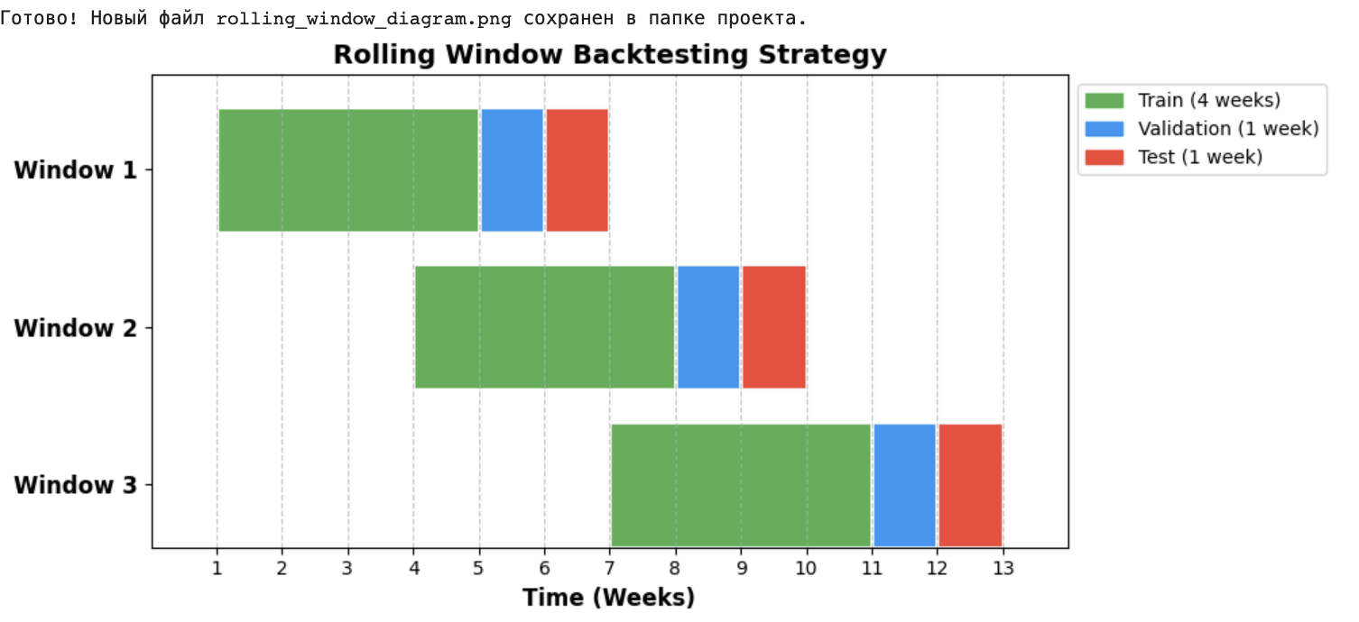
Model Training
Research Seminar
How the Pipeline Works
Rolling Windows: 4 weeks Train -> 1 week Validate -> 1 week Test. Shifted forward by 3 weeks.
Normalization: Z-score scaling and winsorization (0.5% and 99.5%) based only on training data.
The CLI: A fully automated Python package (deepofi) to train, evaluate, and compare models.

Slide 9
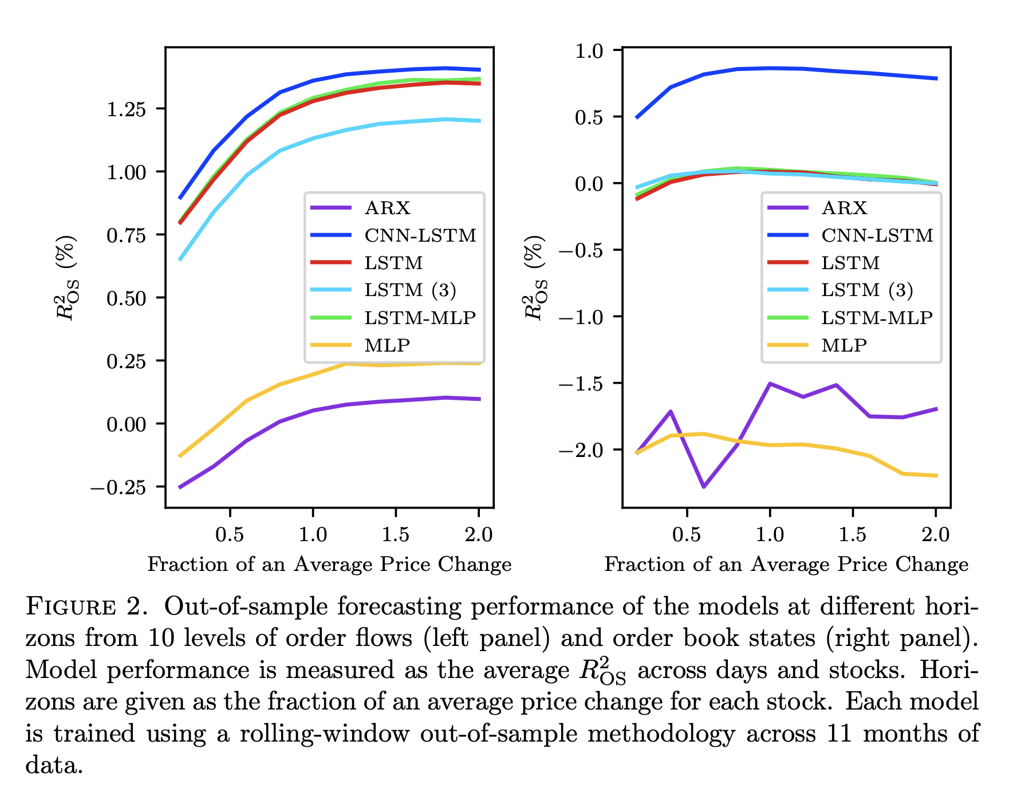
What Did the Original Authors Find?
Research Seminar
Models trained on Order Flow (OF) drastically beat models trained on raw LOB.
LSTMs and CNN-LSTMs are the undisputed champions.
The Decay: Predictive power (R^2(os)) peaks around 1.0 to 2.0 average price changes.
The Scale: On Nasdaq, the best models achieved an average (R^2(os)) of up to 1.2%.

Slide 10
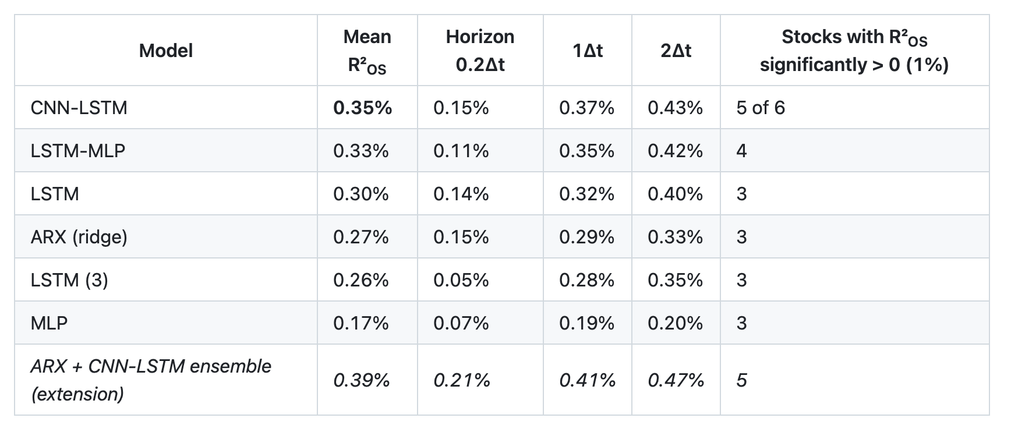
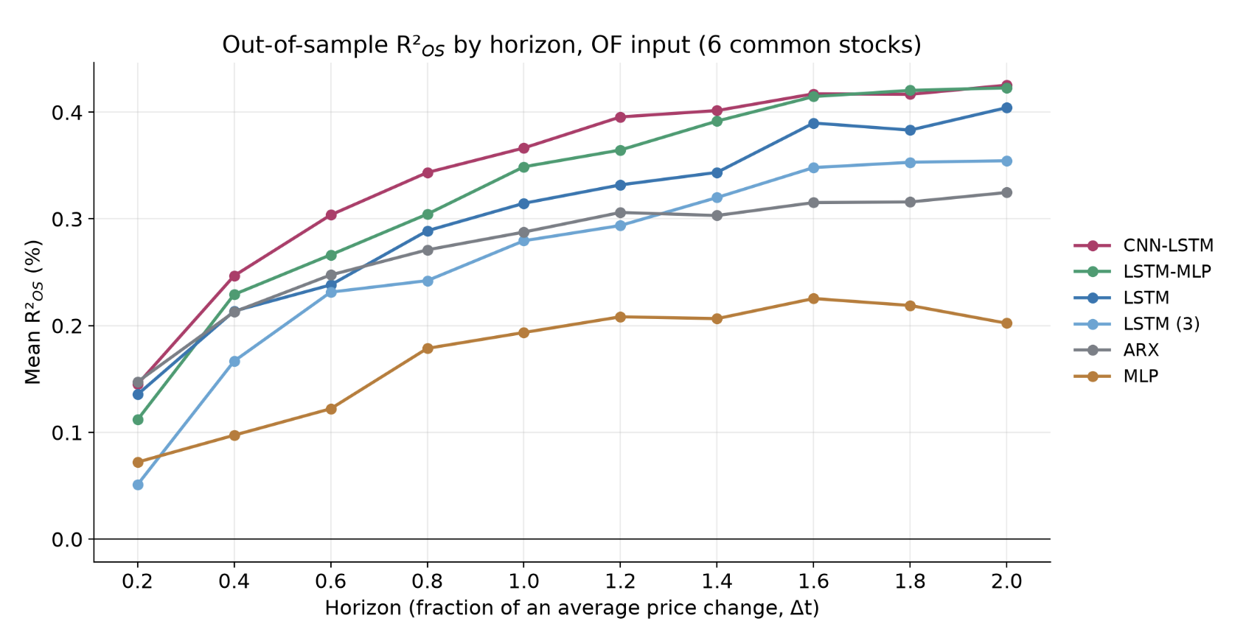
Replicating the Paper on IEX DEEP
(6 Stocks, 3 Windows)
Research Seminar
Model Hierarchy: LSTMs Win
  Top 3 match the paper: CNN-LSTM (0.35%), LSTM-MLP (0.33%), LSTM (0.30%).
  LSTMs significantly outperform simpler models: MLP (0.17%) and ARX (0.27%).
Input Features: OF beats LOB
  Raw LOB is a disaster for neural nets: MLP drops to −2.38% on LOB vs. +0.17% on OF.
  OF is better for 5 of 6 stocks (the exception is small-tick UBER).
Horizon Decay: Alpha is Short-Lived
Stock Characteristics: Tick Size Matters
  Rank correlation with tick size is +0.94. Large-tick stocks (BAC, NKE) reach 0.6% – 0.8%.
  Small-tick (UBER) remains noisy and near zero.

Slide 11
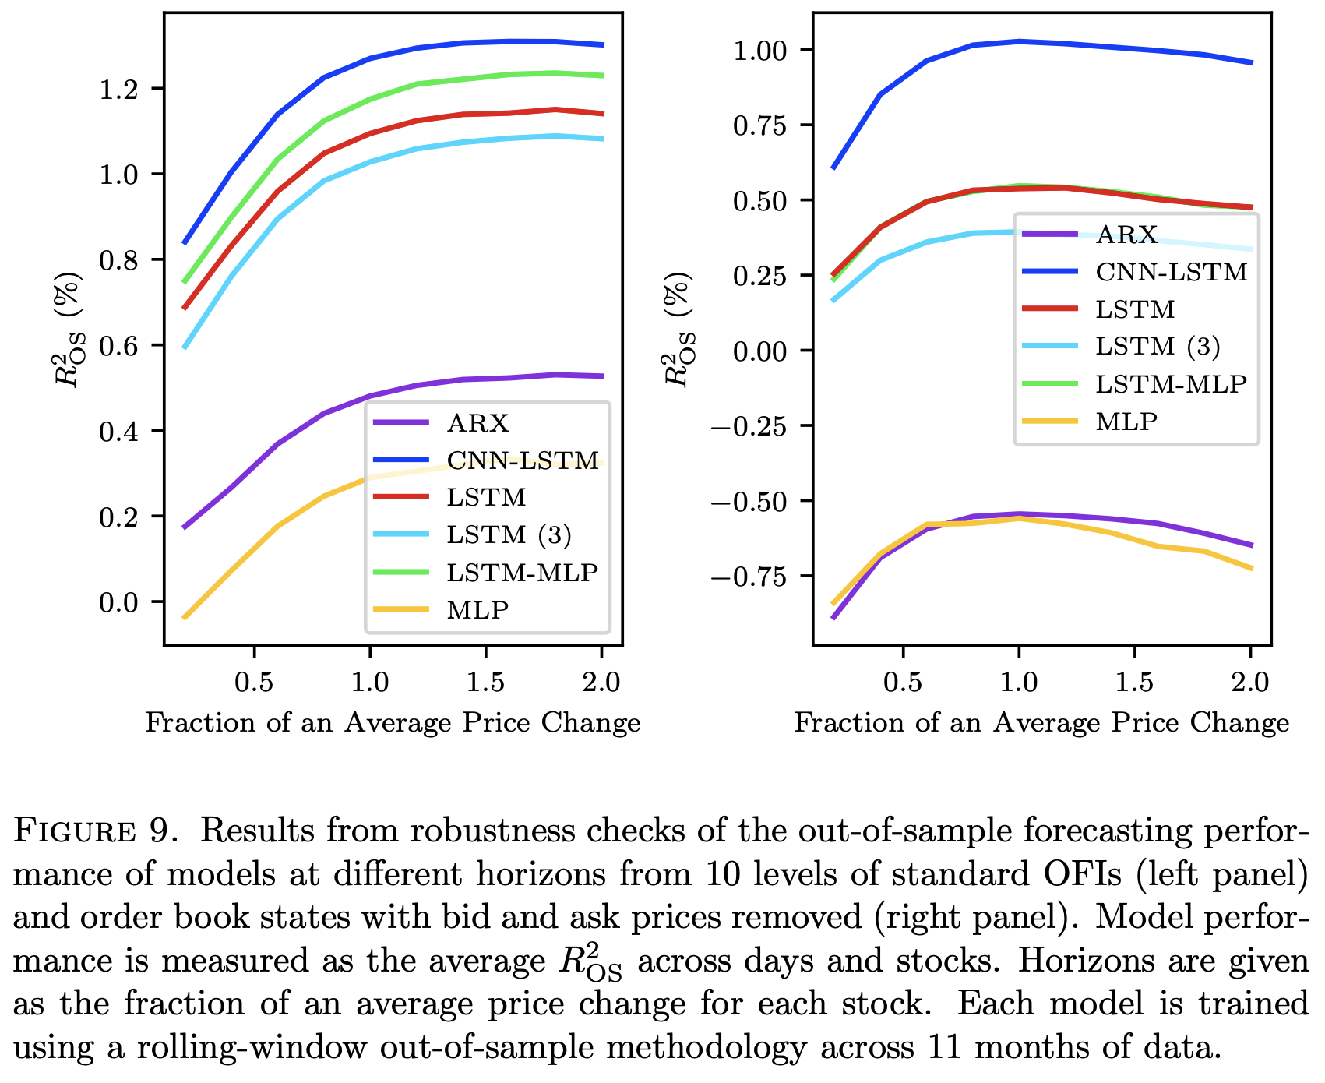
Order Flow (OF) vs. Order Flow Imbalance (OFI)
Research Seminar
The Definitions:
  OF (20 features): Keeps bid and ask volume changes separate. Allows asymmetric learning.
  OFI (10 features): bOF − aOF. A compressed measure of net buy/sell pressure.
What the Original Paper Found (Appendix B.1):
  LSTM-based models: Performance is qualitatively similar on OF and OFI.
  ARX & MLP models: OFI significantly improves performance.
  ARX: R² jumps from 0.1% to 0.5%.
  MLP: R² improves from 0.25% to 0.3%.
  Reason: Fewer input features = fewer parameters = less overfitting.
Our Replication on IEX DEEP:
  We observed the exact same pattern: LSTM-MLP performed equally well on both, while the simpler MLP benefited from the noise reduction of OFI.

Slide 12
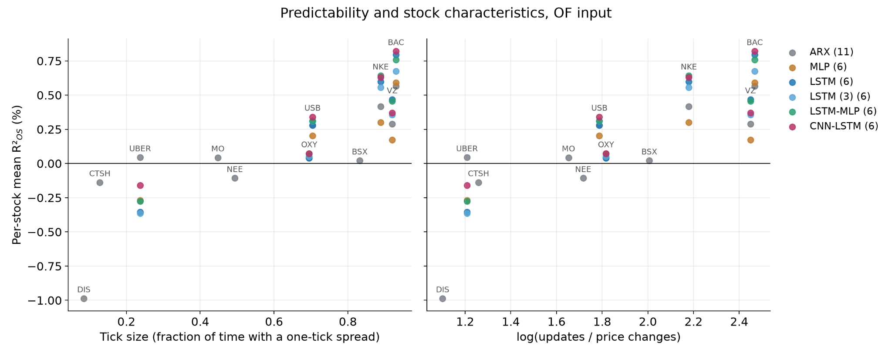

Slide 13
Extensions Beyond the Paper
Research Seminar
Ensemble: test whether combining linear ARX with CNN-LSTM improves forecasts, with no extra model training.
Pooled ARX: test whether one model can learn patterns shared across stocks and replace separate models.
Ridge vs Adam: check whether the estimation method changes accuracy while the ARX architecture stays the same.
Experiment | Implementation | Result: mean R²OS
ARX + CNN-LSTM ensemble | 50/50 average of ARX and CNN-LSTM forecasts. | Better: 0.39% vs 0.35% for CNN-LSTM and 0.27% for ARX (OF, 6 stocks).
Pooled ARX | One ridge ARX for all 11 stocks in each rolling window. | Worse: 0.03% vs 0.07% for separate ARX models (OFI, 11 stocks).
ARX: ridge vs Adam | Same linear architecture, two estimation methods. | Ridge is better: OF 0.27% vs −0.25%, OFI 0.28% vs 0.05% (6 stocks).
Notes:
Source: local project at commit da81528 (2026-10-17), supplied by the user as the current version. The source repository and presentation remain unchanged.
Implementation sources:
/Users/ms/Documents/DEEP-ORDER-FLOW-IMBALANCE-EXTRACTING-ALPHA-AT-MULTIPLE-HORIZONS-FROM-THE-LIMIT-ORDER-BOOK/scripts/extensions.py, run_ensemble: creates the name ens_arx_cnn_lstm, loads previously trained ARX and CNN-LSTM weights, obtains price-scale forecasts through predict(..., y_normalizer=...), and takes torch.stack(forecasts).mean(dim=0). No ensemble weights are trained. OF input, BAC/VZ/NKE/USB/OXY/UBER, three rolling windows.
/Users/ms/Documents/DEEP-ORDER-FLOW-IMBALANCE-EXTRACTING-ALPHA-AT-MULTIPLE-HORIZONS-FROM-THE-LIMIT-ORDER-BOOK/scripts/extensions.py, run_pooled: aggregates _Moments across 11 stocks, using the regular per-stock input and target normalization, chooses the ridge penalty on the pooled validation sample, then tests the same normalized-coordinate model on each stock. A fresh pooled fit is estimated per rolling window. OFI input. The current function saves metrics/history, but does not save a pooled weight file.
/Users/ms/Documents/DEEP-ORDER-FLOW-IMBALANCE-EXTRACTING-ALPHA-AT-MULTIPLE-HORIZONS-FROM-THE-LIMIT-ORDER-BOOK/src/deepofi/models/arx.py: one nn.Linear applied to flattened 100-event windows. fit_moments estimates ridge from X'X and X'Y, does not penalize the intercept, and selects alpha by validation MSE. /Users/ms/Documents/DEEP-ORDER-FLOW-IMBALANCE-EXTRACTING-ALPHA-AT-MULTIPLE-HORIZONS-FROM-THE-LIMIT-ORDER-BOOK/src/deepofi/cli.py --sgd bypasses the closed-form fit and uses engine.train (Adam and early stopping). arx_sgd is a run label and uses Adam despite its name.
Numerical sources: metrics.csv under results/ens_arx_cnn_lstm/of, results/cnn_lstm/of, results/arx/of, results/arx/ofi, results/arx_sgd/of, results/arx_sgd/ofi and results/arx_pooled/ofi. For each stock, exclude date=week rows, average daily R²OS over all 15 test days and 10 horizons, then average stock means. Percentage figures multiply the stored R²OS by 100.
Six-stock OF means: ensemble 0.3917701854%, CNN-LSTM 0.3461391809%, individual ridge ARX 0.2731393034%, Adam ARX -0.2544183954%.
Six-stock OFI means: individual ridge ARX 0.2766631113%, Adam ARX 0.0484027756%.
Eleven-stock OFI means: pooled ridge ARX 0.0288940972%, individual ridge ARX 0.0672943075%. This differs from the six-stock comparison because it includes five additional stocks. Pooled ARX is lower on this descriptive average. No significance claim is made on this slide, and no causal explanation is inferred from these aggregate results.
The interpretation and source descriptions also appear in README.md and DEVIATIONS.md. The paper is the six-architecture reference. These are additional experiments implemented by the team, not a claim to invent a new general modeling method.
Revision: The motivation above the table states the research questions behind each experiment. It does not infer that the ensemble members have independent errors, or that pooling must improve generalization. Better/worse refers only to the displayed descriptive mean R²OS on the same stocks and input within each row. The ensemble requires no additional model training. Pooled models use per-stock normalization and a validation-selected ridge penalty as described above.

Slide 14
Conclusion
Research Seminar
Stationarity is the key. Order Flow (OF) and Order Flow Imbalance (OFI) beat raw order book states - every time, for every model.
Memory matters. Architectures with an LSTM layer consistently outperform linear models and plain MLPs.
Alpha is short-lived. Predictive power peaks around two average price changes and then decays.
Microstructure decides. "Information-rich" large-tick stocks are far more predictable than small-tick ones.
Our contribution: We reproduced all of the above on IEX DEEP, and showed it is feasible on consumer hardware.
Conducted experiments and showed good results (for example ARX + CNN-LSTM ensemble)

Slide 15
Repository Structure
Research Seminar
SOURCE PACKAGE
REPOSITORY ROOT
src/deepofi/
├── README.md overview / results / use
├── cli.py train / evaluate / predict
├── DEVIATIONS.md changes from the paper
├── engine.py training / load weights
├── pyproject.toml package / dependencies
├── config.py read YAML settings
├── requirements.txt editable installation
├── iex/
├── .gitignore exclude local files
│ └── deep.py, hist.py DEEP parser / HIST archive
├── configs/
├── data_process/
│ └── pipeline.yaml, tickers.yaml settings / universe
│ ├── book.py rebuild order books
├── data/
│ ├── clean.py session / book filters
│ └── README.md, samples/*.csv formats / examples
│ ├── characteristics.py daily stock statistics
├── scripts/
│ ├── universe.py stock selection
│ ├── download_days.py, overnight.py download
│ ├── features.py OF / OFI / LOB inputs
│ ├── pilot_day.py stock screening
│ ├── targets.py future mid-price changes
│ ├── build_dataset.py books / metadata
│ ├── preprocessing.py winsorization / z-score
│ ├── freeze_dataset.py, check_dataset.py integrity
│ ├── windows.py sequences / data loaders
│ ├── make_samples.py example CSV files
│ ├── dataset.py books to model inputs
│ ├── train_synthetic.py, train_one_day.py smoke tests
│ ├── splits.py rolling date splits
│ ├── lr_check.py learning-rate check
│ └── synthetic.py artificial data
│ ├── extensions.py ensemble / pooled ARX
├── models/
│ └── make_report.py final figures / tables
│ ├── __init__.py model registry
├── weights/<model>/<input>/.../*.pt saved parameters
│ ├── arx.py, mlp.py linear / dense networks
├── results/
│ ├── lstm.py, lstm3.py 1 / 3 LSTM layers
│ ├── <model>/<input>/.../ metrics / history CSV
│ └── lstm_mlp.py, cnn_lstm.py hybrid networks
│ ├── model_comparison/ comparison PNG / CSV
└── evaluation/
│ └── report/ final figures / tables
└── metrics.py, comparison.py scoring / comparisons
└── tests/test_*.py pipeline / model tests
Notes:
Source: current tracked repository tree at /Users/ms/Documents/DEEP-ORDER-FLOW-IMBALANCE-EXTRACTING-ALPHA-AT-MULTIPLE-HORIZONS-FROM-THE-LIMIT-ORDER-BOOK, commit f4483d3, inspected 2026-10-17. No project files are modified. Left expands the src/deepofi source package. Right shows the other repository root entries. Grouped filenames share the same actual directory. Routine empty __init__.py files are omitted, while the models registry remains explicit. Repeated stock and window directories use ellipses as requested.
Weights are stored as weights/{model}/{input}/{ticker}/window_0N.pt. Not every model has every input. The ensemble reuses member weights and pooled ARX does not currently save a weight checkpoint.
Results are stored under results/{model}/{input}/{ticker}/window_0N/: history.csv and metrics.csv, with predictions.csv local only when requested. Ensemble results have metrics only. The existing model_comparison folder contains earlier comparisons; results/report contains the current final figures and tables. The overview shows both actual directories rather than removing historical outputs.
data/ tracks only README.md and five tiny CSV format examples. Full frozen books, daily metadata and dataset manifest stay in an external local dataset directory. scripts/make_samples.py creates format samples, freeze_dataset.py checksums/exports the dataset, and check_dataset.py reports quality. train_synthetic.py and train_one_day.py are smoke tests, not the main experiment runner. Main experiments use deepofi.cli.
Complete tracked file inventory for traceability:
.gitignore
DEVIATIONS.md
README.md
configs/pipeline.yaml
configs/tickers.yaml
data/README.md
data/samples/BAC_20260720_book.csv
data/samples/BAC_20260720_lob.csv
data/samples/BAC_20260720_of.csv
data/samples/BAC_20260720_ofi.csv
data/samples/BAC_20260720_targets_short.csv
pyproject.toml
requirements.txt
results/arx/of/BAC/window_01/history.csv
results/arx/of/BAC/window_01/metrics.csv
results/arx/of/BAC/window_02/history.csv
results/arx/of/BAC/window_02/metrics.csv
results/arx/of/BAC/window_03/history.csv
results/arx/of/BAC/window_03/metrics.csv
results/arx/of/BSX/window_01/history.csv
results/arx/of/BSX/window_01/metrics.csv
results/arx/of/BSX/window_02/history.csv
results/arx/of/BSX/window_02/metrics.csv
results/arx/of/BSX/window_03/history.csv
results/arx/of/BSX/window_03/metrics.csv
results/arx/of/CTSH/window_01/history.csv
results/arx/of/CTSH/window_01/metrics.csv
results/arx/of/CTSH/window_02/history.csv
results/arx/of/CTSH/window_02/metrics.csv
results/arx/of/CTSH/window_03/history.csv
results/arx/of/CTSH/window_03/metrics.csv
results/arx/of/DIS/window_01/history.csv
results/arx/of/DIS/window_01/metrics.csv
results/arx/of/DIS/window_02/history.csv
results/arx/of/DIS/window_02/metrics.csv
results/arx/of/DIS/window_03/history.csv
results/arx/of/DIS/window_03/metrics.csv
results/arx/of/MO/window_01/history.csv
results/arx/of/MO/window_01/metrics.csv
results/arx/of/MO/window_02/history.csv
results/arx/of/MO/window_02/metrics.csv
results/arx/of/MO/window_03/history.csv
results/arx/of/MO/window_03/metrics.csv
results/arx/of/NEE/window_01/history.csv
results/arx/of/NEE/window_01/metrics.csv
results/arx/of/NEE/window_02/history.csv
results/arx/of/NEE/window_02/metrics.csv
results/arx/of/NEE/window_03/history.csv
results/arx/of/NEE/window_03/metrics.csv
results/arx/of/NKE/window_01/history.csv
results/arx/of/NKE/window_01/metrics.csv
results/arx/of/NKE/window_02/history.csv
results/arx/of/NKE/window_02/metrics.csv
results/arx/of/NKE/window_03/history.csv
results/arx/of/NKE/window_03/metrics.csv
results/arx/of/OXY/window_01/history.csv
results/arx/of/OXY/window_01/metrics.csv
results/arx/of/OXY/window_02/history.csv
results/arx/of/OXY/window_02/metrics.csv
results/arx/of/OXY/window_03/history.csv
results/arx/of/OXY/window_03/metrics.csv
results/arx/of/UBER/window_01/history.csv
results/arx/of/UBER/window_01/metrics.csv
results/arx/of/UBER/window_02/history.csv
results/arx/of/UBER/window_02/metrics.csv
results/arx/of/UBER/window_03/history.csv
results/arx/of/UBER/window_03/metrics.csv
results/arx/of/USB/window_01/history.csv
results/arx/of/USB/window_01/metrics.csv
results/arx/of/USB/window_02/history.csv
results/arx/of/USB/window_02/metrics.csv
results/arx/of/USB/window_03/history.csv
results/arx/of/USB/window_03/metrics.csv
results/arx/of/VZ/window_01/history.csv
results/arx/of/VZ/window_01/metrics.csv
results/arx/of/VZ/window_02/history.csv
results/arx/of/VZ/window_02/metrics.csv
results/arx/of/VZ/window_03/history.csv
results/arx/of/VZ/window_03/metrics.csv
results/arx/ofi/BAC/window_01/history.csv
results/arx/ofi/BAC/window_01/metrics.csv
results/arx/ofi/BAC/window_02/history.csv
results/arx/ofi/BAC/window_02/metrics.csv
results/arx/ofi/BAC/window_03/history.csv
results/arx/ofi/BAC/window_03/metrics.csv
results/arx/ofi/BSX/window_01/history.csv
results/arx/ofi/BSX/window_01/metrics.csv
results/arx/ofi/BSX/window_02/history.csv
results/arx/ofi/BSX/window_02/metrics.csv
results/arx/ofi/BSX/window_03/history.csv
results/arx/ofi/BSX/window_03/metrics.csv
results/arx/ofi/CTSH/window_01/history.csv
results/arx/ofi/CTSH/window_01/metrics.csv
results/arx/ofi/CTSH/window_02/history.csv
results/arx/ofi/CTSH/window_02/metrics.csv
results/arx/ofi/CTSH/window_03/history.csv
results/arx/ofi/CTSH/window_03/metrics.csv
results/arx/ofi/DIS/window_01/history.csv
results/arx/ofi/DIS/window_01/metrics.csv
results/arx/ofi/DIS/window_02/history.csv
results/arx/ofi/DIS/window_02/metrics.csv
results/arx/ofi/DIS/window_03/history.csv
results/arx/ofi/DIS/window_03/metrics.csv
results/arx/ofi/MO/window_01/history.csv
results/arx/ofi/MO/window_01/metrics.csv
results/arx/ofi/MO/window_02/history.csv
results/arx/ofi/MO/window_02/metrics.csv
results/arx/ofi/MO/window_03/history.csv
results/arx/ofi/MO/window_03/metrics.csv
results/arx/ofi/NEE/window_01/history.csv
results/arx/ofi/NEE/window_01/metrics.csv
results/arx/ofi/NEE/window_02/history.csv
results/arx/ofi/NEE/window_02/metrics.csv
results/arx/ofi/NEE/window_03/history.csv
results/arx/ofi/NEE/window_03/metrics.csv
results/arx/ofi/NKE/window_01/history.csv
results/arx/ofi/NKE/window_01/metrics.csv
results/arx/ofi/NKE/window_02/history.csv
results/arx/ofi/NKE/window_02/metrics.csv
results/arx/ofi/NKE/window_03/history.csv
results/arx/ofi/NKE/window_03/metrics.csv
results/arx/ofi/OXY/window_01/history.csv
results/arx/ofi/OXY/window_01/metrics.csv
results/arx/ofi/OXY/window_02/history.csv
results/arx/ofi/OXY/window_02/metrics.csv
results/arx/ofi/OXY/window_03/history.csv
results/arx/ofi/OXY/window_03/metrics.csv
results/arx/ofi/UBER/window_01/history.csv
results/arx/ofi/UBER/window_01/metrics.csv
results/arx/ofi/UBER/window_02/history.csv
results/arx/ofi/UBER/window_02/metrics.csv
results/arx/ofi/UBER/window_03/history.csv
results/arx/ofi/UBER/window_03/metrics.csv
results/arx/ofi/USB/window_01/history.csv
results/arx/ofi/USB/window_01/metrics.csv
results/arx/ofi/USB/window_02/history.csv
results/arx/ofi/USB/window_02/metrics.csv
results/arx/ofi/USB/window_03/history.csv
results/arx/ofi/USB/window_03/metrics.csv
results/arx/ofi/VZ/window_01/history.csv
results/arx/ofi/VZ/window_01/metrics.csv
results/arx/ofi/VZ/window_02/history.csv
results/arx/ofi/VZ/window_02/metrics.csv
results/arx/ofi/VZ/window_03/history.csv
results/arx/ofi/VZ/window_03/metrics.csv
results/arx_pooled/ofi/BAC/window_01/history.csv
results/arx_pooled/ofi/BAC/window_01/metrics.csv
results/arx_pooled/ofi/BAC/window_02/history.csv
results/arx_pooled/ofi/BAC/window_02/metrics.csv
results/arx_pooled/ofi/BAC/window_03/history.csv
results/arx_pooled/ofi/BAC/window_03/metrics.csv
results/arx_pooled/ofi/BSX/window_01/history.csv
results/arx_pooled/ofi/BSX/window_01/metrics.csv
results/arx_pooled/ofi/BSX/window_02/history.csv
results/arx_pooled/ofi/BSX/window_02/metrics.csv
results/arx_pooled/ofi/BSX/window_03/history.csv
results/arx_pooled/ofi/BSX/window_03/metrics.csv
results/arx_pooled/ofi/CTSH/window_01/history.csv
results/arx_pooled/ofi/CTSH/window_01/metrics.csv
results/arx_pooled/ofi/CTSH/window_02/history.csv
results/arx_pooled/ofi/CTSH/window_02/metrics.csv
results/arx_pooled/ofi/CTSH/window_03/history.csv
results/arx_pooled/ofi/CTSH/window_03/metrics.csv
results/arx_pooled/ofi/DIS/window_01/history.csv
results/arx_pooled/ofi/DIS/window_01/metrics.csv
results/arx_pooled/ofi/DIS/window_02/history.csv
results/arx_pooled/ofi/DIS/window_02/metrics.csv
results/arx_pooled/ofi/DIS/window_03/history.csv
results/arx_pooled/ofi/DIS/window_03/metrics.csv
results/arx_pooled/ofi/MO/window_01/history.csv
results/arx_pooled/ofi/MO/window_01/metrics.csv
results/arx_pooled/ofi/MO/window_02/history.csv
results/arx_pooled/ofi/MO/window_02/metrics.csv
results/arx_pooled/ofi/MO/window_03/history.csv
results/arx_pooled/ofi/MO/window_03/metrics.csv
results/arx_pooled/ofi/NEE/window_01/history.csv
results/arx_pooled/ofi/NEE/window_01/metrics.csv
results/arx_pooled/ofi/NEE/window_02/history.csv
results/arx_pooled/ofi/NEE/window_02/metrics.csv
results/arx_pooled/ofi/NEE/window_03/history.csv
results/arx_pooled/ofi/NEE/window_03/metrics.csv
results/arx_pooled/ofi/NKE/window_01/history.csv
results/arx_pooled/ofi/NKE/window_01/metrics.csv
results/arx_pooled/ofi/NKE/window_02/history.csv
results/arx_pooled/ofi/NKE/window_02/metrics.csv
results/arx_pooled/ofi/NKE/window_03/history.csv
results/arx_pooled/ofi/NKE/window_03/metrics.csv
results/arx_pooled/ofi/OXY/window_01/history.csv
results/arx_pooled/ofi/OXY/window_01/metrics.csv
results/arx_pooled/ofi/OXY/window_02/history.csv
results/arx_pooled/ofi/OXY/window_02/metrics.csv
results/arx_pooled/ofi/OXY/window_03/history.csv
results/arx_pooled/ofi/OXY/window_03/metrics.csv
results/arx_pooled/ofi/UBER/window_01/history.csv
results/arx_pooled/ofi/UBER/window_01/metrics.csv
results/arx_pooled/ofi/UBER/window_02/history.csv
results/arx_pooled/ofi/UBER/window_02/metrics.csv
results/arx_pooled/ofi/UBER/window_03/history.csv
results/arx_pooled/ofi/UBER/window_03/metrics.csv
results/arx_pooled/ofi/USB/window_01/history.csv
results/arx_pooled/ofi/USB/window_01/metrics.csv
results/arx_pooled/ofi/USB/window_02/history.csv
results/arx_pooled/ofi/USB/window_02/metrics.csv
results/arx_pooled/ofi/USB/window_03/history.csv
results/arx_pooled/ofi/USB/window_03/metrics.csv
results/arx_pooled/ofi/VZ/window_01/history.csv
results/arx_pooled/ofi/VZ/window_01/metrics.csv
results/arx_pooled/ofi/VZ/window_02/history.csv
results/arx_pooled/ofi/VZ/window_02/metrics.csv
results/arx_pooled/ofi/VZ/window_03/history.csv
results/arx_pooled/ofi/VZ/window_03/metrics.csv
results/arx_sgd/lob/BAC/window_01/history.csv
results/arx_sgd/lob/BAC/window_01/metrics.csv
results/arx_sgd/lob/BAC/window_02/history.csv
results/arx_sgd/lob/BAC/window_02/metrics.csv
results/arx_sgd/lob/BAC/window_03/history.csv
results/arx_sgd/lob/BAC/window_03/metrics.csv
results/arx_sgd/lob/NKE/window_01/history.csv
results/arx_sgd/lob/NKE/window_01/metrics.csv
results/arx_sgd/lob/NKE/window_02/history.csv
results/arx_sgd/lob/NKE/window_02/metrics.csv
results/arx_sgd/lob/NKE/window_03/history.csv
results/arx_sgd/lob/NKE/window_03/metrics.csv
results/arx_sgd/lob/OXY/window_01/history.csv
results/arx_sgd/lob/OXY/window_01/metrics.csv
results/arx_sgd/lob/OXY/window_02/history.csv
results/arx_sgd/lob/OXY/window_02/metrics.csv
results/arx_sgd/lob/OXY/window_03/history.csv
results/arx_sgd/lob/OXY/window_03/metrics.csv
results/arx_sgd/lob/UBER/window_01/history.csv
results/arx_sgd/lob/UBER/window_01/metrics.csv
results/arx_sgd/lob/UBER/window_02/history.csv
results/arx_sgd/lob/UBER/window_02/metrics.csv
results/arx_sgd/lob/UBER/window_03/history.csv
results/arx_sgd/lob/UBER/window_03/metrics.csv
results/arx_sgd/lob/USB/window_01/history.csv
results/arx_sgd/lob/USB/window_01/metrics.csv
results/arx_sgd/lob/USB/window_02/history.csv
results/arx_sgd/lob/USB/window_02/metrics.csv
results/arx_sgd/lob/USB/window_03/history.csv
results/arx_sgd/lob/USB/window_03/metrics.csv
results/arx_sgd/lob/VZ/window_01/history.csv
results/arx_sgd/lob/VZ/window_01/metrics.csv
results/arx_sgd/lob/VZ/window_02/history.csv
results/arx_sgd/lob/VZ/window_02/metrics.csv
results/arx_sgd/lob/VZ/window_03/history.csv
results/arx_sgd/lob/VZ/window_03/metrics.csv
results/arx_sgd/of/BAC/window_01/history.csv
results/arx_sgd/of/BAC/window_01/metrics.csv
results/arx_sgd/of/BAC/window_02/history.csv
results/arx_sgd/of/BAC/window_02/metrics.csv
results/arx_sgd/of/BAC/window_03/history.csv
results/arx_sgd/of/BAC/window_03/metrics.csv
results/arx_sgd/of/NKE/window_01/history.csv
results/arx_sgd/of/NKE/window_01/metrics.csv
results/arx_sgd/of/NKE/window_02/history.csv
results/arx_sgd/of/NKE/window_02/metrics.csv
results/arx_sgd/of/NKE/window_03/history.csv
results/arx_sgd/of/NKE/window_03/metrics.csv
results/arx_sgd/of/OXY/window_01/history.csv
results/arx_sgd/of/OXY/window_01/metrics.csv
results/arx_sgd/of/OXY/window_02/history.csv
results/arx_sgd/of/OXY/window_02/metrics.csv
results/arx_sgd/of/OXY/window_03/history.csv
results/arx_sgd/of/OXY/window_03/metrics.csv
results/arx_sgd/of/UBER/window_01/history.csv
results/arx_sgd/of/UBER/window_01/metrics.csv
results/arx_sgd/of/UBER/window_02/history.csv
results/arx_sgd/of/UBER/window_02/metrics.csv
results/arx_sgd/of/UBER/window_03/history.csv
results/arx_sgd/of/UBER/window_03/metrics.csv
results/arx_sgd/of/USB/window_01/history.csv
results/arx_sgd/of/USB/window_01/metrics.csv
results/arx_sgd/of/USB/window_02/history.csv
results/arx_sgd/of/USB/window_02/metrics.csv
results/arx_sgd/of/USB/window_03/history.csv
results/arx_sgd/of/USB/window_03/metrics.csv
results/arx_sgd/of/VZ/window_01/history.csv
results/arx_sgd/of/VZ/window_01/metrics.csv
results/arx_sgd/of/VZ/window_02/history.csv
results/arx_sgd/of/VZ/window_02/metrics.csv
results/arx_sgd/of/VZ/window_03/history.csv
results/arx_sgd/of/VZ/window_03/metrics.csv
results/arx_sgd/ofi/BAC/window_01/history.csv
results/arx_sgd/ofi/BAC/window_01/metrics.csv
results/arx_sgd/ofi/BAC/window_02/history.csv
results/arx_sgd/ofi/BAC/window_02/metrics.csv
results/arx_sgd/ofi/BAC/window_03/history.csv
results/arx_sgd/ofi/BAC/window_03/metrics.csv
results/arx_sgd/ofi/NKE/window_01/history.csv
results/arx_sgd/ofi/NKE/window_01/metrics.csv
results/arx_sgd/ofi/NKE/window_02/history.csv
results/arx_sgd/ofi/NKE/window_02/metrics.csv
results/arx_sgd/ofi/NKE/window_03/history.csv
results/arx_sgd/ofi/NKE/window_03/metrics.csv
results/arx_sgd/ofi/OXY/window_01/history.csv
results/arx_sgd/ofi/OXY/window_01/metrics.csv
results/arx_sgd/ofi/OXY/window_02/history.csv
results/arx_sgd/ofi/OXY/window_02/metrics.csv
results/arx_sgd/ofi/OXY/window_03/history.csv
results/arx_sgd/ofi/OXY/window_03/metrics.csv
results/arx_sgd/ofi/UBER/window_01/history.csv
results/arx_sgd/ofi/UBER/window_01/metrics.csv
results/arx_sgd/ofi/UBER/window_02/history.csv
results/arx_sgd/ofi/UBER/window_02/metrics.csv
results/arx_sgd/ofi/UBER/window_03/history.csv
results/arx_sgd/ofi/UBER/window_03/metrics.csv
results/arx_sgd/ofi/USB/window_01/history.csv
results/arx_sgd/ofi/USB/window_01/metrics.csv
results/arx_sgd/ofi/USB/window_02/history.csv
results/arx_sgd/ofi/USB/window_02/metrics.csv
results/arx_sgd/ofi/USB/window_03/history.csv
results/arx_sgd/ofi/USB/window_03/metrics.csv
results/arx_sgd/ofi/VZ/window_01/history.csv
results/arx_sgd/ofi/VZ/window_01/metrics.csv
results/arx_sgd/ofi/VZ/window_02/history.csv
results/arx_sgd/ofi/VZ/window_02/metrics.csv
results/arx_sgd/ofi/VZ/window_03/history.csv
results/arx_sgd/ofi/VZ/window_03/metrics.csv
results/cnn_lstm/of/BAC/window_01/history.csv
results/cnn_lstm/of/BAC/window_01/metrics.csv
results/cnn_lstm/of/BAC/window_02/history.csv
results/cnn_lstm/of/BAC/window_02/metrics.csv
results/cnn_lstm/of/BAC/window_03/history.csv
results/cnn_lstm/of/BAC/window_03/metrics.csv
results/cnn_lstm/of/NKE/window_01/history.csv
results/cnn_lstm/of/NKE/window_01/metrics.csv
results/cnn_lstm/of/NKE/window_02/history.csv
results/cnn_lstm/of/NKE/window_02/metrics.csv
results/cnn_lstm/of/NKE/window_03/history.csv
results/cnn_lstm/of/NKE/window_03/metrics.csv
results/cnn_lstm/of/OXY/window_01/history.csv
results/cnn_lstm/of/OXY/window_01/metrics.csv
results/cnn_lstm/of/OXY/window_02/history.csv
results/cnn_lstm/of/OXY/window_02/metrics.csv
results/cnn_lstm/of/OXY/window_03/history.csv
results/cnn_lstm/of/OXY/window_03/metrics.csv
results/cnn_lstm/of/UBER/window_01/history.csv
results/cnn_lstm/of/UBER/window_01/metrics.csv
results/cnn_lstm/of/UBER/window_02/history.csv
results/cnn_lstm/of/UBER/window_02/metrics.csv
results/cnn_lstm/of/UBER/window_03/history.csv
results/cnn_lstm/of/UBER/window_03/metrics.csv
results/cnn_lstm/of/USB/window_01/history.csv
results/cnn_lstm/of/USB/window_01/metrics.csv
results/cnn_lstm/of/USB/window_02/history.csv
results/cnn_lstm/of/USB/window_02/metrics.csv
results/cnn_lstm/of/USB/window_03/history.csv
results/cnn_lstm/of/USB/window_03/metrics.csv
results/cnn_lstm/of/VZ/window_01/history.csv
results/cnn_lstm/of/VZ/window_01/metrics.csv
results/cnn_lstm/of/VZ/window_02/history.csv
results/cnn_lstm/of/VZ/window_02/metrics.csv
results/cnn_lstm/of/VZ/window_03/history.csv
results/cnn_lstm/of/VZ/window_03/metrics.csv
results/ens_arx_cnn_lstm/of/BAC/window_01/metrics.csv
results/ens_arx_cnn_lstm/of/BAC/window_02/metrics.csv
results/ens_arx_cnn_lstm/of/BAC/window_03/metrics.csv
results/ens_arx_cnn_lstm/of/NKE/window_01/metrics.csv
results/ens_arx_cnn_lstm/of/NKE/window_02/metrics.csv
results/ens_arx_cnn_lstm/of/NKE/window_03/metrics.csv
results/ens_arx_cnn_lstm/of/OXY/window_01/metrics.csv
results/ens_arx_cnn_lstm/of/OXY/window_02/metrics.csv
results/ens_arx_cnn_lstm/of/OXY/window_03/metrics.csv
results/ens_arx_cnn_lstm/of/UBER/window_01/metrics.csv
results/ens_arx_cnn_lstm/of/UBER/window_02/metrics.csv
results/ens_arx_cnn_lstm/of/UBER/window_03/metrics.csv
results/ens_arx_cnn_lstm/of/USB/window_01/metrics.csv
results/ens_arx_cnn_lstm/of/USB/window_02/metrics.csv
results/ens_arx_cnn_lstm/of/USB/window_03/metrics.csv
results/ens_arx_cnn_lstm/of/VZ/window_01/metrics.csv
results/ens_arx_cnn_lstm/of/VZ/window_02/metrics.csv
results/ens_arx_cnn_lstm/of/VZ/window_03/metrics.csv
results/lstm/of/BAC/window_01/history.csv
results/lstm/of/BAC/window_01/metrics.csv
results/lstm/of/BAC/window_02/history.csv
results/lstm/of/BAC/window_02/metrics.csv
results/lstm/of/BAC/window_03/history.csv
results/lstm/of/BAC/window_03/metrics.csv
results/lstm/of/NKE/window_01/history.csv
results/lstm/of/NKE/window_01/metrics.csv
results/lstm/of/NKE/window_02/history.csv
results/lstm/of/NKE/window_02/metrics.csv
results/lstm/of/NKE/window_03/history.csv
results/lstm/of/NKE/window_03/metrics.csv
results/lstm/of/OXY/window_01/history.csv
results/lstm/of/OXY/window_01/metrics.csv
results/lstm/of/OXY/window_02/history.csv
results/lstm/of/OXY/window_02/metrics.csv
results/lstm/of/OXY/window_03/history.csv
results/lstm/of/OXY/window_03/metrics.csv
results/lstm/of/UBER/window_01/history.csv
results/lstm/of/UBER/window_01/metrics.csv
results/lstm/of/UBER/window_02/history.csv
results/lstm/of/UBER/window_02/metrics.csv
results/lstm/of/UBER/window_03/history.csv
results/lstm/of/UBER/window_03/metrics.csv
results/lstm/of/USB/window_01/history.csv
results/lstm/of/USB/window_01/metrics.csv
results/lstm/of/USB/window_02/history.csv
results/lstm/of/USB/window_02/metrics.csv
results/lstm/of/USB/window_03/history.csv
results/lstm/of/USB/window_03/metrics.csv
results/lstm/of/VZ/window_01/history.csv
results/lstm/of/VZ/window_01/metrics.csv
results/lstm/of/VZ/window_02/history.csv
results/lstm/of/VZ/window_02/metrics.csv
results/lstm/of/VZ/window_03/history.csv
results/lstm/of/VZ/window_03/metrics.csv
results/lstm/ofi/BAC/window_01/history.csv
results/lstm/ofi/BAC/window_01/metrics.csv
results/lstm/ofi/BAC/window_02/history.csv
results/lstm/ofi/BAC/window_02/metrics.csv
results/lstm/ofi/BAC/window_03/history.csv
results/lstm/ofi/BAC/window_03/metrics.csv
results/lstm/ofi/NKE/window_01/history.csv
results/lstm/ofi/NKE/window_01/metrics.csv
results/lstm/ofi/NKE/window_02/history.csv
results/lstm/ofi/NKE/window_02/metrics.csv
results/lstm/ofi/NKE/window_03/history.csv
results/lstm/ofi/NKE/window_03/metrics.csv
results/lstm/ofi/OXY/window_01/history.csv
results/lstm/ofi/OXY/window_01/metrics.csv
results/lstm/ofi/OXY/window_02/history.csv
results/lstm/ofi/OXY/window_02/metrics.csv
results/lstm/ofi/OXY/window_03/history.csv
results/lstm/ofi/OXY/window_03/metrics.csv
results/lstm/ofi/UBER/window_01/history.csv
results/lstm/ofi/UBER/window_01/metrics.csv
results/lstm/ofi/UBER/window_02/history.csv
results/lstm/ofi/UBER/window_02/metrics.csv
results/lstm/ofi/UBER/window_03/history.csv
results/lstm/ofi/UBER/window_03/metrics.csv
results/lstm/ofi/USB/window_01/history.csv
results/lstm/ofi/USB/window_01/metrics.csv
results/lstm/ofi/USB/window_02/history.csv
results/lstm/ofi/USB/window_02/metrics.csv
results/lstm/ofi/USB/window_03/history.csv
results/lstm/ofi/USB/window_03/metrics.csv
results/lstm/ofi/VZ/window_01/history.csv
results/lstm/ofi/VZ/window_01/metrics.csv
results/lstm/ofi/VZ/window_02/history.csv
results/lstm/ofi/VZ/window_02/metrics.csv
results/lstm/ofi/VZ/window_03/history.csv
results/lstm/ofi/VZ/window_03/metrics.csv
results/lstm3/of/BAC/window_01/history.csv
results/lstm3/of/BAC/window_01/metrics.csv
results/lstm3/of/BAC/window_02/history.csv
results/lstm3/of/BAC/window_02/metrics.csv
results/lstm3/of/BAC/window_03/history.csv
results/lstm3/of/BAC/window_03/metrics.csv
results/lstm3/of/NKE/window_01/history.csv
results/lstm3/of/NKE/window_01/metrics.csv
results/lstm3/of/NKE/window_02/history.csv
results/lstm3/of/NKE/window_02/metrics.csv
results/lstm3/of/NKE/window_03/history.csv
results/lstm3/of/NKE/window_03/metrics.csv
results/lstm3/of/OXY/window_01/history.csv
results/lstm3/of/OXY/window_01/metrics.csv
results/lstm3/of/OXY/window_02/history.csv
results/lstm3/of/OXY/window_02/metrics.csv
results/lstm3/of/OXY/window_03/history.csv
results/lstm3/of/OXY/window_03/metrics.csv
results/lstm3/of/UBER/window_01/history.csv
results/lstm3/of/UBER/window_01/metrics.csv
results/lstm3/of/UBER/window_02/history.csv
results/lstm3/of/UBER/window_02/metrics.csv
results/lstm3/of/UBER/window_03/history.csv
results/lstm3/of/UBER/window_03/metrics.csv
results/lstm3/of/USB/window_01/history.csv
results/lstm3/of/USB/window_01/metrics.csv
results/lstm3/of/USB/window_02/history.csv
results/lstm3/of/USB/window_02/metrics.csv
results/lstm3/of/USB/window_03/history.csv
results/lstm3/of/USB/window_03/metrics.csv
results/lstm3/of/VZ/window_01/history.csv
results/lstm3/of/VZ/window_01/metrics.csv
results/lstm3/of/VZ/window_02/history.csv
results/lstm3/of/VZ/window_02/metrics.csv
results/lstm3/of/VZ/window_03/history.csv
results/lstm3/of/VZ/window_03/metrics.csv
results/lstm_mlp/of/BAC/window_01/history.csv
results/lstm_mlp/of/BAC/window_01/metrics.csv
results/lstm_mlp/of/BAC/window_02/history.csv
results/lstm_mlp/of/BAC/window_02/metrics.csv
results/lstm_mlp/of/BAC/window_03/history.csv
results/lstm_mlp/of/BAC/window_03/metrics.csv
results/lstm_mlp/of/NKE/window_01/history.csv
results/lstm_mlp/of/NKE/window_01/metrics.csv
results/lstm_mlp/of/NKE/window_02/history.csv
results/lstm_mlp/of/NKE/window_02/metrics.csv
results/lstm_mlp/of/NKE/window_03/history.csv
results/lstm_mlp/of/NKE/window_03/metrics.csv
results/lstm_mlp/of/OXY/window_01/history.csv
results/lstm_mlp/of/OXY/window_01/metrics.csv
results/lstm_mlp/of/OXY/window_02/history.csv
results/lstm_mlp/of/OXY/window_02/metrics.csv
results/lstm_mlp/of/OXY/window_03/history.csv
results/lstm_mlp/of/OXY/window_03/metrics.csv
results/lstm_mlp/of/UBER/window_01/history.csv
results/lstm_mlp/of/UBER/window_01/metrics.csv
results/lstm_mlp/of/UBER/window_02/history.csv
results/lstm_mlp/of/UBER/window_02/metrics.csv
results/lstm_mlp/of/UBER/window_03/history.csv
results/lstm_mlp/of/UBER/window_03/metrics.csv
results/lstm_mlp/of/USB/window_01/history.csv
results/lstm_mlp/of/USB/window_01/metrics.csv
results/lstm_mlp/of/USB/window_02/history.csv
results/lstm_mlp/of/USB/window_02/metrics.csv
results/lstm_mlp/of/USB/window_03/history.csv
results/lstm_mlp/of/USB/window_03/metrics.csv
results/lstm_mlp/of/VZ/window_01/history.csv
results/lstm_mlp/of/VZ/window_01/metrics.csv
results/lstm_mlp/of/VZ/window_02/history.csv
results/lstm_mlp/of/VZ/window_02/metrics.csv
results/lstm_mlp/of/VZ/window_03/history.csv
results/lstm_mlp/of/VZ/window_03/metrics.csv
results/mlp/lob/BAC/window_01/history.csv
results/mlp/lob/BAC/window_01/metrics.csv
results/mlp/lob/BAC/window_02/history.csv
results/mlp/lob/BAC/window_02/metrics.csv
results/mlp/lob/BAC/window_03/history.csv
results/mlp/lob/BAC/window_03/metrics.csv
results/mlp/lob/NKE/window_01/history.csv
results/mlp/lob/NKE/window_01/metrics.csv
results/mlp/lob/NKE/window_02/history.csv
results/mlp/lob/NKE/window_02/metrics.csv
results/mlp/lob/NKE/window_03/history.csv
results/mlp/lob/NKE/window_03/metrics.csv
results/mlp/lob/OXY/window_01/history.csv
results/mlp/lob/OXY/window_01/metrics.csv
results/mlp/lob/OXY/window_02/history.csv
results/mlp/lob/OXY/window_02/metrics.csv
results/mlp/lob/OXY/window_03/history.csv
results/mlp/lob/OXY/window_03/metrics.csv
results/mlp/lob/UBER/window_01/history.csv
results/mlp/lob/UBER/window_01/metrics.csv
results/mlp/lob/UBER/window_02/history.csv
results/mlp/lob/UBER/window_02/metrics.csv
results/mlp/lob/UBER/window_03/history.csv
results/mlp/lob/UBER/window_03/metrics.csv
results/mlp/lob/USB/window_01/history.csv
results/mlp/lob/USB/window_01/metrics.csv
results/mlp/lob/USB/window_02/history.csv
results/mlp/lob/USB/window_02/metrics.csv
results/mlp/lob/USB/window_03/history.csv
results/mlp/lob/USB/window_03/metrics.csv
results/mlp/lob/VZ/window_01/history.csv
results/mlp/lob/VZ/window_01/metrics.csv
results/mlp/lob/VZ/window_02/history.csv
results/mlp/lob/VZ/window_02/metrics.csv
results/mlp/lob/VZ/window_03/history.csv
results/mlp/lob/VZ/window_03/metrics.csv
results/mlp/of/BAC/window_01/history.csv
results/mlp/of/BAC/window_01/metrics.csv
results/mlp/of/BAC/window_02/history.csv
results/mlp/of/BAC/window_02/metrics.csv
results/mlp/of/BAC/window_03/history.csv
results/mlp/of/BAC/window_03/metrics.csv
results/mlp/of/NKE/window_01/history.csv
results/mlp/of/NKE/window_01/metrics.csv
results/mlp/of/NKE/window_02/history.csv
results/mlp/of/NKE/window_02/metrics.csv
results/mlp/of/NKE/window_03/history.csv
results/mlp/of/NKE/window_03/metrics.csv
results/mlp/of/OXY/window_01/history.csv
results/mlp/of/OXY/window_01/metrics.csv
results/mlp/of/OXY/window_02/history.csv
results/mlp/of/OXY/window_02/metrics.csv
results/mlp/of/OXY/window_03/history.csv
results/mlp/of/OXY/window_03/metrics.csv
results/mlp/of/UBER/window_01/history.csv
results/mlp/of/UBER/window_01/metrics.csv
results/mlp/of/UBER/window_02/history.csv
results/mlp/of/UBER/window_02/metrics.csv
results/mlp/of/UBER/window_03/history.csv
results/mlp/of/UBER/window_03/metrics.csv
results/mlp/of/USB/window_01/history.csv
results/mlp/of/USB/window_01/metrics.csv
results/mlp/of/USB/window_02/history.csv
results/mlp/of/USB/window_02/metrics.csv
results/mlp/of/USB/window_03/history.csv
results/mlp/of/USB/window_03/metrics.csv
results/mlp/of/VZ/window_01/history.csv
results/mlp/of/VZ/window_01/metrics.csv
results/mlp/of/VZ/window_02/history.csv
results/mlp/of/VZ/window_02/metrics.csv
results/mlp/of/VZ/window_03/history.csv
results/mlp/of/VZ/window_03/metrics.csv
results/mlp/ofi/BAC/window_01/history.csv
results/mlp/ofi/BAC/window_01/metrics.csv
results/mlp/ofi/BAC/window_02/history.csv
results/mlp/ofi/BAC/window_02/metrics.csv
results/mlp/ofi/BAC/window_03/history.csv
results/mlp/ofi/BAC/window_03/metrics.csv
results/mlp/ofi/NKE/window_01/history.csv
results/mlp/ofi/NKE/window_01/metrics.csv
results/mlp/ofi/NKE/window_02/history.csv
results/mlp/ofi/NKE/window_02/metrics.csv
results/mlp/ofi/NKE/window_03/history.csv
results/mlp/ofi/NKE/window_03/metrics.csv
results/mlp/ofi/OXY/window_01/history.csv
results/mlp/ofi/OXY/window_01/metrics.csv
results/mlp/ofi/OXY/window_02/history.csv
results/mlp/ofi/OXY/window_02/metrics.csv
results/mlp/ofi/OXY/window_03/history.csv
results/mlp/ofi/OXY/window_03/metrics.csv
results/mlp/ofi/UBER/window_01/history.csv
results/mlp/ofi/UBER/window_01/metrics.csv
results/mlp/ofi/UBER/window_02/history.csv
results/mlp/ofi/UBER/window_02/metrics.csv
results/mlp/ofi/UBER/window_03/history.csv
results/mlp/ofi/UBER/window_03/metrics.csv
results/mlp/ofi/USB/window_01/history.csv
results/mlp/ofi/USB/window_01/metrics.csv
results/mlp/ofi/USB/window_02/history.csv
results/mlp/ofi/USB/window_02/metrics.csv
results/mlp/ofi/USB/window_03/history.csv
results/mlp/ofi/USB/window_03/metrics.csv
results/mlp/ofi/VZ/window_01/history.csv
results/mlp/ofi/VZ/window_01/metrics.csv
results/mlp/ofi/VZ/window_02/history.csv
results/mlp/ofi/VZ/window_02/metrics.csv
results/mlp/ofi/VZ/window_03/history.csv
results/mlp/ofi/VZ/window_03/metrics.csv
results/model_comparison/of/all_tickers/comparison.csv
results/model_comparison/of/all_tickers/mse_comparison.png
results/model_comparison/of/all_tickers/r2_os_comparison.png
results/model_comparison/ofi/all_tickers/comparison.csv
results/model_comparison/ofi/all_tickers/mse_comparison.png
results/model_comparison/ofi/all_tickers/r2_os_comparison.png
results/report/fig2_arx_all_stocks.png
results/report/fig2_term_structure.png
results/report/fig3_ranks.csv
results/report/fig3_ranks.png
results/report/fig4_lstm_vs_cnn_lstm.png
results/report/fig5_cross_section.png
results/report/figB_arx_of_vs_ofi.png
results/report/table4_significance.csv
results/report/table5_cross_section.csv
results/report/table_data.csv
scripts/build_dataset.py
scripts/check_dataset.py
scripts/download_days.py
scripts/extensions.py
scripts/freeze_dataset.py
scripts/lr_check.py
scripts/make_report.py
scripts/make_samples.py
scripts/overnight.py
scripts/pilot_day.py
scripts/train_one_day.py
scripts/train_synthetic.py
src/deepofi/__init__.py
src/deepofi/cli.py
src/deepofi/config.py
src/deepofi/data_process/__init__.py
src/deepofi/data_process/book.py
src/deepofi/data_process/characteristics.py
src/deepofi/data_process/clean.py
src/deepofi/data_process/dataset.py
src/deepofi/data_process/features.py
src/deepofi/data_process/preprocessing.py
src/deepofi/data_process/splits.py
src/deepofi/data_process/synthetic.py
src/deepofi/data_process/targets.py
src/deepofi/data_process/universe.py
src/deepofi/data_process/windows.py
src/deepofi/engine.py
src/deepofi/evaluation/__init__.py
src/deepofi/evaluation/comparison.py
src/deepofi/evaluation/metrics.py
src/deepofi/iex/__init__.py
src/deepofi/iex/deep.py
src/deepofi/iex/hist.py
src/deepofi/models/__init__.py
src/deepofi/models/arx.py
src/deepofi/models/cnn_lstm.py
src/deepofi/models/lstm.py
src/deepofi/models/lstm3.py
src/deepofi/models/lstm_mlp.py
src/deepofi/models/mlp.py
tests/test_arx.py
tests/test_book.py
tests/test_cnn_lstm.py
tests/test_dataset.py
tests/test_environment.py
tests/test_hist.py
tests/test_metrics.py
tests/test_models.py
tests/test_of.py
tests/test_paper_models.py
tests/test_parser.py
tests/test_targets.py
tests/test_universe.py
tests/test_windows.py
weights/.gitkeep
weights/arx/of/BAC/window_01.pt
weights/arx/of/BAC/window_02.pt
weights/arx/of/BAC/window_03.pt
weights/arx/of/BSX/window_01.pt
weights/arx/of/BSX/window_02.pt
weights/arx/of/BSX/window_03.pt
weights/arx/of/CTSH/window_01.pt
weights/arx/of/CTSH/window_02.pt
weights/arx/of/CTSH/window_03.pt
weights/arx/of/DIS/window_01.pt
weights/arx/of/DIS/window_02.pt
weights/arx/of/DIS/window_03.pt
weights/arx/of/MO/window_01.pt
weights/arx/of/MO/window_02.pt
weights/arx/of/MO/window_03.pt
weights/arx/of/NEE/window_01.pt
weights/arx/of/NEE/window_02.pt
weights/arx/of/NEE/window_03.pt
weights/arx/of/NKE/window_01.pt
weights/arx/of/NKE/window_02.pt
weights/arx/of/NKE/window_03.pt
weights/arx/of/OXY/window_01.pt
weights/arx/of/OXY/window_02.pt
weights/arx/of/OXY/window_03.pt
weights/arx/of/UBER/window_01.pt
weights/arx/of/UBER/window_02.pt
weights/arx/of/UBER/window_03.pt
weights/arx/of/USB/window_01.pt
weights/arx/of/USB/window_02.pt
weights/arx/of/USB/window_03.pt
weights/arx/of/VZ/window_01.pt
weights/arx/of/VZ/window_02.pt
weights/arx/of/VZ/window_03.pt
weights/arx/ofi/BAC/window_01.pt
weights/arx/ofi/BAC/window_02.pt
weights/arx/ofi/BAC/window_03.pt
weights/arx/ofi/BSX/window_01.pt
weights/arx/ofi/BSX/window_02.pt
weights/arx/ofi/BSX/window_03.pt
weights/arx/ofi/CTSH/window_01.pt
weights/arx/ofi/CTSH/window_02.pt
weights/arx/ofi/CTSH/window_03.pt
weights/arx/ofi/DIS/window_01.pt
weights/arx/ofi/DIS/window_02.pt
weights/arx/ofi/DIS/window_03.pt
weights/arx/ofi/MO/window_01.pt
weights/arx/ofi/MO/window_02.pt
weights/arx/ofi/MO/window_03.pt
weights/arx/ofi/NEE/window_01.pt
weights/arx/ofi/NEE/window_02.pt
weights/arx/ofi/NEE/window_03.pt
weights/arx/ofi/NKE/window_01.pt
weights/arx/ofi/NKE/window_02.pt
weights/arx/ofi/NKE/window_03.pt
weights/arx/ofi/OXY/window_01.pt
weights/arx/ofi/OXY/window_02.pt
weights/arx/ofi/OXY/window_03.pt
weights/arx/ofi/UBER/window_01.pt
weights/arx/ofi/UBER/window_02.pt
weights/arx/ofi/UBER/window_03.pt
weights/arx/ofi/USB/window_01.pt
weights/arx/ofi/USB/window_02.pt
weights/arx/ofi/USB/window_03.pt
weights/arx/ofi/VZ/window_01.pt
weights/arx/ofi/VZ/window_02.pt
weights/arx/ofi/VZ/window_03.pt
weights/arx_sgd/lob/BAC/window_01.pt
weights/arx_sgd/lob/BAC/window_02.pt
weights/arx_sgd/lob/BAC/window_03.pt
weights/arx_sgd/lob/NKE/window_01.pt
weights/arx_sgd/lob/NKE/window_02.pt
weights/arx_sgd/lob/NKE/window_03.pt
weights/arx_sgd/lob/OXY/window_01.pt
weights/arx_sgd/lob/OXY/window_02.pt
weights/arx_sgd/lob/OXY/window_03.pt
weights/arx_sgd/lob/UBER/window_01.pt
weights/arx_sgd/lob/UBER/window_02.pt
weights/arx_sgd/lob/UBER/window_03.pt
weights/arx_sgd/lob/USB/window_01.pt
weights/arx_sgd/lob/USB/window_02.pt
weights/arx_sgd/lob/USB/window_03.pt
weights/arx_sgd/lob/VZ/window_01.pt
weights/arx_sgd/lob/VZ/window_02.pt
weights/arx_sgd/lob/VZ/window_03.pt
weights/arx_sgd/of/BAC/window_01.pt
weights/arx_sgd/of/BAC/window_02.pt
weights/arx_sgd/of/BAC/window_03.pt
weights/arx_sgd/of/NKE/window_01.pt
weights/arx_sgd/of/NKE/window_02.pt
weights/arx_sgd/of/NKE/window_03.pt
weights/arx_sgd/of/OXY/window_01.pt
weights/arx_sgd/of/OXY/window_02.pt
weights/arx_sgd/of/OXY/window_03.pt
weights/arx_sgd/of/UBER/window_01.pt
weights/arx_sgd/of/UBER/window_02.pt
weights/arx_sgd/of/UBER/window_03.pt
weights/arx_sgd/of/USB/window_01.pt
weights/arx_sgd/of/USB/window_02.pt
weights/arx_sgd/of/USB/window_03.pt
weights/arx_sgd/of/VZ/window_01.pt
weights/arx_sgd/of/VZ/window_02.pt
weights/arx_sgd/of/VZ/window_03.pt
weights/arx_sgd/ofi/BAC/window_01.pt
weights/arx_sgd/ofi/BAC/window_02.pt
weights/arx_sgd/ofi/BAC/window_03.pt
weights/arx_sgd/ofi/NKE/window_01.pt
weights/arx_sgd/ofi/NKE/window_02.pt
weights/arx_sgd/ofi/NKE/window_03.pt
weights/arx_sgd/ofi/OXY/window_01.pt
weights/arx_sgd/ofi/OXY/window_02.pt
weights/arx_sgd/ofi/OXY/window_03.pt
weights/arx_sgd/ofi/UBER/window_01.pt
weights/arx_sgd/ofi/UBER/window_02.pt
weights/arx_sgd/ofi/UBER/window_03.pt
weights/arx_sgd/ofi/USB/window_01.pt
weights/arx_sgd/ofi/USB/window_02.pt
weights/arx_sgd/ofi/USB/window_03.pt
weights/arx_sgd/ofi/VZ/window_01.pt
weights/arx_sgd/ofi/VZ/window_02.pt
weights/arx_sgd/ofi/VZ/window_03.pt
weights/cnn_lstm/of/BAC/window_01.pt
weights/cnn_lstm/of/BAC/window_02.pt
weights/cnn_lstm/of/BAC/window_03.pt
weights/cnn_lstm/of/NKE/window_01.pt
weights/cnn_lstm/of/NKE/window_02.pt
weights/cnn_lstm/of/NKE/window_03.pt
weights/cnn_lstm/of/OXY/window_01.pt
weights/cnn_lstm/of/OXY/window_02.pt
weights/cnn_lstm/of/OXY/window_03.pt
weights/cnn_lstm/of/UBER/window_01.pt
weights/cnn_lstm/of/UBER/window_02.pt
weights/cnn_lstm/of/UBER/window_03.pt
weights/cnn_lstm/of/USB/window_01.pt
weights/cnn_lstm/of/USB/window_02.pt
weights/cnn_lstm/of/USB/window_03.pt
weights/cnn_lstm/of/VZ/window_01.pt
weights/cnn_lstm/of/VZ/window_02.pt
weights/cnn_lstm/of/VZ/window_03.pt
weights/lstm/of/BAC/window_01.pt
weights/lstm/of/BAC/window_02.pt
weights/lstm/of/BAC/window_03.pt
weights/lstm/of/NKE/window_01.pt
weights/lstm/of/NKE/window_02.pt
weights/lstm/of/NKE/window_03.pt
weights/lstm/of/OXY/window_01.pt
weights/lstm/of/OXY/window_02.pt
weights/lstm/of/OXY/window_03.pt
weights/lstm/of/UBER/window_01.pt
weights/lstm/of/UBER/window_02.pt
weights/lstm/of/UBER/window_03.pt
weights/lstm/of/USB/window_01.pt
weights/lstm/of/USB/window_02.pt
weights/lstm/of/USB/window_03.pt
weights/lstm/of/VZ/window_01.pt
weights/lstm/of/VZ/window_02.pt
weights/lstm/of/VZ/window_03.pt
weights/lstm/ofi/BAC/window_01.pt
weights/lstm/ofi/BAC/window_02.pt
weights/lstm/ofi/BAC/window_03.pt
weights/lstm/ofi/NKE/window_01.pt
weights/lstm/ofi/NKE/window_02.pt
weights/lstm/ofi/NKE/window_03.pt
weights/lstm/ofi/OXY/window_01.pt
weights/lstm/ofi/OXY/window_02.pt
weights/lstm/ofi/OXY/window_03.pt
weights/lstm/ofi/UBER/window_01.pt
weights/lstm/ofi/UBER/window_02.pt
weights/lstm/ofi/UBER/window_03.pt
weights/lstm/ofi/USB/window_01.pt
weights/lstm/ofi/USB/window_02.pt
weights/lstm/ofi/USB/window_03.pt
weights/lstm/ofi/VZ/window_01.pt
weights/lstm/ofi/VZ/window_02.pt
weights/lstm/ofi/VZ/window_03.pt
weights/lstm3/of/BAC/window_01.pt
weights/lstm3/of/BAC/window_02.pt
weights/lstm3/of/BAC/window_03.pt
weights/lstm3/of/NKE/window_01.pt
weights/lstm3/of/NKE/window_02.pt
weights/lstm3/of/NKE/window_03.pt
weights/lstm3/of/OXY/window_01.pt
weights/lstm3/of/OXY/window_02.pt
weights/lstm3/of/OXY/window_03.pt
weights/lstm3/of/UBER/window_01.pt
weights/lstm3/of/UBER/window_02.pt
weights/lstm3/of/UBER/window_03.pt
weights/lstm3/of/USB/window_01.pt
weights/lstm3/of/USB/window_02.pt
weights/lstm3/of/USB/window_03.pt
weights/lstm3/of/VZ/window_01.pt
weights/lstm3/of/VZ/window_02.pt
weights/lstm3/of/VZ/window_03.pt
weights/lstm_mlp/of/BAC/window_01.pt
weights/lstm_mlp/of/BAC/window_02.pt
weights/lstm_mlp/of/BAC/window_03.pt
weights/lstm_mlp/of/NKE/window_01.pt
weights/lstm_mlp/of/NKE/window_02.pt
weights/lstm_mlp/of/NKE/window_03.pt
weights/lstm_mlp/of/OXY/window_01.pt
weights/lstm_mlp/of/OXY/window_02.pt
weights/lstm_mlp/of/OXY/window_03.pt
weights/lstm_mlp/of/UBER/window_01.pt
weights/lstm_mlp/of/UBER/window_02.pt
weights/lstm_mlp/of/UBER/window_03.pt
weights/lstm_mlp/of/USB/window_01.pt
weights/lstm_mlp/of/USB/window_02.pt
weights/lstm_mlp/of/USB/window_03.pt
weights/lstm_mlp/of/VZ/window_01.pt
weights/lstm_mlp/of/VZ/window_02.pt
weights/lstm_mlp/of/VZ/window_03.pt
weights/mlp/lob/BAC/window_01.pt
weights/mlp/lob/BAC/window_02.pt
weights/mlp/lob/BAC/window_03.pt
weights/mlp/lob/NKE/window_01.pt
weights/mlp/lob/NKE/window_02.pt
weights/mlp/lob/NKE/window_03.pt
weights/mlp/lob/OXY/window_01.pt
weights/mlp/lob/OXY/window_02.pt
weights/mlp/lob/OXY/window_03.pt
weights/mlp/lob/UBER/window_01.pt
weights/mlp/lob/UBER/window_02.pt
weights/mlp/lob/UBER/window_03.pt
weights/mlp/lob/USB/window_01.pt
weights/mlp/lob/USB/window_02.pt
weights/mlp/lob/USB/window_03.pt
weights/mlp/lob/VZ/window_01.pt
weights/mlp/lob/VZ/window_02.pt
weights/mlp/lob/VZ/window_03.pt
weights/mlp/of/BAC/window_01.pt
weights/mlp/of/BAC/window_02.pt
weights/mlp/of/BAC/window_03.pt
weights/mlp/of/NKE/window_01.pt
weights/mlp/of/NKE/window_02.pt
weights/mlp/of/NKE/window_03.pt
weights/mlp/of/OXY/window_01.pt
weights/mlp/of/OXY/window_02.pt
weights/mlp/of/OXY/window_03.pt
weights/mlp/of/UBER/window_01.pt
weights/mlp/of/UBER/window_02.pt
weights/mlp/of/UBER/window_03.pt
weights/mlp/of/USB/window_01.pt
weights/mlp/of/USB/window_02.pt
weights/mlp/of/USB/window_03.pt
weights/mlp/of/VZ/window_01.pt
weights/mlp/of/VZ/window_02.pt
weights/mlp/of/VZ/window_03.pt
weights/mlp/ofi/BAC/window_01.pt
weights/mlp/ofi/BAC/window_02.pt
weights/mlp/ofi/BAC/window_03.pt
weights/mlp/ofi/NKE/window_01.pt
weights/mlp/ofi/NKE/window_02.pt
weights/mlp/ofi/NKE/window_03.pt
weights/mlp/ofi/OXY/window_01.pt
weights/mlp/ofi/OXY/window_02.pt
weights/mlp/ofi/OXY/window_03.pt
weights/mlp/ofi/UBER/window_01.pt
weights/mlp/ofi/UBER/window_02.pt
weights/mlp/ofi/UBER/window_03.pt
weights/mlp/ofi/USB/window_01.pt
weights/mlp/ofi/USB/window_02.pt
weights/mlp/ofi/USB/window_03.pt
weights/mlp/ofi/VZ/window_01.pt
weights/mlp/ofi/VZ/window_02.pt
weights/mlp/ofi/VZ/window_03.pt

