Slide 1

REPORT FOR FOOD WEBSITE
As a project work for Course
CSE326
Name:- PANKAJ YADAV
Roll-on:- RK0C01B79
Name:- RITIK KUMAR
Roll-on:- RK0C01A44
Program :- CSE B.TECH
Year-> FIRST YEAR, 2ND SEMESTER
Name of the University: Lovely professional University
Date of submission:- 5Th May2022
SUBMITTED TO :- IMRAN HUSSAIN

Slide 2
INTRODUCTION
The project Online Food ordering system is a web based application that allows the administrator to handle all the activities online quickly and safely.
Using Interactive GUI anyone can quickly learn to use the complete system.
ONLINE TIFFIN BOOKING SYSTEM INTRODUCTION OF ONLINE TIFFIN BOOKING SYSTEM: – Are you looking for Online Tiffin booking system for your final year project?
We are here to help you. You can contact us
The project Online Tiffin booking system is a web based application that allows the administrator to handle all the activities online quickly and safely.
Using Interactive GUI anyone can quickly learn to use the complete system. Final Year Project Help for Computer Science Using this,
the administrator doesn’t have to sit and manage the entire activities on paper, and at the same time, the head will feel comfortable to keep check of the whole system.
This system will give him power and flexibility to manage the entire system from a single online portal

Slide 3
OBJECTIVES
This study lays out a framework for a new system to be developed and brought to the market for maximum use and to create an avenue through the web where users can log on to our server and make a selection of whatever goods or food they like and subsequently pay via the internet.
The following are the objectives this would bring:
1. The home page of this web interfile provides an avenue where customers will be able to gather more and reliable information about what the fast food industry really does.
2. The products and services offered would provide the customers with all the different categories of available products that they can choose and select from.
3. This will provide a user friendly environment between the customer and employee thus increasing the efficiency of the food ordering system.
4. There will also be an online purchase form with which valued customers will be using to get in touch with any of their request whenever the need arises.
5. It will also help for easy retrieval of orders made by the customers.

Slide 4







FLOWCHART
This is the main page where
HOME PAGE
User can see interface and
Oder the food
Costumer can buy subcricpition of food
SUBCRICPITION
Then they need to select plan
Here they can see one month
PACKAGE
3-months and annual Subcricpitions
Here user can order and
Review the food Quality
Order/Review

Slide 5

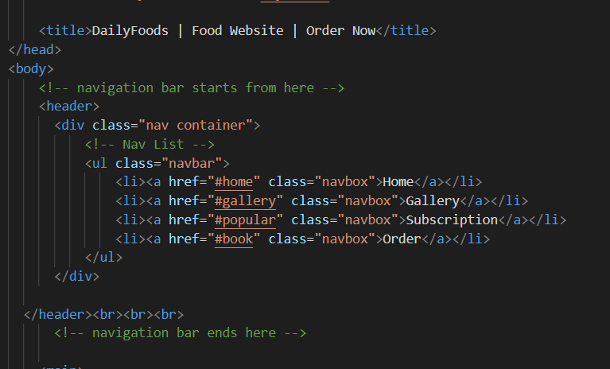
NAVIGATION BAR
Source code
Here the user can see home, Gallary, order and Subscriptions
Tags used here are :–
Div tag
Style tag
Hover effect
Class
Link tag

Slide 6
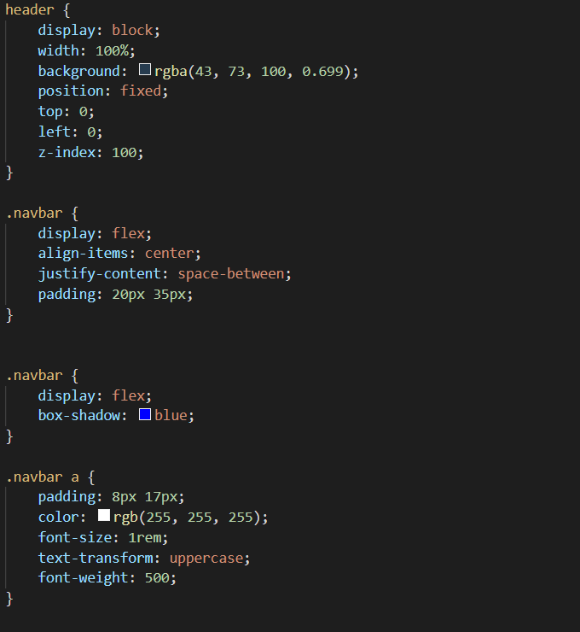
NAVIGATION BAR

Slide 7
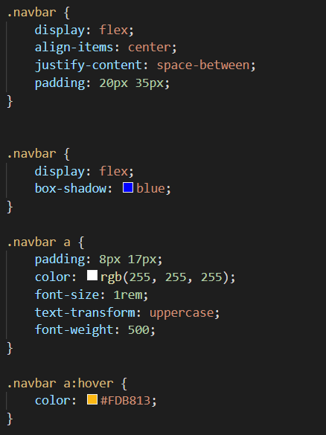
NAVIGATION BAR

Slide 8
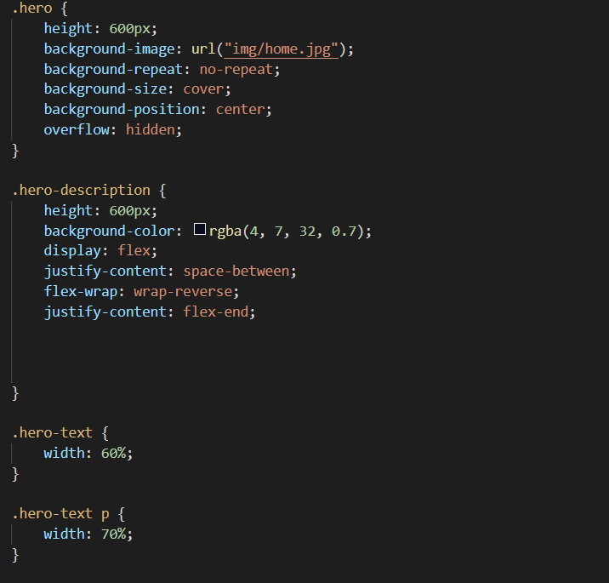
NAVIGATION BAR

Slide 9
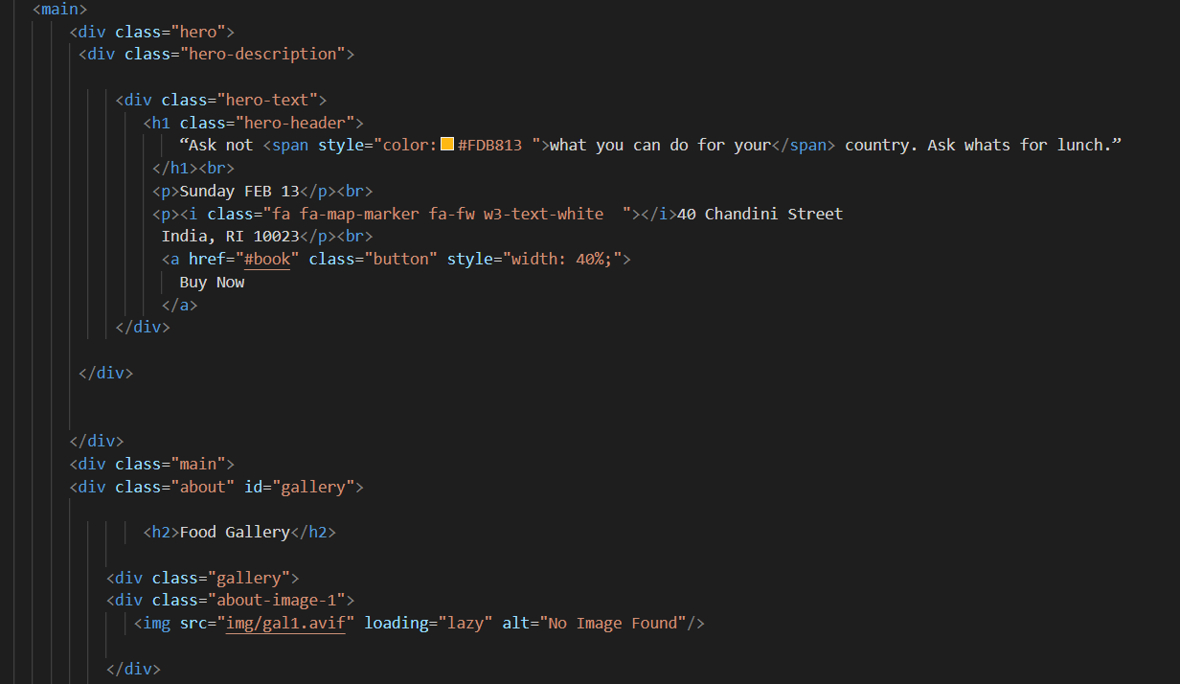
HOME PAGE
Source code

Slide 10
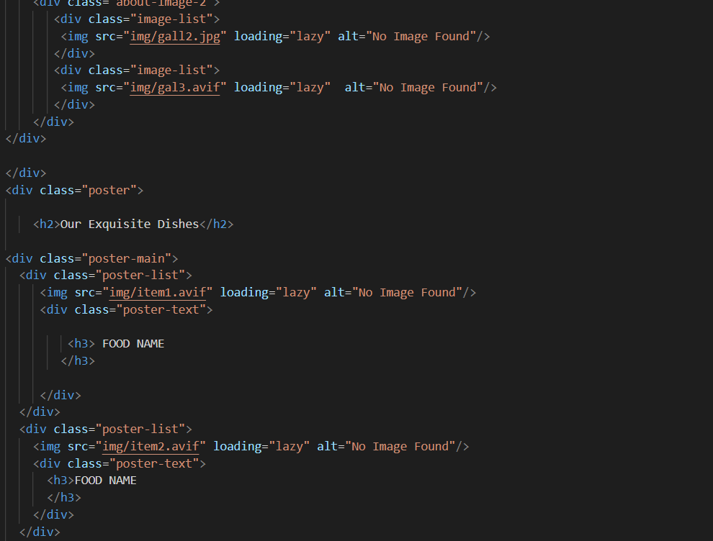
HOME PAGE

Slide 11
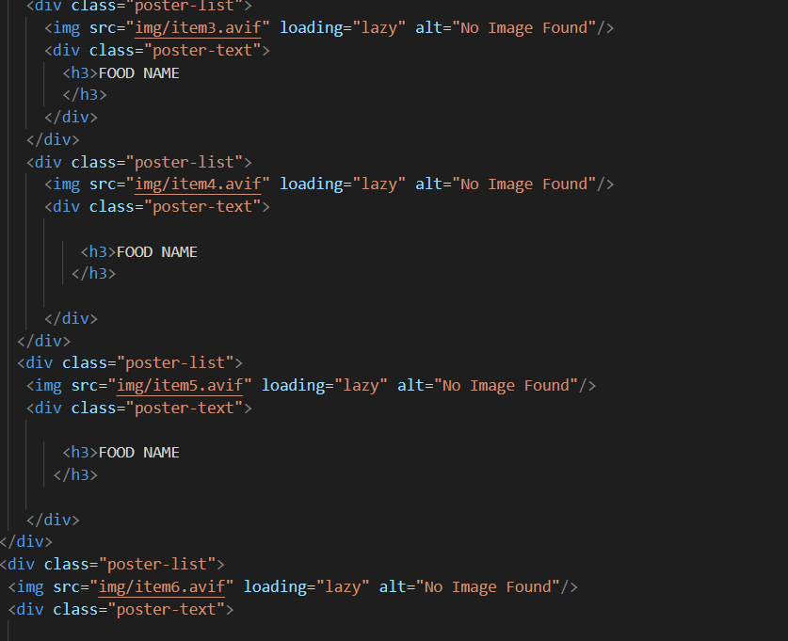
HOME PAGE

Slide 12
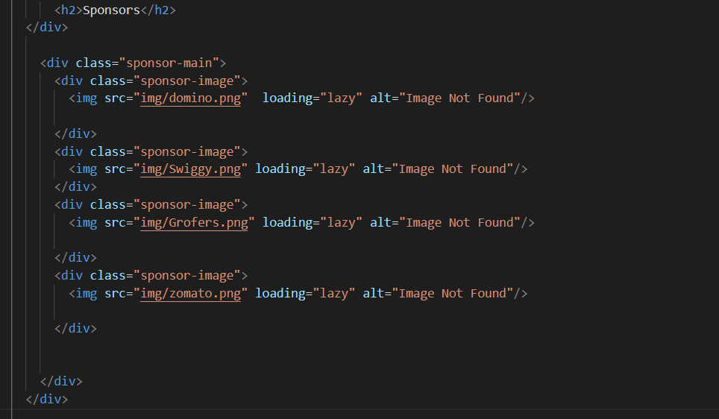
HOME PAGE

Slide 13
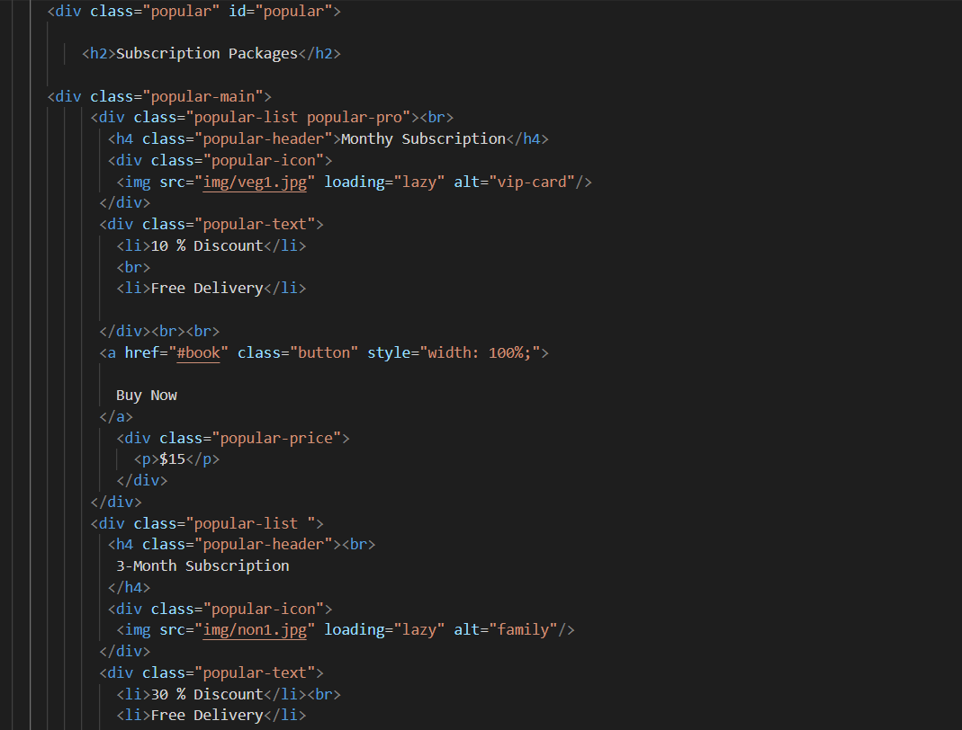
HOME PAGE
CSS

Slide 14
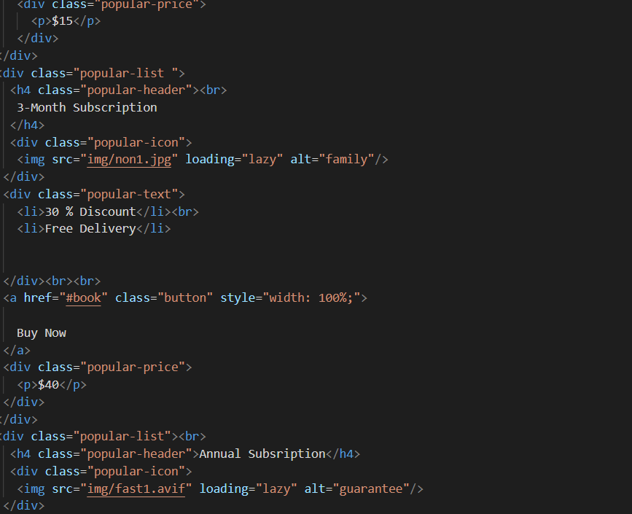
HOME PAGE
CSS

Slide 15
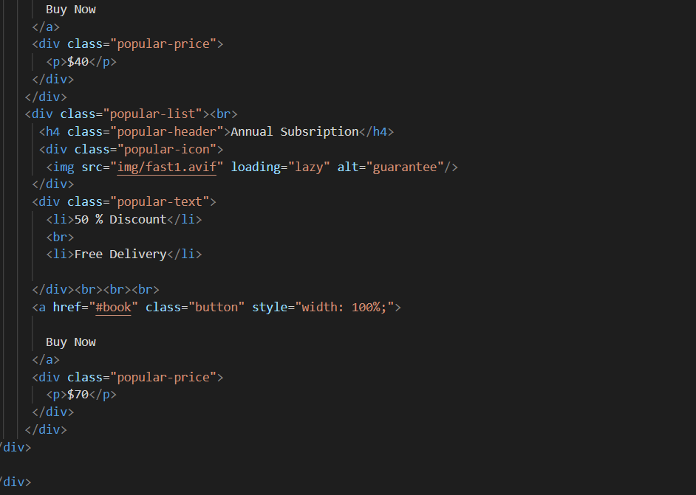
HOME PAGE
C

Slide 16
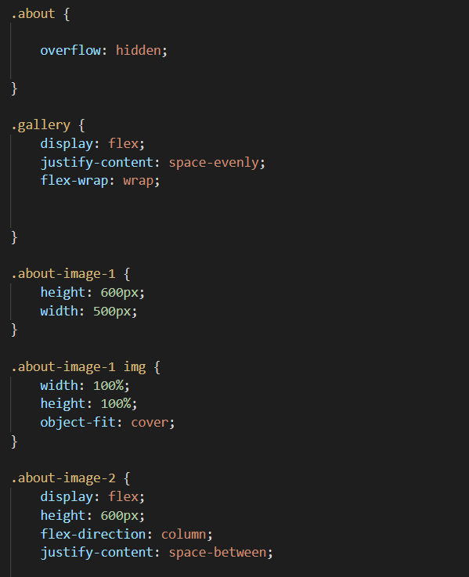
HOME PAGE
CSS
CSS

Slide 17
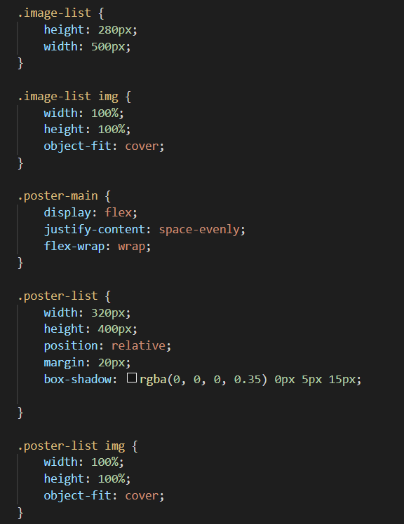
HOME PAGES

Slide 18

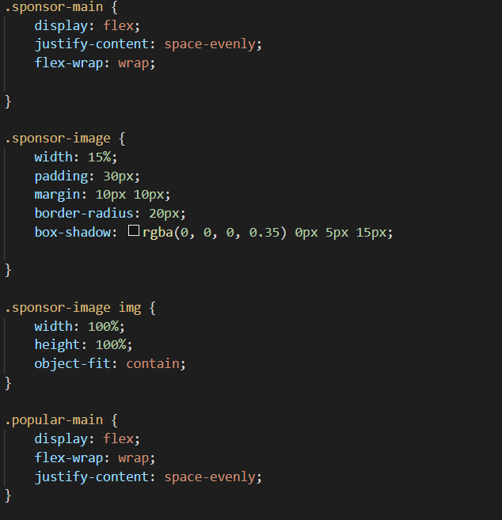
HOME PAGES
CSS

Slide 19
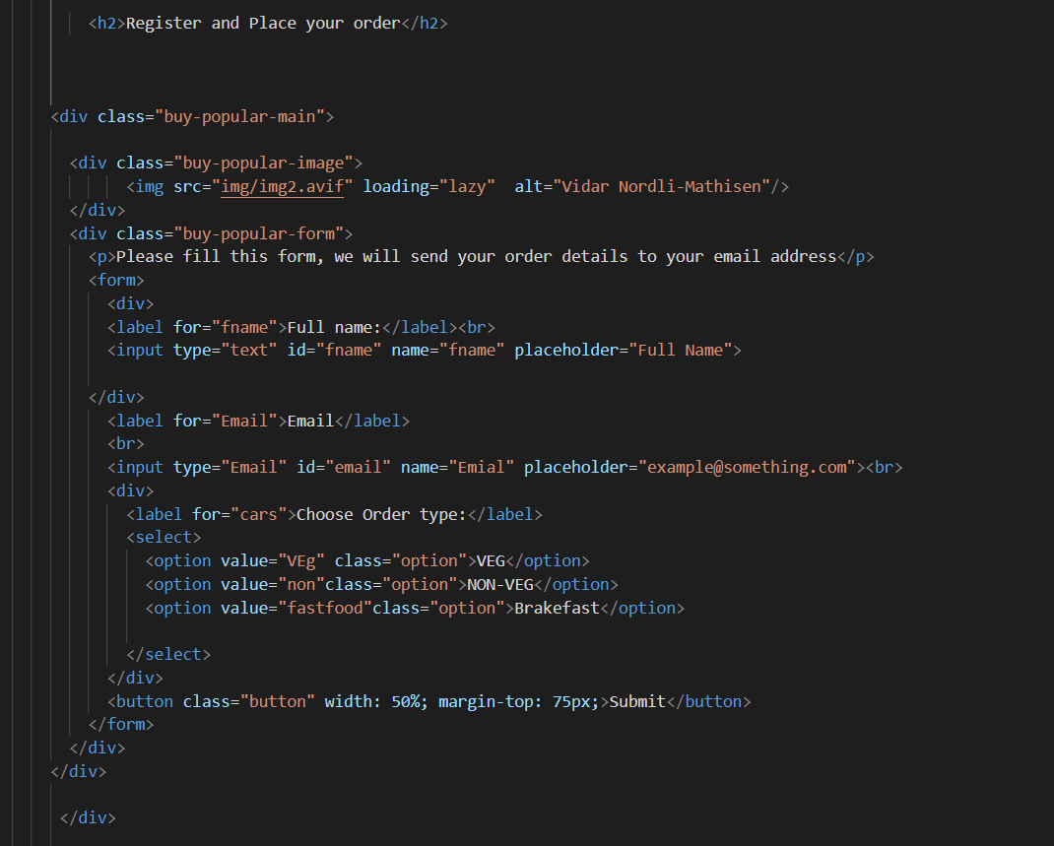
FORM SECTION
Here we had provided our social networks where user can contact us and location of our agency.
Tags used here are -
Div tag
Section tag
Anchor tag
href tag
H3 tag
BY- YOUR NAME

Slide 20
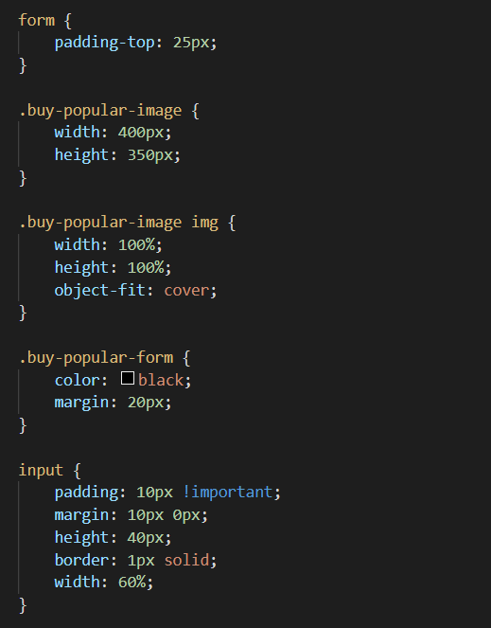
FORM SECTION

Slide 21
CONCLUSION
Finally, in Online Food Ordering system, we have developed secure, user-friendly food ordering Management System. This System can take care of each member whether it is an Administrator or Customer. This System will help them to properly manage the meals of the customers, the delivery boy’s data and help in growth without creating any hassle. This System is completely secure since every user is provided with user ID and Password so there is no chance of any unauthorised access.Online Payment, Registration and cancellation make it easier to use. So, using this system will help in reducing the labour and provide more facility for Customer to like the services.

Slide 22
REFERENCES
Images and logo:--
link :- https://unsplash.com/
link :- https://fontawesome.com/icons
HTML and CSS help:-
link :- https://www.w3schools.com/html/ link :- https://codewithharry.com/

