Slide 1
TDMA Schedule Planner and Optimizer
Distance-2 graph colouring with spatial reuse, and an EMANE bridge
Sudarshan V | Vaan Megam Networks internship task | 1 October 2026

Slide 2
Problem and model
Direct link (1 hop)
Two radios conflict exactly when they are 1 or 2 hops apart.
That is the graph G², so scheduling = vertex colouring of G².
A
B
A and B must use different slots
Hidden terminal (2 hops)
Colour = time slot; number of colours = frame length
Nodes 3+ hops apart reuse a slot (spatial reuse)
Radios are linked if within 500 m
Minimum colouring is NP-hard, so heuristics plus a bound
A
B
C
A and C cannot hear each other but collide at B

Slide 3
Algorithm pipeline
1
2
3
4
5
Graph
Conflict graph
Heuristic
Exact check
Verify
networkx graph, edge if distance <= 500 m
Connect pairs within 1 or 2 hops (G squared)
DSATUR, 300 restarts, local search that empties the top slot
Branch and bound asks: are k-1 slots possible?
Independent re-check from raw coordinates
Lower bound = largest clique of G squared. If the result equals it, the schedule is provably optimal.

Slide 4
Results
9
1.78x
7.77
76
slots for the 16-node grid, proven optimal
capacity gain over token passing (16 slots)
mean optimum on 150 random networks (2.13x gain)
tests pass, zero conflicts in the verifier
Demo: 4 x 4 grid, 300 m spacing, range 500 m. Random: 150 networks, 16 nodes in a 1500 m square. 80 nodes solve to optimal in 0.5 s.

Slide 5
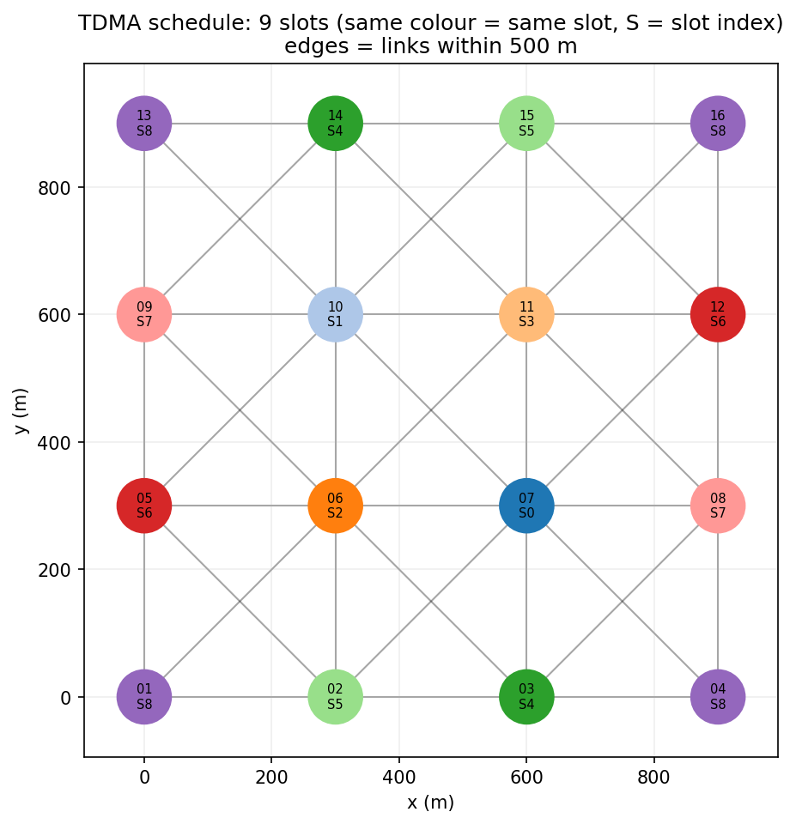
Spatial reuse in action
Corners 01, 04, 13, 16 share slot 8 although 900 m apart.
Radio range changes the frame length (same grid):
Range (m) | Slots
250 | 1
350 | 5
500 | 9
650 | 12
850+ | 16

Slide 6
Part 2: EMANE bridge
schedule.json
>
emane_bridge.py
>
schedule.xml + scenario.eel
>
emaneevent-tdmaschedule
Mapping
Verification plan
Node_NN becomes NEM id NN
1 frame, 1000 us slots, slots = frame length
One element per slot lists every transmitting NEM
Pathloss events (80 / 200 dB) match the 500 m model
scheduleAcceptFull and ScheduleInfoTable per NEM
Traffic between nodes 01 and 16 (same slot, far apart) is received
Tx and Rx slot status tables show no missed slots
Status: bridge tested; EMANE runtime not yet executed

Slide 7
Limitations and next steps
1
Disk model
Real links have SINR and fading; use EMANE packet completion curves
2
Static nodes
Recolour only the affected 2-hop neighbourhood when a node moves
3
One slot per node
Link scheduling weighted by traffic demand for unicast
4
One frequency
Multi-channel reuse could shorten the frame further

