Slide 1


|| Jai Sri Gurudev ||
SJC INSTITUTE OF TECHNOLOGY
DEPARTMENT OF ELECTRONICS AND COMMUNICATION ENGNEERING
National Conference
on
“Innovations in Engineering,Science & Technology
“WIRELESS POWER TRANSMISSION TO
CHARGE MOBILE’’
Project Team Members Project Guide
Sudarshan.G 1SJ20EC147 Dr.S.Bhargavi
Shreyas.S.R 1SJ20EC136 Professor,
Ujwala,H 1SJ20EC165 Dept of ECE,SJCIT

Slide 2
INDEX
ABSTRACT
INTRODUCTION
OBJECTIVES
LITERATURE SURVEY
METHODOLOGY
BLOCK DIAGRAM
HARDWARE REQUIREMENTS
APPLICATIONS
ADVANTAGES & DISADVANTAGES
SUMMARY
REFERENCES

Slide 3
Abstract
The proposed system presents the conception and construction of a wireless mobile charger using inductive coupling. This system demonstrates the concept of wireless mobile charging system . The system allows user to wirelessly charge his mobile phone without plugging in the mobile adapter. The system is demonstrated using a charging pad where user just needs to place his adapter circuit to charge the mobile phone. For this purpose we utilize the advanced power transfer concept.

Slide 4
Introduction
Wireless charging technology enables wireless power transfer from a power source such as charger to a load such as a mobile device conveniently across an air gap by eliminating the bunch of wire.
Wireless power transmission involves the exchange of power without the need for physical connections. The development of this technology started in the late 19th and early 20th centuries, when a number of important innovations in electromagnetic research were made.
These advancements established the basic principles that served as the foundation for modern electrical power transport.
During the past 20 years, improvements in wireless technologies have led to a revival of related research. Public interest in wireless power has also increased with the application of Nikola Tesla ideas and inventions .

Slide 5
Objectives
To design a wireless charger to charge mobile phone by resonant
inductive coupling.
To test and verify the theoretical method of wireless charging.
To acquire the acceptable efficiency of wireless power transfer. 

Slide 6
Literature Survey
Ignatius, Joe Louis Paul & Sooraj, Sasirekha & D, D & Revanth, P. (2020), A Working Model for Mobile Charging using Wireless Power Transmission , International Journal of Engineering & Technology.
This paper [1] analyzes on wireless charging is the transmission of energy from a power source to a consumingdevice without wires or cables. This means that all wireless charging technologies are comprised of both a transmitter (or charging station) that transmits that energy and a receiver(integrated inside a device) that receives the energy to charges the battery of the device. In simpler terms, wireless charging is the transfer of power from a power outlet to your device,without the need for a connecting cable.

Slide 7
Literature Survey
S.Y. Hui, "Planar Wireless Charging Technology for Portable Electronic Products andQi", Proceedings of the IEEE, Vol. 101, No. 6, June 2021
This paper [2] analyzes on Fulton Innovation revealed its bidirectional charging technology called e-Coupling. The technology would essentially allow someone to charge their mobile phone by simply putting it on the back of a tablet, as shown in Figure 2, or another device that has enabled Qi. FultonInnovation has modified Qi WPT technique that permits for the charging of mobile devices without plugging the mobile devices in, by simply placing them on a power station connected to an outlet.

Slide 8
Literature Survey
Eyuphan Bulut and Boleslaw K. Szymanski, "Mobile Energy Sharing through PowerBuddies", Proc. IEEE Wireless Communications and Networking Conference(WCNC), San Francisco, CA, 19-22 March 2022.
This paper[3] explains the working of chargebite which is so much different from the other entire wireless charger available in the market. Basically, chargebite is a device with which we have to connect another two iPhones and these two iPhones charge the third iPhone which is connected. It drains batteryfrom two iPhones and delivers the power to the third one.Chargebite is completely portable and can be attached to a keychain.

Slide 9
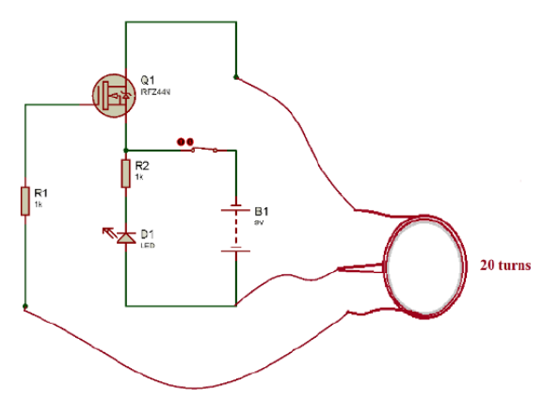
Methodology
The project mainly consists of a transmitter circuit as shown in figure 1 and a receiver circuit as shown in figure 2.
The transmitter will be connected to the power source.
When the power source is on, electric current willflow through the coil
The strength of the magnetic field depends on the number of coil available on the transmitter
Figure 1: Transmitter's circuit

Slide 10
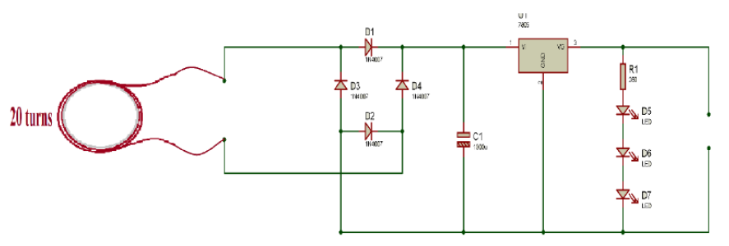
Methodology
When the receiver coil moved closer to the transmitter and the receiver coil will be induced by the transmitter coil.
Hence the transmitter coil has already created a magnetic field in that available space.
A changing magnetic field generate electromotive force.
This makes an alternating electric current in the receiver coil which is converted to DC with a rectifier and then that DC voltage will charge the phone.
Figure 2: Receiver's circuit

Slide 11
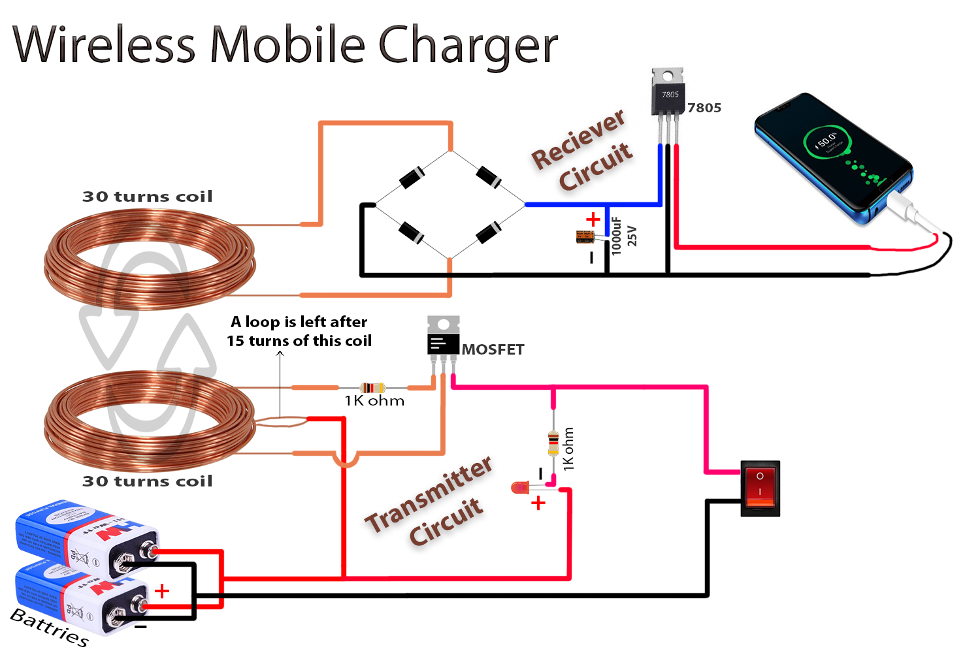
Block Diagram
Figure 3:Block Diagram of Proposed System

Slide 12

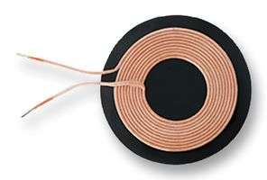
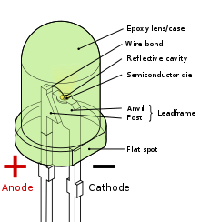
Hardware Components
HARDWARE REQUIRMENTS
Wireless Power Charging Coils
Light Emitting Diode(LED)

Slide 13
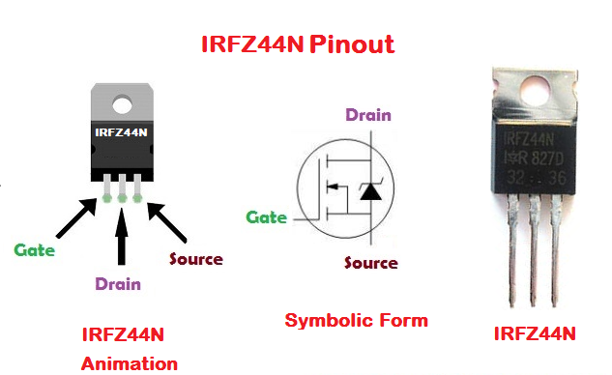
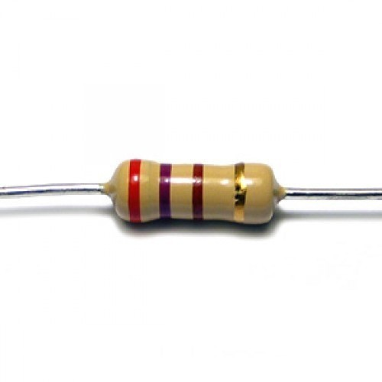
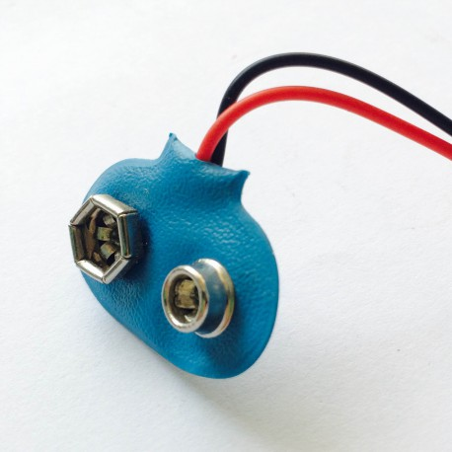
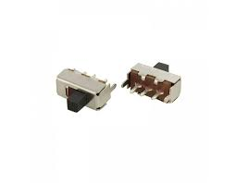
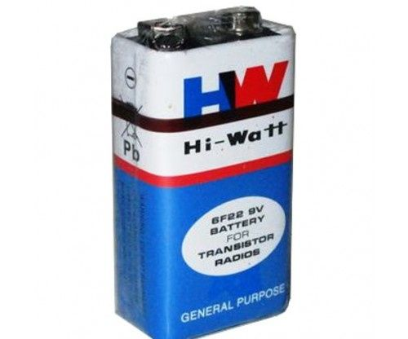
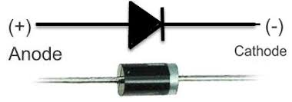
Hardware Components
Resistor
Battery Cap
IRFZ44N MOSFET
Diodes
Switch
9V Battery

Slide 14
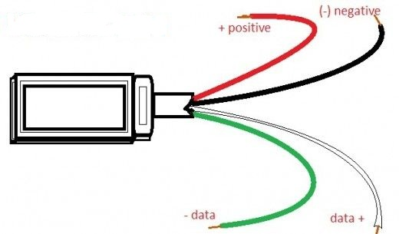
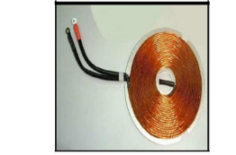
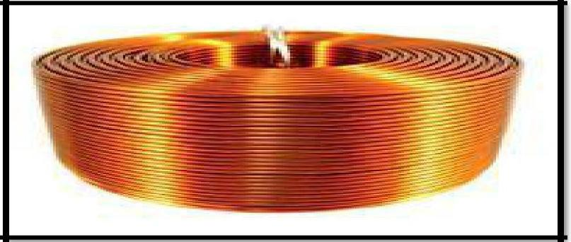
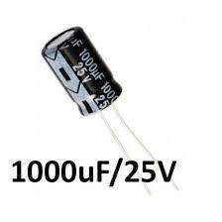
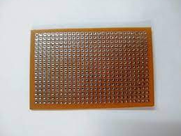
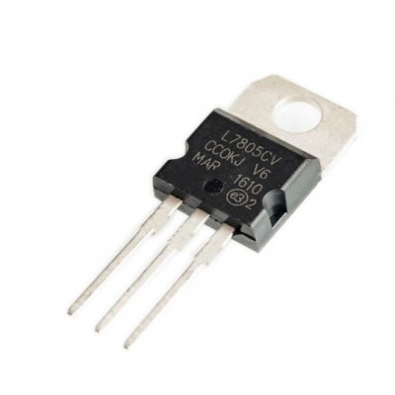
Hardware Components
USB Cable
Transmitter Cable
Receiver Coil
100UF Capacitor25 V
5V Regulator
Zero PCB

Slide 15
Applications
It is used in charging handheld device like phones
Used In wirelessly charging or continuous wireless power transfer in implantable medical devices like artificial cardiac pacemakers.
Proposed applications for this type include solar power satellites and wireless powered drone aircraft

Slide 16
Advantages
The plastic,packaging and electronic waste associated with charges is greatly reduced.Since wireless is economic
The way the technology woks is simple
It is of easy implementation and operation.
It requires low budget for it’s implementation.
It is of safer use than wired charges.
The need for separate chargers for mobile phones is eliminated and makes charging universal.

Slide 17
Disadvantages
The phone cannot be charge by putting it away from the host phones.
The proposed system doesn’t work for long distances.

Slide 18
Summary
From the present Conference it can be conclude that the paper reached the objectives initially proposed at lower cost.
The proposed system has a greater impact on its implementation, working and applications.
Wireless charging has yet to become standard, but it is constantly improving as more companies begin to integrate the technology into their devices.

Slide 19
References
[1].Ignatius, Joe Louis Paul & Sooraj, Sasirekha &D.Revanth, A Working Model for Mobile Charging using Wireless Power Transmission.International Journal of Engineering & Technology. No 24 May 2020, pp.159-160. [2].S.Y. Hui, "Planar Wireless Charging Technology for Portable Electronic Products and Qi", Proceedings of the IEEE, Vol. 101, No. 6, June 2021, pp.1290-1301. [3].Eyuphan Bulut and Boleslaw K.Szymanski, "Mobile Energy Sharing through PowerBuddies",Proc.IEEE Wireless Communications and Networking Conference(WCNC), San Francisco, CA, 19-22 March 2022, pp.1-6.
[4] .Hucheng Sun, Wen Geyi and Xiao Cai, “Wireless Power Transmission to a DeviceShielded by Unknown Electromagnetic Media,” 10th IEEE Global Symposium onMillimeter-Waves, 24-26 May 2020, pp.159-160
[5] https://en.m.wikipedia.org/wiki/Electronic_component accessed on 1st May 2023.
[6] https://www.electronicsandyou.com/blog/electronic-components-parts-and-their-function.html accessed on 1st May 2023.
[7] https://www.watelectronics.com/major-electrical-electronic-components/ accessed on 1st May 2023.

Slide 20
Thank
You

