Slide 1

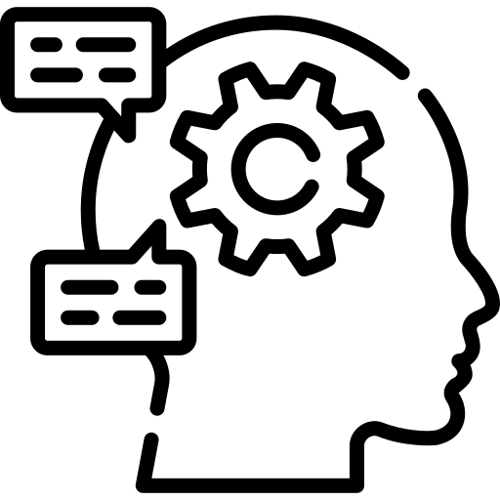
3 Days Workshop on AI, NLP and LLMs

Slide 2
Day 3: RAG and beyond
01
02
03
04
Introduction to RAG
RAG mini project
Basic introduction RAG and it’s components.
A simple study support mini project to help prepare for exams
Agentic AI and beyond
AI/ML Roadmap
Agentic AI, the next wave of intelligent systems.
What to explore after the workshop, resources to follow, and potential project ideas.

Slide 3
01. Itroduction to RAG
Basic introduction RAG and it’s components.

Slide 4
Problems with LLM
LLMs can’t access your private, recent, or external data.
They often make up facts or hallucinate confidently.
Updating their knowledge requires costly retraining or fine-tuning.
They struggle with long documents or large context windows.
Answers are not grounded — you don’t know where the info came from.

Slide 5
RAG
RAG is a method that combines LLMs with external data sources.
It retrieves relevant info from documents before generating an answer.
Uses embeddings to semantically match your question with stored chunks.
The LLM then uses both the prompt and retrieved data to respond.
Great for building “Chat with your data” apps using PDFs, wikis, etc

Slide 6
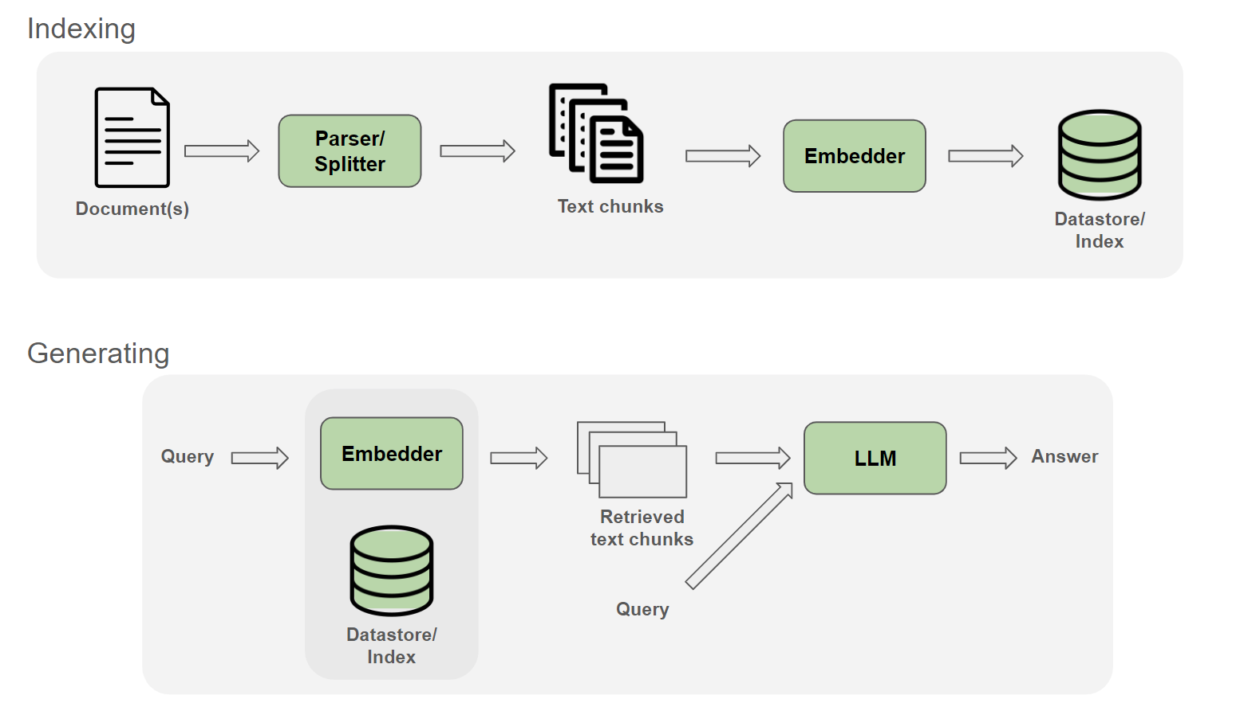
Components of RAG

Slide 7
Parsing
Extracts text, metadata, and structure from PDFs
Use libraries like PyMuPDF, pdfplumber, PyPDF2, pdfminer.six
For scanned/image PDFs, use OCR like pytesseract or easyocr
Use docling or unstructured to preserve layout, headers, and tables
Paid option: LlamaParse (LlamaIndex) offers high-quality, structure-aware parsing
Some LLMs can parse PDFs directly, but offer less control.

Slide 8
Chunking
LLMs have token limits → split large text into smaller parts
Common methods: fixed-size, sliding window, header-based
Overlapping chunks help preserve context
Too large = context cutoff; too small = lacks meaning
Good chunking boosts retrieval accuracy

Slide 9
Embedding
Converts text chunks into numeric vectors that capture meaning
Similar meanings = closer vectors in space
Use sentence-transformers or OpenAI embeddings
These vectors are used to compare queries with documents

Slide 10
Vector Database
Stores and indexes embeddings for fast semantic search
Popular tools: FAISS, Chroma, Pinecone, Weaviate
Supports storing metadata (page, filename, etc.)
Enables top-k similarity search
Forms the memory base for your chatbot

Slide 11
Retrieval
At runtime, user query is embedded into a vector
Vector DB finds top-k similar chunks
Filtering based on score threshold improves relevance
Retrieved chunks are passed as context to the LLM
Ensures answers are grounded in real data

Slide 12
LLM – Final Generation
LLM gets: [retrieved context] + [user query] + [additional prompt]
Generates an answer based only on relevant info
No training or fine-tuning needed
Works with almost any LLM
Produces accurate, contextual, and customized responses

Slide 13
“Continue From Jupyter Notebook...”

Slide 14
Thank You !

