Slide 1

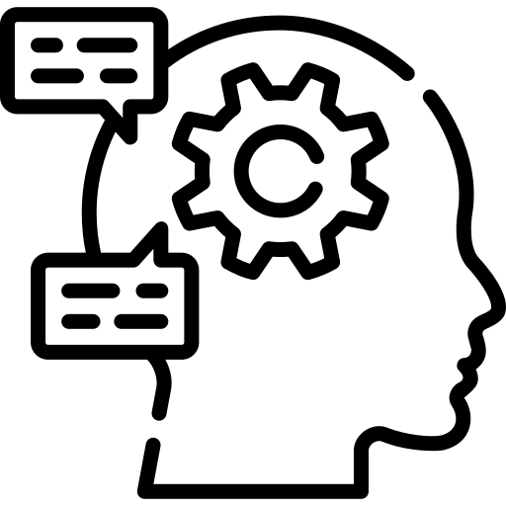
3 Days Workshop on AI, NLP and LLMs

Slide 2
Day 1: Classical NLP
01
02
03
04
Introduction
NLP Overview
Getting started with AI and ML.
Overview of NLP, it’s pipeline and hand on with NLTK library.
Text as a number
Recommandation system
How can we represent text in numbers ?
Code with scikit learn.
Understanding and Building simple content based recommandtion system.

Slide 3
01. Introduction
Getting Started with AI & ML.

Slide 4

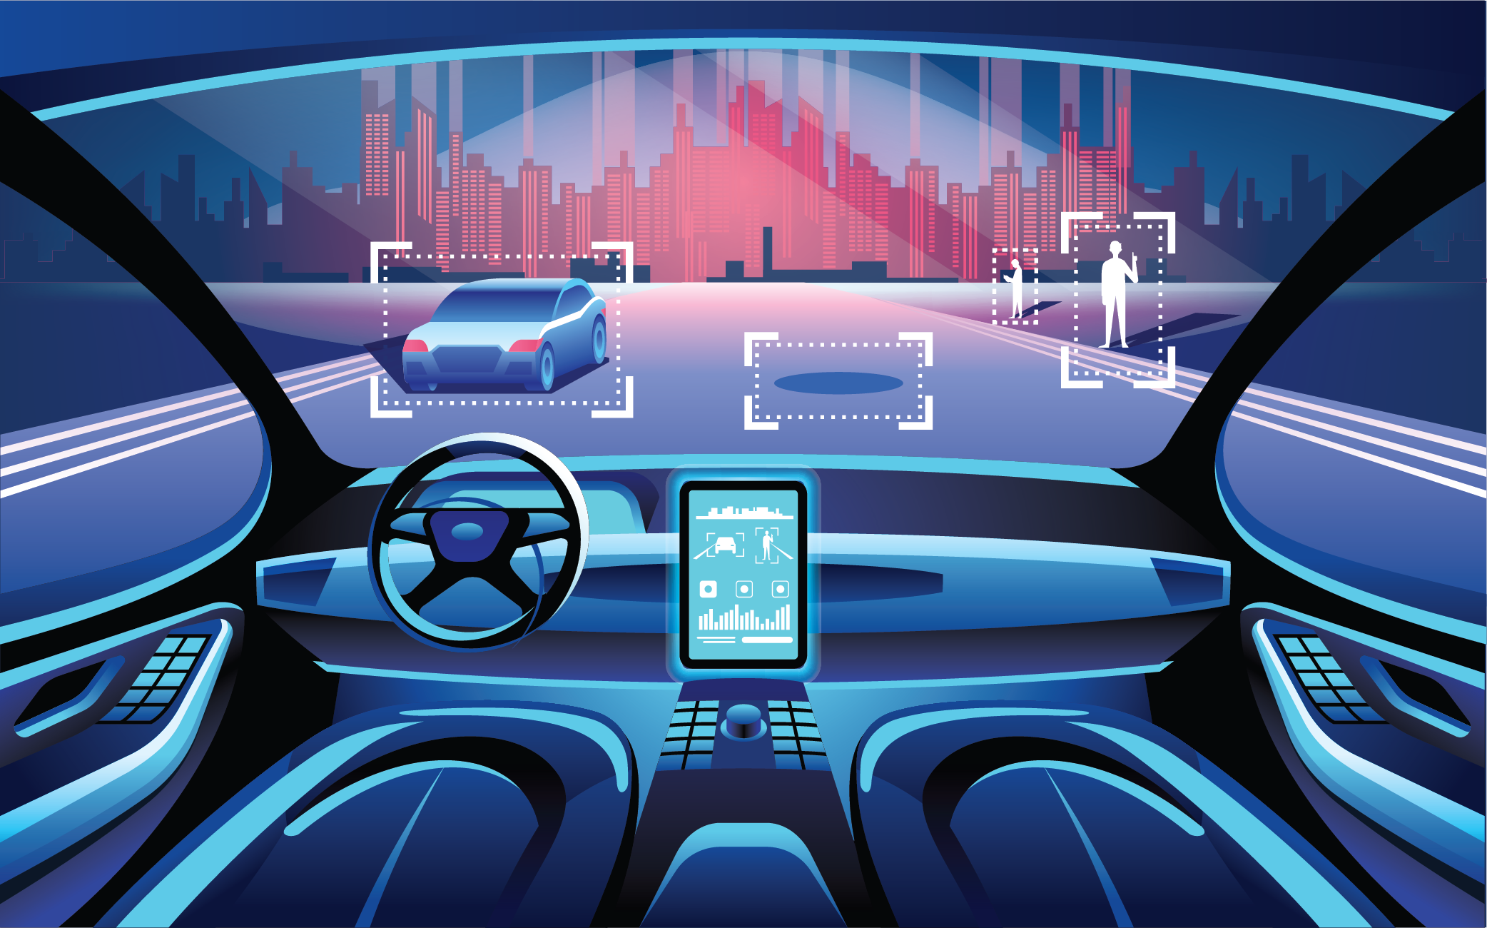
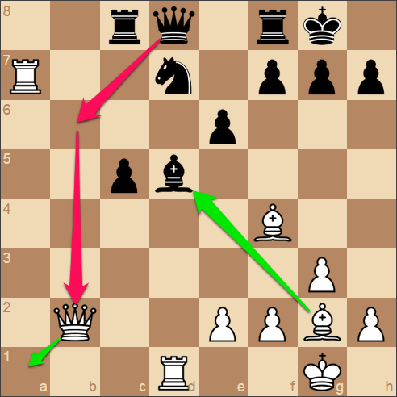

What is Artificial Intellegence ?
AI is the ability of machines to perform tasks that typically require human intelligence.
Examples: decision-making, language understanding, vision, robotics.
Real-world examples: ChatGPT, self-driving cars, chess engines, recommandation systems.

Slide 5
What is Machine Learning ?
ML is a subset of AI where systems learn from data and experience instead of being explicitly programmed.
Example: spam detection learns from past emails.

Slide 6
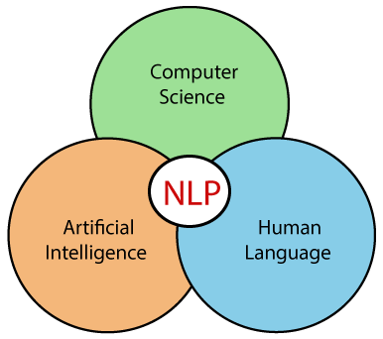
What is Natural Language Processing ?
It is a field under focused on human language.
Examples: chatbots, translation, sentiment analysis.

Slide 7
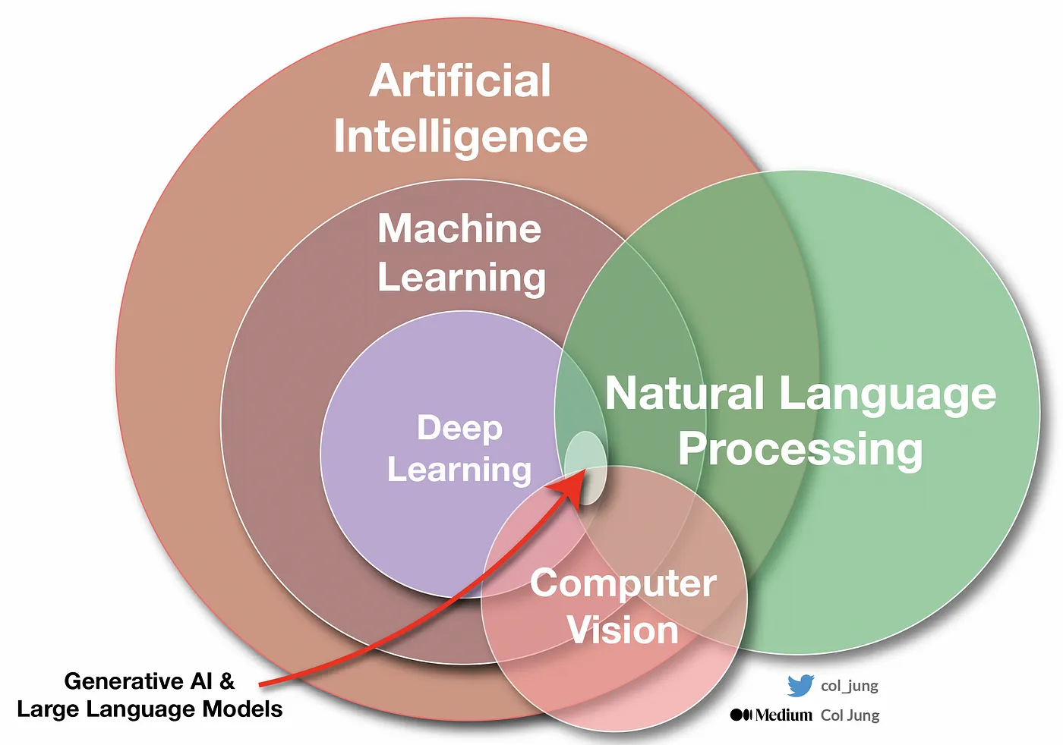
Connection between AI, ML and NLP

Slide 8
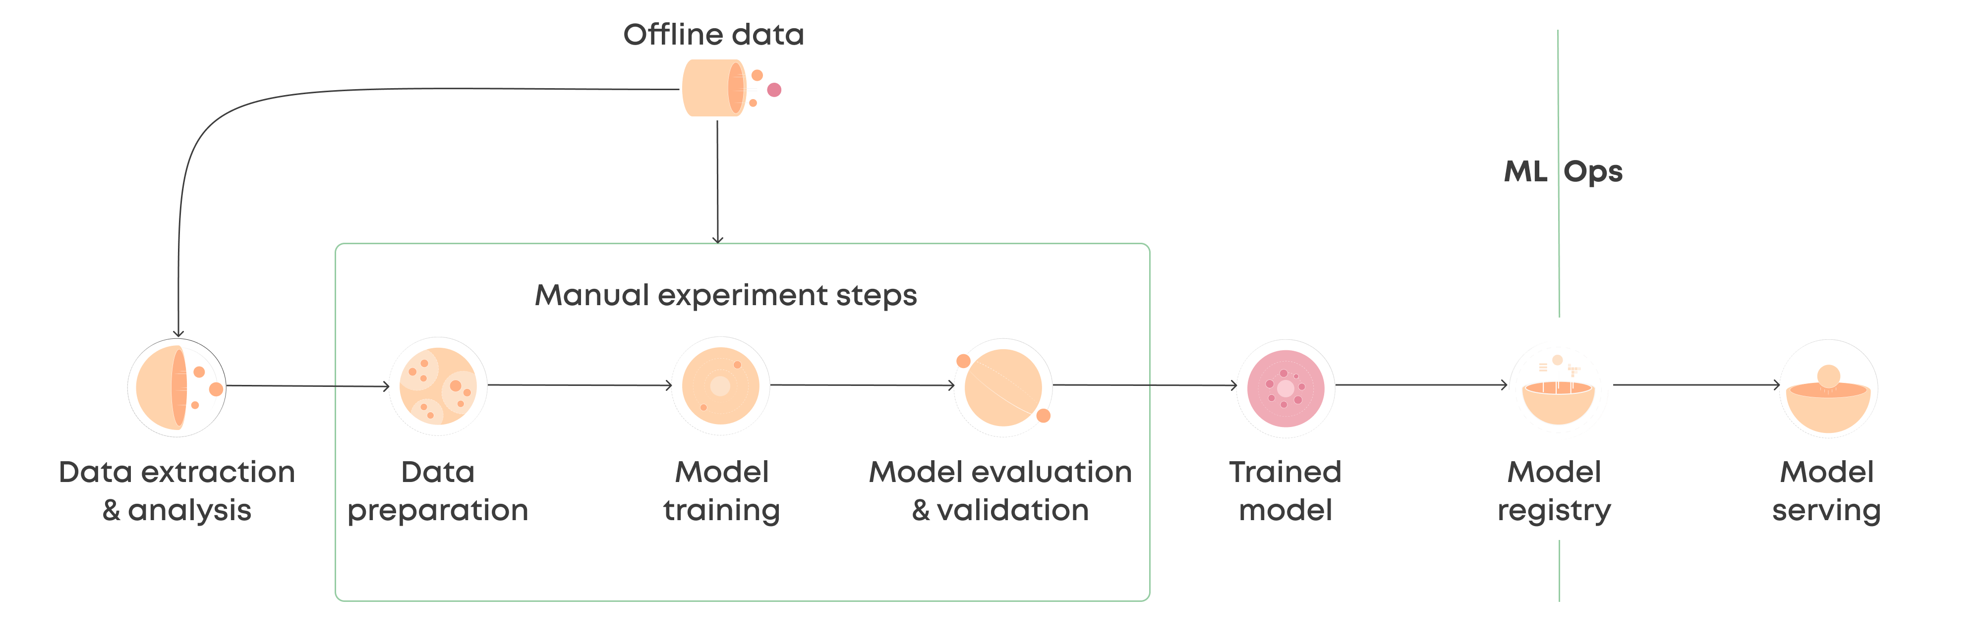
Basic ML Pipeline

Slide 9
What exactly is AI Model ? How does it learn ?
An AI model is made up of math and numbers that help it make decisions.
Inside a model, it has Inputs (what we give it), Weights (how important each input is), Rules (math formulas to process the inputs) and Outputs (the result or prediction).
Models try to make predictions.
They calculate the error between prediction and actual value.
The model adjusts it’s weights to reduce this error (training).

Slide 10
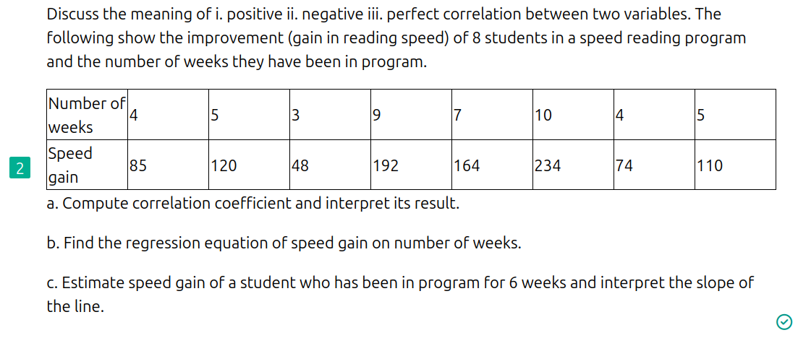
Revisiting Linear Regression

Slide 11
02. NLP Overview
Overview of NLP, it’s pipeline and hand on with NLTK library.

Slide 12
Key challanges in NLP
Representation: Language needs to be converted into numbers.
Ambiguity: Words can have multiple meanings
Context Understanding: Same sentence can mean different things in different situations.
Sarcasm & Emotion: Hard for machines to detect tone, irony, or feelings.
Grammar & Syntax Variability: People don’t always follow rules when speaking or typing.
Multilingual & Code-Switching: People use many languages or mix them in a sentence.
Data Noise: Real-world text (social media, chat) is messy and unstructured.

Slide 13
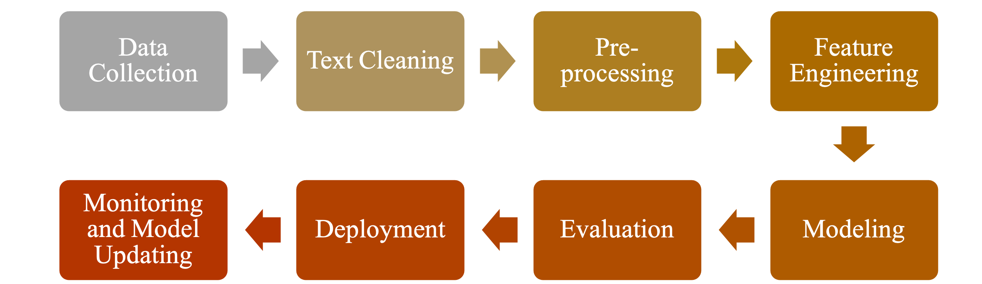
Common NLP Pipeline

Slide 14
“Continue From Jupyter Notebook...”

Slide 15
Thank You !

